Slide 1
Adult Education Survey (AES) in the mixed mode design
Eva Belak, Marta Arnež
Statistical Office of the Republic of Slovenia (SURS) prof. dr. Vasja Vehovar
Faculty of Social Sciences, University of Ljubljana
International Conference on Questionnire Design, Developmnet, Evaluation and Testing (QDET2)
Miami, Florida, 9 – 12 November 2016

Slide 2
Contents
Mixed mode design in household surveys at SURS
Pilot AES WEB survey and CATI re-interview survey
  Sample design
  Goals of the pilot and re-interview
  Questionnaire design issues
  Analysis of paradata, contact strategy
  Analysis of the reported non-formal activities
Conclusions

Slide 3
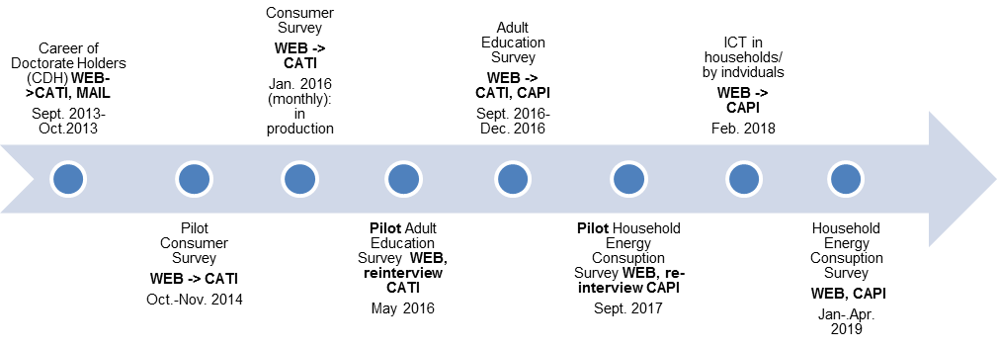

Implementation schedule of mixed mode data collection at SURS
From May 2014 – June 2015
(13 months) WEB project

Slide 4
Adult Education Survey (AES)
Purpose
  to find out in what extent adults participate in any form of education and training (formal, non-formal, informal)
  in what ways they obtain knowledge
  what is their attitude towards education,
  how adults evaluate their knowledge of foreign language
Target population: residents of Slovenia aged 18 - 69
Periodicity: every five year (2007 CATI->CAPI, 2011 CATI->CAPI, 2016 WEB->CATI, CAPI)
Main statistics: number and type of formal and non-formal education of adult population

Slide 5
Design of the WEB pilot and
CATI re-interview survey
Sample design: sampling frame CRP, systematic SRS; stratification: size and type of settlement (6 classes) and level of education (3 classes). Target population for the pilot: 25-64,
Implementation: April, May 2016
  Pilot: WEB ; n=2075, RR= 29 % or 592
  Re-interview survey: CATI; n=500 (res= 400, nr=100),
  RR=41 % (RR_res=44%, RR_nr=27%)
Main survey: 1 September 2016 – 15 December 2016
  consecutive mixed mode design: (WEB → CATI, CAPI)
  n=8504; target population for the main survey: 18-69

Slide 6
Goals of the pilot WEB pilot and
CATI re-interview survey
Pilot WEB:
  To test contact strategy
  To test the overall response rate and the response rate by different age groups
  To test the drop-off rate (the percentage of persons that left the questionnaire)
  To test the length of the questionnaire (in minutes according to the number of non-formal activities)
  To assess the quality of the reported non-formal activities
  Improvement of the coding list for the main survey
CATI re-interview:
  The quality of the WEB questionnaire: the number of non-formal activities reported by the same respondent by different modes.
  Assessment of the impact of WEB survey results on overall survey results.
Improvement of the questionnaire and coding list for the main survey

Slide 7
Questionnaire design issues
A cognitive test of the WEB questionnaire was done prior to the pilot survey.
Persons in the cognitive test forgot to report non-formal education (NFE) at work, but only reported NFE activities at free time.
  „NFE at work“ for inactive persons is not appropriate
Therefore from originally one question for NFE, two blocks of questions were designed: NFE activities at work and NFE activities at free time

Slide 8
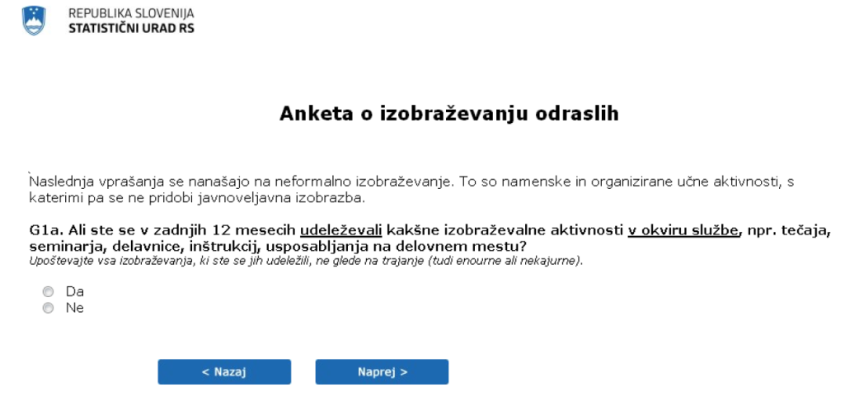
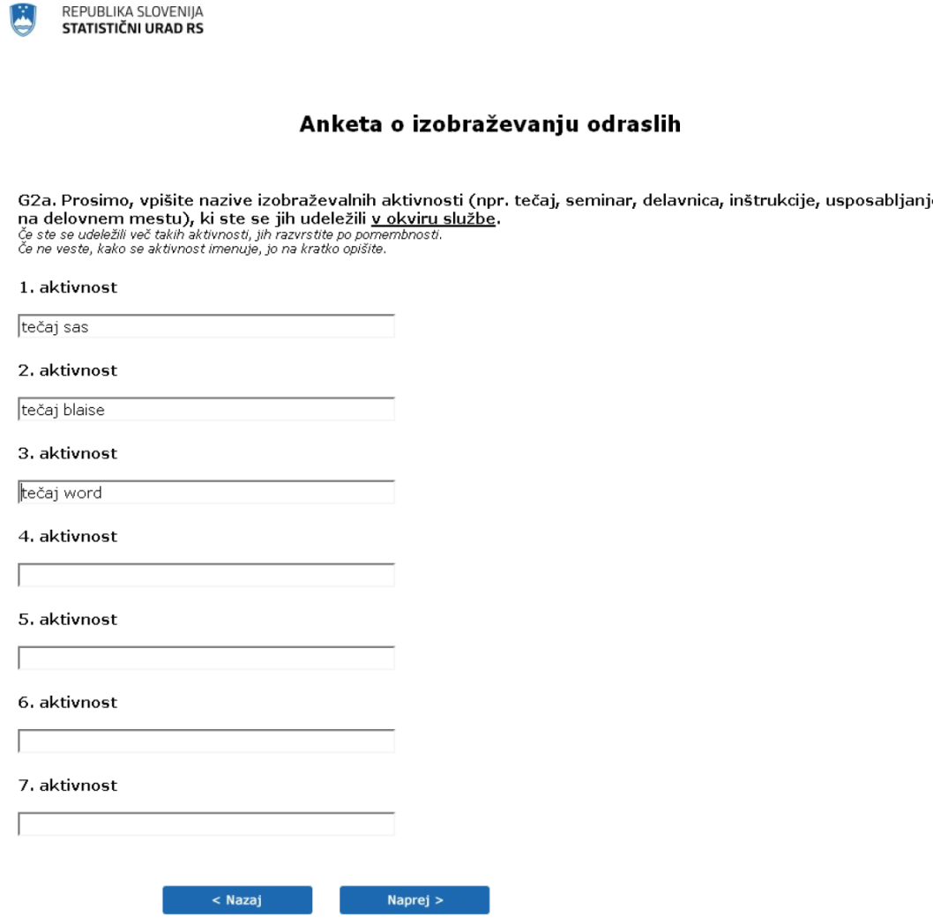
Questions of non-formal educational (NFE) activities in WEB questionnaire
In the main AES two most important activities (to the respondnent) are coded
Introduction to the NFE questions
Filter question NFE activities at work
List of up to 7 NFE activities at work
Filter question NFE activities at free-time
List of up to 7 NFE activities at free-time
In the pilot WEB all reported NFE activities were coded after the data collection.

Slide 9
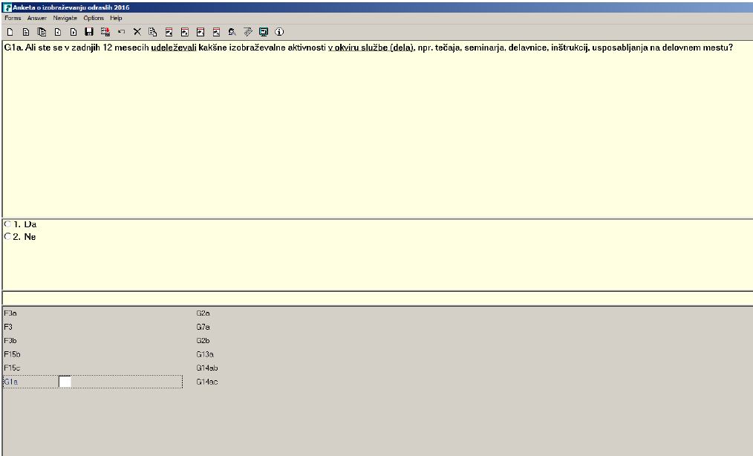
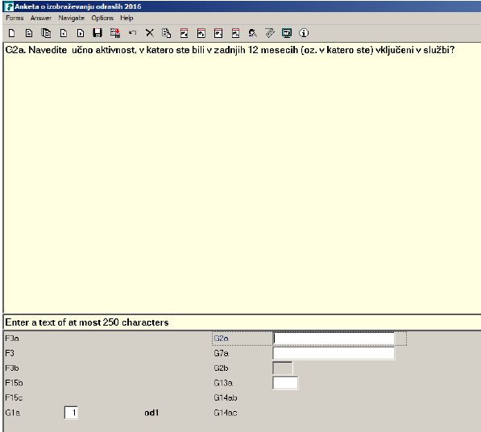
Questions of non-formal educational (NFE) activities in CATI re-interview questionnaire
In the CATI re-interview all reported NFE activities were coded during the telephone interview by interviewer.
No introduction compared to pilot WEB version
Respondent was asked to report activity and then followed some detailed questions regarding this activity

Slide 10
Improvements of the questionnaire for the main survey
WEB and CATI/CAPI wording of the questions on NFE activities is unified in main survey questionnaires.
  The introduction to the question in CATI/CAPI
  In order to minimize order effect:
    respondent was first asked to list all the non-formal activities at work and in free time that he/she attended them in the last 12 months.
    Then follow question which are two most important NFE activities -> some detailed questions regarding these two activities follow
  In the main survey only two most important NFE activities to respondent will be coded, regardless if is NFE activity at work or at free-time.

Slide 11
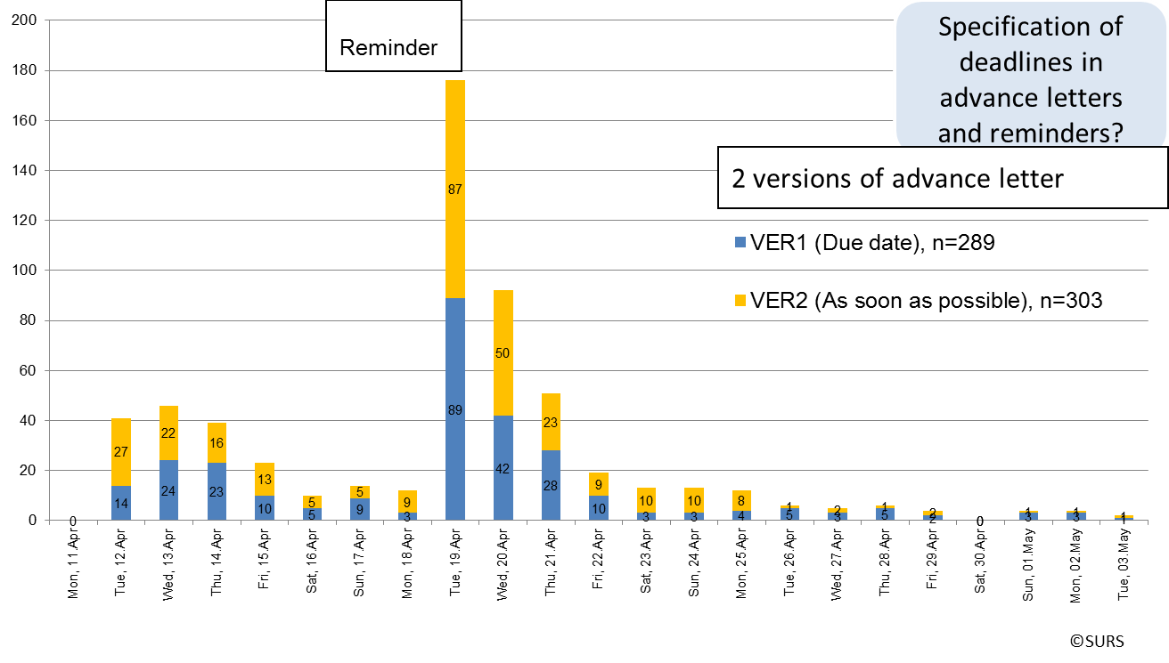
Analysis of paradata and contact strategy
Advance letter sent along with information brochure
  about the survey and how to access the WEB questionnaire
  2 versions of advance letter
One reminder: after 7 days
Completion rate: 29%
  (n=592; 592/2075=29%)
Drop-off rate: 7.2%
  (n=46; 46/(592+46)=7.2) most of the respondents left in the module of NFE activities

Slide 12
Non-formal education (NFE) activities in pilot WEB – CATI re-interview
177 WEB respondents retained in the re-interview analysis
91 (51%) persons reported participation in NFE both in WEB and CATI
61 (34%) has not reported any NFE both in WEB and CATI
About the same of persons who participate in NFE in WEB (105) and CATI (102), but these are not the same persons.
 | Re-interviewNFE Yes | Re-interview NFE No | Total
WEB NFE Yes | 91 | 14 | 105
WEB NFE No | 11 | 61 | 72
Total | 102 | 75 | 177

Slide 13
Matching of persons and number of activities reported in each mode (pilot WEB – CATI re-interview)
Matching WEB-CATI | Number of respondents | Structure | Structure
No NFE activities reported | 61 | 35% | 60% of the respondents gave the same response in both modes
The same number of NFE activities | 45 | 25%
− 1 activity (one activity less on the WEB) | 15 | 8% | 11% of the respondents reported more activities in CATI mode
− 2 activities (two activities less on the WEB) | 3 | 2%
− 3 activities (three activities less on the WEB) | 0 | 0%
− 4 activities (four or more activities less on the WEB) | 1 | 1%
+ 1 activity (one activity more on the WEB) | 20 | 11% | 29% of the respondents reported more activities in WEB mode
+ 2 activities (two activities more on the WEB) | 17 | 10%
+ 3 activities (three activities more on the WEB) | 7 | 4%
+ 4 activities (four or more activities more on the WEB) | 8 | 5%
Total | 177 | 100% | 100%

Slide 14
Analysis of the reported non-formal education (NFE) activities
More NFE are reported in WEB mode.
Reasons:
  Reluctance to report again
  Different design of the question in CATI re-interview
  Other reasons?
Participants in NFE | WEB | CATI | Pilot WEB
 | Re-interview, n=177, unweighted |  | n=592, unweighted
NFE at work | 49% | 44% | 49%
NFE in free time | 27% | 24% | 28%
NFE at work or in free time | 59% | 58% | 58%

Slide 15
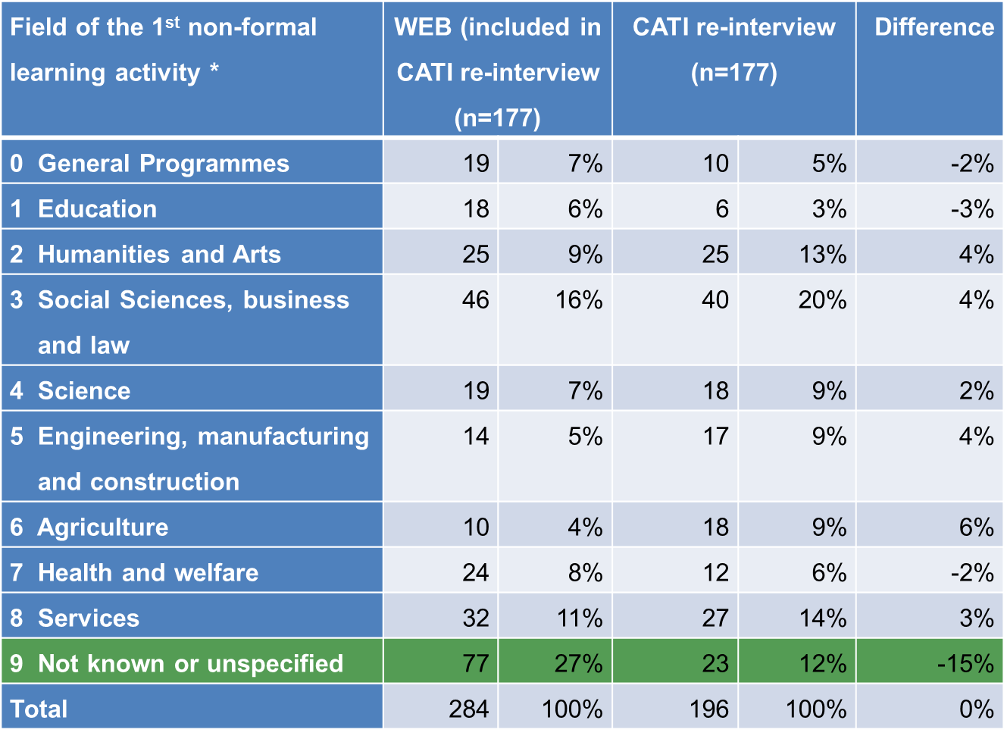
Coding of the NFE activities
In CATI interviewers coded the NFE during the interview; in WEB after the data collection
WEB and CATI data matched according to selected persons and 1 digit activity code: 73% (127 out of 174 activities)
80 activates on the WEB are not matched with those obtained by CATI.
27% of the activities reported in WEB vs. 12% in CATI were not possible to code – to general description

Slide 16
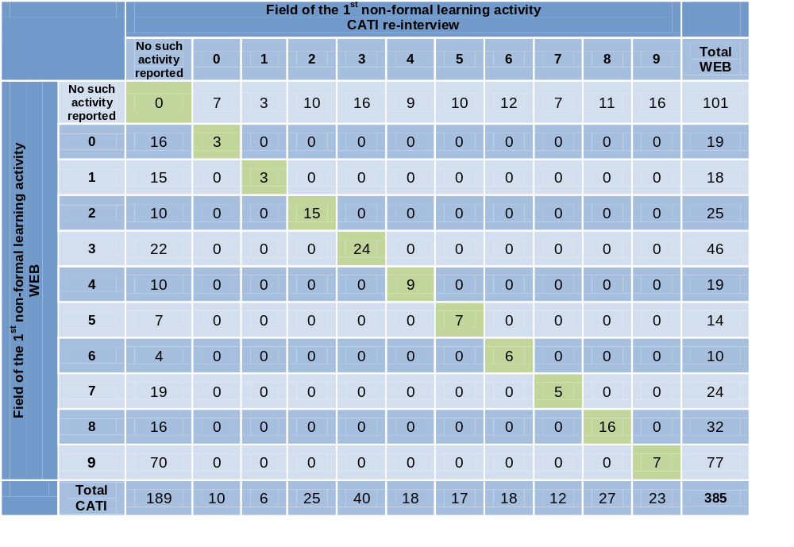
Matching of persons and activity codes reported in each mode (pilot WEB – CATI re-interview)
Matching was done by ID of selected person and by activities reported in each mode
177 persons reported 385 activities on WEB and/or CATI re-interview
  Activities reported on WEB: 385-101=284
  Activities reported on CATI: 385-189=196
95 activities are the same on one digit level in WEB and CATI

Slide 17
Conclusions and Discussion
WEB questionnaire testing very useful. Much improvements of the questionnaire were done for the pilot and the main survey
More time between pilot and main survey should be allotted to implement all the suggested improvements of the questionnaire and coding list (April, May 2016 Pilot, September 2016 main survey)
Question order, question design or mode effect in the case of NFE activities? Re-interview effect?
Your experiences and recommendations when using the re-interview as a method of evaluating measurement error

Slide 18
Thank you for your
attention.
Any comments and suggestions would
be much appreciated.
eva.belak@gov.si

