Slide 1
Web & Mail Surveys with Special Populations: Results on Pretesting Leisure Survey
Merja Kallio-Peltoniemi
QDET2/12th November 2016

Slide 2
Background
Leisure Survey in Finland
Populations leisure hobbies, social and cultural participation, social relationships, ratio between work and leisure.
Trends: 1977, 1981, 1991, 2002, (2017).
Age limit from 10+ → no maximum age.
Previously: CAPI mode
In 2016 pretesting and piloting mixed mode (web + mail)

Slide 3
Questionnaire Design Challenges
Statistics Finland’s strategic goal: web mode option in all personal & household surveys by year 2018
Long questionnaire & new questions
Mode effects
Software choice (Digium), technical restrictions
Resource limitations
Consent issues of underaged participants (unsolved!)
Special populations
  Children 10-14 years old
    Cognitive limitations (e.g. Holaday & Turner-Henson 1989, de Leeuw 2011)
  Elderly respondents (75 years old →)

Slide 4
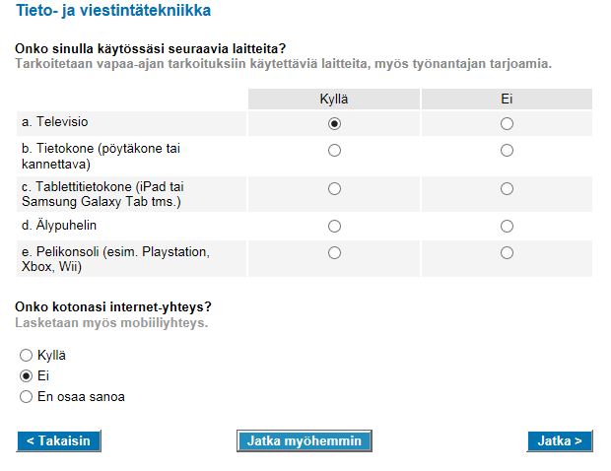

Slide 5
Children’s pretests
In schools (6 classes in Helsinki)
Aged 10-12 year old
20 € gift card incentive
Consent asked from legal guardians
11 web pretests (cognitive/usability test)
100 mail questionnaire pretests (observation)

Slide 6
Results from Children’s pretests
WEB
MAIL
No technical problems with the WEB questionnaire
Difficulties to understand common concepts
Difficulties with logical operations and vague concepts
Difficulties with reference periods
Literal interpretations
Response sets – agreement, ”yes”-saying
Responding, even though they don’t understand
Couldn’t follow MAIL Q skip routes
Difficulties to understand common concepts
Difficulties with logical operations and vague concepts
Difficulties with reference periods
Literal interpretations
Response sets – agreement, ”yes”-saying
Responding, even though they don’t understand

Slide 7
Senior pretests
Sample of 75+ people living in Helsinki
Contact letter
Telephone contact → interview date
Difficulties in recruiting
9 pretests:
  76-86 years old test persons
  6 web-tests (cognitive/usability test),
  3 mail-tests (observation, cognitive test)
20 € gift card incentive

Slide 8
Results from Elderdy respondents’ pretests
WEB
MAIL
Huge technical difficulties with WEB questionnaire
Difficulties to see and read
Memory difficulties
Uncertainty in interpreting layout/cognitive cues
Grids were impossible
Too long questionnaire
Difficulties to follow skip routes
Difficulties to see and read
Memory difficulties
Uncertainty in interpreting layout cues
Grids are impossible
Too long questionnaire

Slide 9
Pilot test
Pilot test with population aged 15-75 years old, N=1000
Incentive, two groups:
  A) Was informed about a prize raffle
  B) Wasn’t informed about the raffle
4 rounds:
  2 contact letters with web response possibility only
  3rd contact letter included mail questionnaire
  4th rnd…

Slide 13
Response Rate (%) by Age Groups

Slide 14
Web response rate (%) by age group

Slide 15
Concluding remarks and the future
Always test!
Mode effects somewhat inevitable
Children questionnaire is going to be revised and pretested again (in the Spring 2017)
  Double checking difficult concepts
  Questions with reference periods left out
  Checking questions due to results from pretests
Extreme diversity characteristic of the elderly population
Reconsidering mixed mode survey strategy (incl. CATI/CAPI?)

Slide 16
Merja Kallio-Peltoniemi
merja.kallio-peltoniemi@stat.fi
QDET2, 12th November 2016

