Slide 1
Combining usability and cognitive tests to optimize the 2021 Census for mobile devices
Joanne Finnie
Data Collection Methodology
Notes:
In 2021 the British Census is going to be predominantly online. I am going to talk today about some iterative testing Data Collection Methodology is doing towards optimising the Census for mobile devices. ONS needs to consider that people are likely to complete the Census on a range of screen sizes. This consideration is driving new designs of Census questions. This isn’t the only research going on, but it’s the part I have been involved in.

Slide 2
Two phases
March 2016 – Phase 1 objectives:-
  Establish whether 2011 online census questionnaire could be completed on mobile devices by testing them for usability with members of the public.
  Analyze feedback regarding participants’ experiences of completing the questionnaire on a mobile device.
  Identify questions that are problematic.
July 2016 – Phase 2
  Redesign socio-demographic questions identified as problematic in Phase 1 in line with recommendations.
  Test redesigned socio-demographic questions with members of public using PCs, laptops and mobile devices.
Notes:
Phase 1 – we started at the baseline, could the unchanged 2011 Census questions be completed online on a range of mobile devices?
Phase 2 – we took into consideration the Phase 1 findings and redeveloped the online questionnaire and the questions accordingly. We then tested them again.

Slide 3
Methodology
Phase 1 - all Census questions tested for usability in Lime Survey.
Phase 2 – subset of redesigned socio-demographic Census questions were tested in Axure:-
  Usability testing - to ensure the online design is appropriate on a range of devices.
  Cognitive testing:-
    Ability to answer - questions are understood by respondents.
    Accuracy of answers - answers meet output requirements.
    Willingness to answer - question and/or question wording is appropriate.
Notes:
Ideally we would have used the Census Electronic Questionnaire which is a corporate platform which will present the Census Test in 2017, but this was still being developed at the time of the research. So, for Phase 1 we used software called Lime Survey because it could respond to different screen sizes and it was the client’s preference.
Limitations in Lime Survey made an alternative necessary for Phase 2.
Because some of the questions had been reworded in Phase 2 it was necessary to cognitively test them to ensure they were understood, the answers given were accurate and met output requirements and respondents were willing to answer them.
If asked: The Lime Survey colour scheme made screens difficult to read for participants and it lacked the functionality to allow previous answers to be piped through to later questions. We used Axure for Phase 2 where we had more control over the look, design, and functionality of the questionnaire - it allowed for more complex functionality, such as piping through respondent details and the design of 2 part questions.
Only if asked: The EQ is a corporate platform for online data collection. It’s in development, but supporting live collection for a small number of businesses. The next use of the EQ will be the Census Test 2017.
Only if asked a further question about mixed modes: The EQ is a platform for self completion only. Using it as a mixed mode platform with interviewers is a long way off.

Slide 4
Participants
Opportunity and snowball sampling methods were used to recruit participants in both Phases.
The sample was recruited purposively to capture a range of the following characteristics:
  Sex
  Age
  Device type (i.e. smartphone, tablet, or laptop)
  Accommodation type
  Household size
  Digital skills
  Employment status
No statistical inferences can be drawn from the findings as this was not a random sample.
Notes:
Interviews were conducted at the participants’ homes or in an ONS office by a trained interviewer and an observer. Participants completed a questionnaire where they self assessed their digital skills. They were given a printed website address to enter in to the browser of their device and a 20 digit internet access code. They were asked to complete the Census or in phase 2 sub-set of questions, with no intervention from interviewers. They were encouraged to think aloud as they did the test and the observer took notes on an observation sheet and asked questions afterwards based on these observations. Once the participant had completed the questionnaire, they were asked about their experience of completing it and, in Phase 2, each redesigned question was revisited and probed specifically by the lead interviewer. Tests and interviews were audio recorded.
If asked: There were 24 participants in Phase 1 and 30 participants in Phase 2.
Ages ranged from 23 to 65 years, most participants were aged between 25 to 49 years.
Four overarching device ‘types’ were used:-
Smart-phones
Tablets
Laptops
PCs
Wide range of device models and screen sizes

Slide 5
Analysis – Phase 1 and 2
Two sources of information:-
  Interviews were audio recorded and transcribed
  Observation sheets were summarised
On the basis of usability, ability, accuracy and willingness questions were given a RAG status:-
  Red – the question or feature should not be used due to it causing inaccurate responses.
  Amber – changes need to be made to the feature or question to improve participant experience, understanding or willingness to answer.
  Green – participants understand and answer question accurately and willingly. Few, if any, changes need making.
Notes:
During Phase 1 the features of the questionnaire and questions were given a RAG status for usability only. In Phase 2 the redesigned questions were given a RAG status for usability and cognitive testing.
If asked: Thematic analysis explored themes of understanding, accuracy of answers, willingness to answer and user behaviour.

Slide 6
Findings – Phase 1
It is possible for the 2011 Census questionnaire to be completed on a mobile device, but:-
  Interviewers had to help some participants log in due to difficulties with the Internet Access Code (IAC).
  The colour scheme made the questionnaire difficult to read.
  Headings and other unnecessary features increased the need for scrolling.
  There specific issues with some of the features and questions, examples follow.
Notes:
I am now going to give you some examples of specific problems encountered in Phase 1 with accessing the questionnaire and with one of the questions. I’ll describe the recommendations we made, show you what we designed for testing in Phase 2 and outline the findings and recommendations from that iteration. The examples from Phase 1 will be as seen on mobile devices, but as Phase 2 concerned both computers and mobile devices, the examples will vary. Unless I specify the findings from Phase 2 were generic for all devices.

Slide 7
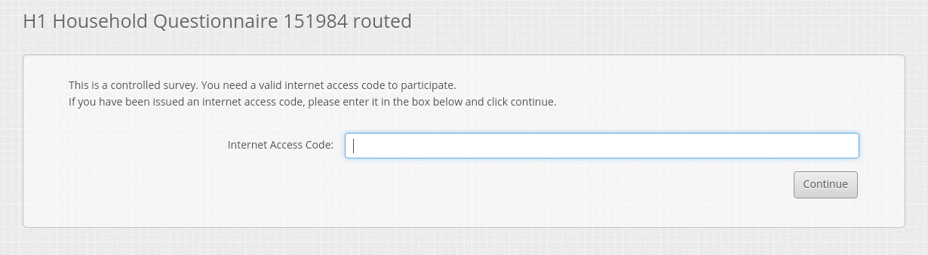
Phase 1 Internet Access Code (IAC) – Amber
Example password - ECN6EYLCTG4M6PLSJGA8
Long and complex – errors
Case sensitive
  - Particularly difficult on a mobile device
“It’s easy to make mistakes, the percentage of human error on that is quite high, just give us a simple code like XYZ123 if possible”
“Switching between capital letters and numbers and all of that…it’s a nightmare”
Notes:
The Internet Access Code was given an amber status because it was long and complex, respondents couldn’t see the letters/numbers they were typing in and it was case sensitive meaning that switching between letters and numbers was difficult for participants, especially those completing on a mobile phone or tablet.

Slide 8
IAC - Recommendations
Shorten the IAC – participants suggested between 8 and 10 digits was acceptable
Break down the code by grouping the characters into small blocks
Participants should be able to see the characters they are entering into the IAC box as they type.
Notes:
We could not shorten the IAC for security reasons. Here we had to balance the needs of security of data with usability and security has to be the priority.

Slide 9
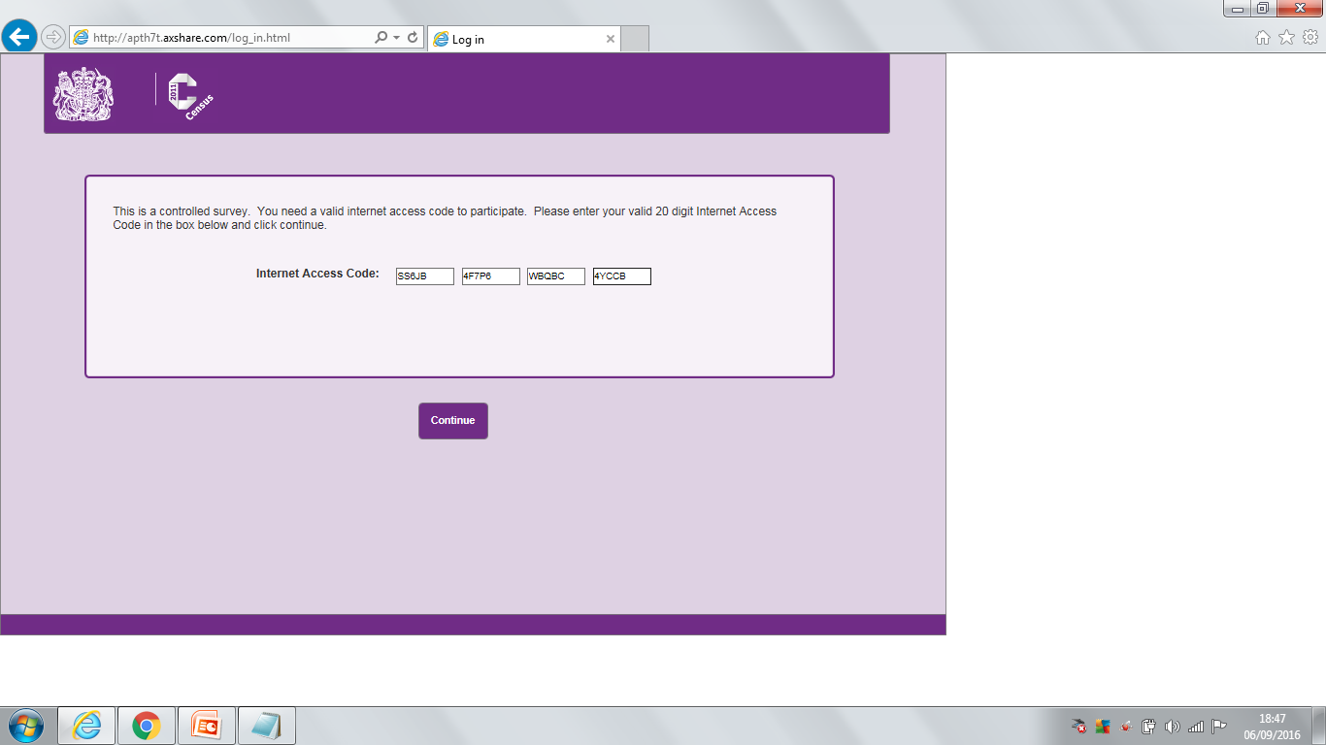
Phase 2 IAC – Amber
Notes:
RAG status remains at Amber. Participants found it easier to enter the IAC in this format than in Phase 1 but we didn’t specify that the password was case sensitive and there were participants who automatically completed the password in small caps.
Participants requested a tabbing facility so that it automatically tabs across to the next field once one field is filled in.
Participants still complained the IAC was long.
Participants didn’t understand the terminology of Internet Access Code and suggested terms such as password or log-in code.
This is a better version than Phase 1 but it could still be improved. We recommended making the letters lower case and having automatic tabbing once each field was filled in.

Slide 10
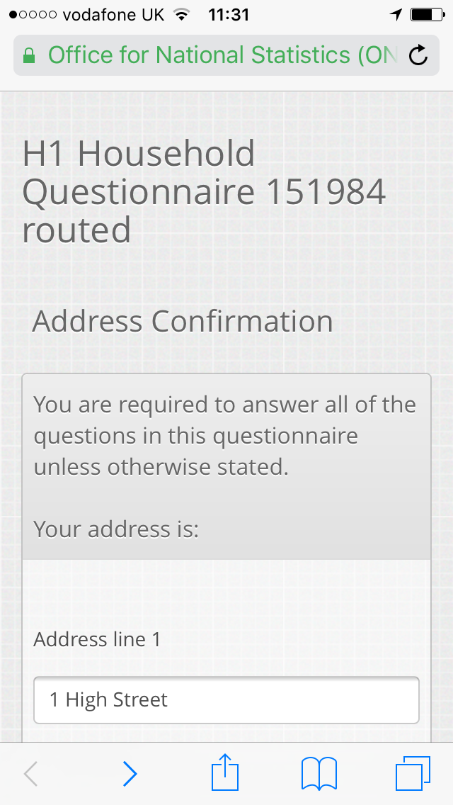
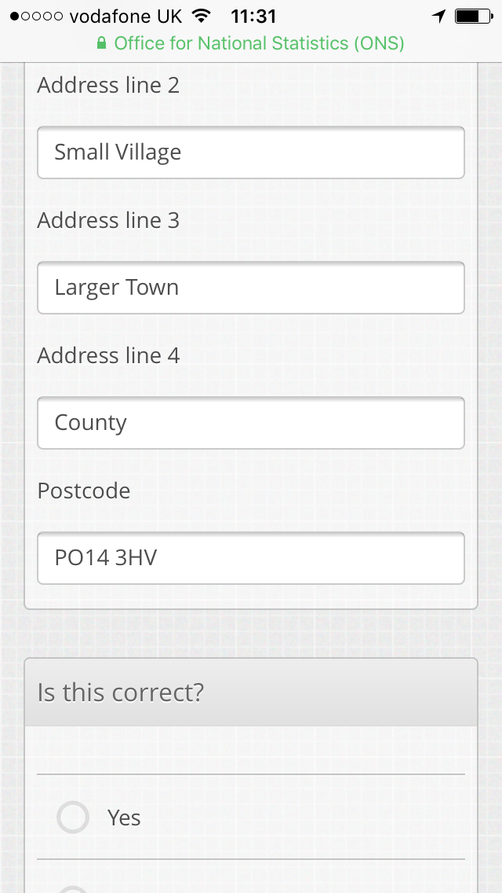
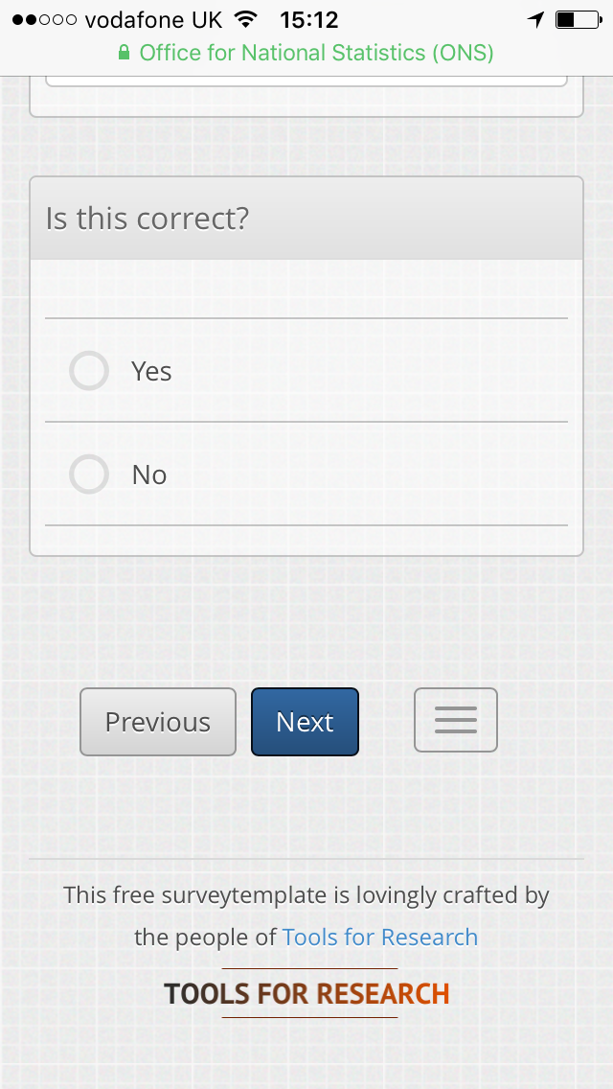
Phase 1 Address Confirmation – Red
Notes:
As part of the logging in process, participants were asked to confirm their address. They complained about the amount of scrolling.

Slide 11
Phase 1 Address Confirmation - Red
No usability problems for correct addresses
Submission of incorrect pre-filled address
Too much scrolling
“You know my address already, this is fantastic”
“I typed over it because I could”
Notes:
Participants could see their address written in the grey boxes. If it was wrong, instead of clicking no this is not correct they changed the words in the grey boxes. Their changes were not saved and the address remained incorrect.

Slide 12
Address Confirmation - Recommendations
Change the way the pre-filled address is displayed.
Show the address as plain text and avoid using open text fields until the participant has indicated that the address is incorrect.
Reduce the need for scrolling.

Slide 13
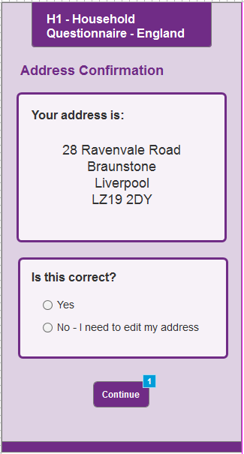
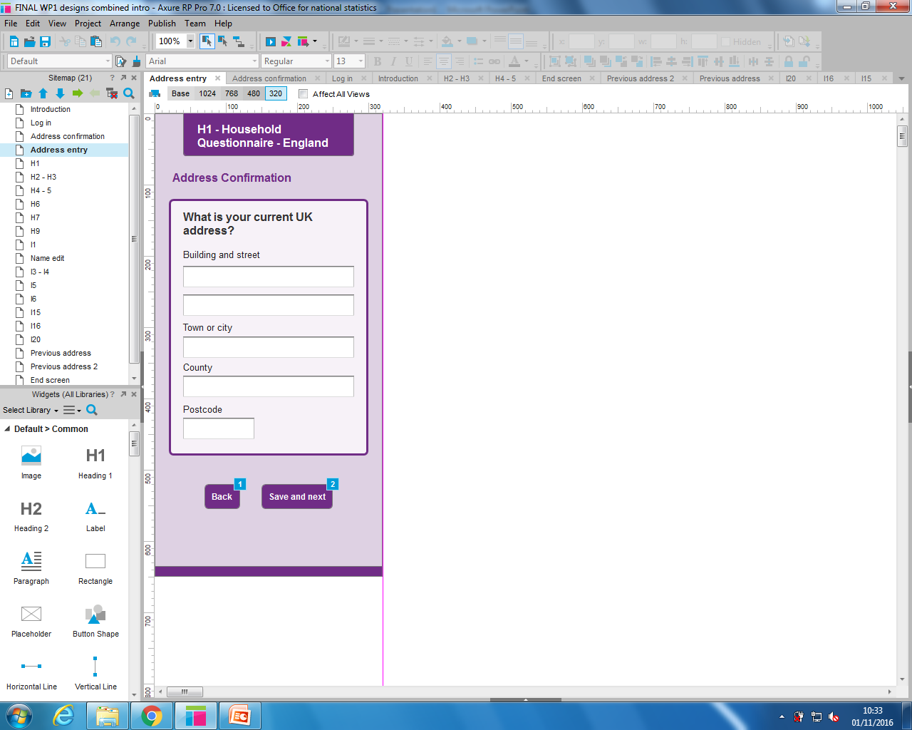
Phase 2 Address confirmation – Green
Notes:
This worked. All participants were presented with this real looking fictitious address. Participants clicked ‘No – I need to edit my address’ and were taken to the next screen where they could free type their address in and save it.
At the end of Phase 2 we said a ‘nice to have’ would be a postcode or zip code finder as there was feedback that this would make it easier for participants to fill in the address.

Slide 14
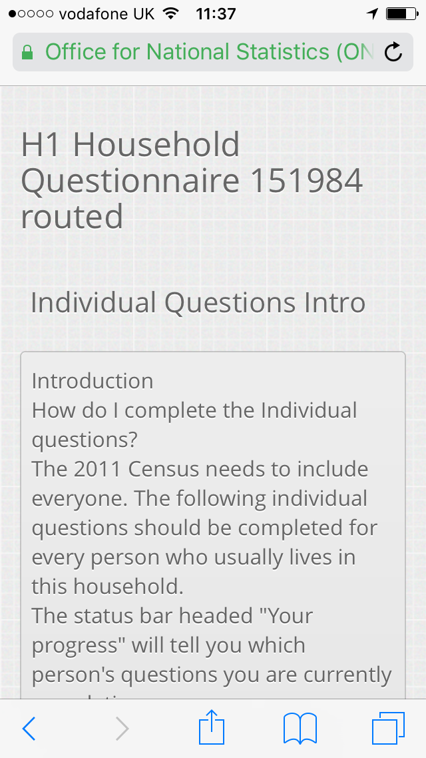
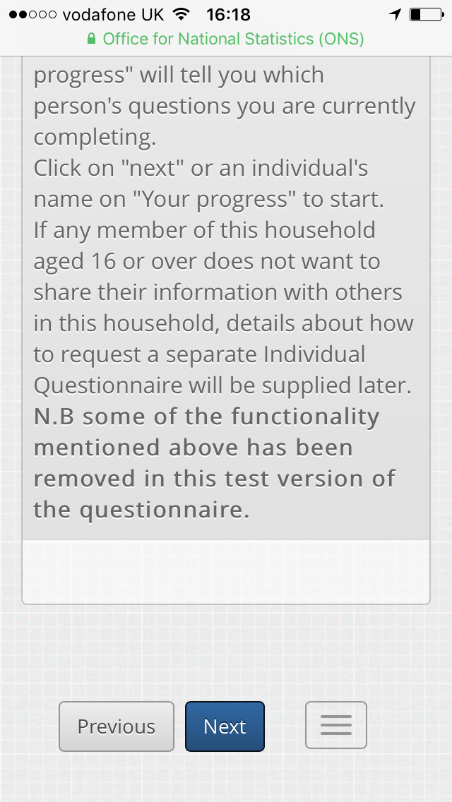
Phase 1 Individual Introduction –Amber
Too much text
Instructions not useful for completing the questions
Blank box
Misinterpreted
  End of the survey?
  Error message?
  Help message?
Notes:
At phase 1, these instructions were presented to participants after they had finished entering the household questions and before they started the individual questions. This caused confusion – participants thought it was the end of the survey or that they had done something wrong. They found they had too much text to read (some of it irrelevant) and too much scrolling to do. There was a blank box at the bottom of the instructions (limitation of Lime Survey) and it caused them to think they had been asked a question somewhere in the instructions and they had to write the answer in the box.

Slide 15
Individual Introduction - Recommendation
Give instructions for the entire questionnaire at the start and explain the format of the questionnaire – that there will be household questions followed by questions for each individual.
Reduce the amount of text on this page by removing non-essential information
Remove the blank box

Slide 16
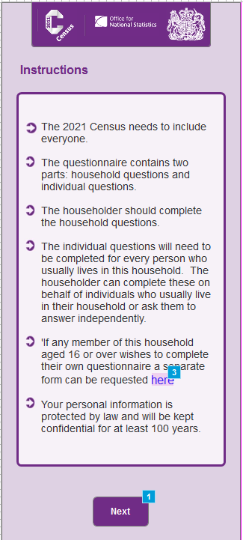
Phase 2 Instructions – Amber
Presented before participants completed any questions
Scrolling not required
Instructions were revisited and cognitively tested
Evidence found of participants skimming or skipping instructions
Notes:
During Phase 2, the instructions were presented to respondents before they completed any questions, right after the address confirmation. The instructions had been shortened and scrolling was no longer required. They are still at amber. This is because when the instructions were read, cognitive tests revealed that participants found them useful and understood them, but evidence from cognitive testing was found of skim reading or not reading them at all. It was recommended after Phase 2 that fail-safes be introduced that mean that even if the respondent doesn’t read the instructions they can still fill out the questionnaire accurately.
If asked - cognitive tests: Participants were asked:-
who they thought should complete the household questions.
who should complete the individual questions.
what they would do if they wanted to keep their responses private.

Slide 17
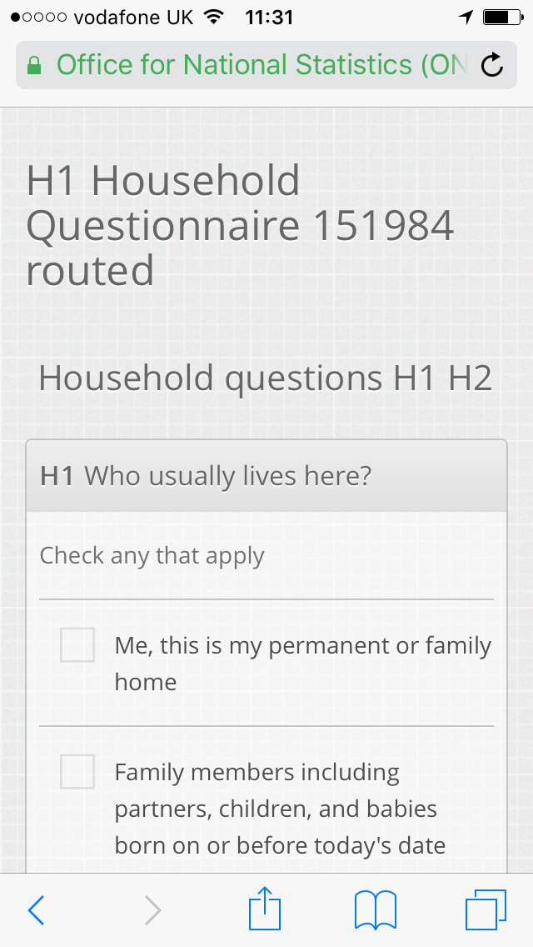
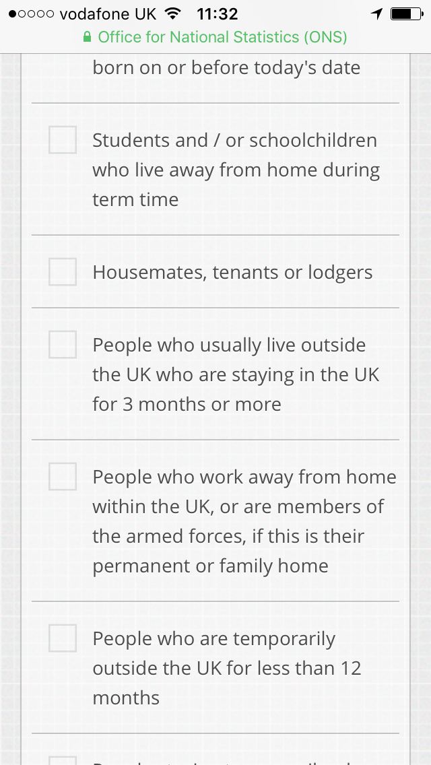
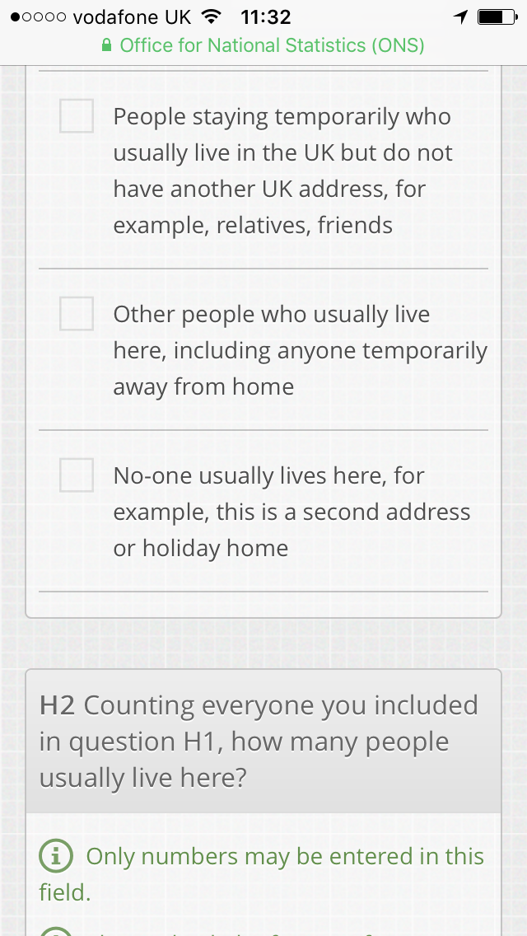
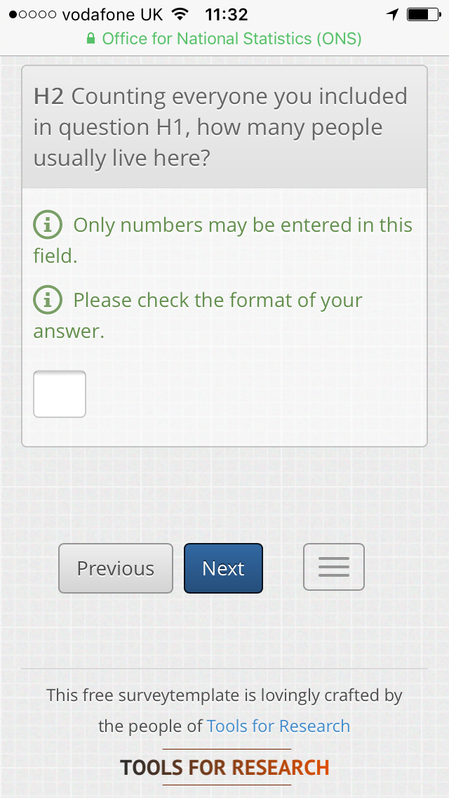
Phase 1 – Who usually lives here? – Red
Guidance ‘check any that apply’ not noticed
Answer options caused confusion
Incorrect information entered
“It was quite off-putting and especially as the very first question, it makes you think ‘oh god this is tedious if every question’s like this”
Notes:
The first Census question was presented to participants during Phase 1 like this. We gave it a red RAG after testing. Participants tended not to notice the guidance ‘check any that apply’. The answer options caused confusion – participants felt that there was too much information to read and were unhappy about the amount of scrolling. They gave inaccurate answers - selecting ‘family members’ and not including themselves or including themselves in the ‘student’ option rather than selecting ‘me, this is my permanent or family home’.
Participants said they would rather navigate through multiple ‘easy’ pages than scroll through a page like this.
Participants didn’t like the terminology ‘check all that apply’, feedback indicated they would prefer ‘tick all that apply’.

Slide 18
Who usually lives here? – Recommendations
Collect this information using multiple questions to help participants answer accurately.
Change ‘check all that apply’ to ‘tick all that apply’ on questions where this instruction is given.

Slide 19
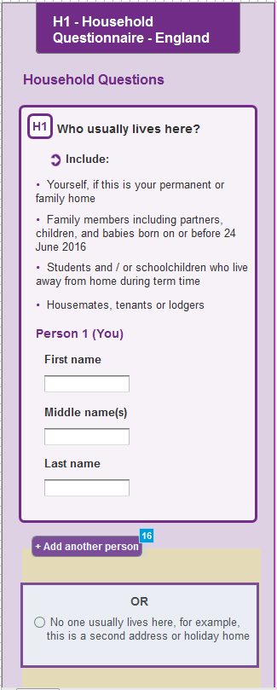
Phase 2 – Who usually lives here?
Usability testing – amber status:-
  Potential to miss ‘add another person’ button.
Cognitive testing – green status:-
  Participants were understanding wording
  Participants were willing and able to give accurate answers
Notes:
For Phase 2 we presented participants a series of shorter questions establishing who lives in the house. We split the long list of tick boxes and converted it into guidance. This is the first question. Instead of ticking boxes that involve concepts that aren’t universally understood, participants acting in the shoes of the householder are invited to write the names of every person who lives in the house using the first part of the guidance. These names can be later piped through to the individual section.
Usability: For usability the question was amber. Participants had no difficulty reading the guidance and entering their first, middle and last names. However, there is potential to miss the ‘add another person’ button. After Phase 2 we recommended making this button more prominent and doing further testing.
Cognitive testing: Feedback indicated the question and guidance was straightforward and understood consistently across the sample and the concept of middle name was understood across the different cultures we covered. Where participants didn’t know a housemate’s middle name, they just filled in the first and surname. No recommendations.
If time: There was feedback that indicated that participants felt unsure whether to include children who did not live with them full time.
With regards to the guidance attached to this question, the feedback indicated:- Respondents found the guidance useful when attempting to answer the question and appreciated that it was short and to the point. There was feed back indicating that it wasn’t needed, but this was not the consensus.

Slide 20
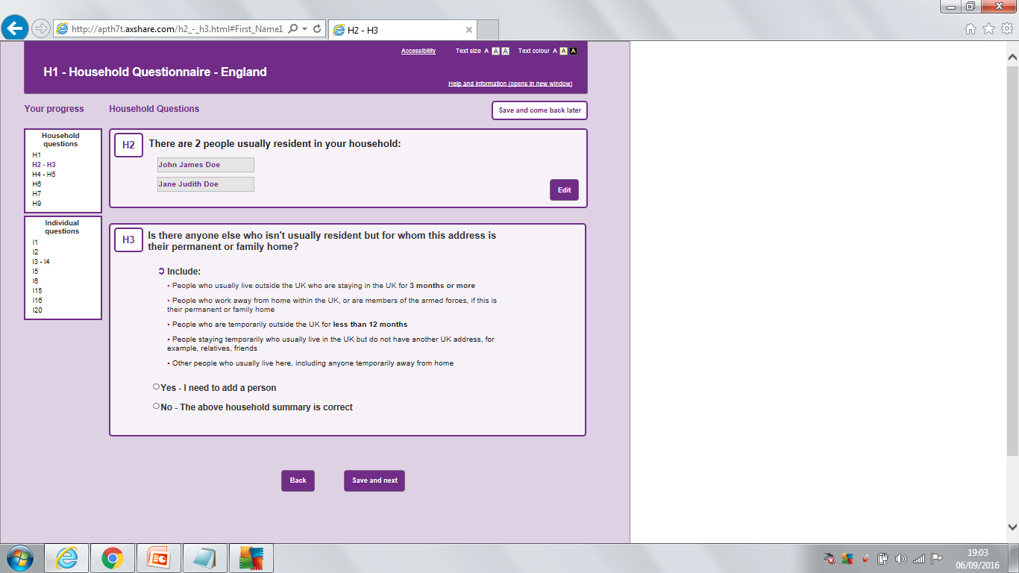
Phase 2 – Household summary
H2 amber H3 green
Notes:
After who usually lives here we presented participants with a household summary and a further question. This is the tablet and computer version.
The household summary questions H2 and H3 establish who lives in the household. H2 presents a household summary that can be checked and edited if required. H3 gives the last part of the split guidance to double check that the participant has included everybody.
H2 – got an amber status because while feedback indicated that it was easy to read the household summary and the edit button was noticed, like with the instructions, there were cases when the summary wasn’t checked and the edit button wasn’t noticed.
H3 – was cognitively tested and given a green status. Participants understood terms such as ‘permanent or family home’ as intended and while they said the extra question was annoying, evidence was found that they understood the guidance and the presence of the question forced them to check they had included everyone in their household.

Slide 21
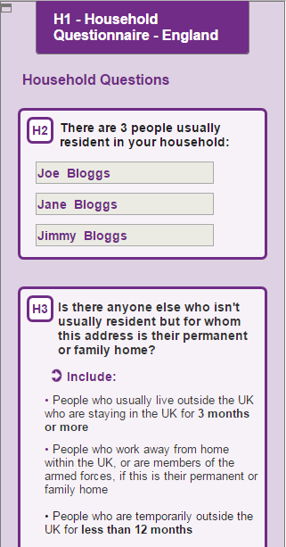
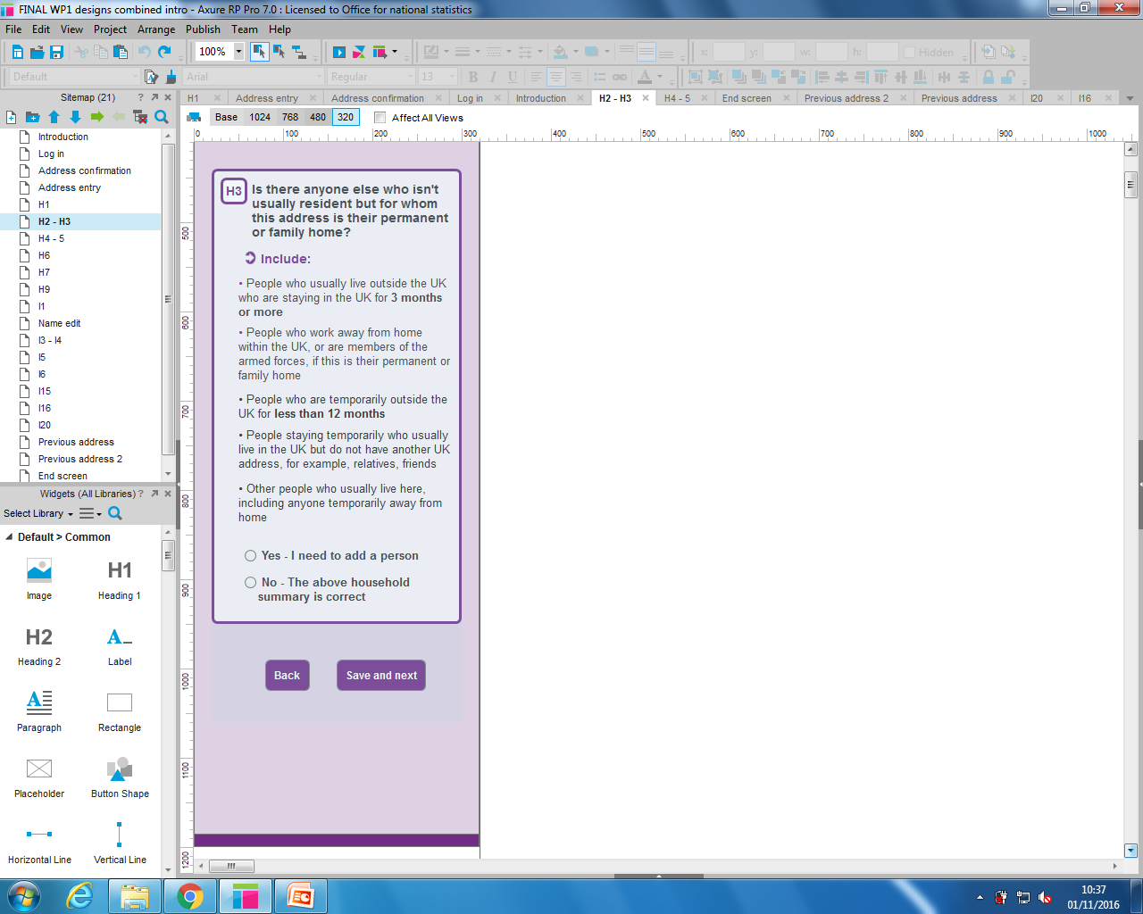
Phase 2 – Household summary – mobile version
Notes:
As can be seen the presentation of the household summary was more problematic on a mobile as respondents had to scroll to see the rest of H3. There was not the functionality on Axure to put in an ‘edit’ button for H2. Here if respondents wanted to change the household summary they would answer ‘yes – I need to add another person’ to H3.
Having a series of questions to establish who lives in the household in Phase 2 gathered more accurate answers than one long question. We recommend putting the household summary on a page on its own to make it stand out and making the edit button present on all devices and more prominent.

Slide 22
Limitations and further research
A major limitation was not having the opportunity to test the questions on the EQ platform that is going to be used to present the Census Test in 2017.
Despite improvements to the questions, there is still work that still needs to be done to change and retest some of them.
This work is ongoing, but in future iterations the questions will be tested in the software that ONS is going to use to deliver the Census Test in 2017.
Notes:
With regard to combining usability testing and cognitive testing in my experience it can be done, but you can only test a few questions because it takes such a long time and you sometimes can’t go as in-depth as you’d like. You’ll probably need more iterations.
Only if asked: The EQ is a corporate platform for online data collection. It’s in development, but supporting live collection for a small number of businesses. The next use of the EQ will be the Census Test 2017.
Only if asked a further question about mixed modes: The EQ is a platform for self completion only. Using it as a mixed mode platform with interviewers is a long way off.

