Slide 1
Aggregating Survey Questions to Reduce Respondent Burden:
Techniques To Assess Comprehension and Reporting Accuracy
Rachel Tesler, Jennifer Crafts, Westat
Brandon Kopp, Laura Erhard, Erica Yu-Wright,
Bureau of Labor Statistics
QDET2, Nov 2016

Slide 2
The Consumer Expenditure (CE) Survey
Sponsored by the Bureau of Labor Statistics
Goals of the CE Survey:
  To meet the need for accurate, complete, timely, and detailed information about the spending patterns of different types of households
  To provide the basis for revising the expenditure weights for the Consumer Price Index (CPI) every two years
2 components:
  Recall interview
  Diary survey

Slide 3
Goals of CE Recall Interview Study
Revise questions designated for Recall Interview
Continue BLS’ investigation of aggregate (“global”) questions
  Shorten the interview
  Reduce interviewer and respondent burden—without sacrificing accuracy or comprehension
This presentation will focus on methods for assessing accuracy and comprehension during qualitative interviews
  Particularly retrospective probing techniques

Slide 4
Aggregate Questions
Items
From the first of [reference month] through…have you [or any members of your household] purchased…Items used to serve, consume, or store food and drink?
Any non-electric kitchen supplies
Tableware
Non-electric cookware
Dishes
Cups
Tupperware
Dry food canisters
Pots
Cookie sheets
Food storage containers

Slide 5
Study Approach
Developed wording for 116 aggregate questions
  Based on review of current interview wording
Conducted 85 qualitative interviews across 9 iterative testing rounds
Respondent Characteristics:
  Mix of household and demographic characteristics
  Majority of interviews in Rockville, MD
  Representation of urban, suburban, rural

Slide 6
Method: Session Procedure
1. Collected expenditure data
  Had expenditure during 3-month reporting period? (Yes/No)
    Total amount spent for 3-month period
    Individual items, cost, and month purchased
  Anything intentionally excluded?
2. Conducted in-depth debriefing
  Name 5 examples (later sessions used probes)
  Judgment task (categorization of items)
  Asked for any forgotten items (not already reported)

Slide 7
Method: Session Procedure
1. Collected expenditure data
  Had expenditure during 3-month reporting period? (Yes/No)
    Total amount spent for 3-month period
    Individual items, cost, and month purchased
  Anything intentionally excluded?
2. Conducted in-depth debriefing
  Name 5 examples (later sessions used probes)
  Judgment task (categorization of items)
  Asked for any forgotten items (not already reported)
=Accuracy =Comprehension

Slide 8
1. Collected Expenditure Data
Q# | From the first of August through the end of October, have you [or any members of your household]… | Expense? (circle No or Yes) Yes → record 3-month total |  | A. Reported a. Item(s) b. Cost(s) c. Month(s) | B. Excluded Yes → Probe why and: a. Item(s) b. Cost(s) c. Month(s)
31 | purchased, either for members of your household or for someone outside of your household… Items used to serve, consume, or store food and drink? | No | Yes Total:

Slide 9
Analysis: Expenditure Data (Accuracy)
Items used to serve, consume, or store food and drink
Items counted as accurate reports
  Applicable for question and
  Purchased within correct 3-month reference period
  Example: Dinner plates bought in September
Items counted as errors
  Not applicable for question and/or
  Outside of correct reference period
  Examples: Dinner plates bought in June
  Microwave bought in October
Accurate and inaccurate exclusions
Applicable forgotten items

Slide 10
Analysis: Expenditure Data (Accuracy)
Items used to serve, consume, or store food and drink
62% of purchases named were applicable
  Tupperware, cups, dishes, silverware, warming trays
38% of purchases named were not applicable
  Disposable food containers and cutlery
  Appliances (fridge, range, microwave) and cabinets
    “I’m storing [food] in the refrigerator, and we got all new cabinets in our kitchen.”
    The range “cooks the food—when you pull it out of there, you're serving it”
Non-applicable purchases led to $3,336 in over-reporting for one respondent!

Slide 11
2. Conducted In-Depth Debriefing
Q# | From the first of August through the end of October, have you [or any members of your household] … | A. Name 5 (in later sessions: Probes) | B. Judgment Task? | C. Recheck: Any other forgotten expense? Yes → Probe why and: a. Item(s) b. Cost(s) c. Month(s)
31 | purchased, either for members of your household or for someone outside of your household… Items used to serve, consume, or store food and drink?

Slide 12
In-Depth Debriefing: Name 5 and Probes
Items used to serve, consume, or store food and drink
“What are 5 examples that come to mind when you hear [insert item wording]? These can be both things you have bought or have never bought before.”
Later sessions used probes
  Felt less like a “test” to participants
  Allowed us to focus on comprehension of specific words
  “What kinds of expenses does this make you think of?”
  “What does ‘non-disposable’ mean to you?”

Slide 13
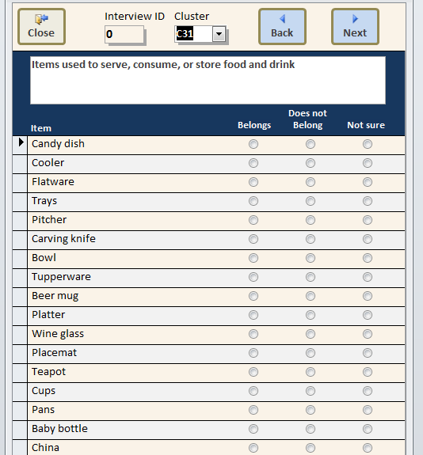
In-Depth Debriefing: Judgment Task
Categorize expenses according to whether they “belong.”

Slide 14
Analysis: Name 5 (Comprehension)
Items used to serve, consume, or store food and drink
59% of named examples were applicable items
41% were not applicable
  E.g., aluminum foil, plastic wrap, cooler, roaster pan, pots, disposable items
“I was just thinking about consuming. I guess you are talking about containers… like a pitcher, a cooling container, that kind of stuff.”
“I’m storing [food] in the refrigerator, and we got all new cabinets in our kitchen [for storing food].”
The range “cooks the food—when you pull it out of there, you're serving it”

Slide 15
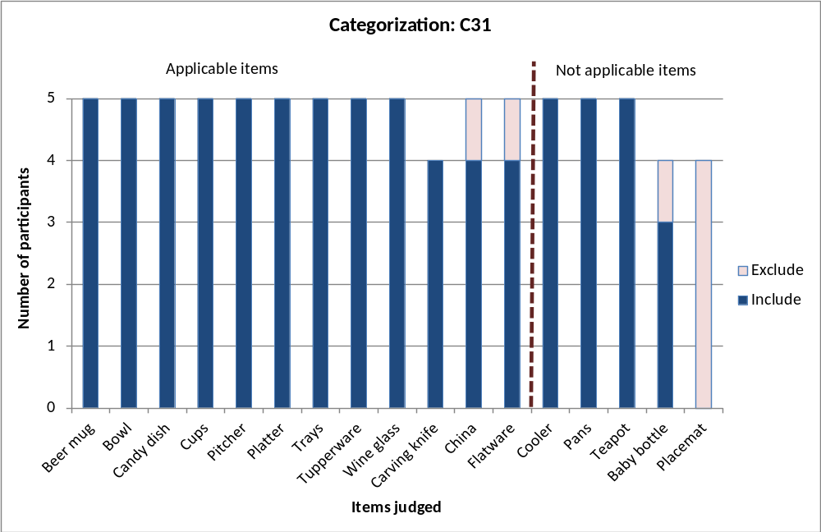
Analysis: Judgment Task (Comprehension)
Items used to serve, consume, or store food and drink

Slide 16
Iterations in Subsequent Rounds
Round 2
Non-disposable containers for storing foods or drinks
Non-disposable tableware for serving, eating, or drinking
  Findings: Based on probing, confusion over what constituted “non-disposable.”
  Round 3
Containers for storing foods and drinks. Do NOT include items you throw away.
Tableware for serving, eating or drinking. Do NOT include items you throw away.
  Findings: Based on probing, respondents showed good understanding of “items you throw away” EXCEPT for Tupperware-like containers.

Slide 17
Results
Overall objective: identify the appropriate level of aggregation and wording of questions to:
  Reduce the number of questions
  Capture accurate expenditure data
Result: ended up with approximately same number of questions with improved question wording and reporting accuracy

Slide 18
Key Takeaways
New approaches to cognitively test questions beyond traditional probes
  Blending of qualitative and quantitative techniques
  Applicability to any surveys requiring categorization of activities
Aggregation may not always reduce burden, and can reduce accuracy and/or comprehension.
  Clarification of wording at existing lower level of aggregation may be more effective
Traditional survey best practices may not always apply (e.g., avoiding use of examples).

Slide 19
Questions?
Contacts:
RachelTesler@westat.com
JenniferCrafts@westat.com
Kopp.Brandon@bls.gov
Erhard.Laura@bls.gov
YuWright.Erica@bls.gov

Slide 20
Supplemental Slides

Slide 21
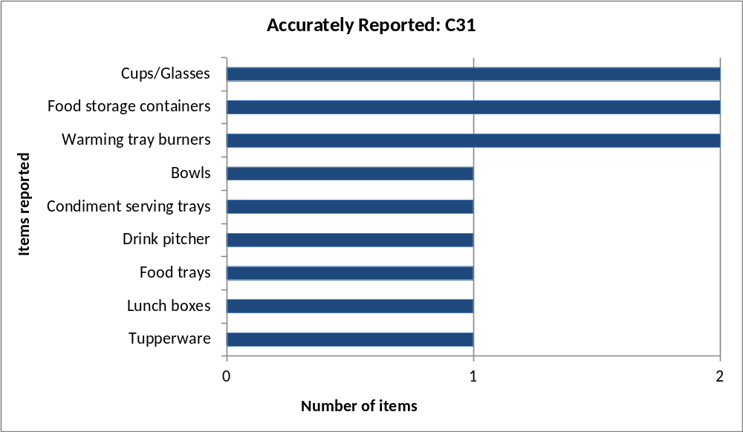
All Accurately Reported Purchases

Slide 22
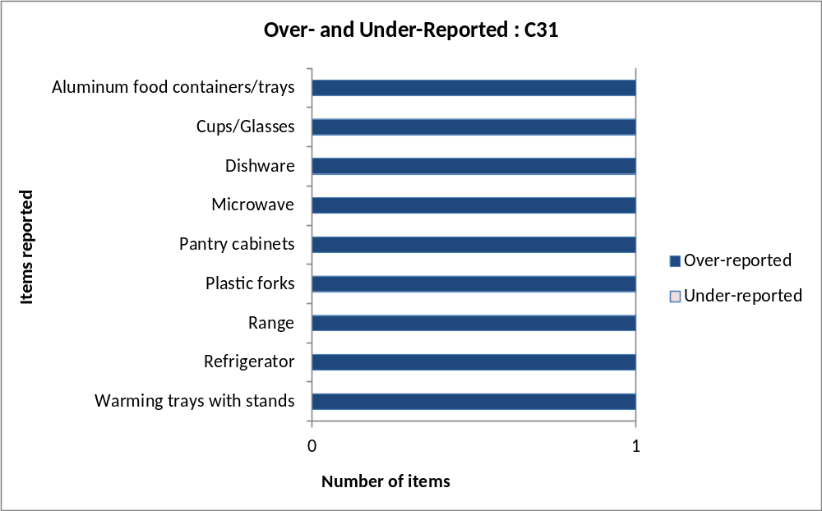
All Over- and Under-reported Purchases

Slide 23
Question Revisions Through Nine Iterative Rounds
At conclusion of testing, 119 questions
  Revised question wording (n = 65)
    Modified wording for definition approach
    Used examples instead of, or in addition to, definition
    Added inclusion or exclusion text
  Split one question into two (or more) questions
  (n = 3)
  Merged two questions to form a higher-level question
  (n = 1)

Slide 24
Question Revisions Through Iterative Rounds: Examples of Changes (Merging)
Before:
  Bus or train fare to reach your destination?
  Local transportation during a trip, such as shuttles, taxis, buses, subways or trains, and ferries?
After:
  Transportation such as shuttles, taxis, buses, subways, trains, or ferries, at any time during a trip?

Slide 25
Question Revisions Through Iterative Rounds: Examples of Changes (Listing Examples)
Before:
  Portable cooling or heating equipment?
After:
  Portable fans, heaters, humidifiers, or dehumidifiers?
  Before:
  Portable memory storage for computers and other electronic devices
  After:
  Portable memory, such as flash drives, external hard drives, memory cards, or blank CDs or DVDs

Slide 26
Question Revisions Through Iterative Rounds: Examples of Changes (Order)
  1. Any towels or other bathroom linens, shower curtains, or bath mats
  2. Non-permanent floor or stair coverings, such as mats, rugs, treads or runners

