Slide 1
Research to Develop and Pretest the
Tribal Enrollment Question for
American Indians and Alaska Natives
Rodney L. Terry, Laurie Schwede, Aleia Fobia,
Anna Sandoval, and Jessica Graber
Center for Survey Measurement (CSM)
U.S. Census Bureau
QDET2 Conference
Miami, Florida
11-12-16
Disclaimer: Any views expressed are those of the authors and not necessarily those of the U.S. Census Bureau.

Slide 2
Overview
Background
  Measuring race and tribe data for American Indians and Alaska Natives (AIAN) in the U.S.
  The role of tribal enrollment in AIAN tribe identification
Method
  Two qualitative studies to develop and then pretest questions designed to collect tribal enrollment data
Results
  Focus group results that informed initial question development
  Cognitive interview results that refined question wording
Discussion

Slide 3
American Indian and Alaska Native
Race and Tribe Measurement
American Indian race measurement is complex.
  It has additional measurement of tribal affiliation or community attachment. (Office of Management and Budget, 1997)
  Several factors affect measurement, including:
    A great diversity of tribes, villages, and other indigenous groups
      American Indians
      Alaska Natives
      Mexican, Central, and South Americans

Slide 4
American Indian and Alaska Native
Race and Tribe Measurement
Tribal enrollment is another factor
  A political and administrative relationship with a tribe or village group
    Helps determine eligibility for funding programs for federally recognized tribes
    Helps maintain cultural identity
    Often considered necessary for official membership
  Not all people with AIAN heritage are enrolled

Slide 5
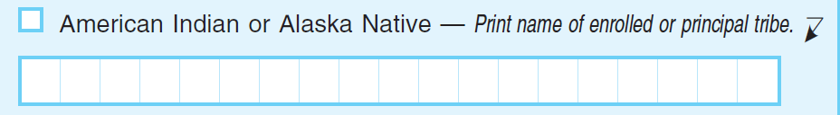
American Indian and Alaska Native
Race and Tribe Measurement
Tribal affiliation is currently measured using an open-ended instruction:
  Collects data on enrolled and non-enrolled relationships
    Never intended to only measure enrollment
  Does not meet the demand of stakeholders wanting specific data on the enrolled AIAN population

Slide 6
Purpose
  Discuss Census Bureau research to explore the feasibility of measuring tribal enrollment for American Indians and Alaska Natives in the 2020 Census
  Findings from two qualitative research studies (Terry, Schwede, & Fobia 2016a; Terry, Schwede, Fobia, Sandoval, & Graber 2016b)
    Focus groups
      To develop new, separate, and specific tribal enrollment question design for cognitive testing
    Cognitive interviews
      To refine question design

Slide 7
Focus Groups:
Enrollment Question Development

Slide 8
Method: Focus Groups
Recruitment
  11 total focus groups
    81 total participants
  Recruitment Diversity
    Focus groups specific to federal (n = 5), state (n = 2), non-recognized (n = 2), and Alaska Native (n = 2) tribe/village groups
    Tribe or village representation (n = 76)
    Tribal engagement
    Reservation Residency (n = 11)
Moderator Guide
  Included topics that informed question development

Slide 9
Results: Focus Groups
Topic | Finding
Meaning of Enrollment | 1. Enrollment status can change. 2. Alaska Natives can have enrollment relationships that are very complex to account for, including: a. Ethnic tribe entities that use terms other than “tribe” to describe themselves b. Shareholder status in federally recognized corporations
Best Wording for an Enrollment Question | Simplicity, clarity, and directness were the most desired traits.

Slide 10
Results: Focus Groups
Topic | Finding
Should the Census Bureau Collect Enrollment Data? | Views were very mixed. Advantage: 1. Perceived as way to better identify the enrolled AIAN population Disadvantages: 1. How data would be used is unclear and could incite fear. 2. Data would be based solely on self-identification.

Slide 11
Enrollment Questions for Cognitive Testing

Slide 12
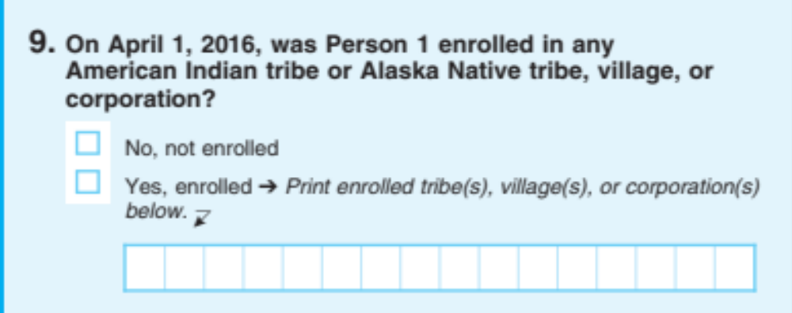
Enrollment Question One for Cognitive Testing: One-Question Format

Slide 13
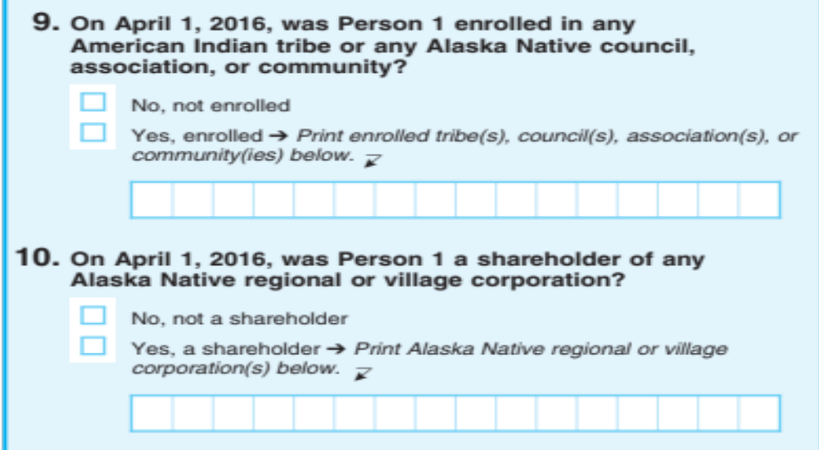
Enrollment Question Two for Cognitive Testing: Two-Question Format

Slide 14
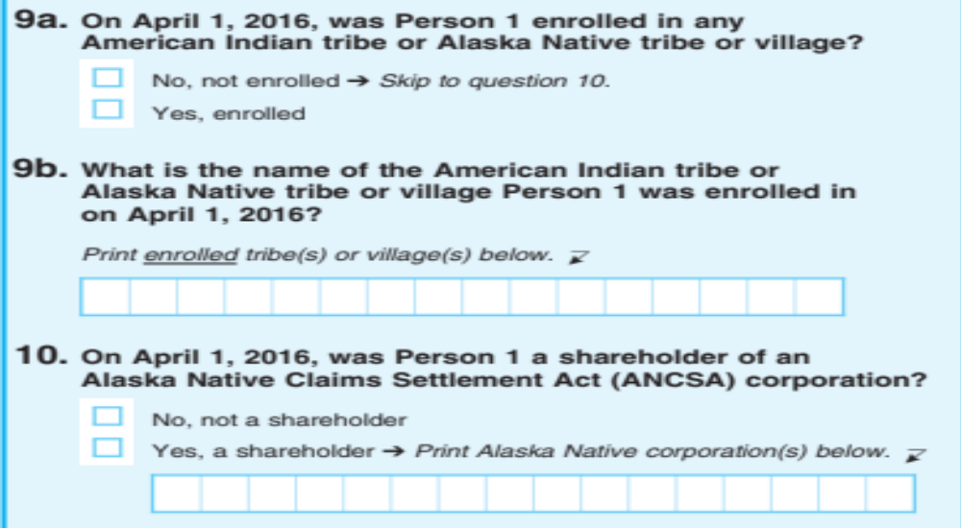
Enrollment Question Three for Cognitive Testing: Three-Question Format

Slide 15
Cognitive Testing:
Enrollment Question Refinement

Slide 16
Method: Cognitive Interviews
Recruitment
  64 total cognitive interviews
  Recruitment diversity
    Federal (n = 27), State (n = 9), Non-recognized (n = 10),
    Alaska Native (n = 12), Indigenous Central and South
    American (n = 6)
    Tribes or villages represented (n = 82)
    Reservation residency (n = 12)
    Tribal engagement
Cognitive interview protocol
  Designed to test how well each enrollment question format works
16
Notes:
16
16

Slide 17
Cognitive Interview Results
Topic | Finding
Form Comprehension | The Indigenous Central and South Americans misunderstood “enrolled” because it’s not relevant to their experience. Almost all did not understand the phrase “Alaska Native council, association, or community,” but it rarely resulted in false positives. Alaska Natives understood corporation questions, but reported corporation relationships less often with the one-question format. Alaska Natives thought younger Alaska Natives would be less familiar with the term “ANCSA Corporation.”
Form Preferences | American Indian respondents preferred Format 1 and Format 3 the most. Alaska Native respondents preferred Format 2 and Format 3 the most.

Slide 18
Recommended
Enrollment Question Format

Slide 19
Recommended
Enrollment Question Format
1. On April 1, 2017, was Person 1 enrolled in any American Indian tribe or Alaska Native tribe or village?
☐ No, not enrolled
☐ Yes, enrolled ➔ Print enrolled tribe(s) or village(s) below. ⬇
2. On April 1, 2017, was Person 1 a shareholder of any Alaska
Native regional or village corporation?
☐ No, not a shareholder
☐ Yes, a shareholder ➔ Print Alaska Native regional or village
corporation(s) below. ⬇
Separate Alaska Native tribe and corporation questions
19

Slide 20
Discussion
Implications for questionnaire design
  Simplicity and clarity are especially needed with designing a complex question targeted towards a diverse group of people.
    Find a design that can work for most rather than trying to account for every difference between groups.
    But, first find out what the differences are via diverse recruitment.

Slide 21
Discussion
Implications for collecting data on sensitive topics
  Social, political, and historical context must be fully appreciated.
    Consider the pros and cons of collecting sensitive data.
    Qualitative research and outreach to external stakeholders are vital.
Next Steps
  2017 Census Test
    Reinterview component

Slide 22
Thank you!
Research to Develop and Pretest the
Tribal Enrollment Question for
American Indians and Alaska Natives
Rodney.Terry@census.gov
Laurel.K.Schwede@census.gov
Aleia.Yvonne.Clark.Fobia@census.gov
Anna.b.sandoval.giron@census.gov
Jessica.ellen.graber@census.gov

