Slide 1

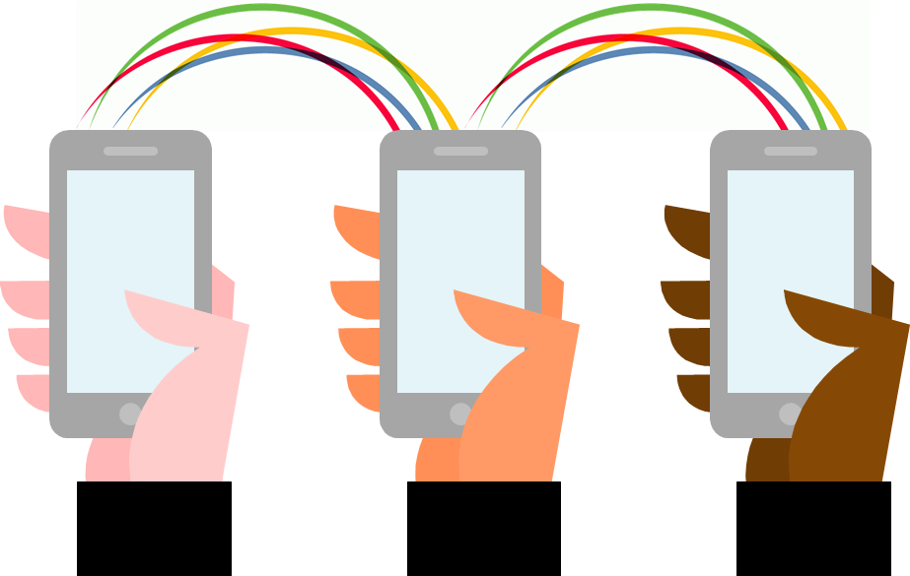

How should we adapt complex social research questionnaires for mobile devices?
Evidence from UK surveys and experiments
Tim Hanson
QDET2, November 12th 2016
QDET2, 2016
Notes:
My presentation is about how we can adapt surveys – and especially lengthy and complex social research questionnaires – to support completion by mobile devices, and I’m particularly focused on smartphones. I know it’s a topic we’ve heard quite a lot about this week but hopefully I’ll be able to add something new to the many interesting insights we’ve heard so far.

Slide 2
Agenda
UK context
Evidence from UK social surveys
Usability testing, key issues and principles
Grids experiment
Conclusions
QDET2, 2016
Notes:
I’ll start by presenting some statistics from the UK to show why this issue is growing in importance and then present current evidence from a range of UK social surveys. I’ll talk about some usability testing we’ve conducted and present the results of an experiment on grids. And I’ll finish by drawing some conclusions based on our work to date.
I won’t be covering the other experiment I mentioned in my abstract on comparing short and long versions of questions – this is still a work in progress so is not quite ready to share yet.

Slide 3
Growth in ownership and use of smartphones for online activity
7 in 10 UK adults (71%) owned a smartphone in Q1 of 2016 – up from 39% in 2012
Importance of smartphones also grows – 36% now cite their smartphone as most important internet enabled device; higher level than for any other device
2016 study showed that UK adults spent an average of 93 minutes per day on their smartphones
Expectation that surveys should be accessible by smartphones
QDET2, 2016
Data from Ofcom’s Communications Market Report, 2016
Notes:
To set some background I’m going to highlight a few trends in ownership and use of smartphones, from the 2016 Communications Market Report from Ofcom – the UK communications sector regulator.
There’s been a steep rise in ownership of smartphones in the last few years – by early in 2016 7 in 10 UK adults owned a smartphone.
The importance of smartphones is also growing – 36% cited a smartphone as their most important internet enabled device – a higher level than for any other device.
People spend a long and increasing amount of time on their smartphones – an average of 93 minutes per day based on another Ofcom study conducted this year.
This all shows an increasing reliance on smartphones, which is likely to be matched by an expectation that people should be able to complete surveys on any internet enabled device they choose.

Slide 4
Smartphones especially important for younger people
Levels of smartphone ownership particularly high among younger people – 9 in 10 aged 16-24 and 25-34 owned a smartphone
More than half of 16-24 and 25-34 year olds cite a smartphone as their most important device (56%)
Same study showed that 16-24 year olds spent 287 minutes per day on their smartphones
Survey response rates usually lowest among 16-24 year olds
Ongoing challenge of representing young people in surveys – important to remove barriers to participation
QDET2, 2016
Data from Ofcom’s Communications Market Report, 2016
Notes:
Another point to stress is that smartphones are particularly important for young people.
There are very high levels of smartphone ownership in the younger age groups and they are by far most likely to select a smartphone as their most important internet enabled device. And 16-24 year olds spent an average of 287 minutes per day on their smartphones – nearly 5 hours!
We know that for all types of surveys it’s hard to get young people to take part. Perhaps one way to encourage their participation is to make surveys more accessible across a range of devices, reflecting the way this group use the internet now.

Slide 5
Evidence from UK social surveys
Notes:
Now a few points on what’s happening on some UK social surveys…

Slide 6
Where we are…
  Now allow smartphones for most online surveys – though often still advise respondents to complete using a larger device
  Most software supports mobile optimisation – but different levels and types of optimisation
  ‘Mobile first’ approach for some new surveys; limited adaptation of existing survey content to date
  Usability testing across different devices increasingly common
  Ongoing experimental work to investigate a range of design issues; ongoing analysis of survey data across different devices to investigate impact on survey response and data quality
  Proportion who choose to complete on smartphones increasing…
QDET2, 2016
Notes:
Certainly in Kantar we now allow people to complete most of our online surveys on smartphones – which was not the case a couple of years ago when we usually blocked them. We do still often advise people to use a larger device as there’s been limited analysis of smartphone use on data quality, at least in the UK, and we know there are also concerns around higher levels of breakoffs.
Most survey software now supports mobile optimisation, though the level of optimisation can vary. At its most basic level this at least means that questionnaires resize to fit different screen sizes.
For new online surveys we’re starting to take what we call a ‘mobile first’ approach – so we set out to design surveys in terms of format and content specifically with smartphones in mind. But we also run lots of surveys that were formerly interviewer administered and have moved over to online methods – for these there has so far been limited adaptation but it is something we’re starting to look at much more.
We now regularly conduct usability testing which I’ll talk about more later.
We’re also starting to conduct more analysis around the impact of device choice – and this analysis is supported by the growing proportions completing surveys using smartphones…

Slide 7
Proportions completing UK surveys on smartphones
Survey | Year | % using smartphone | Base | Contact method | Approx. interview length | Notes
Community Life | 2014-15 | 3% | 2,325 | Letter | 30 mins | Cross-sectional survey, address based sampling
Understanding Society Innovation Panel W8 | 2015 | 5% | 776 | Email/letter | 45 mins | Longitudinal
Understanding Society Innovation Panel W9 | 2016 | 9% | 1,103 | Email/letter | 45 mins | Longitudinal
Understanding Society W8 | 2016 | 14% | 5,699 | Email/letter | 45 mins | Longitudinal, Interim data
Longitudinal Study of Young People in England 2 (Wave 4) | 2016 | 22% | 2,851 | Email/letter | 25 mins | Longitudinal, Interim data; 16-17 year olds
Wellcome Trust Science Education Tracker | 2016 | 25% | 4,081 | Letter | 25 mins | Cross-sectional, 14-18 year olds Named sample
QDET2, 2016
Notes:
This chart shows the proportions of smartphone completions across a range of UK social surveys. I won’t go through each survey – you can see some features are included on the chart - but a few general points:
While levels vary from survey to survey for a variety of reasons, it’s clear that the share of smartphone completions is rising and is now fairly substantial – based on the surveys from this year between 1 in 10 and 1 in 4 used smartphone.
People are completing long and complex surveys on smartphones – to give one example, 14% have so far completed the Understanding Society Wave 8 survey on smartphones – this survey is otherwise known as the UK Household Longitudinal Study and has a 40 minute individual interview, an additional household element, and includes a varied set of often quite detailed questions – so it represents a fairly demanding task for respondents
And levels of smartphone completions are particularly high for surveys among young people – as you can see from the bottom two examples.

Slide 8
Particularly high levels of smartphone completions in younger age groups (from Understanding Society Wave 8)
QDET2, 2016
Base sizes: 16-24 (669); 25-34 (765); 35-44 (988); 45-54 (1,111); 55-64 (1,085); 65+ (1,081)
Notes:
This chart shows proportions using smartphones to complete the current wave of Understanding Society across age bands. As we’d expect, this is highest in the youngest age groups but even if we go up to 35-44 year olds more than 2 in 10 used a smartphone, as did 1 in 10 of those aged 45-54. So levels are higher among younger people but we shouldn’t just associate smartphone completions with the very youngest age groups.

Slide 9
Usability testing, key issues and principles
Notes:
I’ll now describe some of the work we’ve done around usability testing.

Slide 10
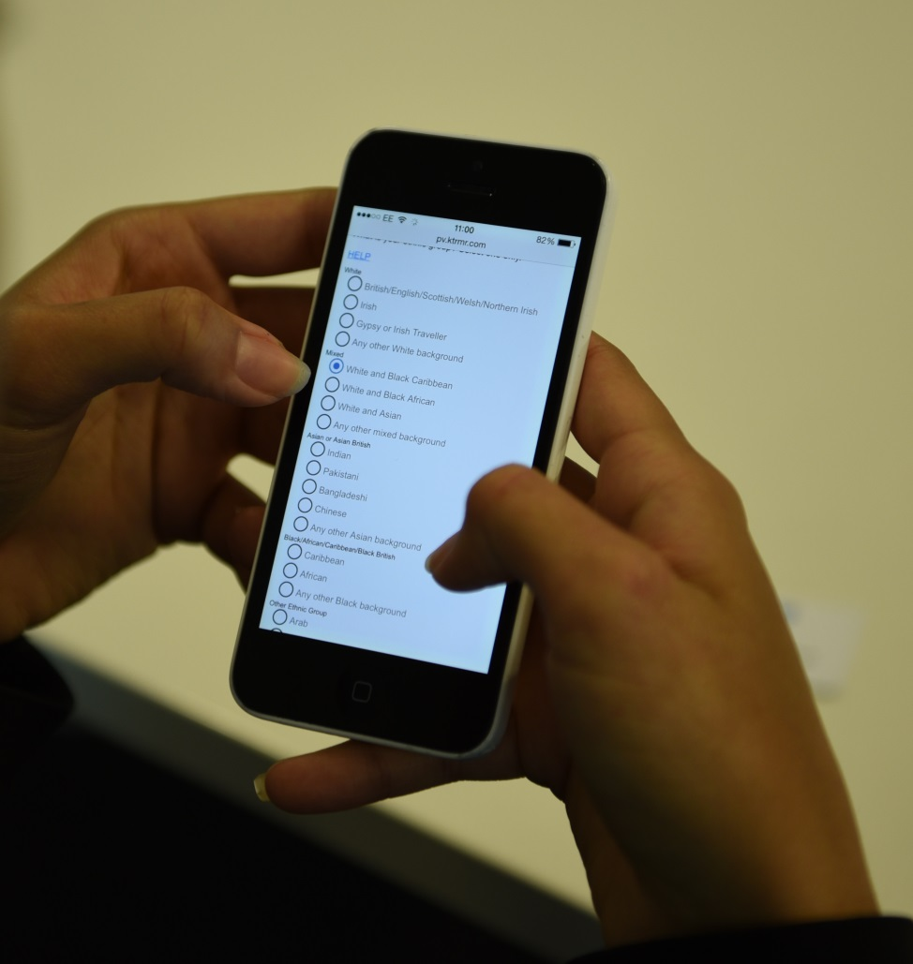
Approach to usability testing
Conducted several rounds of usability testing of Understanding Society questionnaire, as well as for other surveys
Recruit respondents who use their smartphones for online activity on a daily basis
Respondents complete a version of the survey on their smartphone
Asked to flag issues with the survey as they go through; researchers observe and probe around issues
QDET2, 2016
Notes:
We’ve conducted several rounds of usability testing on Understanding Society and a number of other surveys.
For this we recruit respondents who use their smartphone for online activity on a daily basis – as we want to focus on those who may choose to complete surveys on their phones.
We give them a version of the surveys and ask them to complete it on their smartphones. While they do this we sit alongside them, observe their behaviour, ask them to flag issues and probe around particular points of interest – so it’s a very simple method – and we’ve heard about some other more advanced testing methods this week - but we find even this simple method to be very effective.
And I’ll now highlight some of our key findings from testing to date…

Slide 11
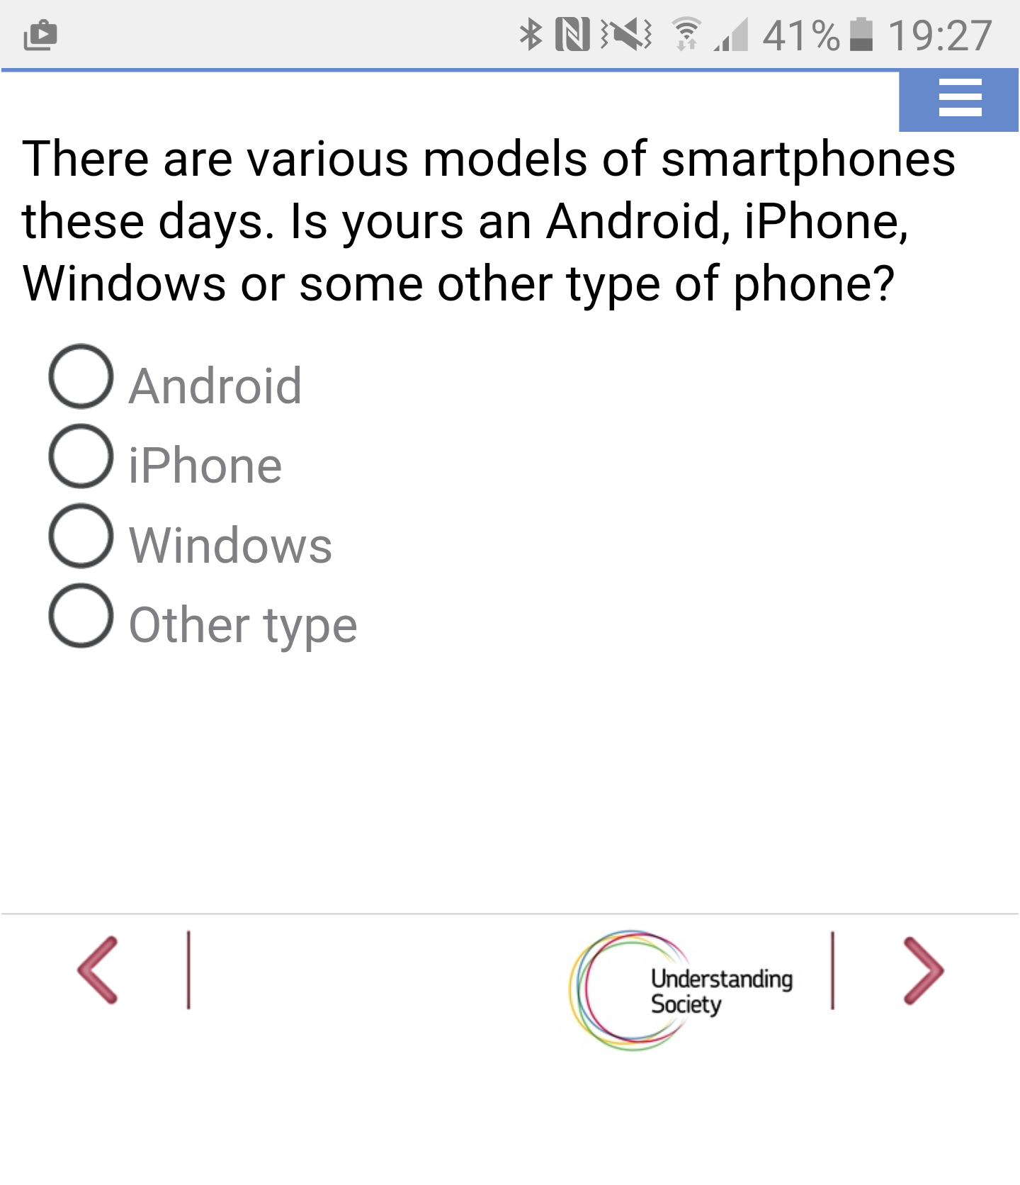
Key issues and principles – from usability testing and analysis to date
Most completed surveys with few issues – importance of device self-selection
Should carefully consider length of questions and response lists – but not just an issue for smartphones!
QDET2, 2016
Notes:
We consistently find that most people get through the surveys with not too many issues. Linked to this, on one of our surveys we also asked respondents whether they would use the same device if they were completing the survey again – and almost all who used a smartphone said they would. Device self-selection is important to stress – and those who choose to use smartphones are likely to be used to using these devices for all kinds of online activities.
We did often receive comments on the length of questions, often based on questions that were originally developed for face-to-face interviews. I have one very basic example to demonstrate this based on a question where we ask respondents what type of smartphone they have … we provide a preamble sentence that doesn’t really add anything and also go through the answer options despite these appearing in the response list. A recent respondent asked when she saw this question: ‘can’t they just ask which of these I have’? – which seems a fair point!

Slide 12
Key issues and principles – from usability testing and analysis to date
Most completed surveys with few issues – importance of device self-selection
Should carefully consider length of questions and response lists – but not just an issue for smartphones!
Important to make sure font size is large enough and consistent throughout; balance between text size and need to scroll / zoom
Response buttons and help buttons should be well spaced out (and easy to select – e.g. have used larger buttons for some surveys)
May be less detail provided at open questions – keep to a minimum?
Drop-down lists can render differently on different devices; also need to check other non-standard formats (e.g. trigrams, slider scales)
More likely to complete on move (though most still complete from home) – need to consider level of detail we ask for
Some demand for progress bars, or explicit option to save responses and complete later
Issues with traditional grids – ‘dynamic’ grids seem to work better but further testing/analysis needed
QDET2, 2016
Notes:
Some respondents commented that the text could be too small – I’d recommend erring on the side of caution and using fairly large text – but be aware that this will mean more scrolling, so a balance needs to be struck
Spacing is important – in some cases buttons were too close together and this caused some frustration for respondents and may lead to mis-coding.
Respondents were generally reluctant to provide much detail at open questions. One of our recent respondents commented that you don’t use your smartphone for ‘detailed’ tasks and it feels like you SHOULD be brief.
Non-standard question formats could cause issues and render differently across devices – so things like drop down lists, slider scales and look up functions should be treated with caution and require considerable testing.
Some of our respondents said they would struggle to provide some of the information we asked for – for example, in relation to their finances – if they were completing away from home. We actually find that most people who complete surveys on smartphones still actually do this at home but we need to consider that if they are using a mobile device they may be completing on the move, and consider just what we can reasonably ask for.
There was some demand for progress bars – or an explicit option to save response in our testing – progress bars are practically difficult due to many of our surveys being heavily filtered but they do auto-save - so if people stop they can return later and start from the same point – but there may be a need to make this more explicit to respondents, as those completing on smartphones may be less likely to be able to complete in one go.
And we – along with others – have found that traditional grid style questions don’t work very well on smartphones – and so we should consider other formats.

Slide 13
Grids experiment
Notes:
And I’m now going to present the results of a recent experiment we have conducted around grid formats. As we’ve heard this week, other studies have highlighted issues with ‘traditional’ grid formats on smartphones, that can result in data quality issues and increase drop-out rates.

Slide 14
Method
Four different formats compared:
‘Traditional’ grids
‘Dynamic’ grids
Item by item paging
Item by item scrolling
Two sets of questions asked – first on leisure and cultural activity; second on attitudes to courts and justice
Allocation to format unchanged between sets
Experiment run on Kantar TNS online omnibus – sample drawn from access panel – impacts on extent to which results can be generalised
Sample size of c. 1,200 per cell; 200-250 per cell using a smartphone or small tablet
Analysis ongoing – initial results presented today
QDET2, 2016
Notes:
For this experiment we compared four different formats (GO THROUGH THEM, WILL SHOW SCREENSHOTS).
We asked respondents two sets of questions – one behavioural, on participation in leisure and cultural activities, and one attitudinal in relation to the courts and justice system. The allocation to one of the four formats was unchanged between the two sets of questions.
The experiment was run on the Kantar TNS online omnibus, which uses sample from an access panel. Access panellists complete quite a lot of surveys and will have been used to a range of question formats – so this does impact on how widely the results can be generalised.
The sample sizes per cell – or format – were around 1,200, including between 200 and 250 completing on a smartphone or small tablet in each group.
And while I will present a few results today analysis is ongoing (the experiment was only conducted a couple of months ago), so this is very much emerging findings.

Slide 15
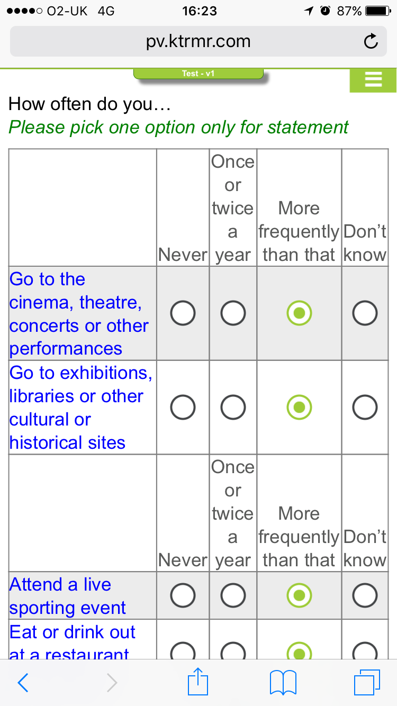
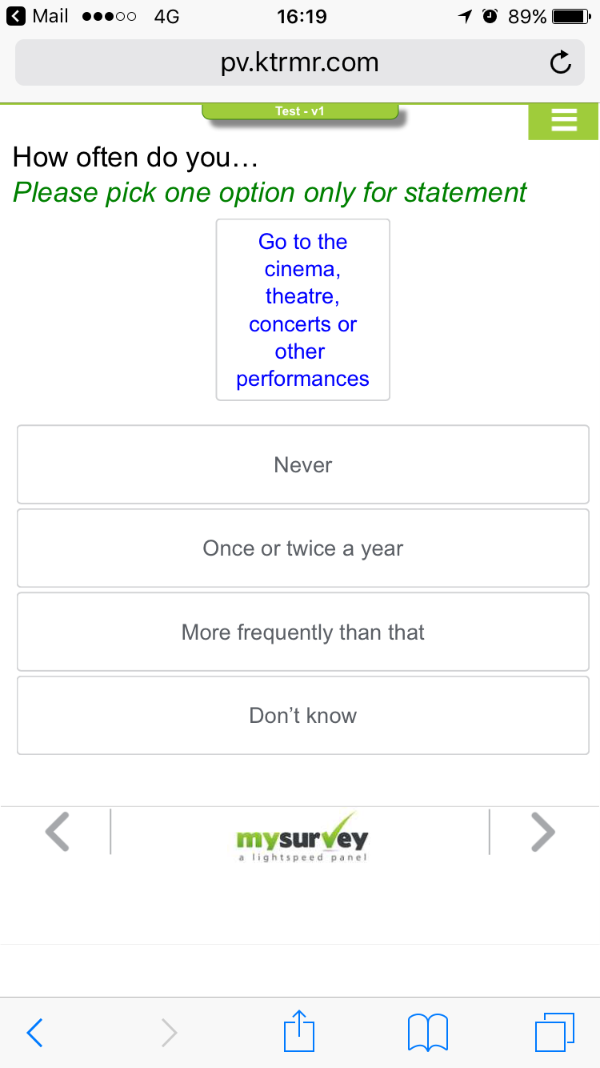
Traditional grid
Dynamic grid
QDET2, 2016
Notes:
And first screenshots so you can see how each version appeared on a smartphone screen…
On the left we have a traditional grid format – as you can see, this is quite squashed on the narrow smartphone screen. It does look better if the phone is rotated to landscape but most respondents won’t do this and we shouldn’t expect them to.
On the right is a dynamic grid – this has been designed with smartphones and other touchscreen devices in mind – and how it works is as follows…

Slide 16
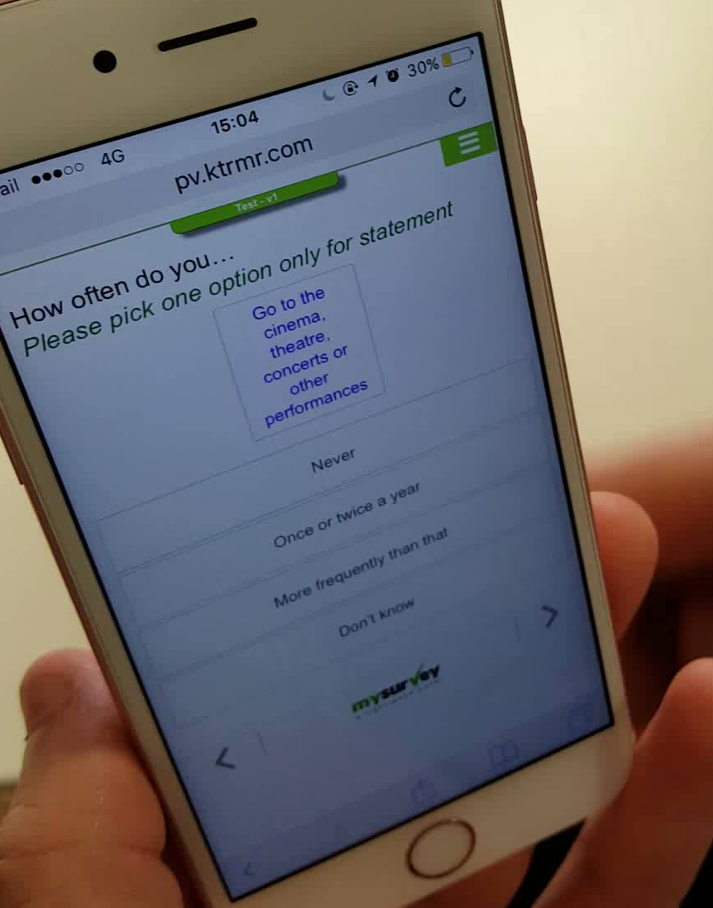
Notes:
So the items appear in a box at the top of the screen and the responses below this. The respondent selects a response in relation to an item and the next item then appears.

Slide 17
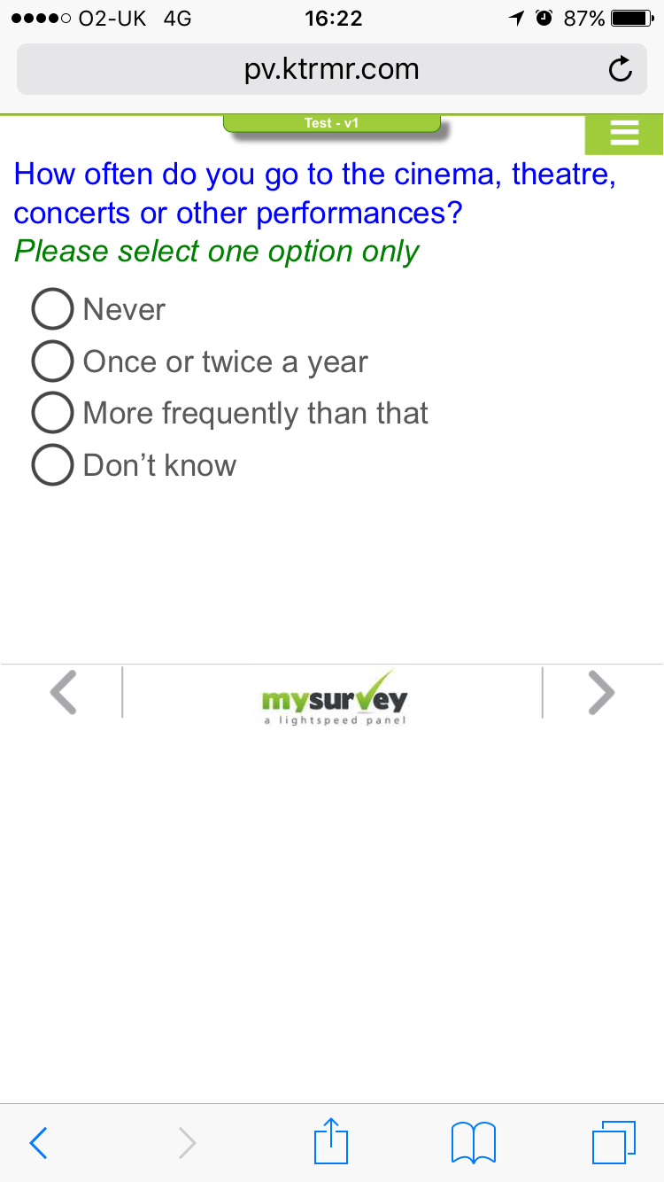
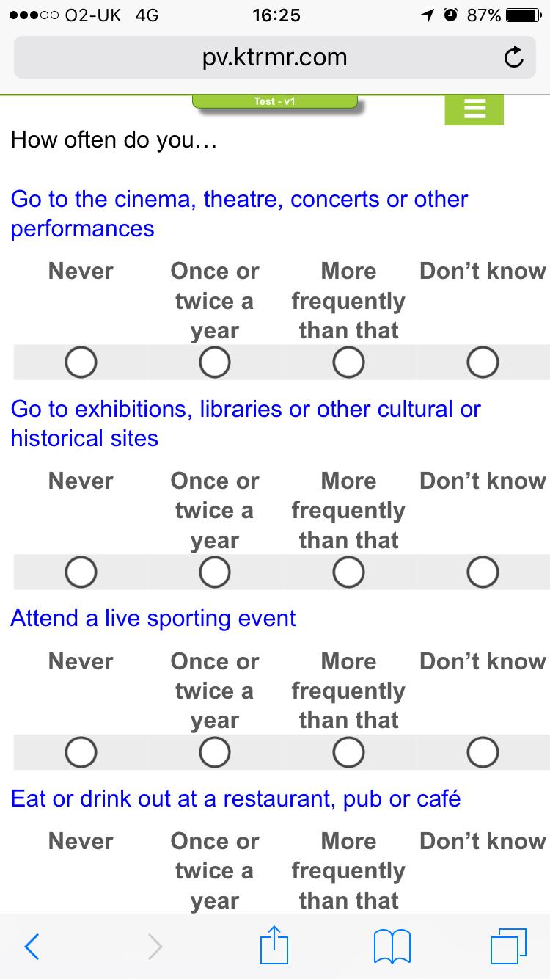
Item by item paging
Item by item scrolling
QDET2, 2016
Notes:
The other two formats were item by item paging – where we switch to having one item per page. And on the right item by item scrolling – where all items appear on one screen but we repeat the response scale for each row, which helps make the screen a bit less squashed compared with traditional grids.

Slide 18
Q1 – proportions doing activities at least twice a year
QDET2, 2016
Base sizes: Traditional (252); Dynamic (216); Paging (236); Scrolling (213)
Notes:
I won’t go through the individual results in detail but I can say that there were few significant differences across the formats – as we can see here for the first question – showing proportions participating in activities at least twice a year - just based on those using a smartphone or small tablet…

Slide 19
Q2 – agreement with statements on courts and justice
QDET2, 2016
Base sizes: Traditional (252); Dynamic (216); Paging (236); Scrolling (213)
Notes:
…And here are the equivalent results at the second question, on courts and the justice system – showing levels of agreement with each statement. Again there few differences and what differences did exist were not in a consistent direction.

Slide 20
Summary of emerging findings
Measure | Findings
Questionnaire length | Item by item paging has longest completion times – difference greater for set 1 Longer completion times for all formats on smartphones – bigger difference for traditional than dynamic grids
‘Don’t know’ rates | For smartphones, rates a little higher for item by item paging, lower for dynamic grids – but differences not significant Typically higher DK rates for smartphones – dynamic grids for set 1 only exception
Missing answers | Low levels attempt to move on without selecting all answers for all formats; for smartphones, lower for dynamic grids versus traditional grids and item by item scrolling (difference significant)
Flatlining | Fairly low levels selecting same response to all items; for smartphone users slightly lower for dynamic and higher for traditional grids but differences not significant
QDET2, 2016
Notes:
Here I’ve have summarised initial findings from a range of data quality indicators, comparing results from the four versions among smartphone users as well as results from smartphones versus other devices more generally – though note that for the latter some of these may have been due to the different types of respondents who use different devices, so it’s not quite a like for like comparison.
The item by item paging format had the longest completion times, I think as we’d expect as questions are split over a number of screens. Those completing on smartphones took longer to complete versus other devices but the difference was less apparent for dynamic grids – again as we might expect as this is intended to be a smartphone optimised format.
Don’t know rates were typically a little higher for smartphones – but there were no significant differences in ‘don’t know’ rates across the four formats.
We flagged cases where respondents tried to move on without selecting an answer for all items – these levels were low but traditional grids and item by item scrolling did have significantly higher rates compared with dynamic grids.
We looked at flatlining - so giving the same response to all items in a set – the proportion doing this was low and there were no significant differences.
So while perhaps not the most exciting results I think these are fairly positive findings – we’d certainly be more concerned if we found huge differences in responses depending on how the questions were presented.
I think the results were also fairly positive in relation to dynamic grids. This was the ‘newest’ of the formats we tested and it delivered broadly similar results to the other formats, and performed well on some of the data quality measures. I should note that it’s likely most of our respondents had seen dynamic grids before – which may not be the case for other samples – but this format has been received positively in our usability testing too, and respondents do seem to find it quite engaging and intuitive, and we are now starting to use this format more widely on our web surveys – though certainly more analysis is needed based on this experiment and more testing generally – ideally based on non-panel samples.

Slide 21
Conclusions
Notes:
Now to finish a few conclusions based on all of the work we have done to date…

Slide 22
Conclusions
1
Growing demand to complete surveys by smartphone – all online surveys should now be designed with smartphones in mind
Work to date is encouraging – respondents can complete lengthy surveys on smartphones with few problems; issues to resolve not insurmountable
But – need for further analysis (data quality indicators, paradata) and experimentation (short vs. long questions, impact of device guidance)
Device usability testing valuable – recommend its inclusion as part of the development process for any new online survey
Different levels of ‘mobile optimisation’ – need to be clear what we mean when we describe ‘optimised’ surveys
Many issues discussed don’t just relate to smartphones – need to design clear, concise and well presented questions across devices and modes
2
3
4
5
6
QDET2, 2016
Notes:
It’s clear there is growing demand to complete surveys by smartphone – and my view is that virtually all surveys should now be designed with smartphones in mind.
The work that we and others have done to date is encouraging – respondents CAN complete fairly lengthy and complex surveys on smartphones – and while there are issues to resolve, these issues don’t appear to be insurmountable.
But this is still a new and rapidly changing area and we need to conduct lots more analysis of the impact of smartphone use on data quality indicators – and the larger numbers of smartphone completions we now have in the UK will enable this. Further experimentation is also needed – I mentioned one experiment we’re running comparing responses to longer and shorter versions of questions, and we’re also planning an experiment looking at what impact removing guidance on which device to use has on device selection and response rates.
We’ve found usability testing to be valuable – and now recommend including this as part of the development process for all new or adapted online surveys – and I plan to investigate some new testing methods based on some of the papers from this week (e.g. Mr Tappy!).
It’s also clear that there are different levels of mobile optimisation. This could just be ensuring that questions are resized to fit smaller mobile screens and no horizontal scrolling is needed. But it can also refer to reverting to alternative question formats – for example dynamic grids. And we also need to consider ‘optimisation’ in terms of content – for example, shortening questions. So when we talk about surveys being ‘mobile optimised’ we need to be clear about what this means.
And finally it’s also clear that while there are some smartphone-specific issues, many of the things I’ve discussed in terms of question design and presentation apply across devices and, in some cases across survey modes – so while the growth of smartphones has heightened some of these issues, some of the improvements that will hopefully arise should have wider benefits.

Slide 23
Thank you
tim.hanson@kantarpublic.com
@timhanson123
QDET2, 2016

