Slide 1
Comparing Face-to-Face Cognitive Interviewing to Unmoderated, Online Cognitive Interviewing with Concurrent and Retrospective Probing
Bill Mockovak and Robin Kaplan
Office of Survey Methods Research
Bureau of Labor Statistics
QDET2
November 2016

Slide 2
Research Questions
1. What is the impact of using concurrent vs.
retrospective probing in think-aloud, online
cognitive interviews?
2. How do results from online cognitive
interviewing compare with results from
face-to-face cognitive interviewing?
Notes:
Before I begin, I want to provide some context and explain the motivation for this research. The general purpose of this research was to shed some light on best practices for conducting cognitive interviews. If you’re familiar with the literature on cognitive interviewing, you know that there are disagreements about what cognitive interviewing is and how best to conduct it. But one thing that many, many researchers do is use probing questions in different ways. What this research hoped to do then is answer a practical question about when probing questions are best asked when you’re testing a lot of survey questions at the same time. Are they best asked immediately after a survey question, or related series of questions, or should you wait until all the survey questions are asked before asking the probe questions. There are advantages and disadvantages to both approaches, and the answer probably depends on the number and type of questions you’re asking.
So, here are the research objectives. First, we wanted to know how changing the location of probe questions in online cognitive interviewing affected the results.
And the second research question was how did the results from these online cognitive interviews compare with results from face-to-face, cognitive interviews? Of course, we’re trying to answer the underlying question of whether online testing can replace face-to-face testing, or only supplement it?

Slide 3
Coding Scheme
(20 Codes)
Comprehension - 6 codes
Response selection – 3 codes
Retrieval – 4 codes
Other – 5 codes, one captured positive comments
Plus 2 additional codes:
  Question asked, no problems (1)
  Question not asked/Valid skip (1)
Notes:
People use probing questions to identify possible problems with the questions. We wanted to quantify the types of problems encountered, so we used a coding system with four high-level categories and 20 separate codes. The ”other” category of codes included positive comments, answers to questions that were inconsistent with previous answers, comments from the respondent that the question was repetitive or redundant, and a comment that the transition between questions was awkward. There were also additional codes for questions where no problems were noted or questions that were skipped or not asked.

Slide 4
Example of Problem Codes Used under Comprehension Category
Respondent interpreted question incorrectly
Wording of question stem was ambiguous, unclear, too abstract, or confusing
Wording of question response option was ambiguous, unclear, too abstract, or confusing
(Face-to-face) Respondent asked that the question be reread/
(Online) Respondent had to read the question more than once
Question was too long or wordy
(Face-to-face) Respondent interrupted reading of the question or
response options /
(Online) Respondent did not fully read the question and all of the
response options out loud
Notes:
I wanted to quickly show you the types of codes that we used. These were the codes that fell under problems with Comprehension.

Slide 5
Measure Used
# of times problem identified
# of times question asked
Notes:
Because there were skip patterns and not all questions were asked the same number of times, the basic measure we used was the number of times a problem was noted for a question, divided by the number of times the question was asked.
Keep in mind that more than one problem code could be assigned to a question, and often was. In this case, each code was counted separately.

Slide 6
Results:
Concurrent Probes vs. Retrospective
Which is better?
No statistically significant results were found
Notes:
So let me tell you the main conclusions or take-away points from our study. First, we found that changing the location of probes in the online testing did not have a statistically significant effect on the number of reported problems. So, we concluded that when you use a think-aloud protocol in online testing with the types of questions we tested, it doesn’t matter if you ask the probes concurrently or retrospectively, even if you’re testing a relatively large number of questions, and in our case we tested 33 questions, although many were quite short.

Slide 7
Results: Face-to-Face vs. Online
Some similar results (r = 0.462 in number of problems identified across 33 questions)
Significant differences on some questions
Online would likely have missed a problem question and didn’t uncover any new issues
Online is not a replacement for face-to-face
Mode of testing is important
Notes:
Our comparison of in-house, face-to-face cognitive interviewing with online cognitive interviewing was more complex. The in-house and online testing produced similar results for some questions, but quite dissimilar results for others. Across the 33 questions we tested, we found that there was a correlation of .462 between the number of problems found in the face-to-face testing and in the online testing, which indicates that the two approaches shared some consistency, but each still contributed something unique. Also, when we compared differences in the number of problems found for individual questions between the face-to-face and online testing, we found that a few were statistically significant, and I’ll discuss some of these shortly.
But even when a question did not have a large number of problems, the type of problem sometimes led to changes in the questions, so qualitative problems were viewed as important. I also want to point out that the face-to-face testing was done first, and the results were analyzed before we conducted the online testing. We did this because of resources. We didn’t have enough resources to conduct the in-house and online tests concurrently. Results were needed, so we had to produce them as quickly as possible.
The online testing did miss a problem question that had been uncovered in the face-to-face testing, and it didn’t uncover any new, significant problems. Therefore, in the context of this type of test, we concluded that online testing is not a replacement for face-to-face cognitive interviewing. But we arrived at this conclusion within the context that part of the face-to-face cognitive interviewing was done over the phone, whereas the online testing was completely self-administered and unmoderated; that is, no interviewer was involved. This reinforces a well-known lesson that mode is important. So, those are our main findings and conclusions. Now I’ll get into the weeds and explain how we arrived at those conclusions.

Slide 8
Background
Sample size: 30 people face-to-face testing, 30 online
  Tried to get a range of jobs and characteristics in both testing modes
Content for the testing
  Focus on questions about paid leave, job flexibility
  33 questions
Notes:
30 participants were involved in the in-house testing, and 30 in the online testing.
We used very general selection criteria for both modes. We tried to get a wide range of jobs and characteristics, and felt that we were successful in doing so.
The focus for the testing was a module proposed for the American Time Use Survey that included questions about paid and unpaid leave, as well as questions about job flexibility.
For reasons I’ll explain shortly, the analysis focused on two sections of the module: one with 15 questions and one with 18, for a total of 33 questions.

Slide 9
Comparison of Face-to-Face and Online On Three Demographic Variables
 |  | Face-to-Face | Online
Gender | Male | 28.6% | 40.7%
 | Female | 71.4% | 59.3%
Educ | High school | 23.8% | 7.4%
 | Bachelor’s | 52.4% | 77.8%
 | Prof/Graduate | 23.8% | 14.8%
Age | 25-34 | 40.9% | 63.0%
 | 35-44 | 31.8% | 29.6%
 | 45-54 | 18.2% | 7.4%
 | 55-64 | 9.1% | 0.0%
Notes:
We were able to compare the participants in the face-to-face testing with the online participants on three demographic variables: gender, education, and age. As shown in this table, the online participants seem to have a better balance in terms of gender, they appear to be somewhat better educated, and also somewhat younger. However, none of the differences shown are statistically significant using a chi-square test.

Slide 10
Protocol 1: Face-to-face
Phone interview usually with 1-2 observers
All face-to-face respondents completed the 5 sections of the module
Follow-up debriefing with pre-determined probes, but emergent/spontaneous probes used as well
Arrive at consensus code (observers + interviewer)
After 15 cases, changed the protocol to address a problem question – hence, called Protocol 2
Notes:
In the face-to-face testing, participants came into our lab. After the usual introductions and administrative steps, we conducted a phone interview with the person that covered all five sections of the module. This phone interview did not use a think-aloud procedure. During this interview, there were usually one or two observers, who took notes, and who coded the interview for potential problems. The phone interviewer also coded potential problems.
After the interview, the interviewer and observers joined the respondent, and the interviewer asked a set of pre-determined, follow-up probes, and either the interviewer or observers asked any new probes that had emerged. After the debriefing, the observers and interviewers discussed the interview and reached a consensus on the codes for each question. To expand the sample and reach some shift workers, two interviews were conducted by telephone, and in this case, there were no observers, so the interviewer coded both cases alone.
As we conducted the initial face-to-face interviews, it became apparent that a question about Types of Leave plans was causing confusion. This question was asked 9th in the first section after a series of questions that asked if a respondent could take paid leave for a variety of reasons. Three of these reasons were repeated in the question about Types of Leave Plans, so respondents commented about the apparent redundancy, and this redundancy might have confused them. So we changed the protocol after 15 cases to see if changing the approach used would address these problems

Slide 11
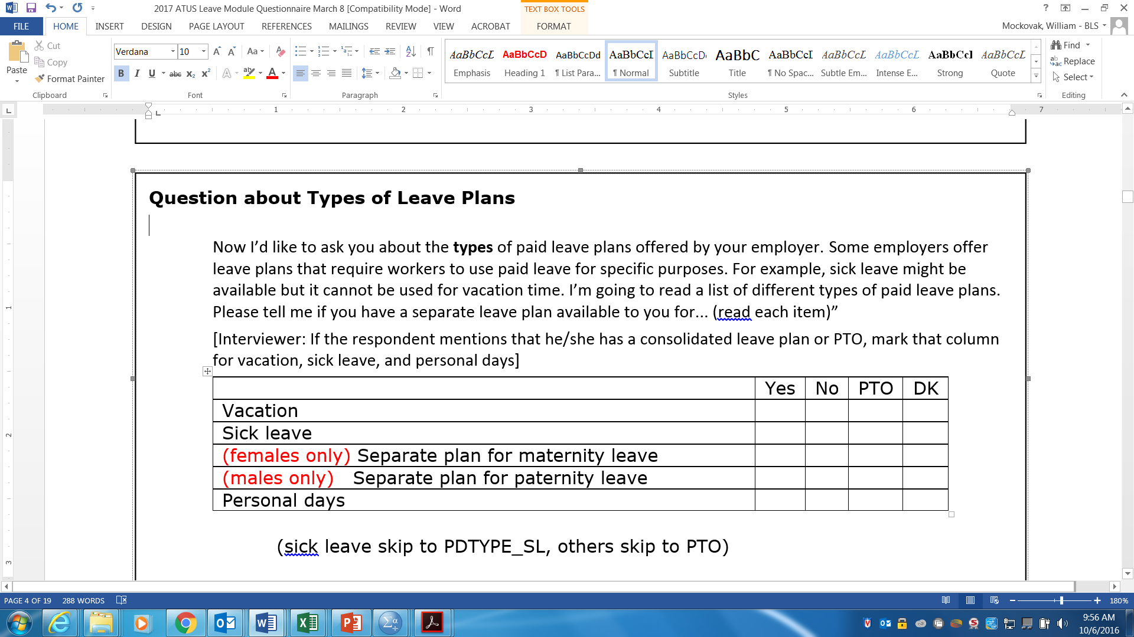

Notes:
Here’s the problem question. One thing you probably notice right away is that it has a long introduction, which was an attempt to transition and introduce a break from the preceding questions. Notice that some of the sub-questions are for females or males only.
As I mentioned, after we had completed 15 cases in the face-to-face testing, the decision was made to see if changing the order of the question and its wording would resolve the problem we were seeing. So the question was changed to an open-ended, conversational question, and it was asked first.

Slide 12
Can you briefly tell me how your current leave plan works? For example, do you get paid vacation and sick time.
Notes:
And here’s how the question was asked as a conversational question. In this case, if the information asked for in the preceding table was not clearly provided, the interviewer probed by asking a question like “Does your leave plan include a separate plan for paid sick leave?” and so on.

Slide 13
Protocol 2
Question about types of leave plans
  Moved from 9th question to 1st question in
  Section 1
  Changed to open-ended, conversational question
Apology
Notes:
As a summary, here’s a description of Protocol 2. The question about types of leave plans was moved from the 9th question to the 1st question, and it was asked as an open-ended, conversational question. At this point, I want to throw in a comment here apologizing for the added complexity of changing the protocol midway through the testing. We hadn’t planned to do that, but since this was real cognitive testing, we decided to try something different, because the approach we were using was not working well. Of course, this change complicates all of our other analyses.

Slide 14
Note: Face-to-face testing done first
Notes:
Just a reminder that the face-to-face testing was done first. We would like to have done the online and face-to-face concurrently, but we didn’t have the resources to do so.

Slide 15
Procedure for Online Testing
Respondents recruited through TryMyUI
Session limit = 20 minutes
Followed instructions on Web pages
Excellent in use of “think aloud”
Used same probes as in face-to-face test
Varied location of the probes
  Concurrent
  vs
  Retrospective
Notes:
The participants in the online testing were recruited by a company called TryMyUI, that provides testers primarily for usability testing, but since we’ve been working with them for years, we’ve been using their testers for online cognitive testing as well.
One of the constraints of this approach is that each session is limited to a 20-minute video, which records what a person is saying, and also shows what they are doing on their computer screen. This is not WebEx. You can’t see the person’s face. TryMYUI testers are generally very comfortable with the think-aloud procedure because it’s widely used in usability testing, and they get rated on how well they think aloud and complete tasks. However, you don’t always get the most experienced, or best people who think aloud, because they’re always breaking in new people. But, in general, I’ve found the quality of these testers when it comes to thinking aloud to be high. Definitely higher than what you get with people who come into our lab.
We used the same probes as used in the face-to-face testing, but they were reworded for self-administration. Finally, the location of the probes varied. In the concurrent condition, they followed the survey question of interest. And in the retrospective condition, they came at the end after all the survey questions had been answered.

Slide 16
Experimental Design for Online Test
 |  | Location of Probes
 |  | Concurrent | Retrospective
Protocol | 1 | 8 | 7
 | 2 | 7 | 8
Total |  | 15 | 15
Online respondents did not complete all 5 sections
Everyone completed Sections 1 & 4 (Total of 33 questions)
Notes:
This is an overview of the experimental design for the online test. The key point to keep in mind is that 15 people got each protocol and 15 people were asked the probes in the two different locations. Because each session was limited to 20 minutes, the online testers did not answer all the survey questions, but they did answer 33 questions in two sections of the 5-section module, Sections 1 and 4, and that’s what our analysis is focused on.

Slide 17
Dependent Variable
Number of problems noted per question, adjusted for number of times question was tested
Multiple codes were allowed, and often occurred
Notes:
As I mentioned previously, the dependent measure in analyses was a proportion which represented how many times problems were noted for a question. Because there were skip patterns in the questions, this proportion was based on the number of times a question was asked by an interviewer or tested online. As I mentioned before, multiple codes were allowed, and often assigned. So, if multiple codes were assigned, their frequency of occurrence was summed.

Slide 18
Results from Online Test
2-way ANOVA: Protocol by Location of Probes
Neither factor was significant, nor was the interaction
Mean proportion of errors –
  Concurrent probing = 0.172
  Retrospective probing = 0.233
Notes:
So, to answer our first question, does the location of probes make a difference on the number of reported problems, the answer is no. We ran a 2-way, fully crossed ANOVA, with protocol and location of probes as the independent variables. None of the main effects or interactions were significant.
More problems were discovered in the retrospective probing condition, but the difference wasn’t significant.

Slide 19
Mean Proportion of Problem Codes by Type of Problem:
Concurrent vs Retrospective Probing
Notes:
We next looked at the number of problems captured by the high-level categories in our classification system. As you can see, the mean number of problems was higher for both comprehension and response selection, which together were the most common types of problems, but differences in the high-level types of problems uncovered by the probe questions were not statistically different.

Slide 20
To Summarize
No significant differences found based on the location of the probe questions
Is this surprising?
  No … because almost all problems were identified watching the videos and hearing testers “thinking aloud”
  Probes identified very few problems
Notes:
To summarize the results so far, changing the locations of the probe questions did not have a measurable effect. With the advantage of hindsight, this result was not surprising at all since almost all of the problems were identified during the thinking aloud. So the probes added very little additional information.

Slide 21
Face-to-face vs.
Online
Notes:
Now let’s talk about the comparison of the online results to the face-to-face results.

Slide 22
Notes:
I know you can’t see the individual results in this graph, but you don’t need to. However, I hope you can see the color variations, where the blue bars are from the in-house testing, and the orange bars from the online testing. Four of the 33 comparisons were statistically significant. The correlation between the number of problems in the face-to-face vs. online testing was .462, so the two approaches are giving some consistent information, but there is also quite a bit of unexplained variation. However, even when some comparisons were not statistically significant, differences could still be qualitatively important.

Slide 23
Line Chart Showing Difference in Number of Problems Identified Between Face-to-Face and Online
More Problems Identified Face-to-Face
More Problems Identified Online
Notes:
I don’t know if this line chart helps any, but it’s just another way of showing the data in the preceding bar chart. The difference in the number of problems found between the face-to-face and online testing were computed for each question and sorted from largest to smallest.

Slide 24
Mean Proportion of Problem Codes by Type of Problem:
Face-to-Face vs Online
Notes:
This figure addresses the question “Did the type of problem identified differ in the in-house and face-to-face testing?”
This figure shows the difference in the average proportion of problem codes assigned to questions in Sections 1 and 4 by High-Level Problem Category in the face-to-face and online testing. Again, those high-level categories were Comprehension, Response Selection, Retrieval, and Other. None of the comparisons between the face-to-face and online testing for a problem category were significantly different.

Slide 25
Example of Mode Difference in Identifying Problems
Notes:
What I’ve done in this graph is pull three related questions from the bar chart with 33 questions that I showed earlier.
In this case, the question JF_6 was a question that asked if the person usually worked a daytime schedule or some other schedule. Note that relatively few problems were observed in the face-to-face or online testing for this question.
If the answer to JF_6 was “some other schedule,” questions JF_7 and JF_8 were asked. JF_7 was a question that asked about the work shift, and question JF_8 asked for the reason they worked this type of shift. As you can see in this figure, JF_7 generated quite a few problems in both modes, and JF_8 generated a lot of problems in the face-to-face testing, but relatively few in the online testing. However, the number of times a question was tested varied, so you have to take that into consideration as well.
For example, question JF_6 was asked 30 times in the face-to-face testing, and 29 times in the online testing. On the other hand, questions JF_7 and JF_8 were asked 10 times in the face-to-face testing, and only 6 times in the online testing.

Slide 26
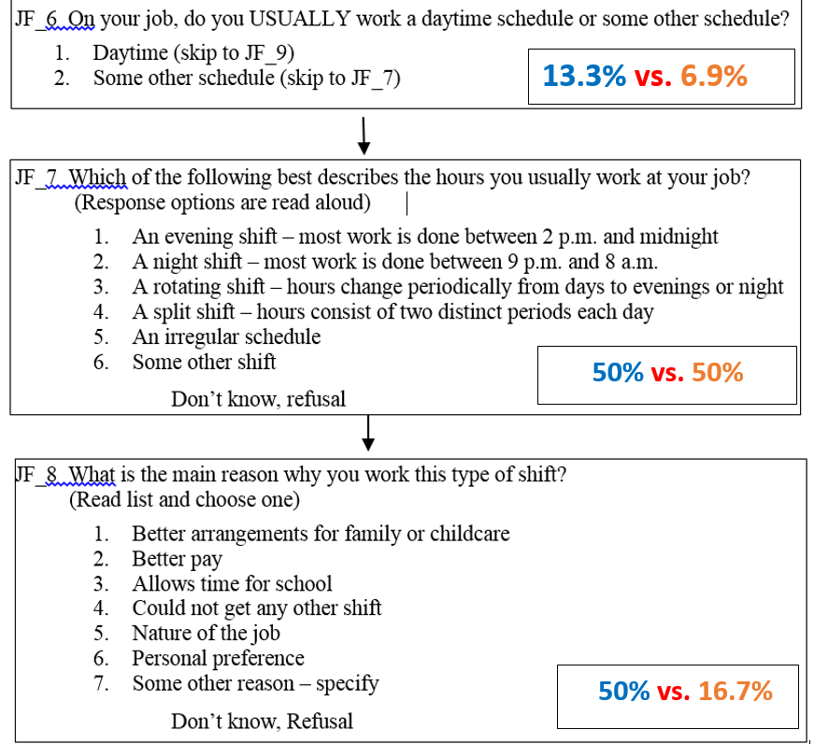
Notes:
Here are the actual questions that were tested. I’ve included the percentages of problems identified during the testing. The blue percentage is from the face-to-face testing, and the orange percentage is from the online testing. You can see that the second question, JF_7, generated a lot of problems in both modes. Most of the problem codes reflected difficulties selecting the most appropriate response.
Notice that the third question, JF_8, generated a high number of problems in the face-to-face testing: this was because respondents had trouble picking a single, best response. But notice that this happened much less frequently in the online testing (50% vs 16.7%). A reasonable assumption is that the number of problem codes was lower for this question in the online testing, because, rather than listening to an interviewer read the response options, respondents could read and compare them visually, which is a much easier task.

Slide 27
Notes:
Do you remember this question that asked about five different types of leave plans? Let’s see how this fared in the face-to-face vs. the online testing.

Slide 28
Face-to-Face
Online
Notes:
The number of problems identified for the sub-parts of this question was relatively high in the face-to-face testing, for all but paternity leave. On the other hand, relatively fewer problems were noted for questions about vacation and sick leave in the online testing versus the in-house testing, although the difference was only statistically significant for sick leave (p=0.01684). This pattern reversed for questions about paternity and personal leave, but the differences here were not significant. However, the percentage of issues noted for paternity leave was clearly inflated in the online testing because several participants answered this question when they didn’t need to, and a common answer given was “don’t know.” This did not happen in the face-to-face testing because the interviewer controlled which questions were asked.
I’m pointing out these results because, with the exception of personal days, the online testing failed to identify these sub-questions as being as problematic as they were in the face-to-face testing. So, why the big differences? This is a good example of a mode difference. Since this question was self-administered online, the response options were not read to the respondent; instead, the respondent saw them as a list and could read them. This apparently helped eliminate some of the ambiguities in the question.
As it turned out, this question was dropped based on the face-to-face testing results, so this is an example of where the online testing failed to uncover parts of a problem question.

Slide 29
Research Questions
1. What is the impact of using concurrent vs.
retrospective probing in think-aloud, online
cognitive interviews?
2. How do results from online cognitive
interviewing compare with results from
face-to-face cognitive interviewing?
Notes:
So, just in case you’ve gotten lost in the weeds of my presentation, let’s return to the original research questions, and our conclusions.

Slide 30
Results
Concurrent Probes vs. Retrospective
No statistically significant results were found
Notes:
Changing the locations of the probe questions in the online testing had no significant impact.

Slide 31
Results: Face-to-Face vs. Online
Some similar results
Online missed a major problem and didn’t uncover any new ones
Online is not a replacement for face-to-face
Mode of testing is important
Notes:
The comparison of the face-to-face cognitive interviewing with the online cognitive interviewing was messier. For some questions, we got similar results, but the online testing missed a major problem and didn’t uncover any new ones. Therefore, in the context of our approach, online testing is not a replacement for face-to-face testing, and the mode of testing is important because it can affect your results.
This conclusion, by the way, agrees with similar research we’ve done in the past.

Slide 32
Bill Mockovak
Senior Survey Methodologist
Office of Survey Methods Research
202-691-7414
Mockovak.William@bls.gov
Notes:
And here is my contact information, if you would like to get in touch with me.

