Slide 1
Qualitative Framework for Iterative Development of NCSES’s Microbusiness Survey
Jennifer Crafts, Westat
Audrey Kindlon, National Science Foundation,
National Center for Science and Engineering Statistics
Brad Chaney, Westat
QDET2, Miami, November 2016

Slide 2
Topics
Survey sponsor
Overview of the Microbusiness, Innovation, Science and Technology (MIST) survey
NSF approach to survey development
Qualitative framework for development and testing
  Research objectives
  Methods
Recommendations

Slide 3
The National Center for Science and Engineering Statistics (NCSES*)
One of the few named “entities” in the National Science Foundation (NSF) with stated responsibilities
“...to provide a central clearinghouse for the collection, interpretation, and analysis of data on scientific and engineering resources and to provide a source of information for policy formulation by other agencies of the Federal Government…”
  *Created by the America Competes Reauthorization Act of 2010 (December 6, 2010) as successor to Science Resources Statistics (SRS)

Slide 4
Overview of the MIST Survey
Rationale: The National Academy of Sciences’ Committee on National Statistics (CNSTAT) recommended developing a new survey to measure R&D and innovation data
Population: Very small (i.e., micro), independent U.S. businesses with fewer than five employees
Planned modes: Web and paper
Planned content:
  Research & Development activities and expenditures
  Innovation, intellectual property, technology transfer
  Entrepreneurial strategies
  Entrepreneur demographic and workforce characteristics

Slide 5
NCSES’s Approach to Survey Development
Data user workshops to elicit data needs
Input from expert panels
Respondent-centered development methods
Iterative test/revise cycles

Slide 6
Research Objectives for Development and Testing
Assess, across respondents:
  Motivation to respond
  Relevance of questionnaire topics
  Feasibility of response
  Question comprehension
  Ease and accuracy of response without record check
Identify causes of reporting issues and errors
Observe navigability

Slide 7
Survey Development and Testing Methods
Method | # Interviews | Format
Exploratory interviews | 17 (in 3 rounds) | In-person, online
Cognitive interviews | 21 (in 3 rounds; plus 4 re-interviews)
Debriefing interviews (Pretest) | 20 | Online
Usability test sessions | 9 (2 rounds; plus 5 re-tests) | In-person, online
Debriefing interviews (Pilot Test) | 26 (in 2 phases) | Online
Total | 93 (plus 9 re-contacts)

Slide 8
Method | Research Objectives
 | Motivation to respond | Relevance of questionnaire topics | Feasibility of response | Question comprehension | Ease and accuracy of response | Reporting issues and errors | Navigability
Exploratory interviews
Cognitive interviews
Debriefing interviews (Pretest)
Usability testing sessions
Debriefing interviews (Pilot test)

Slide 9
Exploratory Interviews
Method | Research Objectives
 | Motivation to respond | Relevance of questionnaire topics | Feasibility of response
Exploratory interviews | XX | XX | XX
XX = Primary focus
during interviews
Interview Procedure
  Interviewer and respondent explored topics, looked at borrowed and new questions to address relevance and feasibility
Respondent Issues
  Topics not relevant
  Key concepts (R&D, innovation, number of employees) difficult to understand and answer about

Slide 10
Cognitive Interviews
Method | Research Objectives
 | Motivation to respond | Relevance of questionnaire topics | Feasibility of response | Question comprehension | Ease and accuracy of response
Cognitive interviews | XX | XX | XX | XX | XX
Interview Procedure
  Respondent: Completed survey
  Interviewer: Observed, administered retrospective debriefing
Respondent Issues
  Although some changes worked, there were still comprehension issues
  Skipped instructions and definitions
  Over-reported research and innovative activities

Slide 11
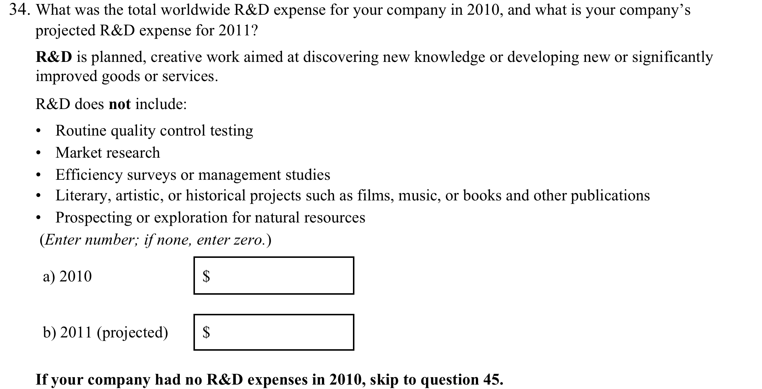
Original Approach for Asking About R&D

Slide 12
Revised Approach for Asking About R&D

Slide 13
Debriefing Interviews (Pretest)
Method | Research Objectives
 | Motivation to respond | Relevance of questionnaire topics | Feasibility of response | Question comprehension | Ease and accuracy of response | Reporting issues and errors
Debriefing interviews (Pretest) | XX | X | XX | X | X | XX
X = Continue to monitor during interviews
Interview Procedure
  Interviewer: Shared screen to show completed survey; probed on motivation to respond, sections/questions respondent mentioned as difficult, inconsistent or atypical responses
Respondent Issues
  Reporting errors
    Inconsistent responses
  Item non-response

Slide 14
Usability Testing Sessions
Method | Research Objectives
 | Motivation to respond | Relevance of questionnaire topics | Feasibility of response | Question comprehension | Ease and accuracy of response | Reporting issues and errors | Navigability
Usability testing sessions | X | X | X | X | X | X | XX
Test Procedure
  Respondent: Completed survey (face-to-face or via shared screen)
  Moderator: Observed; reviewed survey responses and administered retrospective debriefing
Respondent Issues
  Labels for navigation options were misunderstood
  Error message text was misunderstood

Slide 15
Debriefing Interviews (Pilot Test)
Method | Research Objectives
 | Motivation to respond | Relevance of questionnaire topics | Feasibility of response | Question comprehension | Ease and accuracy of response | Reporting issues and errors | Navigability
Debriefing interviews (Pilot test) | XX | X | X | X | X | XX | X (for web responders)
  Interview Procedure
  Interviewer: Shared screen to show completed survey; probed on motivation to respond, difficult sections/questions, inconsistent or atypical responses
Respondent Issues
  Questionnaire itself was easy to understand and answer
  However, motivation was problematic

Slide 16
Methods and Research Objectives
Method | Research Objectives
 | Motivation to respond | Relevance of questionnaire topics | Feasibility of response | Question comprehension | Ease and accuracy of response | Reporting issues and errors | Navigability
Exploratory interviews | XX | XX | XX
Cognitive interviews | XX | XX | XX | XX | XX
Debriefing interviews (Pretest) | XX | X | XX | X | X | XX
Usability testing sessions | X | X | X | X | X | X | XX
Debriefing interviews (Pilot test) | XX | X | X | X | X | XX | XX (for web responders)

Slide 17
Recommendations
Plan for involvement of respondent population throughout development/redesign process
  Ensure breadth of representation
Use multiple methods to elicit respondent input
Define research objectives for each method
Plan for iterative, small-scale testing
  Address feasibility early
  Continuously assess motivation to respond, comprehension, and reporting accuracy
  If possible, test until revisions work well for respondents (saturation) and no new significant issues surface

Slide 18
Questions?
Contacts:
jennifercrafts@westat.com
Audrey Kindlon
akindlon@nsf.gov
www.nsf.gov/statistics/
Brad Chaney
bradchaney@westat.com

