Slide 1

New Pretesting Approaches and Designing for the Digital Age
Development and Implementation Methods of an Offline Survey in Low- and Middle-Income Countries
Scott McIntosh, PhD
University of Rochester Medical Center
Co-Authors:
Esteban Avendaño, Universidad de Ciencias Médicas
Margaret M. Demment, University of Rochester Medical Center
Timothy De Ver Dye, University of Rochester Medical Center
Deborah J Ossip, University of Rochester Medical Center
José G. G. Pérez-Ramos, University of Rochester Medical Center
Carmen Milagros Vélez Vega, Departamento de Ciencias Sociales
Keywords: Offline data collection, REDCap, Survey Development and Implementation

Slide 2
We have global health research projects in several Low and Middle Income Countries (LMIC):
Perceptions of genetic testing / Zika risk (Puerto Rico)
Diabetes prevention (Marshall Islands, Federated States of Micronesia)
Maternal Health (Costa Rica, Dominican Republic, Honduras, Mexico)
Depending on the project, domains assessed often include:
Demographics
Health / Health Risk Behaviors
Maternal Health
Future Family Planning
eHealth Readiness

Slide 3
Our internet-based surveys are developed with these steps:
IRB approvals
Multiple IRBs involved in LMIC research
Frequent mendments as needed (e.g., updated survey versions)
Qualitative research (to confirm Domains for survey development)
Survey draft development (first draft on mTurk ☼)
Pre-Test multiple times (for content and “look”, which differs by country)
Pre-Test both online and offline functionality (version / “meta data” problems)
Back Translation to Spanish (and ongoing pretesting in Spanish as needed)
Sustainable standardization (easily taught “train-the-trainer” methods)
☼ TIP: Fieldwork in Puerto Rico began with the further development of a survey initially available at Mechanical Turk (mTurk), Amazon.com's crowdsourcing website, which greatly expanded our capabilities for low cost and timely survey development.

Slide 4
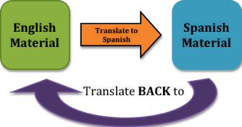
Back Translation
Translated to Spanish (3 bilingual investigators, US and PR)
Back translated to English and compared (3 separate investigators)
Process also served as ongoing pretesting for readability, skip patterns, formatting, and content.
☼ TIP: A short-cut to this Brislin Back-Translation method: If only a subset of items were disagreed upon when compared, only send those items around again for re-review.

Slide 5
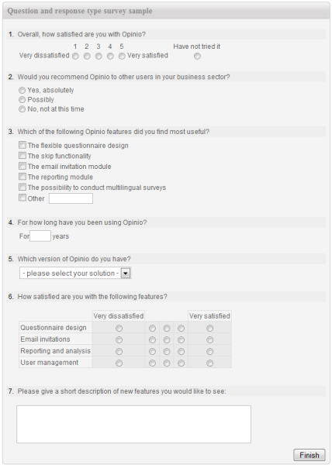

This survey was developed and pretested using the mobile (offline) application of REDCap (Research Electronic Data Capture).
HIPAA-compliant software
Has both an online and offline interface (helpful for extremely remote areas)
Allows direct data entry (IOS and Android)
Allows for tracking of data entry staff by registering individual usernames.

Slide 6
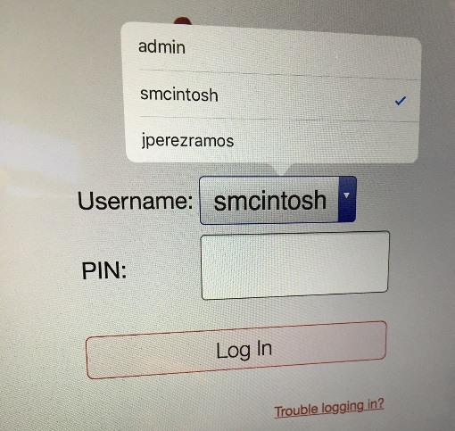
PILOT TEST 1 (Puerto Rico)
Six local data collectors were trained (online and offline procedures) in a 3-hour workshop. They each received a tablet and unique userID. They then trained the other data collectors (“train-the-trainer” model) in subsequent weeks. ☼
☼ TIP: Training data collectors for survey tasks and familiarity with the content of the survey can serve as additional “pre-testing” information prior to Pilot Testing or Final Implementation.

Slide 7
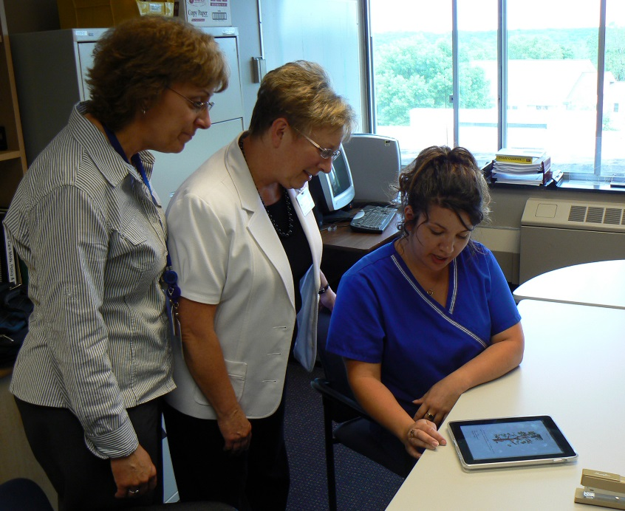
PILOT TEST 1 (Puerto Rico - Continued)
The offline survey was Pilot Tested with iPads at
community health centers in Puerto Rico, where
internet was not available, resulting in 32
completed surveys.
Feedback from data collectors included concerns that the survey was too long, and that some common survey aspects (e.g., Likert Scales) were difficult for respondents.
Approximately 2/3 of respondents felt it was understandable.
Changes from Pilot Testing feedback: Item wording, skip patterns, formatting and navigation issues (related to offline mode).

Slide 8
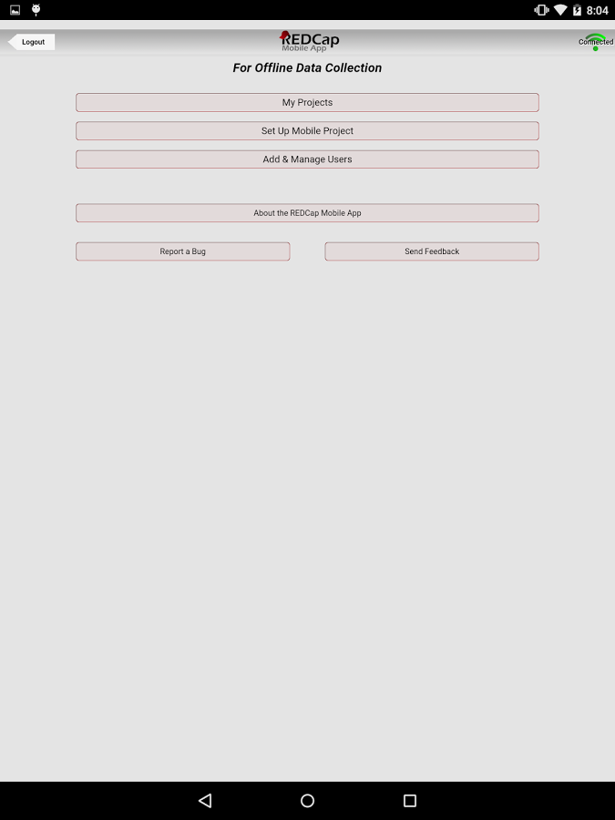
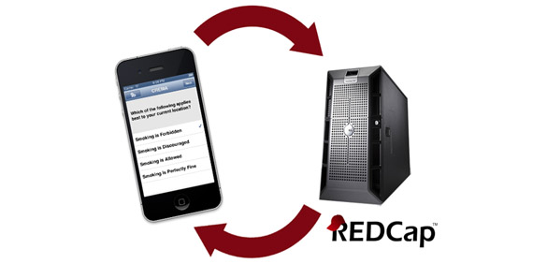

Slide 9
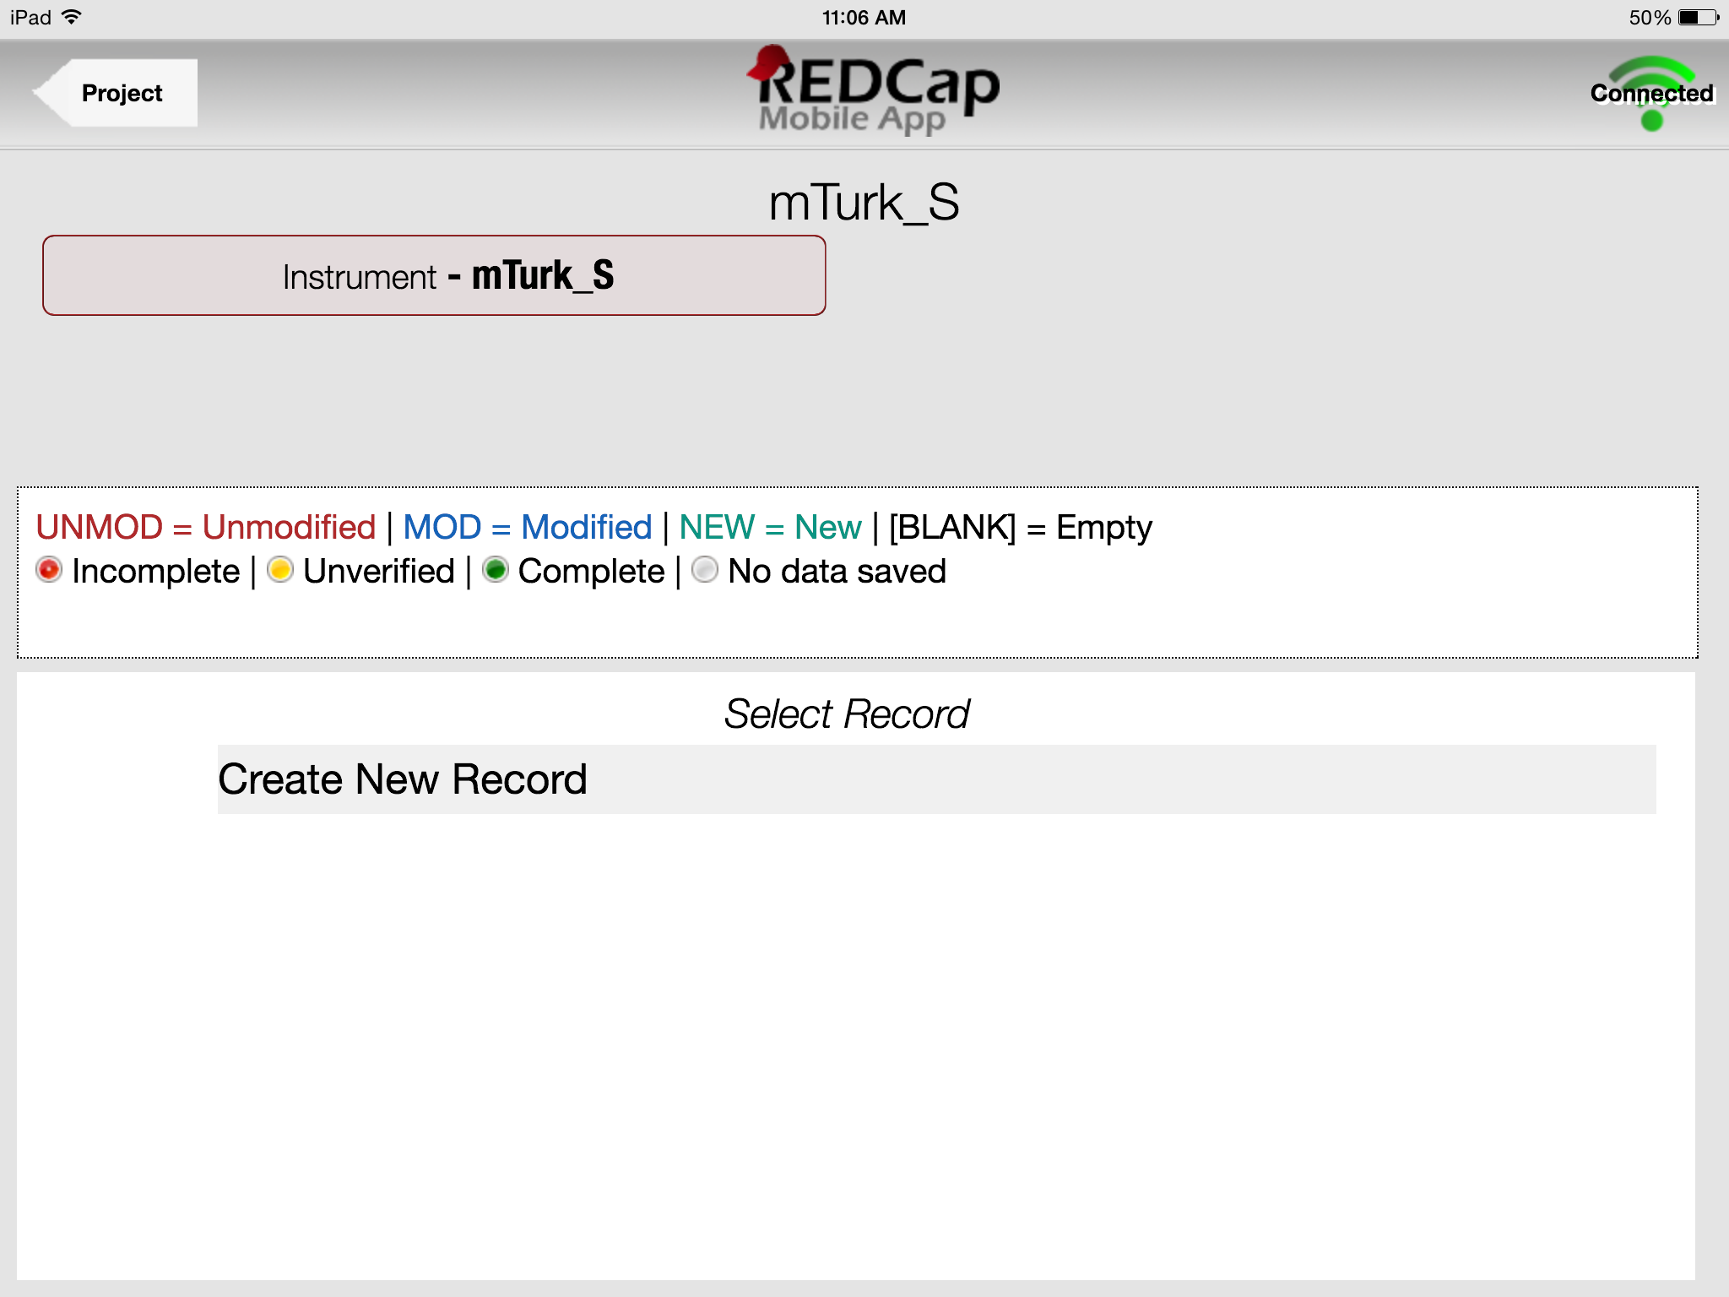

Slide 10

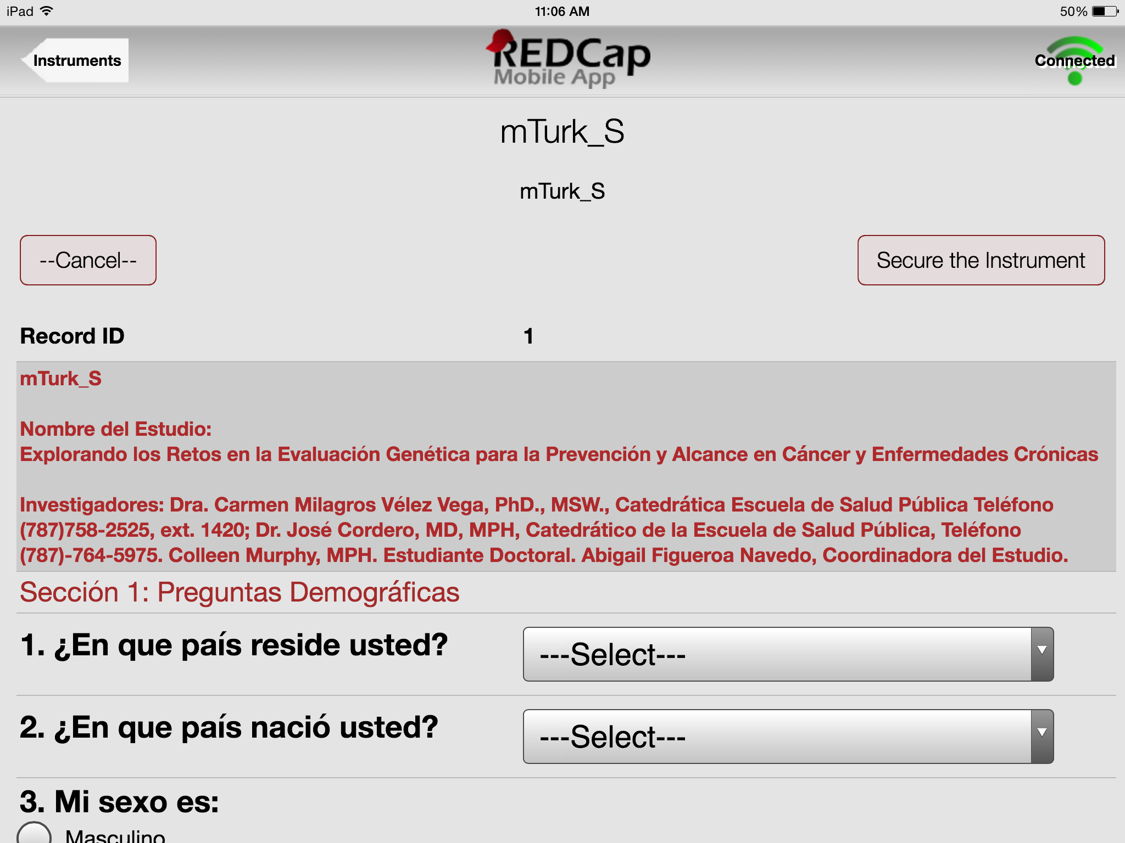
Notes:
MAKE SURE TO PRESS Secure Instrument to Prevent loss of DATA. VERY IMPORTANT!

Slide 11
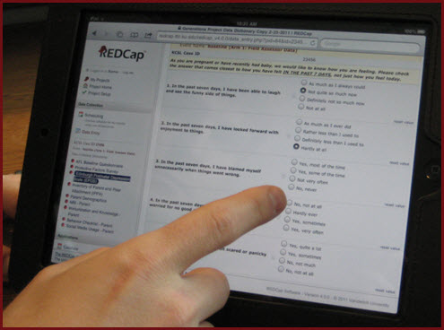
Vivir con conexión a Internet …..
o fuera de línea = “Offline”

Slide 12
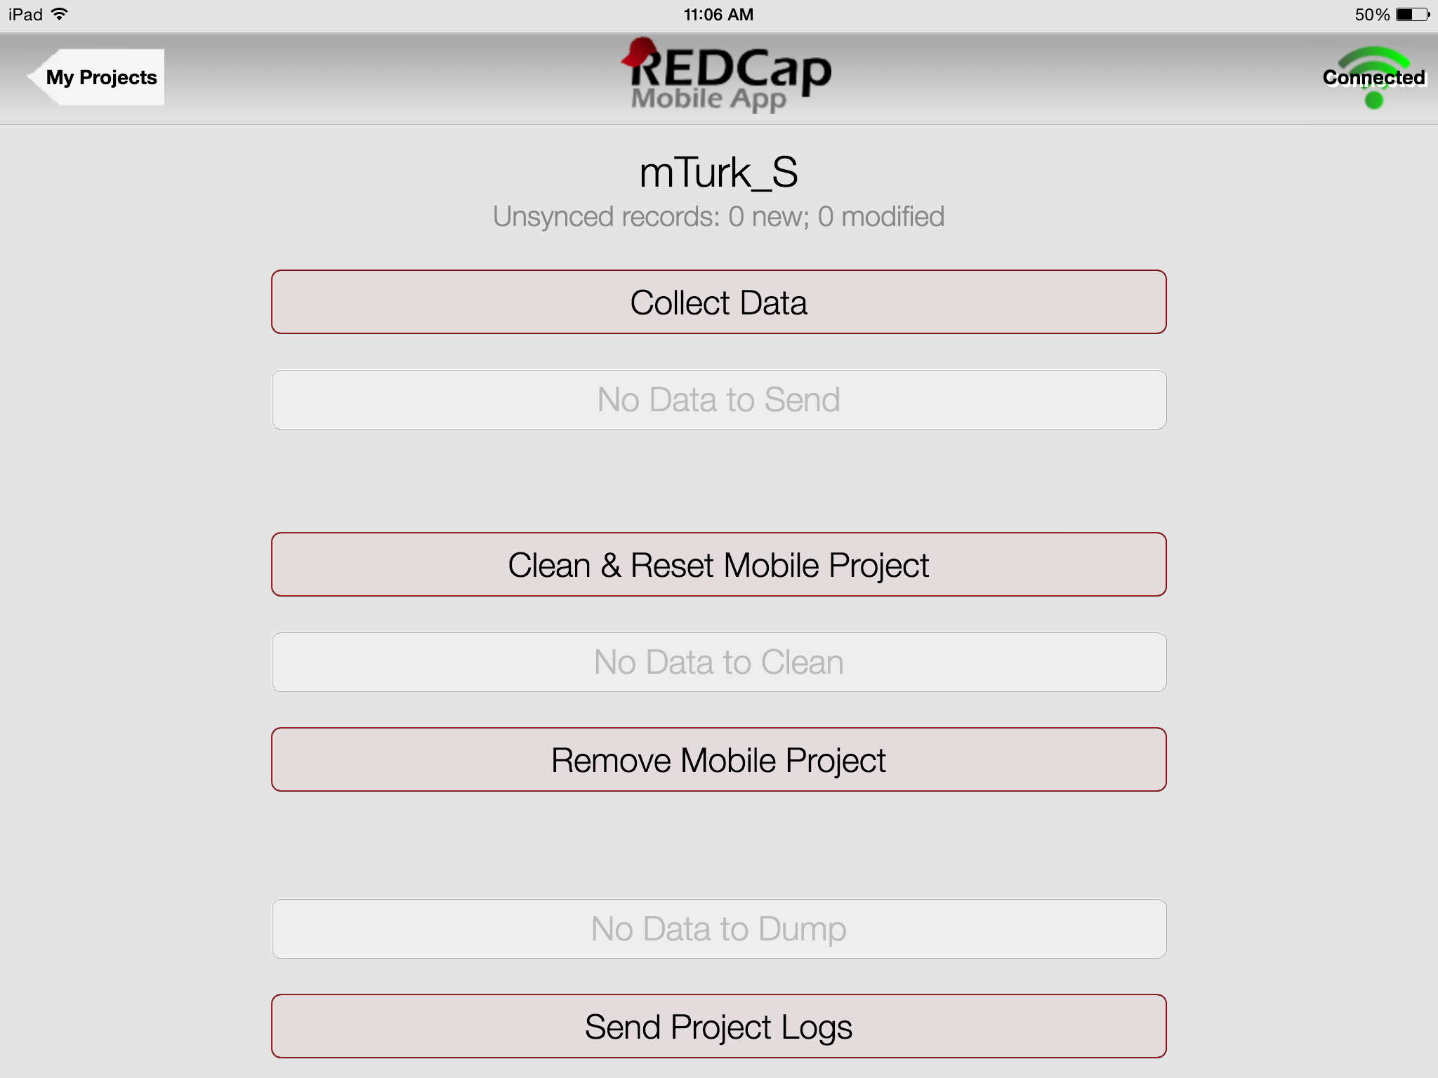
Meta Data Error
META DATA ERROR!
Notes:
Press collect data to start doing the survey,

Slide 13
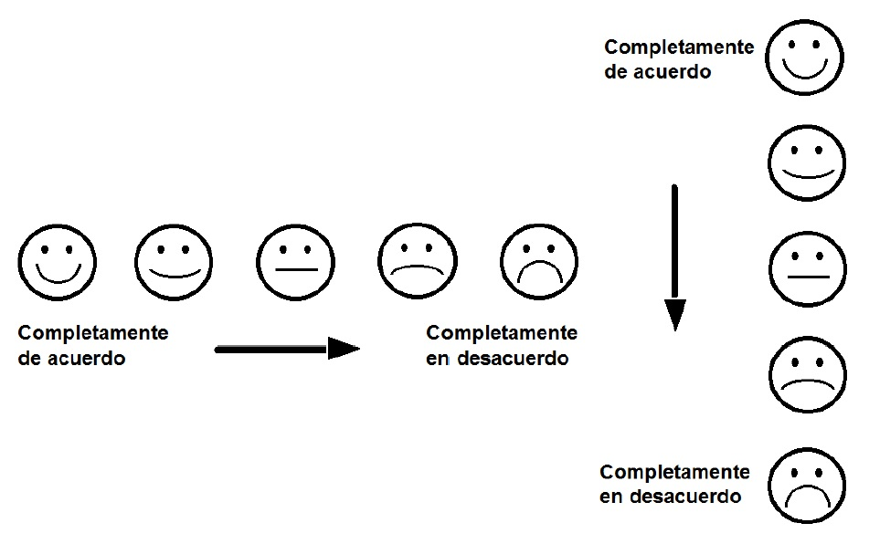
PILOT TEST 2 (Costa Rica)
The Honduran team felt that the proposed layouts for the Likert Scale items using pictures as aids should not go from left-to-right, but from top to bottom.
Pre-tested similar survey with16 trainees (health care workers and information technology staff) at a week-long training course in Costa Rica.
Similar themes: survey was too long, ranking scales and layout were likely to be confusing to their target populations in low-resource areas of Costa Rica, Dominican Republic, and Honduras.
Further cultural adaptation and training will occur prior to a larger scale implementation in early 2017.

Slide 14
Findings from Pretesting and Pilot Testing
Problem | Implication | Potential solution
IRB Approvals | Multiple IRBs and delays are challenges to both initial drafts of methods, and updated methods and instruments | Earlier, centralized engagement with IRBs, and allotment of more time for ethical reviews and approvals.
Unique User IDs | Limits data collection options, such as one device for one collector only. Can result in “Meta Data Errors” if device assigned to a unique user is “logged into” by someone else | Allow more users access to a single device (e.g., a "generic" user ID log in)
Securing the Device | Although intended as a security measure, all data are lost when the device sleeps, is turned off, or the application is closed accidentally | This security measure could be removed, or the device configured to “never sleep”
Survey Length | Respondents and collectors felt the instrument is too long and responses won't be valid | The survey was revised for length and complexity of item response formatting (eg, simpler Likert Scales, use of pictures).
Adapted from McIntosh et al., 2016

Slide 15
Lessons learned:
Plan institutional review board (IRB) approvals in multiple countries carefully (development, implementation, feedback);
In addition to survey content, allow time and consideration for testing use of novel mHealth technology (hardware and software);
Incorporate training for and feedback from project staff, LMIC partner staff, and research participants; and
Change methods accordingly – including content – as mHealth technology usage influences and is influenced by the content and structure of the survey instrument.

Slide 16
Marshall Island Project:
Facebook intervention regarding project staff and peer-produced postings and images regarding Diabetes prevention (healthy eating, screenings, physical activity, etc.)
Started with Focus Groups and Key Informant Interviews
Pre-tested intake survey with two focus groups
Incorporate qualitative and pretesting feedback from project staff, LMIC partner staff, and research participants; and
Changed methods accordingly: the mHealth technology usage influences and is influenced by the content and structure of the survey instrument (e.g., how to “Join” a Facebook group vis-à-vis IRB approved consent forms and Baseline Survey via REDCap link) .

Slide 17
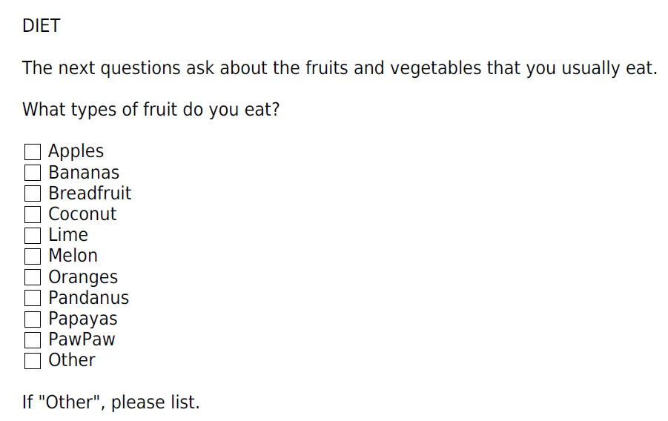
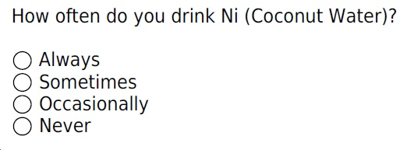
Marshall Island Project:
What is your Facebook Project Study ID Number (provided in your Facebook invitation message)?

Slide 18
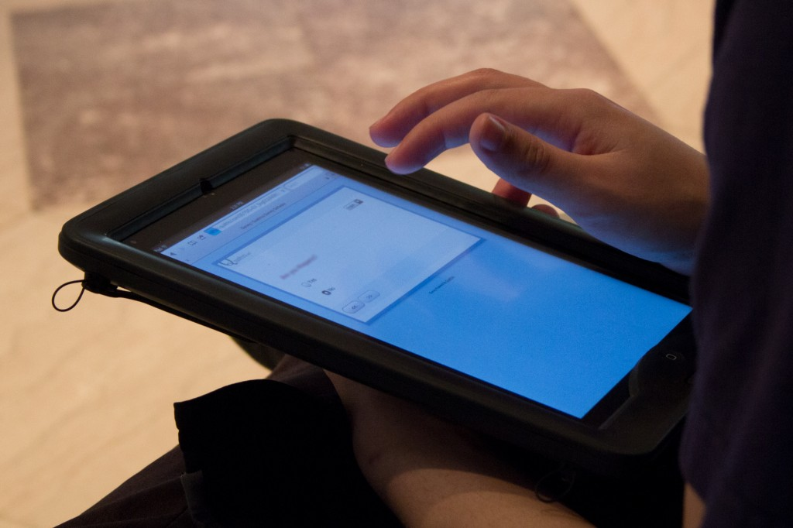
Conclusion:
Lessons learned from early phases of LMIC research projects using emerging mHealth technologies are critical for informing subsequent research methods and study designs with populations in extremely diverse and often low-resource areas.

Slide 19
Thank You
Scott McIntosh, PhD
Associate Professor
Department of Public Health Sciences
University of Rochester
585.802.9944 email: scott_mcintosh@urmc.rochester.edu

Slide 20
Acknowledgements
Funded by the Centers for Disease Control and Prevention, Prevention Research Centers Program (Cooperative agreements: 1U48DP005026-01S1, 1U48DP005010- 01S1, and 1U48DP005023-01S1), and additionally funded by the National Cancer Institute Grant # R01CA152093-01 (PI: McIntosh), and by The National Institutes of Health/Fogarty International Center Grant #1 R25 TW 009697-01A1 (PI: Dye/Ossip).
Drs. Dye and Demment receive funding from Award Number Grant UL1 TR000042 from the National Center For Advancing Translational Sciences, National Institutes of Health. Dr Vélez Vega receives funding from the National Institute of Environmental Health Sciences’ Superfund Research Program Grant # 2P42ES017198-05 (PI: Cordero / Alshawabkeh). The content is solely the responsibility of the authors and does not necessarily represent the official views of the Centers for Disease Control and Prevention, National Center For Advancing Translational Sciences, National Institute of Environmental Health Sciences, National Cancer Institute or the National Institutes of Health.
References
Brislin RW. Back-translation for cross-cultural research (1970). J Cross-Cult Psychol,1(3):185-216.
McIntosh S, Sierra E, Dozier AM, Diaz S, Quiñones Z, Primack A, Chadwick G, Ossip-Klein DJ (2008). Ethical Review Issues in Collaborative Research Between U.S. and Low-Middle Income Country Partners: A Case Example. Bioethics, 22(8): 414-422.
McIntosh S, Pérez-Ramos J, Demment MM, Vélez Vega CM, Avendaño E, Ossip DJ, Dye TD (2016). Development and Implementation of Culturally Tailored Offline mHealth Surveys. Journal of Medical Internet Research: Public Health and Surveillance,2(1):e28.

