Slide 1
Learning from Mouse Movements: Improving Questionnaire and Respondents’ User Experience through Passive Data Collection
Rachel Horwitz* [1]
Sarah Brockhaus [2][3]
Felix Henninger [2]
Florian Keusch [2]
Pascal Kieslich [2]
Frauke Kreuter [2][4][5]
Malte Schierholz [5]
[1] U.S. Census Bureau; [2] University of Mannheim; [3] LMU Munich;
[4] University of Maryland; [5] Institute for Employment Research
*Disclaimer: Any views expressed are those of the author and not necessarily those of the U.S. Census Bureau.

Slide 2
Background – Mouse Tracking
Mouse movements are “Real-time traces of the mind” (Freeman et al., 2011)
Across disciplines, researchers look at similar patterns of movement to understand how users interact with a webpage
These interactions are also used to measure:
  Uncertainty (Cox and Silvia, 2006; Zushi et al., 2012)
  Cognitive conflict (Duran 2010; Freeman 2010)
  Interest (Mueller and Lockerd, 2001; Rodden et al., 2008)

Slide 3
Background – Current Study
  Mouse tracking in survey research has focused on:
    Total distance traveled and its relationship to data quality (Steiger and Reips, 2010)
    How specific movements are related to respondent difficulty (Horwitz et al., 2016)
  Gaps
  Bringing patterns and applications to a survey context
  Finding meaningful indicators
  Predictive link between specific cognitive processes and movements

Slide 4
Methodology - Sample
  Sampling Frame
    Respondents to a 2014-2015 survey conducted by the Institute for Employment Research in Nuremberg, Germany who agreed to be contacted again
    BA Register – majority of the German labor force
  1,627 persons in sample for current study

Slide 5
Methodology – Response Rates
  Sample cases invited using 3 postal mailings and 1 email
  Offered 5€ incentive
  September 5, 2016 – October 23, 2016
  Final response rate: 76.8%
    Removed:
      Cases that did not use a mouse
      Cases that took longer than a predetermined threshold to answer
      Cases where mouse tracking did not work
      Cases with item nonresponse on specific screens

Slide 6
Methodology – Data
  Questions about opinions, employment and demographics
  Experiments
    Sorted VS unsorted response options
    Simple VS complex response options
    Check all that apply VS yes/no format
  Mouse movements
    Collected using JavaScript
    Analyzed using R package mousetrap (https://github.com/PascalKieslich/mousetrap)

Slide 7
Analysis Measures
  Total distance traveled
    Sum of pixels covered by the mouse
  Regressions
    Any movement back and forth in the x- or y-direction
  Hovers
    Holding the mouse still for more than two seconds

Slide 8
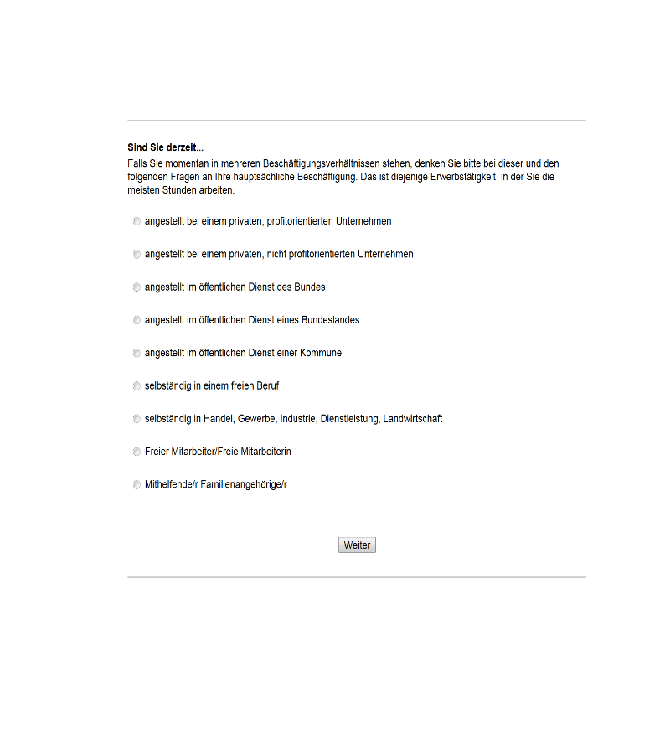
Example – Total distance traveled

Slide 9
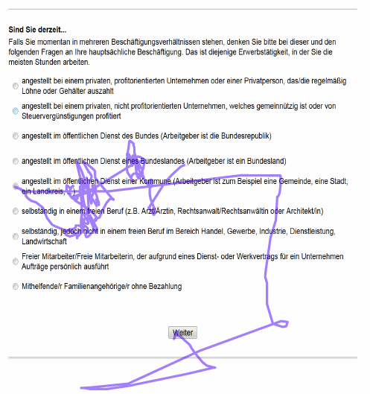
Example – Vertical regressions

Slide 10
Hypotheses
  Sorted vs unsorted lists
    More vertical regressions in unsorted lists [H1]
    Longer total distance traveled in unsorted lists [H2]
  Check all that apply vs yes/no format
    Longer total distance traveled in yes/no format [H3]
    More horizontal regression in yes/no format [H4]
  Simple vs complex response options
    More hovers in the response options for complex [H5]
    Longer hovers for complex [H6]

Slide 11
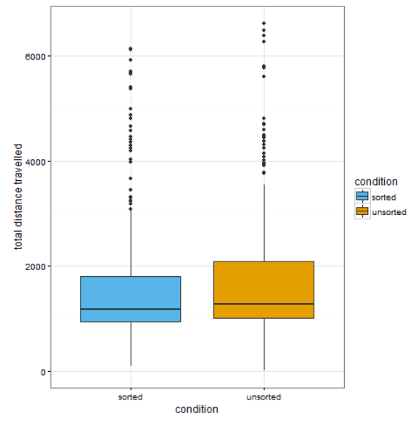
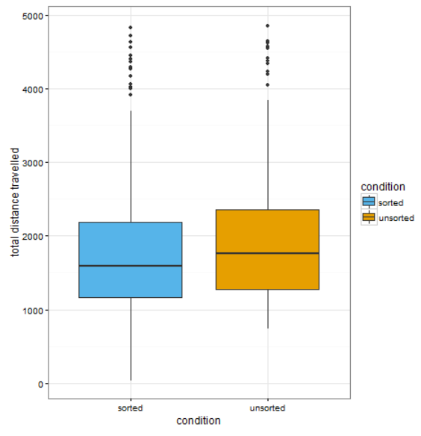
H1: More vertical regressions in unsorted lists vs sorted lists
Type of Employee - p-value = 0.0742
Educational Attainment - p-value = 0.0063
Figures remove top 5% of observations

Slide 12
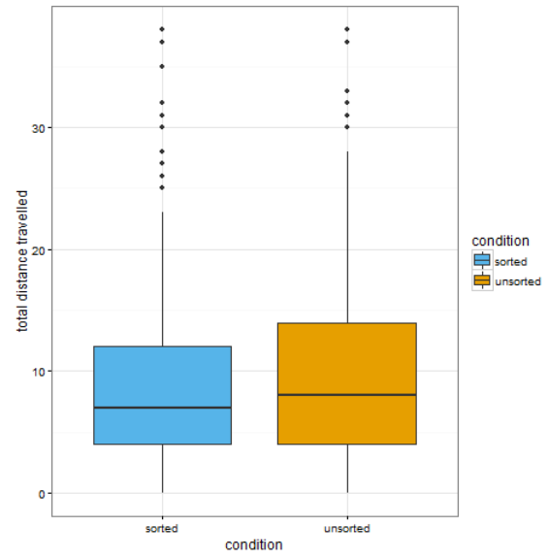
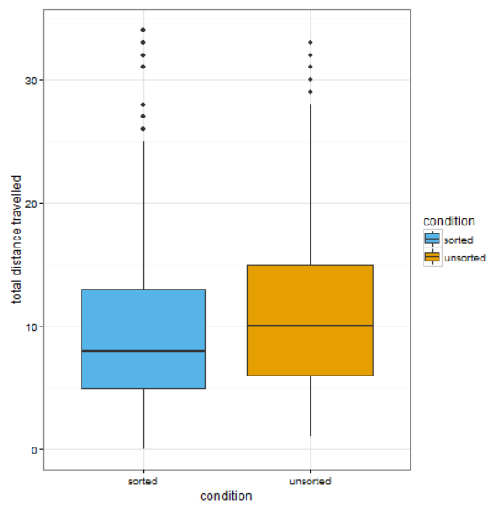
H2: Greater total distance traveled for unsorted lists vs sorted lists
Type of Employee - p-value = 0.0836
Educational Attainment - p-value = 0.0024
Figures remove top 5% of observations

Slide 13
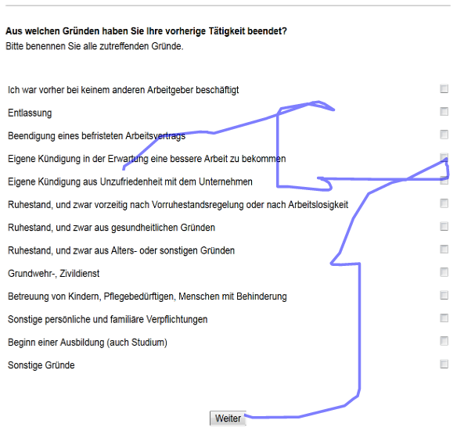
Results – Example check all that apply format

Slide 14
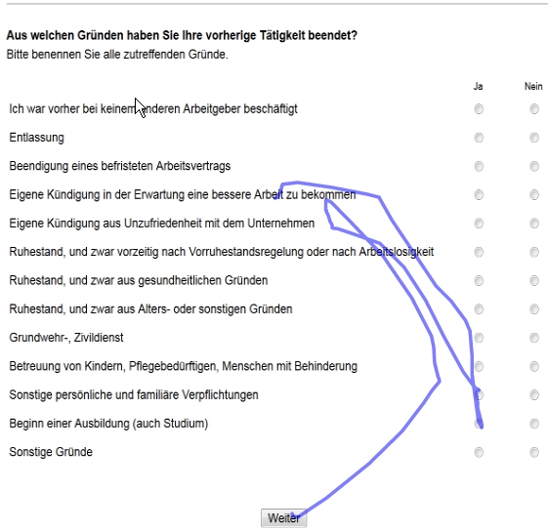
Results – Example yes/no format

Slide 15
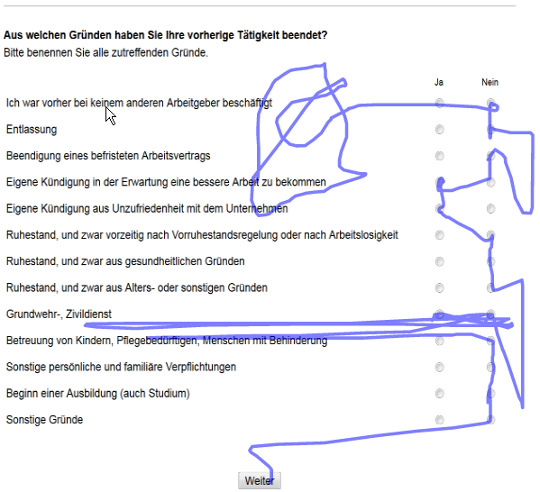
Results – Example yes/no format

Slide 16
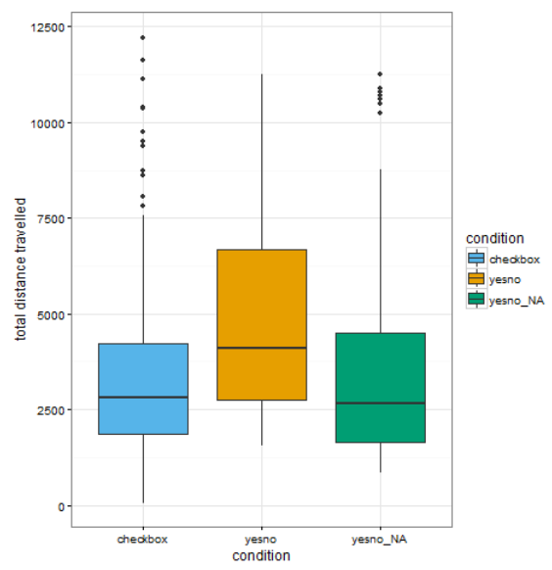
H3: Greater total distance traveled in yes/no format than check all
P<.001
Figures remove top 5% of observations

Slide 17
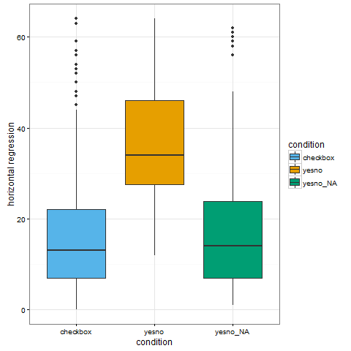
H4: More horizontal regressions in the yes/no format than check all
P<.001
Figures remove top 5% of observations

Slide 18
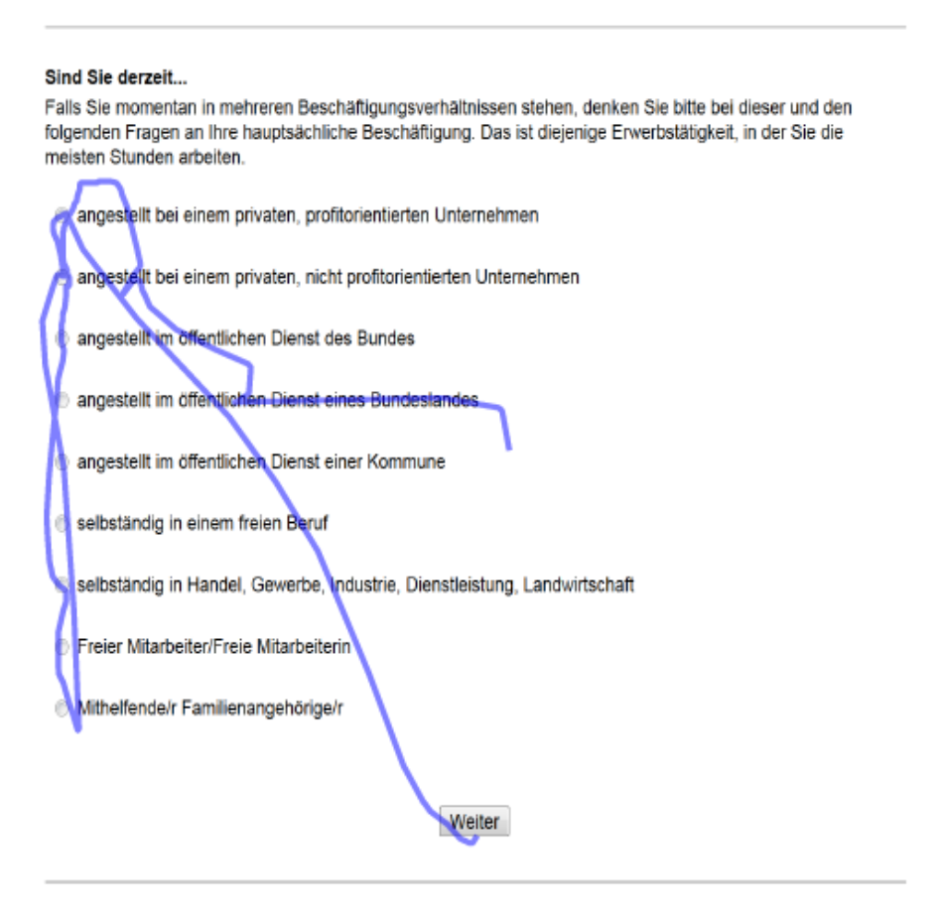
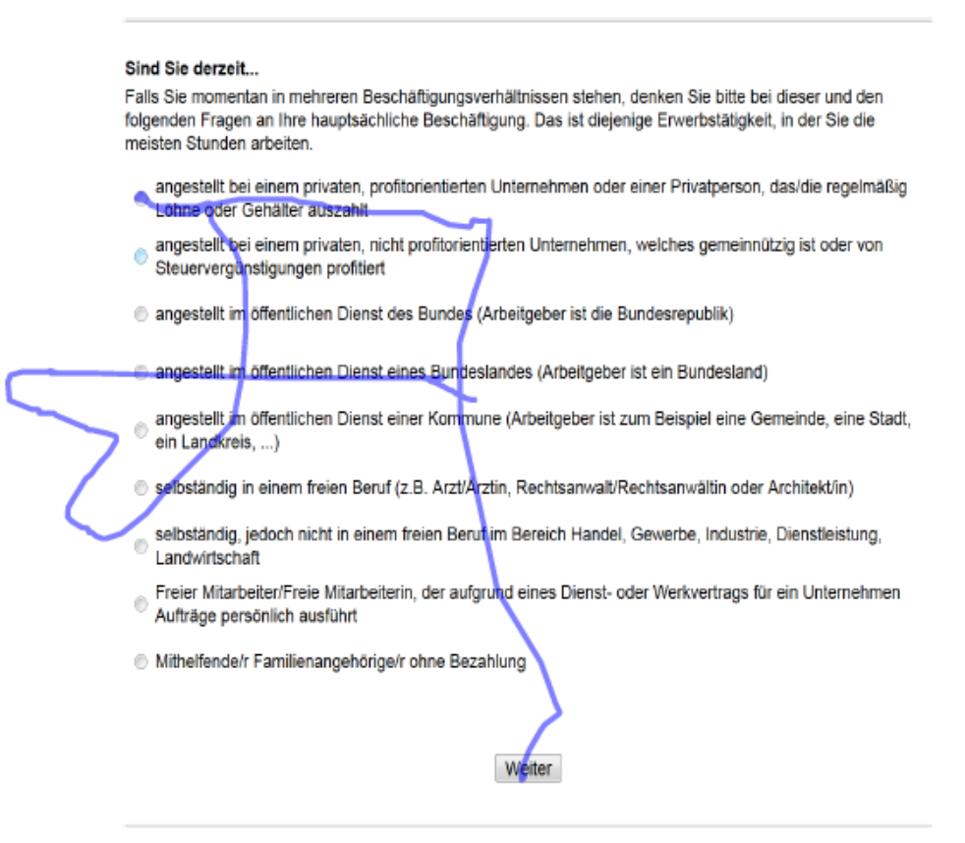
Results – Example simple versus complex response options
Simple
Complex

Slide 19
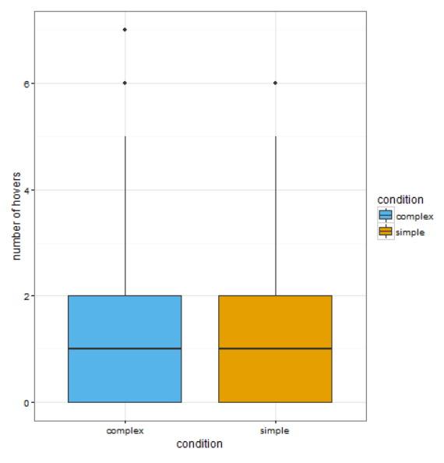
H5: More hovers when the response options are complex vs simple
P = .147
Figures remove top 5% of observations

Slide 20
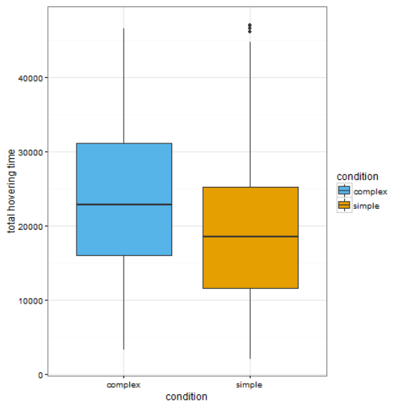
H6: Longer hover duration when the response options are complex vs simple
P<.001
Figures remove top 5% of observations

Slide 21
Summary and Conclusions
  Building a profile of what types of difficulty correspond to different mouse movement patterns
    Total distance traveled associated with all types
    Vertical regressions displayed when response options are not clear
    Hovers displayed when processing information

Slide 22
Thank you!
Rachel.t.horwitz@census.gov
Technical questions?
kieslich@psychologie.uni-mannheim.de
felix.henninger@psychologie.uni-mannheim.de

