Slide 1
Using Iterative, Small-Scale Studies to Redesign a Major Federal Government Survey
A Review of 15 Years of Research to Redesign the CPS ASEC Health Insurance Questions
Joanne Pascale
US Census Bureau
International Conference on Questionnaire Design, Development and Evaluation
November 12, 2016

Slide 2
Impetus for a Redesign
Real-world change ➔ altered language and terms
  Welfare reform of mid-1990s: “AFDC” ➔ “TANF”
Measurement error
  Inverse cultural lag: measurement tools do not keep pace with societal change; e.g. redesign of labor force survey to adjust for:
    Increased role of women in work force
    Shift from manufacturing to service sector jobs
  Mounting evidence of persistent, chronic errors
Unexplained, unwelcome variation in estimate of same construct across multiple data sources; partly an artefact of decentralized statistical system in the U.S.

Slide 3
Variation in Health Insurance Estimates Across HH Surveys
Many surveys contain a module with questions on health insurance:
  Current Population Survey (CPS ASEC)
  National Health Interview Survey (NHIS)
  Medical Expenditure Panel Survey (MEPS)
  Survey of Income and Program Participation (SIPP)
  American Community Survey (ACS)
Pre-Obamacare, estimates of uninsured across these surveys varied from 8-18%

Slide 4
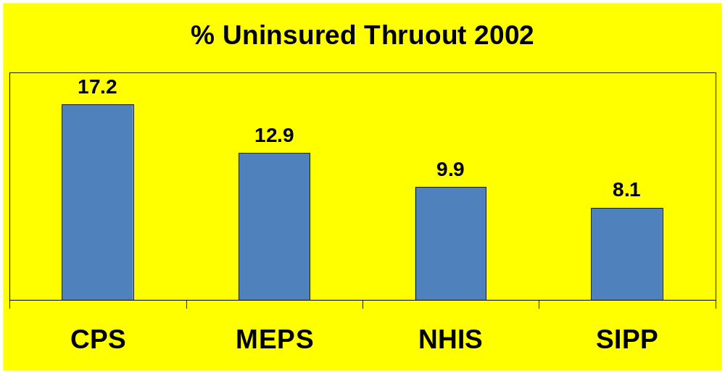
Different Surveys ➔ Different Estimates

Slide 5
Redesign Research Phases
  Phase I: Independent research, 1999-2009
  General approach:
    Inventory issues; keep up with relevant literature
    Isolate and examine key survey design features to identify drivers of measurement error; explore improvements
    Experimentally manipulate and test status quo against experimental version
  Methods
    Craft discrete tests; use results iteratively to hone in on design of next test
    Match research question to test method, blending as needed:
      Quantitative: mainly split-ballot field tests
      Qualitative: mainly cognitive testing
  ➔ Prototype of redesign
Phase II: Inter-divisional sponsored research (2009-2014)
  2009 pretest (n ~ 50)
  2010: split ballot field test (n ~ 8,500)
  2013: content test in production environment (n ~ 30,000)
  ➔ Implemented in production in March, 2014

Slide 6
CPS Health Insurance Module
[Asked in March each year]:
At any time during [last year] was anyone in this household covered by…
a health insurance plan provided through their current or former employer or union?
a health insurance plan that they PURCHASED DIRECTLY FROM AN INSURANCE COMPANY, that is, not related to current or past employment?
the health insurance plan of someone who does not live in this household?
Medicare?
Medicaid, which you may also know as [state-specific name]?
CHIP, that helps families get health insurance for CHILDREN?
TRICARE, CHAMPUS, CHAMPVA, VA, military health care, or Indian Health Service?
A health insurance plan such as the [state name] or any other type of plan?
If yes to any, ask:
Who was covered? [display roster of all household member names]

Slide 7
CPS Health Insurance Module
[Asked in March each year]:
At any time during [last year] was anyone in this household covered by…
a health insurance plan provided through their current or former employer or union?
a health insurance plan that they PURCHASED DIRECTLY FROM AN INSURANCE COMPANY, that is, not related to current or past employment?
the health insurance plan of someone who does not live in this household?
Medicare?
Medicaid, which you may also know as [state-specific name]?
CHIP, that helps families get health insurance for CHILDREN?
TRICARE, CHAMPUS, CHAMPVA, VA, military health care, or Indian Health Service?
A health insurance plan such as the [state name] or any other type of plan?
If yes to any, ask:
Who was covered? [display roster of all household member names]

Slide 8
CPS Health Insurance Module
[Asked in March each year]:
At any time during [last year] was anyone in this household covered by…
a health insurance plan provided through their current or former employer or union?
a health insurance plan that they PURCHASED DIRECTLY FROM AN INSURANCE COMPANY, that is, not related to current or past employment?
the health insurance plan of someone who does not live in this household?
Medicare?
Medicaid, which you may also know as [state-specific name]?
CHIP, that helps families get health insurance for CHILDREN?
TRICARE, CHAMPUS, CHAMPVA, VA, military health care, or Indian Health Service?
A health insurance plan such as the [state name] or any other type of plan?
If yes to any, ask:
Who was covered? [display roster of all household member names]

Slide 9
CPS Health Insurance Module
[Asked in March each year]:
At any time during [last year] was anyone in this household covered by…
a health insurance plan provided through their current or former employer or union?
a health insurance plan that they PURCHASED DIRECTLY FROM AN INSURANCE COMPANY, that is, not related to current or past employment?
the health insurance plan of someone who does not live in this household?
Medicare?
Medicaid, which you may also know as [state-specific name]?
CHIP, that helps families get health insurance for CHILDREN?
TRICARE, CHAMPUS, CHAMPVA, VA, military health care, or Indian Health Service?
A health insurance plan such as the [state name] or any other type of plan?
If yes to any, ask:
Who was covered? [display roster of all household member names]

Slide 10
CPS Health Insurance Module
[Asked in March each year]:
At any time during [last year] was anyone in this household covered by…
a health insurance plan provided through their current or former employer or union?
a health insurance plan that they PURCHASED DIRECTLY FROM AN INSURANCE COMPANY, that is, not related to current or past employment?
the health insurance plan of someone who does not live in this household?
Medicare?
Medicaid, which you may also know as [state-specific name]?
CHIP, that helps families get health insurance for CHILDREN?
TRICARE, CHAMPUS, CHAMPVA, VA, military health care, or Indian Health Service?
A health insurance plan such as the [state name] or any other type of plan?
If yes to any, ask:
Who was covered? [display roster of all household member names]

Slide 11
CPS Health Insurance Module
[Asked in March each year]:
At any time during [last year] was anyone in this household covered by…
a health insurance plan provided through their current or former employer or union?
a health insurance plan that they PURCHASED DIRECTLY FROM AN INSURANCE COMPANY, that is, not related to current or past employment?
the health insurance plan of someone who does not live in this household?
Medicare?
Medicaid, which you may also know as [state-specific name]?
CHIP, that helps families get health insurance for CHILDREN?
TRICARE, CHAMPUS, CHAMPVA, VA, military health care, or Indian Health Service?
A health insurance plan such as the [state name] or any other type of plan?
If yes to any, ask:
Who was covered? [display roster of all household member names]

Slide 12
Inventory of Key Design Features that Vary Across Surveys
Structure of Qs on type of coverage
Reference period
Household- versus Person- level design
12
Notes:
12

Slide 13
Household- versus
Person-Level Design
Household-level Design
“Was anyone in this household covered by [plan 1]?”
[if yes]: Who?
“Was anyone in this household covered by [plan 2]?
[if yes] Who?
[repeat for plans 3-8]
Person-level Design
“Was John covered by [plan 1]?”
[repeat for plans 2-8 for John]
“Was Susan covered by [plan 1]?”
[repeat for plans 2-8 for Susan]

Slide 14
Issues with Household- and Person-Level Designs
Household-level does not “name names”
➔ evidence that some individual household members are forgotten
Person-level “names names” but gets very tedious and repetitive in large households
  ➔ evidence of respondent fatigue and under-
  reporting

Slide 15
Redesign of Household vs Person Level Questions ➔ Hybrid Design
Person 1: Are you covered now? [if yes collect details]:
Plan type (job, Medicaid, etc.)
Months you were covered
Any other household members covered by same plan/plan type?
Others covered same months as you?
(if not): What months were they covered?
Person 2: CHECK: Was Person 2 mentioned by Person 1 as being covered?
Yes ➔ ASK: Does Person 2 have any other coverage?
  yes ➔ collect details (same routine as above)
  no ➔ go to Person 3
No ➔ Repeat Person 1-style question series for Person 2

Slide 16
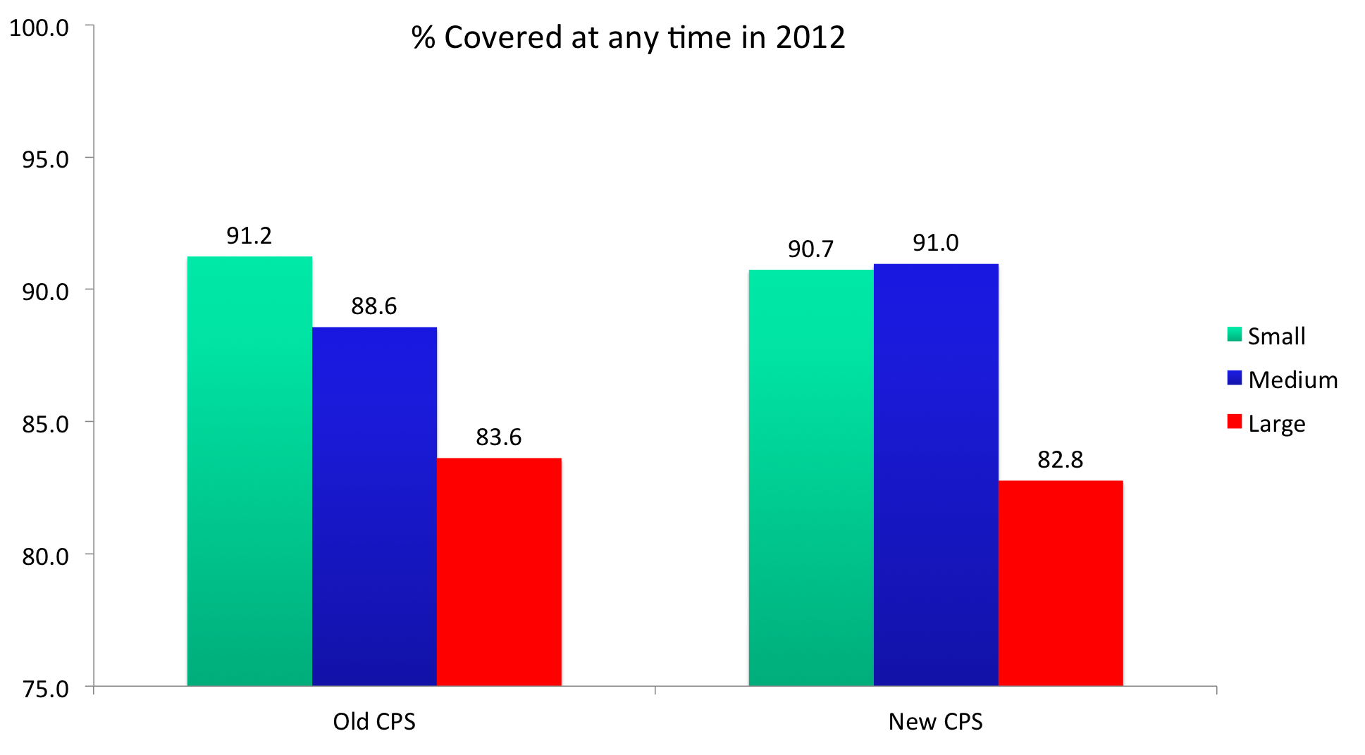
2013 Test: Within Treatment
Coverage Estimates by Household Size

Slide 17
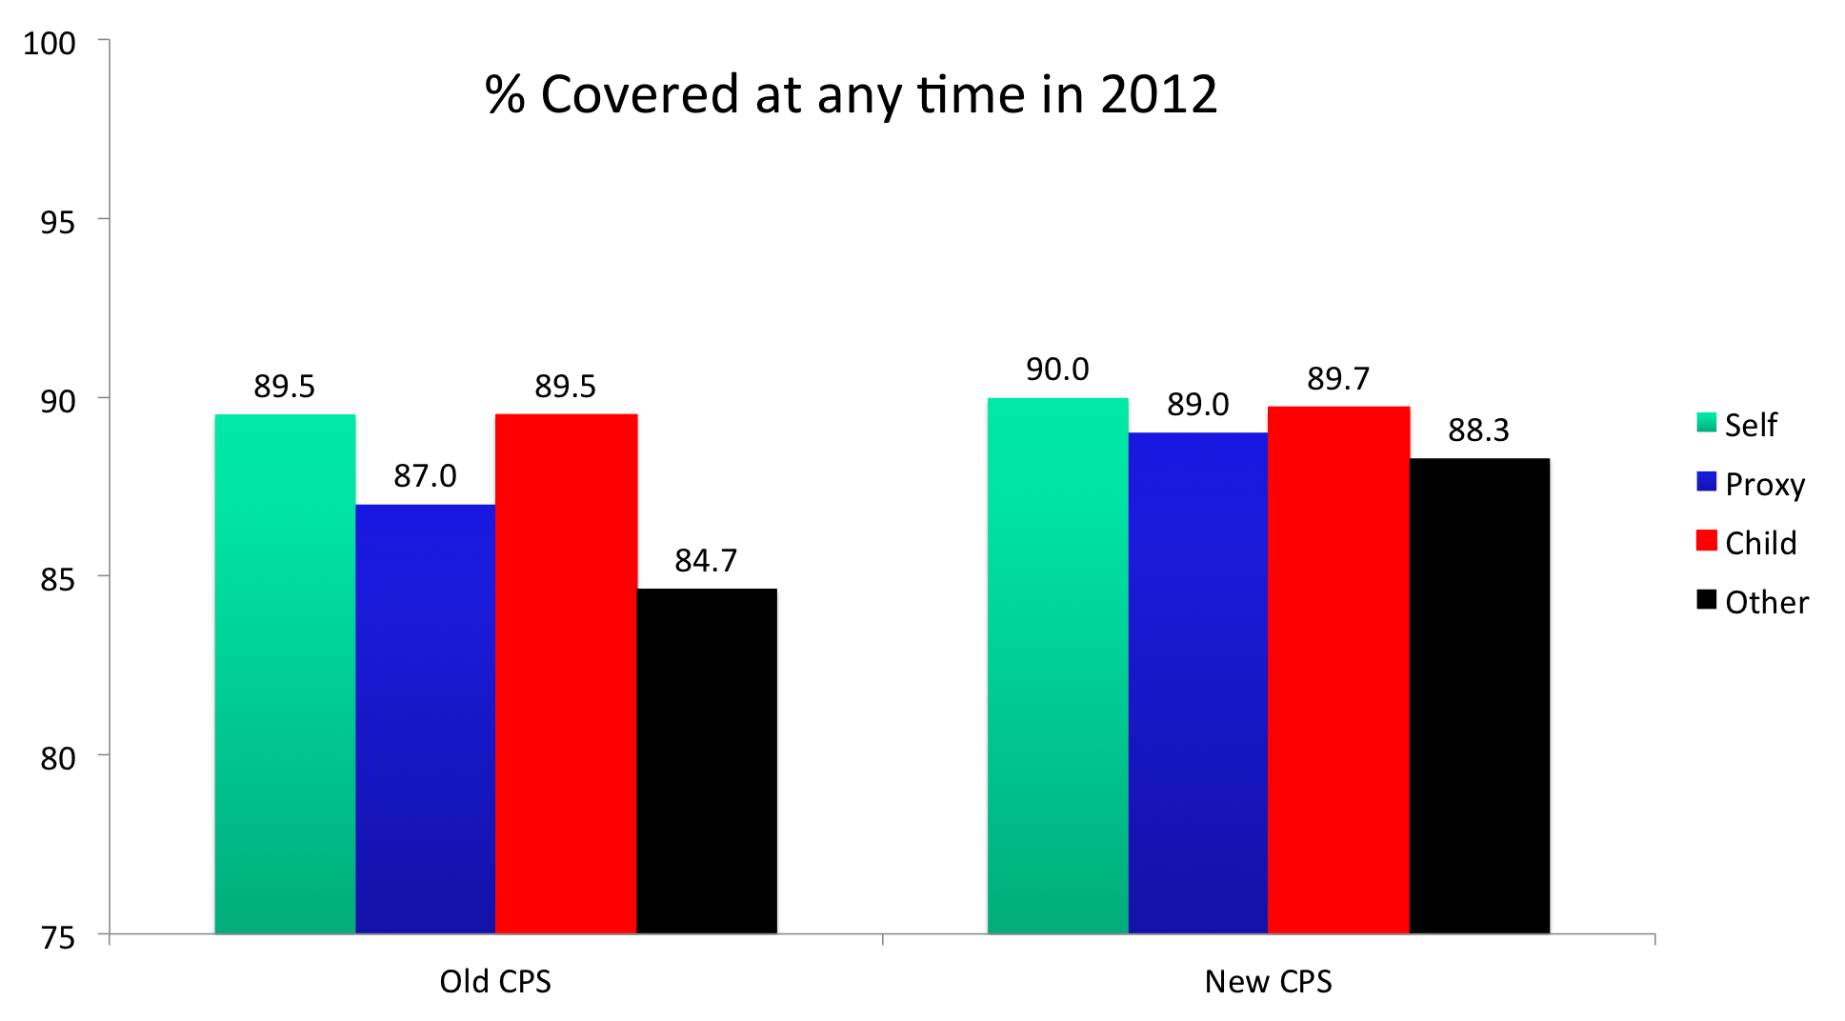
2013 Test: Within Treatment
Coverage Estimates by Self/Proxy

Slide 18
Phase I Tests
Year | Method | Survey Design Feature Tested | Sample Size
1999 | Split-ballot field test | Calendar year vs current reference period HH vs person-level design | 1,291 hh 3,228 people
2000 | Split-ballot field test | Sequence of public and private plan type | 1,862 hh 4,794 people
2003 | Split-ballot field test | Sequence of Medicaid and Medicare Definitions of Medicaid and Medicare | 1,919 hh 4,805 people
2003 | Cognitive Testing | Hybrid hh-person level questions General ➔ specific Qs on plan type | 4 interviewers 20 respondents
2004 | Split-ballot field test | Calendar year vs current reference period HH vs hybrid hh/person-level design | 4,344 hh 10,929 people
2004 | Cognitive Testing | Status quo CPS design | 6 interviewers 27 respondents
2008 | Cognitive Testing | Integrated calendar year/current Qs Hybrid hh/person-level design General ➔ specific Qs on plan type | 8 interviewers 36 respondents

Slide 19
Phase II Tests
Year | Method | Survey Design Feature Tested | Sample Size
2009 | Pretest | Prototype redesign: Integrated calendar year/current Qs Hybrid hh/person-level design General ➔ specific Qs on plan type | 5 interviewers 54 respondents
2010 | Split-ballot field test | Prototype redesign with RDD and Medicare enrollee sample | 5,376 hh 12,743 people
2011-2012 | Expert consultation Focus groups Cognitive testing | Background on Massachusetts version of Affordable Care Act Testing with exchange/marketplace enrollees on terminology of eligibility and enrollment in new plans | 6 conference calls with 12 experts 4 focus groups; 39 participants 4 rounds of cognitive testing; 72 participants
2013 | Field test | Prototype redesign in CPS production environment with: live CPS sample (control) retired CPS sample (redesign) | 13,228 people (control) 16,401 people (test)

Slide 20
CPS Health Insurance Module in Context with Other Redesigns
CPS Labor Force module: 10 years (mid-1980s to 1994)
National Crime Victimization Survey: 20 years (mid-1970s to 1992)
Consumer Expenditure Survey: 14 years (2009-2023)
HHS effort launched in 2016 to bring their surveys and data sources into “alignment”

