Slide 1

Survey Package Design and Response Rates in an Outdoor Recreational Study
Jessica Behm, Westat/Rockville Institute
Cynthia Helba, Ph.D., Westat/Rockville Institute
Mina Muller, Westat/Rockville Institute
W. Sherman Edwards, Westat/Rockville Institute
Regina Yudd, Ph.D., Westat/Rockville Institute

Slide 2
Background and Overview
50-State Survey of Fishing, Hunting and Wildlife-Associated Recreation
Sponsored by Association of Fish and Wildlife Agencies (AFWA)
Funded by Multistate Conservation Grant (#F15AP001640) from the Sport Fish and Wildlife Restoration Program of the US Fish and Wildlife Service and AFWA
Survey conducted every 5 years since 1955

Slide 3
Survey Redesign
Rockville Institute, a non-profit organization affiliated with Westat, began a redesign in January 2015
Objectives:
  Transition from interview to mail
  Address problems facing interview studies
Work in tandem with Census to enable mode comparison

Slide 4
Survey Design
  Initial household screener followed by assignment to one of three survey types (Fishing, Hunting, Wildlife-Associated Recreation)
Pretest
  Household Screener (post card and follow-up mailing by USPS)
  2 waves of detailed data collection
Main Study
  Household Screener (post card and two follow-up contacts)
  2 or 3 waves of detailed data collection

Slide 5
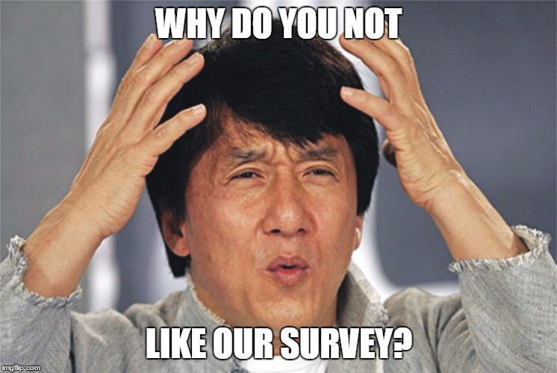
The Problem...
Low response rate on the pretest screener
  Expected: 42%
  Actual: 16%
Why?

Slide 6

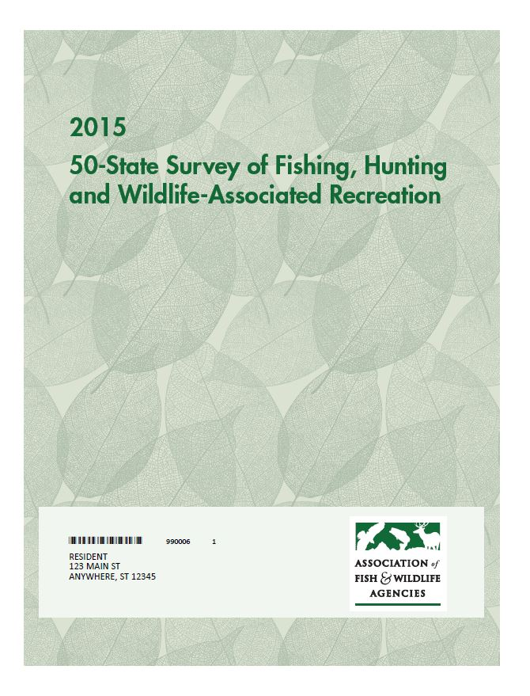

Explanations?
Look unofficial or commercial?
Does it look like we’re asking for money?
Not likeable or meaningful?

Slide 7
What we know about survey covers
Covers should be compelling, have a clear title, and identify the sponsor.
  Slant and Dillman, 1994; Dillman, Smyth, and Christian, 2014
But, there is little empirical evidence to guide cover design
  Nederhof (1988) found complex graphic cover led to increase in response rates
    Unable to replicate in several different settings
      Dillman and Dillman 1995; Gendall ,1996; Gendall,1999; and Leslie, 1996.
  Gendell (2002) found that likeability is key to increasing response rates but the effect is likely to be very small.

Slide 8
What we know about survey covers—continued.
Westat is working with BJS on a companion survey to the National Crime Victimization Survey (NCVS)
Tested likely respondent preference: Creative cover vs. BJS official seal cover.
  Every respondent preferred the BJS seal.
  Survey appeared credible and immediately identified as originating with the U.S. government.
  Inclusion of seal made participants say they were more likely to respond quickly.

Slide 9
What did we do?
Second pretest in 4 states.
  Arizona, Kentucky, Missouri, and Pennsylvania were recruited by AFWA
Used experience with NCVS and the literature to guide change in cover.
Made other package changes.
Also made change to incentives.

Slide 10
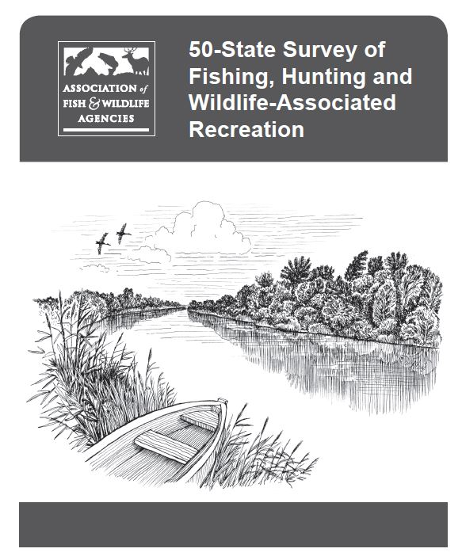
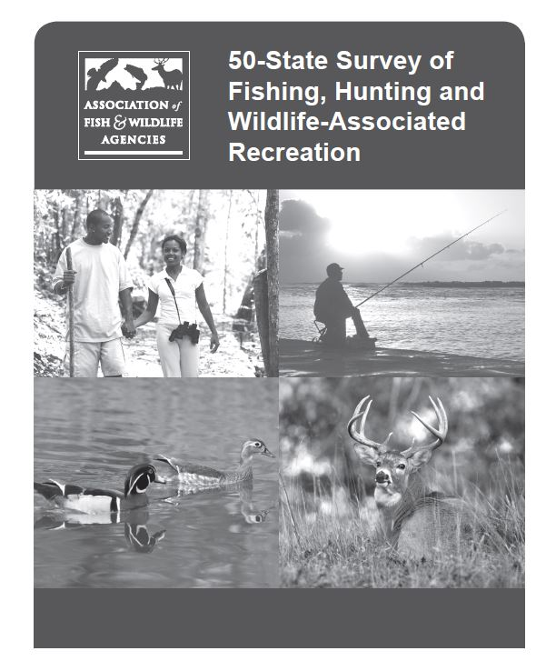
What did we do to the cover?
1. Replaced the old cover with two new survey covers

Slide 11
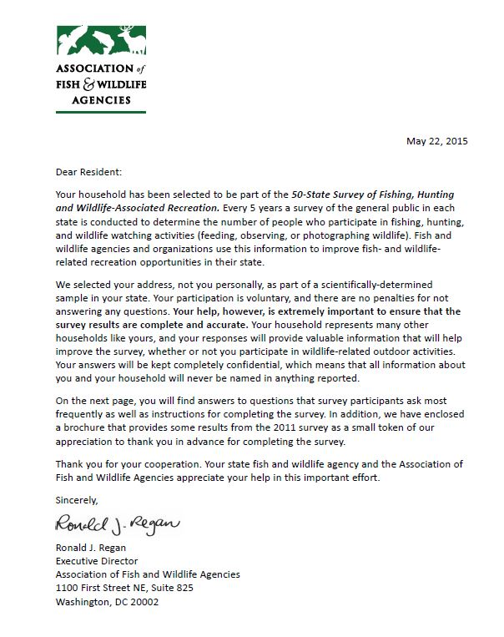
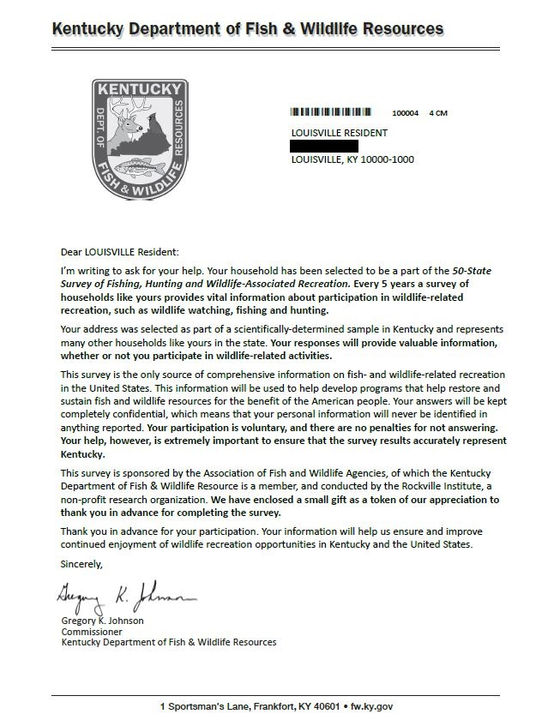
What did we do—continued?
2. Changed the sponsorship

Slide 12
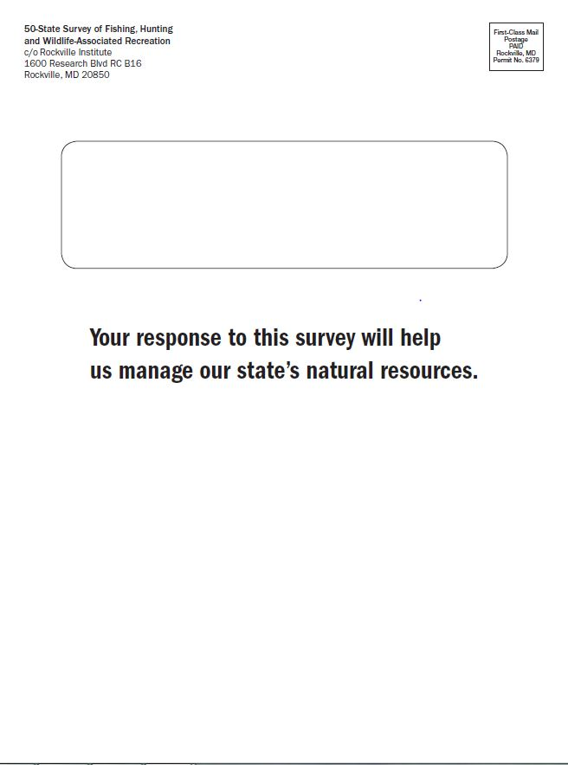
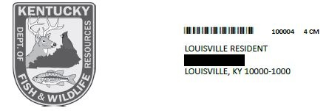

What did we do—continued?
Modified the envelope.

Slide 13
What happened?
Response rates doubled in pretest #2
  Cash incentive for a portion of the sample?
  Third mailing?
  Four states selected for pretest #2?
  Differences in cover?
  ¹ t=-0.843, p=.40
  ² t=1.1583, p=.2469
 | Response Rate (RR1)
Pretest #1 Screener – Overall (N=1,913) | 16.63%
AZ, KY, MO, PA | 19.05%
All other states | 16.38%¹
Pretest #2 Screener (N=1,913) | 30.40%
Picture cover | 31.70%
Drawing cover | 29.14%²

Slide 14
What happened—continued?
  Changes to the sponsorship of the survey package?
    State sponsorship provided a more “official” sense to the package
    ³ t=3.9083, p=0.00
 | Response Rate
Main Study Screener
State agency logos and letters (N=4,000) | 24.93%
AFWA logo and letters (N = 288,044) | 21.98%³

Slide 15
Who returned the survey?
Package changes, including sponsorship, had a slight impact on increasing return rates for non-participants between Pretest #1 and Pretest #2
  Not statistically significant
  ⁴ t=1.4119, p=.1583
 | Return rates
Household Screener | Participant | Non-participant
Pretest #1 | 86.4% | 13.6%
Pretest #2 | 82.7% | 17.3%⁴

Slide 16
What does this mean?
These analyses provide one finding and some suggestions that might shape survey efforts moving forward:
Strong finding: Official look and sponsorship was associated with increased response rates.
Suggestive findings:
  Possible difference in response for photograph vs. line drawing cover bears consideration.
  Package design and sponsorship may yield different rates of returns for participants and nonparticipants.

Slide 17
Contact Information
Jessica Behm (JessicaBehm@Westat.com)
Cynthia Helba, PhD (CynthiaHelba@Westat.com)
Mina Muller (MinaMuller@Westat.com)
Sherm Edwards (ShermEdwards@Westat.com)
Regina Yudd, PhD (ReginaYudd@Westat.com)

