Slide 1
Measuring political affiliation on an 11-point metaphor
Dag F. Gravem
Senior advisor, Division for methods
Statistics Norway

Slide 2
Measuring political affiliation
In politics people sometimes talk of "left" and "right". (Using this card,) where would you place yourself on this scale, where 0 means the left and 10 means the right?
  In Norway, this scale appeared to produce different results in different modes and survey designs

Slide 3
Measurements and modes from the 6 years prior to 2015
  European Social Survey
    Strictly F2F
  Election surveys – after Parliament elections
    Mixed-mode F2F+Phone, non-randomised
  Local democracy survey – after local election
    Paper, in multi-mode Phone->PASI design

Slide 5
How to explain differences in midpoint selection?
Privacy or socially desired responses?
  Mid-category the safest pick when interviewer present?
  Could account for all-F2F ESS results (ab. 24 %)
  And all-Paper Local democracy results (14 %)
    But 2011 survey came in aftermath of Utøya terror attack
    And possible selection effect in the Phone->Paper design correlated with the variable of interest

Slide 6
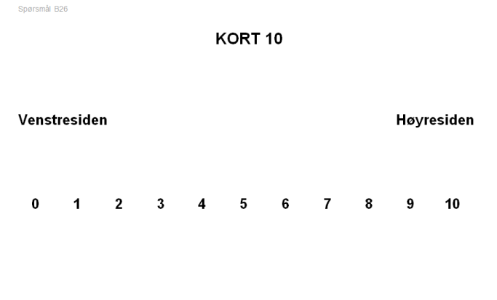
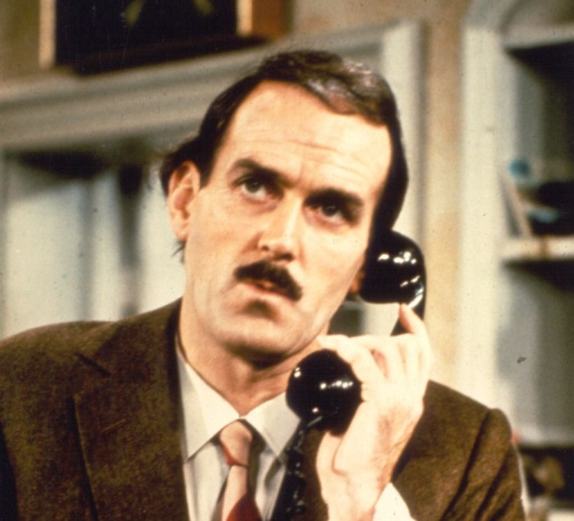
How to explain differences in midpoint selection?
Mode-determined differences in stimulus?
  Show card with scale in ESS and Election survey F2F, a visual aid
  Similar visual stimulus in Paper Local democracy survey
  Election survey Phone offers only aural information

Slide 7
How to explain differences in midpoint selection?
Looking closer at mixed-mode Election survey (F2F+Phone) results:
  Phone considered less privacy-intruding than F2F
  Phone stimulus is more limited
Assumption: Election survey F2F results will differ from Election survey Phone

Slide 8
Election surveys of 2009 & 2013 broken down on Phone/F2F response
2009
2013
Phone
F2F
Assumption appears falsified, though there could be confoun-ding factors due to non-random CATI/CAPI allocation

Slide 9
2015 Local Election Survey: Introducing a new mode
Designed as a Web only survey
European NSIs: Moving from interviewer-administered modes to self-administered web questionnaires (Blanke et al. 2014)
  Re-design of questions, response options, clarification and instructions
  Necessitates analysis of possible mode effects and their sources

Slide 10
What does this mean for the question on left-right political affiliation?
Removal of eventual interviewer presence effects
The possibility of retaining a visual scale
  And how should it be presented on a mobile device?
  The length of the scale implies vertically

Slide 11
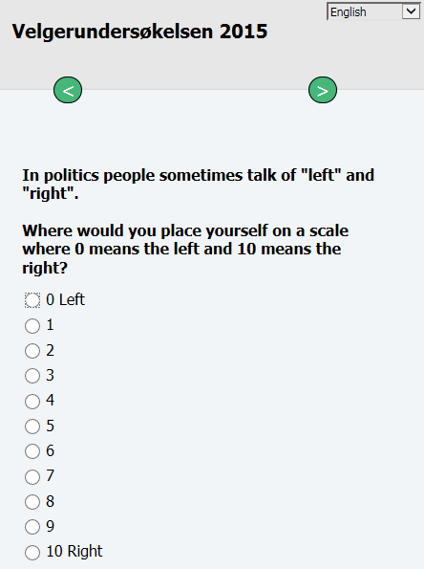
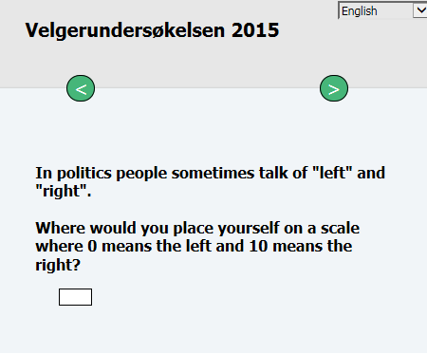
Two versions of the question for a split sample experiment – Local Election survey 2015
“F2F like” with visual aid
“Phone like“ with no visual aid

Slide 12
Experiment 1: different visual designs
Hypothesis A: If there is a visual stimulus effect after all, the visual scale version will resemble the ESS response distribution
Hypothesis B: If there is an interviewer effect, response distributions will resemble the paper Local democracy survey

Slide 13
Results, N=2004
Significant results on 0, 2, 8, and 10, but not on the midpoint
Resembles previous F2F+Phone Election survey results the most

Slide 14
But what does a midpoint response to this question really mean?
Tourangeu et al. (2004, 2007) on interpre-
titive heuristics and questionnaire design
  Middle means typical
  Left and top mean first
  Near means related
  Up means good
  Like in appearance means close in meaning

Slide 15
But what does a midpoint response to this question really mean?
In principle a bi-polar scalar attitude question
Important with proper anchoring (Yan & Keusch 2014)
  Logical to anchor metaphorical left to physical left
  In terms of reading direction, top-bottom is analogue to left-right
Requires knowledge of the left-right political metaphor

Slide 16
Lakoff & Johnson (1980): Metaphors we live by
Much more than rhetorical figures
Most of our fundamental concepts organized in terms of spatialization metaphors, rooted in bodily experiences
  Good is up, bad is down:
    Things are looking up
    It's going downhill from here
  Conscious is up, unconscious is down
    Wake up!
    He is under a spell

Slide 17
Lakoff & Johnson (1980): Metaphors we live by
Coherence in metaphorical systems
  First (left/top) is good and
  More is good (0 to 10)
  In conflict or cancel each another out in Election survey 2015?
Not all cultures give priority to the up-down orientation
  Balance-imbalance
  Centrality-periphery

Slide 18
The left-right political affiliation metaphor
Stems from a unique historical event: the French revolution
  Royalists on the right, revolutionaries on the left
But ultimately rooted in bodily experience?
  Right hand – stable and controlling
  Left hand – instable and controlled
Still, a cultural construct further shaped by historical events of past 200+ years

Slide 19
Question validity: what does a middle answer really mean?
Affiliation with the “centre wing”?
Affiliation with left as well as right?
Respondent considers her/himself “typical”?
Don’t know – undecided?
Don’t know – not familiar with left/right metaphor?
Does not acknowledge left/right metaphor?

Slide 20
Experiment 2: Adding visible DK & RF options
Hypothesis C: Introducing Don’t know and Refusal options will lead to a decrease of middle responses

Slide 21
The effect of adding visible Don’t know and Refusal options. Election survey 2015.
14 % of sample responded DK or RF when options were visible

Slide 22









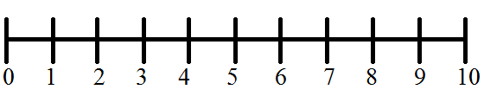
Left-right placement of parties in Parliament according to Election survey 2013 respondents
Mode values

Slide 23

Self-placement of 2013 voters

Slide 24
Self-placement and actual block results
36 %

Slide 25
Some conclusions and recommendations
Keeping it simple (with a text field) seems OK for this 11-point scale
  No alarming mode effect without visual stimulus
A middle response is ambiguous to say the least
Include open Don’t know and Refusal options, ESS too!
Topic context could account for ESS/Election survey difference
  More polarization when politics main topic
Selection effect correlated with variable of interest and 7/21 could account for Local democracy results

Slide 26
Some conclusions and recommendations
An understanding of underlying metaphors and their interpretation is important for certain types of questions
  Cherchez la métaphore!
  Especially in cross-cultural and multi-language studies
  Calls for exploratory and cognitive testing!

Slide 27
References
Blanke, Karen (ed.) (2014): Data Collection for Social Surveys using Multiple Modes. Final report. Eurostat.
Lakoff, George & Mark Johnson (1980): Metaphors we live by. Chicago.
Tourangeau, Roger, Mick P. Couper & Frederick G. Conrad (2004): “Spacing, position and order. Interpretative heuristics for visual features of survey questions.” Public Opinion Quarterly, Vol. 68
Tourangeau, Roger, Mick P. Couper & Frederick G. Conrad (2007): “Color, labels and interpretative heuristics for response scales.” Public Opinion Quarterly, Vol. 71
Yan, Ting & Florian Keusch (2015): “The effects of the direction of rating scales on survey responses in a telephone survey.” Public Opinion Quarterly, Vol. 79.

