Slide 1
Salience of Survey Burden and Its Effects on Response Behavior
Frauke Kreuter, Stephanie Eckman, Roger Tourangeau
QDET2 2016

Slide 2
Thank you!
NSF grants SES0850999 & SES0850445
Institute for Employment Research (IAB)
Dutch LISS Panel
Ruben Bach, Annette Jaeckle, Antje Kirchner, Stanley Presser, Cong Ye

Slide 3
Background – Filter Questions
In the last 3 months, have you purchased pants?
  How much did they cost?
  Does that price include tax?
  Did you buy them for yourself or someone else?
  How satisfied are you with these pants?
In the last 3 months, have you purchased a jacket?
  How much did it cost?
  …
In the last 3 months, have you purchased shoes?
U.S. Consumer Expenditure Survey

Slide 4
Background – Filter Questions
In the last 3 months, have you purchased pants?
In the last 3 months, have you purchased a jacket?
In the last 3 months, have you purchased shoes?
About those pants you bought:
  How much did they cost?
  Does that price include tax?
  Did you buy them for yourself or someone else?
  How satisfied are you with these pants?
About that jacket you bought…
U.S. Consumer Expenditure Survey
Notes:
Incentive – reduction in survey burden
BUT

Slide 5
Research Summary
  Grouped format
  More reports (Kessler et al. 1998, Kreuter et al. 2011)
  Better reporting of filter items (Eckman et al. 2014)
  Incentive to reduce burden (Tourangeau et al. 2015)
  But interleafed
  better cognitive flow (Tourangeau et al. 2000) and
  better data quality for follow up questions
  (Kreuter et al. 2011, Eckman et al. 2014)

Slide 6
Open Questions
How can series of filter and follow up questions be presented to reduce the risk of motivated underreporting without having to ask all filter questions upfront (grouped format)?
What design features can be employed to mitigate the undesirable effects?

Slide 7
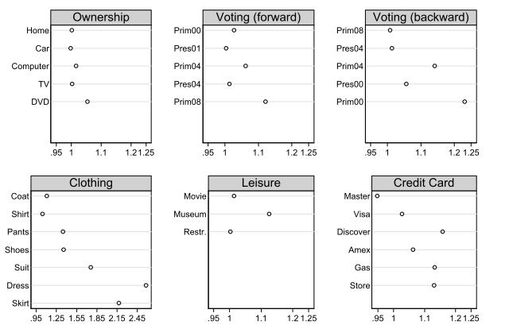
Kreuter, McCulloch, Presser, Tourangeau 2011, Sociological Methods and Research 40(1): 80–104

Slide 9
Design Features
Salience &Burden: Layout
Salience: Repetitiveness
Burden: #Follow Up Items

Slide 10
Experiments
With salience and repetitiveness

Slide 11
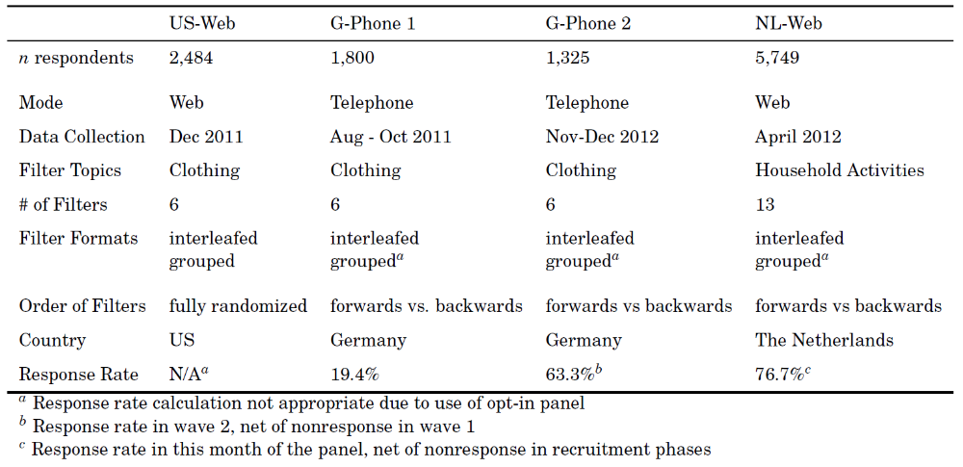

Slide 12
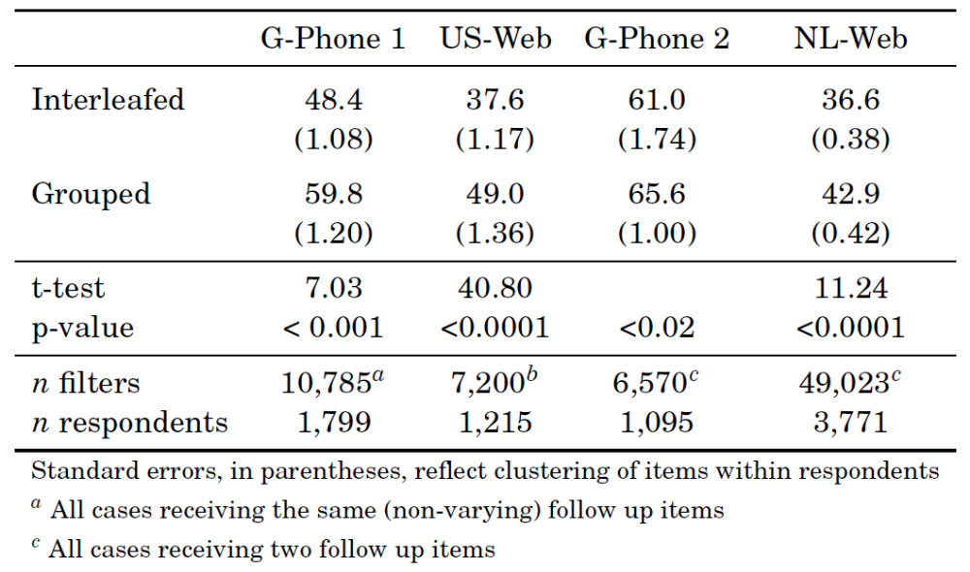
Overall Effect Confirmed
Λ
Λ
Λ
Λ

Slide 13
Results of Manipulations

Slide 14
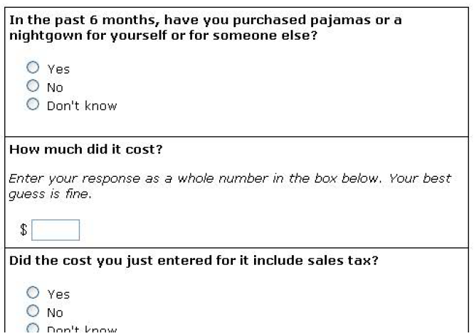
Layout

Slide 15
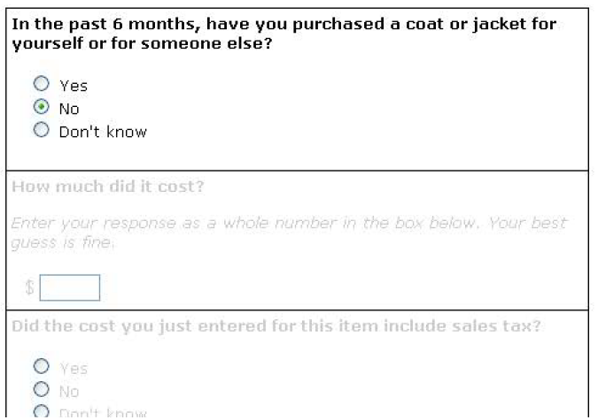
Layout

Slide 16
Use of Grey-Out reduces triggering
 | No Grey-Out | Grey-Out
Single Page | 57% | 45%
Multiple Pages | 37% | N/A

Slide 17
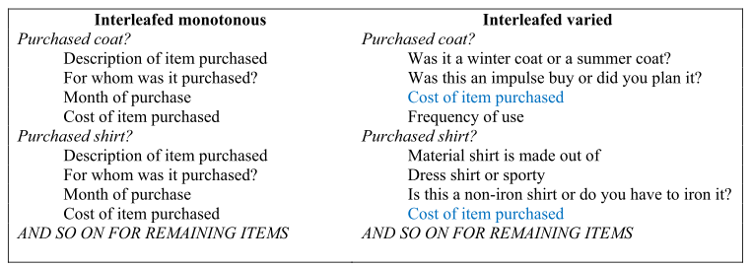
Salience: Repetitiveness

Slide 18
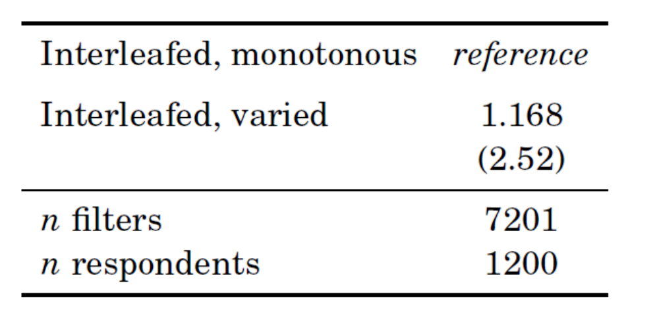
Odds Ratio, Multi-Level Logistic Regression

Slide 19
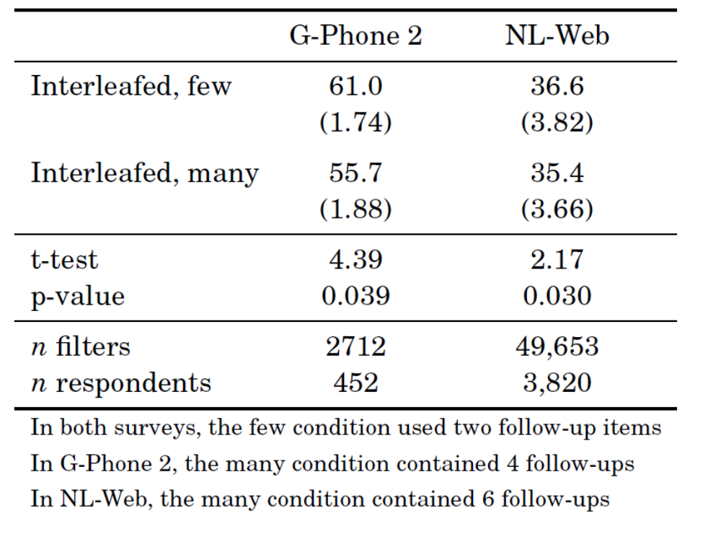
Burden:
#Follow Up

Slide 20
Summary

Slide 21
Summary
Strong sensitivity to formats
Design features can change effects
Reduced salience and burden help

Slide 22
Thank you! fkreuter@umd.edu

