Slide 1
Applicability of Discrete Choice Experiments for Survey Research
Jennifer Childs, Elizabeth Nichols, Casey Eggleston and Gerson Morales
U.S. Census Bureau
QDET2 November 12, 2016
Miami, Florida
This presentation is released to inform interested parties of research and to encourage discussion. The views expressed are those of the authors and not necessarily those of the U.S. Census Bureau.

Slide 2
Research question
Do the results of a Discrete Choice Experiment about government surveys hold when conducting actual surveys?

Slide 3
Introduction
2 Discrete Choice Experiments (DCE) Followed by 2 Traditional Experiments
1st study focused on the relative importance of key elements of a survey invitation
2nd study focused on how messages affect attitudes toward use of administrative records for statistical purposes
Notes:
The first study focused on the relative importance of several key elements of a survey invitation: (1) the uses of the survey data, (2) whether participation is required by law, (3) consequences for those who do not respond, and (4) confidentiality protection.
The second study focused on how three attributes of messages affect attitudes toward use of administrative records for statistical usage purposes: (1) the type of the administrative data used, (2) the source of these data, and (3) the amount of time saved for respondents by using it.

Slide 4
Background
At least three levels of evaluation for respondent reactions to messaging:
Liking/Preference
Intentions/ Beliefs
Behavior
DCE Study
Notes:
Respondent reactions to invitation materials can be evaluated at several levels. Most broadly, do they like the message? Do they find the message motivating – that is, do they think it would encourage them to respond? And more narrowly, how do they behave after receiving the message? Do they respond by completing the survey? The present research attempts to address the second level, but may also inadvertently have captured the first level as well or instead (as I will discuss later).

Slide 5
Discrete Choice Experiment
Discrete Choice Experiment (DCE)—emulates real-world decision-making, presenting elements in packages (not one at a time).
  For example, Hotel 1, Hotel 2 or Hotel 3.
Utility and Importance Scores—values given to element based on respondent choices
Notes:
Discrete Choice Experiment (DCE) is a methodology that emulates real-world decision-making by presenting elements conjointly in packages rather than one at a time. Then, utility scores for the elements are derived statistically based on the choices made by respondents.
Current study tested 4 elements of survey invitations (attributes) with 3 census-specific messages for each element (levels)

Slide 6
Study 1: Survey Invitations

Slide 7
Study 1: Background
Study 1 looks at the impact of different elements of survey invitations on response intentions
Four elements:
  The use of the data
  What is required (by law)
  What happens if you don’t respond
  Confidentiality protection
Notes:
In Fall 2015, CSM worked with QSA Research to obtain information about respondent preferences and prioritization for several key elements of survey invitations using a methodology called Discrete Choice Experiment (DCE) Analysis
Conjoint Analysis is a familiar tool in the marketing world, where it is used to compare product features, but is not commonly used in the survey research world where the possible choices are often less concrete and more nuanced.
Concrete example: In the late 80s/early 90's, Deming's quality movement and "Voice of the Customer" was huge at General Motors. GM wanted to build cars from customer's needs/wants. Conjoint (or similar approach - - "constant sum method" ) was frequently used in their research projects. Trade offs included items such as:
1. price
2. power / speed (engine size, ability)
3. comfort (interior design/materials)
4. style (exterior look)
5. safety
and maybe 1 or 2 more
When asked independently , respondents wanted all of these things - - it was only after putting them up against each other that you saw customer's priorities.
The elements considered in this study were (1) the use of the data, (2) what is required (by law), (3) what happens if you don’t respond, and (4) confidentiality protection.

Slide 8
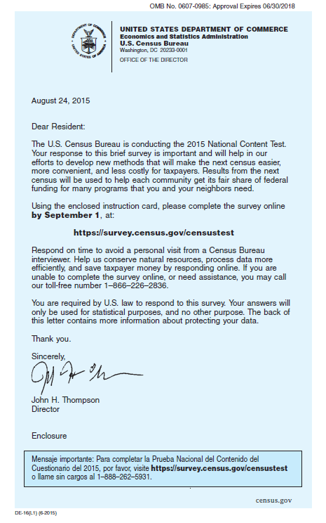
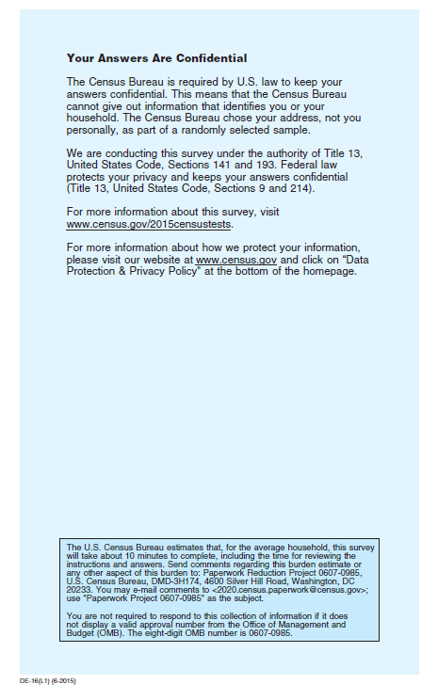
Data use
Notes:
Example of 4 elements from 2015 NCT initial mailing.

Slide 9
What is required
Notes:
Example of 4 elements from 2015 NCT initial mailing.

Slide 10
If you don’t respond
Notes:
Example of 4 elements from 2015 NCT initial mailing.

Slide 11
Confidentiality protection
Notes:
Example of 4 elements from 2015 NCT initial mailing.

Slide 12
Study 1: DCE Methodology
Sample: ≈6,000 email addresses from a volunteer, non-probability panel
Field period: October 22 – November 6, 2015
Contact attempts: A survey invitation email and up to 2 reminder emails
Response rate: ≈7% (439 usable responses)
Notes:
Sample: Almost 6,000 email addresses from a non-probability panel of individuals who signed up to participate in Census Bureau research studies
Field period: October 22 – November 6, 2015
Contact attempts: A survey invitation and up to 2 reminder emails were sent to each selected email address
Response rate: Final response rate was about 7%, providing 439 usable survey responses. This was a number that CSM and QSA Research had agreed was sufficient for the analyses to be conducted.

Slide 13
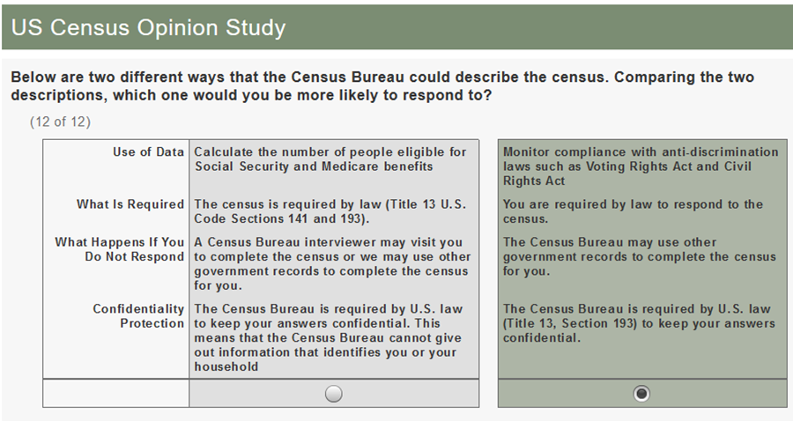
Study 1: DCE Example
Each “question” presents a choice between two distinct combinations of the conjoint elements
Notes:
Note that the instructions ask participants to choose which of the two packages of elements the respondent would be more likely to respond to, not necessarily which set of elements they like the most. Respondents completed numerous training multiple response items to orient them to the survey which explained that they were to select whichever combination of conjoint elements would “compel them to respond” and the instructions above appeared one each screen with the conjoint questions, but it is still unclear to what extent participants kept these instructions in mind. As a result, it could be that some respondents were assessing their beliefs and intentions while others were providing evaluations of their liking or preferences for the messages.

Slide 14
Study 1: Results
DCE Importance Scores
Notes:
Each conjoint question asked respondents to choose between a set of items. The importance scores give an idea for which element within each set was most influential in deciding respondents’ choices.
For this study, data use was the most important. That is, when presented with a package that contained different versions of each of the elements, respondents tended to decide which package to choose based mostly on their preferences for the data use statements.
The results show that, for the items tested, use of data was almost as influential to respondent choices as all 3 other elements combined.
Technical details (from QSA’s report; Quarles, 2015):
“…we have also calculated an Attribute Importance score for each respondent. These scores are based on the range between the highest and lowest utility score for an attribute for each respondent, calculating percentages from the relative ranges, and obtaining that respondent’s set of attribute importance values. These values add to 100 percent.
They are calculated by dividing the range for a given attribute by the sum of all ranges for the attributes included in the study. For example, if range for Attribute A is 0.4 and the total for the ranges of all attributes is 1.50, Attribute A accounts for 26.7% of the all ranges for that respondent. If the values for Attributes B and C are 0.8 and 0.3, they would account for 53.3% and 20.0% of all the ranges for the respondent. These values sum to 100%.
Because these Attribute Importance Scores are computed in this way for each respondent, they will almost always differ from importance scores that have been manually calculated based upon average utilities.”

Slide 15
Study 1: DCE Uses of Data Messages
 | Attribute | Winner | Middle | Loser
1 | Use of Data | Help allocate funds to your state, community, and school district for services, including education, health care, and new business development | Calculate the number of people eligible for Social Security and Medicare benefits | Monitor compliance with anti-discrimination laws, such as the Voting Rights Act and the Civil Rights Act
Notes:
*Remember that these messages occurred in packages, so respondents did not independently rate each message. Thus, demographic differences reported here reflect that a group was more likely to select packages containing the highlighted message.
For use of data, all race groups still had an overall preference for the allocation of funds data use.

Slide 16
Study 1: Demographic Differences
Overall, demographic differences in preferences were minor and usually only a matter of degree rather than direction
 | Attribute | Winner | Middle | Loser
1 | Use of Data | Help allocate funds to your state, community, and school district for services, including education, health care, and new business development | Calculate the number of people eligible for Social Security and Medicare benefits | Monitor compliance with anti-discrimination laws, such as the Voting Rights Act and the Civil Rights Act
*However, Black respondents selected more than White respondents
Notes:
*Remember that these messages occurred in packages, so respondents did not independently rate each message. Thus, demographic differences reported here reflect that a group was more likely to select packages containing the highlighted message.
For use of data, all race groups still had an overall preference for the allocation of funds data use.

Slide 17
Study 1: Experimental Test
Nationally Representative Mailed Sample (General Population)
  9,000 with a response rate of about 40%
  Initial mail-out and 3 reminders.
Messages to be tested
  No data use
  “Standard” data use
  Most influential message from Discrete Choice analysis – Local Benefits
  Least influential message from the Discrete Choice analysis – Anti-Discrimination

Slide 18
Study 1: Experimental Treatments
Standard Data Use Statement | Least Compelling Data Use Statement – Anti-Discrimination | Most Compelling Data Use Statement – Local Benefits
Results from the 2020 Census will be used to: - Allocate resources for schools, health services, and new business development - Prepare your community to meet transportation and emergency readiness needs - Help ensure the political representation of your community | Results from the 2020 Census will be used for a variety of purposes, including to monitor compliance with anti-discrimination laws, such as the Voting Rights Act and the Civil Rights Act. | Results from the 2020 Census will be used for a variety of purposes, including to help allocate funds to your state, community, and school district for services, including education, health care, and new business development.

Slide 19
Study 1: Experimental Test Results (Proportion of Log-ins by Panel)

Slide 20
Study 1: Experimental Demographic Differences
 |  | Proportion of Responses by Condition(%)
 | N | Standard Statement | DCE Loser: Anti-Discrimination Laws | DCE Winner: Funds to Jurisdictions | No Data Use Statement
All Households | 3403 | 24.48 | 25.95 | 25.36 | 24.21
White Only HH | 2400 | 25.75 | 24.88 | 25.33 | 24.04
Black or African American HH* | 261 | 19.16 | 32.57 | 27.59 | 20.69
All Other Race HH | 758 | 24.14 | 23.09 | 25.86 | 26.91
Notes:
Unadjusted overall response rate 37.8%.
*Chi-square analysis of the distribution indicates a significant difference in the likelihood of responding by condition for Black households (Chi-sq=12.37, p=.006). The other groups do not show any significant differences by condition.
Note: Race data collapsed to the household level. A household was coded as white only if respondent reported that every person in the household was white and no other race. A household was coded as Black if any person in the household was reported to have Black race. A household was coded as all other race if anyone in the HH was non-White and not all HH members were Black. The codes for Black HH and Other Race HH are not mutually exclusive (so if a household contained anyone who was Black AND anyone who was some race other than White, it would be represented in both rows of this table).

Slide 21
Study 2: Public Attitudes toward Administrative Records

Slide 22
Study 2: Objective
To understand public views about the statistical use of administrative data as a substitute for survey data.
Three elements:
  Time saved by using outside data
  What outside data we use
  Outside data source
Notes:
*Outside is defined as administrative data
Information can be used to determine language usage for 2020 Census and reduce cost by using admin data

Slide 23
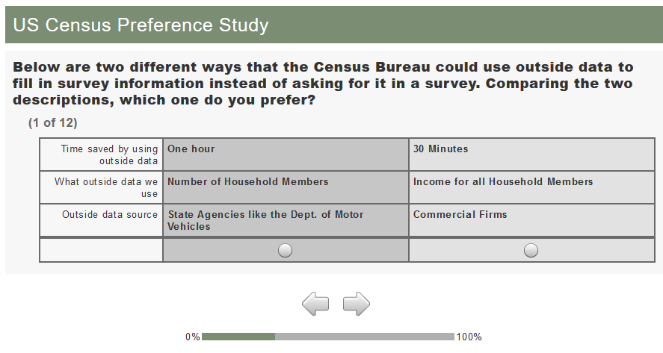
Study 2: DCE Example
Each question presents a choice between two distinct combinations of the conjoint elements (one level from each attribute)
Notes:
No need to go into too much detail, Casey would have explained this.
Participants answered 12 conjoint questions (not all possible combinations)
Responses produces two key values
Utility scores for each feature (that is, for each of the specific messages)
Overall importance scores (for each of the 4 survey invitation elements)
Can also look for patterns related to respondent characteristics
____
In order to get sufficient data about each possible combination while reducing respondent burden, there were 10 different sets of 12 conjoint questions that were randomized across participants.
The statistics behind conjoint analysis utility and importance scores are somewhat complicated, but the information they provide is quite different from what is obtained from other methods. By asking a small number of conjoint questions for each participant, you are able to ascertain the impact of each of the separate elements for each person but in a way that incorporates the influence of all the other elements as well.
Utility scores and importance scores are calculated at the individual level, then summarized into one score.
Because values are computed at the individual level, it is possible to look at differences based on respondent characteristics, like demographic factors.
Technical details (from QSA’s report; Quarles, 2015):
“Utility scores are partial logistic regression slope-function coefficients. Utilities are scaled to sum to zero within each attribute. Hierarchical Bayesian analysis is utilized to calculate the utility values at the individual level. Having individual-level utility scores makes it possible to analyze the data in the same way one might analyze percentages or means.
Conjoint analysis also produces a measure of the overall importance of each attribute. These attributes are calculated based on the range of utility scores across the levels of the attribute. They are scaled so that the sum of all attributes in the exercise is 100% for each respondent. However, the relative importance of each attribute is readily discernable by simply looking at the utility scores. Thus, this report will focus on the utility scores.”

Slide 24
Study 2: DCE Methodology
Sample: ≈6,000 email addresses from a volunteer, non-probability panel
Field period: October 13- 30, 2015
Contact attempts: A survey invitation email and up to 2 reminder emails
Response rate: ≈9% (555 usable responses)

Slide 25
Study 2: DCE Importance Scores
Notes:
The importance scores give an idea for which element was most important in deciding respondents’ choices.
The source of the outside data is by far the most important attribute tested. Government data, particularly Federal government data, is much preferred over data from commercial firms. This suggests that respondents are highly sensitive to concerns about both the integrity of the data and privacy.
Saving survey-taking time is the second most important attribute, but it is much less important than the data source. Generally, the more time saved, the more positive the response.
The type of outside data used is the third most important factor. Birthdates of all household members is the most preferred type of outside data, while income of all household members is least preferred.

Slide 26
 | Attribute | Winner | Middle | Loser
3 | Outside data source | Federal Government Agencies | State Agencies like the Dept. of Motor Vehicles | Commercial Firms
** All groups did not prefer commercial firms.
*All groups preferred Fed Gov. Agencies but was most preferred by Females, Non-Hispanic, College Graduates, and employed.
Notes:
*These groups had high dislike in commercial firms.
For those employed, federal gov agencies were most preferred by those working in the educational services.
It is important to note that all of the subgroups prefer government data sources, particularly Federal government sources, to data from commercial firms.
The table shows the sub groups that have greater consistency in response, which leads to a more strongly held preference.

Slide 27
Study 2: Experiment Methdology
27 conditions from the Discrete Choice study
Each participant randomly assigned to evaluate only 1 message
Sample: ≈13,500 email addresses from a volunteer, non-probability panel
Field period: October 2016
Contact attempts: A survey invitation email and up to 2 reminder emails

Slide 28
Study 2: Experimental Results By Record Source
★
★

Slide 29
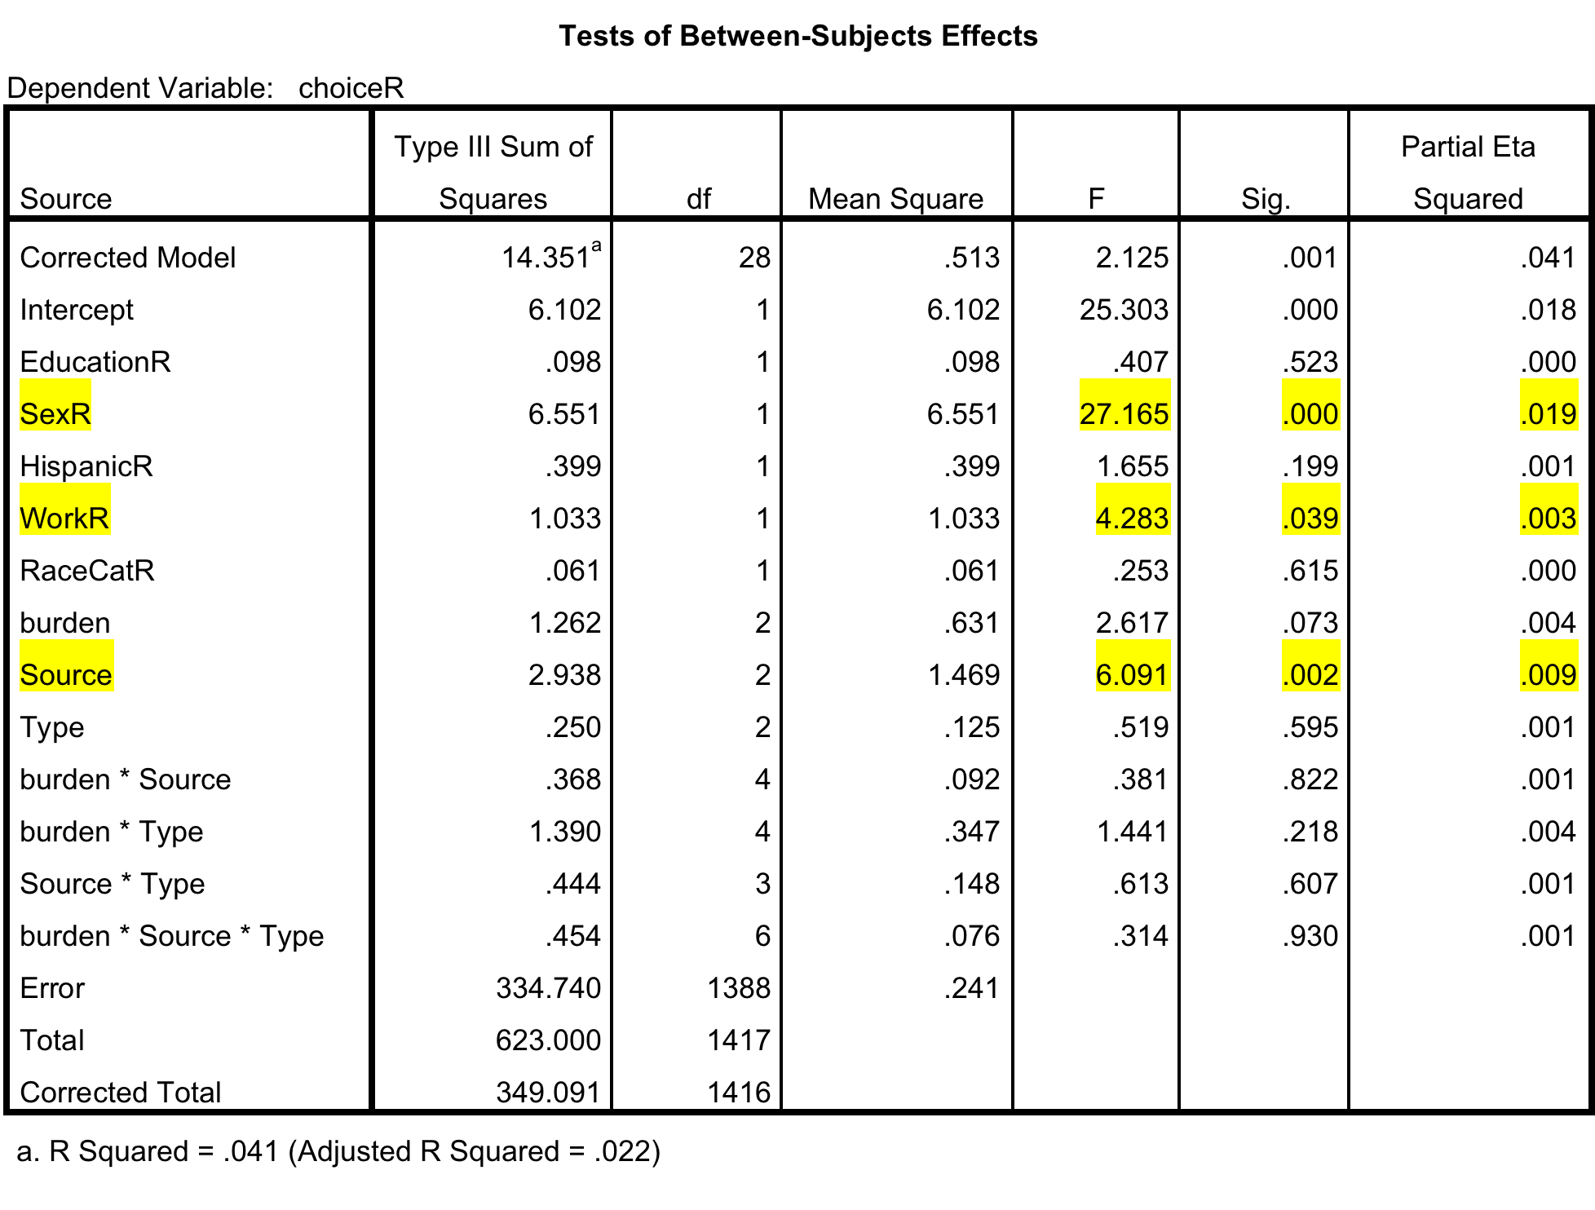
Study 2: Experimental Results Predicting Support for Record Use

Slide 30
Study 2: Results Summary
Both studies indicated that Source of Records is the key variable in supporting records use.
  Both studies indicated that time saved was more important to respondents than type of data.
Both studies indicated differences by sex and work status.
  In addition, conjoint suggested difference by education and Hispanic origin.

Slide 31
Summary of Findings
Study 1 manipulated parts of a survey invitation. Experiment did not replicate DCE results EXCEPT the effect of race.
Study 2 manipulated features of an opinion question. Experiment confirmed results from DCE study (which used half the sample size).

Slide 32
Conclusions
Liking/Preference
Intentions/ Beliefs
Behavior
DCE Strengths
DCE Possibilities
Notes:
Respondent reactions to invitation materials can be evaluated at several levels. Most broadly, do they like the message? Do they find the message motivating – that is, do they think it would encourage them respond? And more narrowly, how do they behave after receiving the message? Do they respond by completing the survey? The present research attempts to address the second level, but may also inadvertently have captured the first level as well or instead (as I will discuss later).

Slide 33
Conclusions
Fit for purpose
DCE worked better for opinion issues than behavior
Possibility that DCE could help identify differences by subgroups

Slide 34
Questions or comments?
Jennifer Hunter Childs
Jennifer.hunter.childs@census.gov

Slide 35
 | Attribute | Level 1 | Level 2 | Level 3
1 | Use of Data | Calculate the number of people eligible for Social Security and Medicare benefits | Monitor compliance with anti-discrimination laws, such as the Voting Rights Act and the Civil Rights Act | Help allocate funds to your state, community, and school district for services, including education, health care, and new business development
2 | What Is Required | You are required by law to respond to the census | The census is required by law (Title 13 U.S. Code Sections 141 and 193) | Collection of the information is Mandatory and is collected under Title 13 U.S. Code Sections 141 and 193
3 | What Happens If You Do Not Respond | The Census Bureau may use other government records to complete the census for you | A Census Bureau interviewer may visit you to complete the census | A Census Bureau interviewer may visit you to complete the census or we may use other government records to complete the census for you
4 | Confidentiality Protection | The Census Bureau is required by U.S. law to keep your answers confidential. This means that the Census Bureau cannot give out information that identifies you or your household | The Census Bureau is required by U.S. law to keep your answers confidential. Your answers will only be used for statistical purposes, and no other purpose | The Census Bureau is required by U.S. law (Title 13, Section 193) to keep your answers confidential
Notes:
Tested 3 versions each of 4 survey invitation elements (use of data, legal requirement, what happens if you don’t respond, confidentiality protection).
For reference, this table presents all of the individual messages tested. For example, we looked at 3 specific data use statements that might be used to describe the census. We could say it is used to determine how many people are eligible for Social Security, or that it is used to assess compliance with anti-discrimination laws, or that it is used to allocate funds to local communities.

Slide 36
 | Attribute | Level 1 | Level 2 | Level 3
1 | Time saved by using outside data | 10 Minutes | 30 Minutes | One hour
2 | What outside data we use | Number of Household Members | Dates of Birth for all Household Members | Income for all Household Members
3 | Outside data source | Federal Government Agencies | State Agencies like the Dept. of Motor Vehicles | Commercial Firms

Slide 37
Study 2: Experimental Results By Survey Length

Slide 38
Study 2: Experimental Results By Type of Record

