Slide 1
Challenges to Developing New Survey Questions: When Cultural Norms Run Counter to Survey Questions
Heather Ridolfo, Virginia Harris and Emilola Abayomi
National Agricultural Statistics Service

Slide 2
Farm Operators
Measure farm operators to assess:
Demographics of farmers
Changes in structure of farming
Assess potential future issues
Assess USDA programs
“Principal” Operator key for understanding the economic well-being of the farm household

Slide 3
Women Operators
Concern over underreporting of women farmers on the Census of Agriculture
In the 2012 Census of Agriculture:
  30% all operators were women
  14% all principal operators were women
  Decline in female operators 2007-2012
  (not significant)

Slide 4
Panel on Women in Agriculture
Changing farm structure
Cultural norms (farms are operated by men)
Panel Recommendations:
Remove labels (operator, principal operator)
Ask about involvement in variety of decisions, allow for joint involvement
Allow up to 4 operators
Transition away from principal operator; allow respondents to report more than one

Slide 5
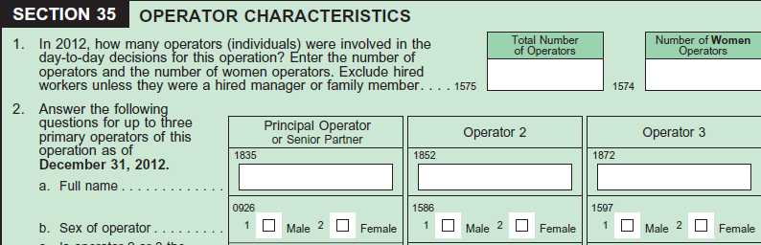
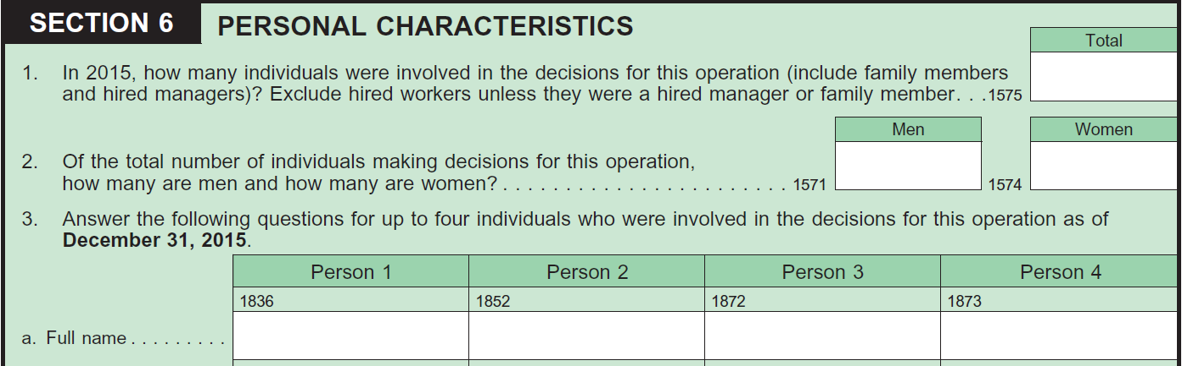
Changes to the Questionnaire
2012 COA
2015 Content Test

Slide 6
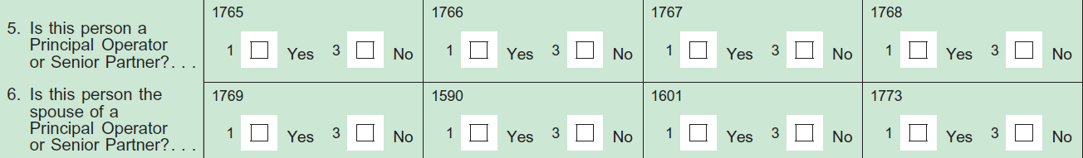
Principal Operator
2012 COA
2015 Content Test

Slide 7
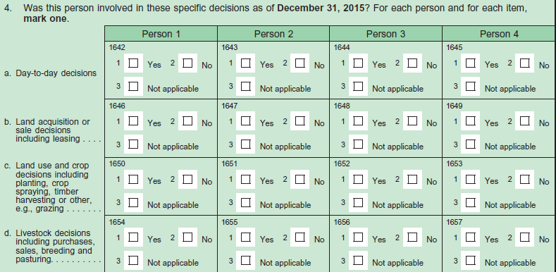
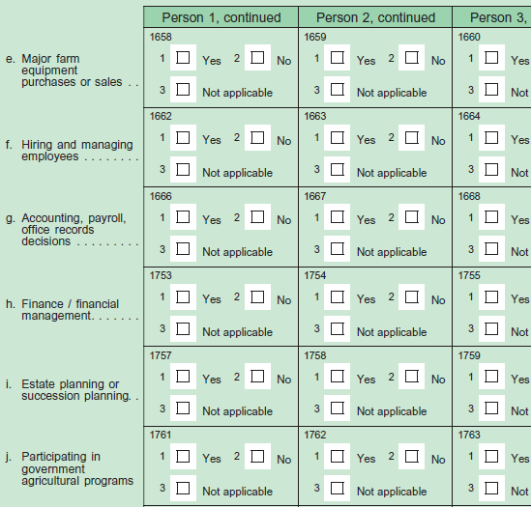
Changes to the Questionnaire

Slide 8
Pre-Testing Methods
Cognitive interviewing
Round 1 (n=8)
Round 2 (n=25)
Round 3 (n=67)
2015 Content Test (n=~30,000)

Slide 9
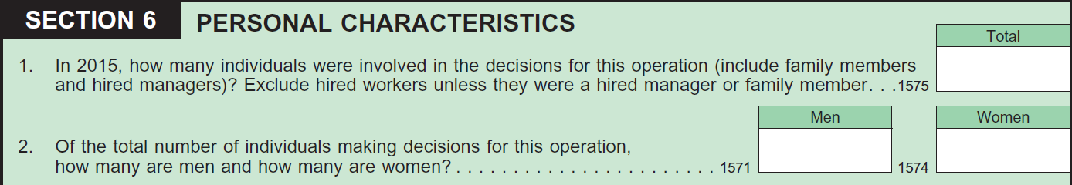
Total Number of Individuals
Capturing involvement in variety of decisions
Broad range of decision types considered
  Day-to-day decisions
  Major decisions
  All decision types
Broad range in level of involvement
  Involved in majority/all decisions
  Involved in one or some decisions
  Providing input
  Making decisions/being final decision maker

Slide 10
Total Number of Individuals
Still undercounts of women
“We always argue her down”
“She just does the bookkeeping”
“The Bible says he’s in charge”

Slide 11
Number of Men and Women
Redundancy and missing data
Some respondents felt these questions were redundant
Majority of the time responses to Question 2 summed to response to Question 1
Respondents with no female operators sometimes left women response space blank

Slide 12
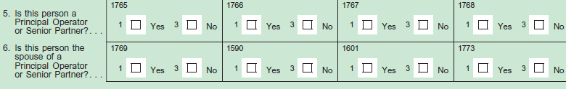
Principal Operator
Data reported are inconsistent (operating jointly = checked yes for all operators, checked no for all operators, or left blank)
Difficult to bridge because concept has changed

Slide 13
2015 Content Test
Sample approximately 30,000
Sample targeted to include operations so all sections of form would be tested
Self-administered paper form, limited CATI and Web
Data collection Jan-April 2016

Slide 14
Total Number of Operators
Consistency of total operators reported and number of men and women reported
 | Count | % of total reports
Consistent | 11105 | 95.26
Not Consistent | 552 | 4.74

Slide 15
Total Number of Operators
Consistency of numbers reported in total question and number of operators reported in the demographic table
 | Count | % of total reports
Consistent | 10290 | 88.27
Not Consistent | 1367 | 11.73

Slide 16
2015 Content Test: Principal Operator
Total Number of Principal Operators Reported | Count | % of total reports
0 | 3060 | 0.26
1 | 5574 | 0.48
2 | 2788 | 0.24
3 | 160 | 0.01
4 | 75 | 0.00

Slide 17
2015 Content Test: Principal Operator
 | Number of Principal Operators
Number of Operators | 0 | 1 | 2 | 3 | 4
0 | 767 | 297 | 84 | 1 | 3
1 | 672 | 3550 | 15
2 | 625 | 1504 | 2438 | 2
3 | 63 | 157 | 169 | 137
4 | 40 | 55 | 59 | 13 | 59
5+ | 30 | 28 | 28 | 7 | 13

Slide 18
Matched Records for 2012 COA and
2015 Content Test
 | 2012 Census |  | 2015 Content Test
 | Sum | Mean | Sum | Mean
Total Operators | 11627 | 1.27 | 13955 | 1.52
Women | 3643 | 0.40 | 4967 | 0.54
Men | 7984 | 0.87 | 9288 | 1.01
Men reported in columns | 8765 |  | 8989
Women reported in columns | 3763 |  | 4519

Slide 19
Conclusion
Cultural norms persist (women still underreported)
Small changes to questionnaire brought small improvement to reporting of women operators

Slide 20
Questions
Heather Ridolfo
heather.ridolfo@nass.usda.gov
Virgina Harris
virginia.harris@nass.usda.gov
Emilola J. Abayomi
emilola.abayomi@nass.usda.gov

