Slide 1
Questionnaire Testing Bento Box:
Multi-method Testing for the 2017 Census of Agriculture
Jaki S. McCarthy
The Second Questionnaire Design, Evaluation, and Testing Conference
November 2016
Miami, Florida

Slide 2
Questionnaire Redesign Bento Box
Testing for the 2017 Census of Agriculture (COA)
Multiple methods employed to:
  Improve Accuracy
  Reduce Burden
  Improve Response
Each method has its own strengths and weaknesses
Combining methods provides complementary information and strengthens overall redesign efforts

Slide 3
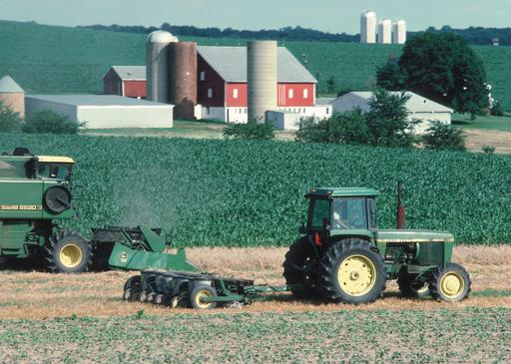
U.S. Census of Agriculture (COA)
Conducted every 5 years, for years ending in 2 and 7
Includes all known and potential farms and ranches ($1000+ in sales)
Long and complex form (24 pages) collecting land use, agricultural production and inventory, farm economics, farm practices, operator characteristics
Primarily self administered form mailed to ~3 million
Multi-method testing used to improve 2017 COA forms

Slide 4
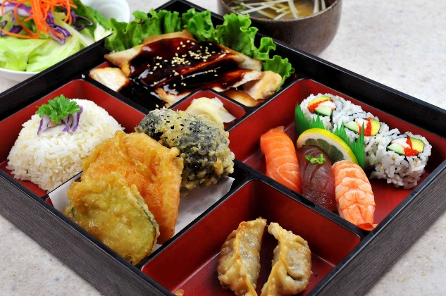
Traditional Japanese Bento Box
Five Principles of Balance
Method (Goho)
  Simmer, steam, grill, fry, raw
Color (Goshiki)
  Red, yellow, green, black, white
Flavor (Gomi)
  Salty, sour, sweet, bitter, spicy
Senses (Gokan)
Viewpoints (Gokan no Mon)
Notes:
* Goshiki (five colors): aka(red); kiiro (yellow); ao (green); kuro (black); shiro (white).
* Goho (five methods): niru (simmer); musu (steam); yaku (grill); ageru (fry); tsukuru (create).
* Gomi (five flavors): shiokarai (salty); suppai (sour); amai (sweet); Nigai (bitter); karai (spicy).
Gokan (five senses): miru (sight); kiku (hearing); kaku (smell); ajiwau (taste); fureru (touch).
Using these principles you can combine any ingredients and make balanced nutritious meals.

Slide 5
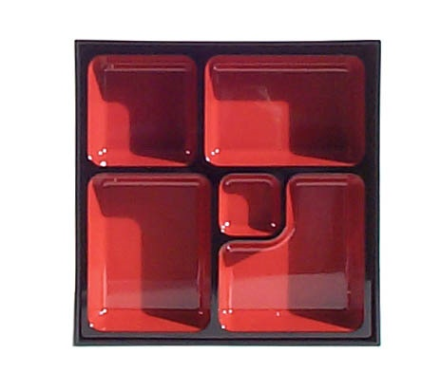
Our Testing Bento Box:
5 Methods
Field Testing
Evaluation of
Historical Data
Expert
Review
Follow Up Interviews
Cognitive
Testing

Slide 6
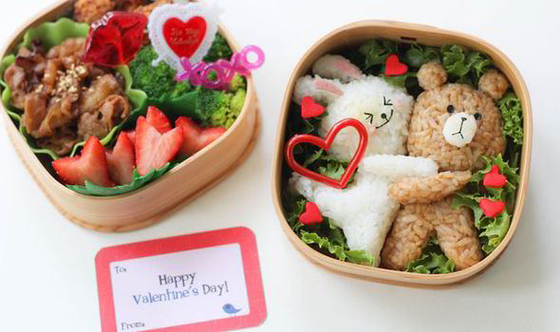
Each method is used in a different way and provides different information
Considerations:
Quantitative versus qualitative
Early or late in schedule
Targeted versus general
Subject matter expertise
Consideration of operational procedures
Costs

Slide 7
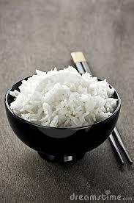
Evaluation of Historical Data from Prior Data Collections
Review existing data to identify potential problems
2012 COA data reviewed item by item:
  Number of edits
  Number of item imputations
Items rank ordered for priority
Review of counts and comments to 2012 COA telephone help-line
  What sections did callers request help on?
  Why else did they call?
  Were requests for help decreased from 2007?

Slide 8
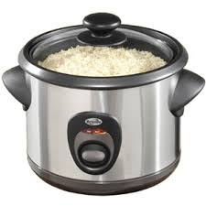
Evaluation of Historical Data
Type of information: quantitative
When to use: early
Population considered: can include full population
Cost: Low
Strengths:
  Is based on actual data collection conditions
  Can be done as soon as data is available

Slide 9
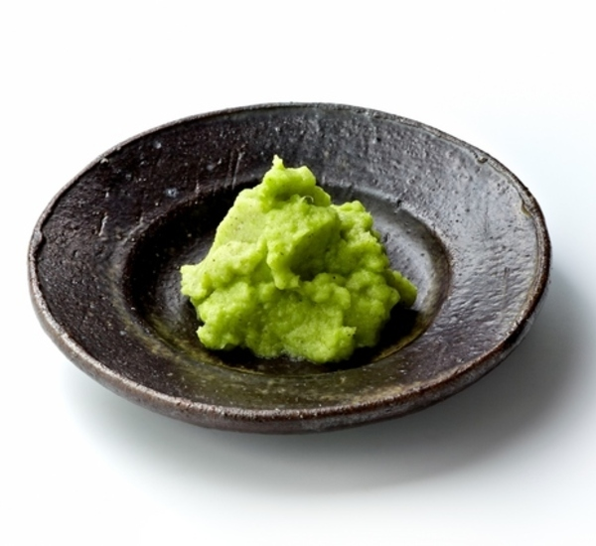
Expert Review
Consult experts to identify potential problems or needed changes. Experts can be from many areas:
  Topic area
  Data users
  Survey design
  Survey operations
NASS has standing external advisory committee
NASS convened expert panel to provide input on measuring women and beginning/younger farmers
NASS collected feedback internally from field staff and subject matter experts on past problems and potential improvements

Slide 10
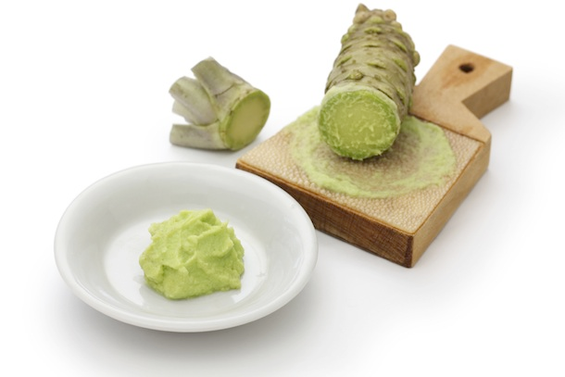
Expert Review
Type of information: usually qualitative and general
When to use: early; suggestions may need additional time to operationalize and may not consider operational constraints
Population considered: narrow perspective based on expertise
Cost: Low
Strengths:
  Can provide insight and perspective not available to survey team
  More likely to suggest major or fundamental changes

Slide 11
Expert Review example
Expert panel on women and beginning farmers suggested:
  Broaden concept of “operator” beyond decision making to involvement in decisions
  collect new information on involvement in specific decisions
Data users suggested new items for
  Veteran operators
  Value added products

Slide 12
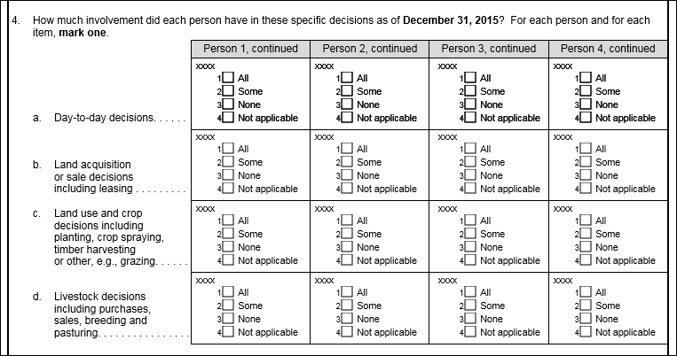
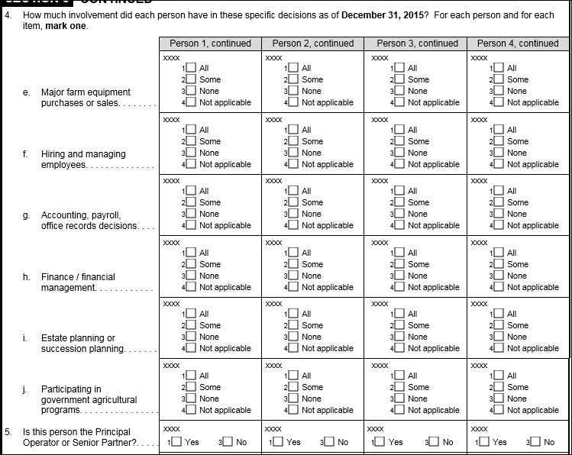
New Questions about Involvement in Decisions

Slide 13

Cognitive Interviews
Respondents observed completing sections of the draft form followed with questions asked about their reporting process
Multiple rounds conducted for subsets of COA form
Included different types of respondents

Slide 14
Cognitive Interviews
Type of information: qualitative; information about reasons for potential problems
When to use: when forms have been drafted
Population considered: small n, no guarantee that all relevant types of respondents are included, artificial interview conditions
Cost: Low overall if small samples, but high cost per interview; requires specially trained staff
Strengths: provides direct evidence of problems and their source

Slide 15
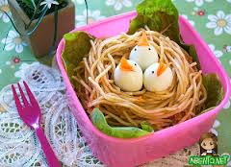
CI example
Questions based on expert panel input were tested
CI Respondents reported:
  Some decision questions were redundant
  Response format proposed was confusing
  More people were reported than with previous “decision making” question, but some women still omitted
All interviews not completed in time to analyze and make changes before field test

Slide 16
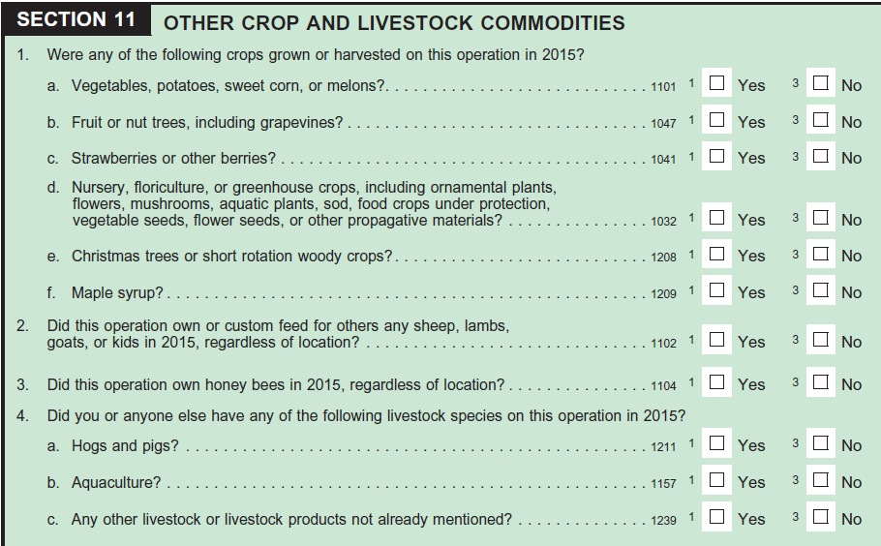
CI example
A short form was developed and tested in CIs
Short form was intended for Rs without certain types of commodities
Respondents able to answer appropriately
Most respondents correctly excluded home gardens

Slide 17

Field Testing
Mailout test conducted with draft COA forms
Sample approximately 30,000
Split samples to test different formats and versions of forms
Sample was targeted to include operations so all sections of form would be tested
Procedures mimicked COA procedures (i.e. initial mailout, post card reminder, 2nd mailing and limited CATI follow up)

Slide 18
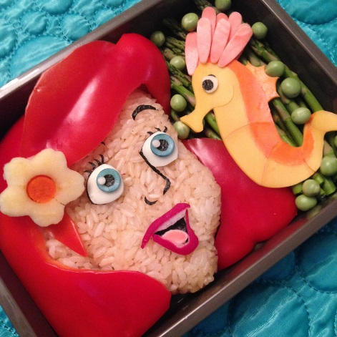
Field Tests
Type of information: quantitative, insight into potential operational issues
When to use: when forms and procedures are near final
Population considered: depends on design, but can include broad range
Cost: High
Strengths:
  Can provide “dry run” of operational procedures
  Can include much broader sample
  Can allow direct comparisons of alternatives

Slide 19
Field Test examples
For questions about operators:
  Confirmed that some decision questions were highly correlated
Test of Short Form
  6% of respondents reported vegetables, when none expected
Tested a pre-survey contact to see if predictive of response:
  Actual response rates for those responding/not responding to pre-survey contact could be measured
  Return of pre-survey contact predictive of response (70% vs 45% RR)
  Could be used in COA to accelerate NR follow up

Slide 20
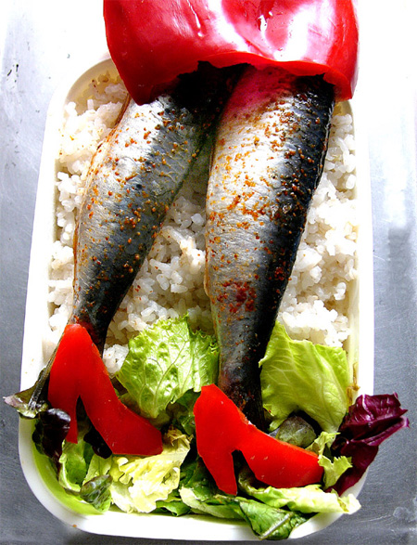
Follow up Interviews
Small sample of field test Rs with potential problems identified and recontacted by phone
Similar to cognitive interviews, respondents asked about their field test data and how/why they answered as they did
Can provide explanation for unusual data

Slide 21

Follow up interviews
Type of information: qualitative and can target specific issues
When to use: as follow on debriefings to field data collection
Population considered: limited
Cost: Low, but varies depending on number of interviews and whether specially trained interviewers needed, mode
Strengths:
  Can target respondents with specific errors or data
  Provides information on reasons for unusual data

Slide 22
Follow Up Interview Example
Respondents reporting unexpected commodities on short form re-contacted and asked to explain
Most reporting vegetables said that they were home gardens for personal consumption; these should not have been included
Recommendation to include instruction to exclude home gardens and collect acreage instead of YES/NO

Slide 23
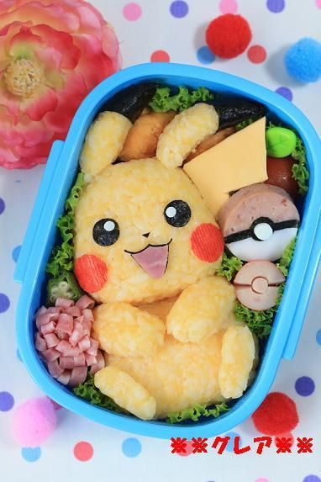
Conclusion
Using multiple methods has lots of advantages, but also requires more planning
Think about:
  when to use,
  type of info you will get,
  how to combine it
Multi mode requires more analysis and time in schedule but gives more confidence in results
For ongoing data collections, start as soon as previous is done

Slide 24

The Five Principles
Ponder deep gratitude for the people who prepared the meal
Perform deeds and have thoughts worthy of receiving such nourishment
Partake of the food with no ire
Realize that you are feeding the soul as well as the body
Be seriously engaged on the road to enlightenment
Notes:
The final set of fives is called the gokan no mon — the five viewpoints or outlooks — a Buddhist doctrine referring to the state of mind to be maintained while partaking of the food. The first tenet is to ponder deep gratitude for the people who prepared the meal. Second is to perform deeds and have thoughts worthy of receiving such nourishment. Third is to partake of the food with no ire. Fourth is to realize that eating this food is feeding the soul as well as the body. And finally, the fifth consideration is to be seriously engaged on the road to enlightenment.

Slide 25
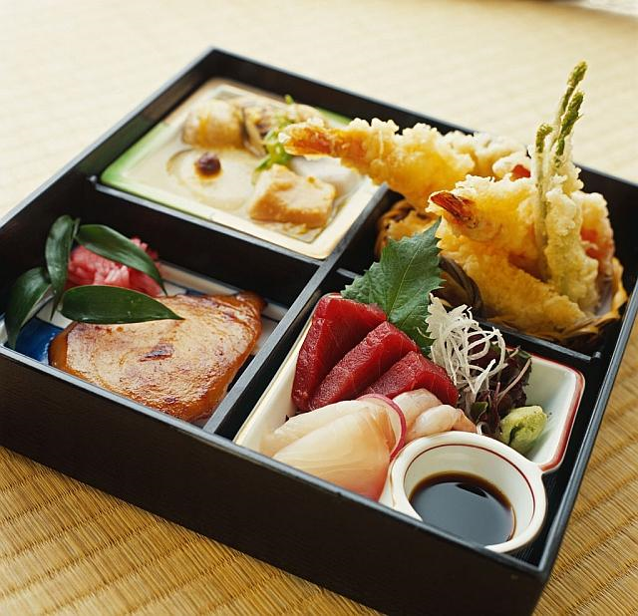
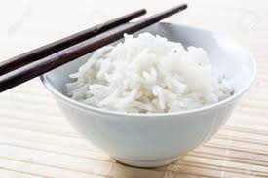
Our questionnaire testing meal

Slide 26
