Slide 1
How the shift from interviews to web-mail self-administration requires changing how we design and test questionnaires
For
QDET2—Miami Florida, November 11, 2016
by
Don A. Dillman
Regents Professor
Washington State University
Pullman, WA 99164-4014
Dillman @wsu.edu

Slide 2
A departure from my normal style and two confessions
This is not my usual style of presentation focus on experimental results.
My focus is five suggestions for changes in emphasis for questionnaire testing and evaluation.
Confession 1. I have had an uneasy relationship with questionnaire testing methods for many years, despite being most frequent user of my department’s social-psychology laboratory.
Confession 2. In 2002 I left QDET 1 feeling uncertain whether I had picked up ideas that I would use.
  The techniques seemed incomplete and isolated from one another, and often specific to certain questions, certain populations and certain data collection situations (A Pogo moment perhaps.)
  Let me begin by sharing three personal stories about what I was dealing with at the time of that conference.

Slide 3
Personal story 1. “It is not all about words”
My introduction to cognitive interviewing at Census in 1991 was getting people to “think out-loud” about what was going through their minds after reading a question.
The anthem seemed to be, “what does this question mean to you.” But, my charge was to improve Decennial Census response rates.
I was also learning that there are four languages used on visual questionnaires—words, symbols, numbers and graphics.
I starting using retrospective methods where I could watch a questionnaire being filled out and debrief to find out why hesitations, misunderstandings, branching errors and other undesired behavioral responses were occurring.
A conclusion. The meaning of cognitive needed to be expanded to included “perceiving and navigating” as well as trying to understand motivation.
My role of cognitive interviewer changed to do more listening while using my theoretical knowledge to recognize vision layout problems and their role in creating response errors.

Slide 4
Personal story 2. Focus groups provided insufficient evidence for an envelope change.
Census policy: “All changes in Census questionnaires must be tested.”
An excellent statistician said to me, “Why don’t you do a few cognitive interviews so we’ll have it tested.”
I objected. A good friend brought me down from the rafters. “Well, Don, in the past questions were changed in meetings without any testing, so this is an improvement.
We then tested a mandatory response message for 2000 Census questionnaires. We did focus groups in Omaha, New York and elsewhere to test two envelope messages:
  “Your response is required by Law: U.S. Census Form enclosed”
  “It pays to be counted in the U.S. Census: U.S. Census form enclosed”
The groups were unanimous, “Don’t do it”.
We went ahead with an experimental test, and it improved response rates by 8-10 percentage points, more than any other single stimulus to that we tested.
Had we not also done the experiment I believe the marketing forms would have been adopted.

Slide 5
Personal story 3. We considered not publishing QDET paper from 2002.
(Dillman and Redline, pages 299-317, Presser et al.)
We compared cognitive interview vs. experimental tests for three studies.
  Why does the “absence of a number” and numbering first item as a “0” on “Gallup Q12” inventory produce a high item nonresponse.
  An “improved” set of branching instructions.
  Marketing vs. Official Census approach to data collection
Results were consistent between experiment and cognitive interviews for all three comparisons.
Our worry was that this was the article that would get cited as cognitive interviews alone provide a sufficient test for making huge decisions.
We resolved this by focusing on how we learn different things from each approach--quantitative estimates of the magnitude of certain impacts from the field tests and the gaining of hypotheses from cognitive interviews that might explain those differences.
Stated conclusion: “Used in tandem, cognitive interviews and field experiments are a powerful means of testing and refining procedures for conduct of self-administered surveys.”

Slide 6
Transition from personal stories to 2016 Issues
These experiences perhaps help explain the angst I was feeling about cognitive and other qualitative means of testing.
That angst has been amplified by the shift in my personal research towards trying to develop effective web-push methods for surveying during the last decade.
I want to suggest five changes in testing approaches that I hope survey methodologists will contemplate.
I will start with how our data collection methods are undergoing substantial change.

Slide 7
The voice telephone era of RDD household surveys is mostly over!
The presenting problems for RDD surveys are:
  Very low response rates—now in single digits .
  People answered phone only once, so that it is becoming a “one chance to persuade” (in 5 seconds or less) methodology
  Need to combine individual (cell) and household (land) lines for coverage.
  Need to devote questions to correcting for area code transportability, ownership of cell/landline access, not driving a vehicle, age of respondent.
  These additional questions compete for precious space in a questionnaire that already needs to be short.
However, cultural change is the biggest problem; the telephone is no longer used for ordinary conversations.
Most telephone communication is asynchronous; texts and emails.

Slide 8
The hoped for Email only contact/web response replacement, is not yet working well
Coverage for household populations is pretty good (80% +).
Individual internet skills are limited among some adults.
No email sample frame for household selection comparable to telephone RDD.
Lack of TRUST on multiple levels; sponsorship, misrepresentation of purpose, threat of malware, and consequences of making a mistake.
Moving from age of desktops, to laptops, (and now) devices, which are not optimally designed for answering surveys—screen size affects when and how they get used.
The “purse and pocket” problem combined with the smartphone response situation of people being “on the move” from one task to another makes getting lengthy and thoughtful survey responses very difficult.

Slide 9
Postal addresses emerged as sample frame with most complete household coverage
~98 %, in the U.S. Postal Service “Delivery Sequence File” available as addresses without names.
Why mail contact is interesting:
  Can provide incentives with the survey request.
  Can deliver follow-up contacts in different forms to offer additional arguments for responding.
  I could try to “push” people to the web instead of asking for a paper response.

Slide 10
Some consequences of trying to replace telephone with a web-push methodology…
Using postal addresses requires mixing survey modes:
  a different contact mode than response mode.
  May involve obtaining responses from more than one mode (e.g. mail or telephone)
  Mixing modes introduces measurement issues
Potential cost savings provided a powerful motivation.
Acceptance by the survey methodology community would be a challenge because of losing “interviewer assistance”.

Slide 11
Questionnaire evaluation and testing is about more than words
One of the megatrends influencing survey design as we near 2020 is greater reliance on self-administration—from banking and travel to buying “everything”.
It’s hard to see surveying as an “exception”
One of the self-administration methodologies for doing that is web-push, whereby we are using mail contact to request Internet responses, with other responses modes being used for follow-up requests.
From 2007-2014 my research team did multiple tests on a wide variety of topics.

Slide 12
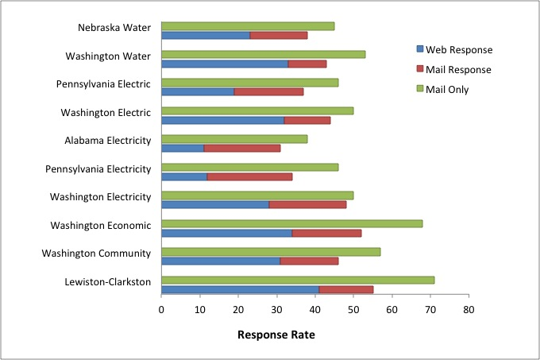
Results from 10 Washington State University general public comparisons: Web-push response rates (mean response, 43%, with 62% over the web) vs. mail out/mail back (mean, 53%) surveys, 2007-2012
(Dillman, Smyth and Christian, 2014, Chapter 11).

Slide 13
Web-push from mail start has been accepted for a variety of survey situations and the list is growing rapidly
American Community survey (web→mail→telephone→in-person)
2016 Canada Census (web→mail→in-person)
National Survey of College Graduates (web→mail→telephone)
National Child Health Survey (phase 1, web+mail→Phase 2 web+mail)
Nexant gas and electric surveys (web→mail and telephone)
2016 Australian Census (web→mail→in-person)
2015 Japanese Census (web→mail→in-person)
…and there are others.
These changes require rethinking some of our testing methods and doing things we have done too little of in the past.

Slide 14
Change 1. We need a greater focus on measurement differences across modes.
The main reason for web-push and other mixed-mode surveys is to improve coverage and response.
Focusing predominately on only one survey mode is not sufficient.
The great divide in measurement is between aural (word only plus interviewer) and visual self-administered methods.

Slide 15
Change 2. Reliance on web and mail requires evaluating much more than question wording.
Four languages contribute to question meaning:
  Numbers (e.g 1,2, 3)
  Symbols (e.g. →)
  Graphical display (size, shape, consistency, etc.)
  (and) words
We have to evaluate all four!
Doing this requires understanding a language of concepts and theoretical concepts.
An example from an earlier time:

Slide 16

NSF National Earned Doctorate Survey (web prototype); a web item that did not work
Some respondents tried to enter alphabetic abbreviations for the month (e.g., Aug.) or to report the year using only two digits, instead of the required four.
Respondents indicated signs of frustration after receiving error messages that their answer was not in the desired format.

Slide 17
Some Mechanisms by which visual Layout influences answers to questionnaires
Pattern recognition (how we navigate pages of information, e.g., top left to lower right).
The limits of attentive processing (e.g., 8-10 character limit of foveal view).
Gestalt Laws of Pragnanz, Proximity, Simplicity, Continuation.
Composition of visual elements: e.g., size, location, brightness, and shape.

Slide 18
How Can We Get People to Report Right the First Time? Multiple Manipulations in Successive Experiments
Size of month box relative to year box (a graphic element).
Use of words (month/year) vs. symbols with imbedded numeracy (MM/YYYY).
Separation of month and year box (Gestalt laws of proximity and similarity).
Changes in wording of the question stem.
Location of symbols in relation to answer space (foveal view and natural reading order).

Slide 19
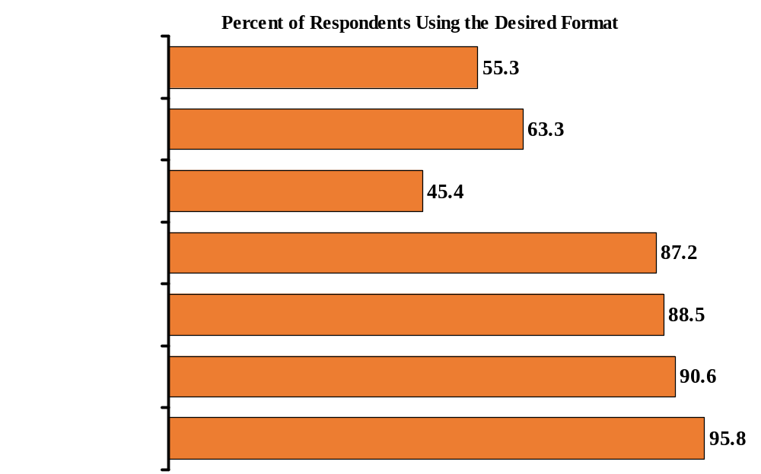
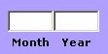
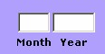
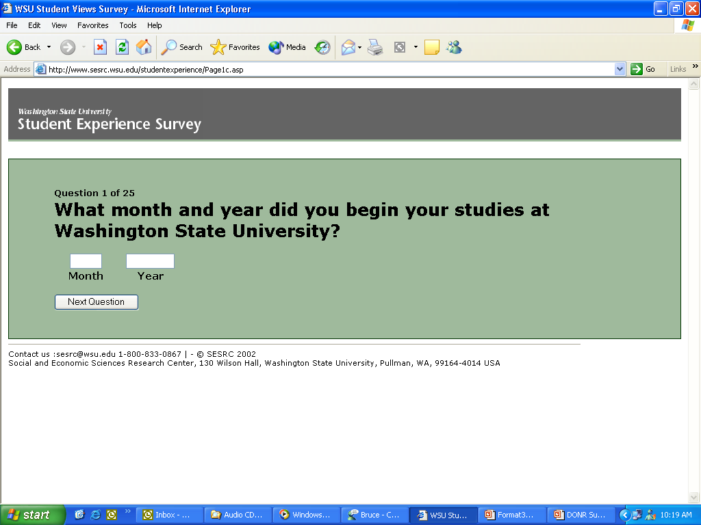
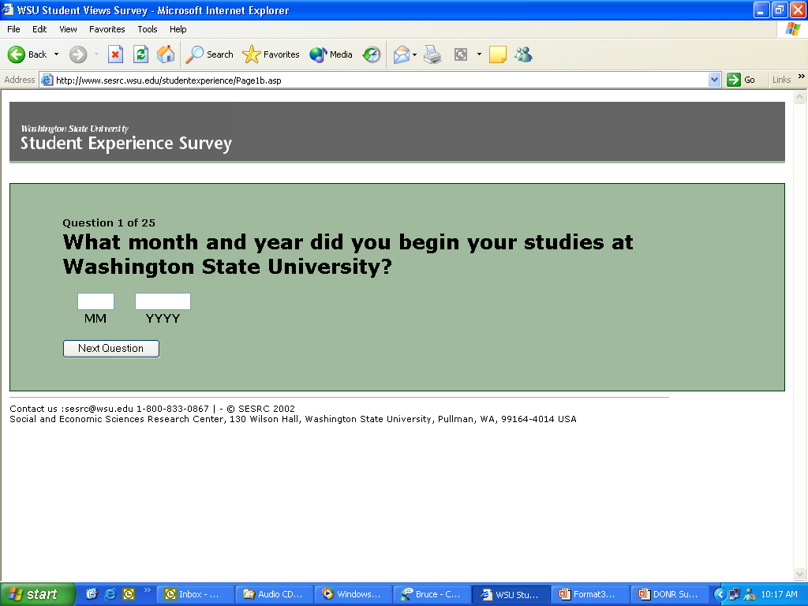
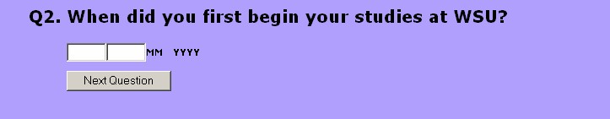
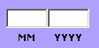
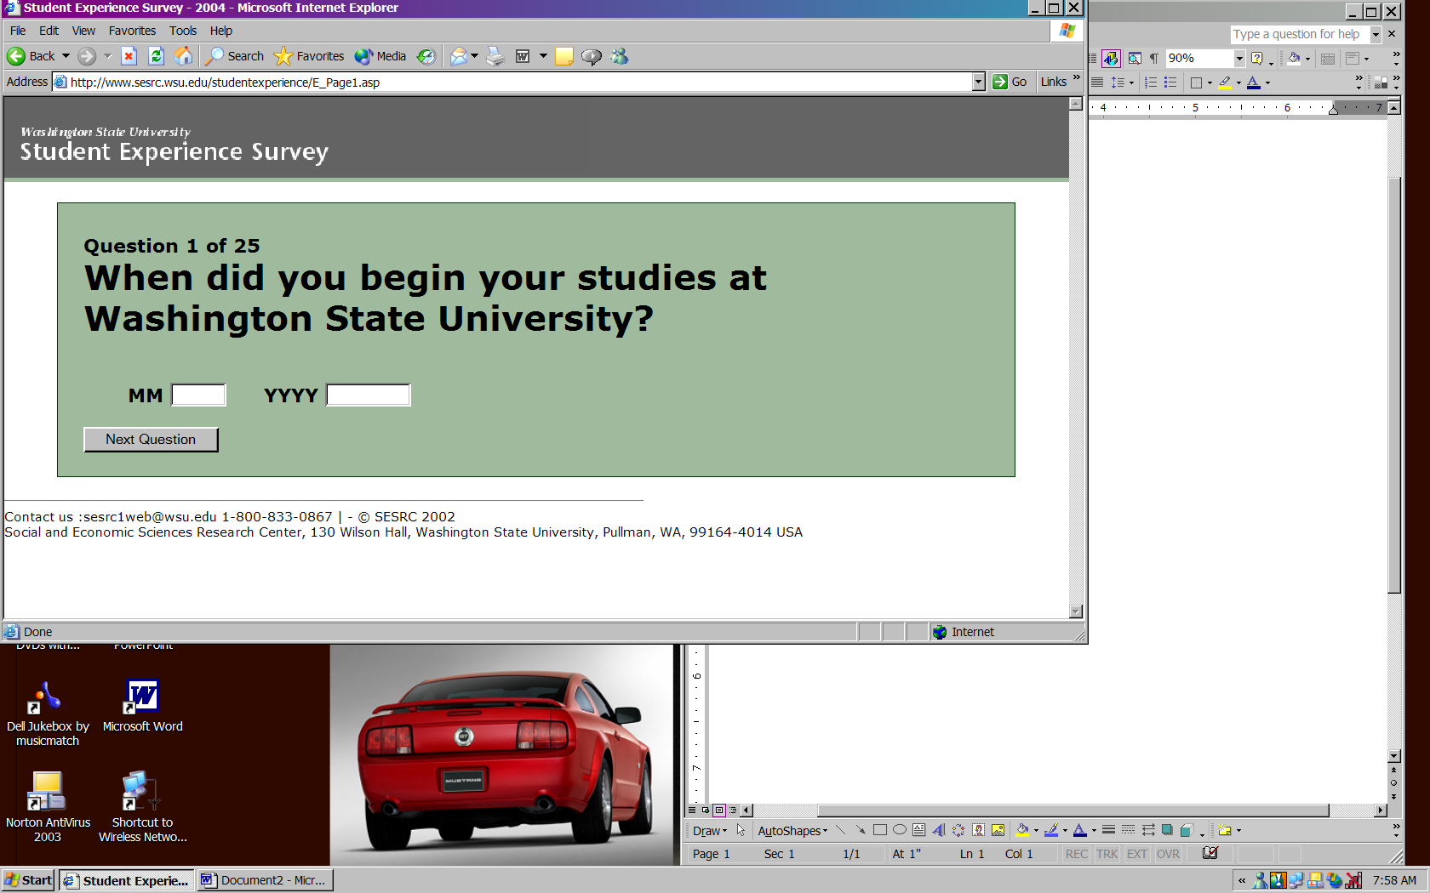
Summary of Experimental Results
Survey #1
#1
#2
#2
#1
#1
#3
0
50
100

Slide 20
Change 3. Unified mode construction needs to replace maximizing question design for each mode.
There are two major sources of measurement differences between modes: wording and question structure.
In single mode studies, we maximized BOTH for each mode.
Examples:
  Check-all that apply (mail and web) vs. forced individual choices (telephone)
  Withheld categories (e.g. no opinion)
  Grids on mail and laptops vs. individual items on smartphones.
  Long fully labeled scales (interviews) vs. short scales (smartphones)
  Drop down menus (web) vs. full display of choices (mail)
Increasingly, we need to build same structures and wording across modes and evaluate to find the most adequate. Smartphones will drive this.

Slide 21
Change 4. Evaluation needs to be from a motivational as well as cognitive perspective
Another big difference between interviews and self-administration of web and mail is motivation has to be built into our questionnaires.
Traditionally, motivation was left to the interviewer and the training they received.
Motivation can stem from questionnaire content, question wording, question order, visual layout, clarity of navigational path, etc.

Slide 22
Change 5. Communications designed to secure responses need to be included in our question evaluation processes
One of the biggest differences the web-push era brings with it is that we are able to use multiple contacts, often by different modes.
That improves response rates by legitimizing studies, and provides the opportunity to tailor follow-up efforts to under-represented groups.
It also raises the question about how these multiple contacts influence answers to individual questions.

Slide 23
Conclusion
The survey design era we now live in is quite different from the one that persisted for QDET1.
We need to think in quite different ways about questionnaire design and testing that mostly existed in 2002.
  Issue 1. A greater focus on measurement differences across modes.
  Issue 2. Evaluation of more than question wording.
  Issue 3. Giving attention to unified mode construction instead of maximizing design for individual modes.
  Issue 4. Motivational as well as cognitive evaluation
  Issue 5.A focus on communications designed to secure responses as part of our questionnaire evaluation process.
Thank you! For questions or comments contact, dillman@wsu.edu

Slide 24
Selected References
Dillman, Don A. and Cleo D. Redline. 2004. "Testing Paper Self-Administered Questionnaires: Cognitive Interview and Field Test Comparisons." In Presser, Stanley et al. (eds.), Methods for Testing and Evaluating Survey Questionnaires. New York : Wiley-Interscience. Pp.299-317.
Dillman, Don A. Forthcoming. Promises and Perils of Pushing Respondents to the web in mixed-mode surveys. Survey Methodology.
Dillman, Don A. Hao, Feng, and Edwards, Michelle. In Press. Improving the effectiveness of online data collection by mixing survey modes. Firelding et al. Online Research Methods. Sage publications.
Dillman, Don A. Jolene D. Smyth and Leah Melani Christian. 2014 Internet, Phone, Mail and Mixed-Mode Surveys: The Tailored Design Method, 4th edition. John Wiley: Hoboken, NJ
Christian, Leah Melani, Don A./ Dillman and Jolene D. Smyth. 2007. “Helping Respondents Get it Right the First Time: The influence of words, symbols, and Graphics in web surveys. Public opinion Quarterly 71(1):113-125.

