Slide 1
Dynamic Question Ordering in Online Surveys
Kirstin Early, Jennifer Mankoff, Stephen Fienberg
Carnegie Mellon University
Notes:
What is meant by ‘dynamic’: Personalize question order to the individual
Use previously-provided information to determine what question is best to ask next—previously-information could be already-given answers or paradata
Burden: question-specific
Going to talk about a general framework that trades off question utility with question burden and a few applications

Slide 2





Example: Predicting a user’s stress level
$
$$$
$$
$$$
Notes:
Predict user’s stress level at a point in time, to give reminders to help them manage their stress, or just display that information to them
Light sensor—cheap, microphone sensor—more expensive sensor (i.e., greater battery drain)
Ask user about upcoming deadlines or sleep quality—requires interrupting user to ask question, v expensive
But maybe you don’t need to know all of these features to make a good prediction—for example, if you know the person has a deadline that afternoon, it’s not as important to check in on their sleep, bc you can already predict that they’re stressed

Slide 3
Personalizing question order can…
Lower costs
  If not all questions need to be asked,
  most useful ones can be asked upfront
Improve outcomes
  Predictions
  Imputations
Engage respondents
  Increase response rates

Slide 4
Background: Machine learning
Test-time feature acquisition
  Learning sequences of features to acquire:
  Strubell 2015, Xu 2014
    Determine cost and order at training time;
    number of features at test time
  Markov decision process:
  He 2012, Weiss 2013, Samadi 2015, Shi 2015
    Determine cost at training time;
    number of features and order at test time
  At test time, use feature’s impact on prediction:
  Pattuk 2015, Early 2016
    Determine cost, number of features, and order at test time
Notes:
Prediction: have model, want to make prediction on new test point; not all features are available, but can acquire add’l ones, at cost
Cost+order at training; # at test: learning sequences of features to add
Strubell15: learn ordering of features with prefix scores
Xu14: classifier cascades and trees
Cost at training; #+order at test:
He12,13; Samadi15; Shi15; Weiss13: MDP: set of features acquired thus far are states, decision of which feature to acquire next as action, reward function reflects how much the next feature improves the prediction (potentially with a penalty on feature cost). They then learn a policy that chooses which action to take based on the current state, from training data
Cost+#+order at test:
Pattuk15: use feature increase in prediction certainty to select next feature, as long as its inclusion doesn’t violate privacy constraint

Slide 5
Background: Survey methodology
Burden
  Subjective: Bradburn 1978, Fricker 2014, Yu 2015
Respondent engagement
  Dropping survey rates: Porter 2004, Shi 2008
  How to motivate people to respond?
    Even in paid surveys, people satisfice: Barge 2012, Kapelner 2010
    Promise personalized feedback: Angelovska 2013
  Paradata can model user engagement: Couper 2010
Adaptive survey design
  Improve survey quality while keeping costs low: Schouten 2013
  Typically changes happen between phases: Groves 2006
Notes:
Burden: subjective, factors include survey length, respondent effort, respondent stress, frequency of interviews. Respondent’s perception of survey affects self-reports of burden. Telling respondents they’ve been screened into longer survey leads to those respondents’ reporting higher burden than those who weren’t told (Yu, Fricker, Kopp 2015)
Engagement: survey rates dropping; even in paid surveys respondents exhibit satisficing behavior; incentivizing respondents with personalized feedback can motivate them—e.g., Angelovska and Mavrikiou (2013): questionnaire with feedback on student’s habits; q that promised feedback on student’s procrastination habits had lower dropout rates (response rates were similar); paradata: online examples (time on page, mouse clicks), model user engagement (Couper et al. 2010)
ASD: goal = improve survey quality (usu in terms of higher response rates) by giving respondents custom survey designs (e.g., number of follow-ups). General technique = maximize survey quality while keeping costs below a budget. Usu, changes in survey design happen between phases, so all respondents within a phase get the same protocol (sampling frame, survey mode, measurement conditions)
Adapting question order to an individual respondent can be considered a type of ASD

Slide 6
We developed a general framework for question ordering
Iterative
  Chooses one question at a time
Utility function
  How “useful” is each question?
Cost function
  How “burdensome” is each question?
Notes:
Iterative
Use previously-acquired information to help inform best next question to ask
Don’t always know budget at test time; e.g., don’t know how many questions a respondent will be willing to answer; they could drop out at any point, and we’ll have gotten the most useful information from them

Slide 7
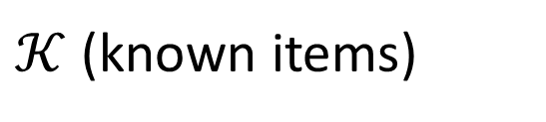
DQO iteratively selects items, trading off utility with cost
Set up: We know a subset of items (green); the rest are unknown (white)
Goal: Choose an unknown item to acquire
$𝒦$ (known items)
···
···

Slide 8
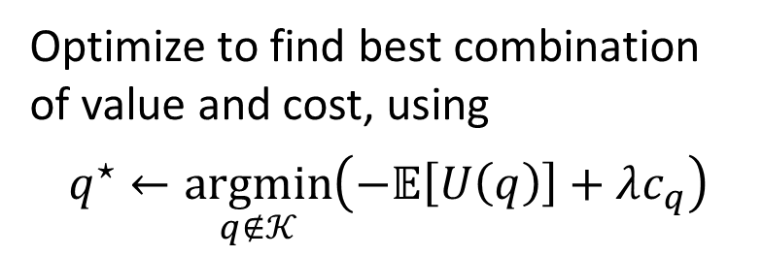


DQO iteratively selects items, trading off utility with cost
$𝒦$ (known items)
q
1
···
···
···
···
···
···
$$𝔼\left[U\left(q\right)\right]$$
2
Optimize to find best combination of value and cost, using
$$q^{⋆}←\underset{q∉𝒦}{argmin}\left(−𝔼\left[U\left(q\right)\right]+λc_{q}\right)$$
Acquire new item
3
···
···

Slide 9
We consider this framework in two general settings
Prediction
  Want to make a prediction on a new test point
    Need to choose which features to acquire
  Don’t need all features to make a good prediction
Survey-taking
  Want to gather information from a respondent
    Need to choose which questions to ask
  Would like to have all answers from respondent
    Model respondent engagement
    to encourage complete response
    Model respondent characterization
    so imputed values are accurate
Notes:
These two categories aren’t necessarily separate—some surveys have a prediction problem (or problems) at their core: e.g., CPS wants to know if respondent is employed, unemployed, or not in the labor force. Over 200 questions are used to assess this.

Slide 10
DQO for prediction
Notes:
Setup: have a predictive model (trained on complete data), want to make a prediction on a new test instance. Here, the items to acquire are features, and they can be acquired, at various costs, from a user, a system, or some other information provider.

Slide 11
The utility function can reflect how a feature influences prediction quality
Prediction error
Prediction certainty
  Regression: Prediction interval width
    Narrower prediction interval == more certain
  Classification: Distance from decision boundary
    Farther from decision boundary == more certain
Notes:
We optimize for prediction certainty in each of our validation datasets due to past work demonstrating the importance of providing people with certainty/confidence of predictions to help them make decisions
Narrower PI == more certain prediction
Farther from decision boundary == more certain prediction

Slide 12
Our three validation applications illustrate different aspects of DQO
Energy estimates for prospective tenants
  Dataset: Residential Energy Consumption Survey (RECS)
  Regression: Uncertainty = prediction interval width
  Cost: User burden
Stress prediction in college students
  Dataset: StudentLife
  Regression: Uncertainty = prediction interval width
  Cost: Battery drain, user burden
    Includes context-dependent costs
Device identification for mobile interactions
  Dataset: Snap-To-It
  Classification: Uncertainty = class probability
  Cost: Computation time, user burden

Slide 13
We compare DQO to a fixed-order baseline
Fixed-order baseline acquires features in the same order,
for all test instances
  Acquires features in the order of forward selection on the training data

Slide 14
DQO yields lower costs than and similar prediction quality as baseline
DQO
DQO
DQO
Notes:
Fix lambda = 0.001

Slide 15
DQO for surveys

Slide 16
Large-scale surveys are complicated
Multi-purpose
Different designs
  One-time vs. longitudinal
    ACS: One-time
    SIPP: Yearly, for 4 years
    CPS: In 4 months, out 8 months, in 4 months
  Sample unit
    ACS: Household
    SIPP: Household/person
    CPS: Housing unit
Notes:
CHALLENGES
One survey can have multiple purposes, for multiple stakeholders. E.g., the American Community Survey collects a broad range of information on the population that is used by government policymakers to distribute funds, by state/local planners to decide where to take action (e.g., add schools and roads), by businesses to make decisions on marketing and expansions, etc…
Different surveys have different designs, in terms of samples, frequency, etc.
Sample unit: individual or household; housing unit (e.g., CPS)
Frequency: one-time or multiple? E.g., a home is surveyed at most once in the ACS timeframe of one year. The SIPP is a multi-wave survey in which households are contacted yearly for four years; CPS design: housing unit is interviewed for four months, out for eight, then back in for four—this design adds stability to the estimates, month-to-month and year-to-year

Slide 17
Including insights from cognitive survey research
Cognitive burden
  Easier for people to answer related questions once a concept is loaded into their mind
Order effects
  Order in which questions are asked can affect respondent’s interpretation and answer
Notes:
Example: commute questions in ACS
Consider questions in sets rather than individually
Example: hispanic origin + race
Constrain order—could be incorporated as context-dependent costs, where cost of a dependent question is infinite when its prerequisite question(s) haven’t been asked yet

Slide 18
A case study in DQO on SIPP
Use participation in food stamps as prediction to guide question ordering
Similar approach as previous section

Slide 19
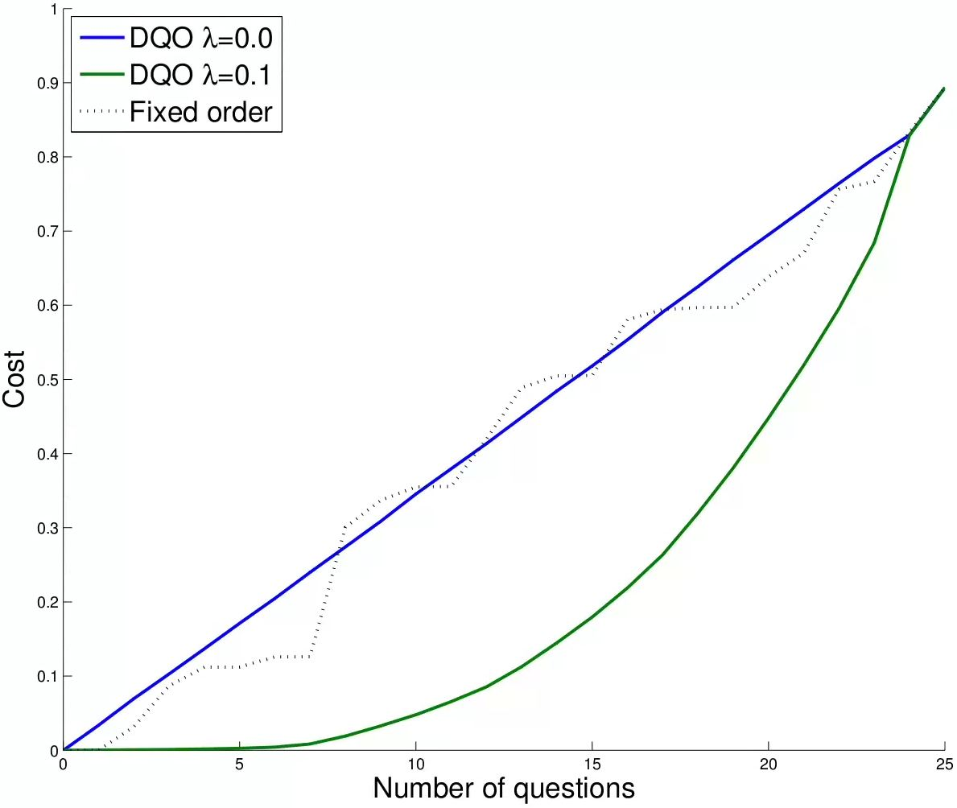
Dynamically-ordered questions yield lower cost than fixed order baseline

Slide 20
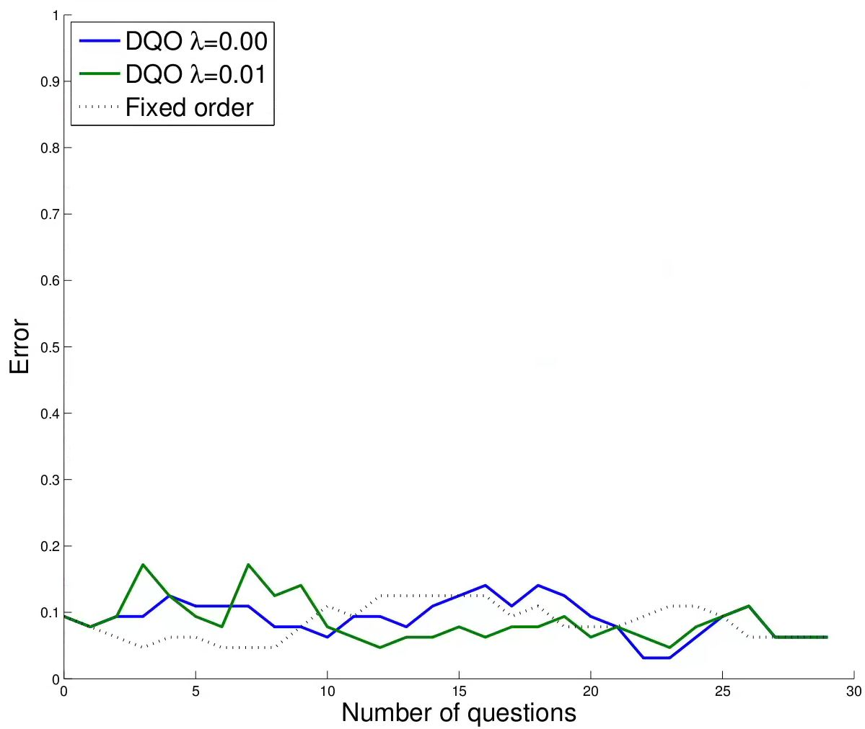
…and similar accuracy

Slide 21
The DQO framework is general
Two components to question selection rule
  Utility function
  Cost function
So far we have applied the framework to several applications focused on prediction, yielding similar-quality predictions at lower costs than fixed-order baselines
Notes:
In conclusion…
Utility and cost can be defined however makes sense for the problem
Future work in engaging respondents and improving imputation

Slide 22
Future work
Using paradata to model respondent engagement and ordering questions to encourage complete response
Considering the impact of future questions on population-level estimates
Switching between types of questions
Notes:
First two: about changing utility function
Final: e.g., ask someone income; if they don’t respond, ask for income category (can get coarser and coarser)

Slide 23


Dynamic Question Ordering in Online Surveys
Kirstin Early
kearly@cs.cmu.edu
www.cs.cmu.edu/~kearly

Slide 24
References
Angelovska, J., & Mavrikiou, P. M. (2013). Can creative web survey questionnaire design improve the response quality? University of Amsterdam, AIAS Working Paper, 131.
Bradburn, N. (1978). Respondent burden. Health Survey Research Methods, DHEW Publication No.(PHS), 79 (3207), 49.
Calinescu, M., Bhulai, S., & Schouten, B. (2013). Optimal resource allocation in survey designs. Eur. J of Operational Research, 226 (1), 115-121.
Couper, M. P., Alexander, G. L., Maddy, N., Zhang, N., Nowak, M. A., McClure, J. B., . . . others (2010). Engagement and retention: Measuring breadth and depth of participant use of an online intervention. Journal of Medical Internet Research, 12 (4), e52.
Early, K., Fienberg, S., & Mankoff, J. (2016). Test-time feature ordering with FOCUS: Interactive predictions with minimal user burden. In Proceedings of the 2016 ACM International Joint Conference on Pervasive and Ubiquitous Computing, 992-1003.
Early, K., Mankoff, J., & Fienberg, S. (2016). Dynamic question ordering in online surveys. Journal of Official Statistics (in submission).
Fricker, S., Yan, T., & Tsai, S. (2014). Response burden: What predicts it and who is burdened out. In JSM proceedings (pp. 4568-4577).
Groves, R. M., & Heeringa, S. G. (2006). Responsive design for household surveys: Tools for actively controlling survey errors and costs. Journal of the Royal Statistical Society: Series A (Statistics in Society), 169 (3), 439-457.
Horwitz, R., Tancreto, J., Zelenak, M. F., & Davis, M. (2012). Data quality assessment of the American Community Survey internet response data.
Pattuk, E., Kantarcioglu, M., Ulusoy, H., & Malin, B. (2015). Privacy-aware dynamic feature selection. In 2015 IEEE 31st international conference on data engineering (pp. 78-88).
Samadi, M., Talukdar, P., Veloso, M., & Mitchell, T. (2015). AskWorld: Budget-sensitive query evaluation for knowledge-on-demand. In Proceedings of the 24th International Conference on Artificial Intelligence (pp. 837-843).
Schouten, B., Calinescu, M., & Luiten, A. (2013). Optimizing quality of response through ASD. Survey Methodology, 39 (1), 29-58.
Shi, T., Steinhardt, J., & Liang, P. (2015). Learning where to sample in structured prediction. In AISTATS (pp. 875-884).
Strubell, E., Vilnis, L., Silverstein, K., & McCallum, A. (2015). Learning dynamic feature selection for fast sequential prediction. arXiv:1505.06169.
Weiss, D. J., & Taskar, B. (2013). Learning adaptive value of information for structured prediction. In Advances in neural information processing systems (pp. 953{961).
Xu, Z. E., Kusner, M. J., Weinberger, K. Q., Chen, M., & Chapelle, O. (2014). Classier cascades and trees for minimizing feature evaluation cost. Journal of Machine Learning Research, 15 (1), 2113-2144.
Yu, E. C., Fricker, S., & Kopp, B. (2015). Can survey instructions relieve respondent burden? In AAPOR.

