Slide 1
Streamlining the Edit Review Process: Using Programming to Reduce Time Cost
Richard Windle
Board of Governors of the Federal Reserve System
The Editor Assistant (EA) user interface for the Survey of Consumer Finances (SCF) reflects input from many past and current members of the Microeconomic Surveys section at the Federal Reserve Board, but especially Jesse Bricker, Kevin Moore, and John Sabelhaus. The analysis and conclusions set forth are those of the author and do not indicate concurrence by other members of the research staff or the Board of Governors.
Notes:
Good afternoon, everyone. Today I’ll be talking to you about how a Comprehensive Program Interface can reduce the time cost of survey data editing. In particular, I’ll be discussing how the implementation of such a system affected data editing for the 2013 Survey of Consumer Finances, with an update on the system’s ongoing performance for the 2016 survey, currently in the field. For those of you who are unfamiliar, the SCF is a nationwide household finance survey conducted in the United states every three years. It gathers data on household balance sheets, income, and demographics.

Slide 2
Why Edit Survey Data?
Impossible to account for all possible question interpretations and financial situations
  Interviewer comments and field notes can be used to explain circumstances and misunderstandings
Correct data inconsistencies
  Related concepts appear in multiple survey sections, and answers sometimes disagree
Notes:
The first question you might have is: why Edit survey data? Well, there are two main reasons. First, it’s impossible…
So, we give interviewers the option to make comments on all questions answered. This allows interviewers to explain unusual circumstances and misunderstandings experienced by the respondent.
The second reason is to correct…

Slide 3
Effect on the Data
  10 percent of the data are edited
Details in Bricker, Moore, & Windle (2014)
Editing:
  Reduces measurement error
  Makes it cost effective to represent entire population with a relatively small sample
Notes:
You might be wondering: How does this editing affect the data? Well, overall, about 10 percent of the data have been edited in previous surveys. For more details, please see Bricker, Moore and Windle. And since edits are only made when they improve data quality, you can see that the benefits to the SCF data from editing in the past are exceptional…

Slide 4
Challenges of Data Editing
High time cost
  Board and users want public data release ASAP
  Time required to perform editing is significant (14 months in years prior to 2013)
Using multiple Editors can affect data consistency
  Accounted for with extensive training
Notes:
But these benefits do come at a cost. Let’s take a quick look at some of the main challenges of data editing. The first is a high time cost.

Slide 5
A Comprehensive Program Interface Addresses Both of These
Saves time
  Small time-saving measures over thousands of cases add up to big reductions in time cost
  Reduces the amount of time required for effective training
Increases consistency
  Encapsulate accumulated knowledge
  Include forms for complex edits and reference materials to aid in making consistent decisions
Notes:
Both of these Data Editing Challenges can be better met by using a Comprehensive Program Interface. That is, a program which brings together the survey data, comments, summary statistics, and edit code generating software into one, quick and easy-to-use dashboard.
First, it saves time by implementing dozens of small, time-saving measures, which when added up over thousands of cases create a significant impact. Also, by making editing easier and clearer, it reduces the amount of time required for effective training.
Second, it increases consistency by…

Slide 6
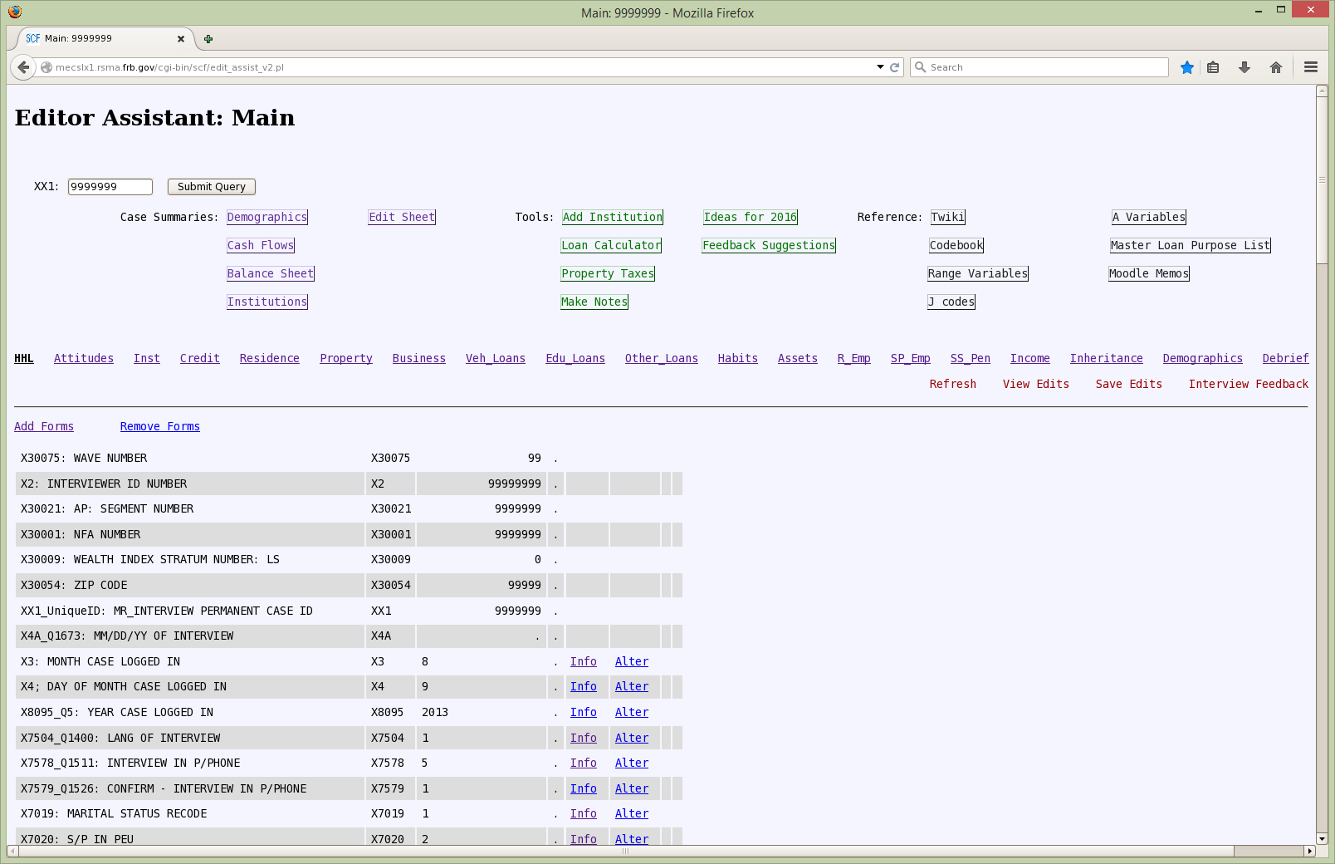
The Editor Assistant (EA) Main Page
Main Interface of the EA program
Notes:
What we ended up with was something that looked like this: a comprehensive interface accessed through an internal web browser. We call it ‘The Editor Assistant.’ Along the top are links to different tools, reference materials, and here at the bottom is the actual data itself, along with links to edit the data.

Slide 7
The Data Editing Process
Pre-Editing Analysis
Editing Survey Data
Analyzing the Effects
Notes:
So now, let me take you through each step of the SCF data editing process, and show you how the EA decreases time cost, while maintaining, or even improving, consistency and data quality.

Slide 8
I. Pre-Editing Analysis
Notes:
After an editor has been trained, they can begin to edit cases. The first step is called pre-editing analysis, which is now conducted by reviewing what we call summary sheets.

Slide 9
Summary Sheet Programs
Difficult to understand cases quickly by looking at a column of data
  Summary sheet programs grab data and calculate statistics about the case
Before the EA, editors created and ran their own summary programs
  This interrupted the flow of editing
Using the EA, standardized programs are run by clicking a button
  EA alters and runs the program automatically
  Consistency increases since all editors are now using the same programs
Notes:
You see, it’s difficult to understand…

Slide 10
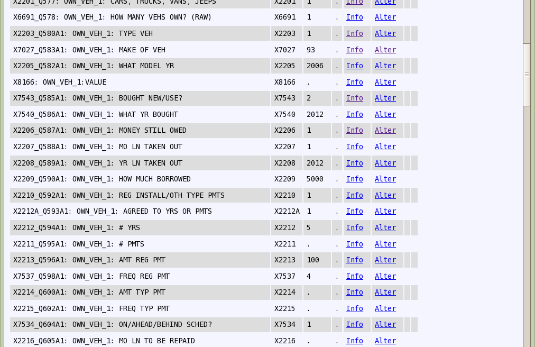
Data
An example of loan data
Notes:
As an example, take a look at this column of data. You can probably understand some of it, but a lot of it is dependent on codes and understanding the variable summaries. But after a summary sheet program has been run, we get output that looks like this…

Slide 11
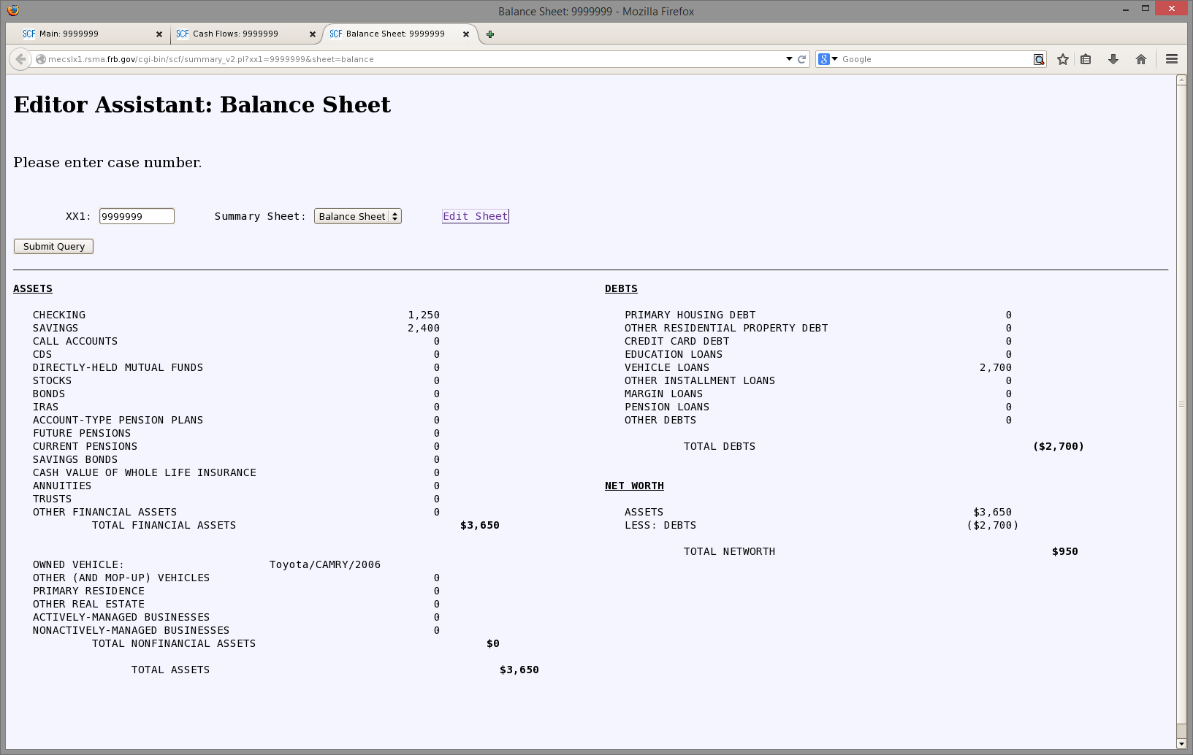
Balance Sheet
Balance sheet of a low income family
Notes:
Now we can see more clearly the state of this household, by examining their balance sheet, which brings together data from multiple sections of the survey to give a clear picture of what’s going on. There are summary sheets for income, demographics, as well as a sheet containing all of the interviewer comments. Again, all of these programs are now available at the click of a button from our main program interface.

Slide 12
Summary Sheets in Action
Respondent lists an Actively-Managed Business Asset in the Balance Sheet Summary
Respondent makes a comment on the Edit Sheet
  “My construction business did really well last year, so our income is unusually high.”
But, Income sheet has no business income for that year, only wage income
This inconsistency tells us it is likely that income was misclassified, and should probably be moved from wages to business income
Notes:
Now let me discuss a couple of examples how these summary sheets can give us quick insight into potential problems for a case. Let’s say…

Slide 13
Summary Sheets in Action
Respondent makes a comment on the Edit Sheet
  “We’re really sad that our daughter is leaving for college soon.”
On the Demographics page, there is no daughter listed
This inconsistency tells us that the household listing is potentially incomplete. It might be required to add the daughter to the listing, since she has not yet left for college
Notes:
For another example, let’s say that a…

Slide 14
II. Editing Survey Data
Notes:
Once an editor has a good idea of a household’s situation, they can then begin going through the data and making edits.

Slide 15
Editing Tools and Reference
Edits can rarely be made automatically
  Similar enough that combining a smart program interface and Editor input can reduce time cost
This is done using tools, such as customized forms with instructions and text boxes
  Adding a checking account requires adding balance and financial institution information
Editors also able to make notes on cases, check loan terms, and easily access reference materials
Everything available with the click of a single button
Notes:
Households are unique enough that edits can rarely be made automatically.

Slide 16
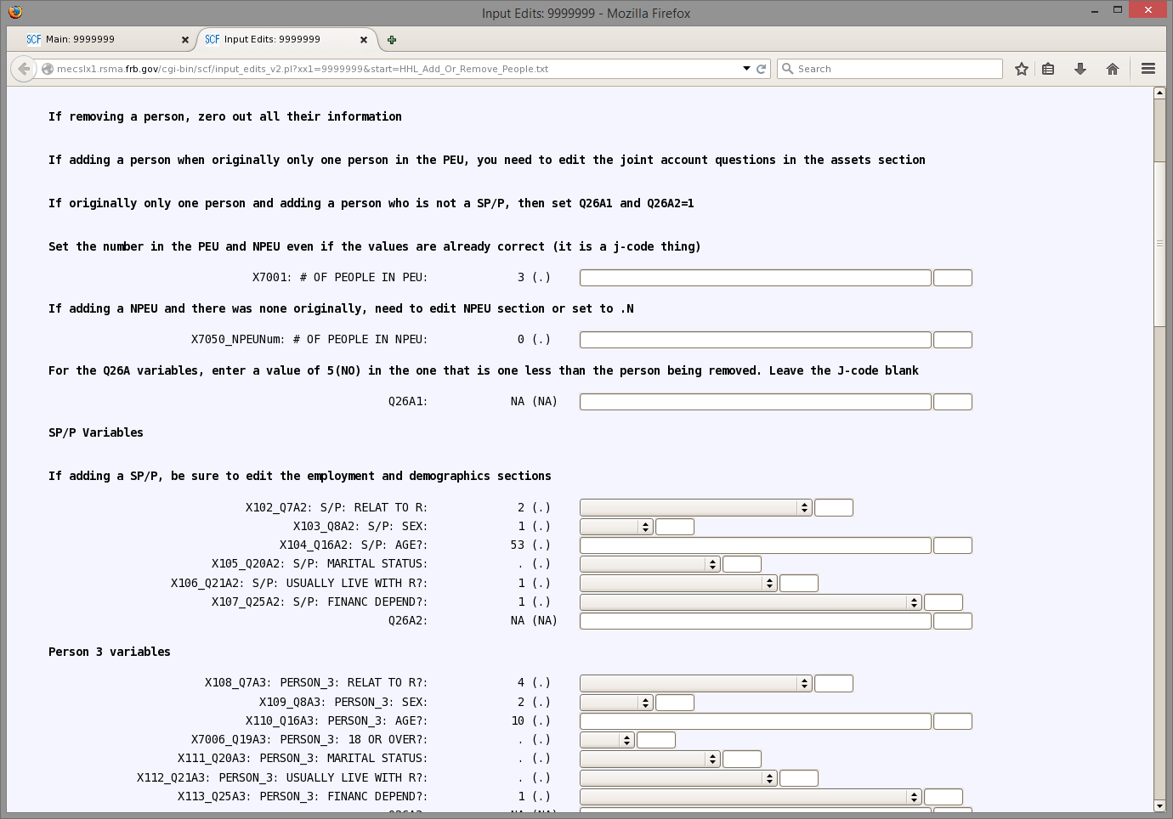
Add or Remove Person Form
Form for adding or removing a person, information that was formerly memorized
Notes:
Here is an example of one of the forms available through the EA. The bold text provides instructions, and the actual data can be added to or changed using these web text boxes and drop down menus. Before the EA, all of this would have to be manually written out, with no specific instruction, only non-specific survey documentation.

Slide 17
III. Analyzing the Effects
Notes:
Once an editor has gone through all the data and made their edits, the next step is to analyze the effect of those edits. How do changes interact with other data collected on the household?

Slide 18
Saving and Error Check Sequence
The Editor clicks a button to run a final review
A table of differences between the pre-edit and post-edit datasets created by the edit code
  Editor verifies that desired changes were accomplished
  Discrepancy => return to edit mode and fix edits
Once satisfied with the results, the final edits are saved by clicking the “Save Edits” button
Notes:
Doing this requires entering what we call the saving and error check sequence.
After last bullet point: This writes out all of the edits in programming language format to be applied to the data later.

Slide 19
Does the Editor Assistant Work?
The Editor Assistant helped reduce post-survey processing time by several months in 2013
Number of checks increased, even as the time to perform checks decreased
  A second round of editor review was formally incorporated
New editors were able to complete as many cases as old editors
  The three new editors required the same amount of time as old editors to complete their case load
2013 SCF | 860 cases/editor | 9 months
2010 SCF | 930 cases/editor | 18 months (due to 2009 panel)
2007 SCF | 900 cases/editor | 14 months
2004 SCF | 900 cases/editor | 14 months
Notes:
So, in summation then, can we say that the Editor Assistant is working? Is it saving us time while maintaining consistency and quality? The answer seems to be yes. As you can see in this table…
To conclude: Using smart programming, it was possible to make survey data editing much more manageable for the SCF. Other surveys have resisted engaging in data editing, but with tools such as a comprehensive programming interface, the costs can be greatly reduced, warranting another look at this practice.
Times for post-survey processing vary due to number of editors and number of cases during each survey year, not to mention the 2009 panel. Getting cases per editor to try and account for this.
2013: 860 cases per editor, ~6000 families, ~7 Editors,
2010: 930 cases per editor, ~6500 families, 7 Editors
2007: 900 cases per editor, ~4500 families, 5 Editors
2004: 900 cases per editor, ~4500 families, 5 Editors
860/900 = X/14
X~13
Given the ratios, we would expect the post-processing time to take about 13 months, holding everything else constant, so we can attribute a ~4 month reduction due to the EA
2013 SCF Bulletin article released in September 2014 (9 months)
2010 SCF Bulletin article released in June 2012 (18 months, higher due to delays related to the 2009 panel)
2007 SCF Bulletin article released in February 2009 (14 months)
2004 SCF Bulletin article released in February 2006 (14 months)

Slide 20
The Editor Assistant in 2016
Currently in the field
Number of editors increased to ten
Additional minor improvements have been made to the EA since 2013
With the increased number of editors, and the efficiencies generated by the EA, editing is no longer the lengthiest portion of the process
  Editors will be fully caught up to the field before the end of the field period
On track to slightly improve upon the time cost reductions in 2013
Notes:
So, in summation then, can we say that the Editor Assistant is working? Is it saving us time while maintaining consistency and quality? The answer seems to be yes. As you can see in this table…
To conclude: Using smart programming, it was possible to make survey data editing much more manageable for the SCF. Other surveys have resisted engaging in data editing, but with tools such as a comprehensive programming interface, the costs can be greatly reduced, warranting another look at this practice.
Times for post-survey processing vary due to number of editors and number of cases during each survey year, not to mention the 2009 panel. Getting cases per editor to try and account for this.
2013: 860 cases per editor, ~6000 families, ~7 Editors,
2010: 930 cases per editor, ~6500 families, 7 Editors
2007: 900 cases per editor, ~4500 families, 5 Editors
2004: 900 cases per editor, ~4500 families, 5 Editors
860/900 = X/14
X~13
Given the ratios, we would expect the post-processing time to take about 13 months, holding everything else constant, so we can attribute a ~4 month reduction due to the EA
2013 SCF Bulletin article released in September 2014 (9 months)
2010 SCF Bulletin article released in June 2012 (18 months, higher due to delays related to the 2009 panel)
2007 SCF Bulletin article released in February 2009 (14 months)
2004 SCF Bulletin article released in February 2006 (14 months)

Slide 21
Questions?
richard.a.windle@frb.gov
Notes:
Thank you.

