Slide 1
Measuring Disability Equality in Europe:
Design and Development of the European Health and Social Integration Survey Questionnaire
Amanda Wilmot, Westat
International Conference on Questionnaire Design, Development, Evaluation and Testing, Miami, Florida, November 10, 2016
Disclaimer: Any opinions expressed in this presentation are those of the presenter and do not represent the European Commission’s official position.

Slide 2
Acknowledgments
European Commission and Eurostat
  sponsored and oversaw the research
Sogeti, Luxembourg
  supported main-stage cross-national administration and data delivery
RTI International, USA
  contributed to cross-national survey quality report
In-country Survey Contractors
  contributed to questionnaire development and survey implementation
Professor Howard Meltzer, University of Leicester, UK
  questionnaire design, development, evaluation and testing

Slide 3
European Union Requirements
The European Union Disability Action Plan (EU DAP) 2004-2010 called for data on the societal integration of people with disabilities using a common survey data collection instrument
Cross-national comparable data were to be produced that could also be aggregated at the EU level
In 2012/13, main-stage survey conducted in 26 Member States, plus Norway and Iceland
Notes:
I’ll start by just providing some background as to how the survey came about.
The European Union Disability Action Plan provided a framework for ensuring that disability issues were considered in all relevant EU policies.
The Action Plan called for statistical data to be produced on the integration of people with disabilities, through the use of a common survey data collection instrument, where cross-national comparable data were to be produced that could also be aggregated at the EU level.
In 2012/13, the main-stage EHSIS was conducted across Europe in 26 Member States as well as Norway and Iceland.
(27 MS at the time – Ireland unable to take part)

Slide 4
A Different Approach to Measuring Disability
A measure of disability based on the biopsychosocial model, introduced by the International Classification
of Functioning, Disability and Health (ICF)
A view of disability as being an interaction between
an individual and the context in which they live - considering both health and social factors
Described as a ‘paradigm shift’ in the way health
and disability are understood and measured
(Kostanjsek, 2011)

Slide 5
Questionnaire Design: Harmonised Inputs
Harmonised inputs provided:
  detailed source questionnaire in English
  accompanying instructions for face-to-face interviewer administration

Slide 6
Questionnaire Design: Operationalising the International Classification of Functioning, Disability and Health (ICF)
Select domains
Map domain concepts to provide a questionnaire framework
Decide on level of detail
Simplify language

Slide 7
Questionnaire design: Classification Reduction
10 life domains selected related to two main themes
of ‘environmental factors’ and ‘participation’:
  Mobility
  Transport
  Accessibility to buildings
  Education and training
  Employment
  Internet
  Social contact and support
  Leisure pursuits
  Economic life
  Attitudes and behaviour of others

Slide 8
Questionnaire Design: Example Barrier Question
EdPrv APPLIES IF: Not currently studying DK/REF allowed . SHOWCARD
[*] Is there anything which prevents you from studying for a qualification at the moment? Please use this card as a guide and choose all that apply. CODE ALL THAT APPLY
01) Financial reasons (lack of money, can’t afford it)
02) Too busy (with work, family, other responsibilities
03) Lack of knowledge or information (about what is available)
04) A longstanding health condition, illness, or disease
05) Longstanding difficulties with basic activities (such as seeing, hearing,
concentrating, moving around)
06) Difficulties getting on a course
07) Difficulties getting to learning facility
08) Difficulties accessing or using buildings
09) Attitude of employer or teacher
10) Lack of self confidence or attitudes of other people
11) Other reasons
12) Don’t want to study for a qualification
13) No, nothing prevents me from studying for a qualification at the moment

Slide 9
Questionnaire Development and Testing: Overview
Source questionnaire in English
Cumulative approach in three waves of testing:
  Wave 1 (2007): 3 MS - United Kingdom, Italy, Lithuania
  Wave 2 (2009/10): 10 MS - Bulgaria, the Czech Republic,
  Estonia, Finland, Greece, Hungary,
  Latvia, Malta, Slovakia, Spain
  Wave 3 (2012/13): All 28 countries implementing main-stage
Changes made to source questionnaire after W1 and W2
Country adaptions after W3
Notes:
So how did we get there. There were in effect 3 waves of testing which were cumulative in that each wave built on the findings from previous waves and the number of countries involved increased. We tried to ensure a good spread of countries based on perceived cultural differences (East/West/ North and South).
Both quantitative and qualitative testing methods were used. Although no one method was given preference, as we considered both to be valid testing methods.
Wave 1 comprised initial testing with 3 Member States. The main objective was to focus more on the functioning of the questionnaire - question wording, formatting and conceptual understanding - rather than to examine specific national issues at this stage.
Wave 2 testing was carried out in 10 Member States, not previously involved. The focus now was more on specific national issues, but still with a view to making changes to the source questionnaire rather than allowing for specific country adaption at this stage.
And prior to field work, all 28 countries conducting the main-stage survey also conducted testing.
The important point to note is that changes and adaptions were made only to the source questionnaire initially. It was only after testing prior to main stage that country specific adaptions were allowed.

Slide 10
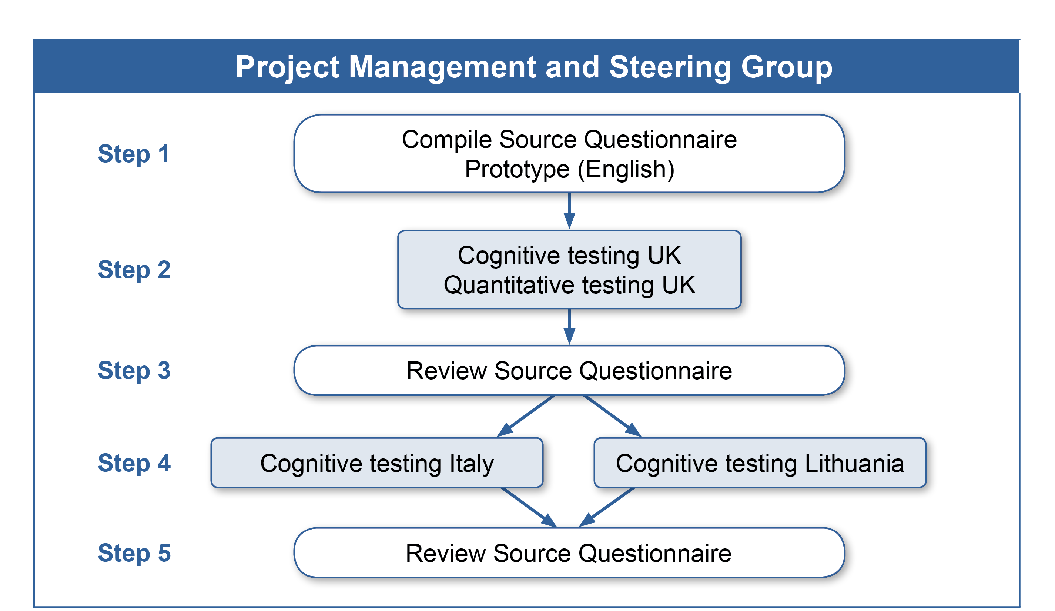
Wave 1: Testing Process

Slide 11
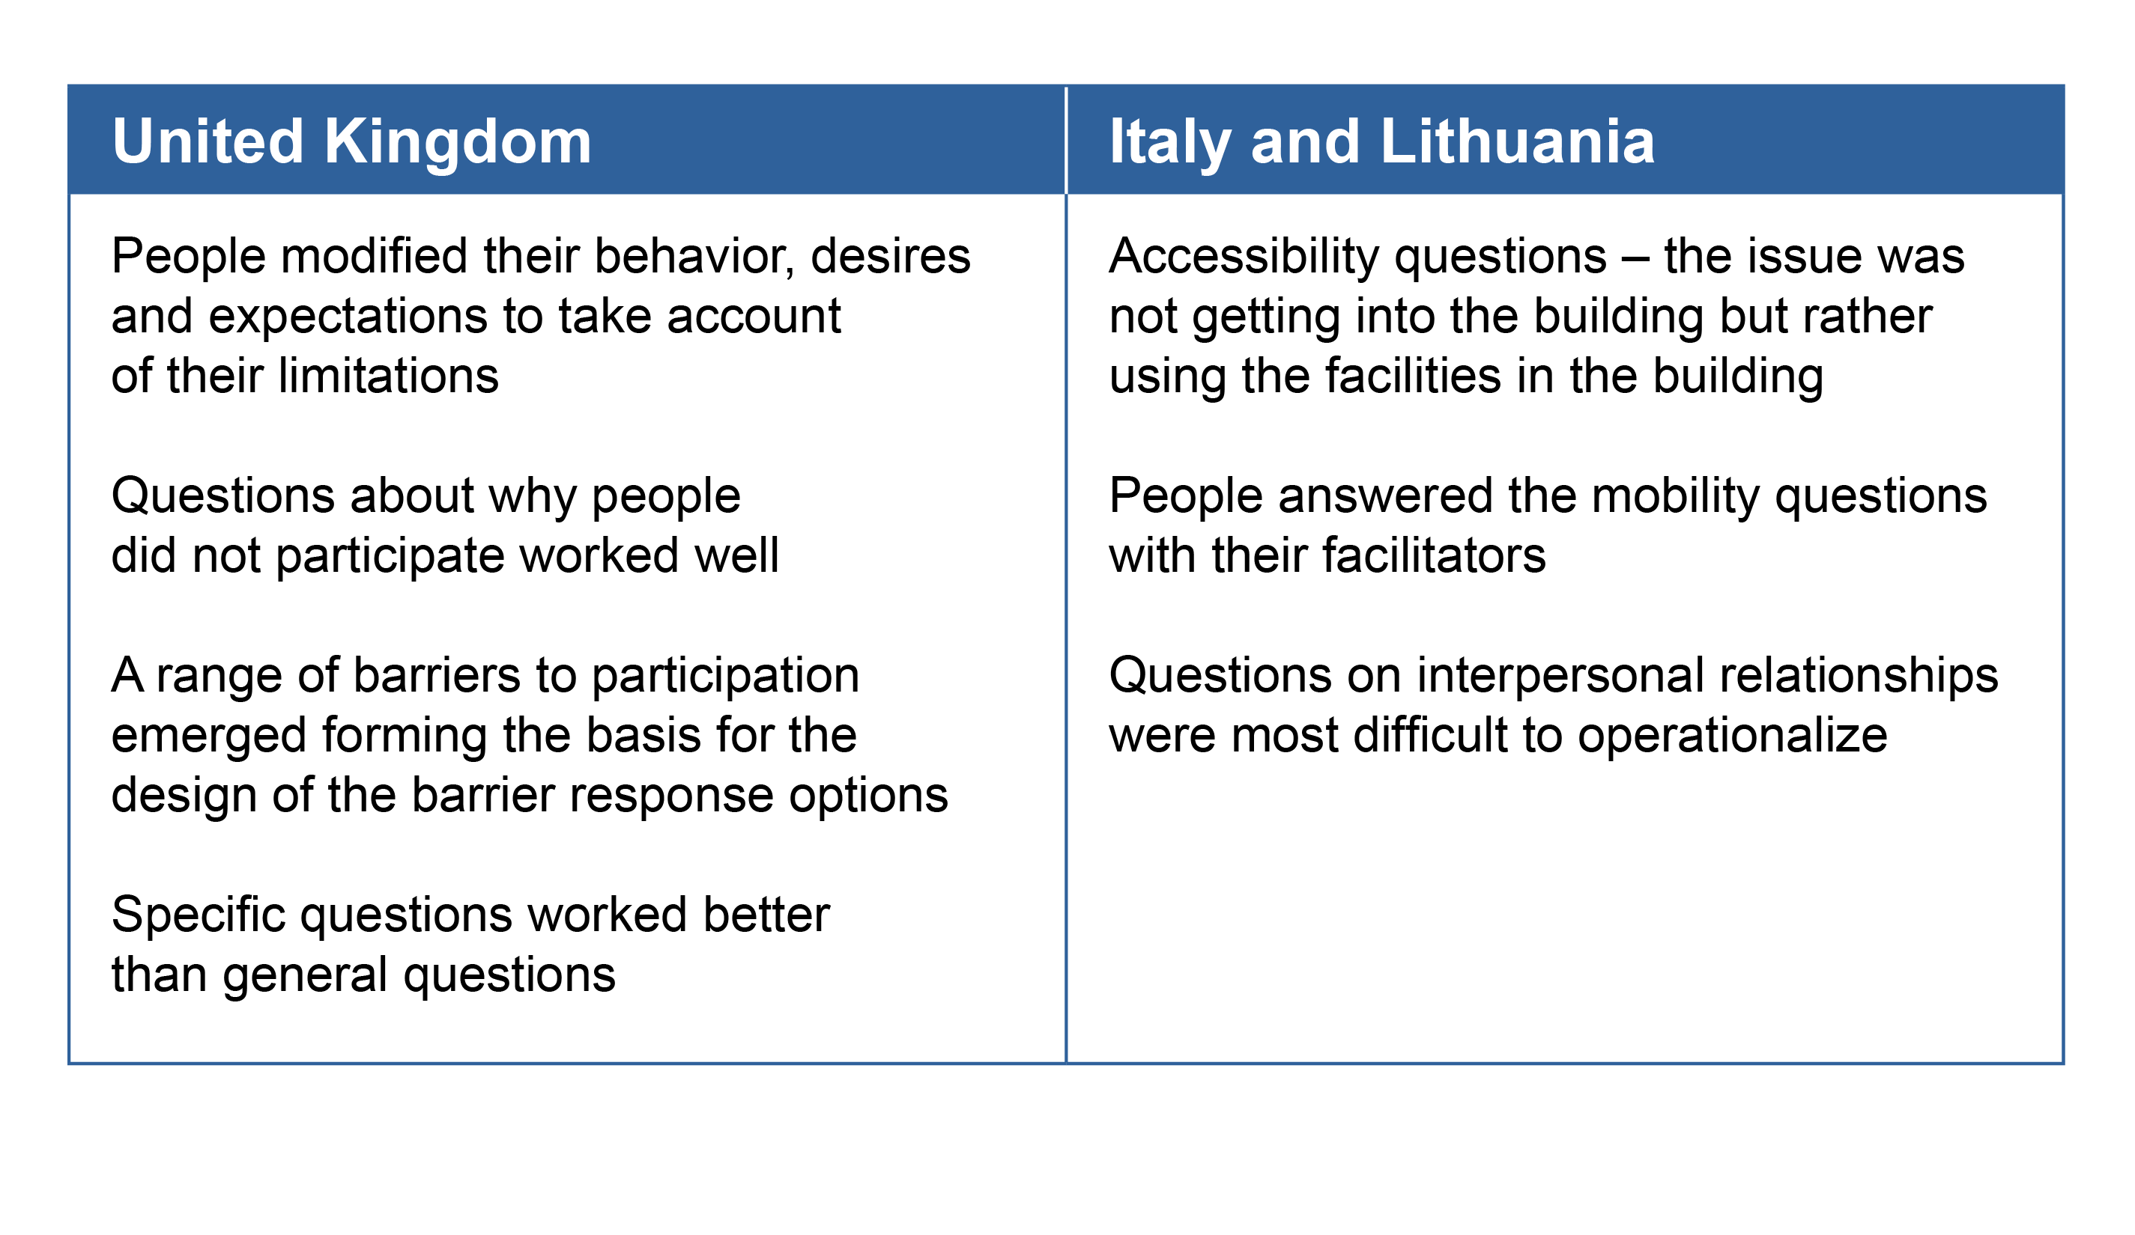
Wave 1: Main Findings

Slide 12
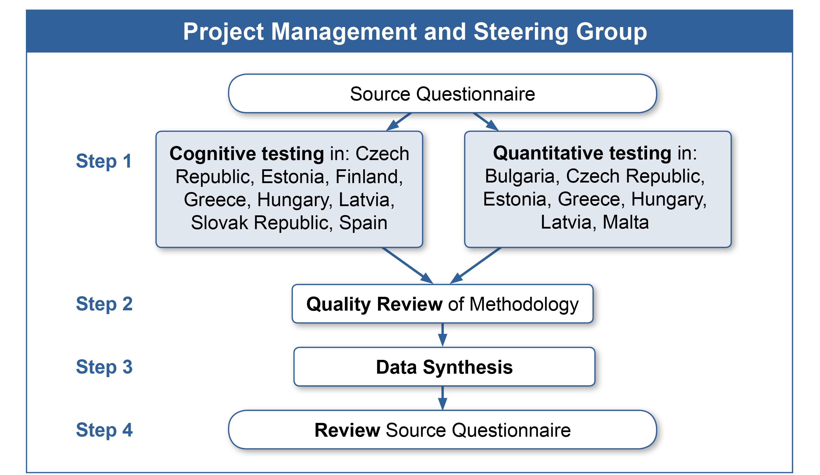
Wave 2: Testing Process

Slide 13
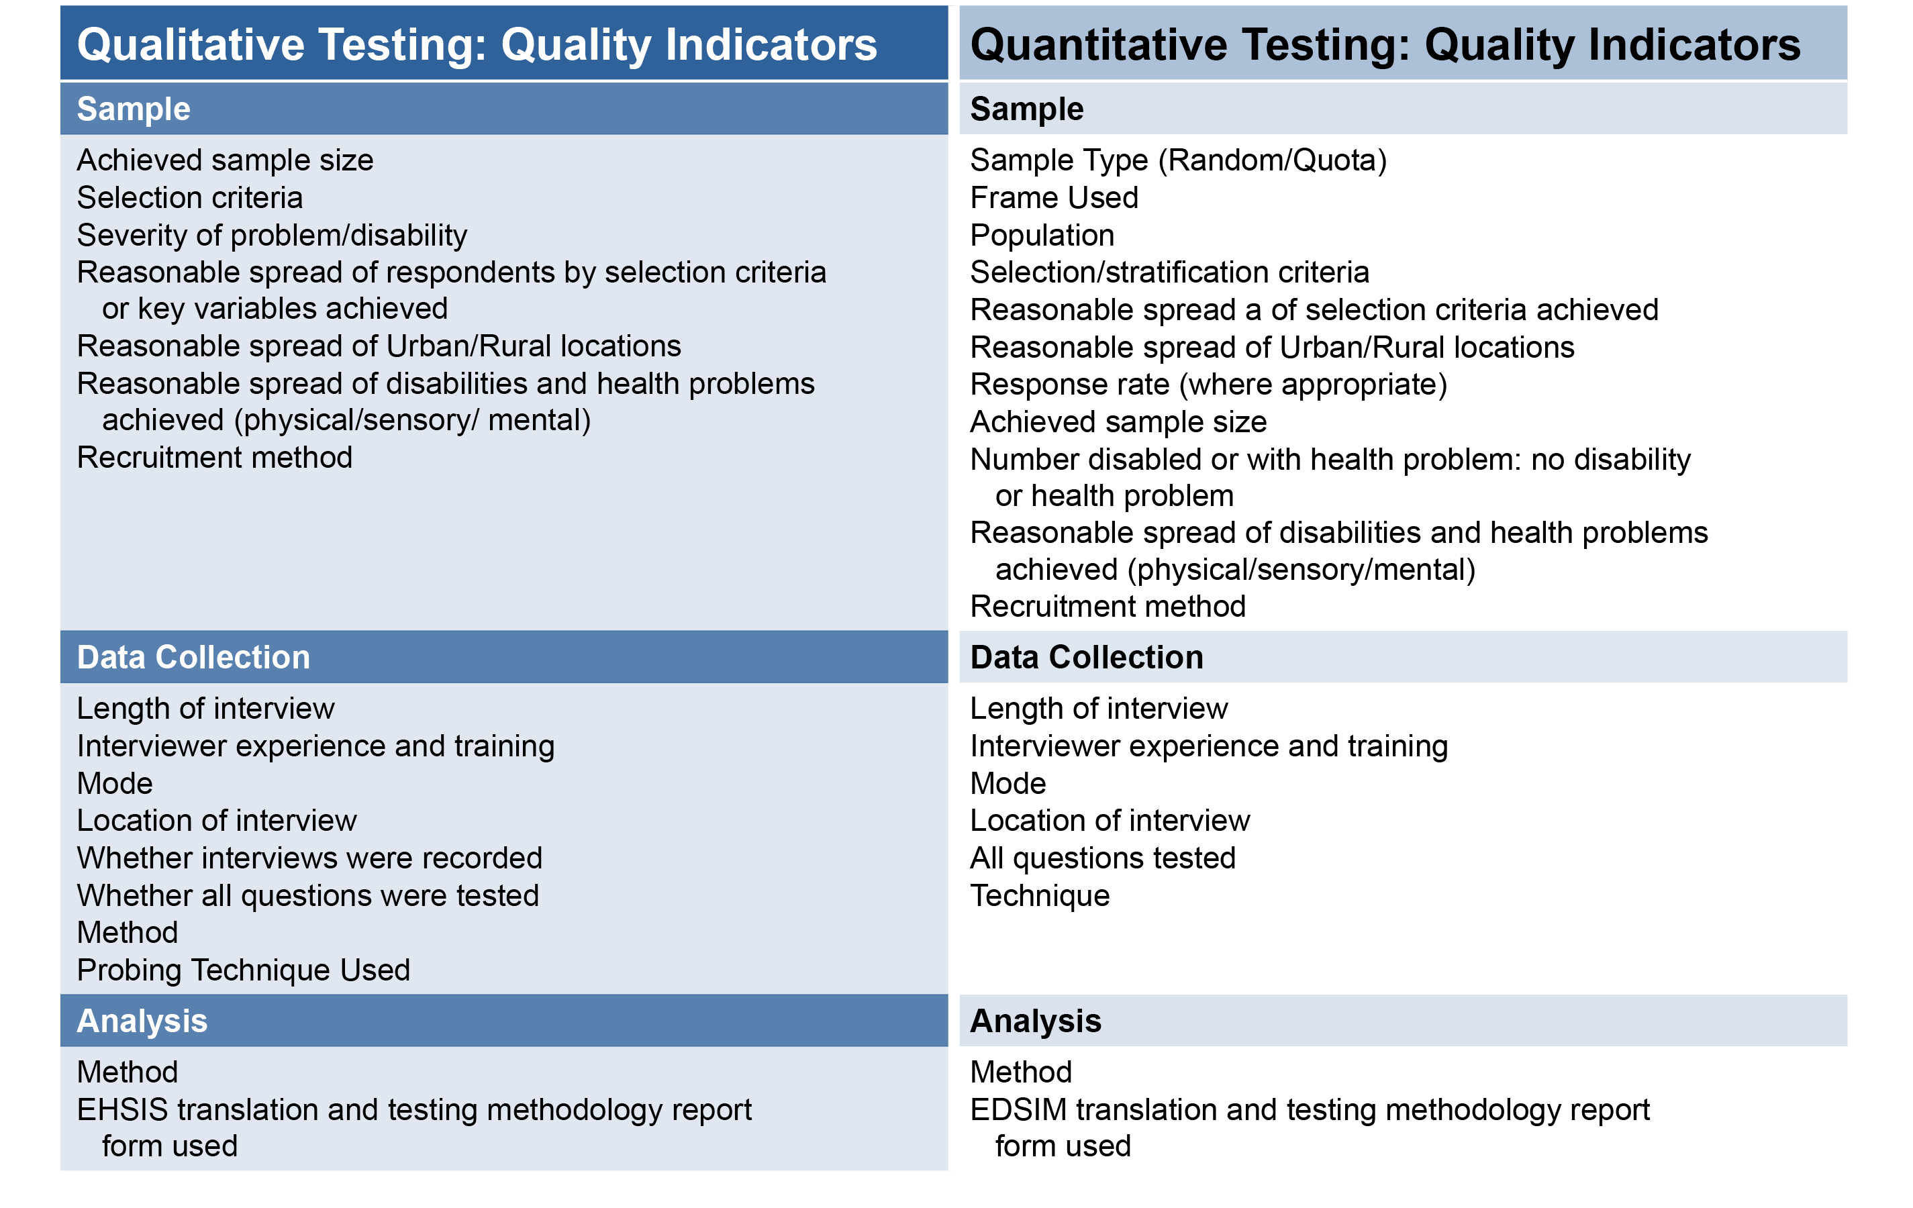
Wave 2: Quality Review

Slide 14
Wave 2: Data Synthesis
Collate all material for each questionnaire section
Examine all comments and recommendations for each question within each section
Produce a data set for cross-national review
Make recommendations for change or adaption to the source questionnaire

Slide 15
Wave 2: Problem Types
Cross-national problems
  Question wording
  Question concept
  Section order
  Section concepts
  Internal harmonisation
Translation issues
  Particular words or phases
  Question structure
Linguistic or cultural differences
  Particular words, phrases and concepts
Notes:
Three types of problems were apparent from the wave 2 testing: <CLICK>
1) Those which I have described as cross-national in nature, where similar problems were raised by a number of different countries. In these circumstances less weight was given to the initial methodological evaluation.
For example, half of the countries taking part reported problems with understanding the question about ‘accessing the Internet for any reason’ . The concept of learning in a group environment was not conveyed well and some section concepts were too broad, for example, the inclusion of both formal and informal education.
Starting the survey with the section about Internet access confused respondents who didn’t really see the relevance to the survey topic.
But the majority of cross-national issues related to the lack of internal harmonization of the barrier questions. This led to us standardizing the format, question stem and response categories throughout. <CLICK>
2) There were some errors made during translation, although surprisingly few, probably due to the fact that most countries adopted the Eurostat translation protocol.
One example was in Greece, where “learning opportunities” was translated into “learning program”, which may have indicated more formal learning than the question originally intended.
And in some cases the question structure did not translate well meaning questions were more cumbersome for interviewers to read out loud in certain languages. <CLICK>
3) linguistic or cultural differences related to particular words or concepts that did not translate well in certain countries, or indeed at all.
It was said that there was no direct Finnish equivalent to the English concept of “making ends meet”; while in some other countries respondents were reluctant to answer “with great difficulty, because they were not able to make ends meet at all. Changes were made to the source questionnaire.
In the Czech Republic the meaning of the response choices “very often” and “quite often” were considered identical. After wave two testing these vague quantifying scales were eliminated from the source questionnaire altogether.
Indeed, the title of the survey, which had originally included the word “disability” was said to have negative connotations in some eastern European countries. This meant that those without impairments were reluctant to take part, leading to a decision to change the survey title.
((The word “access” sometimes taken to mean having the actual equipment to access the Internet.)
(The question was subsequently changed to: “How easy or difficult is it for you to pay for the essential things in life?” with the addition of an introduction that gave examples “…such as food, clothing, medicine, housing and transport

Slide 16
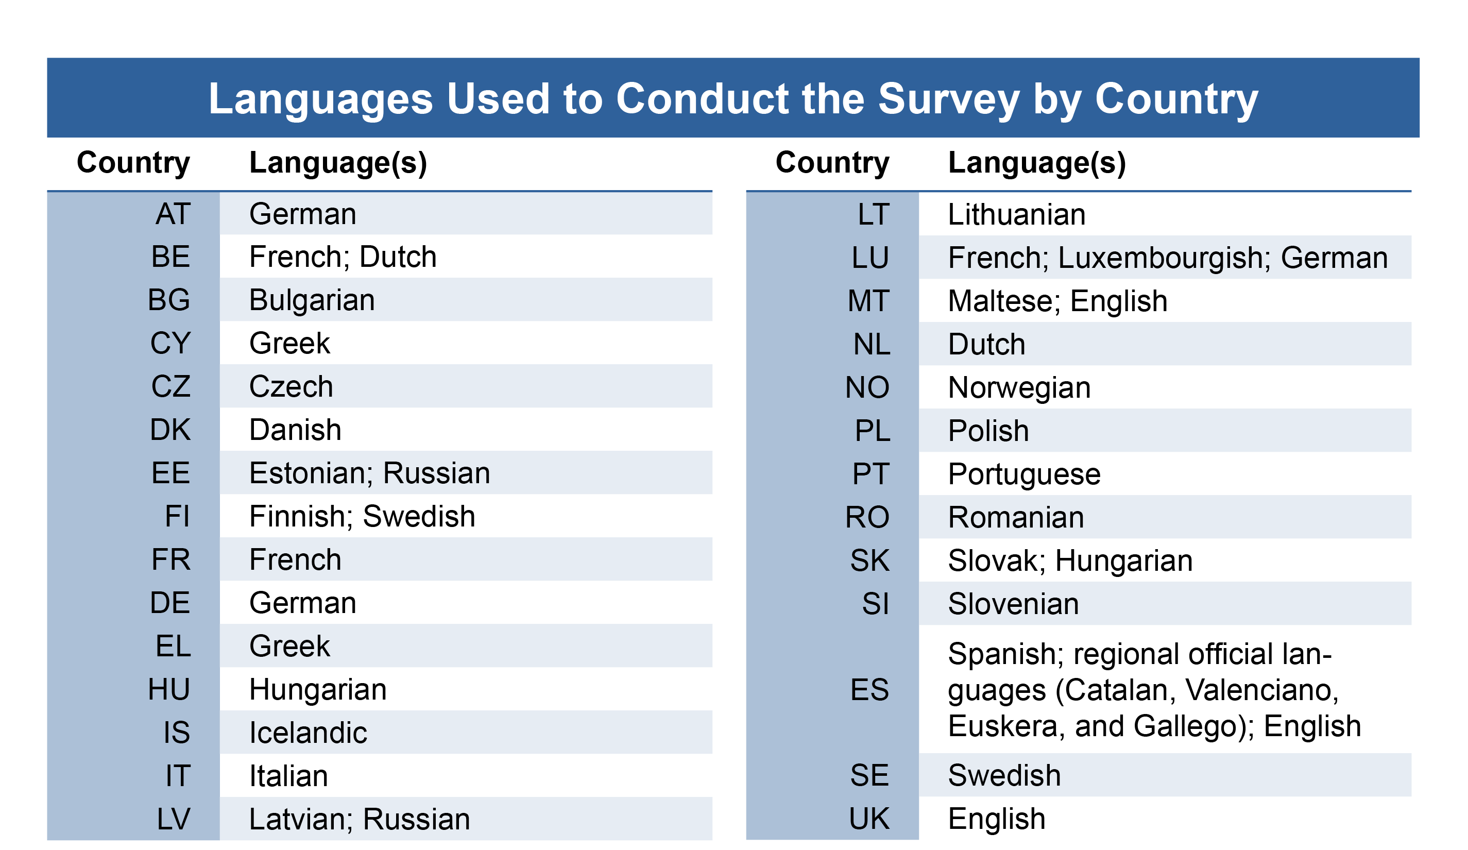
Main Stage: Translation Process
Notes:
This slide shows all of the languages into which the questionnaire was translated. Only two countries deviated from the team-based protocol using back translation.
Each country was required to complete a translation report form detailing problems and proposed solutions.

Slide 17
Main Stage: Testing
Quantitative pilot
  Test programming and supporting systems
Cognitive testing
  Test questionnaire translation

Slide 18
Main Stage: Implementation
Keeping in touch
  Email correspondence
  Frequently asked questions (FAQ) periodically issued

Slide 19
Following Main Stage Implementation
Reporting of unauthorised changes or adaptions
Mode differences: face-to-face, telephone, web
  Impact of reading lists when individually prompted
  in telephone administration

Slide 20
Lessons Learned
Simplicity
  Clearly defined concepts and definitions
  Standard question wording and constructs
Steering group
Translation protocol
Cumulative testing in multiple countries
  Cultural knowledge and understanding
  Time for review and revision of source questionnaire
  All country testing to support questionnaire translation

Slide 21
Lessons Learned (Cont.)
Quality assessment of testing methods used
Input harmonisation incl. written interviewer instructions
Mode of administration
Questionnaire designers involved at main stage fielding
Open lines of communication
Pragmatism

Slide 22
End
Contact: Amanda Wilmot
Email: amandawilmot@westat.com
Phone: (001) 301 610 5541

