Slide 1
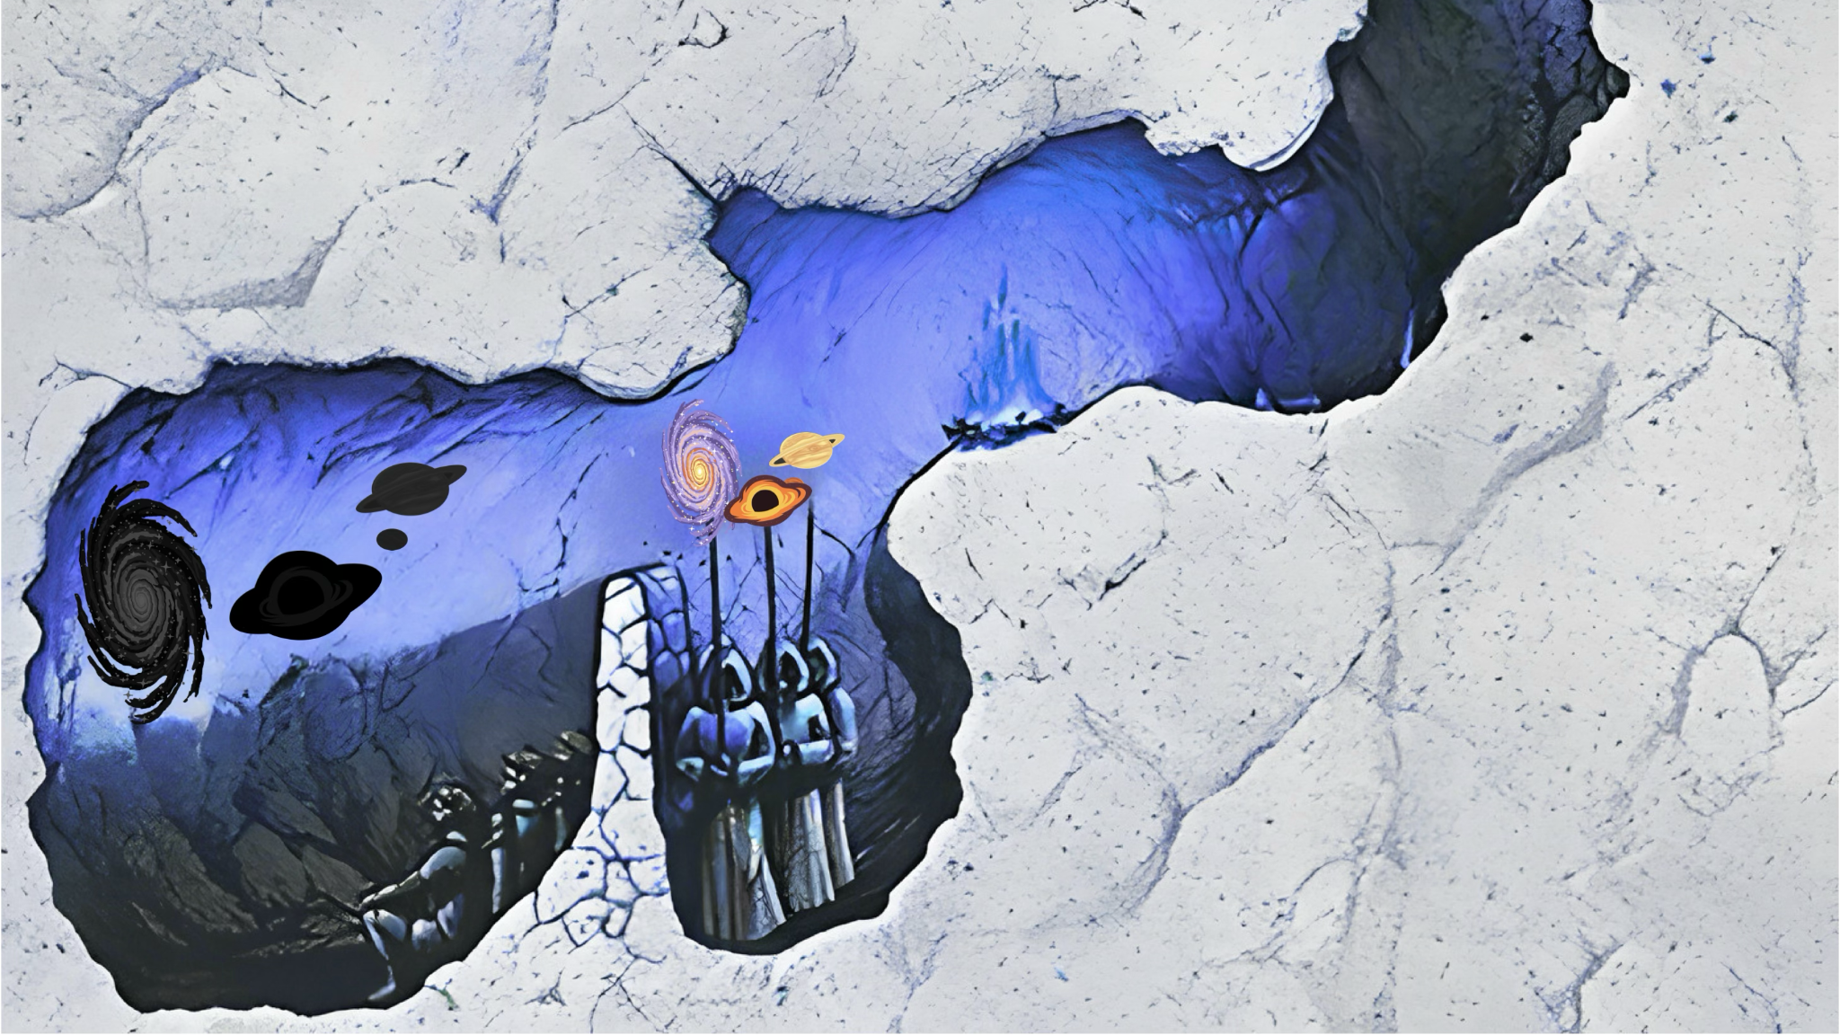

Astronomy from the Machine
Mike Smith
AstroAI, Harvard-Smithsonian Center for Astrophysics

Slide 2
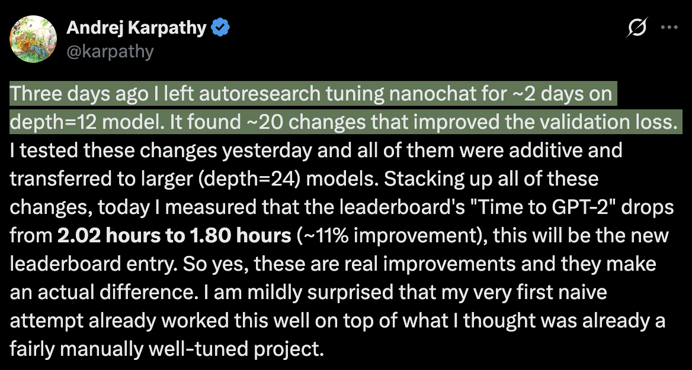

Slide 3
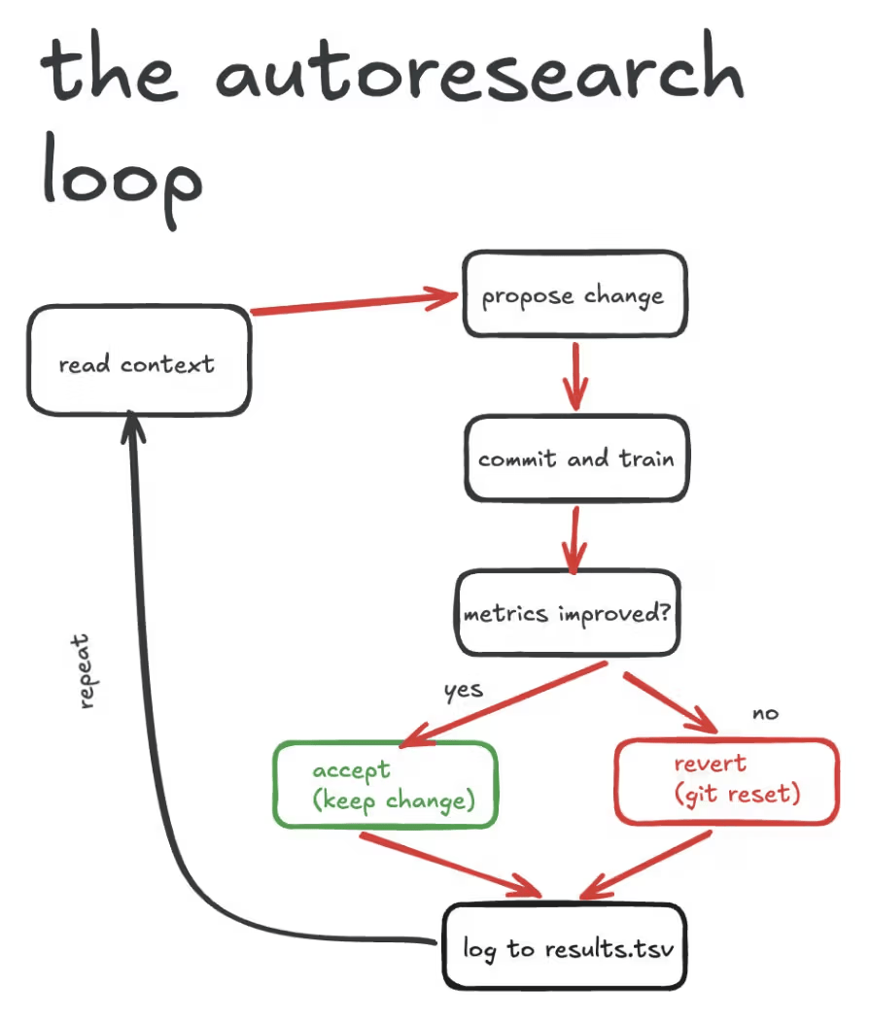
Cerebras 2026

Slide 4
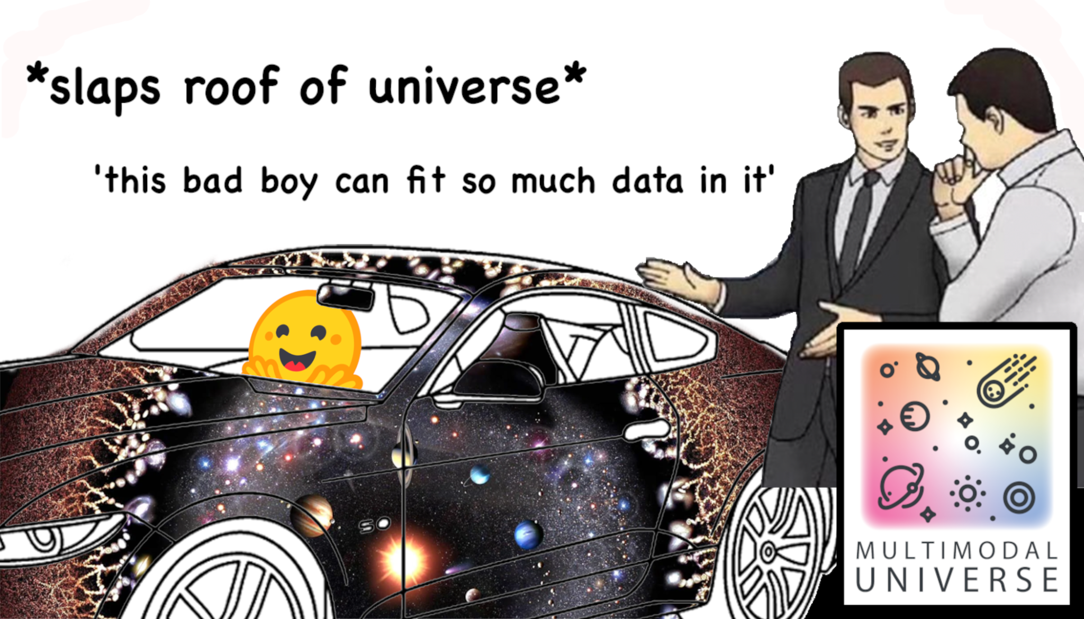
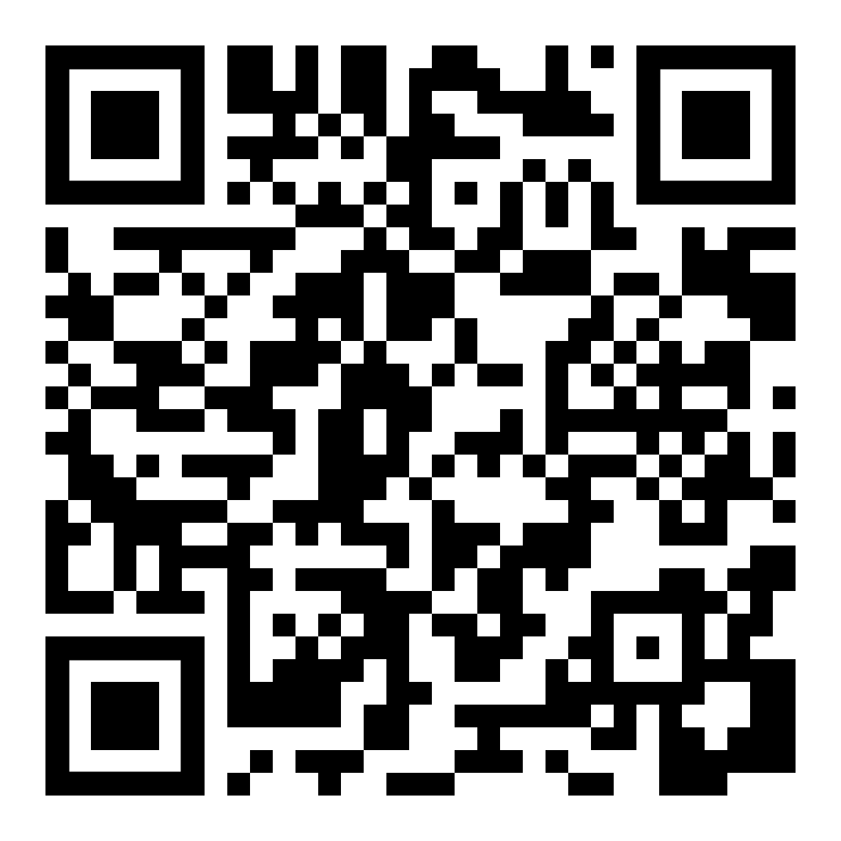
Multimodal Universe x HATS
The MMU is a 80TB dataset of 30+ astronomical modalities that we have newly converted into the HATS dataset format
It contains galaxy postage stamp imagery, spectra, time series, and more
We have uploaded these datasets onto Hugging Face, with cross-matches and raw data now streamable to your laptop
This means you only need ~4GB of RAM to load and crossmatch e.g. DESI spectra and the Legacy Survey

Slide 5
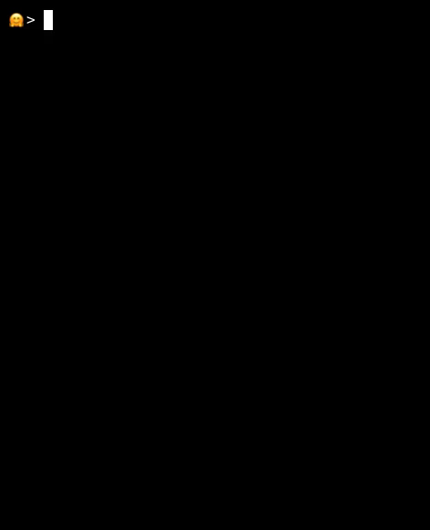

Slide 6
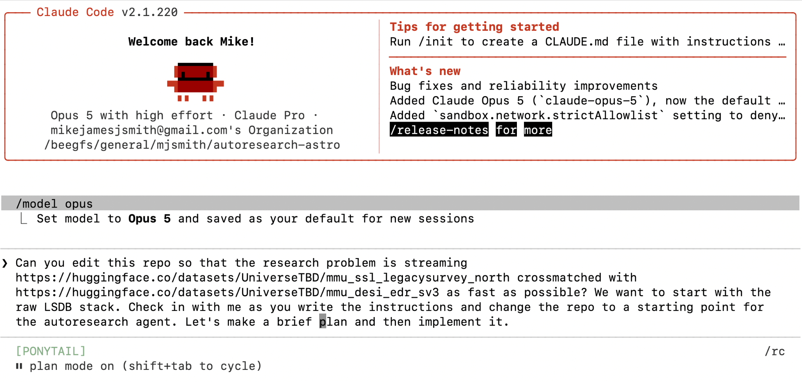

Slide 7
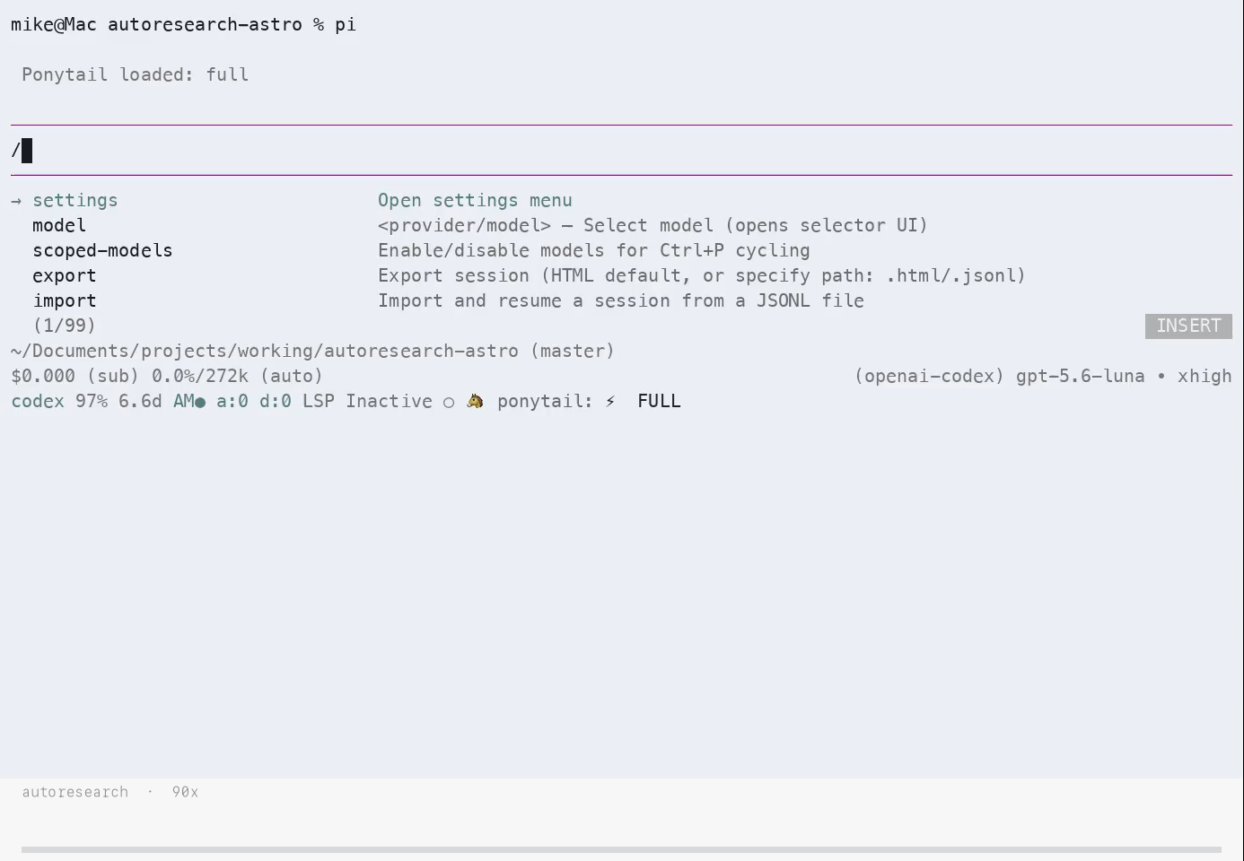

Slide 8
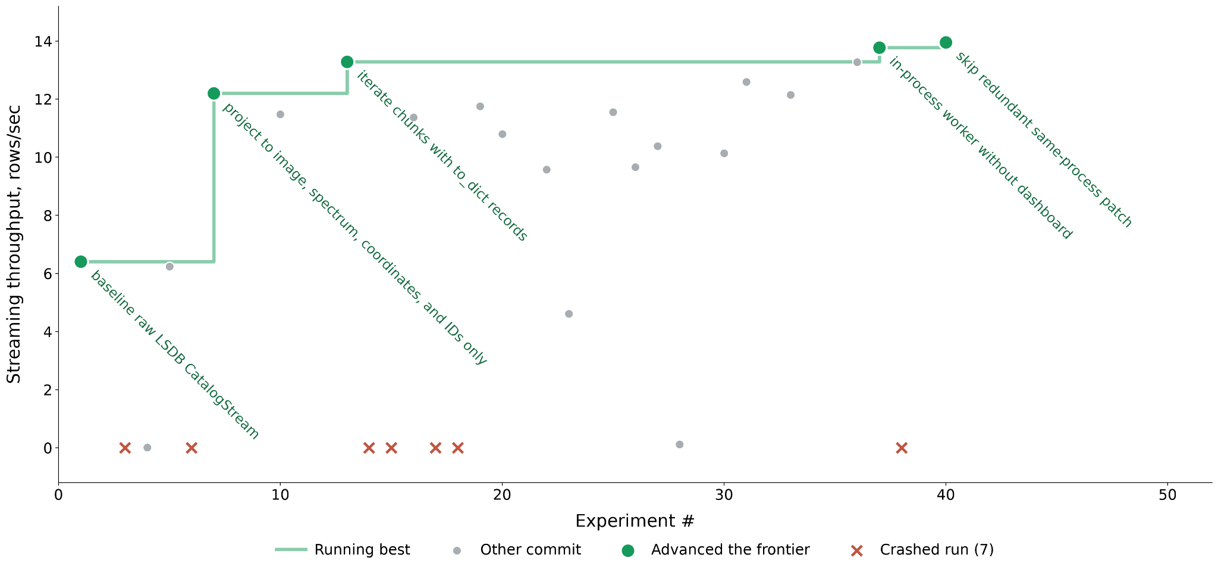

Slide 9
What was kept
Exp 1: baseline, 6.4 rows/s. Raw CatalogStream over the crossmatch.
Exp 7: column projection (6d5310a). Passed columns_a/columns_b to open_crossmatch so only image, spectrum, ra, dec, object_id are read.
Exp 13: to_dict(orient="records") (660b85e). Replaced chunk.iterrows(). iterrows builds a Series object per row (dtype coercion, index alloc); to_dict does one bulk conversion per chunk.
Exp 37: in-process worker, no dashboard (5e3c979). Single-worker scheduler means chunks are returned without pickling across a process boundary.
Exp 40: drop redundant patch (32ea86d). client.run(prepare.patch_lsdb_empty_margin)was a no-op round-trip.

Slide 10
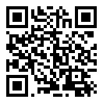
Try it yourself!
Andrej Karpathy’s autoresearch is in the link to the right 👉
I used:
  The pi harness (pi.dev)
  The pi-autoresearch package
  A $20 Codex subscription with GPT-5.6 Luna at xhigh reasoning
  My Macbook Air

Slide 11
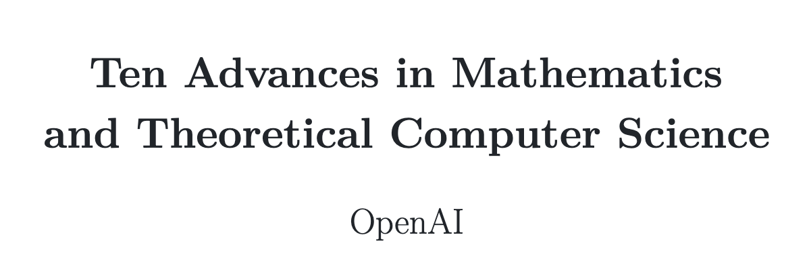
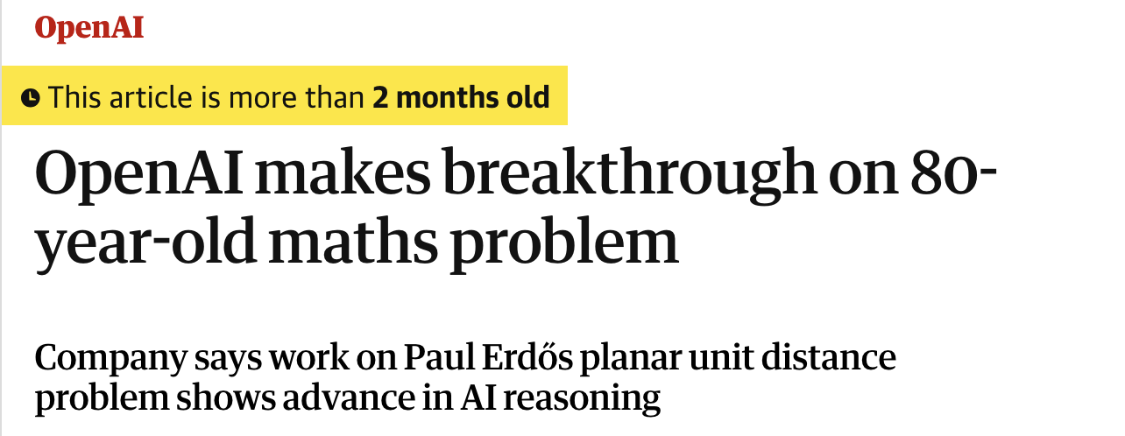
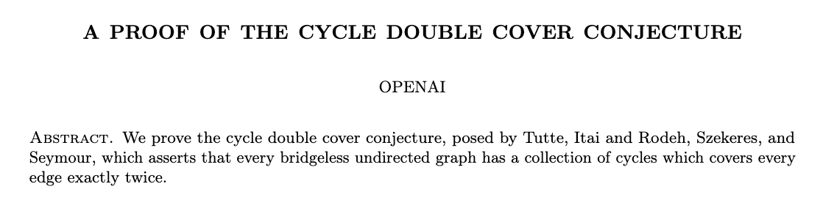
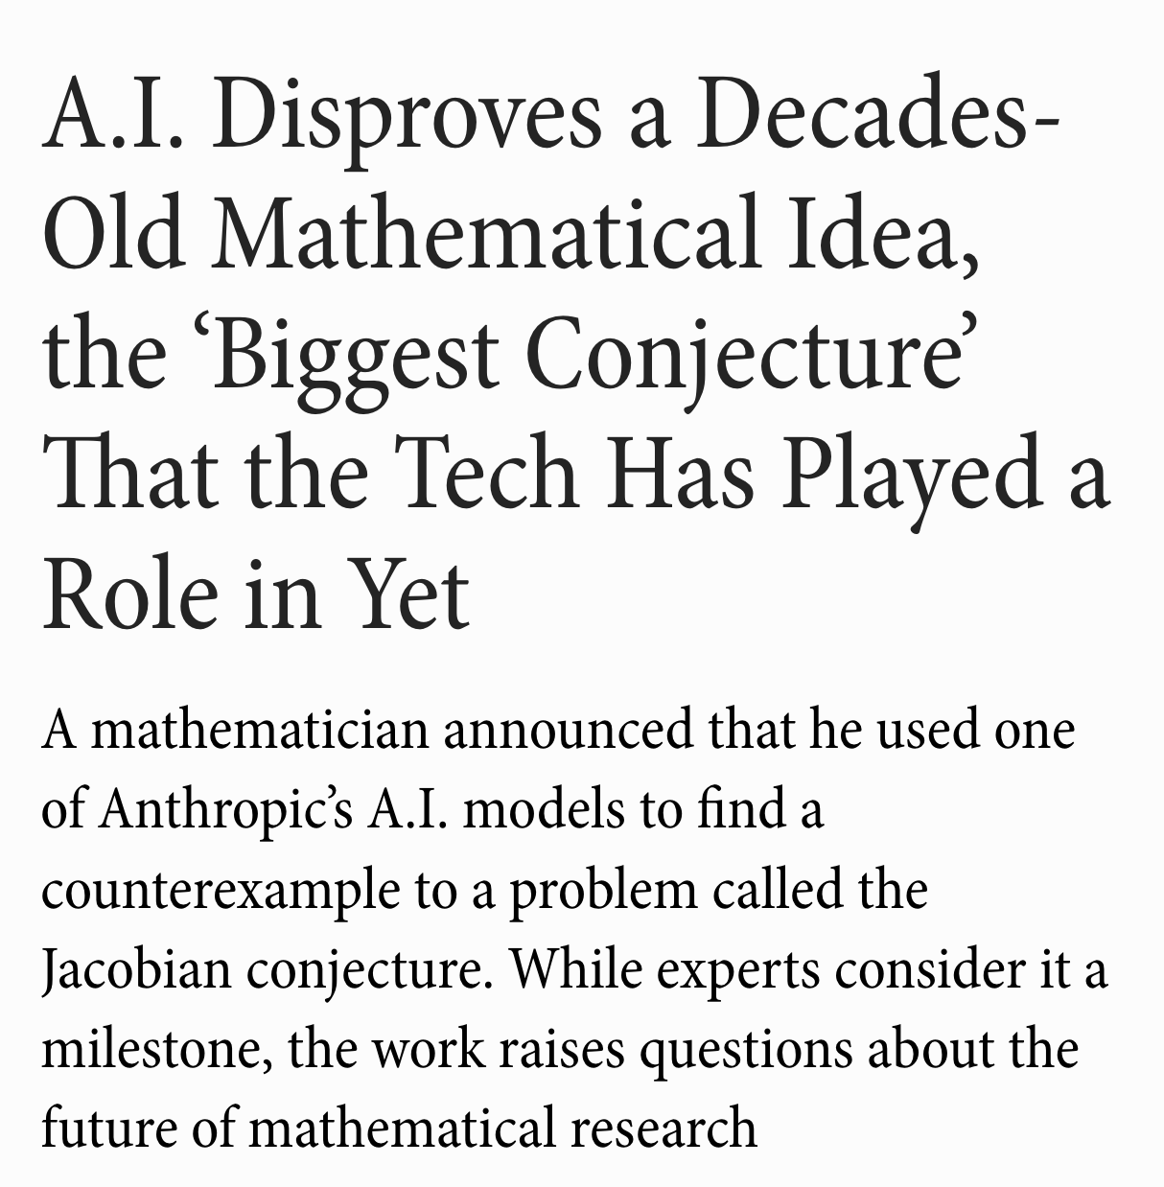
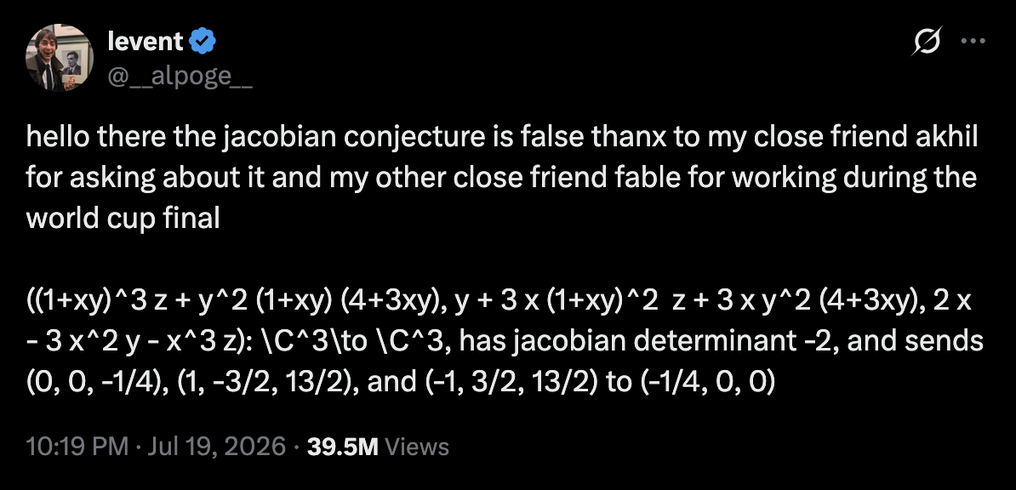
This is a toy problem, but what is coming down the pipeline?

Slide 12
Some questions for us
Is (computational/theoretical) astronomy fundamentally different from mathematics or computer science, fields that are already undergoing significant change due to automated AI research?
If AI is able to automate significant chunks of our work, what will our roles become? What about the roles of people at different career stages?
How will the scientific process differ between institutes that have access to these tools and ones that do not have access? How will this evolve over time?
Do we need to rethink the structures within which we do science? What about how we disseminate science?
What skills would a researcher need in this new paradigm?

