Slide 1
A Hierarchy of Classification
V. Ashley Villar
Harvard University, Assistant Professor

Slide 2
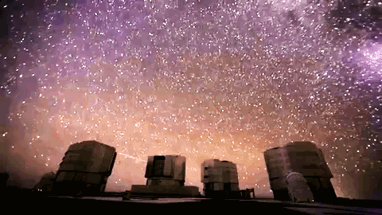
VLT

Slide 3
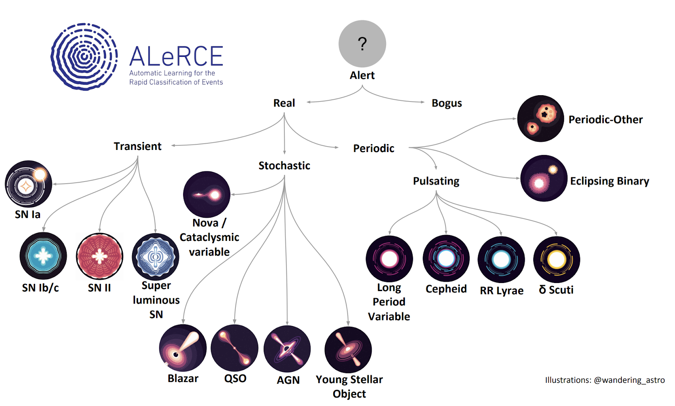
We must classify a zoo of astronomical events
Sánchez-Sáez et al. (2020)
@wandering_astro (illustrations)
Sánchez-Sáez et al. (2020)
@wandering_astro (illustrations)

Slide 4
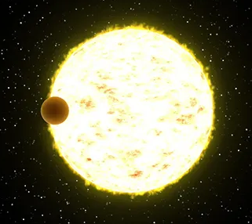
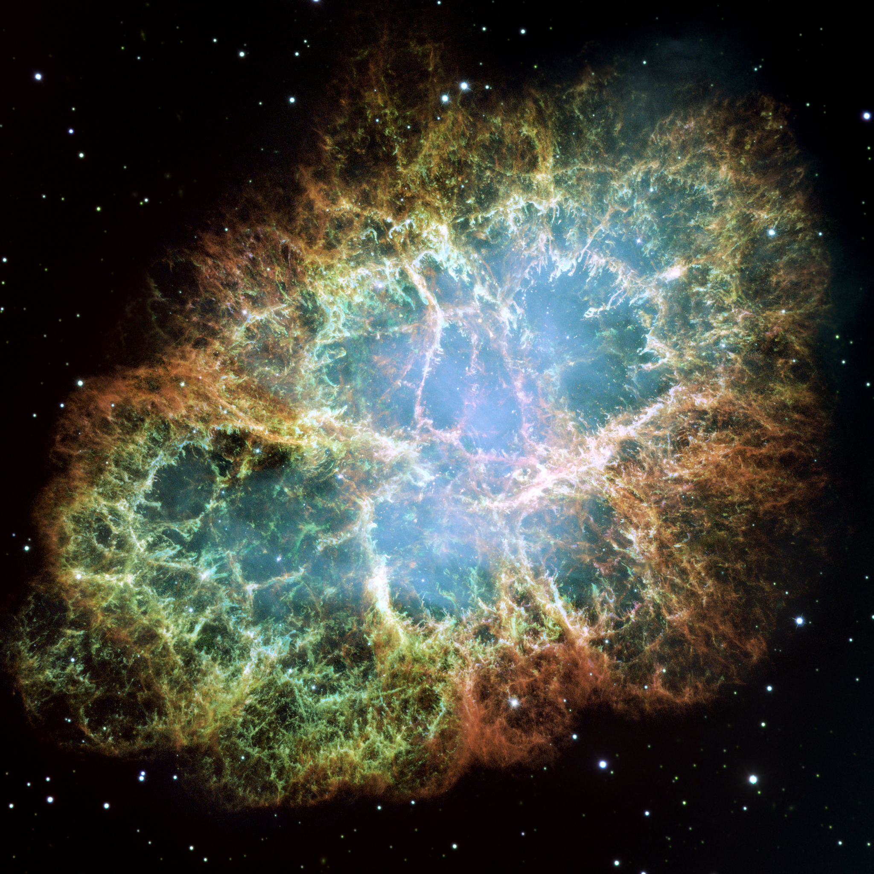
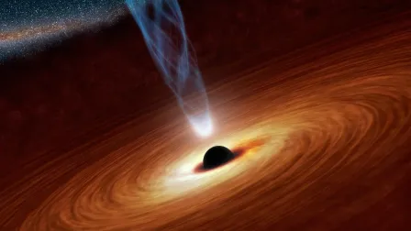
We must classify a zoo of astronomical events
Sánchez-Sáez et al. (2020)
@wandering_astro (illustrations)
Sánchez-Sáez et al. (2020)
@wandering_astro (illustrations)

Slide 5
We must classify a zoo of astronomical events
Sánchez-Sáez et al. (2020)
@wandering_astro (illustrations)
Sánchez-Sáez et al. (2020)
@wandering_astro (illustrations)

Slide 6
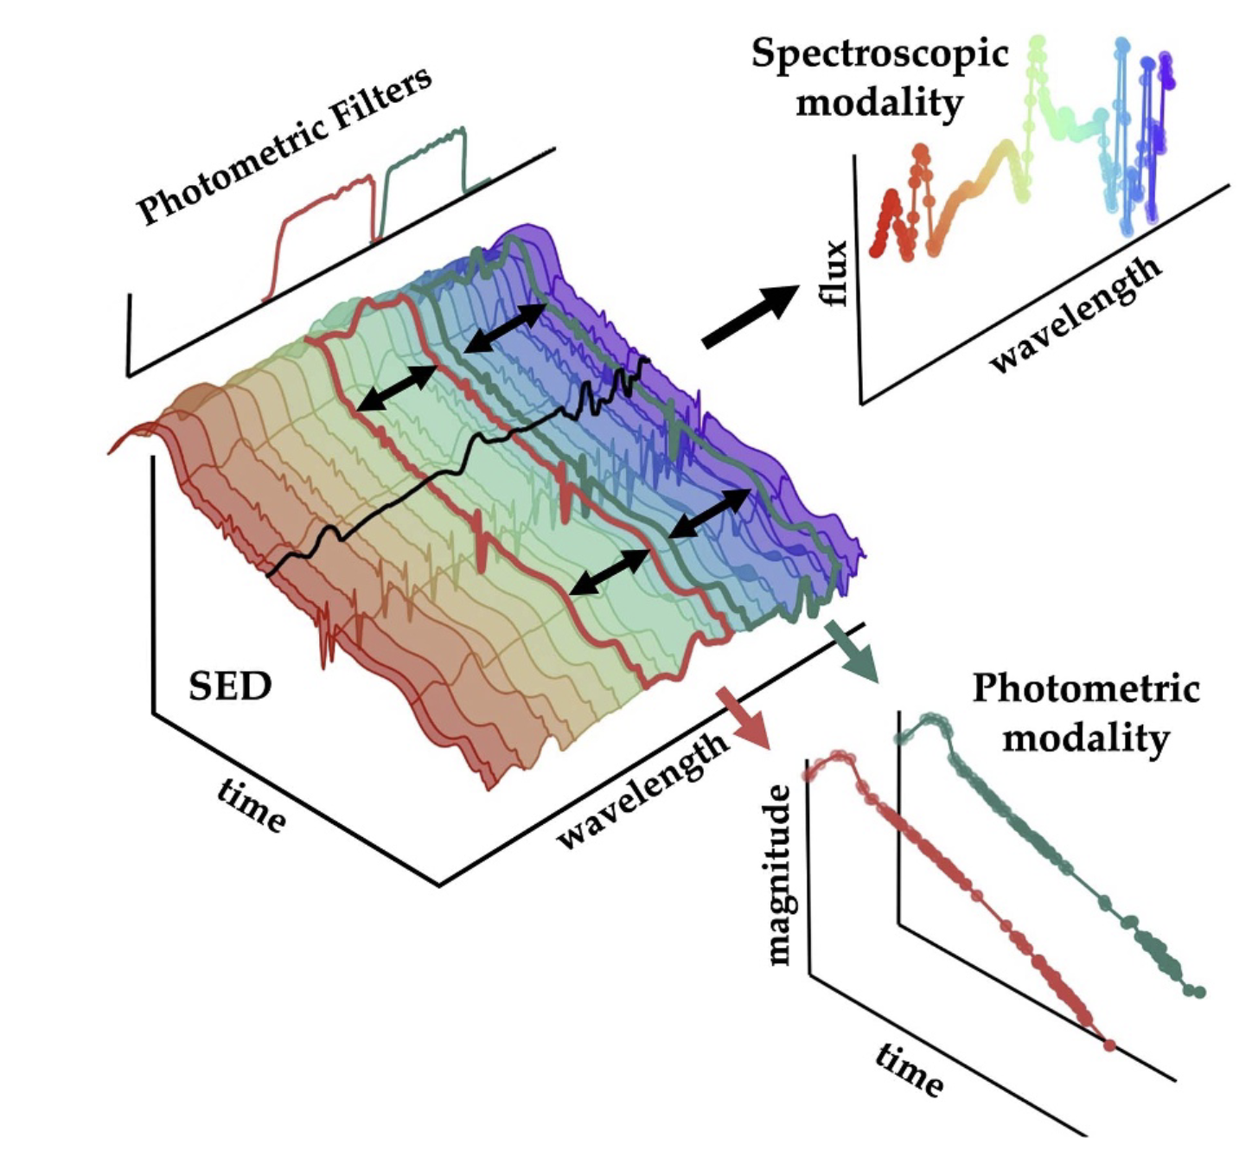
Astrophysical events can be observed in many ways

Slide 7

How does one decide upon a taxonomy anyway?

Slide 8
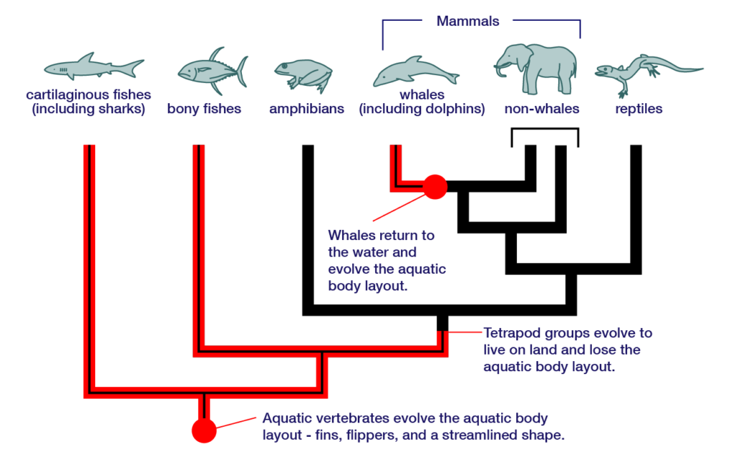
How does one decide upon a taxonomy anyway?

Slide 9
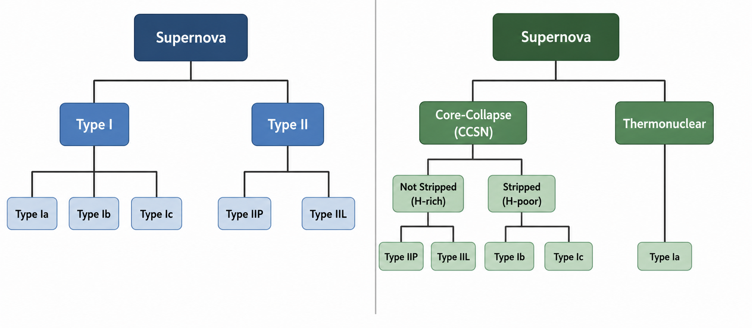
Taxonomy: features or physics?

Slide 10
Does any of these even matter for classification?

Slide 11
Does any of these even matter for classification?
Traditionally: no!

Slide 12
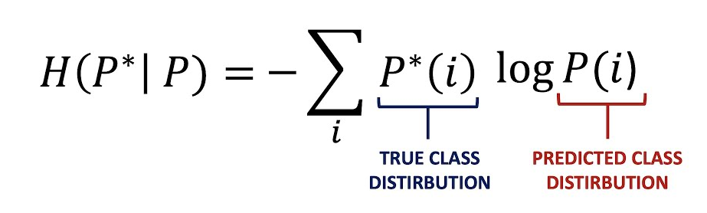
Classic classification objective: cross entropy

Slide 13
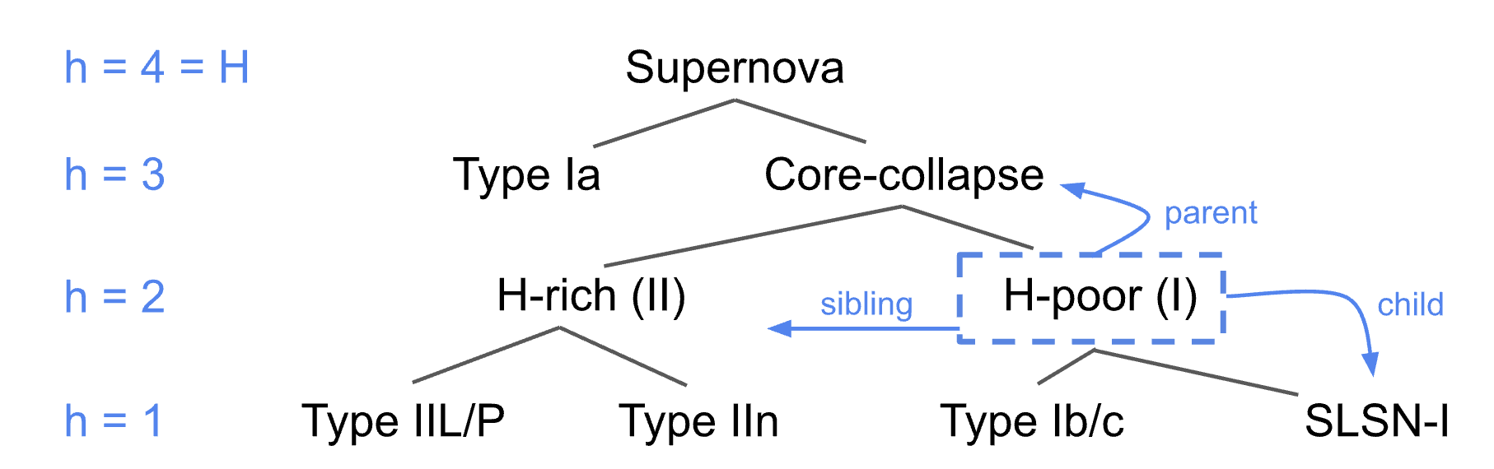
But we can incorporate this hierarchy
Physics-based vs [feature based]
Bertinetto+20, VAV+25

Slide 14
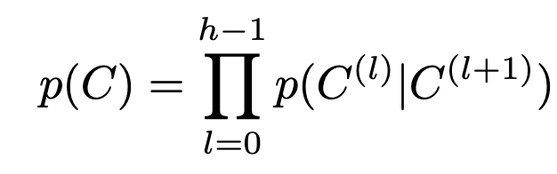
But we can incorporate this hierarchy
Physics-based vs [feature based]
Bertinetto+20, VAV+25

Slide 15
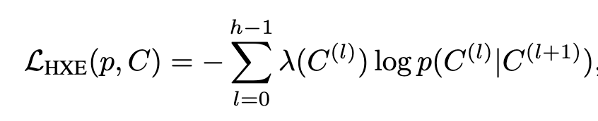
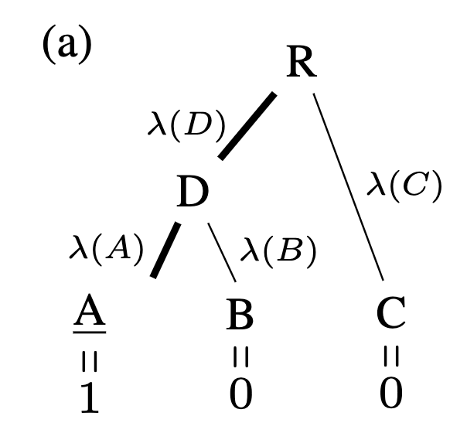
Hierarchical cross entropy
True edge
Predicted class
Bertinetto+20, VAV+25
VAV adds additional weighting to account for class imbalance

Slide 16
Hierarchical Cross Entropy…
Performs as well as flat classifiers, but not necessarily any better

Slide 17
Hierarchical Cross Entropy…
Performs as well as flat classifiers, but not necessarily any better
In theory, makes better ‘mistakes’ by labeling within the correct “family”
  In practice, this is not necessarily true for the astrophysical case

Slide 18
Hierarchical Cross Entropy…
Performs as well as flat classifiers, but not necessarily any better
In theory, makes better ‘mistakes’ by labeling within the correct “family”
  In practice, this is not necessarily true for the astrophysical case
Gives notable flexibility in tasks
  By giving access to a “node-specific” pseudo-probability, one can answer many more classification questions without retraining

Slide 19
What if we want a feature-based taxonomy?
Particularly valuable for fuzzy labels

Slide 20
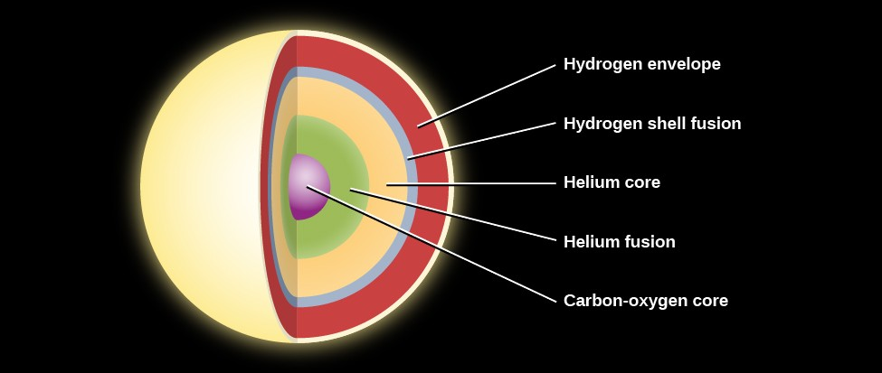
E.g., some supernovae classes are clearly “fuzzy”

Slide 21
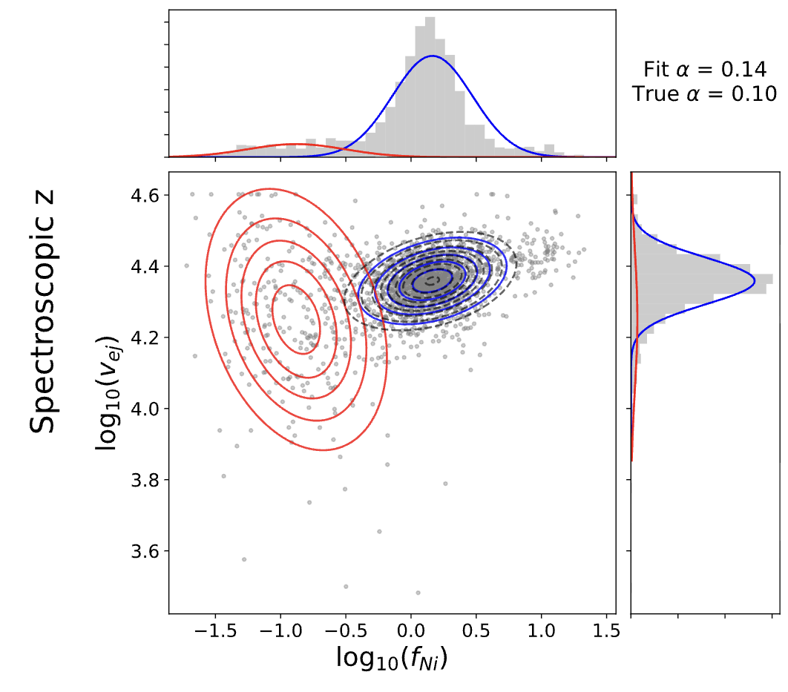
Classification as a(n unsupervised) mixing problem
Uzsoy+VAV, sub.

Slide 22
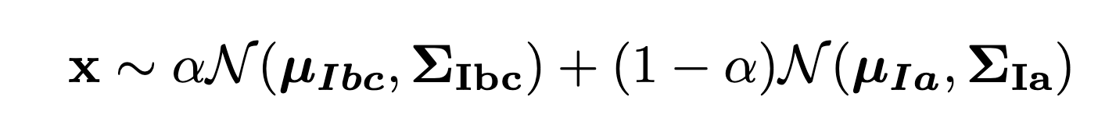
Classification as a(n unsupervised) mixing problem
Uzsoy+VAV, sub.

Slide 23
Classification as a mixing problem…
Performs as well as classic supervised methods, with no need for expensive labeling
Naturally finds ambiguous events…if your latent space is reasonable

Slide 24
Classification as a(n unsupervised) mixing problem
Uzsoy+VAV, sub.

Slide 25
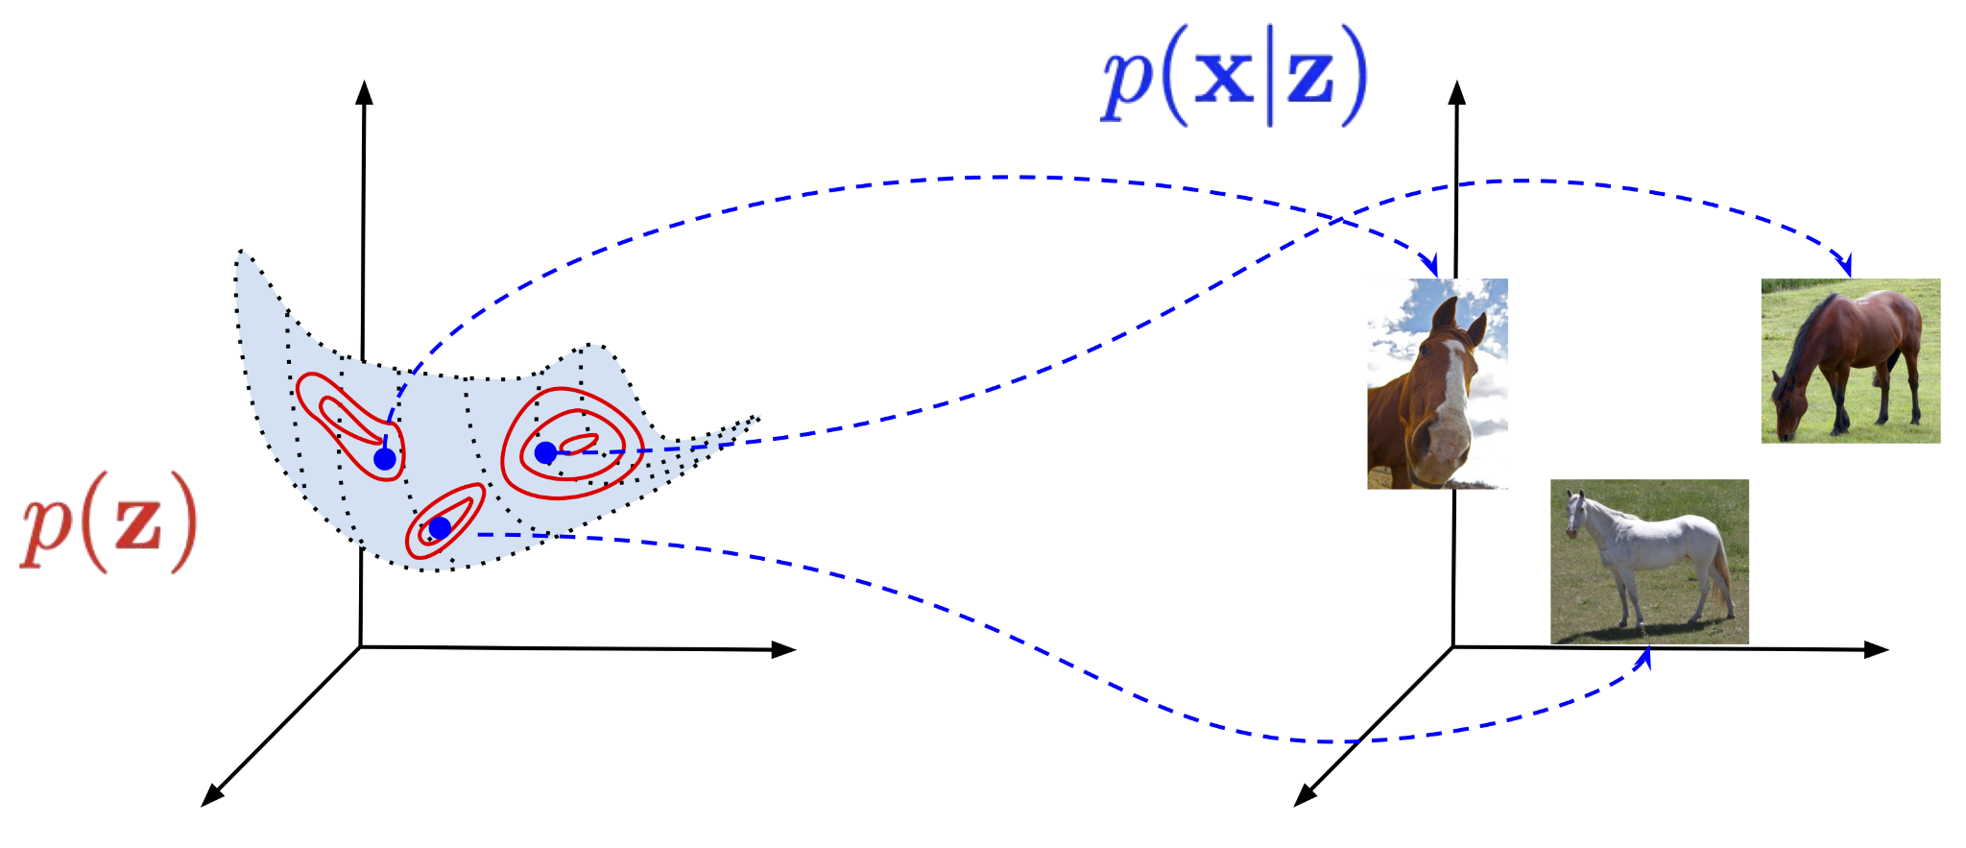
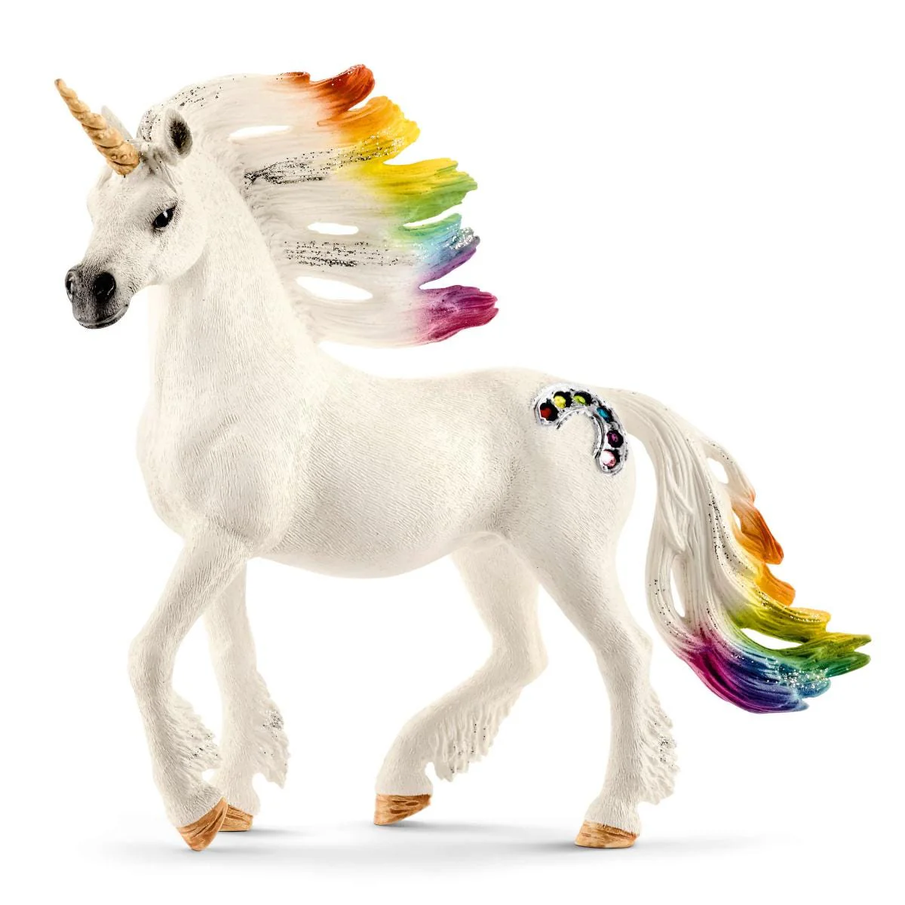
No guarantee that my feature space captures all

Slide 26
Many open problems remain
How do we unify “fuzzy labels” with hierarchical learning in a well-structured way?
Can we learn the true latent (aka physical) model from a large enough sample?
How do we calibrate any of these probabilities?
Thank you!

Slide 27

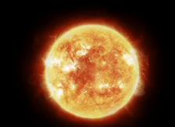

Slide 28
Title: A hierarchy of classification
Abstract: The taxonomy of physical events in the night sky (erupting stars, stellar explosions, and even gravitational lensing) is inherently hierarchical in nature. Broad physical families subdivide into increasingly specific physics, forming a tree-structured classification problem. Standard classification objectives typically ignore said structure and treat all misclassifications equally, rather than encouraging classifiers to "make better mistakes". In this talk, I will discuss a few approaches to modeling hierarchical class structure within the objective function. I will also discuss open issues of "fuzzy boundaries" within this taxonomy, in which both discrete and continuous subclasses exist.
20 min

