Slide 1
JSM, Boston, August 8, 2014
Privacy, Big Data and The Public Good: Statistical Framework
Stefan Bender (IAB)
Notes:
Tipps für die Nutzung der Titelfolie
Der Titel ist optimiert für 1-2 Zeilen.

Slide 2
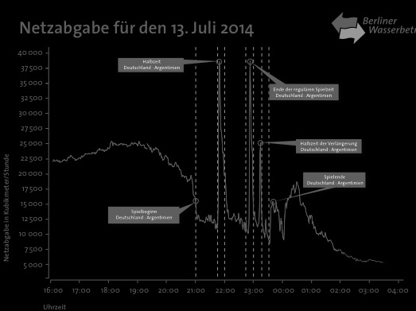
Waterconsumption in Berlin during the Final

Slide 3
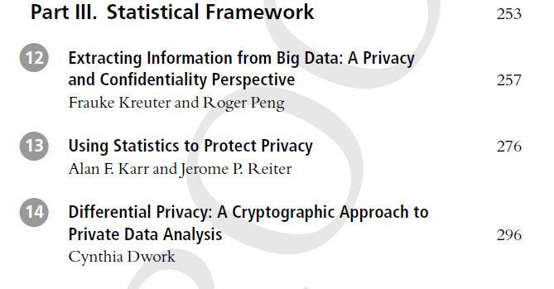
Content

Slide 4
Key themes
Importance of valid inference – and the role of statisticians
New analytical framework: differential privacy
Inadequacy of current statistical disclosure limitation approaches
Possibilities for accessing big data (without harming privacy)

Slide 5
Extracting Information from Big Data (Kreuter/Peng)
The challenges of extracting (meaningful) information from big data are similar to those of surveys.
Two main concerns when it comes extracting information from data:
Measurement and
Inference.

Slide 6
Extracting Information from Big Data (Kreuter/Peng)
Knowledge of the data generating process is need (Total Survey Error framework).
Good starting point
Need for development
It is the difference between designed and organic data (Bob Groves) that poses challenges to the extraction of information.
Solutions and new challenges: data linkage and information integration.

Slide 7
Access and Linkage (Kreuter/Peng)
Essential to understand data quality and break-downs
Challenged by ... different privacy requirements
Open issues of ownership
Lack of trusted third parties
However ... likely leads to good data documentation
Reproducible research
Transparency

Slide 8
The Need for a Measure for Privacy (Dwork)
Big data mandates a mathematically rigorous theory of privacy, a theory amenable to measure – and minimize – cumulative privacy, as data are analyzed, re-analyzed, shared, and linked.
Nothing is absolute safe/secure.

Slide 9
Differential Privacy (Dwork)
Definition of privacy has to take into account; that we want to learn useful facts out of the data. It does not matter if you are in the data base, because the generalized result affects you: differential privacy.
Data usage should be accompanied by publication of the amount of privacy loss, that is, its privacy ‘price’.
The chosen statistics should be published using differential privacy, together with the privacy losses.

Slide 10
Releasing Record-level Data (Karr/Reiter)
Risky for data subjects and stewards
Data often from administrative sources, hence available to others.
Large number of variables means everyone is a populaton unique.

Slide 11
Might typical disclosure control methods provide an answer? (Karr/Reiter)
Many data stewards alter data before releasing them
Aggregate data, swap records, add noise...
Usually minor perturbations for quality reasons
Typical methods not likely to be effective
Low intensity perturbations not protective
High intensity perturbations destroy quality

Slide 12
A Potential Path Forward (Karr Reiter)
An integrated system including
unrestricted access to highly redacted data (synthetic data), followed with
means for approved researchers to access the confidential data via remote access solutions, glued together by
verification servers that allow users to assess the quality of their inferences with the redacted data.

Slide 13
We Have the Building Blocks (Karr/Reiter)
Synthtic data
Synthetic Longitudinal Business Database.
Automated methods based on machine learning.
Remote access solutions
NORC virtual data enclave.
Virtual machines and protected data networks.
Verification servers
Not been built yet, but we have ideas for quality measures.

Slide 14
Data Access for Research to Big Data
Data access and combination of data sources is needed (Kreuter/Peng)
Ideal scenario: data is held be a trusted or trustworthy curator: the data remain secret, the responses are published. Cryptography helps to be close to the ideal scenario (Dwork).
Wallet Gardens (Stodden).
„The New Deal on Data“ (Greenwood et al.).

Slide 15
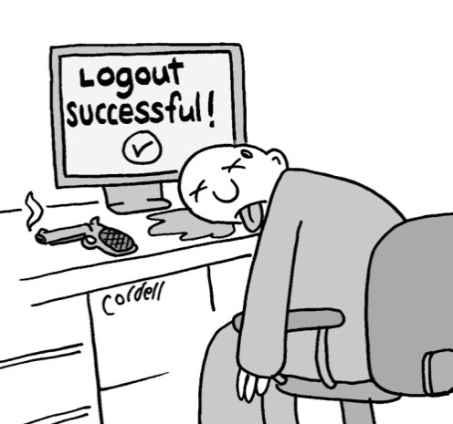
My Conclusion
Blend big data and survey-based/official data.
Use RDC structure for access to big data or combined data.
No longer hands on work with data.
Discussion of many topics needed: informed consent, non-participation, inference, privacy …
Main issues: data protection, access and trust.
We have to be more active in the public discussion, because big data is affecting our daily work!!!

Slide 16
http:/fdz.iab.de/en.aspx
Stefan Bender stefan.bender@iab.de

