Slide 1
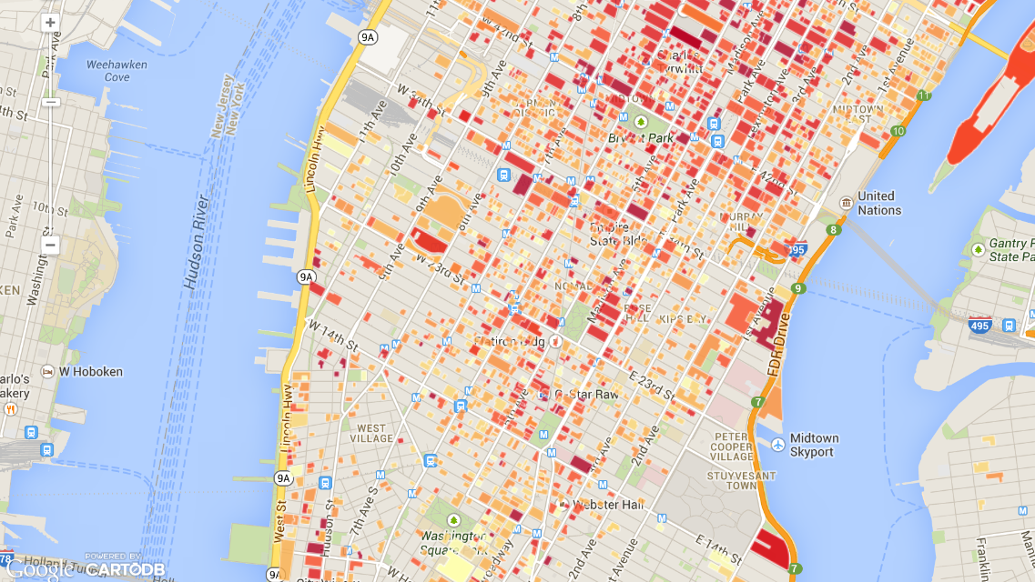
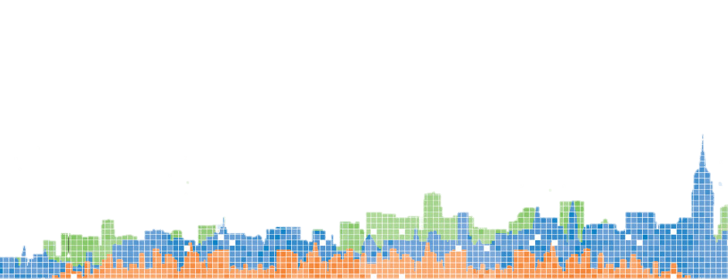

Privacy & Big Data
An Introductory Overview Lecture
August 6 2014

Slide 2
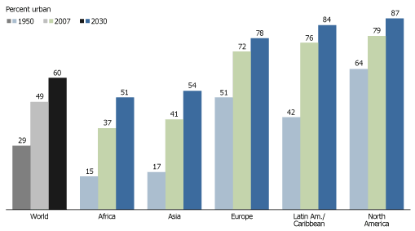
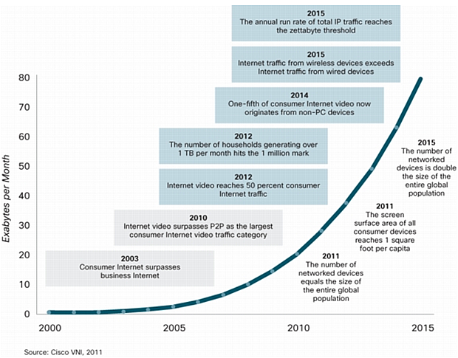
Big Cities + Big Data
Global network traffic, 30% CAGR
The world is urbanizing
Cities are the loci of consumption, economic activity, and innovation
Cities are the cause of our problems and the source of the solutions
Informatics capabilities are exploding
Storage, transmission, analysis
Proliferation of static and mobile sensors
Internet of things

Slide 3
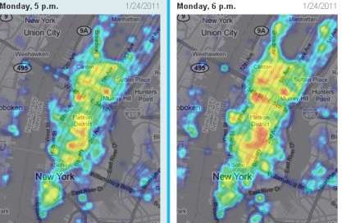
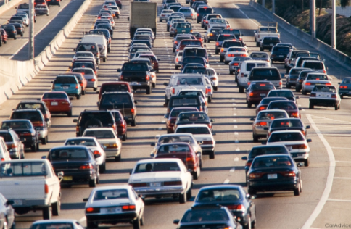
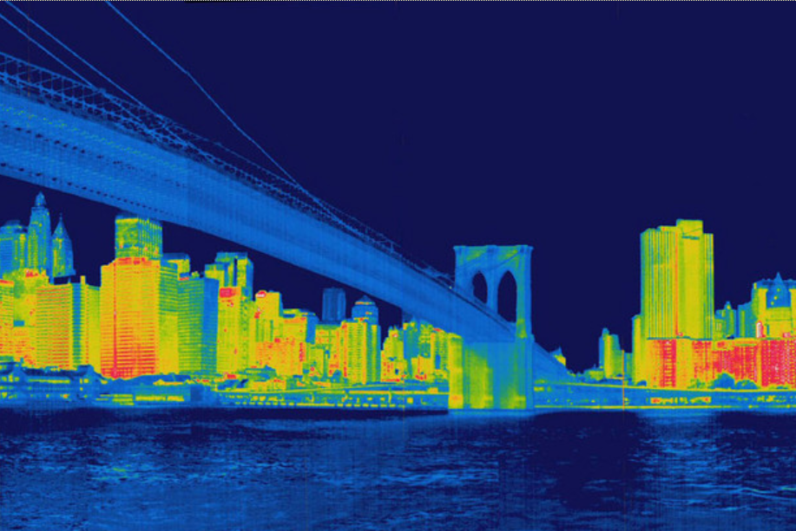
Urban Data Sources: Acquire, Integrate, Use
Organic Data Flows
Sensors
Novel Technologies
Administrative records (census, permits, …)
Transactions (sales, communications, …)
Operational (traffic, transit, utilities, health system, …)
Social media (Twitter, Facebook, blogs, …)
Personal (location, activity, physiological)
Fixed in situ sensors
Crowd sourcing (mobile phones, …)
Choke points (people, vehicles)
Visible, infrared and spectral imagery
RADAR, LIDAR
Gravity and magnetic
Seismic, acoustic
Ionizing radiation, biological, chemical
…

Slide 4
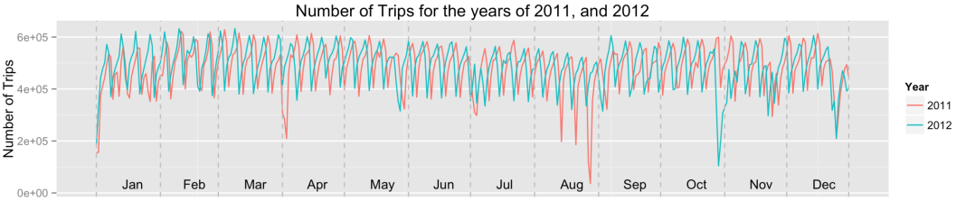
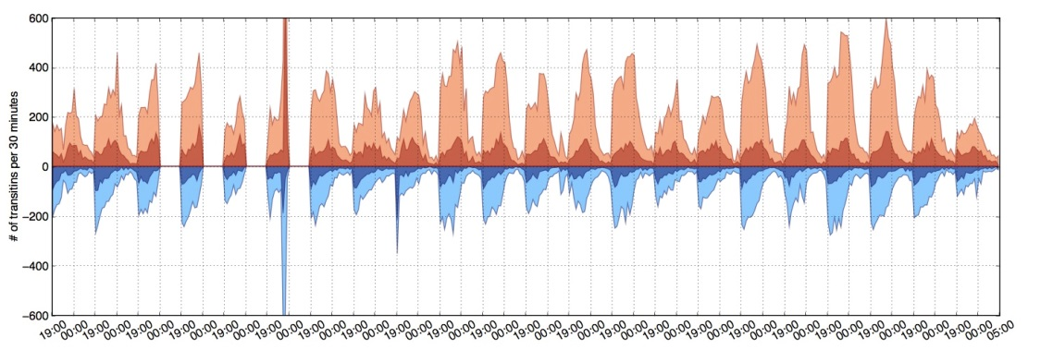
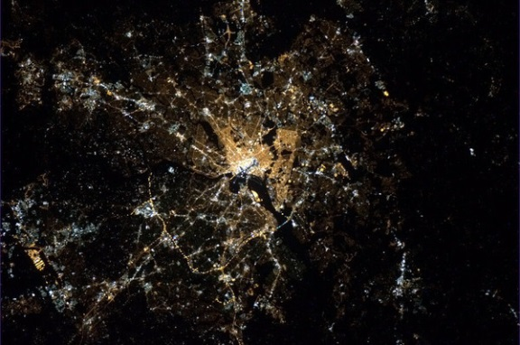
Thoughts on the big science questions
Can we document the “pulse of the city” in its various dimensions?
Normal? Variability? Correlations?
Response to perturbations? Predictability? Precursors?
How do the macro observables arise from micro behavior?
Santa Fe scaling?
Physical structure of cities?
Decision rules in agent-based models
Role of geography? Culture? Policies?

Slide 5
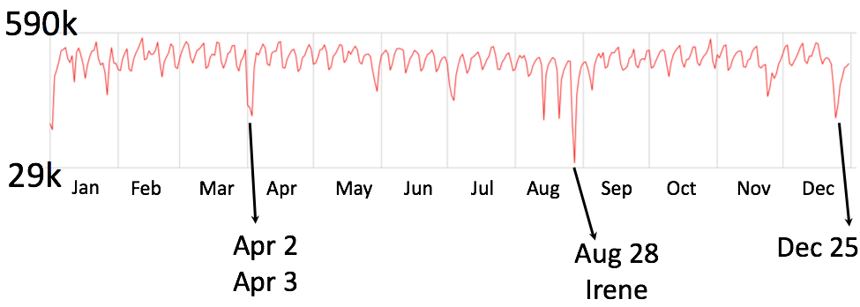
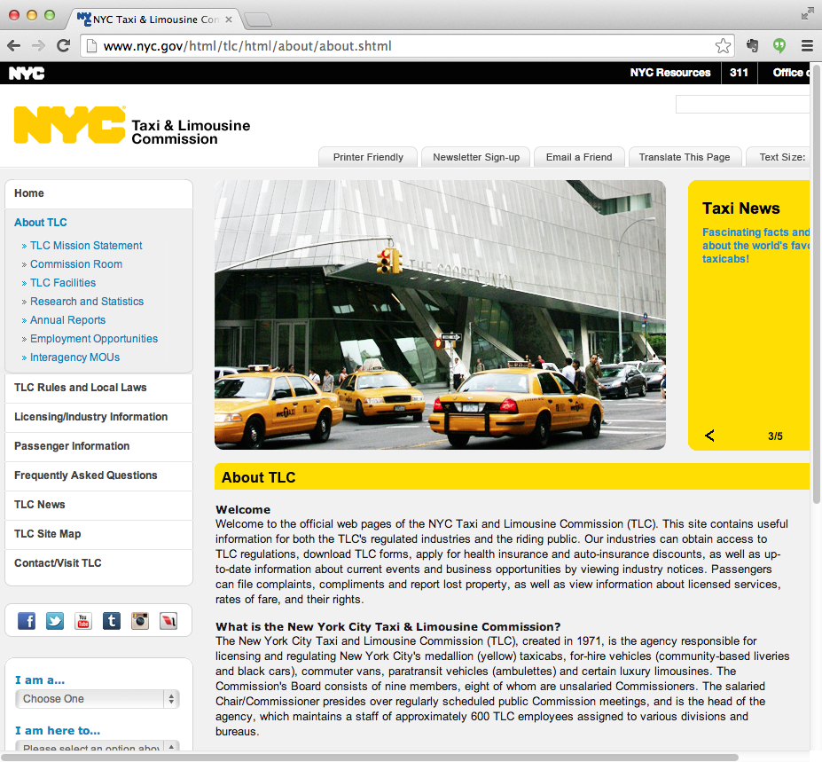
Taxi as city sensors
Silva, Friere, Vo, et al.
NYC Taxi Rides by Day in 2011

Slide 6
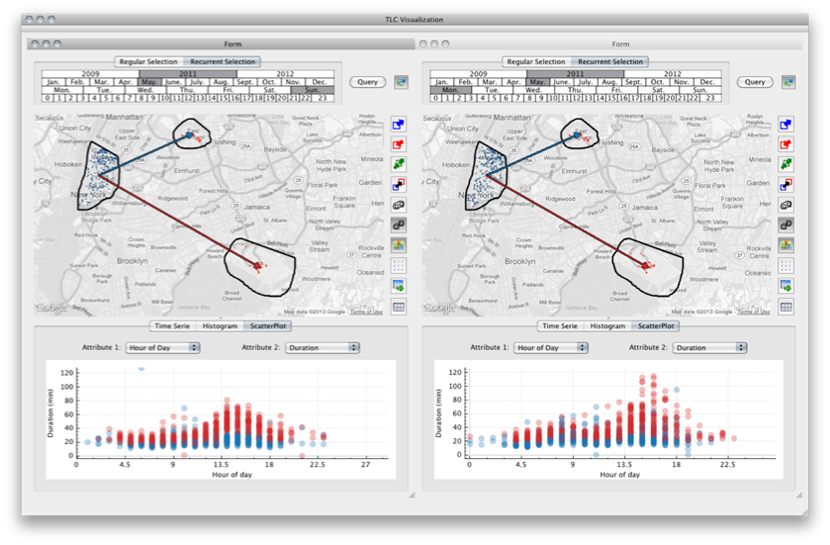
TaxiVis: Interactive Visual Exploration of NYC Taxi Records
Silva, Friere, Vo, et al.

Slide 7
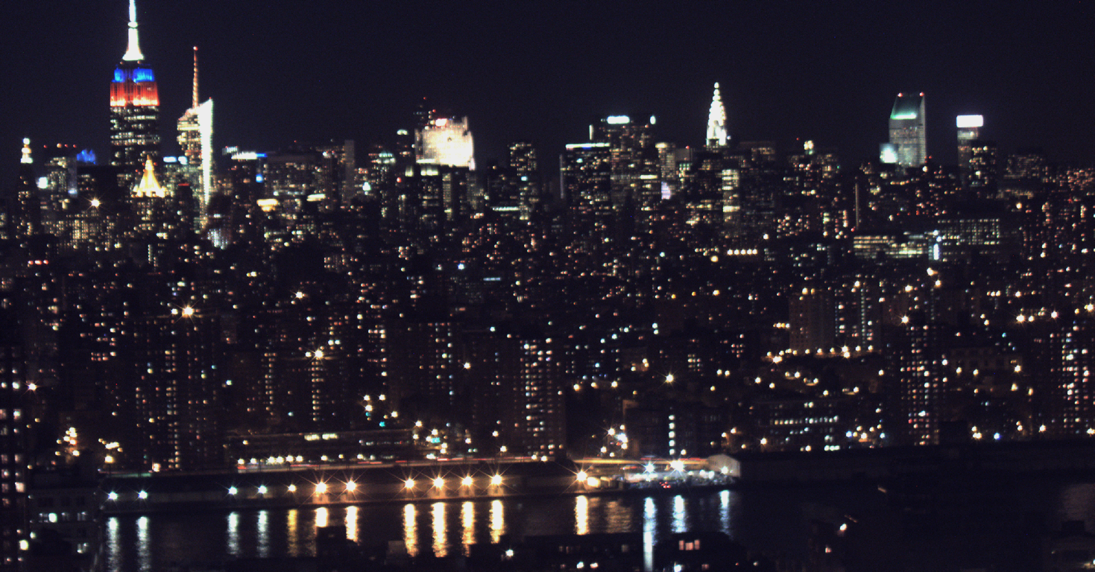
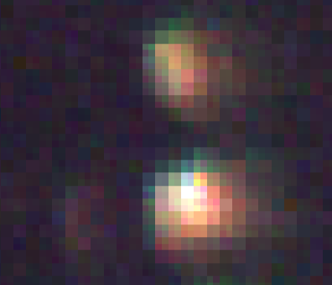
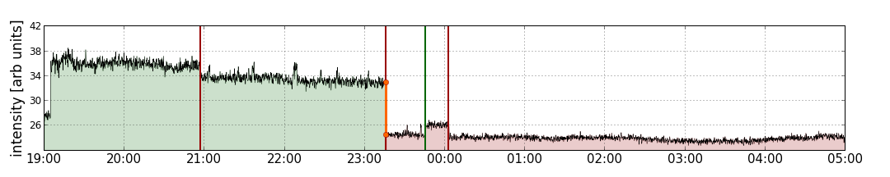
Dynamics of the Urban Lightscape
Camera:
Point Grey Flea 3 USB
8.8 Mega-pixels
raw image output
25mm focal length lens
Observations:
1 image every 10 seconds
from Oct 26 to Nov 16, 2013
3 color images at 25MB each
total data volume ~4.5TB
custom data processing pipeline
- each frame is “registered” to a common frame by spatial correlations
- 4,200 window apertures are identified by hand (out of approximately 20,000 windows in the scene)
- for each frame, the average brightness of each source is calculated in 3 bands (RGB)
- the brightness of a given source as a function of time is referred to as its “light curve”
Dobler, et al.

Slide 8
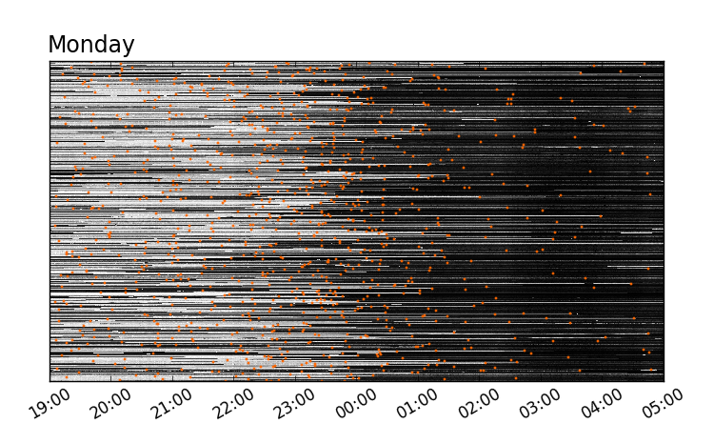
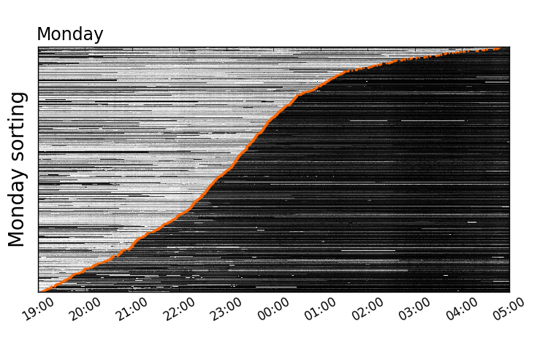
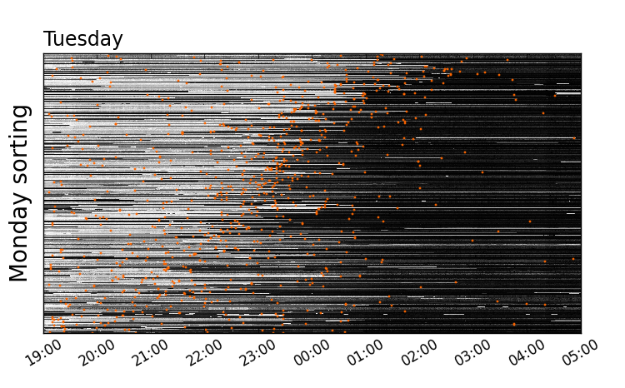
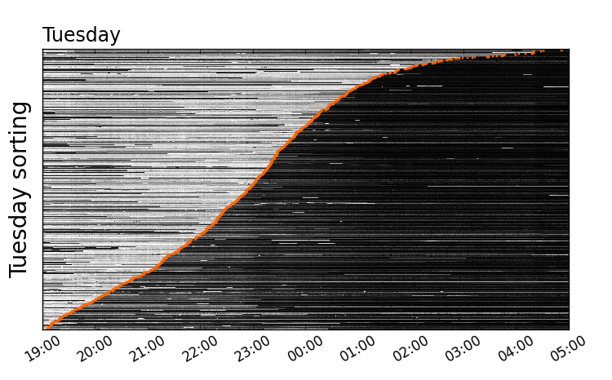
Identifying patterns of behavior
Dobler, et al.

