Slide 1
Missing details in Administrative data and impact on phenotyping and cohort identification
International Conference on Health Policy Statistics 2020
Chunhua Weng
Presented by Casey Ta

Slide 2
Overview
Li et al. Comparing ICD9-Encoded Diagnoses and NLP-Processed Discharge Summaries for Clinical Trials Pre-Screening: A Case Study. AMIA 2008 Symposium Proceedings
Compare eligibility queries over ICD9 diagnoses vs. NLP-processed discharge summaries
Summarize the strengths and weaknesses of both data sources:
  information completeness
  expressiveness
  code granularity
  accuracy of temporal information

Slide 3
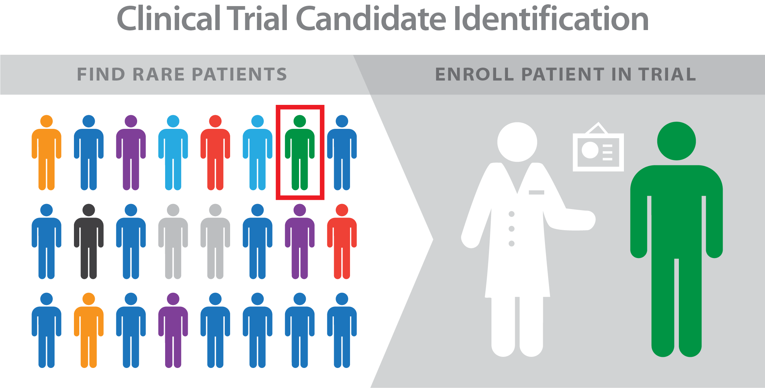
Clinical Trial Patient Prescreening
EMRs accelerate subject prescreening for clinical trials by providing rich clinical data in both structured and free-text formats
Administrative data such as ICD9 codes are popular for EMR-based patient eligibility alert systems despite known issues with poor granularity and accuracy for identifying patients with specific diseases
What are the strengths and weaknesses of using structured or textual clinical data for clinical trials eligibility pre-screening?

Slide 4


Research Design
NYP/CUIMC CDW
Selected an ongoing clinical trial at NYP/CUIMC with low enrollment
Collected records for all patients in 2005 from NYP/CUIMC’s CDW
  269,647 patients with 9,022,255 ICD9 diagnoses
  21,833 patients with 29,016 discharge summaries
2 eligibility queries
  Discharge summaries → MedLEE NLP
  ICD9 codes
Sampled unique patients from each query result for manual chart review and comparison
Discharge Summaries
ICD9 Diagnoses
Clinical Trial Eligibility Criteria
MedLEE Query
ICD9 Query

Slide 5
Clinical Trial Eligibility Criteria
Patients must meet one of:
Documented previous ischemic stroke (all of the following must be satisfied):
  A focal ischemic neurological deficit persistent for more than 24 hours;
  Considered being of ischemic origin. Onset within previous 5 years but not within 8 weeks prior to enrollment;
  Patients with previous atrial fibrillation should be excluded;
  A CT scan or MRI must have been performed to rule out hemorrhage and non ischemic neurological disease.
Symptomatic carotid artery disease with ≥ 50% stenosis
Asymptomatic carotid stenosis ≥ 70%
History of carotid revascularization (surgical or catheter-based).

Slide 6
Queries
MedLEE query identified patients when notes were found…
ICD9 query identified patients that included / excluded codes corresponding to the above terms
Codes reviewed by two internal medicine physicians
including the terms “ischemic stroke” “carotid endarterectomy / revascularization” “cerebral vascular disease/accident” “carotid narrowness /stenosis /occlusion” “thrombotic stroke” | excluding the terms “atrial fibrillation / flutter” “cerebral hemorrhage” “transient ischemic attack”

Slide 7
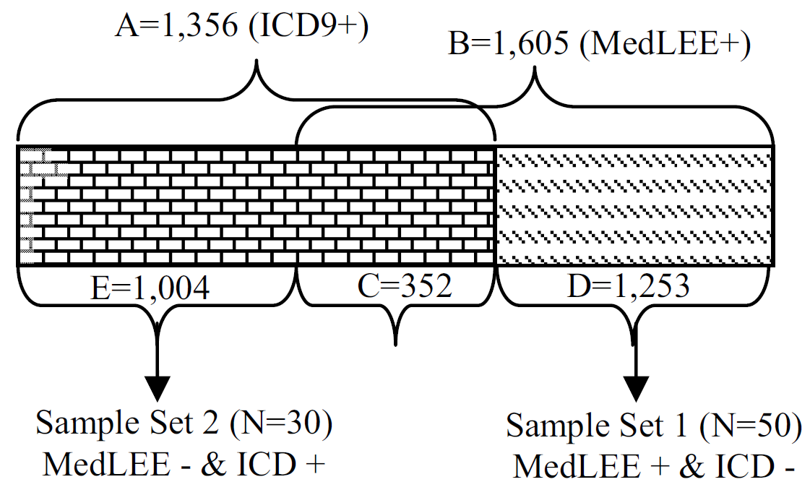
Query Results
ICD9 query returned 1,356 patients
MedLEE query returned 1,605 patients
352 patients identified by both queries
1,004 patients identified by ICD9 only
  Randomly selected 30 patients for review
1,253 patients identified by MedLEE only
  Randomly selected 50 patients for review

Slide 8
MedLEE-only patients
MedLEE (+) ICD9 (-) | Causes of Discrepancies | Count
MedLEE True Positive N=28 (56%) | MedLEE provided additional information about past medical histories | 19 (38%)
 | MedLEE provided additional information from lab reports | 2 (4%)
 | MedLEE provided etiological information for diagnoses | 7 (14%)
MedLEE False Positive N=22 (44%) | Inclusion and exclusion criteria were met in different notes | 4 (8%)
 | There was incompleteness and inconsistency between notes and ICD9 codes | 1 (2%)
 | There were documentation errors in notes | 17 (34%)

Slide 9
MedLEE-only patients: true-positive cases
MedLEE (+) ICD9 (-) | Causes of Discrepancies | Count
MedLEE True Positive N=28 (56%) | MedLEE provided additional information about past medical histories | 19 (38%)
 | MedLEE provided additional information from lab reports | 2 (4%)
 | MedLEE provided etiological information for diagnoses | 7 (14%)
MedLEE False Positive N=22 (44%) | Inclusion and exclusion criteria were met in different notes | 4 (8%)
 | There was incompleteness and inconsistency between notes and ICD9 codes | 1 (2%)
 | There were documentation errors in notes | 17 (34%)
MedLEE provided additional information about past medical histories
  4 patients had “carotid endarterectomy”
  2 patients had “carotid stenosis”
  13 patients had “stroke”
these patients did not have corresponding ICD9 diagnoses

Slide 10
MedLEE-only patients: true-positive cases
MedLEE (+) ICD9 (-) | Causes of Discrepancies | Count
MedLEE True Positive N=28 (56%) | MedLEE provided additional information about past medical histories | 19 (38%)
 | MedLEE provided additional information from lab reports | 2 (4%)
 | MedLEE provided etiological information for diagnoses | 7 (14%)
MedLEE False Positive N=22 (44%) | Inclusion and exclusion criteria were met in different notes | 4 (8%)
 | There was incompleteness and inconsistency between notes and ICD9 codes | 1 (2%)
 | There were documentation errors in notes | 17 (34%)
MedLEE provided additional information from lab reports
Two patients had “carotid stenosis” in their laboratory reports
  “carotid artery stenosis L 60-79%”
  “Doppler of her carotid which showed 99% right internal carotid artery stenosis…”
neither of them had corresponding ICD9 diagnoses

Slide 11
MedLEE-only patients: true-positive cases
MedLEE (+) ICD9 (-) | Causes of Discrepancies | Count
MedLEE True Positive N=28 (56%) | MedLEE provided additional information about past medical histories | 19 (38%)
 | MedLEE provided additional information from lab reports | 2 (4%)
 | MedLEE provided etiological information for diagnoses | 7 (14%)
MedLEE False Positive N=22 (44%) | Inclusion and exclusion criteria were met in different notes | 4 (8%)
 | There was incompleteness and inconsistency between notes and ICD9 codes | 1 (2%)
 | There were documentation errors in notes | 17 (34%)
MedLEE provided etiological information for diagnoses
7 patients had “stroke” specified in their past medical histories. 4 patients had hemiplegia with the body location specified
None of these patients had ICD9 diagnoses for “stroke”, but for “Hemiplegia Unspecified Side”
Hemiplegia can be caused by multiple etiologies and was not included in our queries
Lack of etiological information in ICD9 codes lowered the sensitivity of our ICD9 query
Additionally, the less specific “Hemiplegia Unspecified Side” code was used although the side was known

Slide 12
MedLEE-only patients: false-positive cases
MedLEE (+) ICD9 (-) | Causes of Discrepancies | Count
MedLEE True Positive N=28 (56%) | MedLEE provided additional information about past medical histories | 19 (38%)
 | MedLEE provided additional information from lab reports | 2 (4%)
 | MedLEE provided etiological information for diagnoses | 7 (14%)
MedLEE False Positive N=22 (44%) | Inclusion and exclusion criteria were met in different notes | 4 (8%)
 | There was incompleteness and inconsistency between notes and ICD9 codes | 1 (2%)
 | There were documentation errors in notes | 17 (34%)
Inclusion and exclusion criteria were met in different notes
Four patients had “stroke” (inclusion criteria) and “atrial fibrillation” (exclusion criteria) specified in different notes
MedLEE was applied on individual notes and did not collect information across notes

Slide 13
MedLEE-only patients: false-positive cases
MedLEE (+) ICD9 (-) | Causes of Discrepancies | Count
MedLEE True Positive N=28 (56%) | MedLEE provided additional information about past medical histories | 19 (38%)
 | MedLEE provided additional information from lab reports | 2 (4%)
 | MedLEE provided etiological information for diagnoses | 7 (14%)
MedLEE False Positive N=22 (44%) | Inclusion and exclusion criteria were met in different notes | 4 (8%)
 | There was incompleteness and inconsistency between notes and ICD9 codes | 1 (2%)
 | There were documentation errors in notes | 17 (34%)
There was incompleteness and inconsistency between notes and ICD9 codes
One patient had “stroke” recorded in his discharge summary, but also had an ICD9 code for “Transient Cerebral Ischemia NOS”, which made this patient ineligible by criterion A

Slide 14
MedLEE-only patients: false-positive cases
MedLEE (+) ICD9 (-) | Causes of Discrepancies | Count
MedLEE True Positive N=28 (56%) | MedLEE provided additional information about past medical histories | 19 (38%)
 | MedLEE provided additional information from lab reports | 2 (4%)
 | MedLEE provided etiological information for diagnoses | 7 (14%)
MedLEE False Positive N=22 (44%) | Inclusion and exclusion criteria were met in different notes | 4 (8%)
 | There was incompleteness and inconsistency between notes and ICD9 codes | 1 (2%)
 | There were documentation errors in notes | 17 (34%)
There were documentation errors in notes
17 patients were considered eligible by MedLEE due to documentation errors
  complicated negations
  unusual abbreviations
  incorrect grammar
  spelling errors
Such documentation errors were also difficult for human experts to interpret, e.g., “?afib, CT scan r/o bleding/strokes”

Slide 15
ICD9-only patients
ICD9 (+) MedLEE (-) | Causes of Discrepancies | Count
ICD9 True Positive N=27 (90%) | Fragmented information scattered across multiple notes | 12 (40%)
 | Defects in MedLEE Query | 15 (50%)
ICD9 False Positive N=3 (10%) | Diagnoses satisfying exclusion criteria missed by ICD9 codes | 3 (10%)

Slide 16
ICD9-only patients: true-positive cases
ICD9 (+) MedLEE (-) | Causes of Discrepancies | Count
ICD9 True Positive N=27 (90%) | Fragmented information scattered across multiple notes | 12 (40%)
 | Defects in MedLEE Query | 15 (50%)
ICD9 False Positive N=3 (10%) | Diagnoses satisfying exclusion criteria missed by ICD9 codes | 3 (10%)
Fragmented information scattered across multiple notes of the same or different types
12 patients had ICD9 diagnoses for “Cerebral Vascular Disease”, but no pertinent information was specified in their discharge notes
The diagnoses may be elaborated in discharge notes dated other than year 2005 or in other data sources such as admission notes, progress notes, laboratory reports that were not part of our sample

Slide 17
ICD9-only patients: true-positive cases
ICD9 (+) MedLEE (-) | Causes of Discrepancies | Count
ICD9 True Positive N=27 (90%) | Fragmented information scattered across multiple notes | 12 (40%)
 | Defects in MedLEE Query | 15 (50%)
ICD9 False Positive N=3 (10%) | Diagnoses satisfying exclusion criteria missed by ICD9 codes | 3 (10%)
Non-exhaustive MedLEE Query
Our MedLEE query failed to retrieve 15 eligible patients because we did not specify appropriate attributes in the query
Example: “CT/MRI demonstrated with small acute infarct in R upper posterior left basal ganglia/corona radiate”
MedLEE has the capacity to extract the location information “basal ganglia” for term “infarction”; however, due to our oversight, we did not add the specific location constraints in our query and hence missed the patient
Requires query author to thoroughly consider all possible combinations of semantic classes and attributes

Slide 18
ICD9-only patients: false-positive cases
ICD9 (+) MedLEE (-) | Causes of Discrepancies | Count
ICD9 True Positive N=27 (90%) | Fragmented information scattered across multiple notes | 12 (40%)
 | Defects in MedLEE Query | 15 (50%)
ICD9 False Positive N=3 (10%) | Diagnoses satisfying exclusion criteria missed by ICD9 codes | 3 (10%)
Diagnoses satisfying exclusion criteria missed by ICD9 codes
3 patients with inclusion ICD9 codes for “Cerebral Vascular Disease/Accident” also met exclusion criteria (cerebral hemorrhage or atrial fibrillation) specified only in the discharge summaries

Slide 19
Notes vs. Diagnoses Codes
How NLP-processed notes and ICD9 diagnoses complement each other for clinical trials pre-screening
Information completeness
Information expressiveness
Concept encoding granularity
Accuracy of temporal information

Slide 20
Information Completeness
Past medical history information in notes can capture information missing in ICD diagnoses for various reasons:
  Diagnoses made prior to CDW or EMR system deployment
  New patients with previous diagnoses
  Mobile patients utilizing multiple hospital systems
Diseases previously diagnosed are often not recorded as a diagnosis code if they’re
  non-progressive
  unrelated to the patient’s current admission
  asymptomatic
Clinicians may briefly describe them in the past medical history, review of systems, or laboratory results
  4 patients with “carotid stenosis” in medical history
  2 patients with narrowness described in laboratory reports
  1 patient instructed to follow-up with outpatient clinic

Slide 21
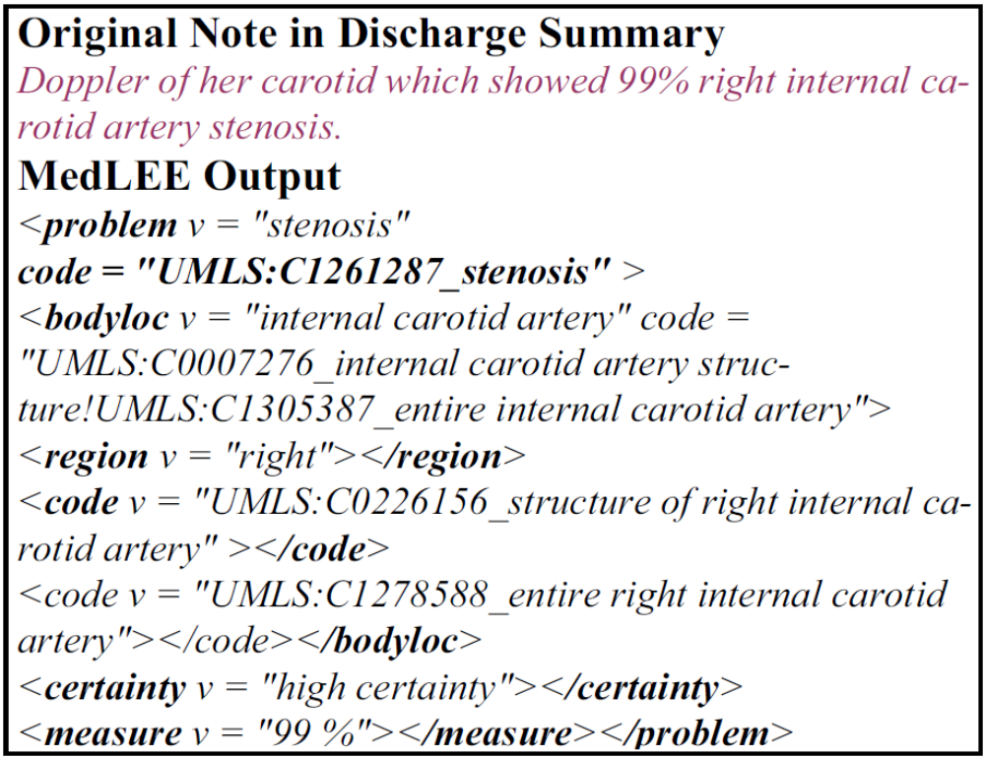
Information Expressiveness
Laboratory results in the notes provide specific details that cannot be represented by ICD9 codes
Patients with specific degrees of carotid stenosis
  Criteria 1B: 50% stenosis if symptomatic
  Criteria 1C: 70% stenosis if asymptomatic
MedLEE can recognize quantitative measurements and encode them in structured output
Laboratory data in LOINC codes can supplement ICD diagnostic codes
  78913-1: Percent stenosis of Ramus intermedius branch from left main coronary artery by Cardiac angiogram

Slide 22
Granularity
Granularity is a common challenge for both ICD9 diagnosis codes and MedLEE-processed notes
ICD9 codes for “cerebral vascular disease” and “cerebral vascular accident” were used to encode diagnoses for ischemic stroke, hemorrhagic stroke, or carotid occlusion
  False-positives due to exclusion of patients with hemorrhage
Patients with history of stroke and diagnosis code for “Hemiplegia” caused by the stroke
  False-negative since these patients cannot be included without knowing etiological reason
In discharge summaries, clinicians often used “stroke” without specifying ischemic or hemorrhagic stroke
  False-positives in cases of hemorrhagic stroke

Slide 23
Accuracy of Temporal Information
Eligibility criteria usually have temporal constraints on clinical phenotypes
  Example: patients with cerebral vascular disease within the past 5 years, but not within the past 8 weeks
Accuracy of temporal information is a common challenge for both ICD9 codes and NLP-processed notes
Primary diagnosis time of ICD9 diagnoses may not necessarily indicate the disease onset time
Narrative patient reports may state “stroke in the past” without providing accurate onset time

Slide 24
Takeaways
NLP-processed notes are valuable data sources for clinical trial pre-screening by providing past medical histories that capture diseases not formally diagnosed by clinicians
NLP processed notes can provide more specific details about diseases that are unavailable in diagnosis codes
  “99% right internal carotid artery stenosis”
  hemiplegia caused by stroke
NLP queries require more exhaustive effort to design queries for greater sensitivity
  “small acute infarct in R upper posterior left basal ganglia/corona radiate”
Ambiguities and documentation errors are common in clinical narratives
  “?afib, CT scan r/o bleding/strokes”
Both data sources have issues with granularity and accuracy of temporal information

Slide 25
Thank you
Questions?

Slide 26
MedLEE
Patient report
....New maculopapular rash on trunk ….
Medical Language Extraction and Encoding System
Developed at Columbia University by Carol Friedman to process medical narratives
Generates structured, computer-recognizable, XML-coded concepts using semantic classes for problem, finding, body location, region, etc.
Extracts modifiers linked to concepts (certainty, status, location, quantity, degree)
Concepts encoded by Unified Medical Language System (UMLS)
MedLEE
Problem:rash
Status:new
Descriptor:maculopapular
Bodyloc:trunk
Code:C0460005 (trunk)
Code:C0241488 (trunk
maculopapular rash)
Coded data

