Slide 1
Topic Models Applied to Centers for Disease Control and Prevention (CDC) Grants
Office of Public Health Scientific Services
Matt Eblen, MPIA
Robin M. Wagner, PhD, MS
Presented at the International Conference on Health Policy Statistics
Charleston, SC
January 11th, 2018

Slide 2
Background
From fiscal year 2012 to 2016, the CDC administered over $5 billion a year in extramural grants on average
  Nearly 90% of these grants were cooperative agreements with state/local governments to pursue various public health objectives
  Other grants supported research and training in public health
Wanted to depict CDC’s grant investments from a holistic public health perspective
  But how best to classify grants?
  Roughly 800 funding opportunity announcements a year from 13 different Centers, Institutes or Offices (CIOs)
Latent Dirichlet Allocation (LDA) Topic Models emerged as good candidates for classifying CDC’s grant portfolio into topic areas

Slide 3
What are Topic Models?
A collection of machine learning and natural language processing methods that aim to uncover the textual themes that run through large collections of documents
Prior annotations or labeling of documents is unnecessary - the thematic topics emerge through analysis
  Unsupervised analysis
Algorithms are applied to the words of documents to find the underlying themes in the documents

Slide 4
What is Latent Dirichlet Allocation (LDA)?
LDA is a generative topic model, where each document is produced by:
  choosing a distribution over topics
  generating each word at random from the word distributions (or vocabularies) of the chosen topics
Unlike other topic models, LDA allows a document to consist of multiple topics and words can be in multiple topic vocabularies
  E.g., a document’s topic distribution may be 50% “cancer” topic and 50% “HIV” topic
  the word “prevention” may be in the vocabulary of both topics

Slide 5
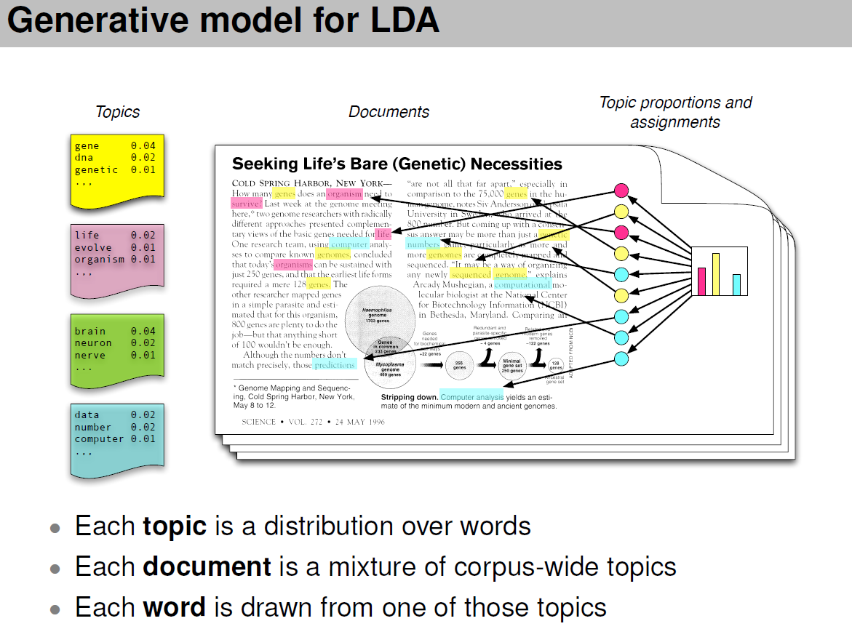
Source: David M Blei, “Introduction to Probabilistic Topic Models”, 2011

Slide 6
Data Preparation
Collected titles and abstracts for 85% (6,067/7,147) of grant projects funded between FY 2012 and FY 2016
  Due to some missing abstracts, topic modeling is not exhaustive
Removed words not helpful in classifying the corpus:
  Numbers, punctuation, and stop words (e.g., “the”, “and”)
  Location names
  Ubiquitous words (e.g., “health”)
  Sparse words – used in less than 25 abstracts
Set number of topics to 100
  The number of topics is chosen by the analyst prior to fitting the model
Notes:
Grant projects often extend over multiple years and usually consist of a “new” grant followed by a series of “continuation” grants and “supplement” grants. The abstracts typically do not change over the course of the project. For this analysis, we only count the distinct number of grant projects, not all of the continuations and supplements.
Techniques exist to estimate the optimal number of topics to choose (e.g., held-out likelihood), but these techniques have been found to often produce results that do not agree well with the judgments of human evaluators (see “Reading Tea Leaves: How Humans Interpret Topic Models”, by Chang, et. al.). Better to select the number of topics that is useful for the analysis you are trying to do or that produce results that are functional in real-world settings.

Slide 7
Model
Ran LDA model with 100 topics on the available CDC grant abstracts
  “text2vec” package in R
The model assigned a vocabulary to each topic with each word given a probability weight based on how frequently it was used within that topic. E.g.,:
  Topic 1: cancer 4%, screening 2%, breast 2%, colon 1%, …
  Topic 2: hiv 5%, aids 4%, testing 3%, …
A topic distribution was estimated for each grant abstract
  E.g., Abstract #1 estimates might be: 50% topic 4, 25% topics 23 and 61, and 0% for all other topics

Slide 8
Results
Results shown for top 5 topics in terms of # of grants
  Grant abstracts that had high distributions (>= 20%) in a particular topic were assigned to that topic
  Grant # 1 would be assigned to topics 1, 3, and 5
Topic distributions in the form of word clouds
  Word size corresponds to frequency weight in the topic
Top CIOs administering each topic also shown
Grant Abstract # 1 | Topic 1 | Topic 2 | Topic 3 | Topic 4 | Topic 5 | Topic 6 | Topic 7 | Topic 8 | Topic 9 | Topic 10
Distribution | 25% | 0% | 25% | 0% | 25% | 0% | 10% | 10% | 5% | 0%
Notes:
Note that the top 5 topics would be different if we looked at the number of grant dollars assigned to each topic instead of the raw number of grant projects. (I.e., award sizes of grants vary a lot).
The 20% cutoff figure is somewhat arbitrary. Choosing a lower cutoff will result in higher grant counts for all topics. However, the topic rankings are robust to whatever figure is chosen.

Slide 9
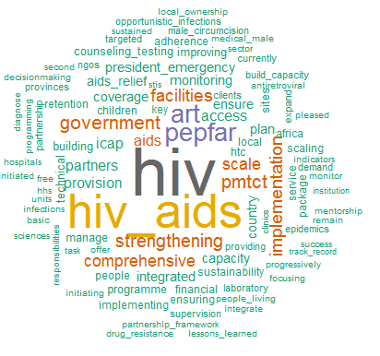
Topic 1: Global HIV/AIDS
Administering CIO | # of Topic 1 Grants | % of Topic 1 Grants
Center for Global Health | 165 | 55.7%
National Center for HIV/AIDS, Viral Hepatitis, STD and TB Prevention | 129 | 43.6%
Others | 2 | 0.7%
Total | 296 | 100.0%
Topic 1 is heavily concentrated in two CIOs
Notes:
ART = antiretroviral therapy; PMTCT = prevention of mother to child transmission; PEPFAR = president’s emergency plan for AIDS relief

Slide 10
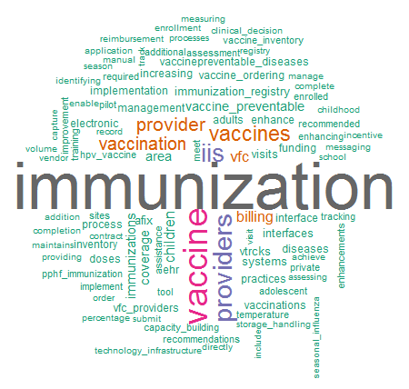
Topic 2: Immunization
Administering CIO | # of Topic 2 Grants | % of Topic 2 Grants
National Center for Immunization and Respiratory Diseases | 277 | 98.2%
Others | 5 | 1.8%
Total | 282 | 100.0%
Topic 2 is heavily concentrated in one CIO
Notes:
iis = immunization information systems
In 2012, NCIRD launched the creation of the IIS Strategic Plan to create a vision for the future—and a path forward—for advancing IIS so that real time, consolidated immunization data and services could be available for authorized clinical, administrative, and public health users and consumers, anytime and anywhere.

Slide 11
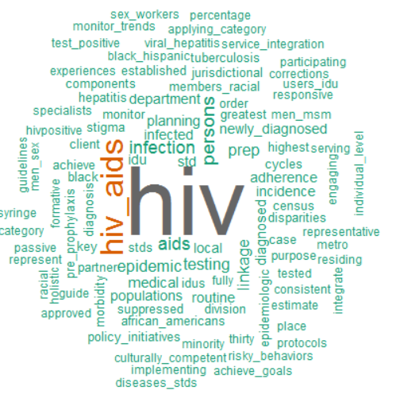
Topic 3: Domestic HIV/AIDS
Administering CIO | # of Topic 3 Grants | % of Topic 3 Grants
National Center for HIV/AIDS, Viral Hepatitis, STD and TB Prevention | 200 | 95.2%
Center for Global Health | 6 | 2.9%
Others | 4 | 1.9%
Total | 210 | 100.0%
Topic 3 is similar to Topic 1, except there are no terms related to global health. The model is flexible enough to use “HIV” in different contexts.

Slide 12
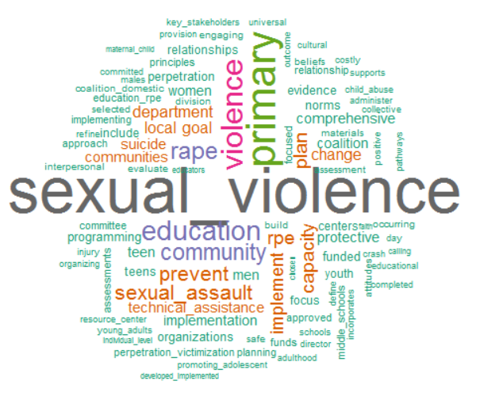
Topic 4: Sexual Violence
Administering CIO | # of Topic 4 Grants | % of Topic 4 Grants
National Center for Injury Prevention and Control | 187 | 98.4%
Others | 3 | 1.6%
Total | 190 | 100.0%
Topic 4 is heavily concentrated in one CIO
Notes:
RPE: Rape prevention and education

Slide 13
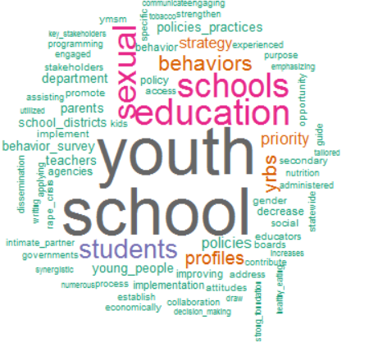
Topic 5: Adolescent Health
Administering CIO | # of Topic 5 Grants | % of Topic 5 Grants
National Center for HIV/AIDS, Viral Hepatitis, STD and TB Prevention | 92 | 48.9%
National Center for Chronic Disease Prevention and Health Promotion Center | 82 | 43.6%
National Center for Injury Prevention and Control | 11 | 5.9%
Others | 3 | 1.6%
Total | 187 | 100.0%
Topic 5 is cross-cutting. Adolescent health touches on areas related to sexual health, chronic conditions, and violence, among others.
Notes:
YRBS: The Youth Risk Behavior Surveillance (YRBS) System is run by the Division of Adolescent and School Health out of the National Center for HIV/AIDS, Viral Hepatitis, STD and TB Prevention.
It monitors six types of health-risk behaviors that contribute to the leading causes of death and disability among youth and adults, including—
Behaviors that contribute to unintentional injuries and violence
Sexual behaviors related to unintended pregnancy and sexually transmitted diseases, including HIV infection
Alcohol and other drug use
Tobacco use
Unhealthy dietary behaviors
Inadequate physical activity

Slide 14
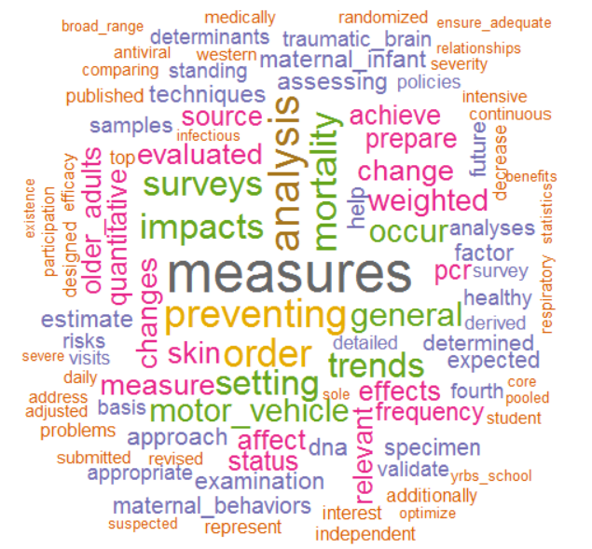
Topic 87: Measures/Analysis?
Administering CIO | # of Topic 87 Grants | % of Topic 87 Grants
National Institute for Occupational Safety and Health | 7 | 41.2%
National Center for Injury Prevention and Control | 4 | 23.5%
Others | 6 | 35.3%
Total | 17 | 100.0%
Not all topics have a clear theme. These tend to be topics with fewer numbers of grants.

Slide 15
Conclusion
Topic models offer a method to classify the general content of large collections of health-related texts with minimal resources – the content emerges by way of an algorithm rather than expert opinion
  The model’s results can be used to identify crosscutting trends and areas of mutual interest or overlap
The unsupervised LDA algorithm (using only the words of titles and abstracts) produced topics that agreed well with the public health areas addressed by specific CIOs at CDC
  Many topics were dominated by a particular CIO
    the Immunization topic and the Sexual Violence topic
  There were also areas of overlap or mutual interest
    the HIV-related topics and the Adolescent Health topic

Slide 16
Contact Information
Matthew Eblen, MPIA
Senior Mathematical Statistician
Email: yxw7@cdc.gov Office: 404-498-6509
Robin M. Wagner, PhD, MS
Chief Science Officer
Email: riw8@cdc.gov Office: 404-498-2491
Office of Public Health Scientific Services
Centers for Disease Control and Prevention (CDC)
2500 Century Center Blvd., NE, Mailstop E35
Atlanta, GA 30345

