Slide 1
Open Science and Data Access: Where are we on the Clinical Trial Data Transparency Journey?
Frank W. Rockhold, PhD
Professor of Biostatistics and Bioinformatics
Duke University Medical Center
Biopharmaceutical Statistics Workshop
Washington DC, Sept 13, 2018

Slide 2
Disclosure Statement –
Frank W Rockhold, PhD
Research Funding: NIH, PCORI, Duke Clinical Research Institute, Astra Zeneca, ReNeuron, Luitpold, Alzheimer's Drug Discovery Foundation, Janssen, BMS
Consulting and Honoraria: https://dcri.org/about-us/conflict-of-interest/
Boards: Frontier Science Board of Directors, DataVant Scientific Advisory Board, European Medicines Agency Technical Advisory Group
Equity Interest: GlaxoSmithKline

Slide 3
Open vs Transparent vs Access (Sharing)
What does it mean to be “open” or “transparent” and why is it important?
Transparency and openness are strategy or belief systems
Disclosure and access are actions which are necessary steps on that journey
What is the difference between “access” and “sharing”?
Disclosure or access without full transparency (data utility), while perhaps checking a regulatory box, does not necessarily help patients, healthcare practitioners or researchers.
Transparency can only be achieved if people disclose completely in a manner digestible by the recipient

Slide 4
Clinical Trials: The journey to “transparency”
ICMJE 2005
CT.Gov and WHO ICRTP
FDAAA 2007
IOM 2015 Report
EMA Policy 70
ICMJE Proposal 2016
FDA and NIH Final Rules 2016
Sprint Challenge and NEJM meeting 2017
ICMJE 2017 Requirements
OHRP HHS 2017 Revised Informed Consent Rule
NLM/NIH Meeting 2017 on Open Science
AAMC Meeting 2018 on Academic Incentives
Vivli Launch 2018
……..

Slide 5
We have CT.Gov So Why Do More?
Result summaries and publications have limitations
  Summarise data from the study population with statistics to compare treatment groups.
  Do not include the data from each research participant.
Primary Efficacy Results: Total Population
Emetic Episodes Day 1 To Day 5 | Dose 1 | Dose 2 | Dose 3
Complete (0 Episodes) | 7 (19) | 8 (22) | 10 (31)
Major (1-2 Episodes) | 10 (28) | 14 (39) | 10 (31)
Minor (3-5 Episodes) | 0 | 1 (3) | 0
Failure (>5 Episodes/Rescued) | 19 (53) | 13 (36) | 12 (38)
Dose 2 vs Dose 1 | 0.848

Slide 6
The pyramid of evidence
Meta-Analysis
Prospective Cohort
Case-control Study
Retrospective Cohort
Cross-sectional Study
Case Series
RCT

Slide 7
Creating Access to Individual Trial Patient (IPD) Data Creates Value
Data access is the practice of making scientific, clinical or other data available to other investigators, researchers or the public and:
  Enables new discovery and new research questions through using and combining existing data with increased statistical power.
  Validates existing research results by peer review and reanalysis.
  Broadens research by enabling appropriate aggregation of data derived from disparate data generators.
  Prevents repetitive trials—that may put additional participants at risk—when data already exist.
  Targets analysis of benefit to risk of therapies in subgroups (“precision medicine”).
  Strengthens trust in clinical research through enhanced openness and transparency.
  Honors the commitment to patients who volunteer for trials.

Slide 8
The Patient’s View- NEJM

Slide 9
Main Considerations around IPD Access
Safeguarding the privacy and confidentiality of research participants including informed consent
  Continues to evolve.. Impact of GDPR, Facebook, etc….
Providing data in ways that enable external researchers to understand and navigate the information- data utility
Creating incentives for academic researchers to share data
Balancing the needs of the data generators and secondary researchers
Ensuring the data are used for scientific purposes?
Protecting intellectual property and maintaining commercial incentives?

Slide 10
GDPR is here….
GDPR: General Data Protection Rule: www.eugdpr.org
Issues not restricted to the EU
NY Times Review May 15 2018:
“Europe’s Data Protection Law Is a Big, Confusing Mess”
www.nytimes.com/2018/05/15/opinion/gdpr-europe-data-protection

Slide 11
Data Utility
EMA POLICY 0070
  4.3. Data utility: Different anonymisation techniques will lead to different levels of data utility in the anonymized reports. Applicants/MAHs should take into consideration the impact of the data transformations/redactions on the scientific usefulness of the data.
OECD: Organization for Economic Co-operation and Development
  Data Utility Definition: “A summary term describing the value of a given data release as an analytical resource. This comprises the data’s analytical completeness and its analytical validity. Disclosure control methods usually have an adverse effect on data utility. Ideally, the goal of any disclosure control regime should be to maximize data utility whilst minimizing disclosure risk. In practice disclosure control decisions are a trade-off between utility and disclosure risk.”

Slide 12
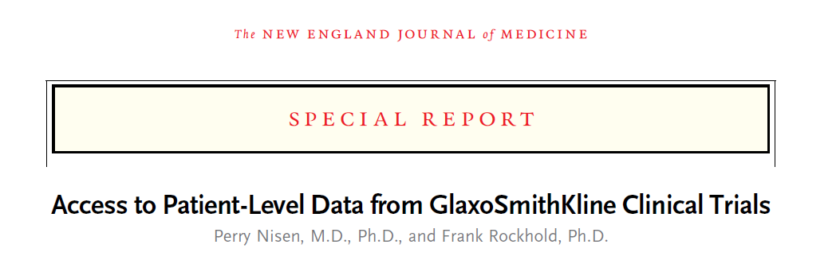

A first step in 2013
In May 2013, GSK launched a system to provide greater access to anonymized patient level data from our clinical trials.

Slide 13
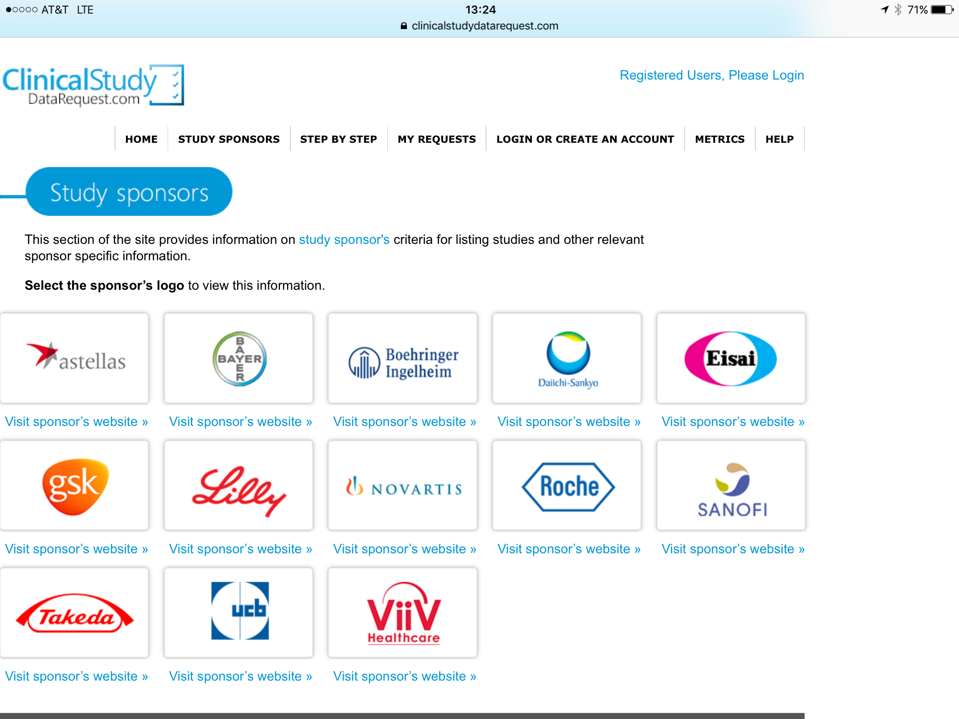

Slide 14
2018: Numerous other platforms in place!
Clinical Study Data Request: multi-sponsor request site (13 companies), managed by the Wellcome Trust
YODA: Yale Open data Access for two sponsors (Janssen/Medtronic)
Project Data Sphere (CEO roundtable on cancer)
INSPIIRE : Integrated System for Pfizer Investigator Initiated Research
SOAR: Bristol Myers Squibb and Duke Data Strategic Initiative (DCRI)
Celgene’s Clinical Trial Data Sharing
NIH BioLiNCC
Vivli.org
And many others in development
So good news and in some ways but a fractured, disconnected approach

Slide 15
Spectrum of Data Sharing Models
Publically available; downloadable data
Evaluate for COIs and scientific relevance
Restricted access to certain data elements
IRB approval required
DUAs
Secure interface
Independent Review Panel
Detailed analysis plan, including statistical plan required
Access restricted based on credentials of requestors
Contributors determine access/ can veto requests
Open Access
Restricted Access

Slide 16
Academics Weigh In!
DCRI and SAS open heart-disease data to researchers May 4, 2016 –
Access to decades of patient data on America’s deadliest disease could lead to new treatments.
A new collaboration will give more researchers access to the largest and oldest cardiovascular database in the world. The DCRI and analytics leader SAS will provide researchers worldwide with data management and analytics tools to explore 45 years of cardiovascular patient data collected by the Duke University Health System.

Slide 17
Duke Principles for Open Science 2018
At the Duke University School of Medicine, we believe in…
  Appropriate access to research information, so patient privacy is maintained, with the understanding that the nature of the study and sharing method will necessitate a range of privacy controls
  Proper oversight with minimum barriers to data access, to prevent against misuse of data, while promoting new discovery
  Maintaining utility of data, such that shared data can be used for new analyses
  An expectation that results of analyses from shared data will similarly be shared
  Acknowledgement of the work of original contributors

Slide 18
What information should be made available?
The following anonymized data and documents (with personally identifiable
information redacted) can be made accessible in a secure system:
  Raw dataset
  Analysis-ready dataset
  Protocols with any amendments
  Annotated case report form
  Reporting and analysis plan
  Dataset specification
  Redacted (for privacy) Clinical Study Report including modular appendices
  (potentially identifiable information, including patient level data and patient narratives are removed)

Slide 19
Potential Format of research proposals
Research plan
  Title
  Lay summary
  Study design
  Studies selected
  Endpoints
  Statistical analysis plan
  Publication plan
Information about research team
Funding
Conflicts of interest
Other information

Slide 20

Independent Review Panel
Provides scientific and ethical review of proposals to:
  Protect patient confidentiality/Privacy
  Ensure appropriate secondary uses of data
  Review scientific and analytical robustness of research proposals
  Assess the capabilities of the data requestor
  Enhance public trust

Slide 21

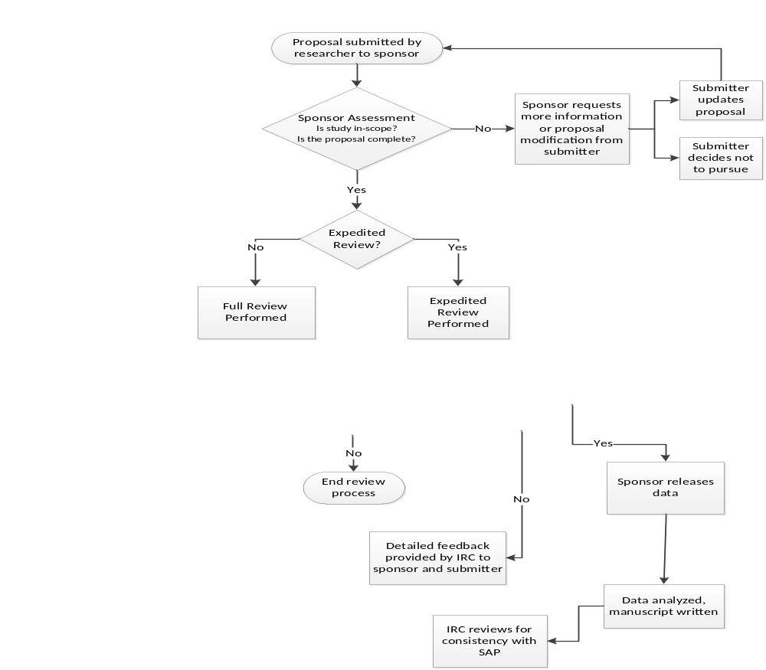
Administrative Assessment

Slide 22
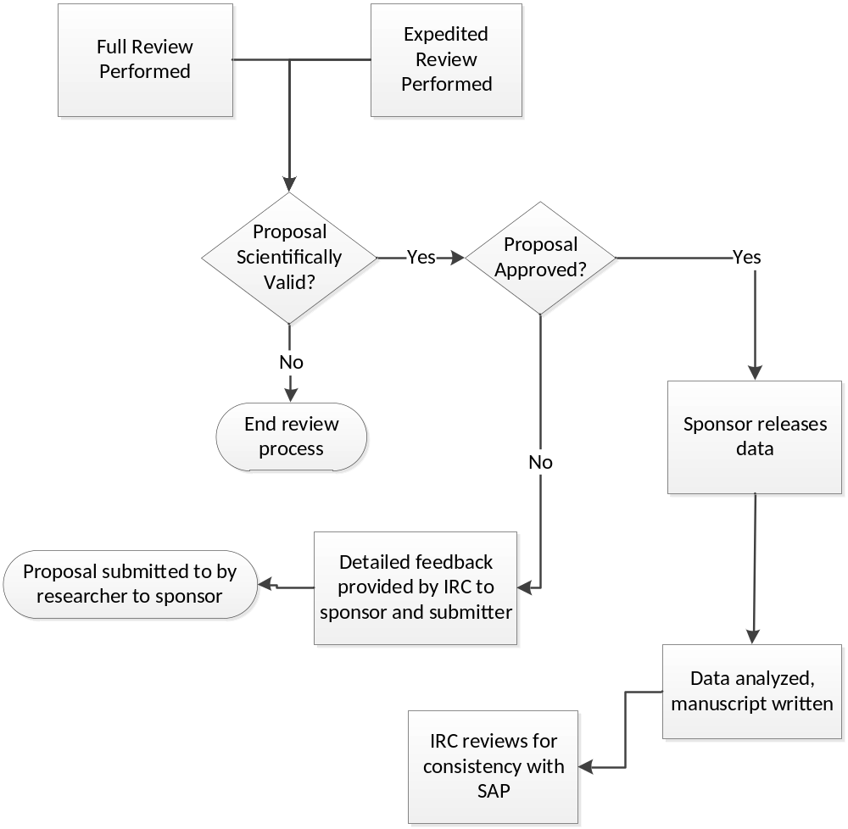
Scientific Assessment
Notes:
Full autonomy for release of the data is up to the IRC – this was key for DCRI as an academic research institution

Slide 23
NEJM Data Sharing Meeting April 2017
Some trialists seemed reluctant to share patient level data, questioning the value and timing of sharing and need to keep data to incentivize research
Patient panels expressed consensus that their data should be shared (with their privacy protected) and made available.
Patients were quite surprised that there was any debate over this issue.
Cost is an issue but we need to sort out how before “how much”. (Cost relative to research cost is low)
One debate will be on length of “exclusivity period” to allow front line manuscripts to be completed
The value of granting access has value to society in increasing trust in clinical research even if no one ever actually uses the data—similar to CT.Gov

Slide 24
Incentives for Data Generators*
Clinical trialists could be given incentives to share data. Trialists could receive appropriate acknowledgment and academic rewards when other researchers use “their” shared data to publish papers.
Secondary investigators analyzing shared clinical trial data should provide a research question and data-analysis plan when requesting data access, submit their findings to a peer-reviewed journal, and share their own data analyses.
Collaboration between clinical trialists and secondary users of data sets should be promoted. Data sharing is often perceived as a zero-sum game in which the original trialists lose if others perform secondary analyses. But trialists and secondary investigators could be collaborators rather than antagonists
*Lo, B. and DeMets, D.L., Incentives for Clinical Trialists to Share Data. NEJM, 2016. 375(12): p. 1112-1115
*Bierer, B.E., Academic Incentives for data sharing. New England Journal of Medicine, 2017.

Slide 25
One Solution: A trusted global neutral data sharing platform
Minimize risks to all stakeholders
Ensure maximum participant safety and privacy
Allow participation of academia, industry, government, non-profits, and others
Enable transparent and inclusive governance
Provide interoperability of data
Ensure Data security

Slide 26
Benefits of a common or federated system
Advantages for researchers:
  Inventory of trials can be searched in one place and Integrated search functionality
  Requests for data from multiple sponsors require one proposal, one review, and one set of communications.
  Data should be accessible in a common standard facilitating data access and integration
  Facilitates integration of data from multiple sources.
  Provide for hosting of global clinical trials data if needed
Should be more Cost effective in the long run
  Avoids duplication of infrastructure
  Standard data use agreements

Slide 27
The Vivli Solution (in partnership with Microsoft and others)
Independent non-profit organization bringing together multiple stakeholders in a trusted, neutral entity under transparent shared governance
Harmonized policies and streamlined processes for data submission, data request, data access, and sharing of academic credit
State-of-the-art user-friendly data sharing platform providing
    easy process for cataloging which studies are available for sharing
    powerful precise searching of study features to identify studies of interest
    personal dashboards of data request, approval, and data sharing status
    data standards and anonymization processes for submission of individual participant-level data
    automated data set and citation tracking

Slide 28
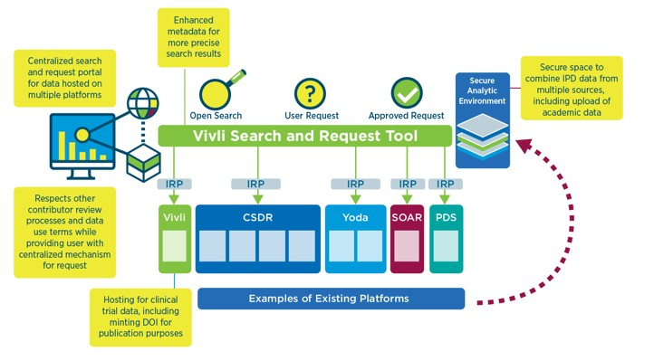
Vivli Workflow

Slide 29
Key Summary Points
We owe it to patients who enroll in trials to make data available or “open” for further evaluation
We need to view ”Data Access” effort as a journey that benefits patients in first instance and other requirements from journals and legislators, etc. will follow in place.
There are some challenges and some risks, all of which are manageable and can be overcome with focus and effort.
  Understanding of “Openness” and “Transparency”
    Patient Privacy and Informed Consent
    Data Utility
    Data Standards and interoperability
    Incentives for researchers
    Proof of value
A common standardized system has advantages over a fractured and siloed approach

Slide 30
Questions and Discussion

Slide 31
Extras

Slide 32
What is DukeCath?
A de-identified dataset that includes one record for every cardiac catheterization procedure performed at DUMC between 1985 and 2013 (155,000 procedures in 85,000 patients)
Primary source is a clinical care database used to generate reports for the patient’s medical record.
A single patient may have multiple cath procedures (multiple records) in the dataset, one for each procedure.
Includes long-term follow-up for clinical outcomes on a subset of patients.

Slide 33
Immune Tolerance Network- Trial share
Open access to ITN data after registration and agreement to terms of use
No further approval process
Downloadable data
ClinicalStudyDataRequest.com
Multiple industry sponsors; governance ranges by sponsor
Secure interface, DUA, IRP
IRP considers scientific relevance, COIs, and investigator expertise
Some sponsors may review requests, and veto based on data specific considerations, competitive risk etc.
AHA Precision Medicine Initiative
CV and stroke data
Cloud-based, secure sharing environment
Forum for collaboration
Data access is granted in private workspaces by data contributor
YODA
Generally, data is not downloadable
DUA, IRP
Data requests evaluated for scientific merit and COIs
Restrictions to data access for legal or commercial purposes
Project data sphere (PDS)
Oncology research
Downloadable data
DUAs
Open to all
Control Group Only
Vivli
Attempting to harmonizing data sharing governance
Secure interface, DUAs, IRP
Review process considers the research plan, team, statistician, and COIs
Contributors can veto requests, but number and reasons for rejections will be made public
SOAR
DUA, IRP
Evaluates for COIs and research quality
Requirement for detailed statistical analysis plan, evaluated for major design flaws
Final analyses are reviewed by the IRC prior to publication
Open Access
Restricted Access

Slide 34
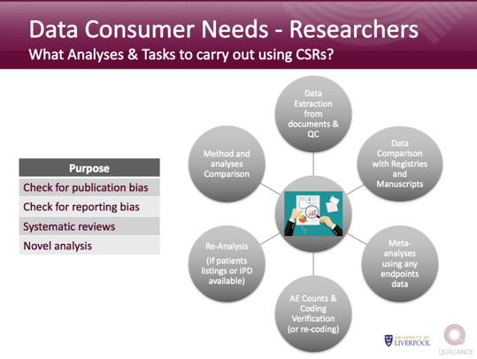

Slide 35
Evolution and learnings from progress so far
Navar, A.M., Pencina, M.J., Rymer, J.A., Louzao, D.M., and Peterson, E.D., Use of Open Access Platforms for Clinical Trial Data. JAMA, 2016.
Strom, B.L., Buyse, M.E., Hughes, J., and Knoppers, B.M., Data Sharing - Is the Juice Worth the Squeeze?
Bierer, B.E., Li, R., Barnes, M., and Sim, I., A Global, Neutral Platform for Sharing Trial Data. N Engl J Med, 2016.
Horton, R., Offline: Data sharing—why editors may have got it wrong. The Lancet, 2016.
Toward Fairness in Data Sharing. New England Journal of Medicine, 2016.
Warren, E., Strengthening Research through Data Sharing. New England Journal of Medicine, 2016.
Taichman, D.B., et al., Data Sharing Statements for Clinical Trials: A Requirement of the International Committee of Medical Journal Editors. Annals of Internal Medicine, 2017
Bierer, B.E., Academic Incentives for data sharing. New England Journal of Medicine, 2017.
Rockhold, F., Data Access and Sharing: Are we being transparent about clinical research? Let's do what's right for patients. Ann Oncol, 2017.
Etc…. http://www.nejm.org/page/data-sharing

Slide 36
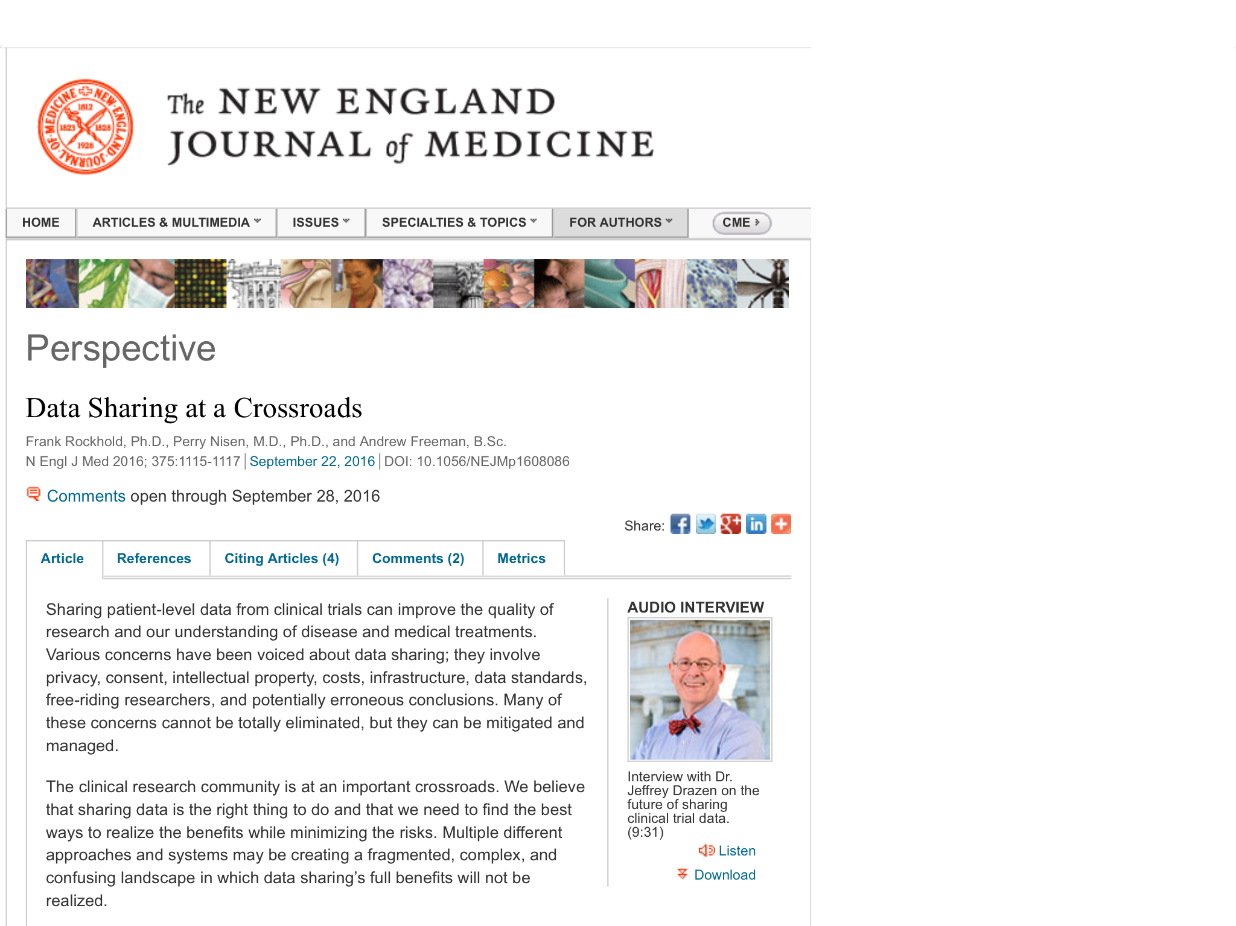

Slide 37
Other Approaches
Therapeutic-specific “warehouses”, e.g. expanded version of PDS, ACCESS
Institution-specific Registries or databases
Regulatory or health authority platforms
…
All provide access or sharing and could work in a federated model based on standards and an ability to search across repositories.

Slide 38
Key Summary Points
We owe it to patients who enroll in trials to make data available for further evaluation
We need to view ”Data Access” effort as a journey that benefits patients in first instance and other requirements from journals and legislators, etc. will follow in place.
There are some challenges and some risks, all of which are manageable and can be overcome with focus and effort.
    Patient Privacy
    Informed Consent
    Data Standards and interoperability
    Incentives for researchers
    Proof of value
A common standardized system has advantages over a fractured and siloed approach

Slide 39
Extras

Slide 40





















Vivli: A vision of worldwide collaborating stakeholders
Industry
Academia
Non-profits
Associations
Regulatory agencies
Foundations
Participants
Industry
Non- Profits
Academia
Patient Orgs
Gov’t
Journal Editors

Slide 41
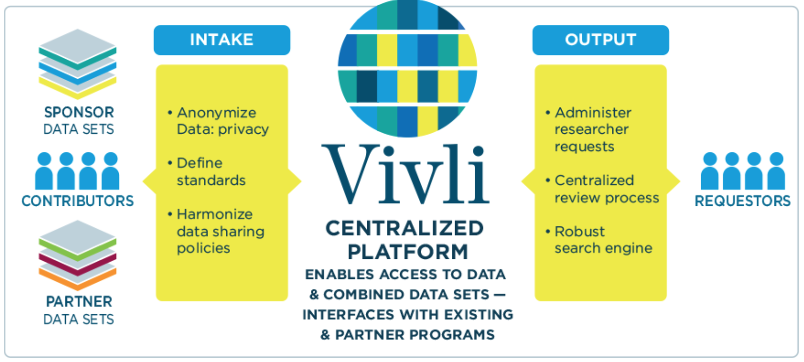
Proposed Model Platform

Slide 42


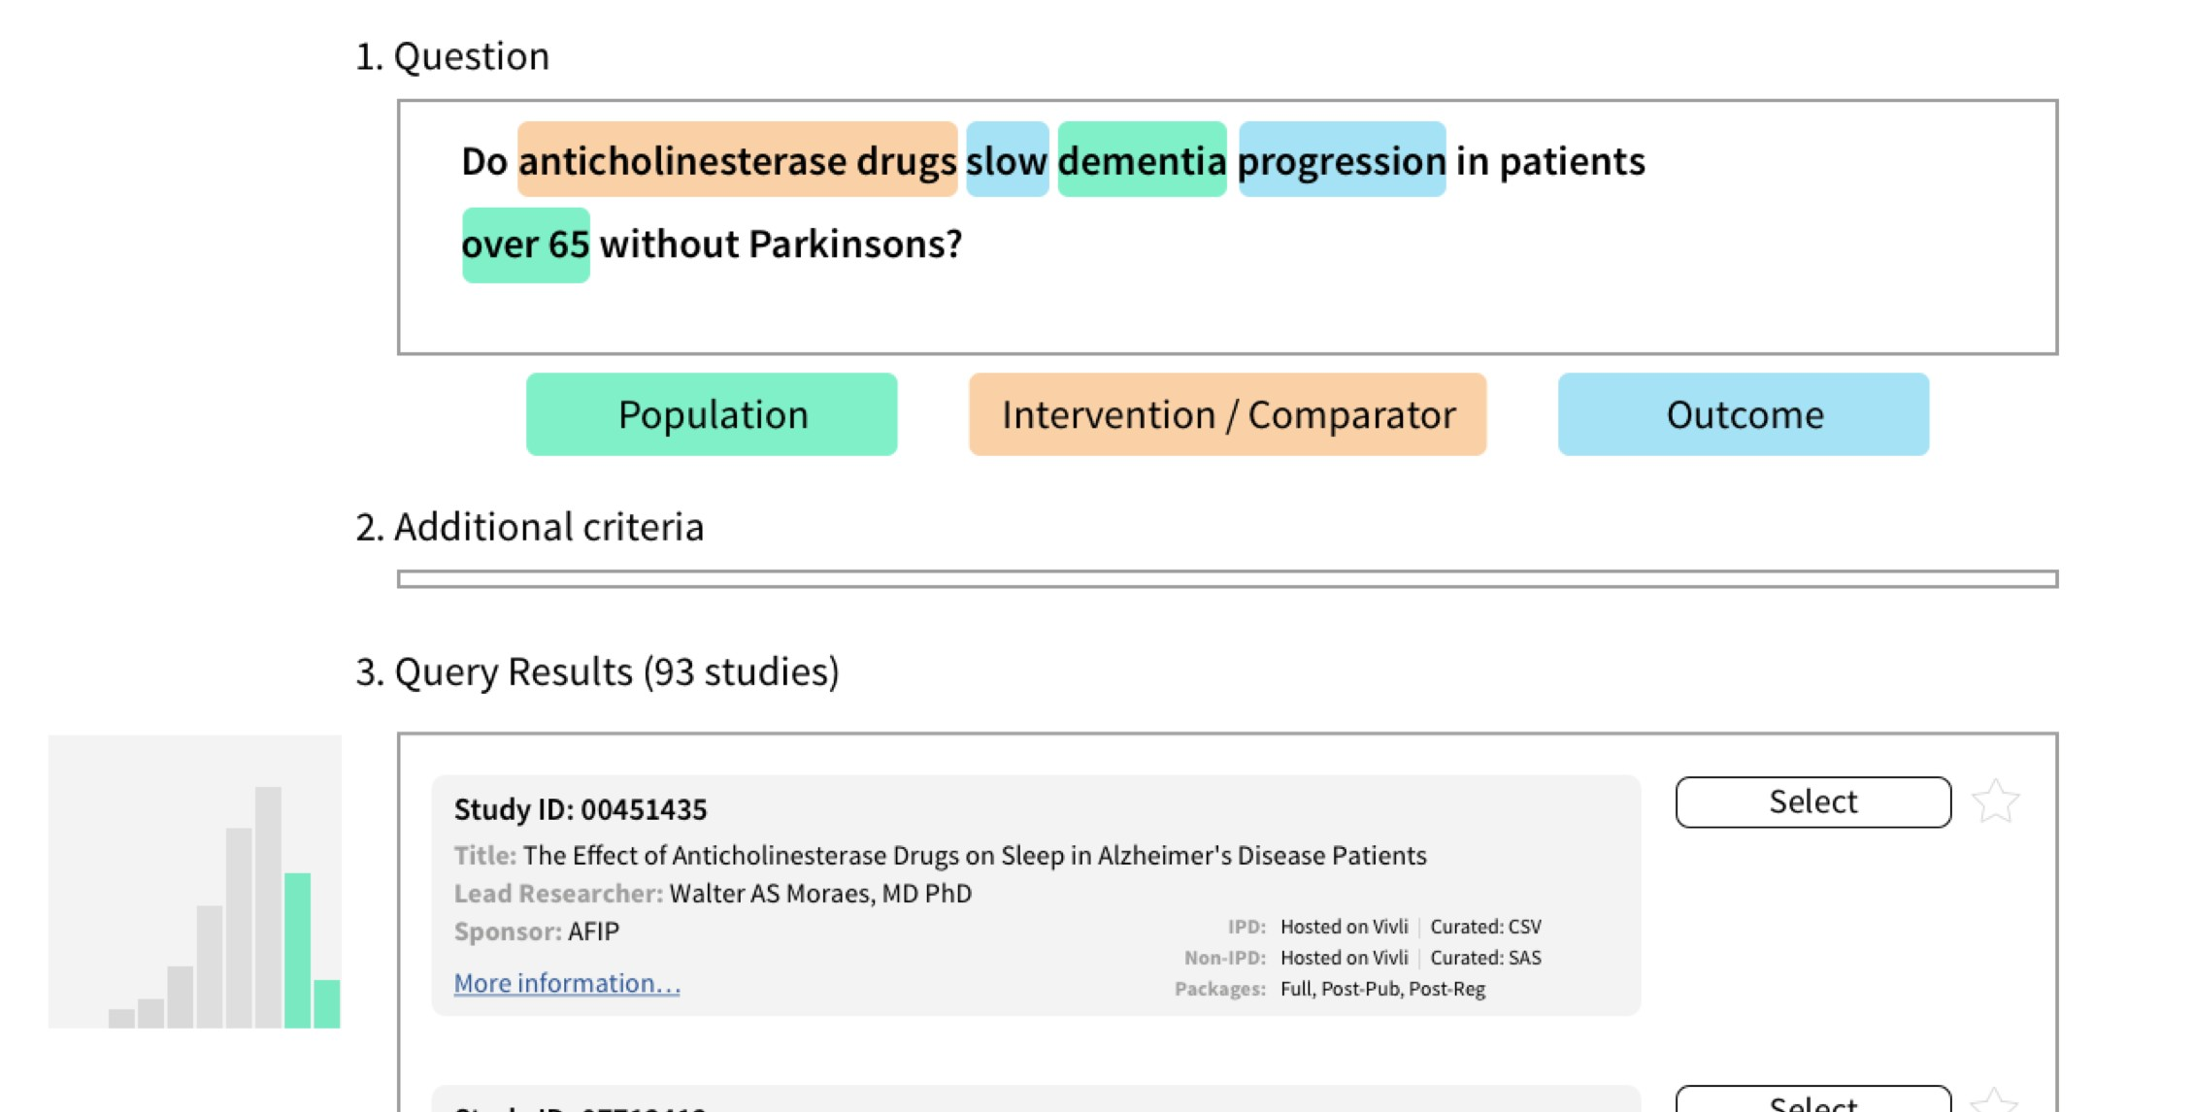






Example of Curated Metadata Search
Automated
classification of terms into a “PICO” query
Supporting fee-text natural language search
User can easily
reclassify a term into a different PICO category
Detailed and graphical descriptions of study features for interactive browsing

Slide 43


Host and/or
Option 1: IPD Hosted on Vivli
make IPD
a
available vi
Vivli
Deposit IPD for Vivli to host
1
in SDTM
anonymized in SDTM
curated, de-identified IPD
2a
Individual Participant Data (IPD)
by sponsor
anonymized in SDTM
2
to be put into SDTM
2b
not in a standard model
by Vivli
3
basic anonymization
leave unstandardized
Vivli-hosted IPD
  when data request approved, IPD dataset is made available through Vivli
    only for the approved user and for the approved request
  if requester wishes to combine Vivli-hosted IPD with non-Vivli-hosted IPD, this will be done via a secure VM which will be destroyed when done

Slide 44
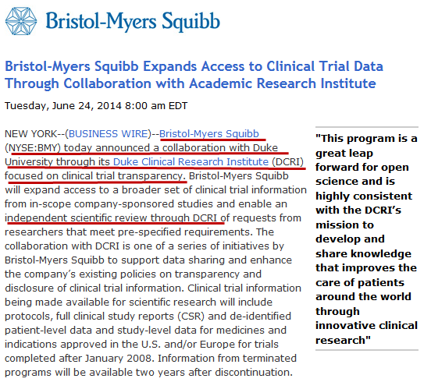
Supporting Open Access for Researchers
Notes:
SOAR is currently a partnership between the Duke Clinical Research Institute and Bristol-Myers Squibb where DCRI serves as an independent review committee of requests for access to patient-level data from clinical trials at BMS. In this presentation I will describe the operational processes that have been implemented for this review as well as highlight key areas of difference between SOAR and other existing review processes.

