Slide 1

A Simple Approach for Comparing the In Vitro Dissolution Profiles of Highly Variable Drug Products: A Proposal
Marilyn N. Martinez and Xiongce Zhao
US FDA, Center for Veterinary Medicine (CVM), Office of New Animal Drug Evaluation

Slide 2

The views expressed in this presentation are solely those of Drs. Martinez and Zhao and do not reflect the views of the US Food and Drug Administration.

Slide 3
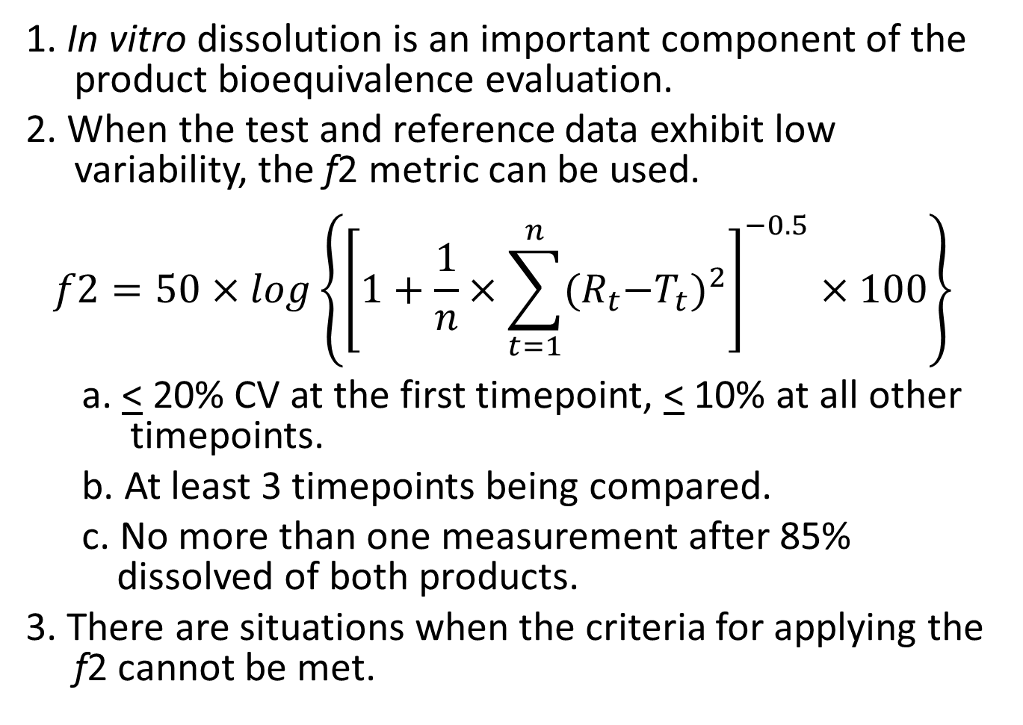
The Problem
1. In vitro dissolution is an important component of the product bioequivalence evaluation.
2. When the test and reference data exhibit low variability, the f2 metric can be used.
$$f2=50×log{\left\{{\left[1+\frac{1}{n}×\sum_{t=1}^{n}{{{(R}_{t}−T_{t})}^{2}}\right]}^{−0.5}×100\right\}}^{}$$
a. < 20% CV at the first timepoint, < 10% at all other timepoints.
b. At least 3 timepoints being compared.
c. No more than one measurement after 85% dissolved of both products.
3. There are situations when the criteria for applying the f2 cannot be met.

Slide 4
Problem Not Unique to Veterinary Medicine
Numerous publications suggest procedures that still rely upon comparisons based on a single value composite such as:
  Multivariate Statistical Distance (MSD) which is based upon an estimated mean difference between the test and reference profiles and a pooled variance between batches.
  Bootstrap f2 estimates (constrained by resampling of observed values).
  Tolerance limits about the f2 (using the same concepts as f2 but now adding a statistical confidence about the assessment).
By using a single value to describe the profile comparisons, the importance of time of the differences cannot be evaluated, and depending on the number of samples, these differences (particularly at early timepoints) can be overlooked.
Moreover, although %CV may differ across the sampling times, again, such differences are not considered when comparing product profile using these methods.

Slide 5
There Are Also Some Issues Unique to Veterinary Medicine
High inter-and intra-lot variability (e.g., some Type A Medicated Articles). When reference product between lot variability exceeds variability within lots, more than one product lot needs to be included in our product profile comparison.
In other cases, and similar to that in human medicine, the intralot > interlot variability. However, we are still dealing with only 12 profiles being compared for the test and reference formulations.

Slide 6
Objectives of Our Alternative Approach
Method should allow for product comparability determinations at each sampling time. This necessitates careful protocol development to maximize likelihood of in vivo relevance.
Rather than focusing on mean values, method should allow for an evaluation of the relative spread of the test versus reference observations at each sampling time.
Can accommodate situations when interlot variability < intralot variability (e.g., tablets) or when intralot variability < interlot variability (e.g., mediated feeds).
The method should not:
  Rely upon a statistical treatment comparison (p values can be misleading).
  Rely upon an assumption of test – reference homogeneity of variances. This is especially important when test < ref variability.
  Should not require curve fitting (which introduces a risk of model-misspecification)

Slide 7
The Method
Product equivalence is based upon confirmation that the individual observations of the test product are contained within limits established about the reference product dissolution at each sampling time.
Thus, we are not performing a statistical comparison of the test and reference products and the criteria for comparability reflect the characteristics of the reference product % dissolved at each sampling time.

Slide 8
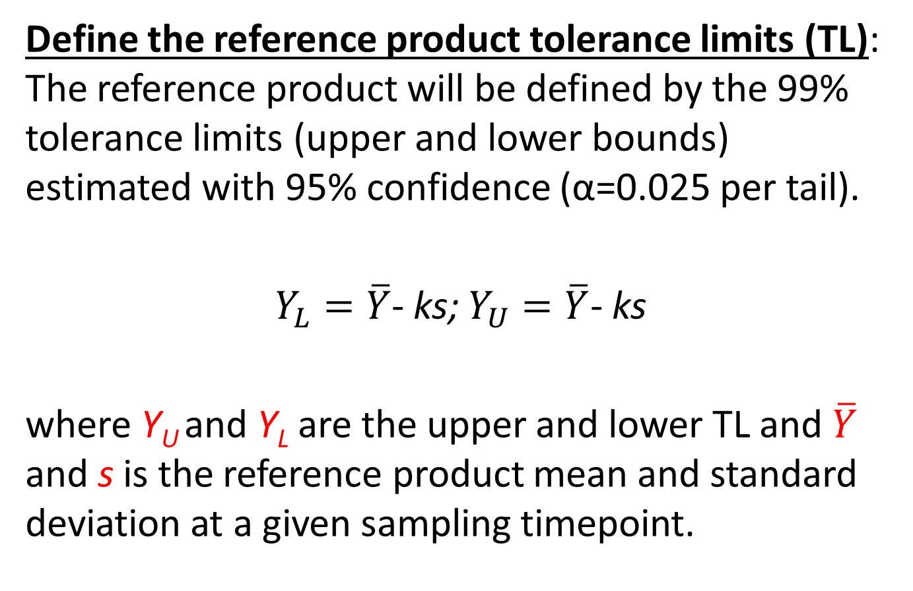
The Method
Define the reference product tolerance limits (TL): The reference product will be defined by the 99% tolerance limits (upper and lower bounds) estimated with 95% confidence (α=0.025 per tail).
$Y_{L}=\overline{Y}$- ks; $Y_{U}=\overline{Y}$- ks
where Y_{U} and Y_{L} are the upper and lower TL and $\overline{Y}$ and s is the reference product mean and standard deviation at a given sampling timepoint.

Slide 9
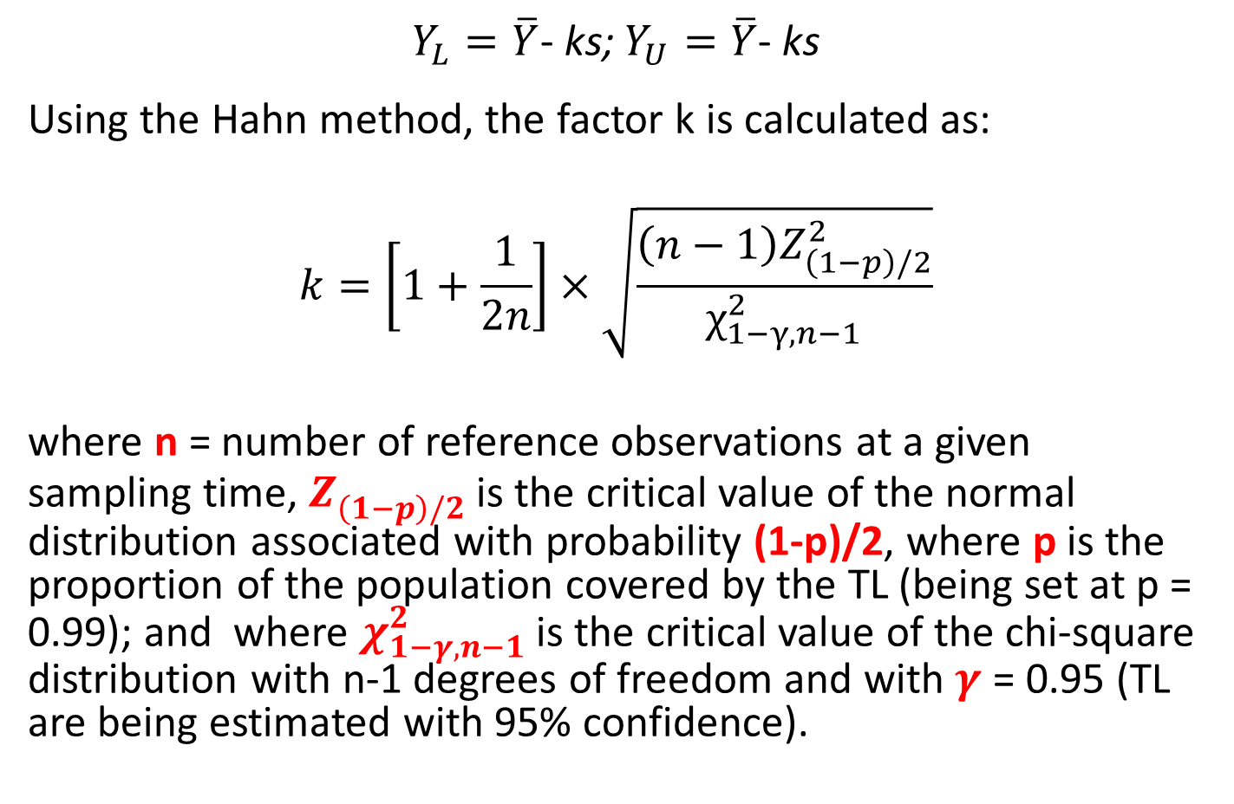
The Method
$Y_{L}=\overline{Y}$- ks; $Y_{U}=\overline{Y}$- ks
Using the Hahn method, the factor k is calculated as:
$$k=\left[1+\frac{1}{2n}\right]×\sqrt{\frac{\left(n−1\right)Z_{\left(1−p\right)/2}^{2}}{χ_{1−γ,n−1}^{2}}}$$
where n = number of reference observations at a given sampling time, $Z_{\left(1−p\right)/2}^{}$ is the critical value of the normal distribution associated with probability (1-p)/2, where p is the proportion of the population covered by the TL (being set at p = 0.99); and where $χ_{1−γ,n−1}^{2}$ is the critical value of the chi-square distribution with n-1 degrees of freedom and with $γ$ = 0.95 (TL are being estimated with 95% confidence).

Slide 10
The Method
Defining the criteria for product comparability: Based upon the ability to declare sameness to self, it was determined that the TL alone resulted in an unacceptable frequency of failure. Since the goal is to confirm product comparability and not statistical sameness, the limits defining product comparability are adjusted by the inclusion of acceptable deviations.

Slide 11
The Method
Defining the criteria for product comparability:
The allowable deviations about Q are defined by the S1 and S2 acceptance criteria of USP <711>.
Q = the 99% TL (defined with 95% confidence).
Level S1: This boundary is defined as Q ± 5% at each timepoint (without being truncated between 0 - 100%) E.G., if TL = 20% to 60%, then the S1 bounds would be 15% to 65%. For every 12 profiles tested, only one can exceed the S1 bounds.
Level S2: This boundary is defined as Q ± 15% at each timepoint (without being truncated between 0 - 100%). E.G., if TL = 20% to 60%, then the S2 bounds would be 5% to 75%. No observation from any of the test dissolution profiles can exceed a value of Q +/- 15%.

Slide 12
The Method
Caveat: when inter-lot variability needs to be factored into the assessment, we often have only a single pre-market lot of the test product available. Therefore, to accommodate this imbalance, we have imposed the need to estimate the f2 metric and allow for the TL approach to be applied only when the means differ by no more than 10% (i.e., f2 >50).

Slide 13
The Method – f2 Caveate
We are estimating f2 on the basis of mean values. We are not considering the variability component as that aspect is the focus of the TL criteria.
When the reference mean profile fails to achieve 85% dissolved, there is a risk for under-estimating the difference in mean profiles because %dissolved is expressed relative to the administered dose. Therefore, a normalization procedure is necessary.

Slide 14
Example: Low %Dissolved and Inequivalent
In the original dataset, the maximum amount dissolved (Ref) was 29%. Here we see marked differences in the test and reference profiles, but when applying f2 to the original data, the products would be declared equivalent.
In contrast, when we take the same dataset and correct each value by 85/29, we see that the relative profiles did not change, but the f2 metric clearly identifies the two profiles as being inequivalent.

Slide 15
The Method
Hypothetical case (based upon observed data). Ref interlot >> intralot variability. Ref = 5 lots, n=12/lot, test = 1 lot (n=36). One ref lot showed lower release, which would have resulted in wide TL criteria and Test being declared equivalent to Ref. However, this risks post-approval test product lots outside the equivalence bounds. Therefore, f2 was calculated (Ref_{mean} vs Test_{mean}). Since f2=42, an application of the TL criteria was deemed inappropriate .

Slide 16
Method Performance Evaluation
1. Verifying the self-containing success rate: Monte Carlo (MC) simulations to generate either 36 or 60 observations using single mean reference profiles but varying the %CV associated with the profiles (same %CV at each timepoint per set of MC simulations).
2. MC simulations to explore how the method performs across a range of test versus reference profiles (where mean and variability differ in test vs reference products).
3. Assess how method performs with single sets of test and reference profiles reflecting a range of relationships.
a. n=36 for test and reference (interlot considerations).
b. n=12 for test and reference (intralot>interlot).

Slide 17
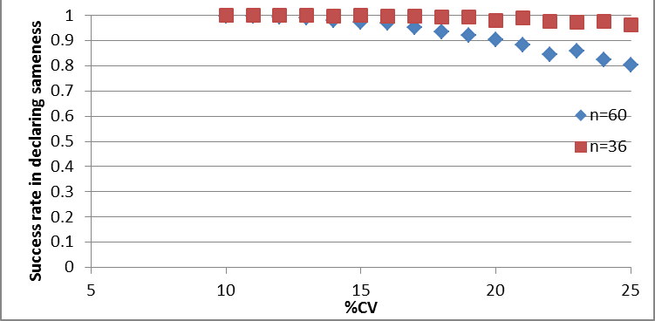
RESULTS: Ability to declare reference equivalent to self using our proposed method

Slide 18
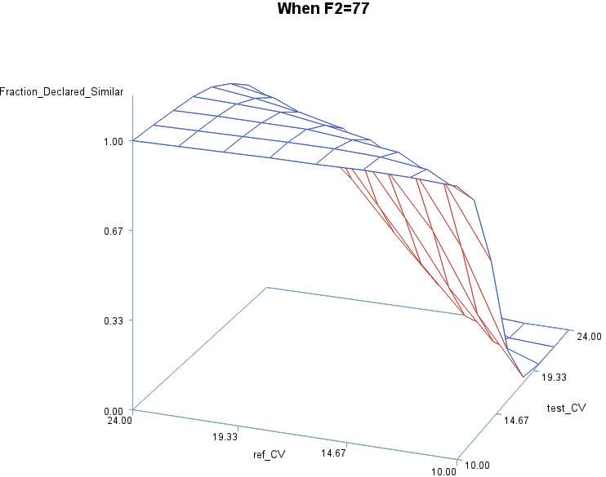
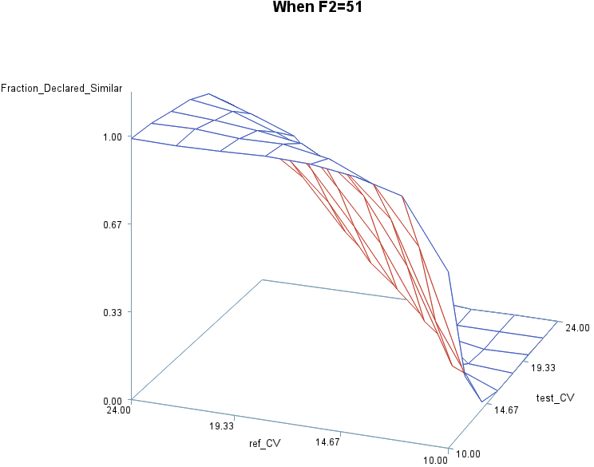
Frequency of declaring similar for test vs reference formulation
Test %CVV
Test %CVV

Slide 19
Relationship between comparative variability versus profile shape on the likelihood of demonstrating product comparability based solely upon the TL criteria

Slide 20
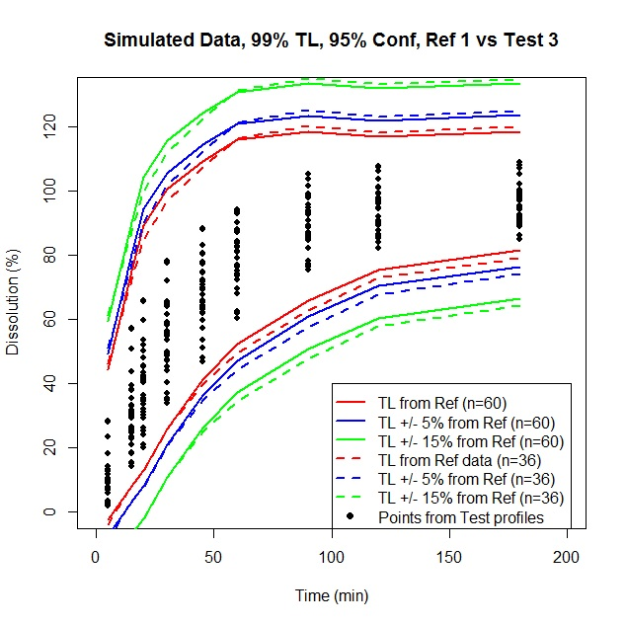
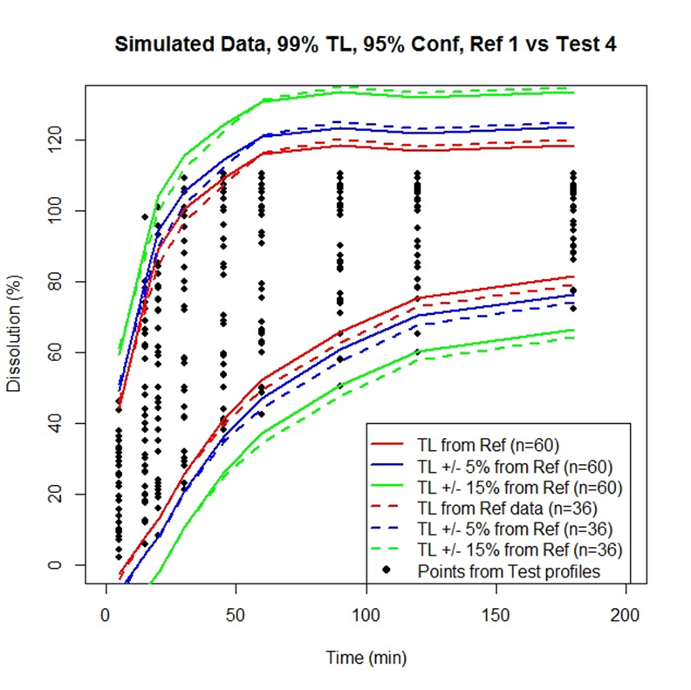
Method Performance: two examples
Test 3: f2 = 52.4, slightly more variable than Ref
Test 4: nearly identical profiles (f2=80.6) but greater variability than reference.

Slide 21
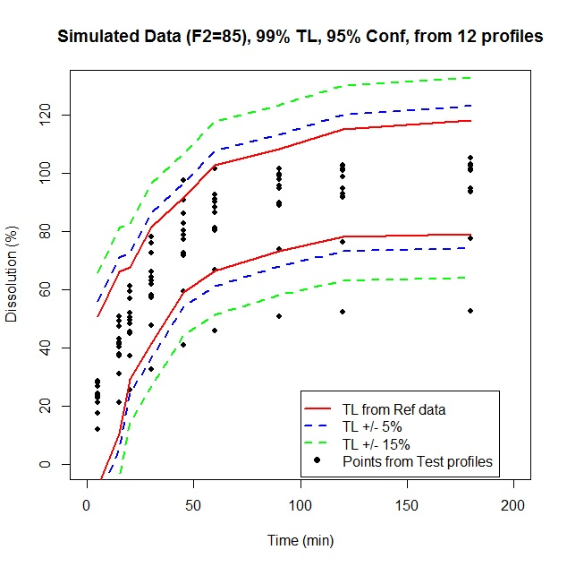
Additional Work
We also explored the ability of this method to be used to compare profiles when n=12 for the test and reference product but the f2 metric cannot be applied.
The Ref %CV was less than 10% from 20 to 180 minutes but was 33% and 17% at 5 and 15 minutes, respectively. The corresponding test product %CV ranged from 20%-25% across all sampling times.

Slide 22
Please see Martinez and Zhao, AAPS J, 20:78, 2018 for a details on the simulations used to characterize the performance of this method under a range of conditions.
We welcome your thoughts on this method, your perspectives on its applicability in veterinary medicine, and if you have any suggestions or comments.

Slide 23
THANK YOU FOR YOUR ATTENTION
Marilyn Martinez, Ph.D.
marilyn.martinez@fda.hhs.gov

