Slide 1
Extrapolation in Pediatric Drug Development: An Evolving Science
Lynne P. Yao, M.D.
Director, Division of Pediatric and Maternal Health
Center for Drug Evaluation and Research
U.S. FDA
September 13, 2018

Slide 2
Disclosure Statement
I have no financial relationships to disclose relating to this presentation
The views expressed in this talk represent my opinions and do not necessarily represent the views of FDA

Slide 3
Pediatric Drug Development
General Principles
Children first described as the therapeutic orphan in 1963 by Harry Shirkey, M.D.
Pediatric patients should have access to products that have been appropriately evaluated
Product development programs should include pediatric studies when pediatric use is anticipated
From FDA guidance to industry titled E11 - Clinical Investigation of Medicinal Products in the Pediatric Population, December 2000
Notes:
6-14-09
3

Slide 4
U.S. Evidentiary Standard for Approval
For approval, pediatric product development is held to same evidentiary standard as adult product development:
A product approved for children must:
  Demonstrate substantial evidence of effectiveness/clinical benefit (21CFR 314.50)
  Clinical benefit:
    The impact of treatment on how patient feels, functions or survives
    Improvement or delay in progression of clinically meaningful aspects of the disease
Evidence of effectiveness [PHS Act, 505(d)]
  Evidence consisting of adequate and well –controlled investigations on the basis of which it could fairly and responsibly be concluded that the drug will have the effect it purports to have under the conditions of use prescribed, recommended, or suggested in the labeling
Adequate safety information must be included in the application to allow for appropriate risk benefit analysis [FD&C 505(d)(1)]

Slide 5
Special Considerations for Pediatric Product Development
Ethical considerations
  Children should only be enrolled in a clinical trial if the scientific and/or public health objectives cannot be met through enrolling subjects who can provide informed consent personally (i.e., adults)
  Absent a prospect of direct therapeutic benefit, the risks to which a child would be exposed in a clinical trial must be “low”
  Children should not be placed at a disadvantage after being enrolled in a clinical trial, either through exposure to excessive risks or by failing to get necessary health care
  Ethical considerations do play a role in the need to correctly apply pediatric extrapolation
Feasibility considerations
  The prevalence and/or incidence of a condition is generally much lower compared to adult populations
  Feasibility, by itself, is not a scientific justification for use of extrapolation

Slide 6
U.S. Pediatric Drug Development Laws
Best Pharmaceuticals for Children Act (BPCA)
  Section 505A of the Federal Food, Drug, and Cosmetic Act
  Provides an incentive in the form of marketing exclusivity to companies to voluntarily conduct pediatric studies for therapies with potential public health benefit in children
  FDA and the National Institutes of Health partner to obtain information to support labeling of products used in pediatric patients (Section 409I of the Public Health Service Act)
Pediatric Research Equity Act (PREA)
  Section 505B of the Federal Food, Drug, and Cosmetic Act
  Requires companies to assess safety and effectiveness of certain products in pediatric patients
  PREA does not apply to any drug for an indication for which orphan designation has been granted
Goal of both programs is to increase the number of approved therapies for children
Notes:
6-14-09
6

Slide 7
Pediatric Extrapolation
1994: Final Regulation: Pediatric Labeling Rule
“A pediatric use statement may also be based on adequate and well-controlled studies in adults, provided that the agency concludes that the course of the disease and the drug’s effects are sufficiently similar in the pediatric and adult populations to permit extrapolation from the adult efficacy data to pediatric patients. Where needed, pharmacokinetic data to allow determination of an appropriate pediatric dosage, and additional pediatric safety information must also be submitted”
Efficacy may be extrapolated from adequate and well-controlled studies in adults to pediatric patients if:
  The course of the disease is sufficiently similar
  The response to therapy is sufficiently similar
Dosing cannot be fully extrapolated
Safety cannot be fully extrapolated

Slide 8
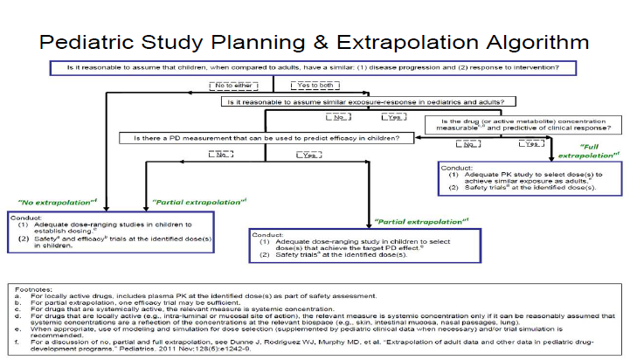
FDA Draft Guidance: General Clinical Pharmacology Considerations for Pediatric Studies for Drugs and Biological Products, December 2014

Slide 9
Pediatric Labeling Changes 1998-2017
Notes:
738 labeling changes as of end of May.
R2=0.62

Slide 10
Evolving Science and Use of Pediatric Extrapolation
Increased understanding of overall pediatric drug development
Increased scientific knowledge
Increased experience in the use of pediatric extrapolation in drug development

Slide 11
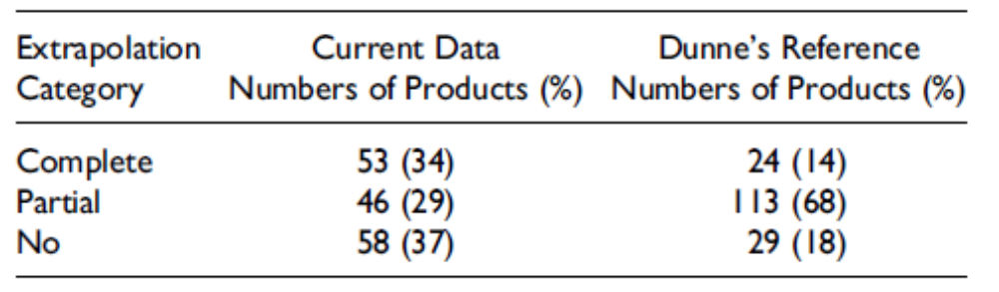
Follow-up on FDA Experience with Pediatric Extrapolation
Recent analysis of products with new pediatric labeling between 3/1/2009 – 12/31/2014
Compared to FDA pediatric extrapolation publication (Dunne, et al.) with new pediatric labeling between 2/1/1998 – 2/2009
Copied with author’s permission; Sun et al., Ther Innov Regul Sci. 2017;2017:1-7
Notes:
Possible reasons and examples for the pattern shifting:
Failures when a single adequate and well-controlled trial was thought to be sufficient
Inability to identify an exposure response relationship in the overall pediatric population or in an age subgroup
More studies difficult to study in children are now being required or requested

Slide 12


Extrapolation approaches in pediatric programs
1 or more adequate-well controlled studies powered on a clinically meaningful endpoint
  Bipolar disorder, systemic juvenile idiopathic arthritis, major depression, migraine, polyarticular JIA (pJIA), bronchopulmonary dysplasia, ADHD, nausea/vomiting, partial seizures (<4 y/o), respiratory syncytial virus, prophylaxis of venous thromboembolism, atopic dermatitis, etc.
1 or more adequate-well controlled studies powered on a surrogate endpoint
  Diabetes, anemia, idiopathic thrombocytopenia, treatment of venous thromboembolism, hypertension, hypercholesterolemia, asthma, etc.
Controlled study without formal statistical power
  Community acquired pneumonia, nosocomial infections, skin and skin structure infections, etc.
Increasing level of evidence required from pediatric studies
Descriptive efficacy study without concurrent control
  Plaque psoriasis, Neurogenic detrusor over-activity, pJIA (NSAIDs), etc.
Small dose-ranging studies (randomization to multiple dose levels)
  Sedation, ulcerative colitis, Crohn’s, etc.
Increasing level of confidence in similarity of disease/response
Small PK/PD studies (single dose level matching adult exposures)
  HIV, erosive esophagitis (infants), anesthetics, pulmonary arterial hypertension,
~60% Pediatric Programs
require at least 1 adequate, well-controlled efficacy trial (clinical or surrogate endpoint)
PK/safety only (single dose level matching adult exposures)
  gastroesophageal reflux disease, bacterial sinusitis, herpes simplex, analgesics/anesthetics (well known MOAs; over 2 y/o), imaging products, melanoma (adolescents)
List partially adapted from Dunne et al. Pediatrics 2011

Slide 13
Extrapolation in Pediatric Medical Devices
Guidance published “Leveraging Existing Clinical Data for Extrapolation to Pediatric Uses of Medical Devices”
  Draft published 2015; final guidance published 2016
  https://www.fda.gov/downloads/medicaldevices/deviceregulationandguidance/guidancedocuments/ucm444591.pdf
Medical device approval regulations different from drug approval regulations
Introduces Bayesian concept of borrowing from one population or data set (e.g., prior adult information) to come to a posterior conclusion about another population (e.g., pediatric effectiveness or safety)
Notes:
“Extrapolation" refers to the leveraging process whereby an indication for use of a device in a new pediatric patient population can be supported by existing clinical data from a studied patient population
That is, when existing data are relevant to a pediatric indication and determined to be valid scientific evidence, it may be scientifically appropriate to attempt to extrapolate such data to a pediatric use in support of demonstrating a reasonable assurance of effectiveness or probable benefit and, occasionally, safety.

Slide 14
EMA Reflection Paper
Published as draft in October 2017
Addresses the use of quantitative methods to help assess the relevance of existing information in a source population to one or more target population(s)
  Extrapolation Concept
  Intended to identify gaps in knowledge
  Strength of evidence available
Address gaps in knowledge and assumptions, so that the totality of available evidence can address the scientific questions of interest for marketing authorisation in the target population
  Extrapolation Plan
  Studies to be conducted/Information to be collected to address gaps in knowledge
Validation of the Extrapolation Concept and Mitigation of Risks associated with Extrapolation
Does not discuss “categories” extrapolation (i.e., full or partial extrapolation)

Slide 15
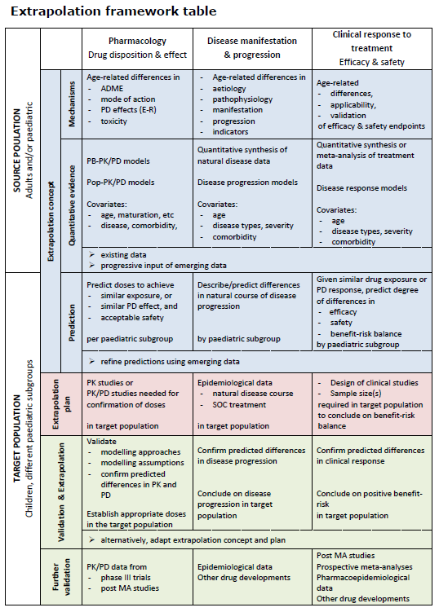
EMA Reflection paper on the use of extrapolation in the development of medicines for paediatrics, October, 2017

Slide 16
ICH E11(A): Pediatric Extrapolation
Recently finalized E11(R1) Addendum recognized the need for more detailed ICH guidance on Pediatric Extrapolation
Concept Paper finalized in October 2017
Expert Working Group assembled
  Global Regulatory Authorities and Drug Development Organizations
Align terminology
Systematic approach to use pediatric extrapolation
Study designs, statistical methodologies, and Modeling and Simulation strategies that can be considered
Current goal is to have guidance available for public comments by November 2020 (Step 2a/2b)
Notes:
FDA, EMA, HC, PMDA/MHLW, PhRMA, BIO, SwissMedic, JPMA, CFDA, TFDA Chinese Taipei

Slide 17
Assessment of Disease Similarity and Response to Intervention
The assessment is not a simple “yes or no”
Quantitative assessment of differences between target and source population
  Evidence of common pathophysiology, natural history
  Similarity in response as assessed by similar endpoints, mode of action, or biological pathway, experience with drugs in the same therapeutic class
What assumptions or uncertainties exist in this assessment
  Quantity of evidence
  Quality of evidence
Degree of confidence in similarity will affect the information that will need to be collected to support efficacy

Slide 18
Extrapolation and Bayesian Approach
Bayesian Approach Applied to Pediatric Trials
  Make use of, or borrow, prior information in pediatric trials
  Provides a formal approach for incorporating prior information into the planning and the analysis of the next study
Prior information may include:
  Adult Trial Data
    Same disease with same treatment
    Different population
  Similar Pediatric Trial Data
    Similar population
    Same disease with similar treatment
    Different indication with same treatment
  PK/PD Data
    Same population with same disease under same treatment
    Different endpoint

Slide 19
Prior information
Clinical input on whether prior information is reliable
Similarity
  Population
    Baseline characteristics and demographic information
  Disease progression
    Baseline disease characteristics
    Placebo information
  Treatment effect (both disease and MOA)
    Treatment group information
Uncertainty regarding the validity of prior information can be accounted for in Bayesian statistical modeling
Sometimes Bayesian modeling will allow for few patients in a clinical trial but not always

Slide 20
Approaches Pediatric Trial Design
Trial should be designed to fill gaps in knowledge
  Amount of information needed will be based on the confidence in assumptions about disease similarity and response to intervention
Modeling and Simulation
Innovative Statistical Analyses including Bayesian Approaches
  Make use of, or borrow, existing information to increase efficiency of pediatric drug development
Confidence in both of these approaches depends on multiple factors
  Quality and quantity of data used
  Accuracy of assumptions made
Availability of pediatric-specific biomarkers and endpoints may also affect clinical trial design
Availability of patients, existing therapies, and operational issues may also affect trial design

Slide 21
Summary
Pediatric extrapolation can be used to maximize the efficiency of pediatric product development while maintaining important regulatory standards for approval
Pediatric extrapolation has matured over the last 20 years.
Increases in understanding of disease mechanisms and progression have been an important benefit from pediatric extrapolation
FDA continues to review assumptions about the acceptability of pediatric extrapolation approaches based on new knowledge gained
Advances in understanding of basic pathophysiology and natural history are critically important

Slide 22
Acknowledgements
Lily Mulugeta, PharmD.
Haihao Sun, M.D.
Suzie McCune, M.D.

