Slide 1
Bayesian models for objective performance criteria
Laura Hatfield, PhD
Associate Professor, Harvard Medical School
ASA Biopharmaceutical Section
Regulatory-Industry Statistics Workshop
Sept 14, 2018 | Baltimore, MD

Slide 2
Advances in Regulatory Science
Need for New Methods
FDA Reauthorization Act of 2017
FDA Modernization Act of 1997
21st Century Cures Act 2016

Slide 3
Pre-Market Evidence
Two-Arm Trial
Directly observes contemporary randomized controls
One-Arm Trial
Indirectly uses historical control data
Compare treated and control outcomes for safety and efficacy
Compare trial patient outcomes to objective performance criteria (OPC) or performance goal (PG)

Slide 4
OPC vs PG
Objective Performance Criteria
relatively mature technology
high-quality historical clinical evidence
Performance Goal
less mature device area
more heterogeneous evidence
sponsor and FDA consult
public standard

Slide 5
History and Future of OPCs/PGs
Past OPC approvals
surgical aortic valve replacement (see table)
global endometrial ablation (Minerva)
Past PG approvals
transcatheter aortic valve replacement (CoreValve)
peripheral vascular devices (Supera Peripheral Stent System)
left ventricular assist devices (Heart Ware VAS, Thoratec HeartMate II LVAS)
Future OPC/PG
coronary artery stents
critical limb ischemia
Sorin Mitroflow Aortic Pericardial Heart Valve | 2007
Medtronic ATS 3F Aortic Bioprosthesis, Model 1000 | 2008
St. Jude Medical Trifecta Valve | 2011
Sorin Freedom SOLO Stentless Heart Valve and SOLO Smart Stentless Heart Valve | 2014
Sorin Perceval Sutureless Heart Valve | 2016
Edwards Intuity Elite Valve System | 2016
Edwards Lifesciences Inspiris Resilia Aortic Valve | 2017
Medtronic Avalus Bioprosthesis | 2017

Slide 6
Methods Questions
outcomes
safety
efficacy
comparator devices
control populations
covariate adjustment
trial-specific parameters
sources of uncertainty
current trial outcomes
previous trial outcomes
within-person correlation
patient-reported
previous generations
competitors

Slide 7
An Ideal OPC
adapts to changing evidence
reflects prognostic factors of patients
is acceptable to stakeholders
accounts for statistical uncertainty
is clinically meaningful and patient-centered
across multiple outcomes

Slide 8

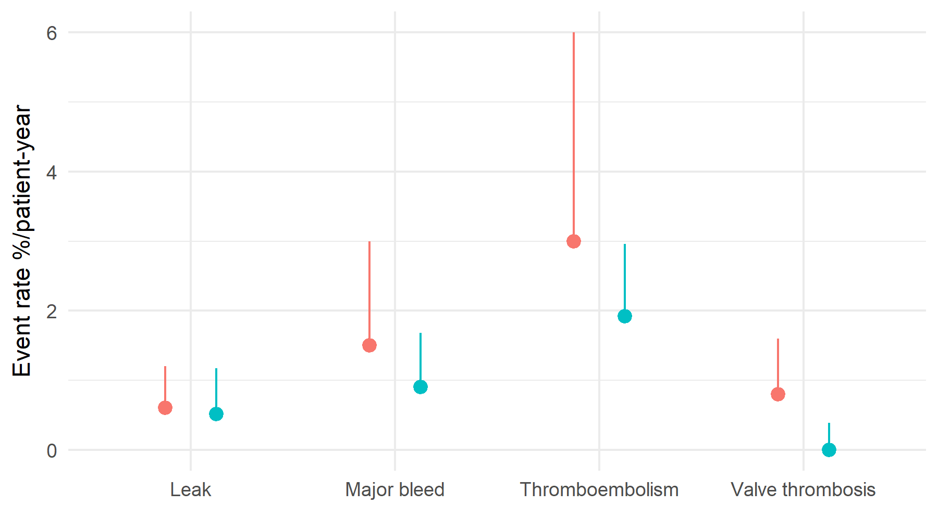
Old surgical heart valve OPC
2xOPC
OPC
Upper bound
Pass: upper bound < 2xOPC
with 800 valve-years
Observed rate

Slide 9

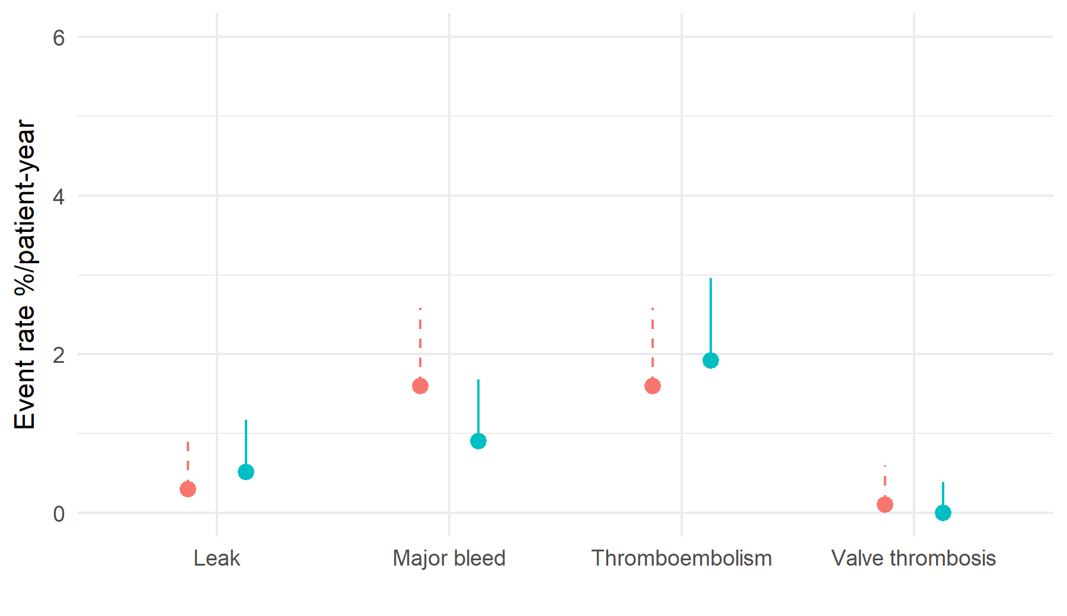
New surgical heart valve OPC
“Shadow” bound
OPC
Upper bound
Pass: observed < OPC
with 800 valve-years
Observed rate

Slide 10
Proposal
All trial data on related devices
Hierarchical Bayesian model for multiple (semi-competing) outcomes
Joint posterior distributions of multiple event rates
Compare observed event rate upper bounds to Bayesian credible region
See also: O’Malley, Normand, Kuntz 2003 Stat in Med

Slide 11






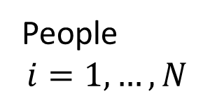






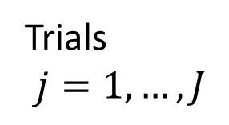



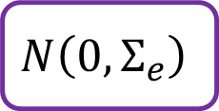







Hierarchical Model
$$N(0,Σ_{u})$$
$$N\left(0,Σ_{e}\right)$$
$$x_{ij}$$
$$u_{1j}$$
$$e_{1ij}$$
$$u_{2j}$$
$$e_{2ij}$$
$$μ_{1ij}$$
$$y_{1ij}$$
PH
$$c_{1ij}$$
$$u_{3j}$$
$$μ_{2ij}$$
$$e_{3ij}$$
PH
$$y_{2ij}$$
$$c_{2ij}$$
$$μ_{3ij}$$
$$u_{4j}$$
$$e_{4ij}$$
PH
$$y_{3ij}$$
$$μ_{4ij}$$
$$c_{3ij}$$
PH
$$y_{4ij}$$
Trials
$$j=1,…,J$$
People
$$i=1,…, N$$
$$c_{4ij}$$

Slide 12
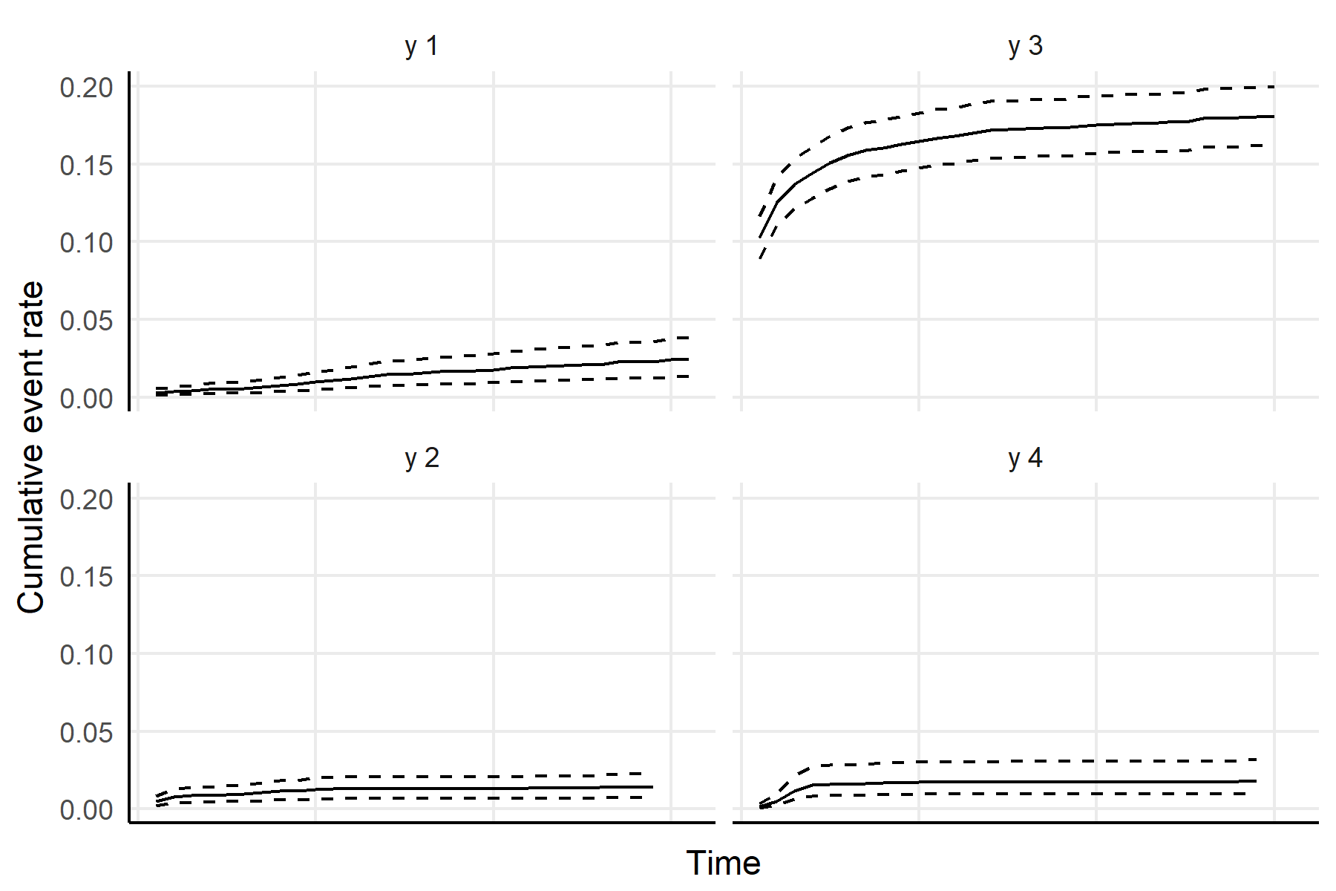
Posterior event probabilities

Slide 13
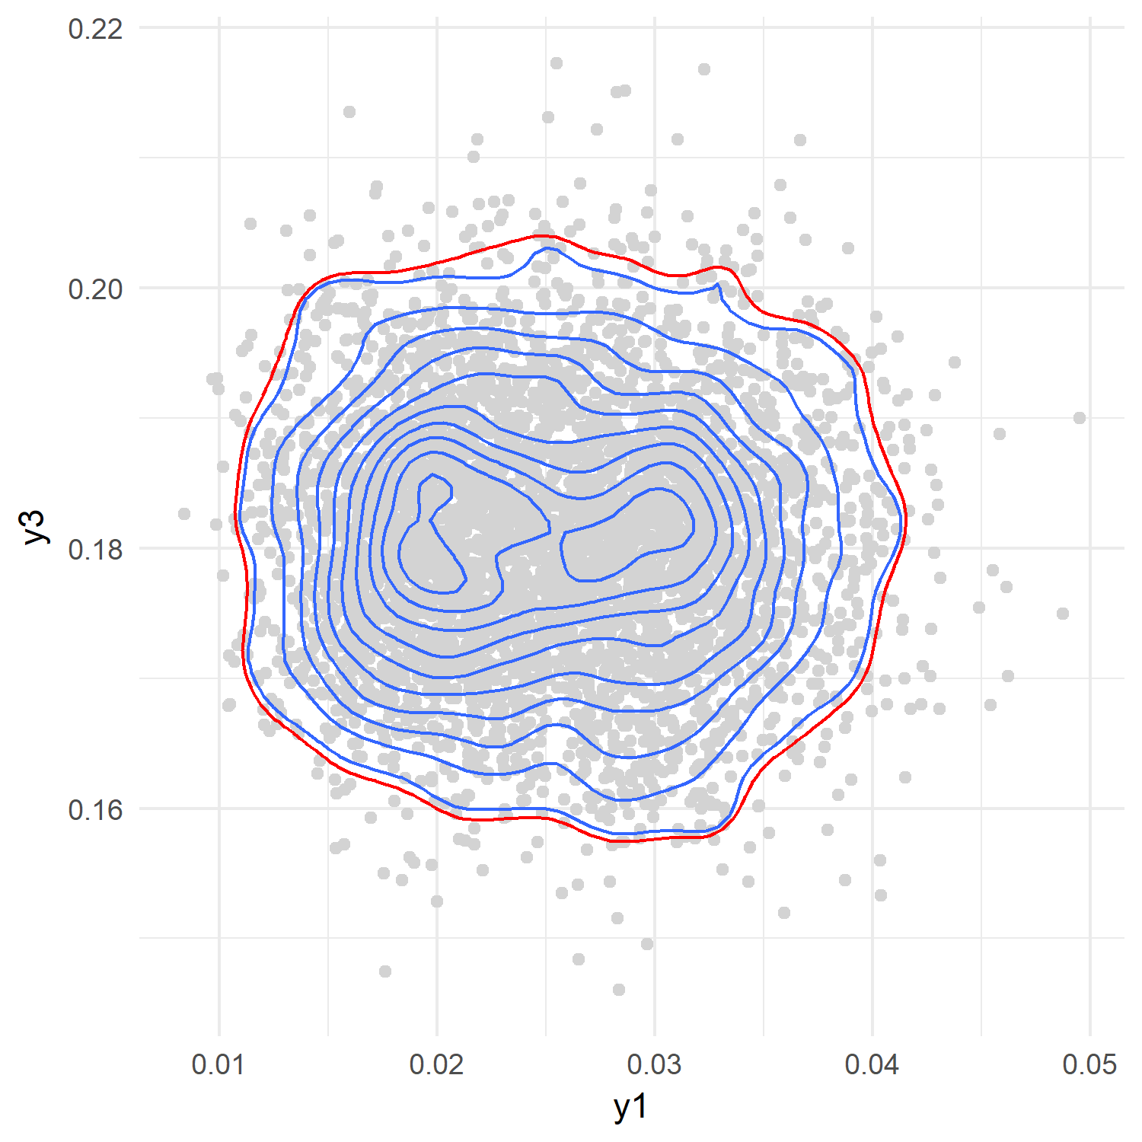
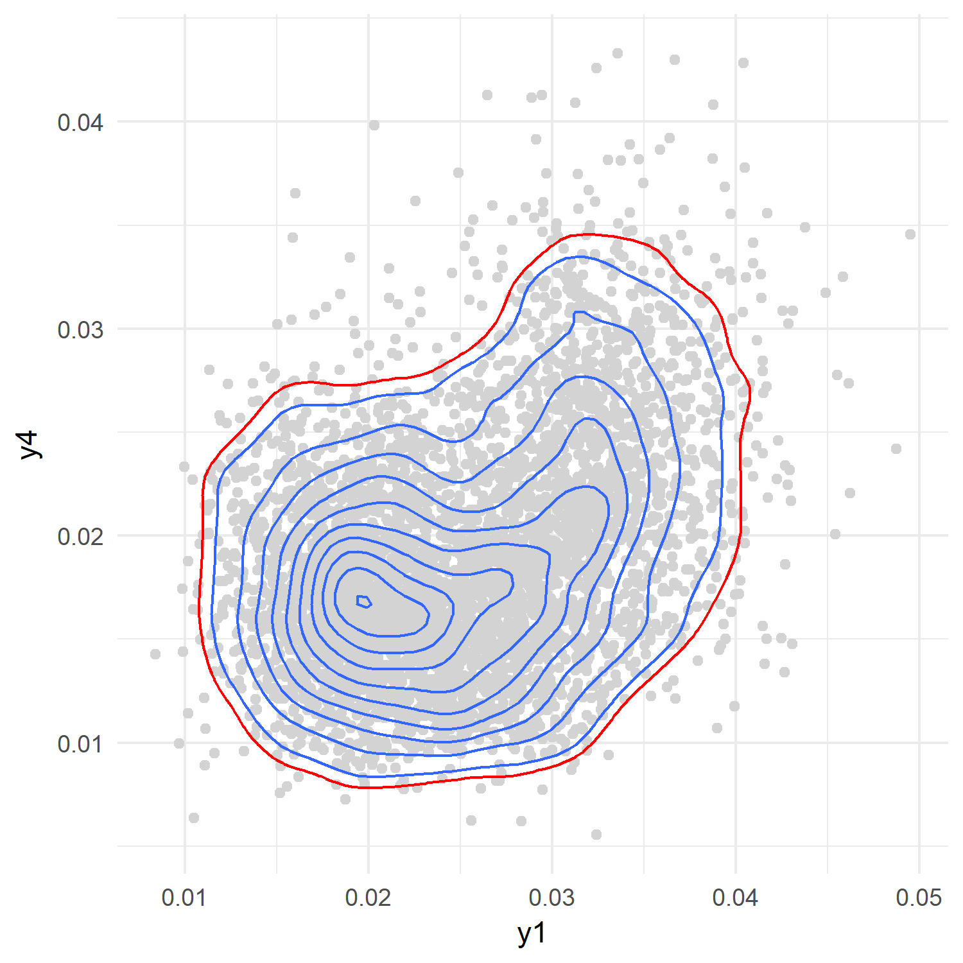
Joint credible regions
Pass: observed event rate upper bounds inside posterior credible region

Slide 14
Advantages
Patient covariates
Joint outcome model
Direct probability interpretation
Accounts for uncertainty
Adaptive
OPC can be adjusted for future trial populations
facilitates correct joint inference
Bayesian credible intervals/regions
multiple outcomes, multiple trials
reflects the strength of evidence to date

Slide 15
Challenges
Limited data
Missing data
Rare outcomes
Parametric model
few trials, some parameters poorly identified
Heterogeneity
in patient populations, devices, and outcomes
depends on correct specification
difficult to model
not all trials collected all outcomes, covariates

Slide 16
Conclusions
Bayesian methods well suited to incremental device evolution
Proposed method is a step in the direction of an “ideal” OPC
Next steps:
  stakeholder buy-in
  incorporate additional data (e.g., registries) and patient-centered outcomes
  apply to real device areas (e.g., stents, TAVR)

Slide 17
Thank you!
hatfield@hcp.med.harvard.edu
@laura_tastic
@HPDSLab
healthpolicydatascience.org

Slide 18
References: FDA Perspectives
Design Considerations for Pivotal Clinical Investigations for Medical Devices Guidance for Industry, Clinical Investigators, Institutional Review Boards and Food and Drug Administration Staff. 7 Nov 2013. U.S. Department of Health and Human Services, Food and Drug Administration.
Faris and Shuren. (2017) An FDA Viewpoint on Unique Considerations for Medical-Device Clinical Trials. N Engl J Med, 376(14):1350-7.

Slide 19
References: Cardiovascular Devices
Chen et al. (2006) FDA perspective on clinical trial design for cardiovascular devices. Ann Thorac Surg, 82(3):773-5.
Dhruva, Bero, Redberg. (2009) Strength of study evidence examined by the FDA in premarket approval of cardiovascular devices. JAMA, 302(24):2679-85.
Head et al. (2016) Considerations and Recommendations for the Introduction of Objective Performance Criteria for Transcatheter Aortic Heart Valve Device Approval. Circ, 133(21):2086-93.
Sapirstein. (2001) Designing trials for testing prosthetic cardiac valves: A Food and Drug Administration perspective. Am Heart J, 141(5): 861-3.
Wu et al. (2014) Clinical evaluation of new heart valve prostheses: update of objective performance criteria. Ann Thorac Surg, 98(5):1865-74.

Slide 20
References: Other Device Areas
O'Malley, Normand, Kuntz. (2003) Application of models for multivariate mixed outcomes to medical device trials: coronary artery stenting. Stat Med, 22(2):313-36.
Parides et al. (2006) Progress versus precision: challenges in clinical trial design for left ventricular assist devices. Ann Thorac Surg, 82(3):1140-6.
Wu et al. (2014) United States Food and Drug Administration perspectives on the update to the objective performance criteria for surgically implanted heart valve prostheses. Ann Thorac Surg, 98(5):1890-1.

Slide 21
References: Other Device Areas
Conte et al. (2009) Suggested objective performance goals and clinical trial design for evaluating catheter-based treatment of critical limb ischemia. J Vasc Surg, 50(6):1462-73.e1-3.
Kumar, Brooks, Cavanaugh, Zuckerman. (2009) FDA perspective on objective performance goals and clinical trial design for evaluating catheter-based treatment of critical limb ischemia. J Vasc Surg, 50(6): 1474-1476.
Goode, Sapirstein Zuckerman. (2007) FDA perspective on clinical trial design for femoropopliteal stent correction of peripheral vascular insufficiency cardiovascular devices. Catheter Cardiovasc Interv, 69(6):920-1.

Slide 22
References: Modeling
Held. (2004) Simultaneous Posterior Probability Statements from Monte Carlo Output. J Comput Graph Stat, 13(1): 20-35.
Gorfine and Hsu. (2011) Frailty-based competing risks model for multivariate survival data. Biometrics. 67(2):415-26.
Prentice et al. (1978) The analysis of failure times in the presence of competing risks. Biometrics. 34(4):541-54.

