Slide 1
Issues in Hypothesis Testing in the Context of Extrapolation
Forrest Williamson, Ph.D.
Research Scientist
13 September 2018
2018 ASA Biopharmaceutical Section Regulatory-Industry Statistics Workshop

Slide 2
Outline
Need for Extrapolation
Case Study 1: Consistency Check Approach
Case Study 2: Combination Approach
Further Considerations

Slide 3
Moral obligation for the use of pediatric extrapolation or use of efficient innovative designs
Children are a vulnerable patient population (Kipnis, 2003): lack the developed cognitive capacities necessary to deliberate about and consent to participate in research
Scientific Necessity: a child should only be enrolled in a clinical trial if it is necessary to answer an important question about the health and welfare of children (Belmont Report)
There is an obligation to build the foundation for the use of pediatric extrapolation and related innovative analytical strategies with appropriately designed adult clinical trials.
Evidentiary requirements in children are no different from those in adults
Pediatric Extrapolation ``as an approach to providing evidence in support of the safe and effective use of drugs in the pediatric population when it can be assumed that the course of the disease and the expected response to a medicinal product would be sufficiently similar in the pediatric (target) and reference (source) population’’ (ICH E11[R1]).
Designing adult trials that have the potential to support pediatric trials, i.e., implying early consideration of pediatric drug development.
Consider innovative trials that have the possibility of being completed in a timely manner.
Kipnis, K. (2003). Seven vulnerabilities in the pediatric research subject. Theoretical Medicine and Bioethics, 24, 107-120.

Slide 4

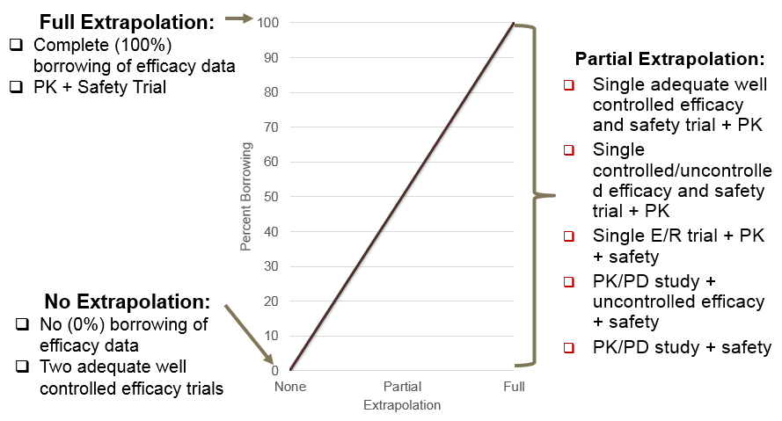
Variations in clinical development depends on identified knowledge gaps
Most of the time, based on the identified gaps and projected data in source population prior to start of pediatric study, we make a prediction on what would be sufficient data to be generated while balancing benefit-risk (in the indication), feasibility (and timely access of drugs to children)
How similar is similar enough?
When are Bayesian designs applicable?
How do we agree on the amount of information which can be borrowed?

Slide 5
Examples
Case Studies
Consistency Check with Internal Validity
Open-label Combination Approach

Slide 6
Case Study 1
Study Info
Design
Indication exists in adults and pediatrics
Non-rare disease
Treatments approved in adults and pediatrics
Similarity in treatment between populations
First in class therapy in target indication
Open-label PK lead in
Randomized, controlled trial (Treatment vs. Control)
Extrapolation from adolescents to children
  360 adolescents
  160 children
Bayesian analysis

Slide 7
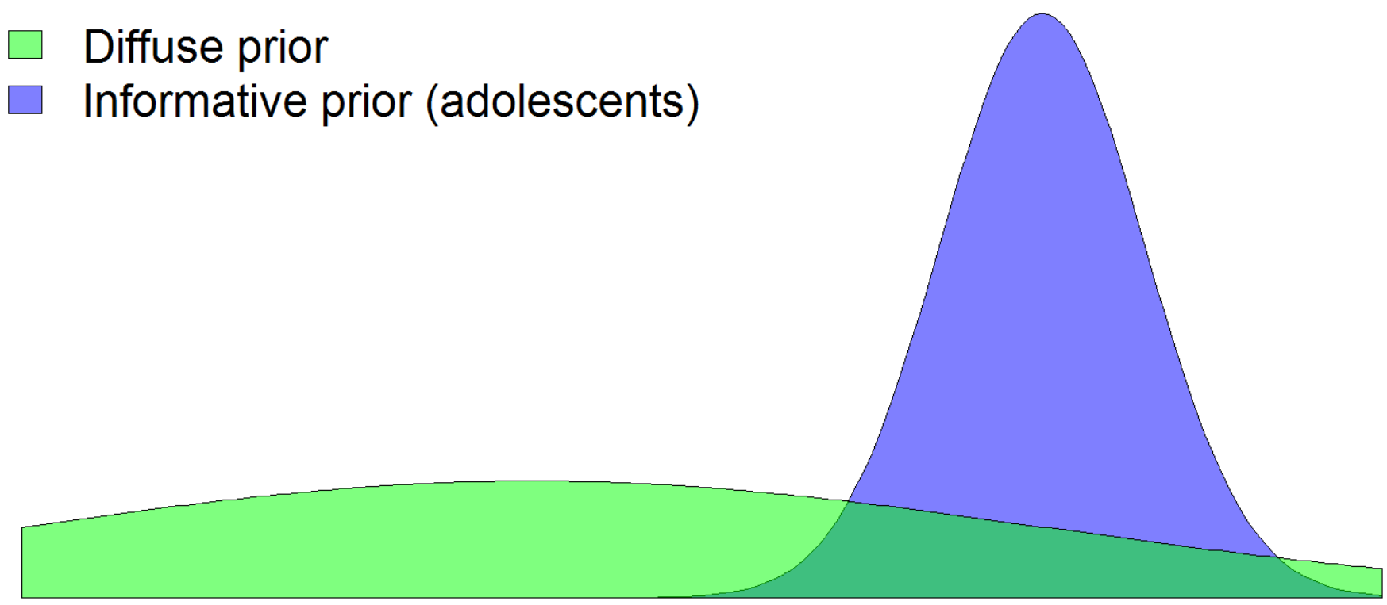
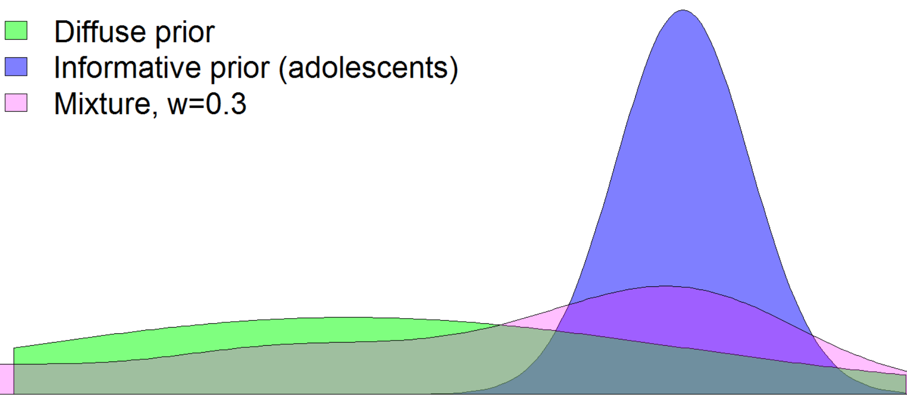
Case Study 1: Methods
Method 1: Mixture Prior
Method 2: Consistency Check
Adolescents
Children
Mean Response
Treatment response point estimate in children is above the lower bound of the 95% CI of treatment response in adolescents
Trt
Trt
Mixing probability
Pbo treatment response point estimate in children is below the upper bound of the 95% CI of Pbo treatment response in adolescents
Pbo
Pbo
A goal of extrapolation is to validate an assumption of similarity

Slide 8
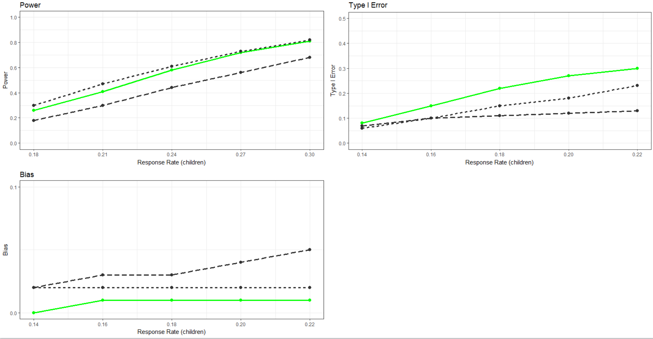
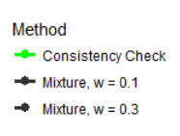
Case Study 1: Simulation Findings

Slide 9
Case Study 2
Study Info
Design
Indication exists in adults and pediatrics
Rare disease in pediatrics
No approved treatment for pediatric patients
Prospect of Direct Benefit
One previous trial attempted, but could not finish
Adult trial was randomized, placebo controlled
Open-label pediatric study
Binary endpoint
Extrapolation of efficacy from adults to pediatrics
Frequentist design
  55 patients

Slide 10
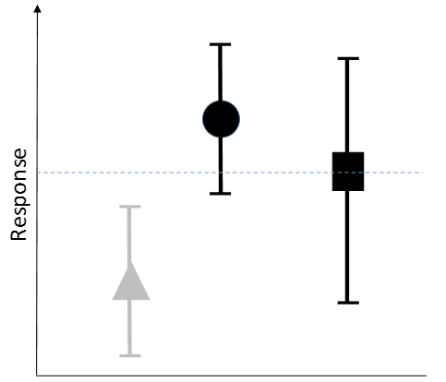

Case Study 2: Methods
Method 1: Traditional Test
Method 2: Combination
Frequentist test for difference between adult and pediatric response rates
Check that response in pediatrics is
  greater than lower bound of response in adults
  greater than upper bound of placebo response in adults
Adult Pbo
Adult Trt
Pediatric Trt

Slide 11
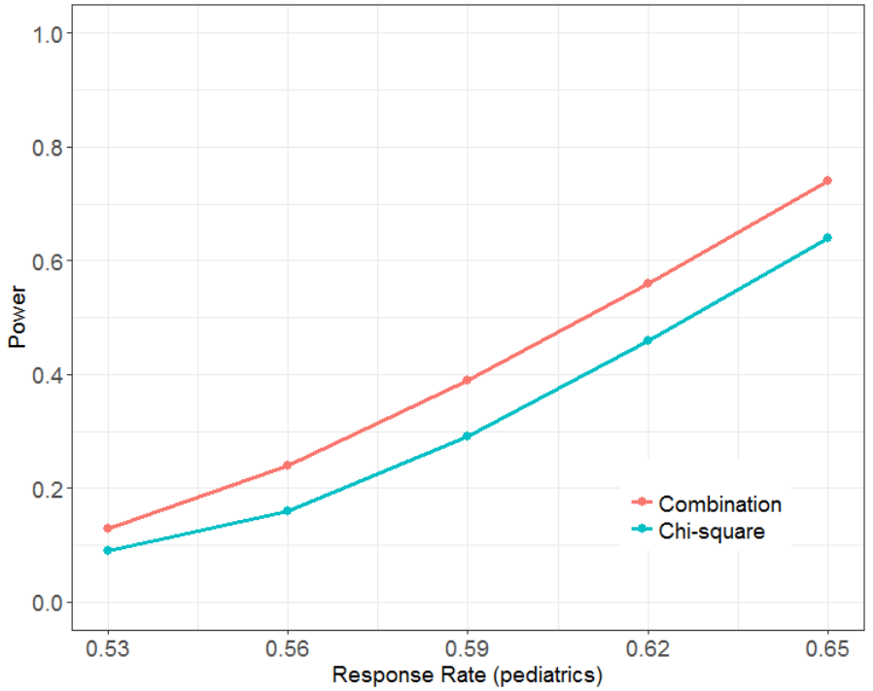
Case Study 2: Simulation Findings
Combination
Traditional

Slide 12
Further Considerations
Amount of borrowing is based on clinical judgment and evolving science
Demonstration of operating characteristics of Bayesian decision from a frequentist perspective
How much information is gained with the use of the prior? (Prior ESS)
Assessment of bias
Is the assessment of multiplicity for multiple secondary endpoints important in the context of extrapolation?
How do estimands play a role in extrapolation?

