Slide 1
Large Electronic Healthcare Data
Fit for Purpose?
Thoughts on Data Quality and Study Design Considerations
Rima Izem, PhD
Food and Drug Administration
Center for Drug Evaluations and Research

Slide 2
Disclaimer
The views expressed in this presentation are the presenter’s and not necessarily those of the Food and Drug Administration

Slide 3

Drug Benefit-Risk Evaluation
Marketing Approval Labeling, Drug Safety Communication, Post-market requirements
Pre-Market
Post-market
Risk Evaluation and Mitigation Strategies (REMS)
Spontaneous reporting (FAERS)
Drug use data
Surveillance studies
Controlled epidemiologic studies (e.g. cohort, case control, self-controlled)
Pregnancy registries
Surveys to assess knowledge
Adequate and well controlled studies
Randomized studies
Drug Development Regulatory Life Cycle

Slide 4
For More Details and Examples on Data Sources
Therapeutic Innovation & Regulatory Science Vol 52: 159-198
Izem R, Sanchez-Kam M, Ma H, Zink RC, Zhao Y. (2018). Sources of Safety Data and Statistical Strategies for Design and Analysis: Postmarket Surveillance
Zink RC, Marchenko O, Sanchez-Kam M, Ma H, and Jiang Q., Safety Data and Statistical Strategies for Design and Analysis: Clinical Trials
Marchenko O, Russek-Cohen E, Levenson M, Zink RC, Krukas-Hampel MR, and Jiang Q Sources of Safety Data and Statistical Strategies for Design and Analysis: Real World Insights
Ma H, Russek-Cohen E, Izem R, Marchenko OV, Jiang Q. (2018). Sources of Safety Data and Statistical Strategies for Design and Analysis: Transforming Data Into Evidence

Slide 5
Take Home Messages
Post-market evaluation considers a multitude of observational data sources and study designs
  (non-RCT) gold standard designs exist for causal inference
  most evaluations weigh all evidence
Areas (beyond RCT) worth exploring by statisticians: signal detection with large databases, causal inference with observational data, and post-market drug use analyses

Slide 6
Background

Slide 7
Large Electronic Healthcare Databases
Already routinely used today
  Administrative claims data (e.g. Sentinel),
  Spontaneous reporting databases
  Pharmacy sales
  Registries (drug or population specific)
  Surveillance databases (e.g. poison control, NEISS CADES)
Possible growing sources
  Electronic medical records
  Healthcare social media
  Mobile health

Slide 8
Case studies
Products and adverse events | Regulatory Action | Observational Studies Evidence
New anticoagulant (NOAC) and bleeding | Drug safety communications; conducting multiple FDA led studies (CMS; Sentinel) | FDA adverse event reporting system (FAERS); published studies (some FDA led)
Phosphodiesterase-5 inhibitors (PDE5i) and Non-arteritic anterior ischemic optic neuropathy (NAION) | Drug Safety Alert, Postmarket safety studies commitment, labeling changes | FAERS, sponsor-led postmarket comparative safety studies
Testosterone products and cardiovascular (CV) outcomes | Labeling changes; drug safety communication: Requiring sponsor-led CV outcome trials (ongoing) | Drug use; published comparative safety studies
Tumor necrosis factor (TNF) blockers and pregnancy related outcomes | Labeling changes | Completion of sponsor-led pregnancy studies and published evidence

Slide 9
Importance of signal detection
Chapter 1

Slide 10
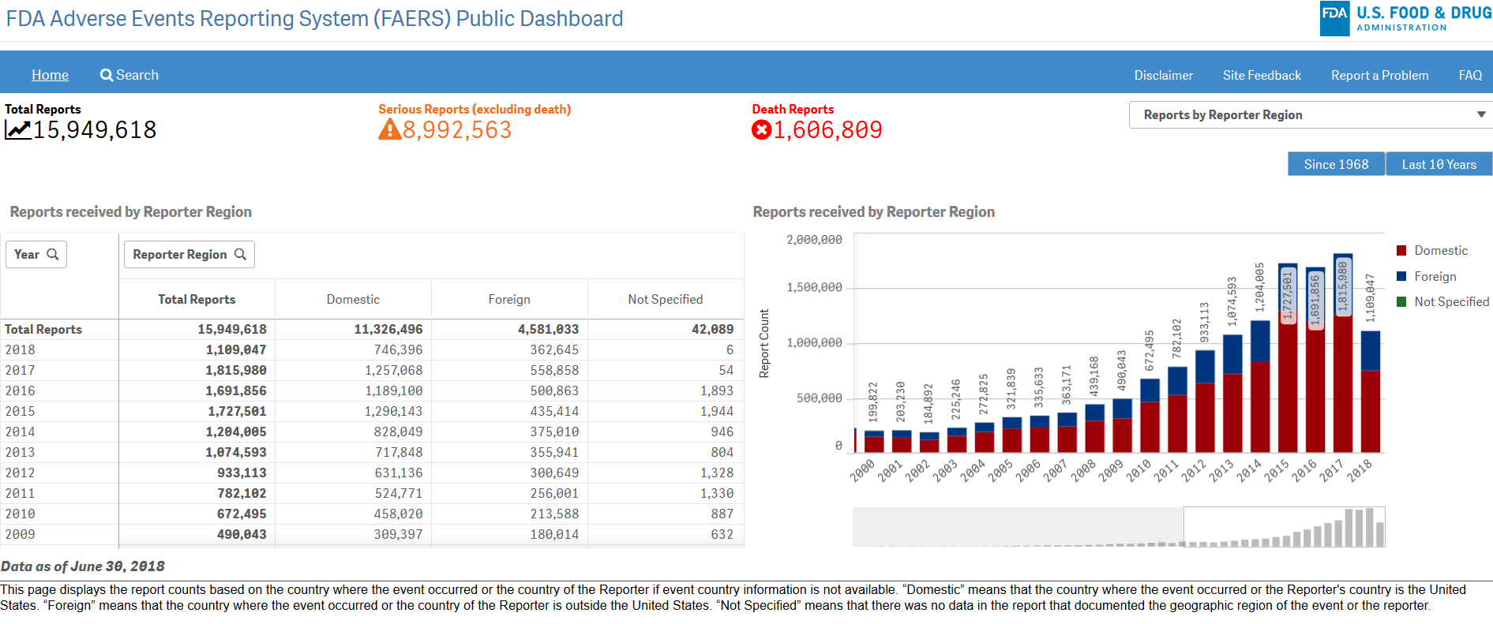
Signal Detection Today, FAERS
Source: FAERS Public Dashboard, https://www.fda.gov/Drugs/GuidanceComplianceRegulatoryInformation/Surveillance/AdverseDrugEffects/ucm070093.htm

Slide 11
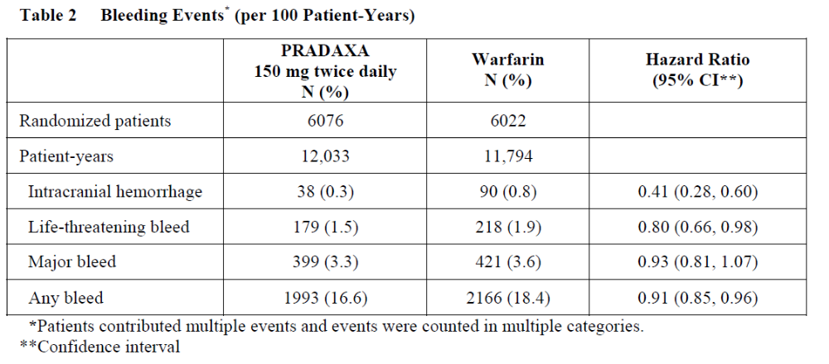
Role of Signal Detection in NOAC Case Studies
“[12-7-2011] The U.S. Food and Drug Administration (FDA) is evaluating post-marketing reports of serious bleeding events in patients taking Pradaxa (dabigatran etexilate mesylate). Pradaxa is a blood thinning (anticoagulant) medication used to reduce the risk of stroke in patients with non-valvular atrial fibrillation (AF), the most common type of heart rhythm abnormality.
[….]
FDA is working to determine whether the reports of bleeding in patients taking Pradaxa are occurring more commonly than would be expected, based on observations in the large clinical trial that supported the approval of Pradaxa.
[…]
FDA will communicate any new information on the risk of bleeding and Pradaxa when it becomes available.”
Sources: FDA Drug Safety Communication, https://www.fda.gov/Drugs/DrugSafety/ucm282724.htm; Pradaxa label with bleeding results from RELY RCT (drugs @ FDA)
Note: Drug approved on 10/19/2010; other drug safety communications were issued on 11/2/2012 and 5/13/2014

Slide 12
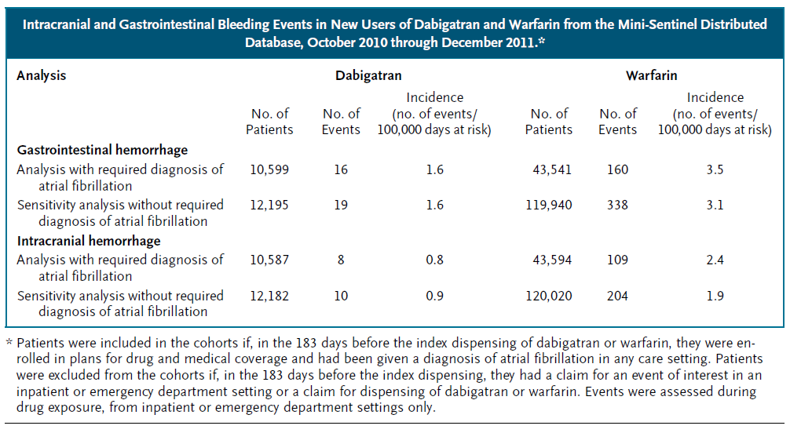
Signal Detection, NOAC (follow-up)
From publication “…large numbers of reported cases of bleeding with dabigatran is an example of stimulated reporting. The Mini-Sentinel assessment suggests that bleeding rates with dabigatran are not higher than those with warfarin, a finding that is consistent with the results of RE-LY” April 2013
Same message in FDA drug safety communication on 11/2/2012
Sources:
Publication: N Engl J Med 2013; 368:1272-1274
Drug Safety communication: http://wayback.archive-it.org/7993/20161022203758/http://www.fda.gov/Drugs/DrugSafety/ucm326580.htm

Slide 13
Signal Detection in PDE5 Inhibitors
“FDA ALERT [7/2005]: FDA has approved new labeling for Viagra, Levitra, and Cialis regarding postmarketing reports of vision loss related to NAION (non-arteritic anterior ischemic optic neuropathy). Most, but not all, of these patients had underlying anatomic or vascular risk factors for development of NAION, including: low cup to disc ratio (“crowded disc”), age over 50, diabetes, hypertension, coronary artery disease, hyperlipidemia and smoking. Given the small number of events, the large number of users of PDE-5 inhibitors and the fact that this event occurs in a similar population to those who do not take these medicines, it is not possible to determine whether these events are related directly to the use of PDE-5 inhibitors, to the patient’s underlying vascular risk factors or anatomical defects, to a combination of these factors, or other factors. We cannot currently draw a conclusion of cause and effect. FDA will continue to evaluate the issue.
[…]
As of May 18, 2005, a total of 43 cases of ischemic optic neuropathy (ION) among patients using the marketed PDE-5 inhibitors (sildenafil, tadalafil, vardenafil) have been reported to the FDA’s Adverse Event Reporting System. ”
Source: https://wayback.archive-it.org/7993/20170723113804/https://www.fda.gov/Drugs/DrugSafety/PostmarketDrugSafetyInformationforPatientsandProviders/ucm162862.htm
Note: This information is not current. The FDA has issued new information about these drugs (see Drugs @ FDA)

Slide 14
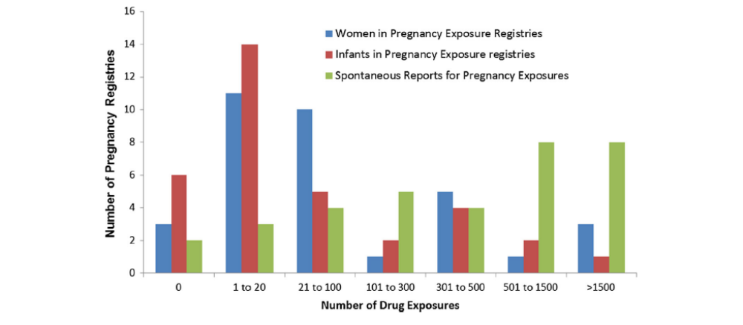
Signal Detection, Pregnancy Drug Exposures
Source: Bird et al, Drug Saf (2018) 41:87–94

Slide 15
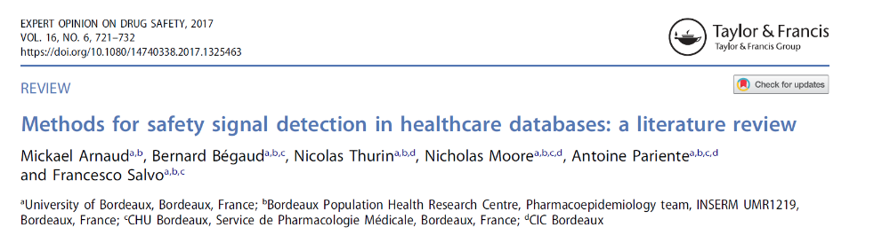
Signal Detection Tomorrow, Large Electronic Health Databases?
Methods include: Spontaneous reporting like methods; LGPS-LEOPARD; traditional pharmacoepidemiologic designs; sequence symmetry analysis; sequential statistical testing; temporal association rule ; supervised machine learning; Tree-based scan statistic

Slide 16
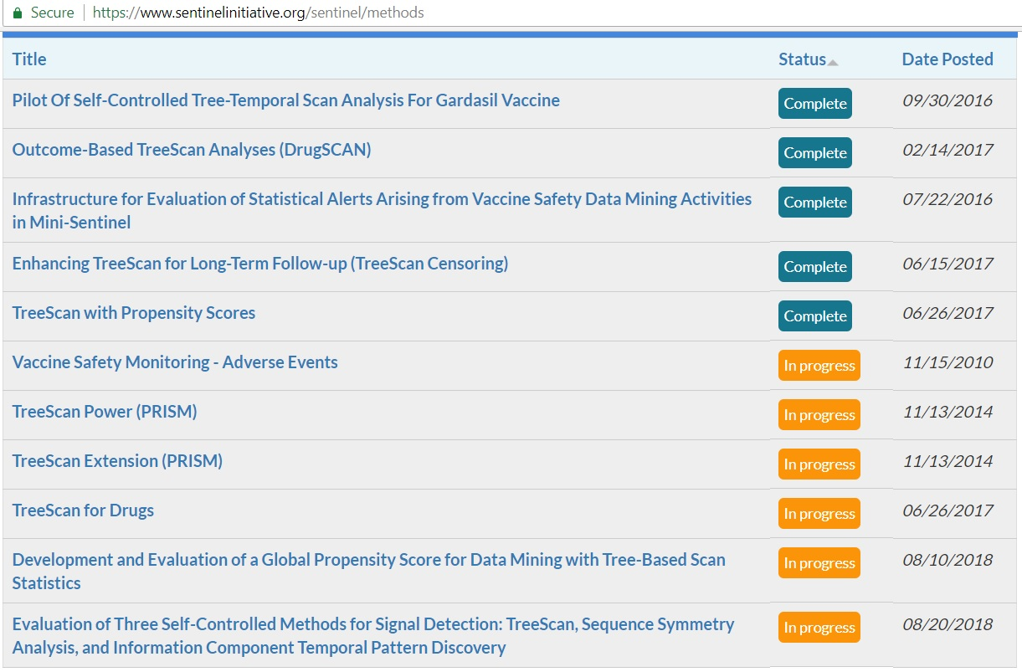
Signal Detection Tomorrow (continued)

Slide 17
design Standards in EPI Design for causal inference
Chapter 2

Slide 18
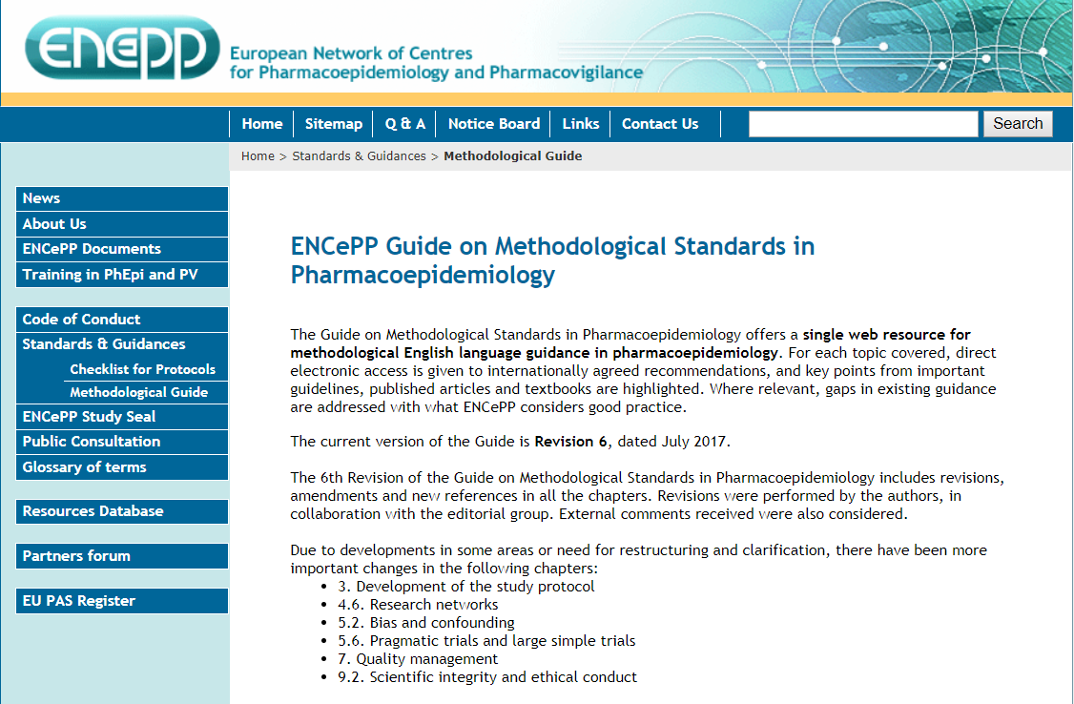
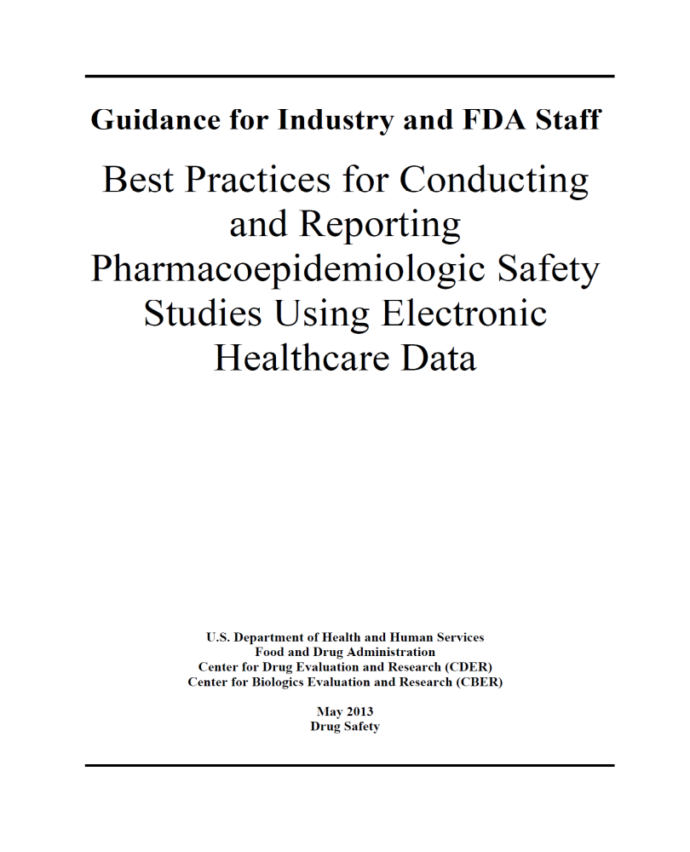
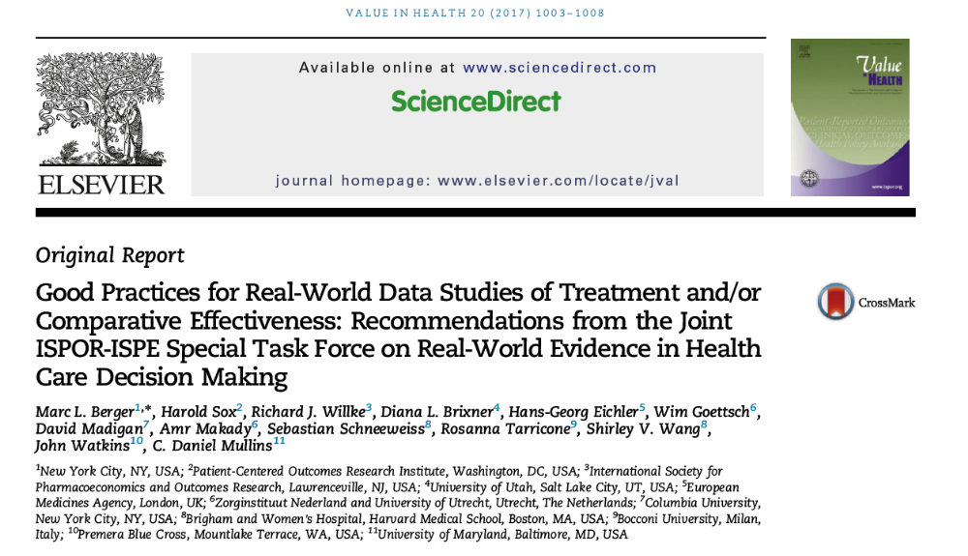
Setting: Best Practices Guidelines
Good analyses practices include pre-specification of hypotheses and analysis plan
Control for biases and confounding by design involve judicious choices of
  Data source (good capture of exposure, outcome and confounders)
  Inclusion/exclusion criteria (e.g. incident exposure cohort design)
  Appropriate comparators (e.g. second line therapy vs. second line therapy)
  Validated algorithms for outcome, exposure and covariates

Slide 19
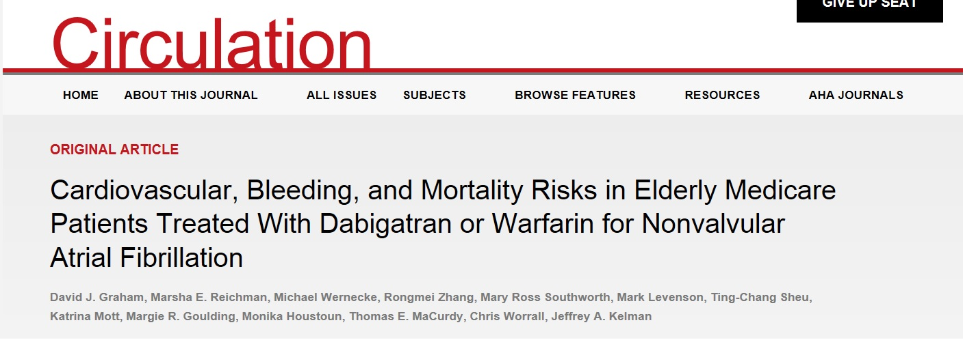
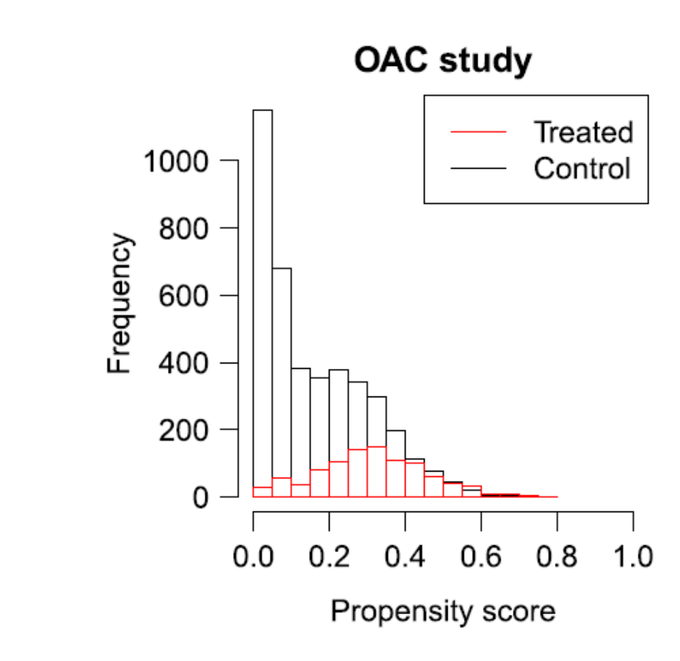
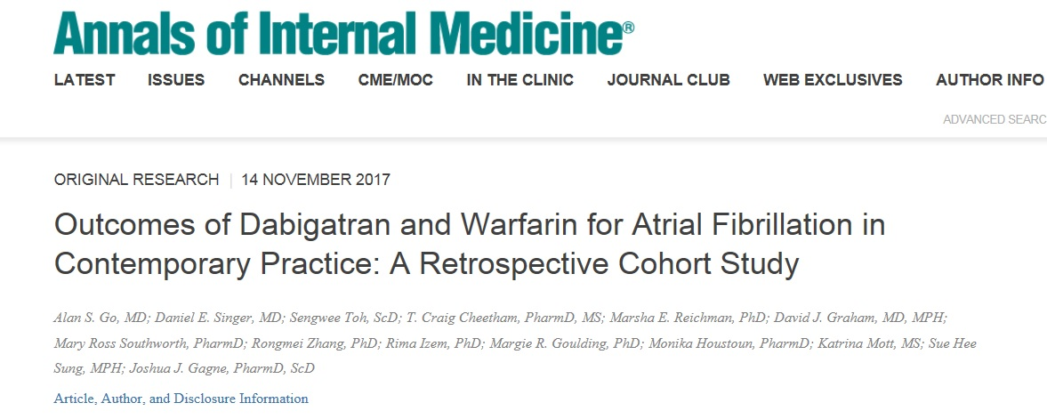
Best Practices Examples, FDA led studies on NOAC
Design Elements: Administrative claims Data, Retrospective Incident Exposure Cohort, 1:1 propensity score (PS) matching to control for confounding, short-term and long term outcomes (time to event analyses)
Published online October 2014
Sources:
Source: Franklin et al (2017) – Statistics in Medicine

Slide 20
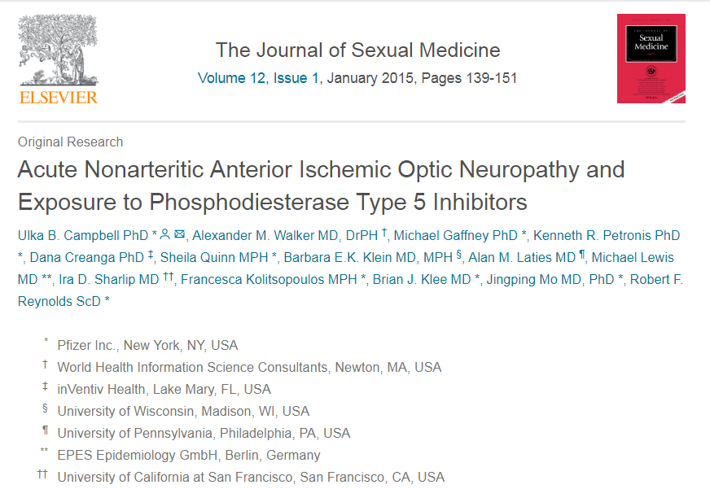
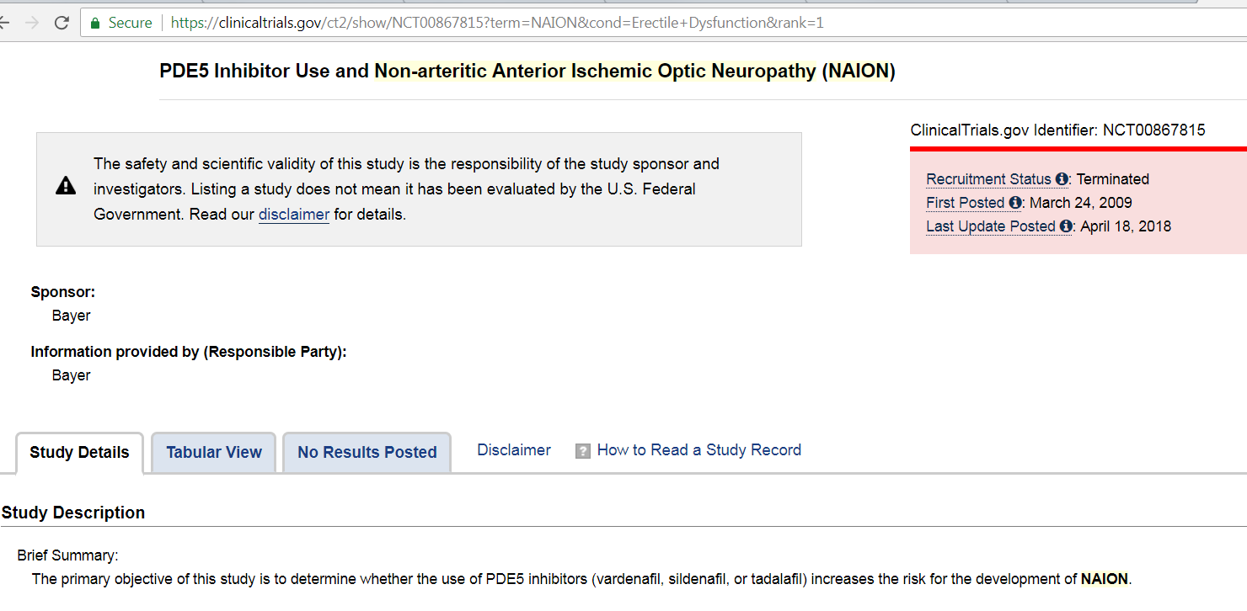
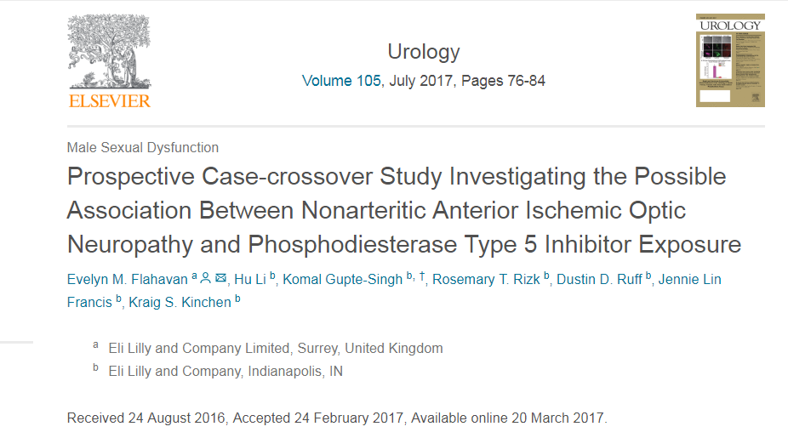
Best practices
PDE5 Inhibitors Examples
Case-Crossover Studies

Slide 21
Examples of when achieving best practices is difficult
Administrative claims data source do not capture exposure to over the counter drugs and linkage to US death or cancer registry are often not timely
Inclusion/exclusion criteria to limit bias may limit sample size and power for low exposure drugs
Appropriate comparator drugs do not exist when alternate choices for the same indication(s) are non-drug therapies or no treatment
Validated algorithms for outcome, exposure and covariates

Slide 22
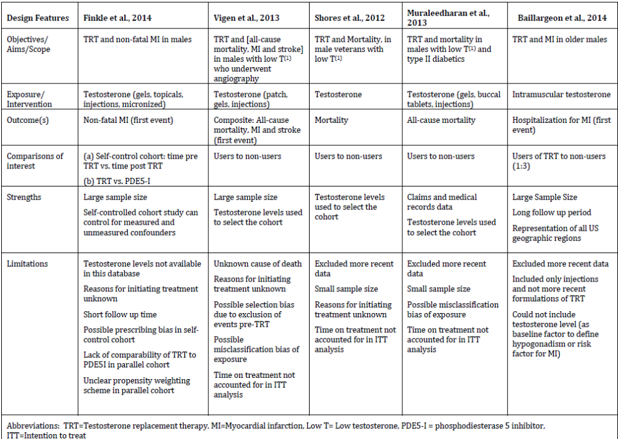
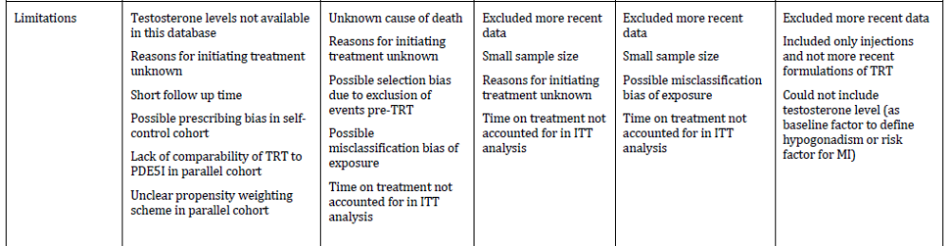
Case Study, Testosterone, Indication and Comparator
Source: Table 1 of FDA background package, Advisory Committee on September 17th 2014. https://wayback.archive-it.org/7993/20170403223746/https://www.fda.gov/AdvisoryCommittees/CommitteesMeetingMaterials/Drugs/ReproductiveHealthDrugsAdvisoryCommittee/ucm404895.htm

Slide 23
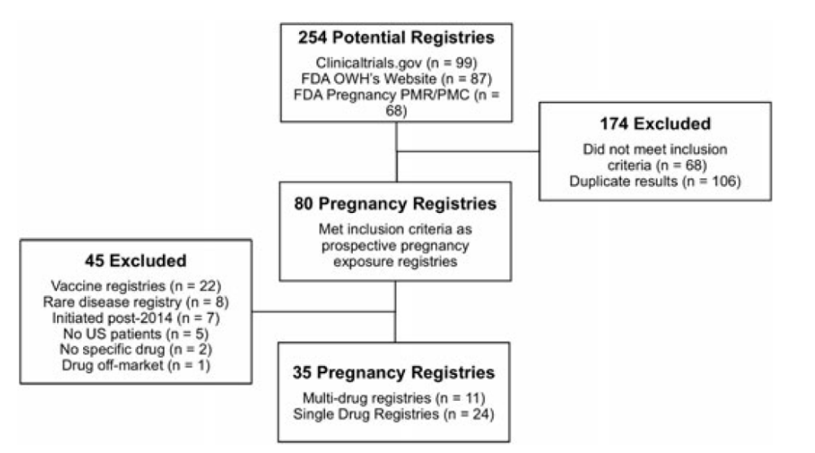
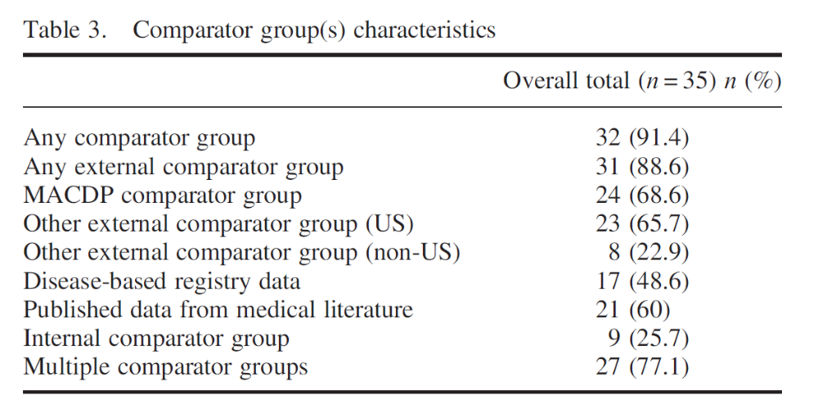
Pregnancy Registry Studies, Comparator
Gelperin et al (2017). pharmacoepidemiology and drug safety 2017; 26: 208–214

Slide 24
TNF Blockers and Use in Pregnancy
Etanercept label, Section 8.1 (10/06/2017)
Adalimumab label, Section 8.1 (8/2/2018)
“ A prospective cohort pregnancy registry conducted by OTIS in the US and Canada between 2000 and 2012 compared the risk of major birth defects in liveborn infants of women with rheumatic diseases or psoriasis exposed to etanercept in the first trimester. The proportion of major birth defects among liveborn infants in the etanercept-exposed (N = 319) and diseased etanercept unexposed cohorts (N = 144) was 9.4% and 3.5%, respectively. The findings showed no statistically significant increased risk of minor birth defects and no pattern of major or minor birth defects.
A Scandinavian study compared the risk of major birth defects in liveborn infants of women with chronic inflammatory disease (CID) exposed to TNF-inhibitors during early pregnancy. Women were identified from the Danish (2004-2012) and Swedish (2006-2012) population based health registers. The proportion of major birth defects among liveborn infants in the etanercept-exposed (N=344) and CID etanercept unexposed cohorts (N = 21,549) was 7.0% and 4.7%, respectively.
Overall, while both the OTIS Registry and Scandinavian study show a higher proportion of major birth defects in etanercept-exposed patients compared to diseased etanercept unexposed patients, the lack of pattern of birth defects is reassuring and differences between exposure groups (e.g. disease severity) may have impacted the occurrence of birth defects. “
“A prospective cohort pregnancy exposure registry conducted by OTIS/MotherToBaby in the U.S. and Canada between 2004 and 2016 compared the risk of major birth defects in live-born infants of 221 women (69 RA, 152 CD) treated with adalimumab during the first trimester and 106 women (74 RA, 32 CD) not treated with adalimumab. The proportion of major birth defects among live-born infants in the adalimumab-treated and untreated cohorts was 10% (8.7% RA, 10.5% CD) and 7.5% (6.8% RA, 9.4% CD), respectively.
The lack of pattern of major birth defects is reassuring and differences between exposure groups may have impacted the occurrence of birth defects. This study cannot reliably establish whether there is an association between adalimumab and major birth defects because of methodological limitations of the registry, including small sample size, the voluntary nature of the study, and the non-randomized design.”

Slide 25
Importance of Drug use analysis In study design and decision making
Chapter 3

Slide 26
Drug Use Design and Analyses
Analyses include
Interesting Statistical Considerations
National estimates of sales and drug use in different metrics (by kg, eaches or extended unit, or number of users)
Drug use by subgroup such as indication, age, pregnancy status
Drug use characteristics such as duration of use, number of Rx, concomitant therapy…etc
Generalizability: many large data sources with granular information are convenience samples
Exposure assessment: algorithms for duration of use from Rx vary and misclassification is not well characterized

Slide 27
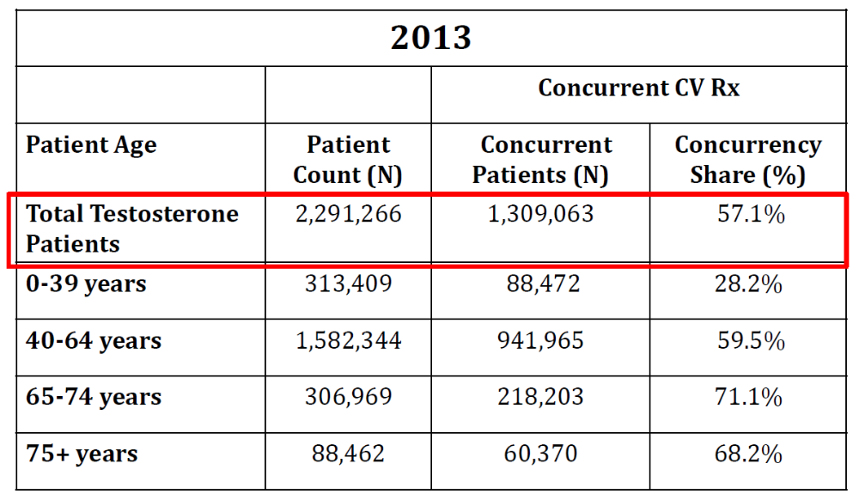
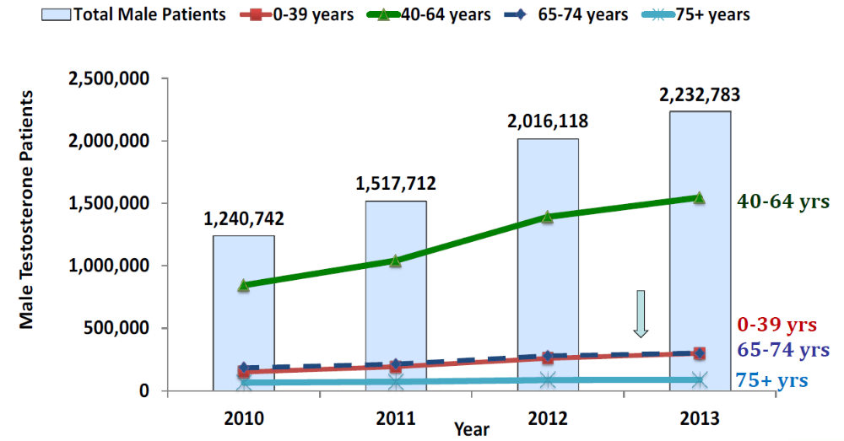
Drug Use in Testosterone Case Study
Data source cited*: IMS Health, IMS National Sales PerspectivesTM
Data source cited*: Symphony Health Solutions APLDTM
Source*: Slides 7 and 10, Mohamoud MA FDA presentation, Advisory Committee on September 17th 2014. https://wayback.archive-it.org/7993/20170403223746/https://www.fda.gov/AdvisoryCommittees/CommitteesMeetingMaterials/Drugs/ReproductiveHealthDrugsAdvisoryCommittee/ucm404895.htm

Slide 28
Pregnancy Drug Exposures
Data source for drug use: Sentinel Distributed Database
Source: Figure 2, Bird et al, Drug Saf (2018) 41:87–94

Slide 29
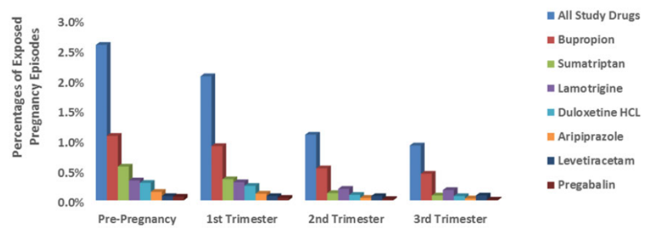
Drug Use in Pregnancy (continued)
Data source: Sentinel Distributed Database
Source: Iloh et al. Pharmacoepidemiol Drug Saf. 2018;27:604–611

Slide 30
Episodes of Drug Use, Stockpiling Algorithms
Estimated duration of exposure of 119 days
30 days
30 days
Overlap: 6 days
30 days
Gap:
8 days
Gap:
15 days
Dispensings
Toy Example, algorithm accruing overlap (up to 7 days), allowing gaps in therapy up to 15 days

Slide 31
EPILOGUE

Slide 32
Epilogue for Case Studies
NOAC: dabigatran, drug safety communication on 5/14; other studies initiated with other NOACs
PDE5I: label updates on 3/14 and 2/18 with NAION study results
Testosterone: label update 2/15 and post-market requirement for CV outcome trials 3/15
TNF Pregnancy registries: updated labels (slide 23)

Slide 33
Take Home Messages
Post-market evaluation considers a multitude of observational data sources and study designs
  (non-RCT) gold standard designs exist for causal inference
  most decisions account for all evidence
Areas (beyond RCT) worth exploring by statisticians: signal detection with large databases, causal inference with observational data, and post-market drug use analyses

Slide 34
Acknowledgments
For primary stat review of case studies within OB/DB7: Rongmei Zhang, Elande Baro, and Joo-Yeon Lee
All safety WG members at the ASA Biopharm Section. Special thanks to co-authors in TIRS papers Matilde Sanchez-Kam, Olga Marchenko, Qi Jiang, Richard Zink and new causal inference WG observational study task force Bill Wang, Ed Whalen, Yong Ma, and Alice Benson

Slide 35
Back up

Slide 36
Summary of References by Case Studies

Slide 37
Best Practices, NOAC, Regulatory Impact
Drug Safety communication http://wayback.archive-it.org/7993/20161022053428/http://www.fda.gov/Drugs/DrugSafety/ucm396470.htm

Slide 38
Post-market for Drugs, Test Cases
Hierarchy of Decisions
Hierarchy of Data and Designs
Post-market requirement
Labeling
Drug safety communication
Spontaneous reports (FAERS)
Drug pregnancy registries
Drug use analyses in administrative claims databases
Controlled studies in administrative claims or electronic health care data
In future: signal detection in administrative claims or electronic healthcare data

Slide 39
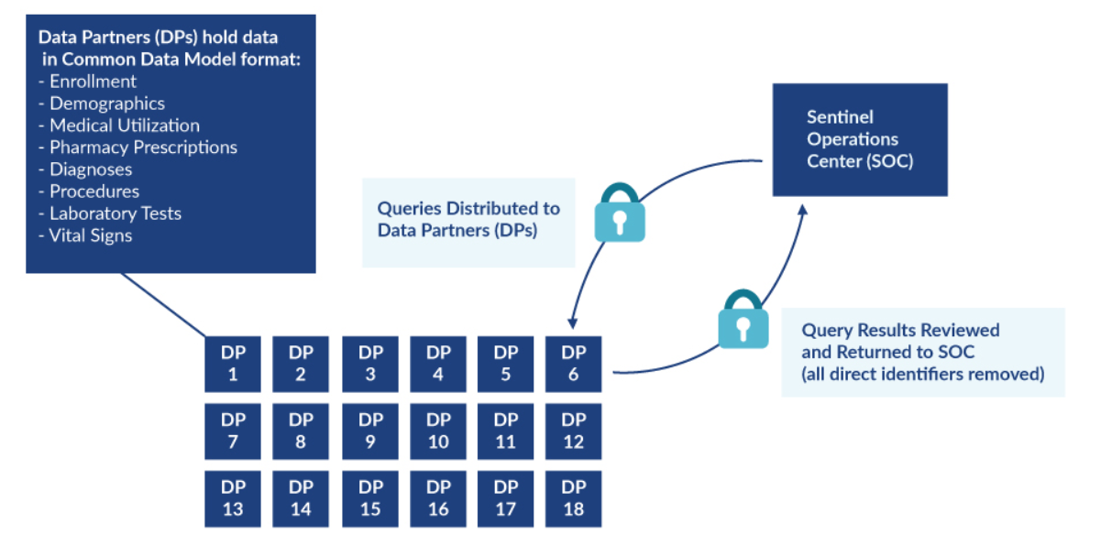
Setting: FDA Sentinel System
https://www.sentinelinitiative.org/sentinel/data/distributed-database-common-data-model

Slide 40
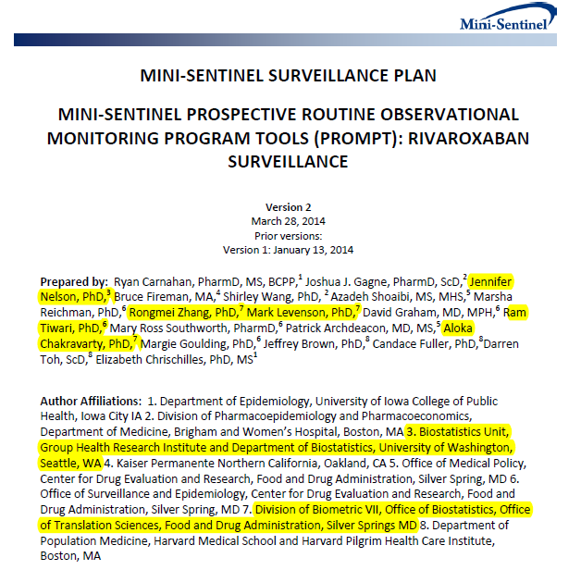
Rivaroxaban Example
Protocol Based Assessment (level 3 like query)
Protocol
Adjusted, Sequential Analyses
New user cohort study
Variable ratio propensity score matching to control for confounding in each site
Sequential looks (5) with Pocock stopping boundary
Primary analysis is time to event using cox regression stratified by site
http://www.mini-sentinel.org/work_products/Assessments/Mini-Sentinel_PROMPT_Rivaroxaban-Surveillance-Plan.pdf

Slide 41
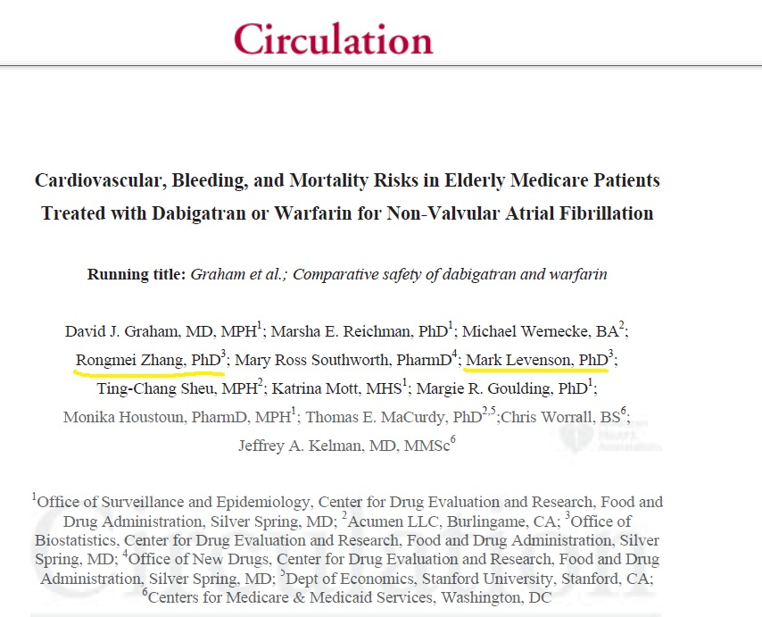
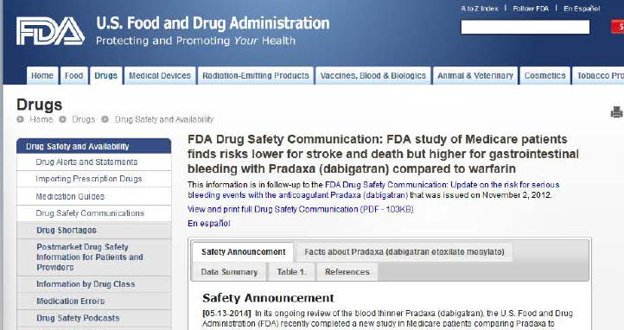
Best practices – NOAC examples
“In this study…Pradaxa was associated with a lower risk of clot-related strokes, bleeding in the brain, and death, than warfarin. The study also found an increased risk of major gastrointestinal bleeding with use of Pradaxa as compared to warfarin.”
-May 2014
Published online October 2014
Notes:
Although the mini-sentinel study is still ongoing, I can share with you the results of the other study which confirmed the results of the randomized clinical trials. That is lower risk for both strokes and bleeding. However, dabigatran had more gastrointestinal bleeding

Slide 42
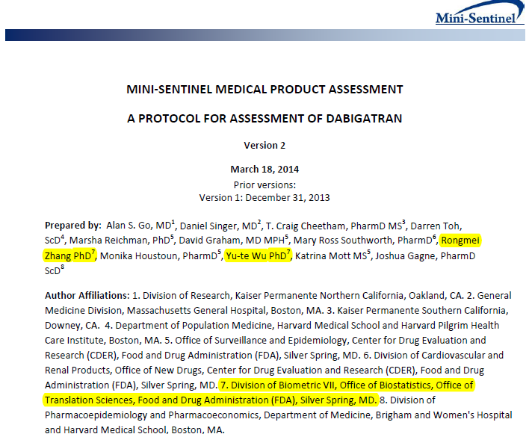
NOAC Case study,
Sentinel Protocol Based Assessment
New user cohort study
Propensity score matching by site to control for confounders
Primary analysis is time to event using cox regression stratified by site
Protocol
Adjusted Analysis
http://www.mini-sentinel.org/work_products/Assessments/Mini-Sentinel_Protocol-for-Assessment-of-Dabigatran.pdf

Slide 43
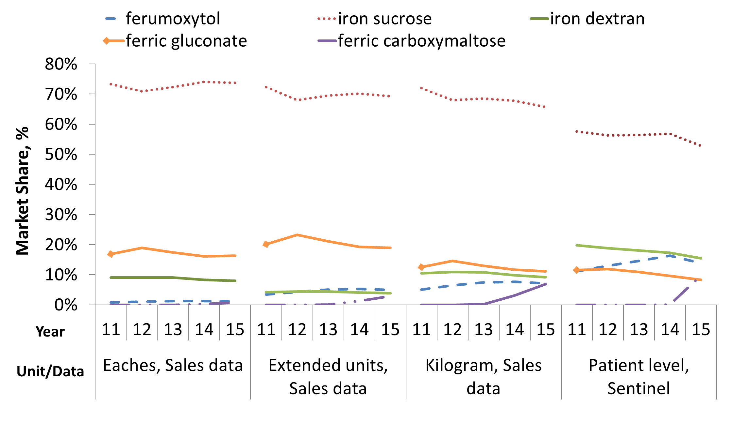
Drug Use, comparison of units

