Slide 1
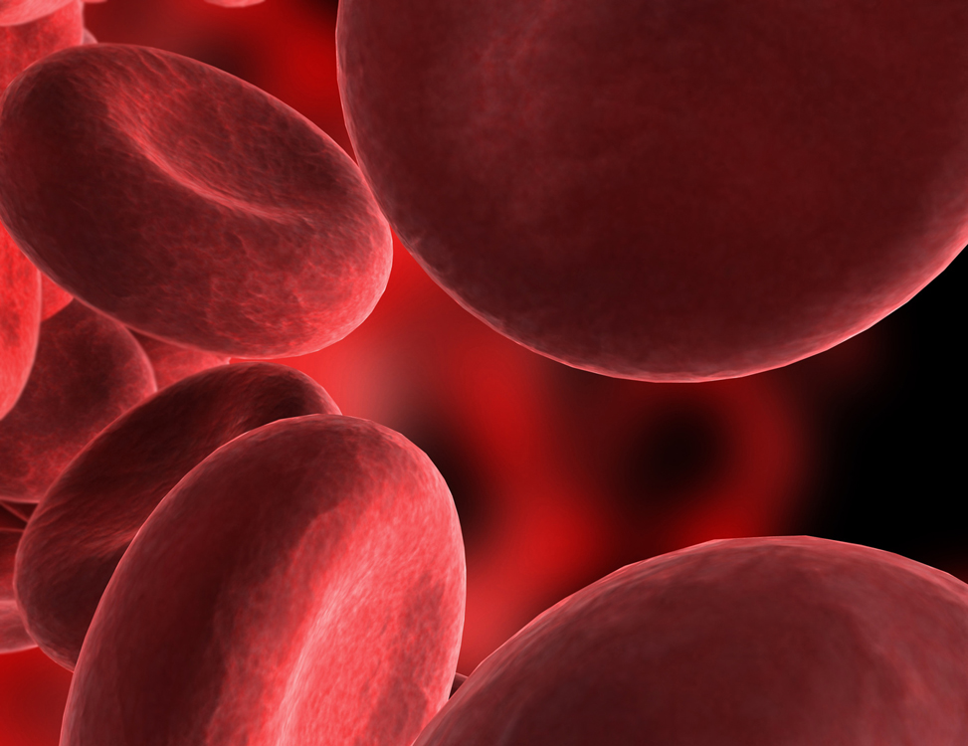
Clinical Validation of cobas® EGFR Mutation Test in Blood Samples (Liquid Biopsy) as a Companion -Diagnostic Test for Tarceva®
Regulatory Industry Statistics Workshop 2018
Abha Sharma, Roche Molecular Systems

Slide 2
Overview of Presentation
Introduction and Definitions
Liquid Biopsy: An Unmet Need
Tissue and Plasma Samples differences
Agreement Between Tissue and Plasma Samples
Estimated PPV and NPV based on Prevalence in different populations
Drug Efficacy in Observed data
Modeled Drug efficacy in Plasma Positive Patients
Summary

Slide 3
Introduction and Definitions
cobas® EGFR Mutation Test
  A real-time PCR test for detecting defined mutations of the epidermal growth factor receptor (EGFR) gene in non-small cell lung cancer (NSCLC) patients
TARCEVA®
  First-line treatment of patients with metastatic NSCLC whose tumors have EGFR exon 19 deletions or exon 21 (L858R) substitution mutations
Liquid Biopsy
  Blood (Plasma) samples from Cancer patients are also referred to as ‘liquid biopsy’ samples as opposed to the tumor samples which are obtained by ‘surgical biopsy’.
  The test benefits patients who may be too ill or are otherwise unable to provide a tumor sample for EGFR testing.

Slide 4
Challenges with Tissue Biopsy and need for “Liquid Biopsy” or Blood Test
Biopsy ineligible population
Clinical complications: 18% rate of adverse events
Inadequate biopsy sample
Tumor heterogeneity
Tissue preservation: (FFPE) process
Delays in time to test results with Tissue Biopsy

Slide 5
Agreement between Matched Tissue and Blood Samples from the Same Patient in Literature:
Intended use for Blood Test
EGFR Mutation Test Results in Tissue and Blood Samples¹
 | Tissue Samples Mutations
Blood Samples Mutation |  | Positive² | Negative | Total
 | Positive | 72 | 5 | 77
 | Negative | 24 | 137 | 161
 | Total | 96 | 142 | 238
2: A Positive result implies presence of Exon 19 deletions or Exon 21 L858R mutation
Positive Percent Agreement (PPA) = 75% (72/96)
Negative Percent Agreement (NPA) = 96% (137/142)
Patient samples testing positive in tissue samples may be negative in Blood sample.
Initially screen with blood test, if negative result then test Tissue samples if available.
¹T Mok et al., Clinical Cancer Research 2015

Slide 6
Clinical Validation Study: Bridging Study
Retrospective Testing of Blood Samples from ENSURE study enrolling patients using Tissue Samples
Tarceva® (n=105)
Stage IIIB/IV NSCLC
Previously untreated
n= 647
Screening
EGFR mut (+)
(n= 210)
1:1R
With Tissue samples
Chemotherapy
(n=105)
ENSURE: Multicenter, open-label randomized phase III study that evaluated the efficacy and safety of Tarceva versus Chemotherapy as the first-line treatment for stage IIIB/IV NSCLC patients with mutations in the TK domain of EGFR in their tumors

Slide 7
Plasma Samples from ENSURE
Enriched study design: Larger percent of plasma samples are available from tissue mutation positive patients compared to tissue mutation negative patients
431 patients matched tumor and plasma with 2mL vol.
647 (100%) patients screened using Tissue Samples
601 (92.9%) valid Ex19 Del or L858R
517 (86.0%) had matched plasma
431 patients had both tumor and 2mL plasma samples with available EGFR mutation analysis results

Slide 8
Bridging Study Definitions and Analyses
When patient enrollment is not based on the results of the test to be used as final companion diagnostic test for the drug, a Bridging study is required³
Patients were screened using cobas® EGFR mutation test results in tissue samples in ENSURE
Bridging study³: Available plasma samples (n=441) with 2 mL volume were tested with cobas® EGFR plasma test to
  -Assess agreement between matched tissue and plasma specimens
  - Bridge the clinical data from Tissue to Plasma samples and evaluate drug efficacy in the intended use population for Plasma Samples
³Li, M, Statistical Consideration and Challenges in Bridging Study of Personalized Medicine. Journal of Biopharmaceutical Statistics. 2015; 25(3), 397-407.

Slide 9
Assessing Agreement Statistics between Tissue and Plasma Samples in ENSURE
 | Tissue Samples Mutation Results
Plasma Samples Mutation Results |  | Positive | Negative | Total
 | Positive | 161 | 4 | 165
 | Negative | 49 | 217 | 266
 | Invalid | 2 | 8 | 10
 | Total | 212 | 229 | 441
Agreement based on the Valid Results
PPA: 76.7% (161/210) (95% CI, 70.5%,81.9%)
NPA: 98.2% (217/221) (95%CI, 95.4%, 99.3%)

Slide 10
Estimating PPV and NPV Based on Prevalence
p = Prevalence of Tissue Mutation Positive Results in a Screening Population

Slide 11
Estimates of PPV and NPV based on
Assumed Prevalence in different populations
The prevalence of EGFR mutations in the Asian population is higher than that seen in the US population (40-50% vs. 15-20%, respectively)
Assumed EGFR Mutation Prevalence in Tissue | Positive Predictive Value (PPV) | Negative Predictive Value (NPV)
15% | 88.8% ( 80.0%, 96.4%) | 96.0% ( 94.4%, 97.4%)
20% | 91.6% ( 84.8%, 97.2%) | 94.4% ( 92.4%, 96.2%)
30% | 94.9% ( 90.6%, 98.7%) | 90.8% ( 88.4%, 93.4%)
40% | 96.8% ( 93.3%, 99.5%) | 86.4% ( 83.3%, 89.3%)
50% | 97.8% ( 95.2%, 100.0%) | 80.7% ( 77.4%, 84.5%)
Note: The 95% CIs were calculated from bootstrap method.

Slide 12
Estimating Drug efficacy in Tissue Positive and Plasma Positive Subset
Erlotinib Arm
68 Mutation Detected
22 No Mutation Detected
217 (100%) patients enrolled
180 (82.9%) with sufficient plasma volume
Chemo Arm
69 Mutation Detected
20 No Mutation Detected
Hazard Ratio = 0.29 (95% CI 0.19, 0.45)

Slide 13
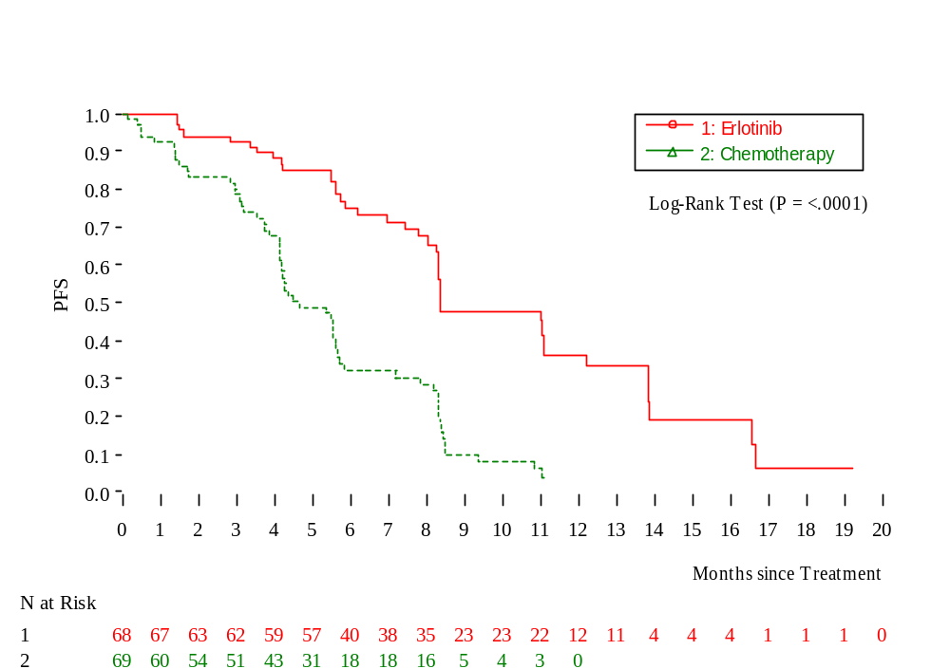
Kaplan-Meier Curve of Investigator-Assessed PFS in Tissue Positive Plasma Positive Subset
HR = 0.29 (95% CI, 0.19,45)

Slide 14
Estimating Hazard Ratio (Drug Efficacy) for Plasma Positive subset
 | Tissue Samples Mutations
Blood Samples Mutation |  | Positive | Negative | Total
 | Positive | n₁₁ | n₁₀ | n₁
 | Negative | n₀₁ | n₀₀ | n₀
 | Total |  |  | n
ln(HR)_{pEGFR+} = ln(HR) _{(pEGFR+∩ tEGFR +)}×PPV + ln(HR)_{(pEGFR+∩ tEGFR -)} ×(1-PPV )
= δ1×PPV + δ2×(1 − PPV)
Here, δ1 is drug efficacy (ln(HR) in Plasma Positive Tissue Positive subset.
And δ2 is drug efficacy (ln(HR) in Plasma Positive Tissue Negative subset

Slide 15
Estimating Hazard Ratio (Drug Efficacy) for Plasma Positive subset (Contd)
Estimate of δ1 is available from the observed data
But since Tissue negative Plasma Positive patients are not enrolled in the trial, the estimate of drug efficacy δ2 is not available.
Assume that δ2 = c× δ1 for c in (0,1) and Var(δ2 ) = Var(δ1 )
c | HR|pEGFR+ | 95% CI LL | 95%CI UL
0.00 | 0.301 | 0.196 | 0.462
0.25 | 0.298 | 0.195 | 0.456
0.50 | 0.295 | 0.194 | 0.451
0.75 | 0.293 | 0.192 | 0.446
1.00 | 0.290 | 0.191 | 0.442

Slide 16
Summary
Liquid Biopsy meets an unmet needs of patients
Approximately 75% of patients testing positive in tissue test positive in Plasma Samples
If Plasma Test is negative then obtain a tissue sample if possible
Patients testing positive in Plasma positive samples have acceptable drug efficacy.

Slide 17
Doing now what patients need next

