Slide 1
Population bioequivalence, in-vitro bioequivalence and CMC or analytical equivalence
Yi Tsong, CDER, FDA
Disclaimer: This presentation reflects the views of the author and should not be construed to represent FDA’s views or policies.

Slide 2
Outline
Average Bioequivalence Test
Individual Bioequivalence Test
Population Bioequivalence Test
Reference Scaled Average Bioequivalence Test
In-Vitro Equivalence Test
Conclusion and Summary

Slide 3
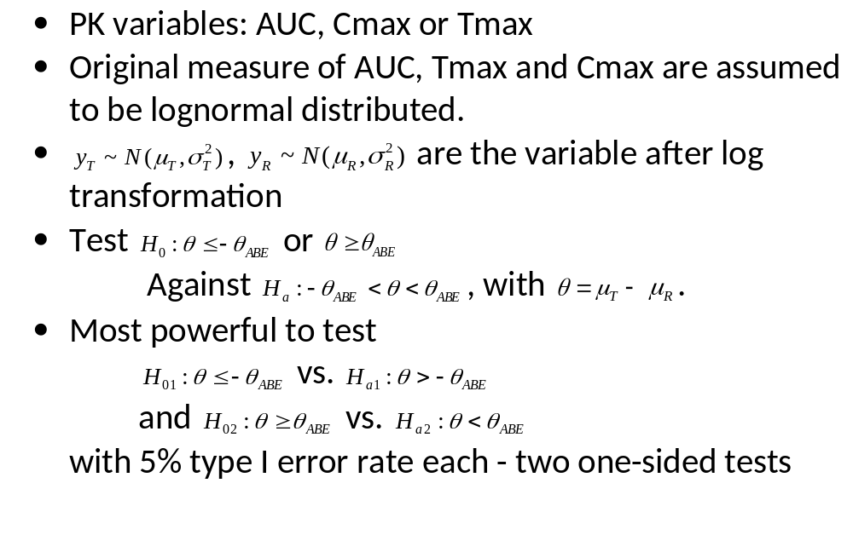
Average Bioequivalence

Slide 4
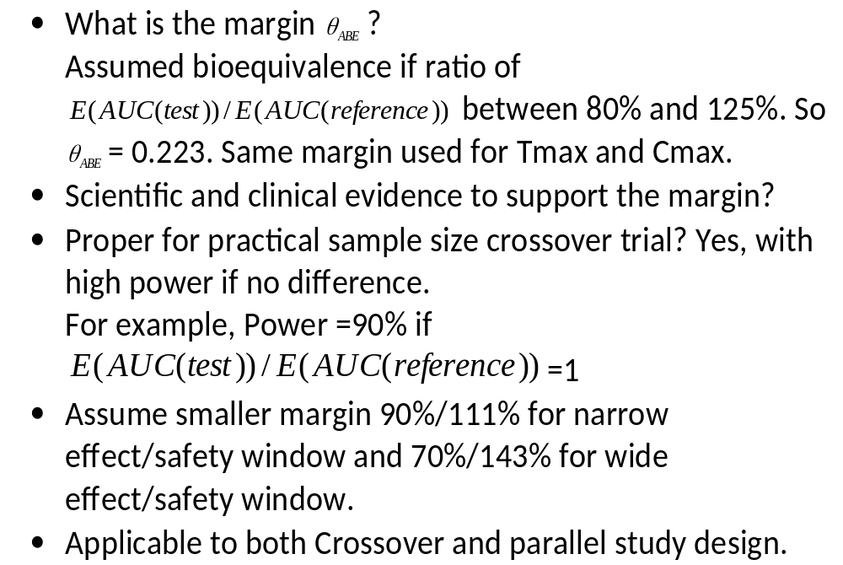

Slide 5
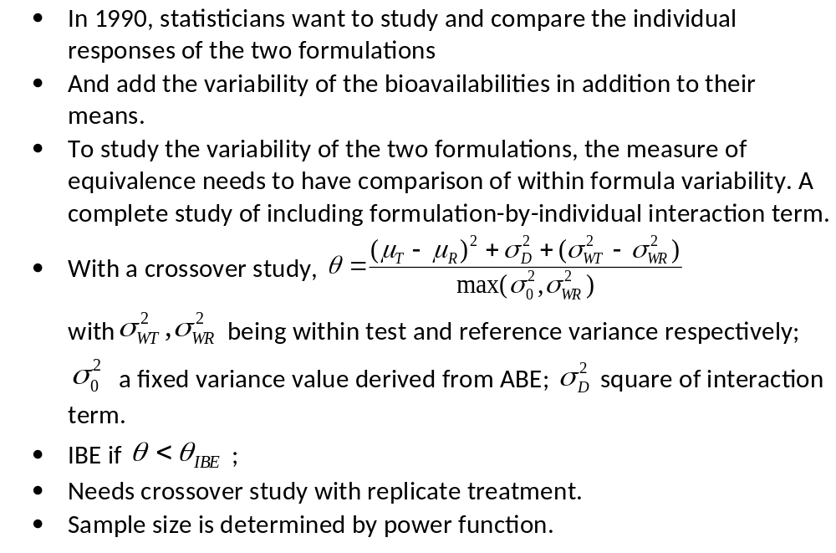
Individual Bioequivalence

Slide 6
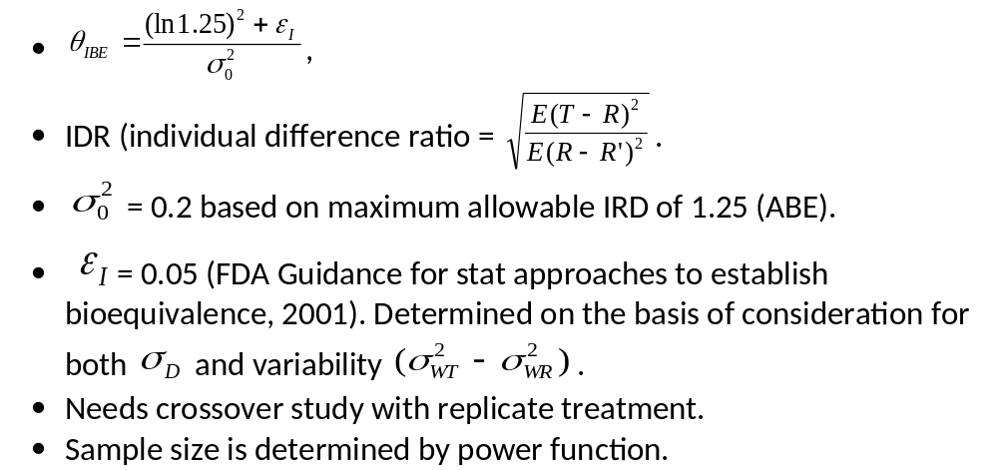

Slide 7
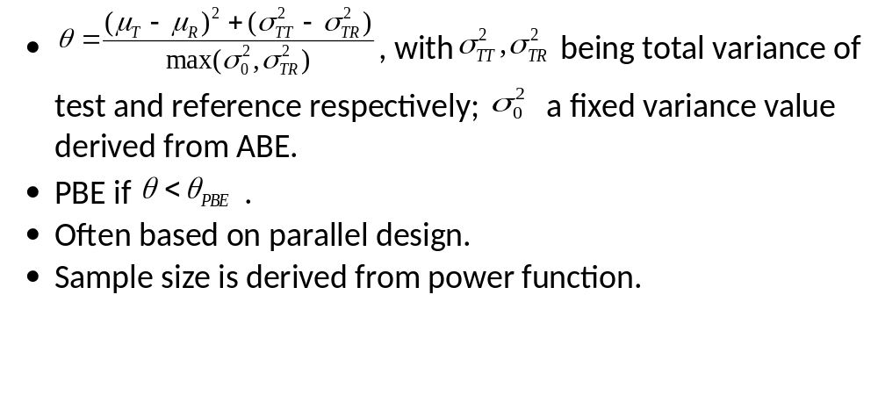
Population Bioequivalence and In-vitro BE

Slide 8
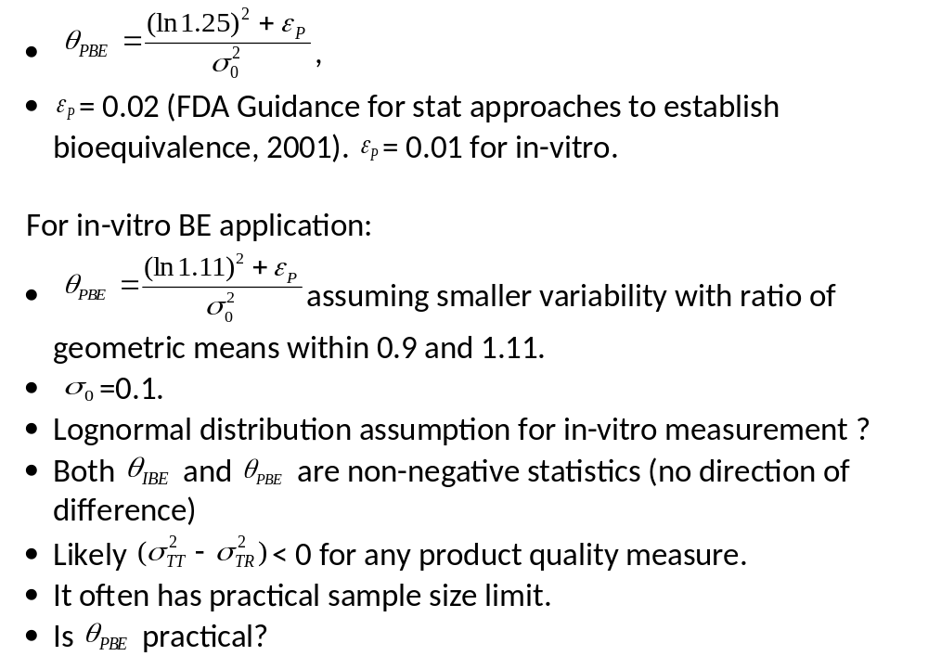

Slide 9
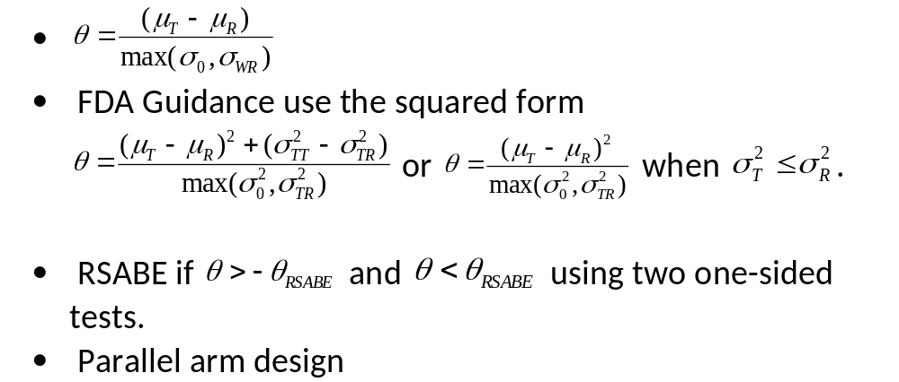
Reference Scaled Average Bioequivalence

Slide 10
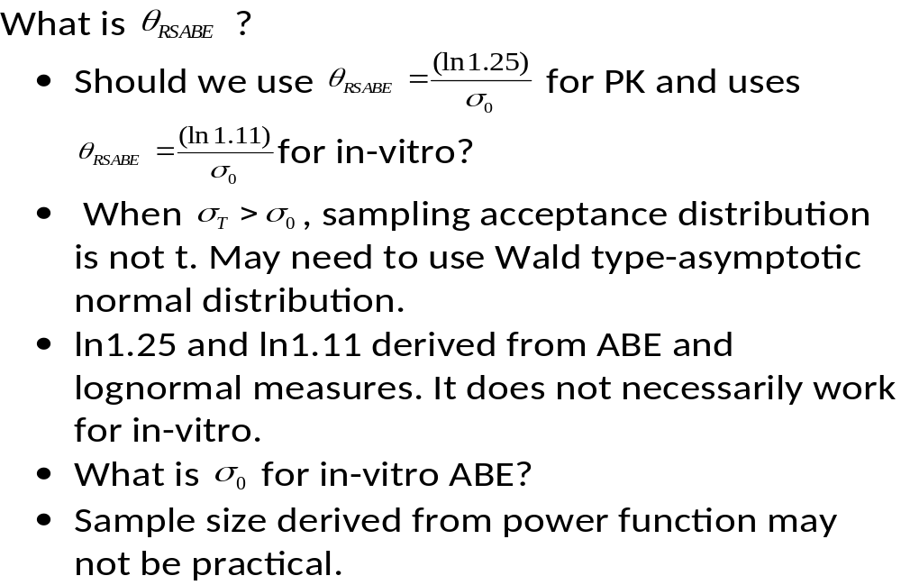

Slide 11
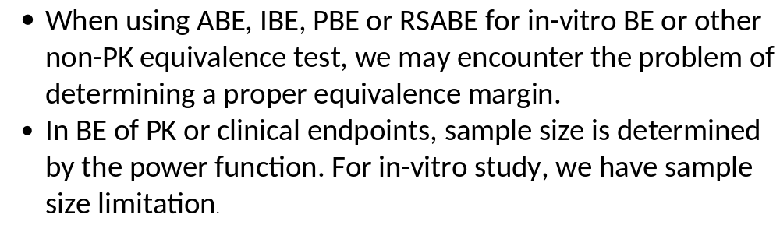
Summary and Conclusion

Slide 12
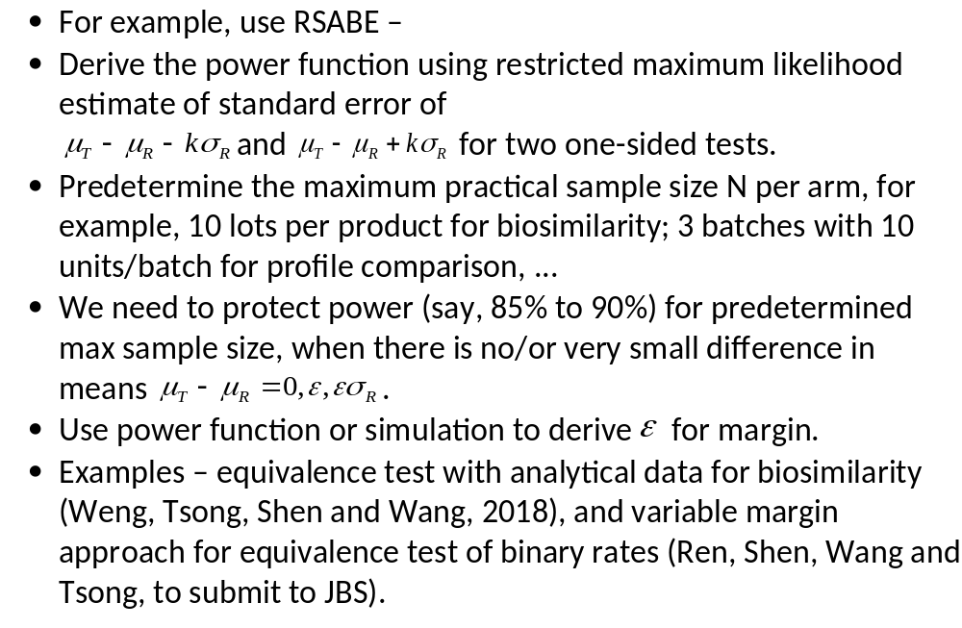
Potential Solution

Slide 13
Thank you for your attention !!!

