Slide 1
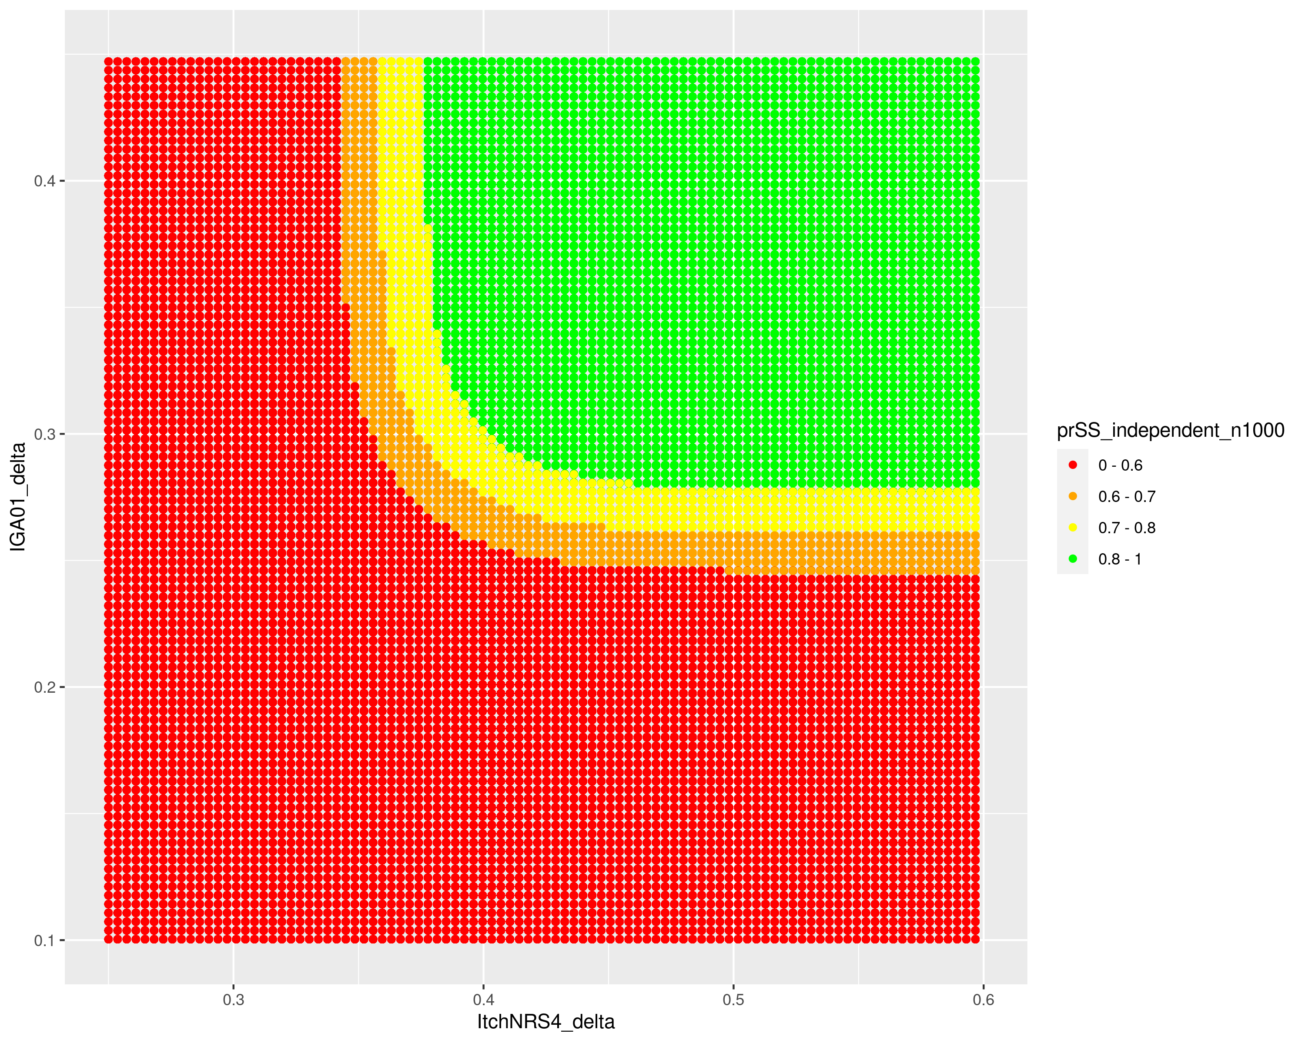
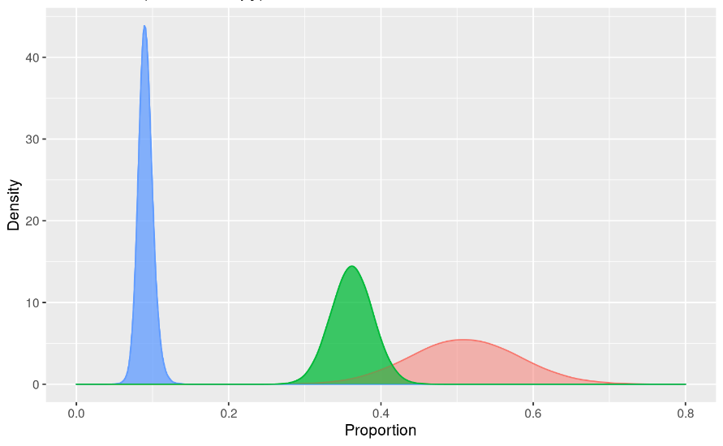
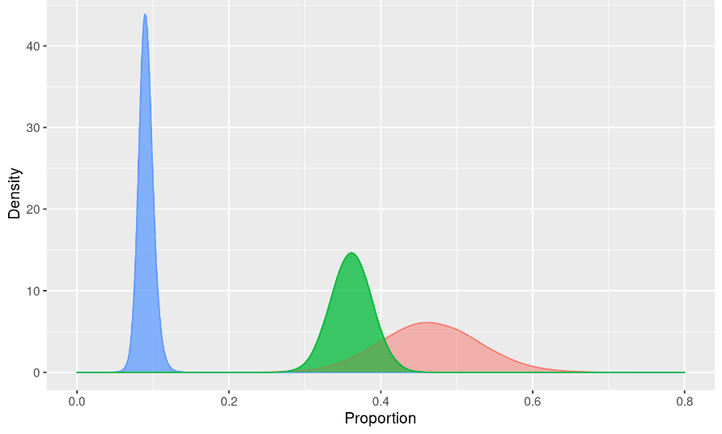
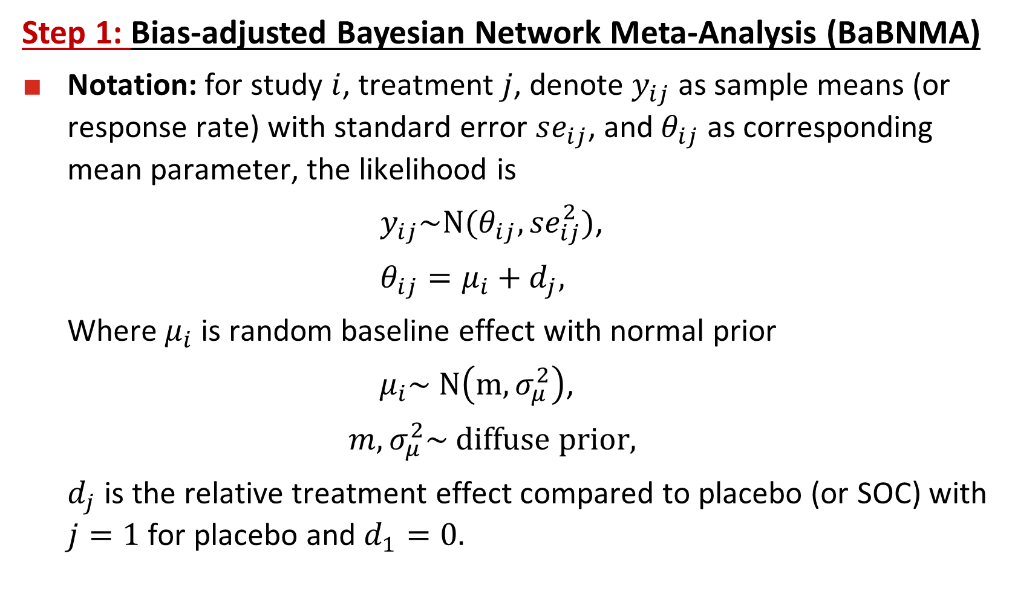
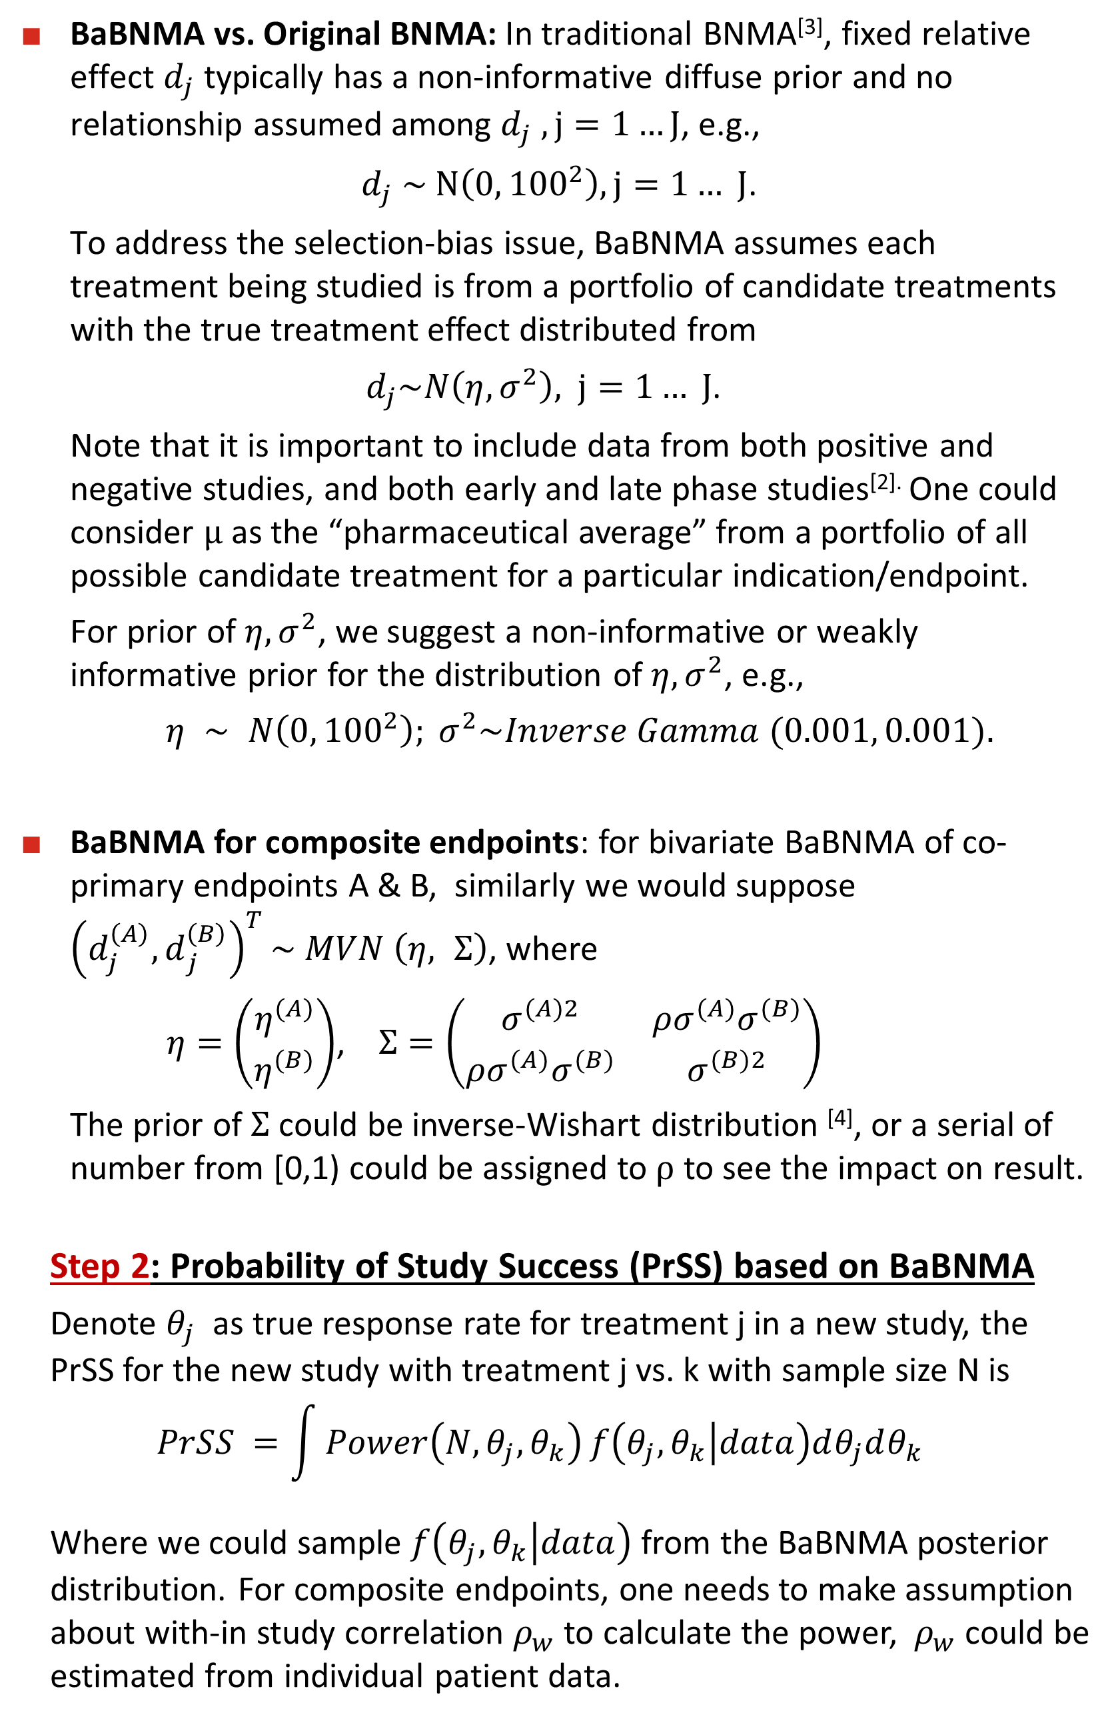
Poster # 302412
Probability of Study Success (PrSS) assessment based on Bias-adjusted Bayesian Network Meta-Analysis (BaBNMA)
Ying Zhang, Karen Liu, Lei Shen, Jingyi Liu
Eli Lilly and Company, Indianapolis, USA;
BACKGROUND
BaBNMA vs. Original BNMA: In traditional BNMA^{[3]}, fixed relative effect $d_{j}$typically has a non-informative diffuse prior and no relationship assumed among $d_{j} , j=1…J$, e.g.,
$d_{j} \sim N\left(0, {100}^{2}\right), j=1… J$.
To address the selection-bias issue, BaBNMA assumes each treatment being studied is from a portfolio of candidate treatments with the true treatment effect distributed from
  ${ d}_{j}\sim N\left(η, σ^{2}\right),$ $j=1… J$.
  Note that it is important to include data from both positive and negative studies, and both early and late phase studies^{[2].} One could consider $μ$ as the “pharmaceutical average” from a portfolio of all possible candidate treatment for a particular indication/endpoint.
  For prior of $η, σ^{2}$, we suggest a non-informative or weakly informative prior for the distribution of $η, σ^{2}$, e.g.,
  $η ∼ N\left(0, {100}^{2}\right); σ^{2}\sim Inverse Gamma (0.001, 0.001).$
BaBNMA for composite endpoints: for bivariate BaBNMA of co-primary endpoints A & B, similarly we would suppose ${\left({d_{j}^{\left(A\right)}, d}_{j}^{\left(B\right)}\right)}^{T}\sim MVN$ $\left(η, Σ\right)$, where
$η=\left(\begin{matrix}η^{(A)} \\ η^{(B)}\end{matrix}\right)$, $Σ=\left(\begin{matrix}σ^{(A)2} & ρσ^{(A)}σ^{(B)} \\ ρσ^{(A)}σ^{(B)} & σ^{(B)2}\end{matrix}\right)$
    The prior of $Σ$ could be inverse-Wishart distribution ^{[4]}, or a serial of number from [0,1) could be assigned to $ρ$ to see the impact on result.
  Step 2: Probability of Study Success (PrSS) based on BaBNMA
  Denote $θ_{j}$ as true response rate for treatment j in a new study, the PrSS for the new study with treatment j vs. k with sample size N is
    $$PrSS =\int{Power\left(N, θ_{j}, θ_{k}\right)}f\left(θ_{j}, θ_{k} | data\right)dθ_{j}dθ_{k}$$
  Where we could sample $f\left(θ_{j}, θ_{k} | data\right)$ from the BaBNMA posterior distribution. For composite endpoints, one needs to make assumption about with-in study correlation $ρ_{w}$ to calculate the power, $ρ_{w}$ could be estimated from individual patient data.
RESULTS (univariate endpoint)
RESULTS (bivariate endpoint)
  Drug development is a complex and costly process, and one of the most critical decision is if a compound should move to late-stage clinical trial for registration purpose once the proof-of-concept study result is available.
  One big challenge is the effectiveness of the drug is unknown and the treatment effect is not easy to quantify. Bayesian Network Meta-Analysis (BNMA) is commonly used to synthesize relevant data and derive the distribution of multiple treatment effects, which is essential for Probability of Study Success (PrSS) ^{[1]} calculation. Then PrSS could be used to facilitate the investment decision.
  Selection bias exists since only compounds with promising results from the small study would move to the next development stage ^{[2]}.
For univariate endpoint, the framework has been implemented to an ongoing clinical development with itch as the endpoint. All treatments are de-identified. We had drug A Ph2 result, a competitor drug B’s Ph3 data, and other historical data. To decide whether to move A to Ph3 H2H (A vs. B), BaBNMA was performed and PrSS was calculated based on BaBNMA. The comparison of posterior distribution for A, B and placebo response rates from BaBNMA and original BNMA are as follows.
For composite endpoints (both Itch and Skin), we could also use PrSS based on BaBNMA to inform decision making.
The graph is the PrSS decision-rule chart, for each possible observed result, BaBNMA was performed and PrSS was derived.
Go/no-go decision was based on pre-specific threshold for PrSS (>0.8/ <0.6). If observed value falls in green area, the a “go” decision would be triggered.
Skin (Pbo Subtracted)
PrSS
PBO
Original BNMA,
PrSS(A vs B, N=500) =0.8
OBJECTIVE
B
  Enhance original BNMA with selection bias adjustment
  Derive PrSS and quantitative go/no-go decision rule for both univariate and bivariate endpoint based on bias-adjusted BNMA
A
Itch (Pbo Subtracted)
conclusions
METHODS
PBO
  BaBNMA has been proposed to address the selection-bias issue. A hierarchical model for distribution of the efficacy for a portfolio of compounds was considered, which can serve as the prior distribution.
  PrSS based on BaBNMA is a useful approach to inform go/no-go decision making. An example of PrSS and decision rule for a real clinical development program in both univariate and bi-variate endpoint was demonstrated.
BaBNMA
PrSS(A vs B, N=500) =0.6
  Step 1: Bias-adjusted Bayesian Network Meta-Analysis (BaBNMA)
Notation: for study $i$, treatment $j$, denote $y_{ij}$ as sample means (or response rate) with standard error $se_{ij}$, and$θ_{ij}$ as corresponding mean parameter, the likelihood is
      $y_{ij}\sim N(θ_{ij}, {se}_{ij}^{2})$,
      $θ_{ij}=μ_{i}+d_{j},$
    Where $μ_{i}$ is random baseline effect with normal prior
    $μ_{i}\sim N\left(m, σ_{μ}^{2}\right)$,
    $m,σ_{μ}^{2}\sim diffuse prior,$
    $d_{j}$ is the relative treatment effect compared to placebo (or SOC) with $j=1$for placebo and $d_{1}=0.$
B
A
REFERENCES
  [1] Wang, Y., Fu, H., Kulkarni, P., & Kaiser, C. (2013). Evaluating and utilizing probability of study success in clinical development. Clinical Trials, 10(3), 407-413.
  [2] Qu, Y., Du, Y., Zhang, Y., & Shen, L. (2020). Understanding and adjusting for the selection bias from a proof‐of‐concept study to a more confirmatory study. Statistics in Medicine, 39(30), 4593-4604.
  [3] Dias, S., Welton, N. J., Sutton, A. J., & Ades, A. E. (2011). NICE DSU technical support document 2: a generalised linear modelling framework for pairwise and network meta-analysis of randomized controlled trials.
  [4] Bujkiewicz, S., Achana, F., Papanikos, T., Riley, R., and Abrams, K. (2019). NICE DSU technical support document 20: Multivariate meta-analysis of summary data for combining treatment effects on correlated outcomes and evaluating surrogate endpoints.
Comparing BaBNMA result to original BNMA, almost no difference was observed for B, as B has Ph3 data of large sample size, the impact of prior is negligible. However, for A with Ph2 data of small sample size, we could see the bias-adjustment in A’s distribution, which leads to smaller PrSS.
1
2021 ASA Biopharmaceutical Section Regulatory-Industry Statistics Workshop; September 21-24, 2021
Sponsored by Eli Lilly and Company

