Slide 1
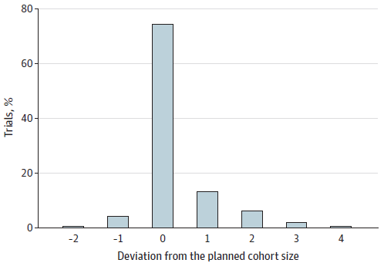
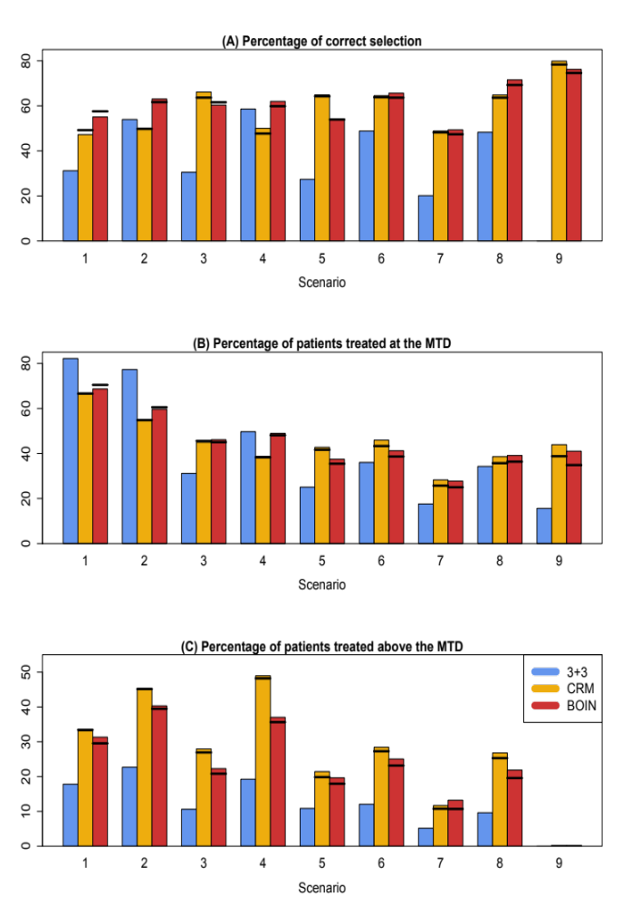
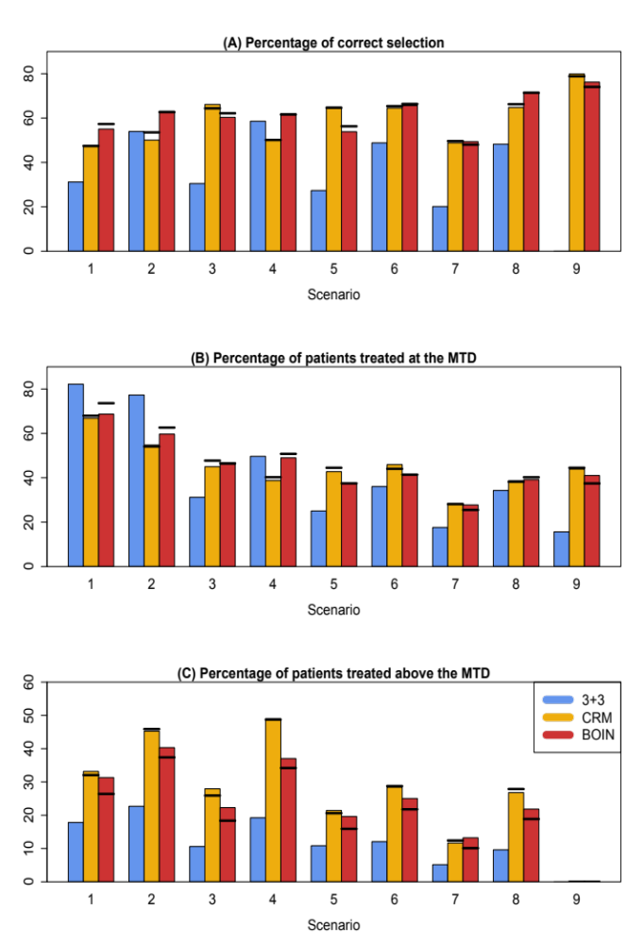
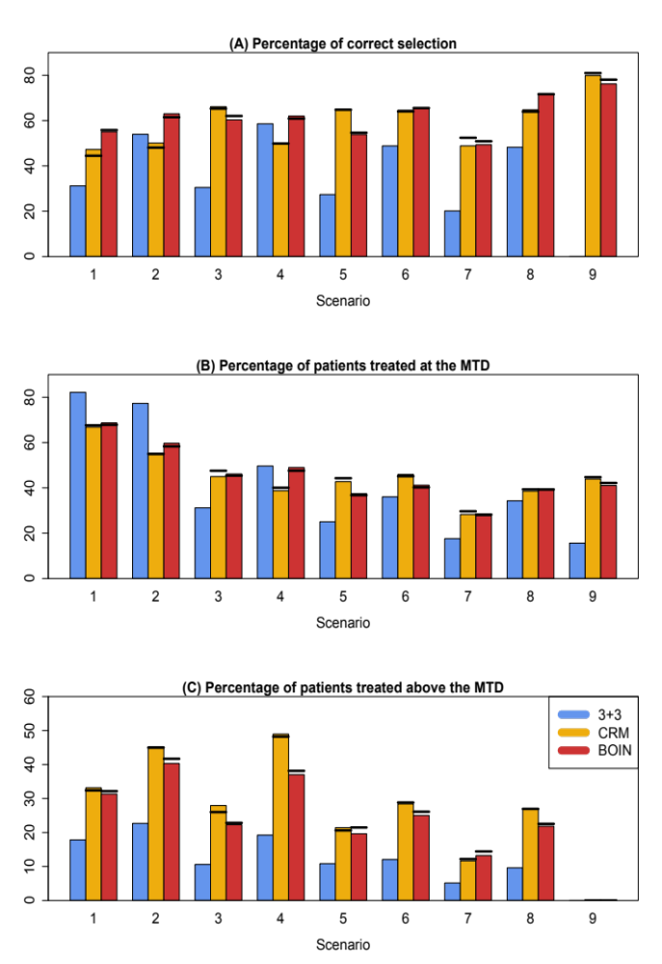

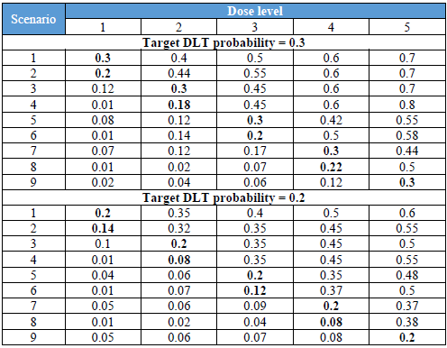
Evaluation of Deviation From Planned Cohort Size and Operating Characteristics of Phase 1 Trials
Minjeong Park¹, PhD, Suyu Liu², PhD, Timothy Anthony Yap^{3,4,5}, MD, Ying Yuan², PhD
¹Food and Drug Administration/Center for Drug Evaluation and Research /Office of Transitional Sciences/Office of Biostatistics/Division of Biometrics 1;
²Department of Biostatistics, ³Department of Investigational Cancer Therapeutics, ⁴ Khalifa Institute for Personalized Cancer Therapy, ⁵The Institute for Applied Cancer Science, The University of Texas MD Anderson Cancer Center
Background
Results
In phase I oncology trials which primarily establish the maximum tolerated dose (MTD) of a new drug, the size of the cohort is typically prespecified to facilitate the trial implementation and evaluation of the operating characteristics of the design. However, the actual cohort size used during the trial implementation often deviates from the prespecified one due to various reasons. Despite its pervasiveness in phase I trials, the impact of cohort size deviation on the operating characteristics of the trial is not clear. The goal of this article is to systematically investigate this issue and provide some practical guidance using statistical rationale and evidence.
Random cohort size deviation
Figure 2 shows the results when cohort size deviation follows what was observed in real trials when the target DLT rate was 30%. CRM and BOIN yield significantly higher accuracy in identifying the MTD than the 3+3 design. On average, the PCS of the MTD for CRM and BOIN was 25% and 26%, respectively, higher than that of the 3+3 design. In addition, CRM and BOIN allocated 4-5% more patients to the MTD. The 3+3 design is the most conservative, assigning fewer patients to doses above the MTD.
Cohort size deviation has minimal impact on the performance of CRM and BOIN. Compared to the counterpart that strictly follows the planned cohort size of 3, in the presence of cohort size deviation, the average PCS of CRM is reduced by merely 0.87% with the range of (-2.5%, 1.96%), and the average PCS of BOIN is reduced by 0.84% with the range of (-2.3%, 2.5%) across 9 dose-toxicity scenarios. The percentage of patients treated above the MTD is reduced by 0.75% with the range of (-1.6%, 0.25%) for the CRM, and reduced by -1.5% with the range of (-2.5%, 0%). The results for target DLT rate of 20% are similar and provided Figure S2 in Supplementary Data.
Informative cohort size deviation
Figures 3-5, respectively, show the results for the target DLT probability of 0.3 under three different types of informative cohort size deviation: (1) if any DLT is observed in the current cohort, expand the size of the next cohort to 4; (2) if any DLT is observed in the current cohort, reduce the size of the next cohort to 2; and (3) if any DLT is observed in the current cohort, expand the size of the current cohort to 4. Overall, CRM and BOIN are remarkably robust to the informative cohort size deviation. The accuracy of selecting the MTD is barely affected and the average change in PCS is less than 0.5%, compared to the counterpart that strictly follows the planned cohort size of 3. Cohort size deviation has relatively more impact on the percentage of patients treated at the MTD, and the percentage of patients treated above the MTD. The range of change in these two metrics is wider than that under the random cohort size deviation. For example, under a third type of informative cohort size deviation, the change in the percentage of patients treated above the MTD is (-3.7%, 1.3%) for CRM and (-4.5%, 0%) for BOIN. Nevertheless, this range of change is still small and of little practical concern. The results for a target DLT probability of 20% are similar.
Methods
We reviewed 102 phase I dose-escalation trials published between January 2017 and May 2018 in 3 peer-reviewed journals (Journal of Clinical Oncology, Clinical Cancer Research, and Cancer) to obtain an estimate of cohort size deviation to set up simulation parameters. Of 102, a total of 45 trials were used due to lack of information or aggregated data without details.
Simulation study
Simulation studies were performed to systematically investigate the impact of cohort size deviation on the operating characteristics of the trial by using the 3+3 design, continual reassessment method (CRM) and Bayesian optimal interval (BOIN) designs. Five dose levels with a maximum sample size of 30 and prespecified cohort size of 3 were considered. Simulations were conducted under two mechanisms, random and informative. Under the random mechanism, the cohort size deviation was independent of the interim toxicity data, generated randomly from the empirical distribution of the cohort size from literature reviews. Three informative mechanisms were considered, 1) if any dose limiting toxicity (DLT) was observed in the current cohort, next cohort was expanded to 4; 2) if any DLT was observed in the current cohort, next cohort was reduced to 2; 3) if any DLT was observed in the current cohort, current cohort was expanded to 4. Target DLT probabilities of 20% and 30% were considered, and for each target DLT rate, we considered nine toxicity scenarios, representing a variety of dose-toxicity relationships (Table 1). Under each scenario we simulated 5,000 trials to evaluate the operating characteristics of the three designs. Following three metrics were considered to measure the performance of the designs; the percentage of correct selection (PCS) of the maximum tolerated dose (MTD), the average number of patients allocated to the MTD, and the average number of patients allocated to the doses above the MTD.
Figure 1.
Cohort size deviation in phase I trials, where 0 indicates that the actual cohort size used is consistent with the prespecified cohort size
Figure 2. Simulation results of the 3+3, CRM, and BOIN designs when the cohort deviation was generated according to the frequency observed in real trials.
Figure 3. Simulation results of the 3+3, CRM, and BOIN designs under informative cohort size deviation where if any DLT was observed in the current cohort, the size of the next cohort was expanded to 4.
Figure 4. Simulation results of the 3+3, CRM, and BOIN designs under informative cohort size deviation where if any DLT was observed in the current cohort, the size of the next cohort was reduced to 2.
Figure 5. Simulation results of the 3+3, CRM, and BOIN designs under informative cohort size deviation where if any DLT was observed in the current cohort, the size of the current cohort was expanded to 4.
Table 1.
Eighteen dose-toxicity scenarios considered in the simulation study. The doses in bold are the MTD. To reflect what may happen in practice, the MTD does not necessarily have the DLT probability equal to the target DLT probability.
*Note: The bars show the performance (percentage) of the designs when the planned cohort size was strictly followed; the horizontal lines indicate the value of the performance metric in the presence of cohort size deviation. The target DLT rate was 0.3.
Discussion
Our results also elucidate an advantage of novel model-based and -assisted designs, such as CRM and BOIN, over the conventional 3+3 design, which is rarely discussed and under-appreciated in the literature: the ability to make real-time decision in the presence of over-enrolling or under-enrolling cohorts. Such flexibility is important from a practical standpoint and reduces the logistic difficulties for implementing trials. In contrast, the 3+3 design does not have any built-in rule to handle cohort size deviation (i.e., no rule is defined when the number of patients deviates from 3 and 6), and investigators have to resort to additional, often subjective rules to make decisions on dose escalation/de-escalation, which typically are not described in the trial protocol or publication. Investigators who are interested in leveraging the flexibility of BOIN and CRM for occasional cohort size deviations should prespecify it in the protocol.
Disclaimer
This article reflects the views of the author and should not be construed to represent FDA’s views or policies.

