Slide 1


Sylva H. Collins
Director,
Office of Biostatistics
OTS, CDER, FDA
ASA Biopharmaceutical Section RISW
September 2020

Slide 2
Disclaimer
This presentation reflects the views of the author and should not be construed to represent FDA’s views or policies.

Slide 3
Outline
Lead and Impact: Turning Innovation into Practice
Where we are
What is possible
What is needed
What are the benefits
How to do it

Slide 4
What Does Leadership have to do with turning Innovation into Practice?
Lead and Impact
Turning Innovation into Practice

Slide 5
Faster, Cheaper, Better
Are there parts of clinical development processes that can be done
    10 times faster
    4 times cheaper
    14 times better

Slide 6
R&D Costs
Average R&D expenditure for each new drug is
  US$1.3 billion – The London School of Economics*
  US$2.6 billion – CenterWatch**
  *Olivier J. Wouters et al, JAMA, March 3, 2020, Volume 323, Number 9
  ** Ken Getz, The Cost of Clinical Trial Delays, Tufts CSDD, Tufts University School of Medicine, January 2015

Slide 7
Clinical Development Time
6-7 years development phase
12% or less make it to approval
* Biopharmaceutical Research and Development - Overview

Slide 8
Regulatory agencies and sponsors have a role to play to modernize clinical development in order to improve the efficiency and help to improve the speed of R&D processes.

Slide 9
Modernizing FDA’s New Drugs Regulatory Program
FDA is constantly seeking to reform its processes
Integrated review process
Re-organization
Standardization of roles and processes

Slide 10
Standardization of roles and processes
Within the Office of Biostatistics, we are measuring and standardizing workflow, roles and responsibilities, and identifying opportunities to improve our operational efficiency

Slide 11
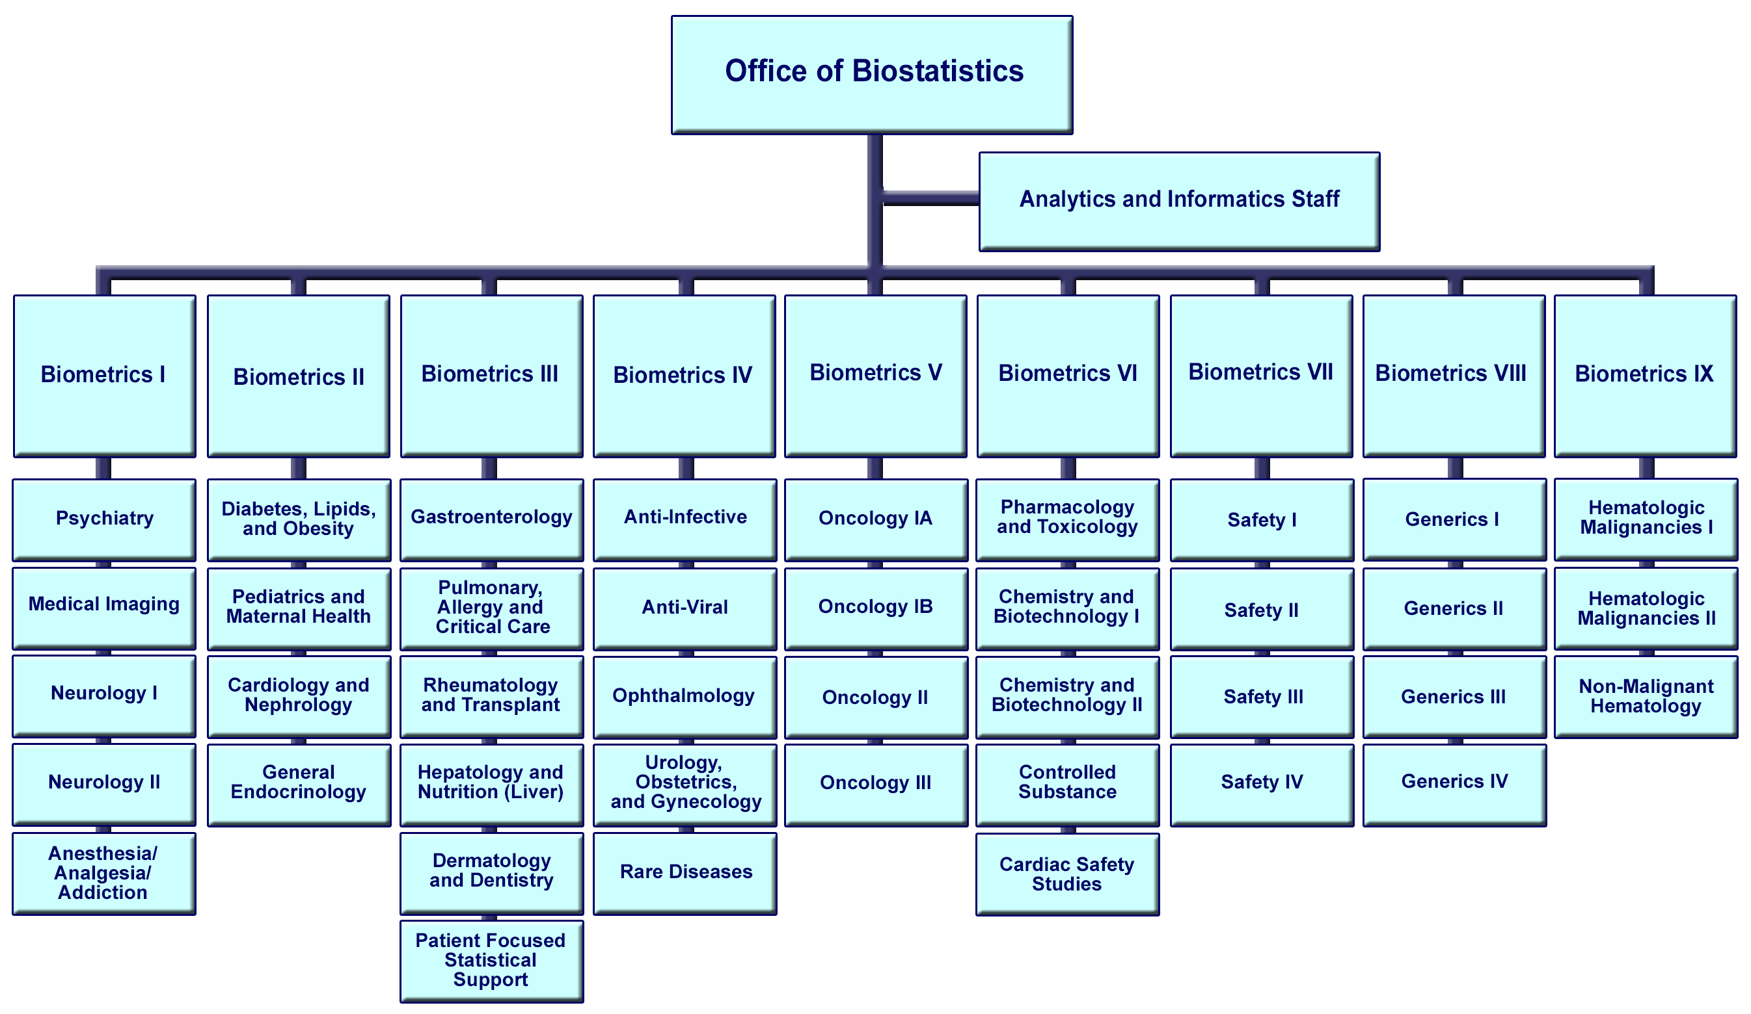
Reorganization

Slide 12
Modernizing FDA’s New Drugs Regulatory Program
An important component of these efforts is to identify opportunities
to increase the speed and efficiency of our review processes and
to increase the consistency of regulatory decision-making across the review divisions

Slide 13
Modernizing FDA’s New Drugs Regulatory Program
Complex Innovative Designs (CID) Pilot Meeting Program
  Launched in 2018
Real World Data/Evidence (RWD/RWE)
  RWE draft Framework issued in 2018
Patient Focused Drug Development (PFDD)
  PFDD Final Guidance issued in 2020
    “Patient-Focused Drug Development: Collecting Comprehensive and Representative Input”

Slide 14
Modernizing FDA’s New Drugs Regulatory Program
to promote the use of advanced scientific approaches and technologies
to ensure effective communication among the stakeholders
to strengthen regulatory acceptance of non-traditional approaches and optimize decision-making process

Slide 15
“Novel”
Approaches to Accelerate Clinical Development
Adaptive Designs
Real World Evidence
Master Protocols
Bayes methods
We’ll use the word “novel” not because these approaches are necessarily new but because they are not commonly used.

Slide 16
Not So “Novel”
The concepts of adaptive designs, Bayesian approaches, master protocols or RWE are not new
  New concepts for adaptive designs are discussed endlessly
  The use of Real-World data and Real-World Evidence has been bruited for decades
  Master protocols have been around for more than 10 years
  Reverend Bayes has been dead since 1769

Slide 17
Use of “Novel” Designs
FDA is receptive to these approaches and encourages their appropriate use
In 2019,
  FDA published the Final Guidance for Industry on the use of Adaptive Designs
  FDA Draft Guidance on interacting with the FDA on Complex Innovative trial designs
Sponsors are constantly grasping at new approaches
In principle, sponsors embrace the use of adaptive designs, Bayesian approaches, the use of RWE, PFDD and other innovations

Slide 18
Appropriate Use of Innovative Designs
Drug development carries a high risk of failure
An innovative design will not make an ineffective drug into a successful drug
However, appropriate use of innovations can allow meaningful conclusions to be reached sooner and at less cost
Many clinical trials would benefit from some type of novel approach

Slide 19
In Theory
In theory, the benefits of these approaches are enormous and realizable
In theory, most dose-finding studies would achieve far greater efficiency if an ineffective treatment arm is dropped after an interim analysis
In theory, sample size re-estimation can be conducted to help ensure that the outcome of a clinical trial is statistically meaningful
In theory, this would accelerate clinical development and save their sponsors a significant portion of the cost of clinical trials

Slide 20
All of this is true in theory.
Why not in practice?

Slide 21
Why not in practice?
Of the more than 2,000 protocols submitted to the FDA during 2020*
  Less than 9% used adaptive design
  Less than 4% used Bayes methods
Of the more than 200 NDAs/BLAs submitted*
  Less than 2% used adaptive design
*Office of Biostatistics submissions tracking system

Slide 22
In theory, there is no difference between theory and practice.
In practice, there is.
Yogi Berra

Slide 23
Why are innovative designs so rarely used?
Leadership is needed to turn theory into practice

Slide 24
The Need for Speed
The biggest obstacle to the deployment of innovative adaptive designs is speed
An adaptive trial is simply not useful if the time needed to collect the data, to clean the data, to lock the database and to analyze the data is too long

Slide 25
The keys to greater speed
Measurement
Standardization
Leadership

Slide 26
Protocol Amendments
According to CenterWatch, each protocol amendment can cost*
  A half million US dollars
  Three months of delay
*The CenterWatch Monthly, Volume 23, Issue 04, 2016

Slide 27
Careful Planning is Needed
Sponsors often focus on starting a clinical trial as fast as possible
In doing so, many aspects of the trials do not get the careful planning and thoughtful analysis that they deserve
The urgency to start patient enrolment without careful planning, results in numerous protocol amendments, added costs and delays clinical development.
Careful planning of the critical elements of the study design is needed for successful execution of adaptive designs
  Extensive simulations are needed prior to protocol approval
  Establishing procedures to minimize operational bias in order to protect trial integrity
  FDA encourages sponsors to have early discussions during the development of such trials

Slide 28
Metrics
If adaptive designs are being contemplated, these time estimates are crucial
  How long does it take to lock a database (DBL) after the Last Patient’s Last Visit?
  How long after DBL to Top Line results?
  How long to re-configure the eCRF (electronic Case report Form)?
  How much time to re-configure clinical supplies?

Slide 29
A big part of Speed is Standardization
eCRFs and data standards
Standard Tables, Listings, Figures (TLFs)
Standard Statistical Programs

Slide 30
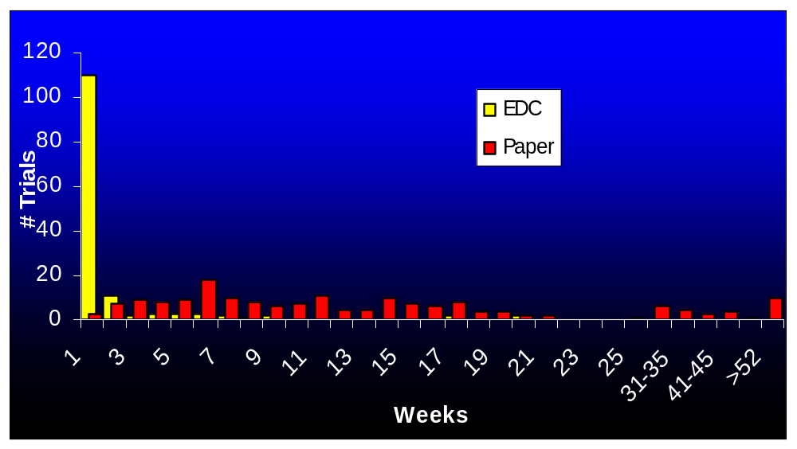
A Case Study
Time to lock a Database after LPLV (Last Patient Last Visit)

Slide 31
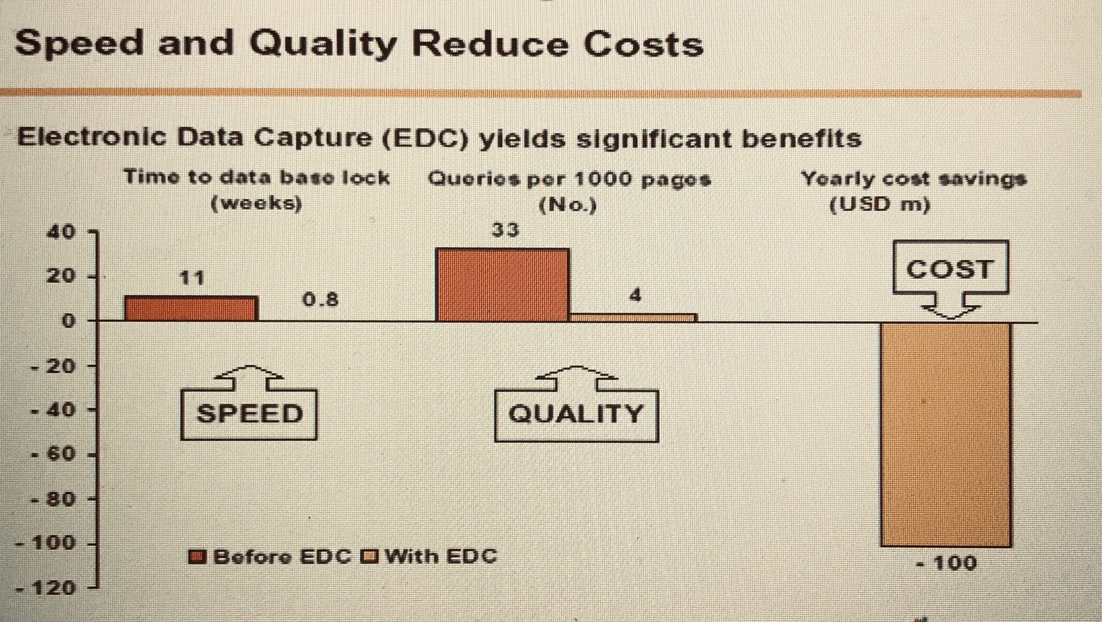
A Case Study

Slide 32
Why then is this not routinely done?
These things do not happen by themselves
Leadership is needed

Slide 33
Leadership is Needed
Leadership is needed to establish standards, to ensure their use and for consistent adherence across the organization.
Managers must visibly support the effort and clearly communicate the common goals
Almost everyone will make the right decision when the choice is obvious
Almost no one will make the right decision when the choice appears arbitrary

Slide 34
PALM EBOLA Study*
PAmoja TuLinde Maisha: together save lives
Adaptive Master protocol
Treatment arms
  Zmapp (control)
  Remdesivir
  MAb114
  REGN-EB3
*Mulangu et al, A Randomized Controlled Trial of Ebola Virus Disease Therapeutics, NEJM, Dec 12, 2019, Vol 381, Vol 24, 2293-2303

Slide 35
Speed - PALM EBOLA Study
One obvious conclusion is that locking databases, completion of statistical analyses and reaching clinical decisions had to be done fast
A third of all subsequent deaths were made preventable simply by choosing the better regimens

Slide 36
Collaboration and Coordination
PALM EBOLA Study
INRB of the Congo
NIAID (NIH)
Alliance for International Medical Action (ALIMA)
International Medical Corps (IMC)
Doctors Without Borders (Paris)
WHO (Geneva)
National and international Health agencies
Government leaders
Pharmaceutical companies
Oversight boards
Scientists
Nongovernmental organizations
Staff in the field

Slide 37
PALM EBOLA Study
The obstacles that this study needed to overcome
Language barriers
National jurisdictions
Extraordinarily dangerous working conditions for caregivers, and
Cultural complications
For study managers
Interim analyses required re-randomization of patients and
Rapid changes in the logistics pipeline for the selected treatments
Nonetheless, they got it done

Slide 38
COVID-19 Pandemic
Our response has included some elements of innovation, standardization and adaptation, but mainly it has included exceptionally long hours and placing COVID-19 studies at the front of the line for development

Slide 39
Speed must be a routine
The objective of the steps that I outlined is to make speed a routine
It is not more work to become faster, it is the same work done at a different time

Slide 40
Lessons Learned
Do it Fast
  To be fast some of the time, you must be fast all of the time.
    If your routine is to be slow, you cannot suddenly become fast because of urgency
    You cannot suddenly streamline your processes or decide to use an innovative design because we have a pandemic

Slide 41
Do not try to do this all at once
Start with something simple
Adaptive Master Protocol
RWE
Bayes
Seamless 2/3
Re-estimate sample size
External controls
Drop and add arms

Slide 42
The Good News
  No new theory
  No new technology
  No greater effort
  No new Act of Congress - is needed to accomplish this goal
Statisticians are key
Statisticians have the data, the know-how and the wherewithal to make a compelling case to their management to carry out clinical trials far more effectively than is currently the norm

Slide 43
Resistance to Change
Reform will meet resistance
The longer a reform takes, the more resistance it will generate
Reform cannot easily be done slowly
Big organizations are dynamic
  People change, roles change, technology changes, objectives change
Getting a large organization to change how it does things requires urgency and forcefulness

Slide 44
It Can Be Done
Statisticians in industry and regulators are in the best position to make the case to their respective organizations for the benefits of
  standardization, process reform, and innovative clinical trial designs

Slide 45
The keys to impactful innovation
Standardize
Careful planning of study design
Have early discussions with FDA
Become relentless advocates
Be persuasive- it’s an easy case to make!
Be Fast- ALL THE TIME!

Slide 46
Lead and Impact:
Turning Innovation into Practice
Collect your information, gird yourself for grievous battle and persuade your management to listen to your advice
It will not be easy, but the rewards will be enormous

Slide 47
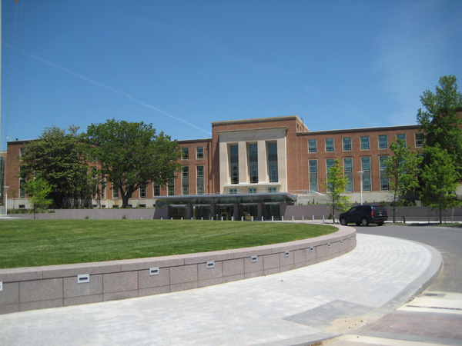
Thank you sylva.collins@fda.hhs.gov

