Slide 1
Case Study of Multiple Criteria Decision Analysis for Quantitative Benefit Risk Assessment
ASA Biopharmaceutical Meeting 2020
Sai Dharmarajan
FDA/CDER/OTS/OB

Slide 2
Disclaimer
This presentation reflects the views of the author and should not be construed to represent FDA's views or policies.

Slide 3
Outline
MCDA Example: Ticagrelor
  A brief summary of the Decision Science and Analysis Team (DSAT) review memo, available online as a part of approval package
MCDA Shiny App Implementation
Notes:
First part – results, what I present here is a summary of a portion of the publicly available review of the product Ticagrelor, specifically I’ll be summarizing the work done by DSAT – you can find the details decision science memo

Slide 4
Multi-criteria Decision Analysis (MCDA)
Define the decision problem
Identify the key benefits and risks (value tree) and gather data (effects table)
Quantify the relative importance or value of the benefits and risks
  How do we think about changes within an outcome (for example, increasing or decreasing the likelihood of a benefit or risk)?
  How do we make tradeoffs between outcomes?
Assess the options (#1) by combining the estimates of the benefits and risks (#2) with the quantified value information (#3) to determine the overall value of each option
Sensitivity testing and interpretation
The process and discussion it generates is as important, if not more, than the number we get at the end

Slide 5
MCDA Step 1
Decision Problem: sNDA for primary prevention of MI and stroke
Drug (Ticagrelor) currently approved for prevention of CV death, MI, and stroke in patients with acute coronary syndrome or history of myocardial infarction
  Approved with a boxed warning for “significant, sometimes fatal bleeding”
sNDA is for primary prevention of MI and stroke in high risk patients, specifically patients with type 2 diabetes (T2DM) and established coronary artery disease (CAD)
The risk of thrombotic events associated with T2DM and CAD (and with no history of MI) is similar to the risk associated with history of MI but no T2DM

Slide 6
MCDA Step 2
Key Benefits & Risks
Drug
Benefits: Prevention of CV events (composite)
CV Death
Ischemic Stroke
Risks: Increase in major bleeds
Fatal bleeds
Type 1 MI
Intracranial hemorrhage
Bleed with loss of >5 g/dL Hb

Slide 7
MCDA Step 2
Clinical Significance of Benefits & Risks
Benefits
CV Death – fatal
Type 1 MI (spontaneous) and ischemic stroke negatively affect maintenance of normal autonomous functioning, including ability to perform activities of daily living as well as extended activities that require physical effort and adequate mentation
Risks
Fatal Bleed - fatal
Similar to Type 1 MI and ischemic stroke, intracranial hemorrhage negatively affects maintenance of normal autonomous function, including activities of daily living and activities requiring physical effort and mentation
Major bleed with loss of >5 g/dL Hb is associated with potential sequalae (e.g., hypovolemic shock and cardiac events) that may require a blood transfusion if sufficient loss of blood has occurred
Notes:
Get confirmation – do your weights based on these definitions – note if you have very different understanding
Granger’s paper on expert elicitation

Slide 8
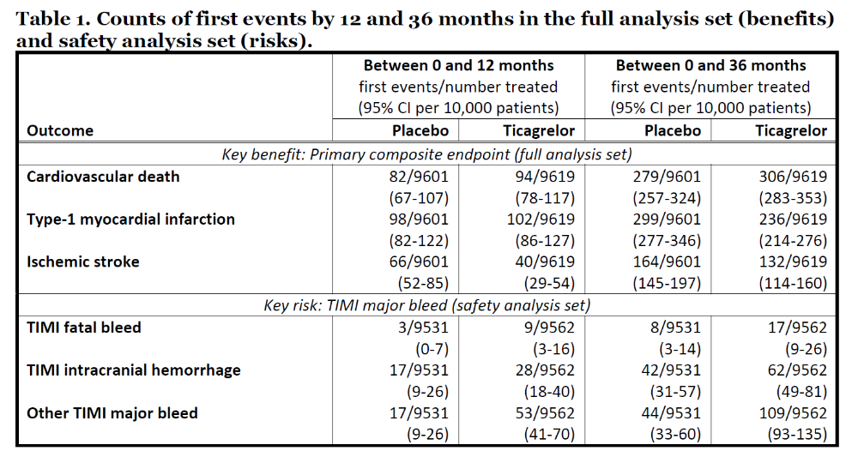
MCDA Step 2
Effects Table
Source: https://www.accessdata.fda.gov/drugsatfda_docs/nda/2020/022433Orig1s028.pdf
Notes:
Source using public URL

Slide 9
MCDA Step 2
Feasible Ranges
Effect For every 10,000 patients treated, number experiencing one or more events | 0-12 months |  | 0-36 months
 | Min (Best) | Max (Worst) | Min (Best) | Max (Worst)
CV Death | 65 | 120 | 255 | 355
Type 1 MI | 80 | 130 | 210 | 350
Ischemic Stroke | 25 | 90 | 110 | 200
Fatal Bleed | 0 | 20 | 0 | 30
Intracranial hemorrhage | 5 | 45 | 30 | 85
Bleed with loss of >5 g/dL Hb | 5 | 75 | 30 | 140
Minimum and maximum encompass the 95% confidence intervals for the treatment and placebo arms
Could be interpreted as the best-case (minimum) and worst case (maximum)
Trial designed to assess efficacy at 36 months
Also considering the 12-month timepoint since benefit is delayed, risk is not
Source: https://www.accessdata.fda.gov/drugsatfda_docs/nda/2020/022433Orig1s028.pdf
Notes:
Round the ranges to 5’s (down/up)

Slide 10
MCDA Step 3a
Valuing changes within an outcome
Linear
We care about each increment equally
For example, if we consider the effect on a population, each increment is another person getting or not getting the outcome; each person is equally important
Best (1.00)
0.75
Non-linear type 1
We care about changes more as we get closer to the min
If min zero and max is 0.4, we might care more about reducing the probability from 0.05 to 0.00 (eliminating) than we would about reducing the probability from 0.4 to 0.35 (still high)
Relative value
0.50
0.25
Non-linear type 2
We care about changes more as we get closer to the max
For example, if the min is 0.6 and the max is 1.00, we would care more about increasing the the probability from 0.95 to 1.00 (making it certain) than we would about increasing the probability from 0.60 to 0.65
Worst (0.00)
Min
Max
Probability of a negative outcome

Slide 11


MCDA Step 3b
Valuing tradeoffs between outcomes
Which “swing” from worst to best is most important?
How important are the other swings, relative to the most important one?
Outcome 1
Outcome 2
Outcome 3
Outcome 1
Outcome 2
Outcome 3
Worst
Worst
Worst
Worst
Worst
Worst
Best
Best
Best
Best
Best
Best
59
100
37
Swing: imagine being able to go instantaneously from the worst-possible (maximum risk) to the best-possible (minimum risk)

Slide 12
MCDA Step 3b
Importance ranking
Reviewers were asked to first rank importance:
  Which outcome is the “worst” if an individual patient experiences it?
  In other words: which outcome do you most want to avoid by prescribing the medication?
And then value tradeoffs:
  How many of the other outcomes is “equivalent” to the “worst” outcome?
  If the “worst” outcome is a risk, how many of the benefit outcomes would you need to avoid in order to offset an event of the risk outcome?
Tradeoffs against cardiovascular death for Reviewer A | Tradeoffs against cardiovascular death for Reviewer B
1 cardiovascular death is equal in importance to: | 1 cardiovascular death is equal in importance to:
10 type-1 myocardial infarctions 1 ischemic stroke 1 TIMI fatal bleeds 2 TIMI intracranial hemorrhages 50 other TIMI major bleeds | 13 type-1 myocardial infarctions 10 ischemic strokes 1 TIMI fatal bleeds 12 TIMI intracranial hemorrhages 40 other TIMI major bleeds
Source: https://www.accessdata.fda.gov/drugsatfda_docs/nda/2020/022433Orig1s028.pdf

Slide 13
MCDA Step 3b
Final Swing Weights
Outcome | Reviewer A |  |  | Reviewer B
 | Tradeoff vs. CV death | Swing Weightª at 0 to 12 months | Swing Weightª at 0 to 36 months | Tradeoff vs. CV death | Swing Weightª at 0 to 12 months | Swing Weightª at 0 to 36 months
CV Death | 1 | 85 | 100^{b} | 1 | 100^{b} | 100^{b}
Type 1 MI | 10 | 8 | 14 | 13 | 7 | 11
Ischemic Stroke | 1 | 100^{b} | 90 | 10 | 12 | 9
Fatal bleed | 1 | 31 | 30 | 1 | 36 | 30
Intracranial hemorrhage | 2 | 31 | 28 | 12 | 6 | 5
Other TIMI major bleed | 50 | 2 | 2 | 40 | 3 | 3
ªSwing weight = (100 x swing width of outcome) / (swing width of most important outcome x tradeoff against the most important outcome) where Swing width = 10,000 x (worst – best);
^{b}Most important outcome determined from the stated tradeoff against cardiovascular death and the swing width at that timepoint; manually assigned a swing weight of 100
Source: https://www.accessdata.fda.gov/drugsatfda_docs/nda/2020/022433Orig1s028.pdf

Slide 14
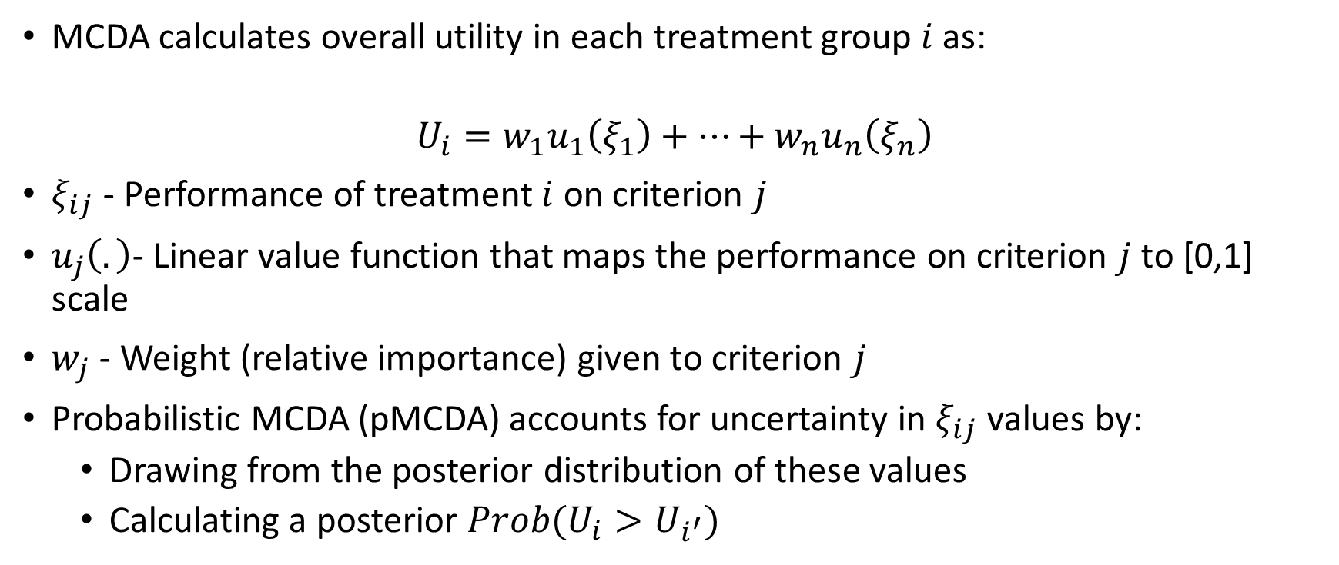
MCDA Step 4, 5
MCDA and Probabilistic MCDA
MCDA calculates overall utility in each treatment group $i$ as:
$$U_{i}=w_{1}u_{1}\left(ξ_{1}\right)+…+w_{n}u_{n}\left(ξ_{n}\right)$$
$ξ_{ij}$ - Performance of treatment $i$ on criterion $j$
$u_{j}\left(.\right)$- Linear value function that maps the performance on criterion $j$ to [0,1] scale
$w_{j}$ - Weight (relative importance) given to criterion $j$
Probabilistic MCDA (pMCDA) accounts for uncertainty in $ξ_{ij}$ values by:
  Drawing from the posterior distribution of these values
  Calculating a posterior $Prob(U_{i}>U_{i^{′}})$

Slide 15
Results and Interpretation
MCDA Step 4, 5

Slide 16
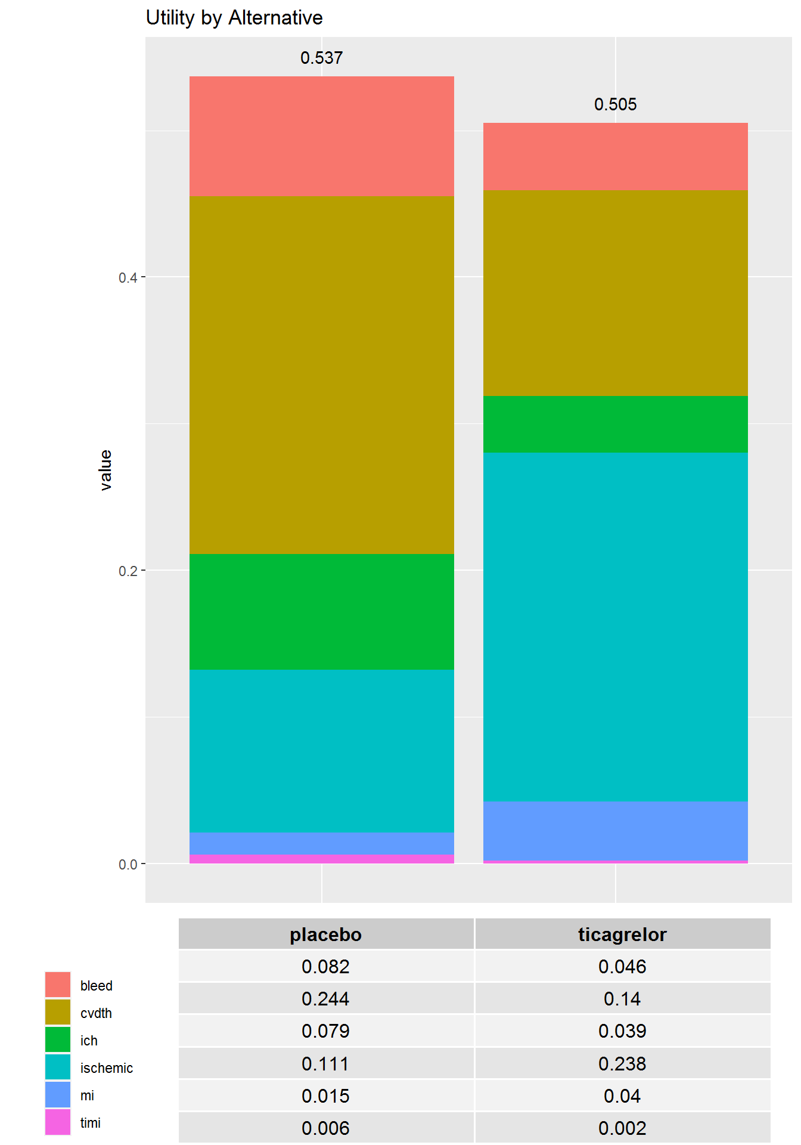
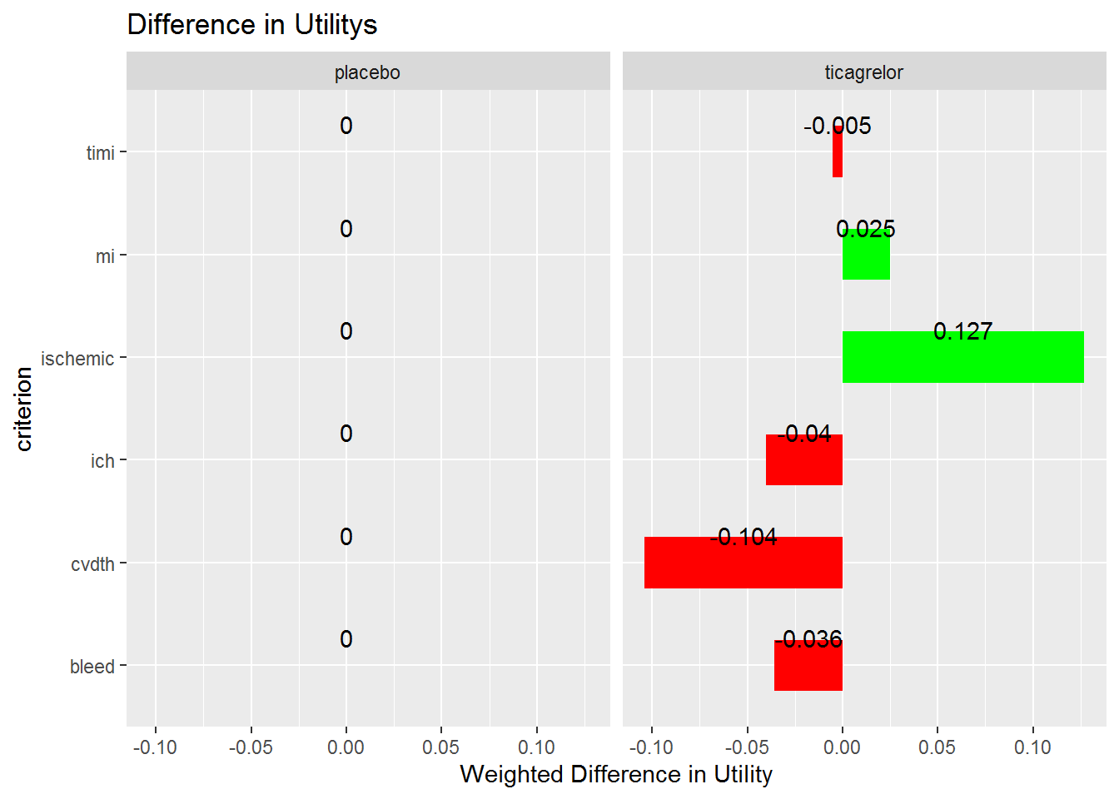
Reviewer A (0-36 months)
Source: Analyses based on data provided in https://www.accessdata.fda.gov/drugsatfda_docs/nda/2020/022433Orig1s028.pdf

Slide 17
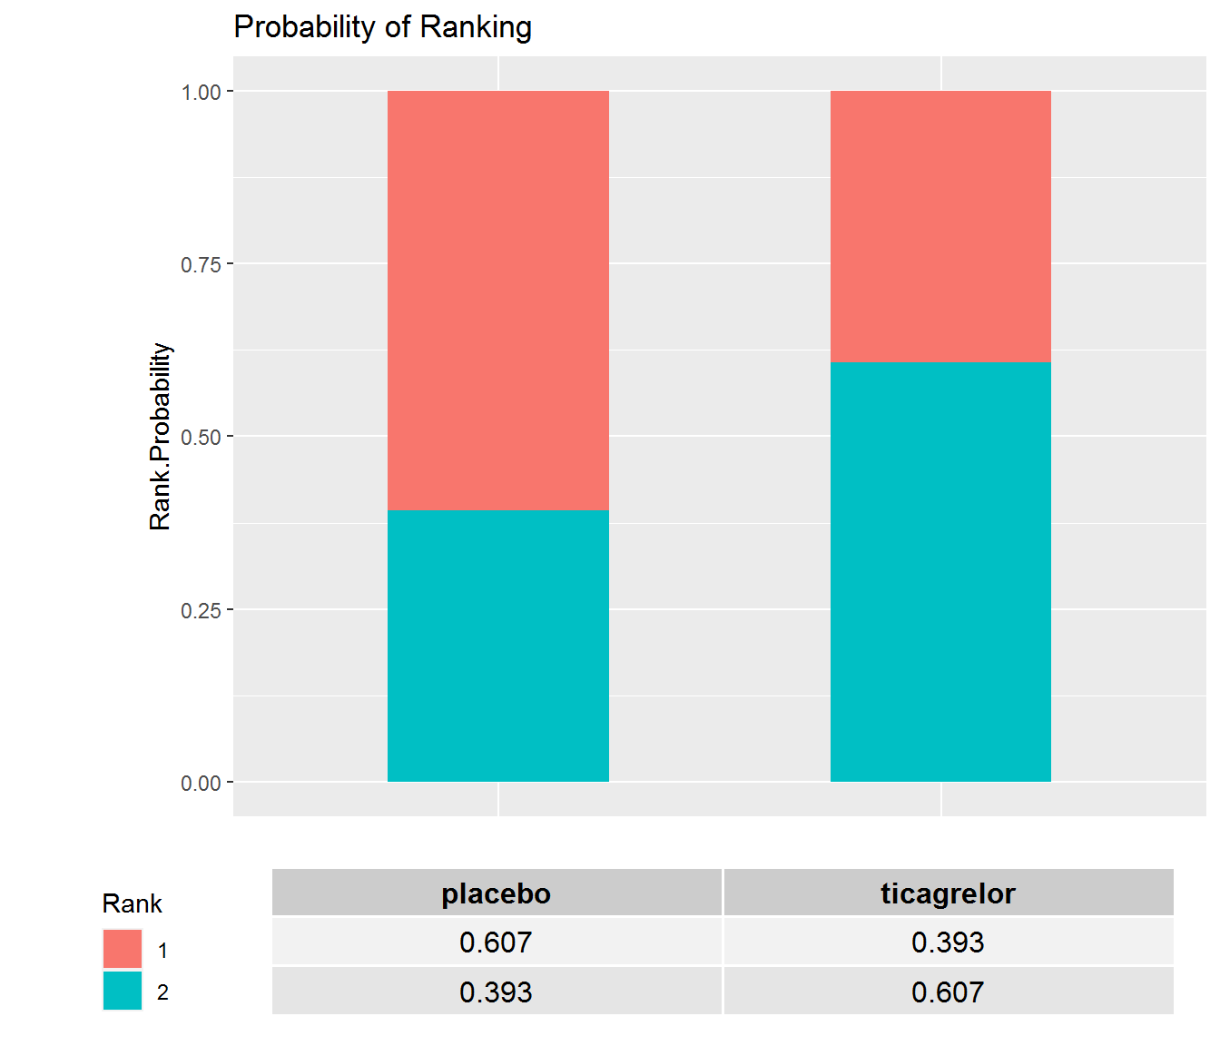
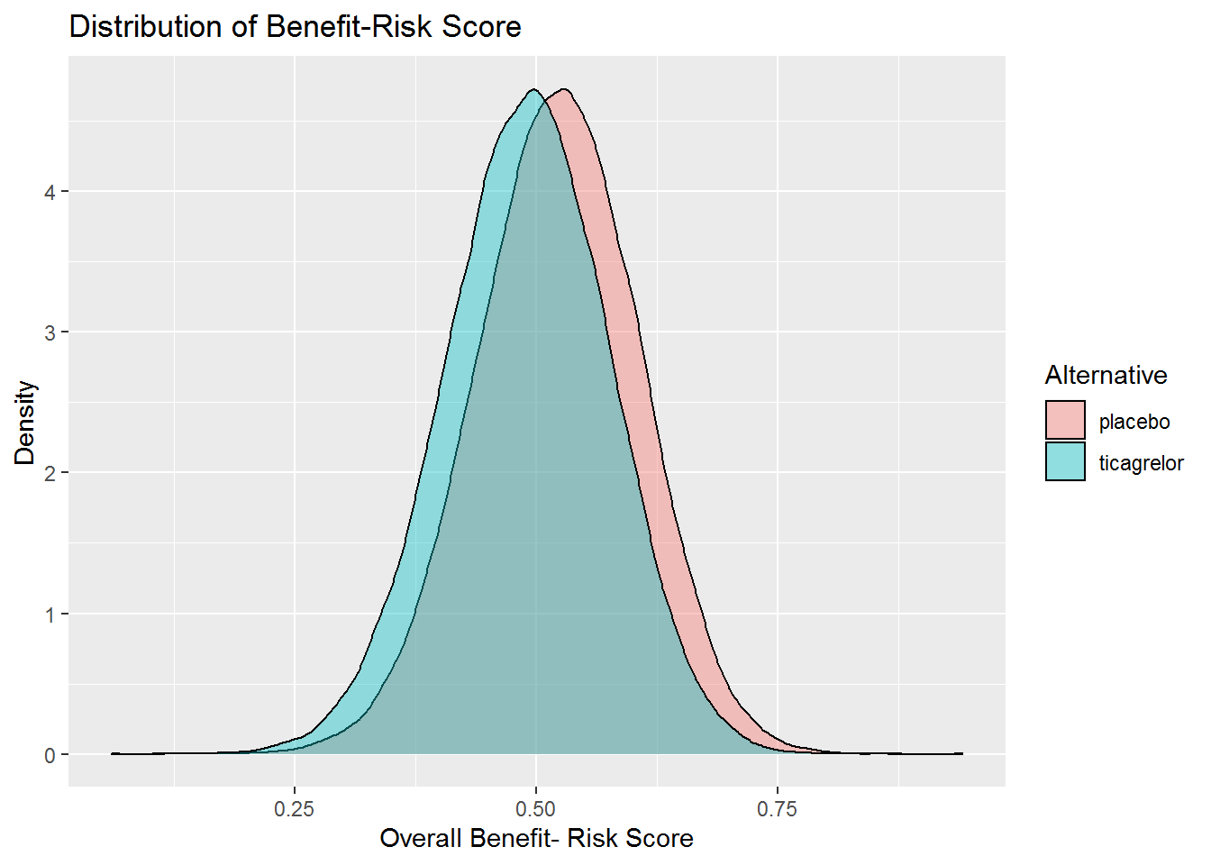
Reviewer A (0-36 months), pMCDA
Source: Analyses based on data provided in https://www.accessdata.fda.gov/drugsatfda_docs/nda/2020/022433Orig1s028.pdf

Slide 18
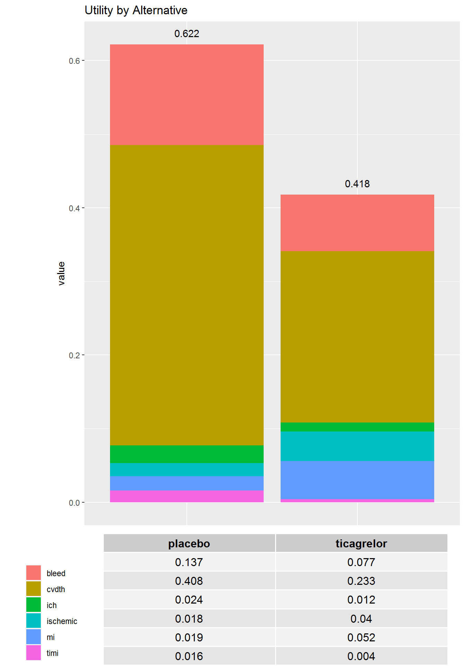
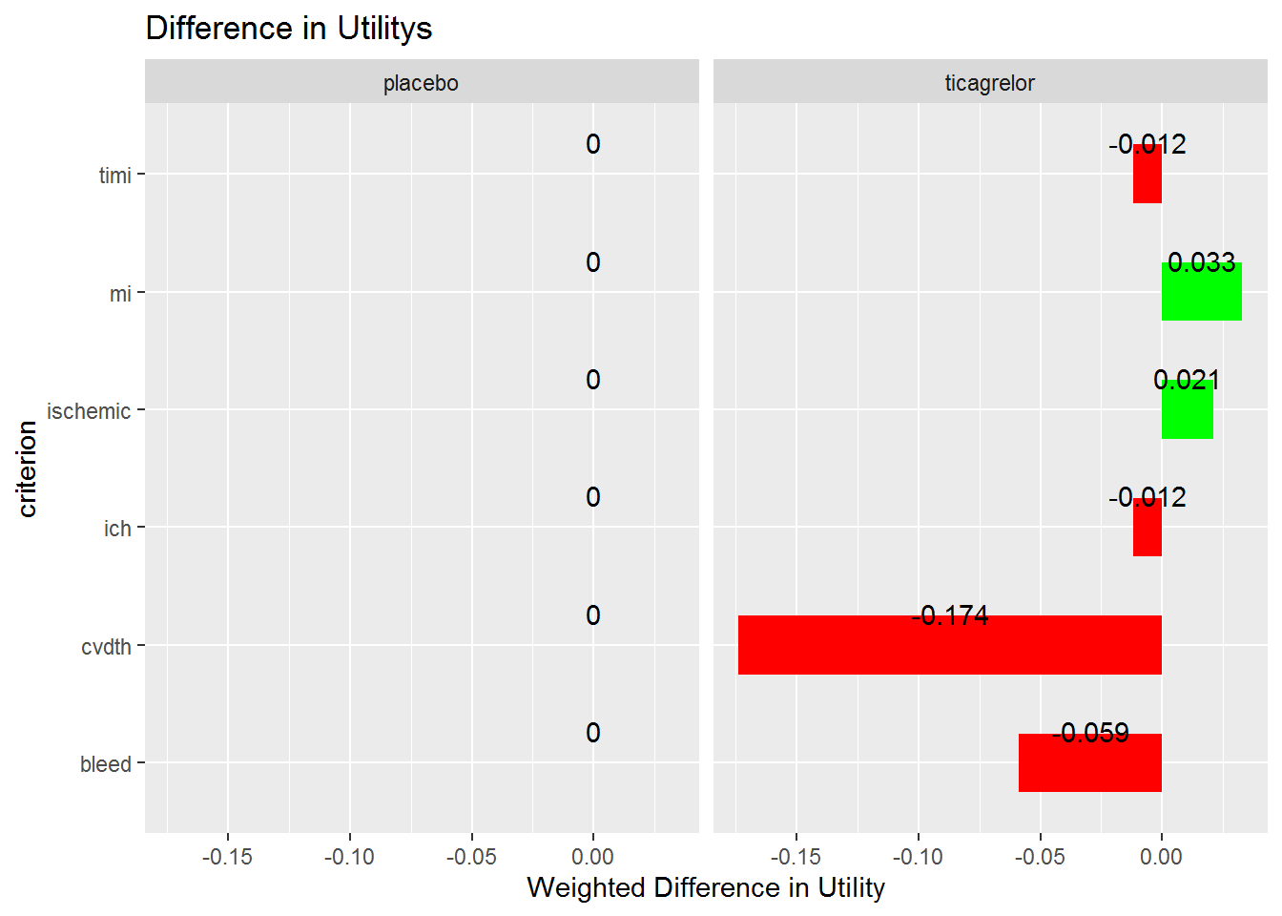
Reviewer B (0-36 months)
Source: Analyses based on data provided in https://www.accessdata.fda.gov/drugsatfda_docs/nda/2020/022433Orig1s028.pdf

Slide 19
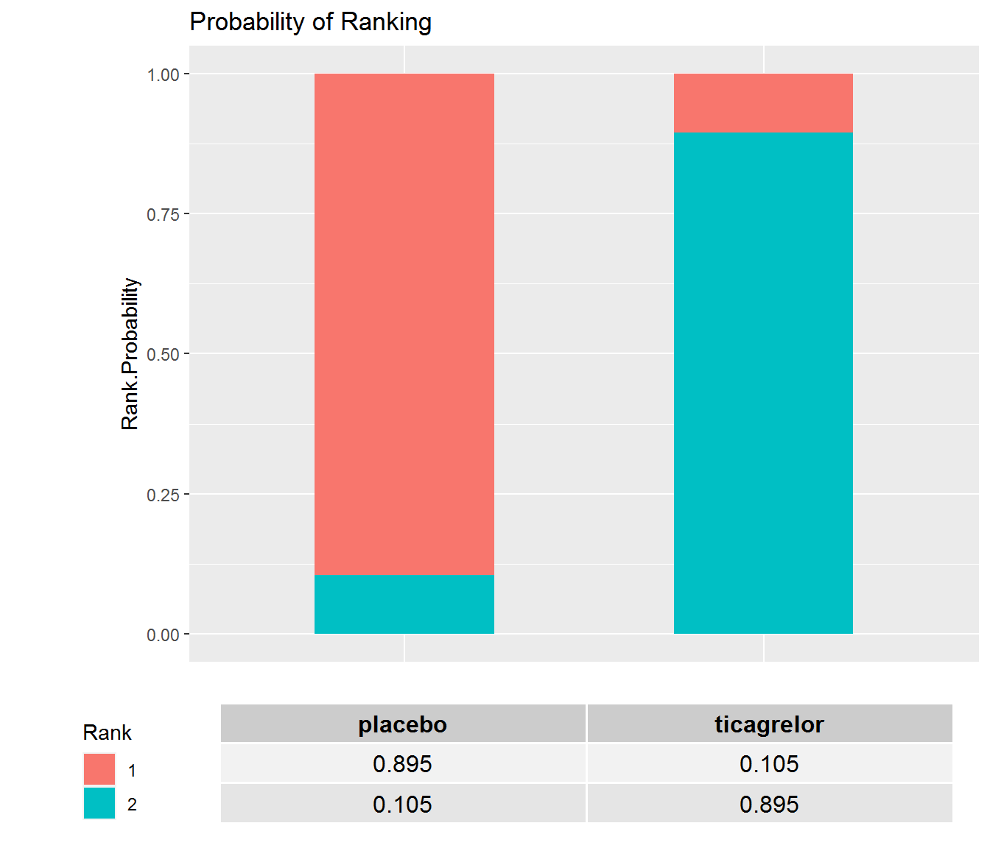
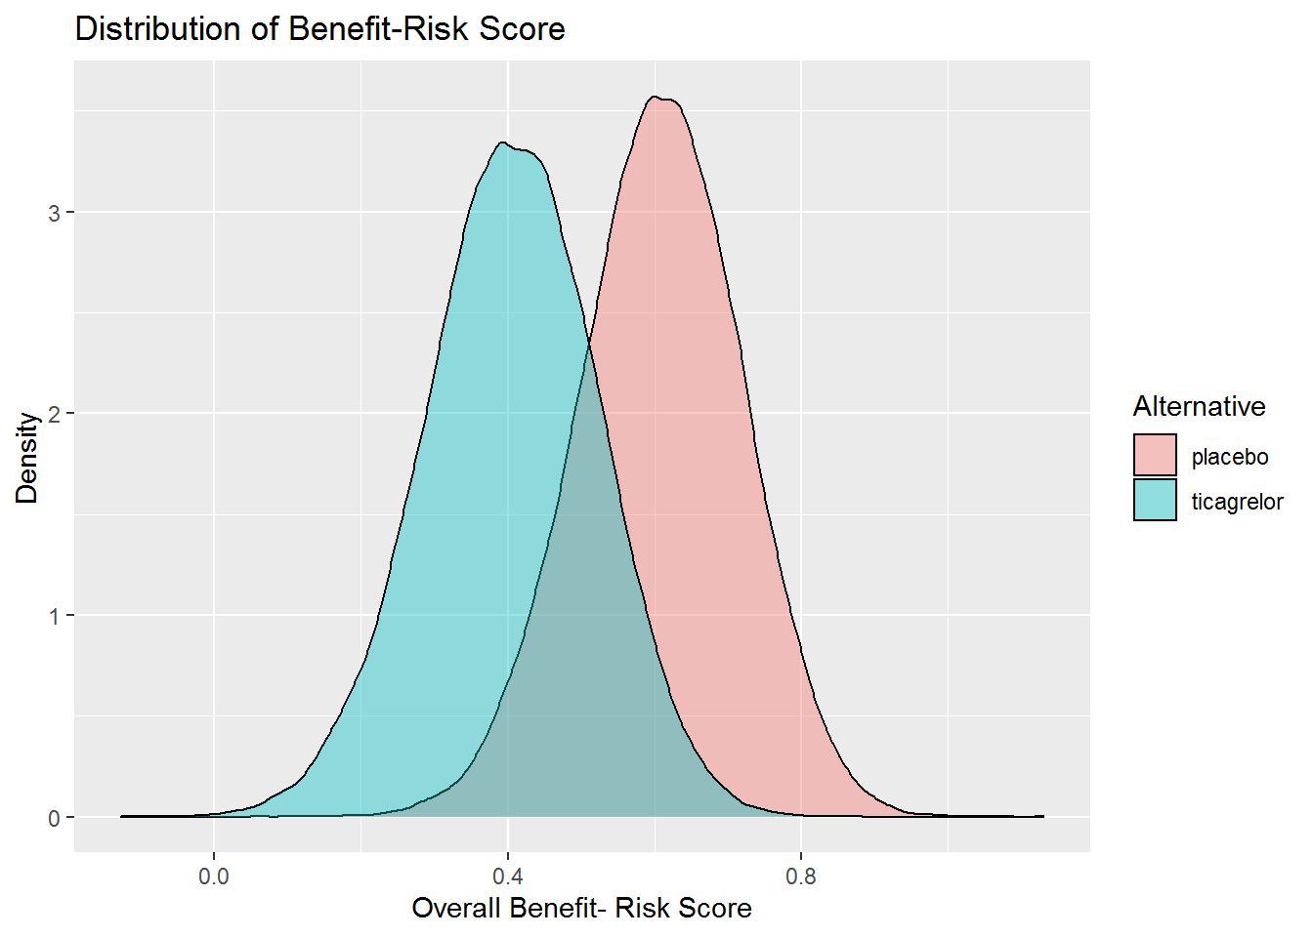
Reviewer B (0-36 months), pMCDA
Source: Analyses based on data provided in https://www.accessdata.fda.gov/drugsatfda_docs/nda/2020/022433Orig1s028.pdf

Slide 20
Interpretations
At 36 months, Reviewer A preferences indicated ticagrelor will be favored 39% of the time, compared to 11% for Reviewer B
  Similar results at 12 months
Differences between the reviewers is driven primarily by the greater relative importance reviewer A placed on ischemic stroke
Individuals think differently about the key benefits and risks
Adequately describing the different outcomes in labeling supports benefit-risk decision-making by patients and providers

Slide 21
Implementing MCDA Analysis using a Shiny App

Slide 22
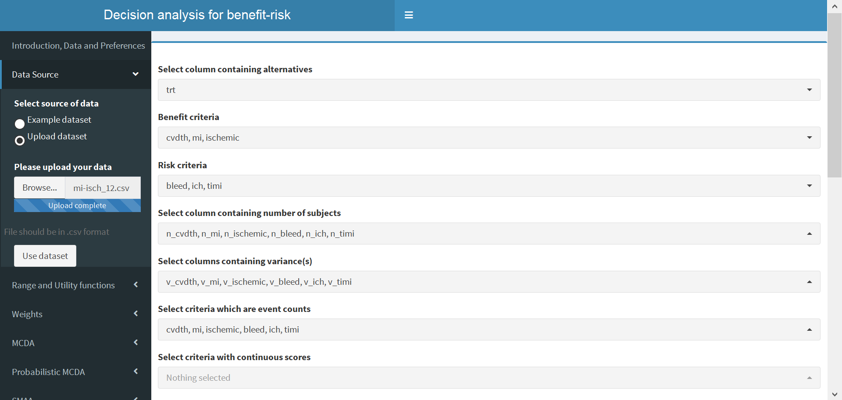
Input Dataset

Slide 23
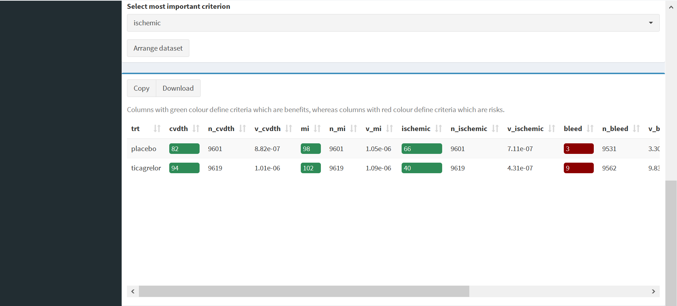
Arrange Dataset

Slide 24
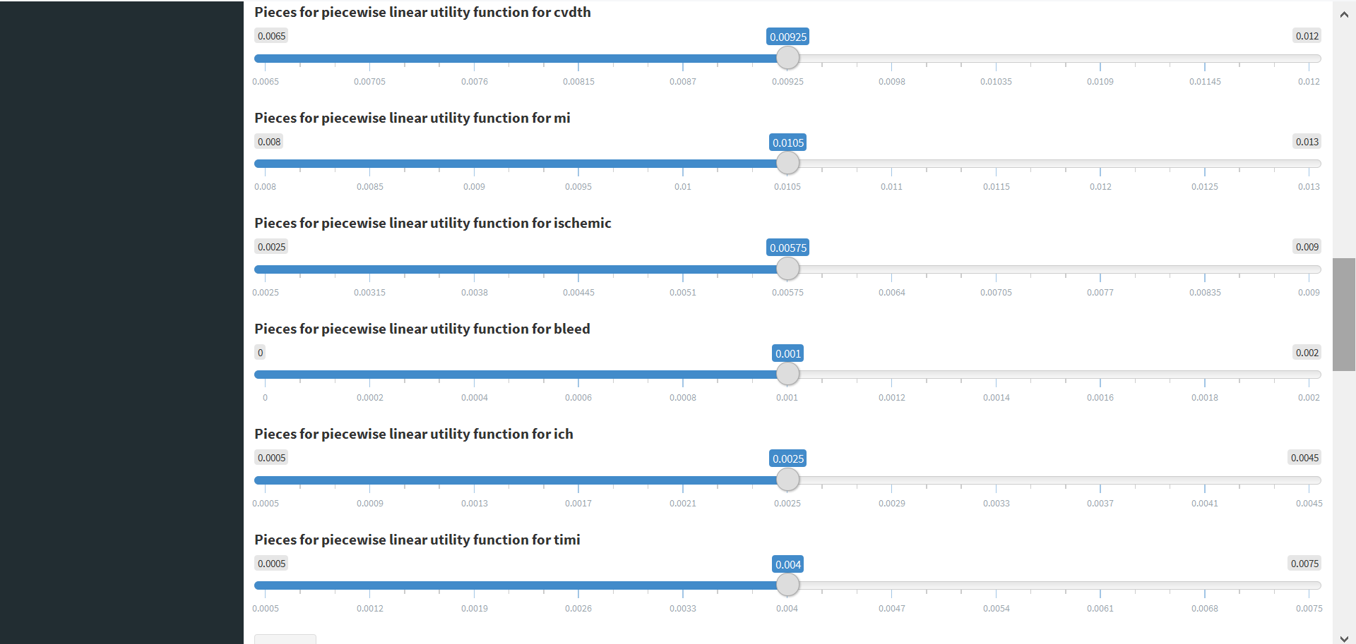
Set Range

Slide 25
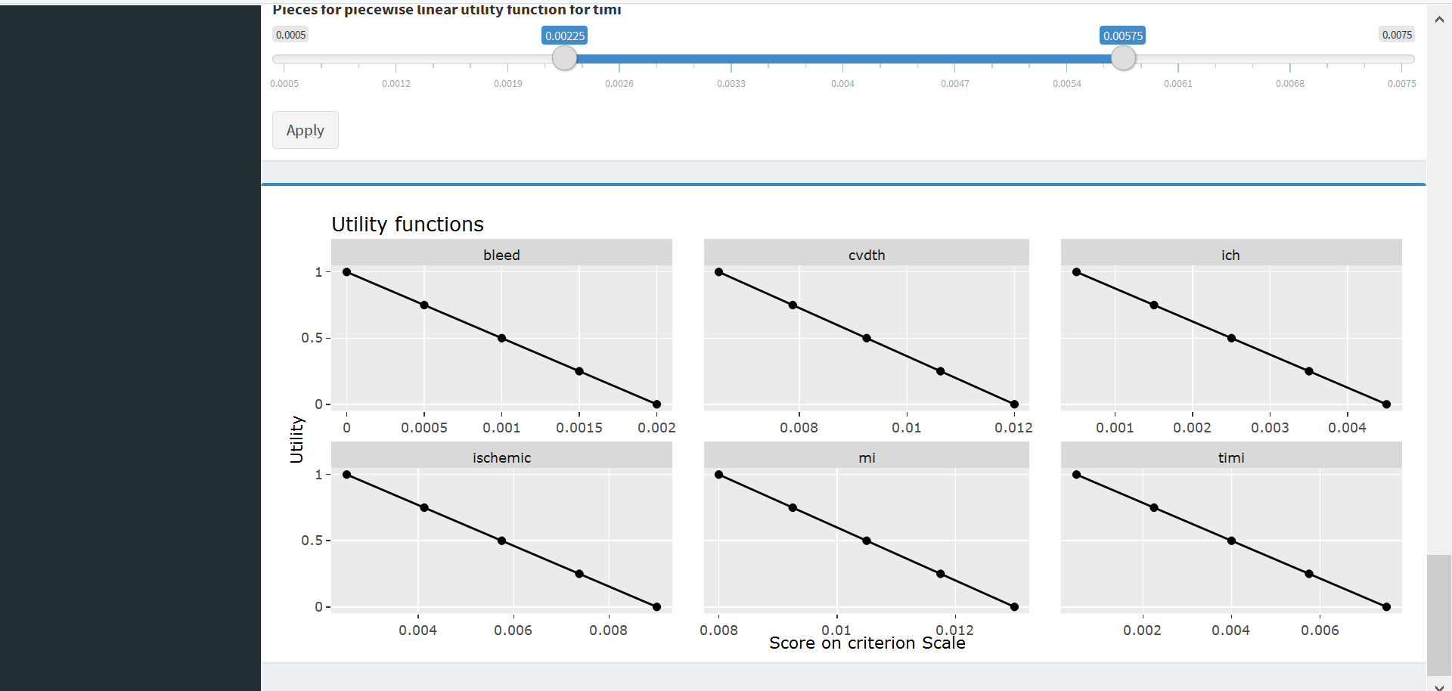
View Utility Functions

Slide 26
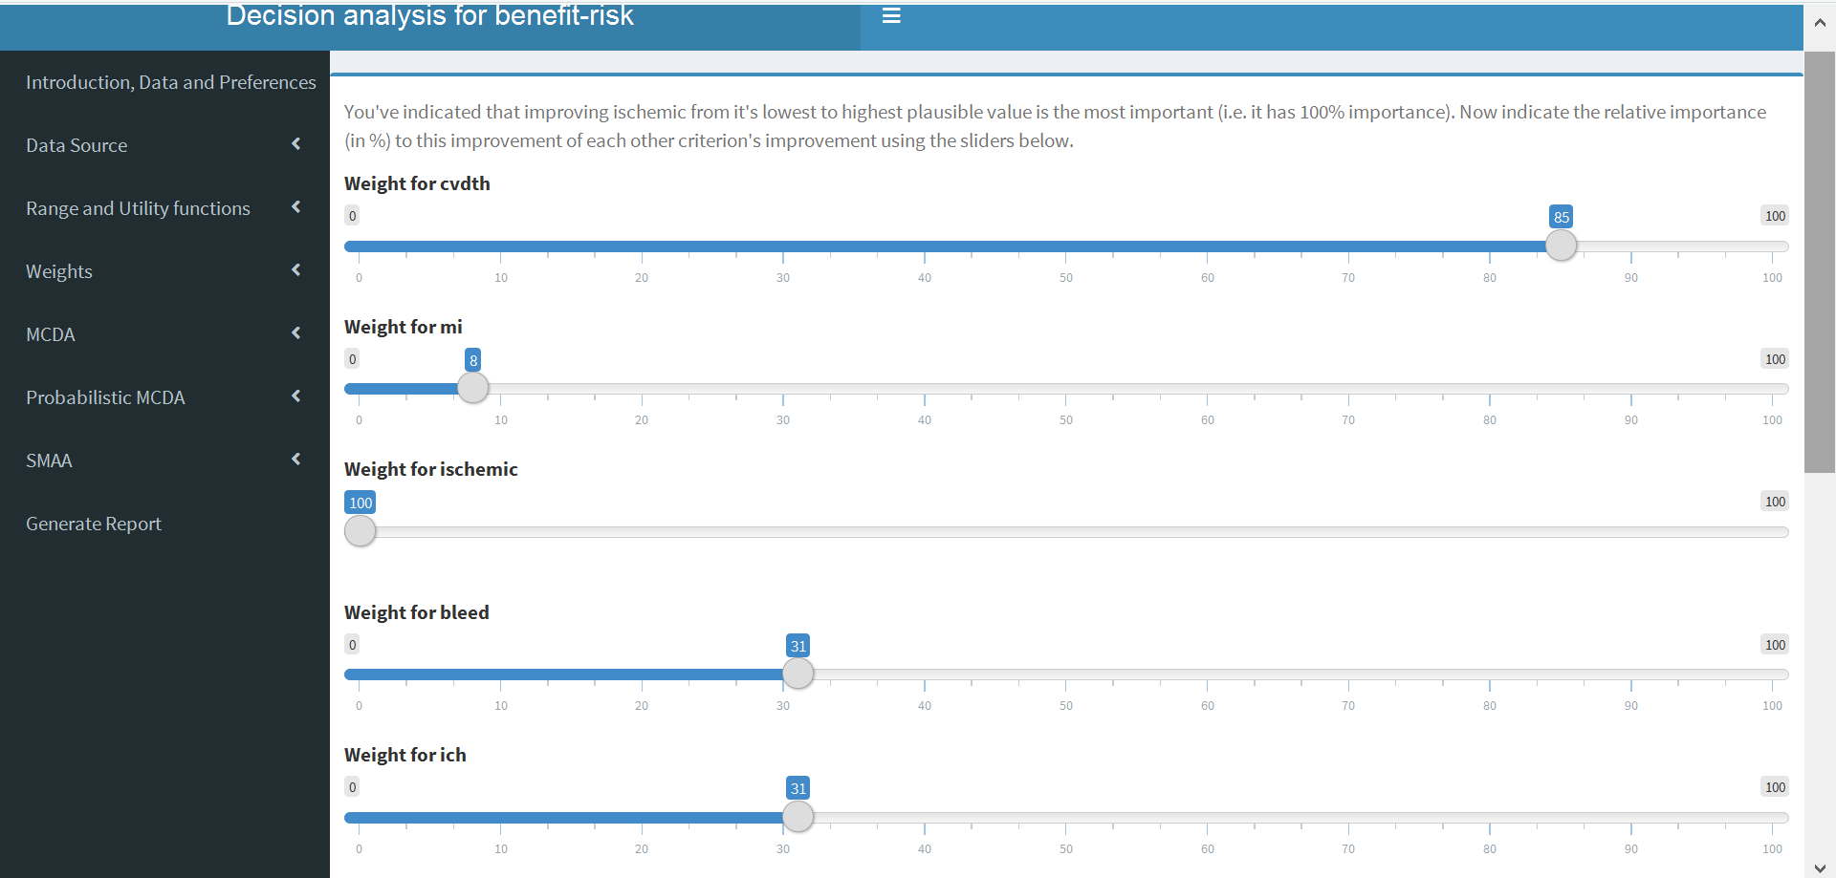
Set Weights

Slide 27
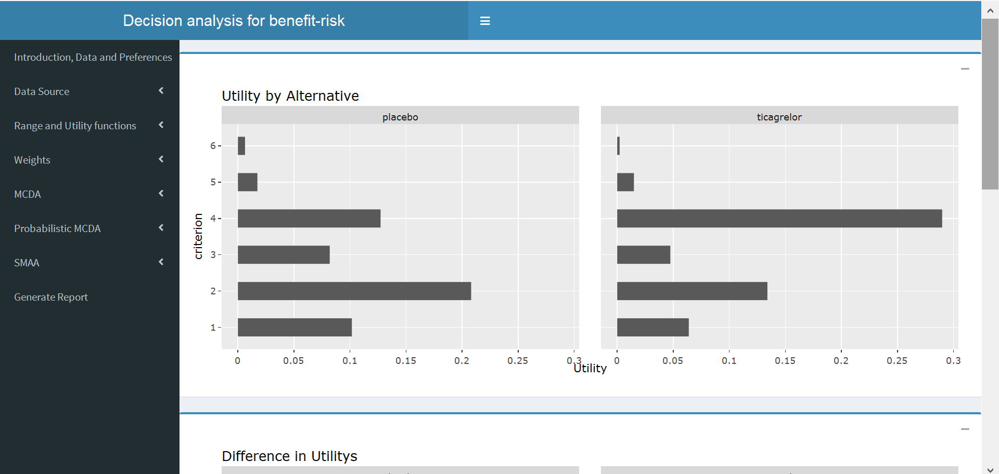
View MCDA Analysis Results

Slide 28
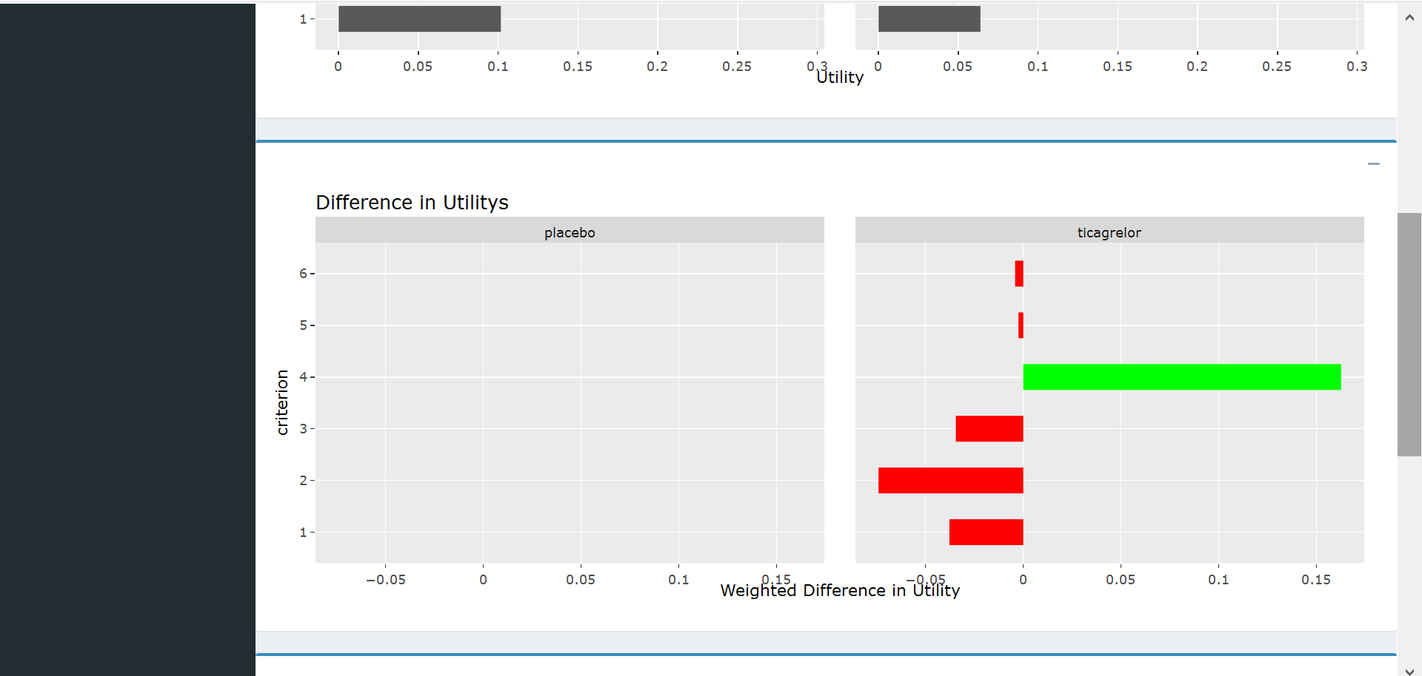
View MCDA Analysis Results II

Slide 29
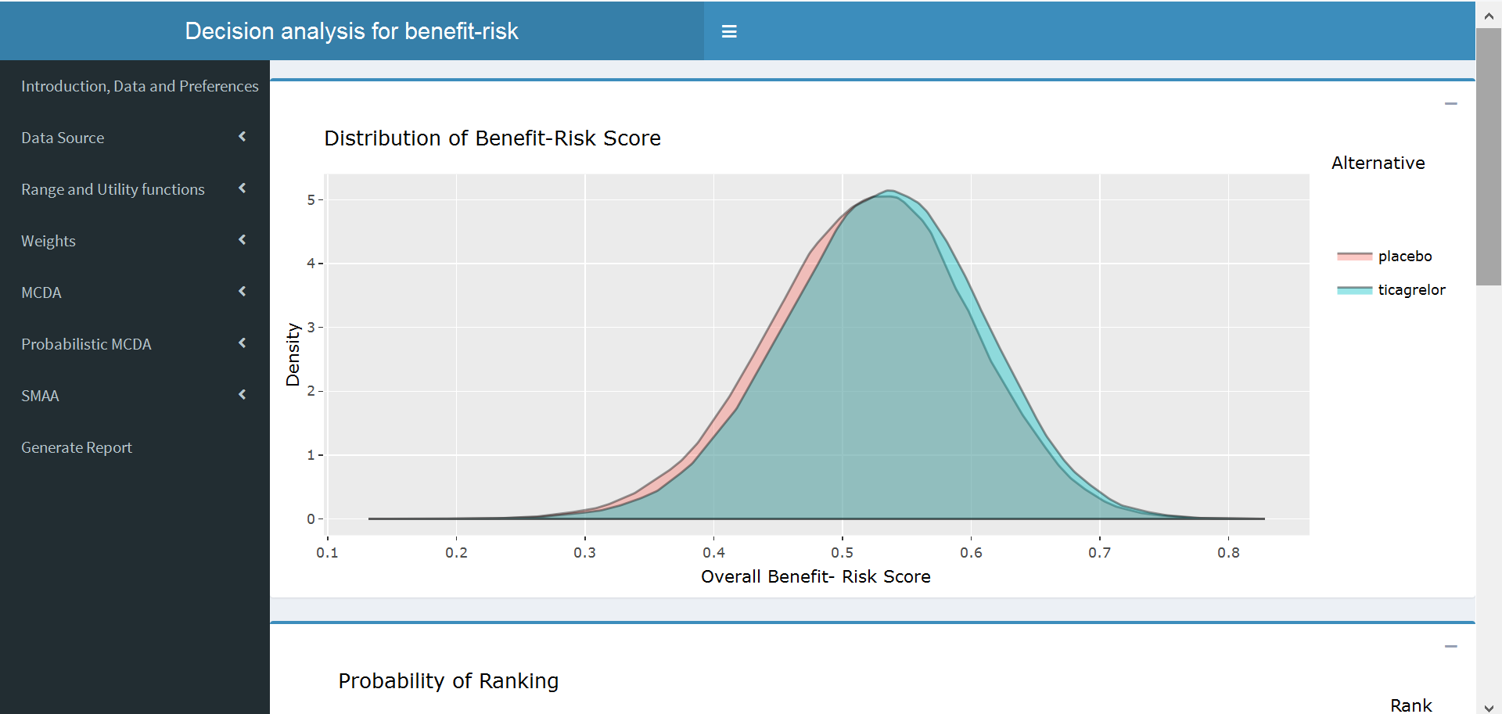
View Probabilistic MCDA / SMAA Results
Do screenshots of input and report

Slide 30
Conclusions
Carrying out an MCDA analysis can help inform decision making
  Exercise is helpful even if results do not indicate a clear winner
  Especially useful with multiple benefits / risks and multiple alternatives
With an interactive application can explore the impact of different tradeoffs
  Different visualizations help in understanding / explaining to a wide audience
Limitations:
  Assumed independence across outcomes – looking into a bootstrapping approach to remedy this

Slide 31
Backup

Slide 32
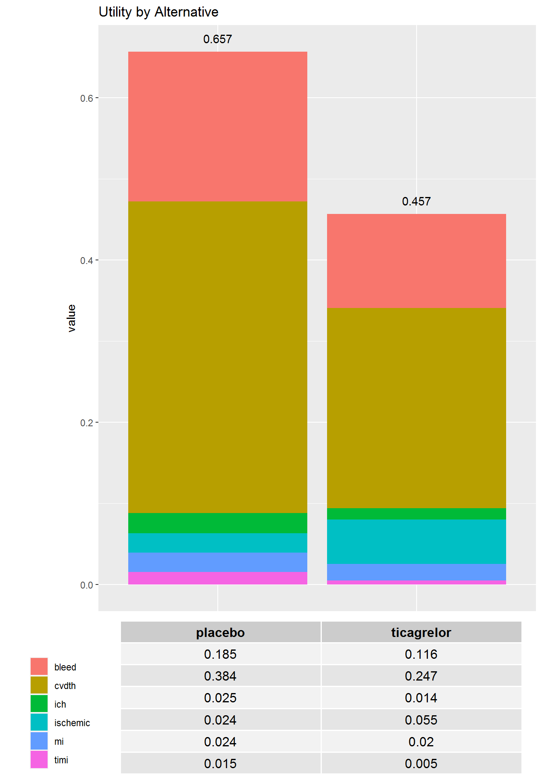
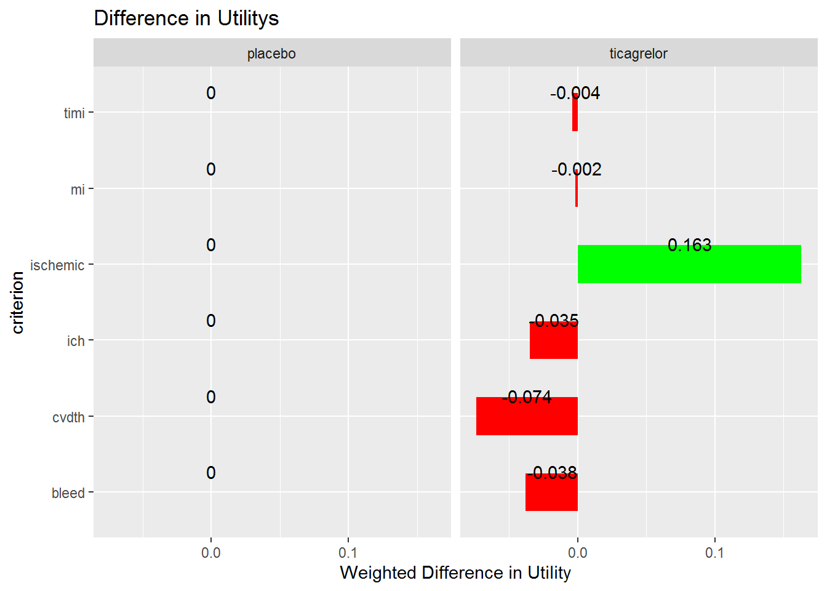
Reviewer A (0-12 months)
Source: Analyses based on data provided in https://www.accessdata.fda.gov/drugsatfda_docs/nda/2020/022433Orig1s028.pdf

Slide 33
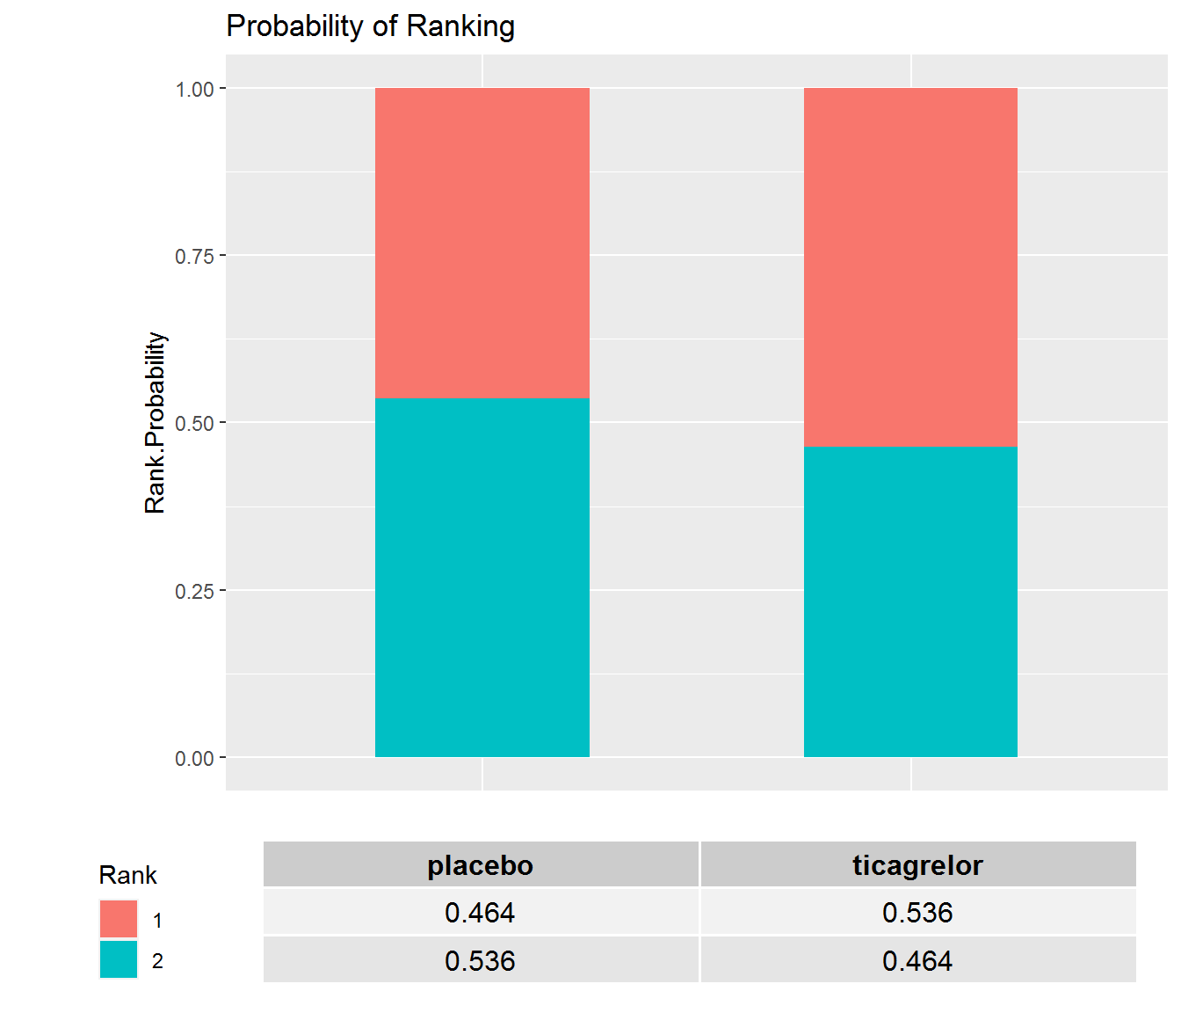
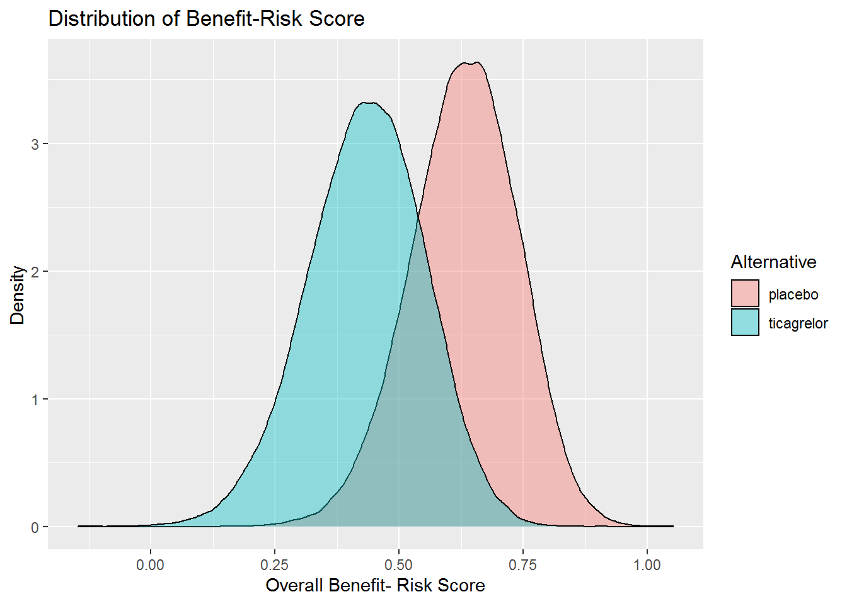
Reviewer A (0-12 months), pMCDA
Source: Analyses based on data provided in https://www.accessdata.fda.gov/drugsatfda_docs/nda/2020/022433Orig1s028.pdf

Slide 34
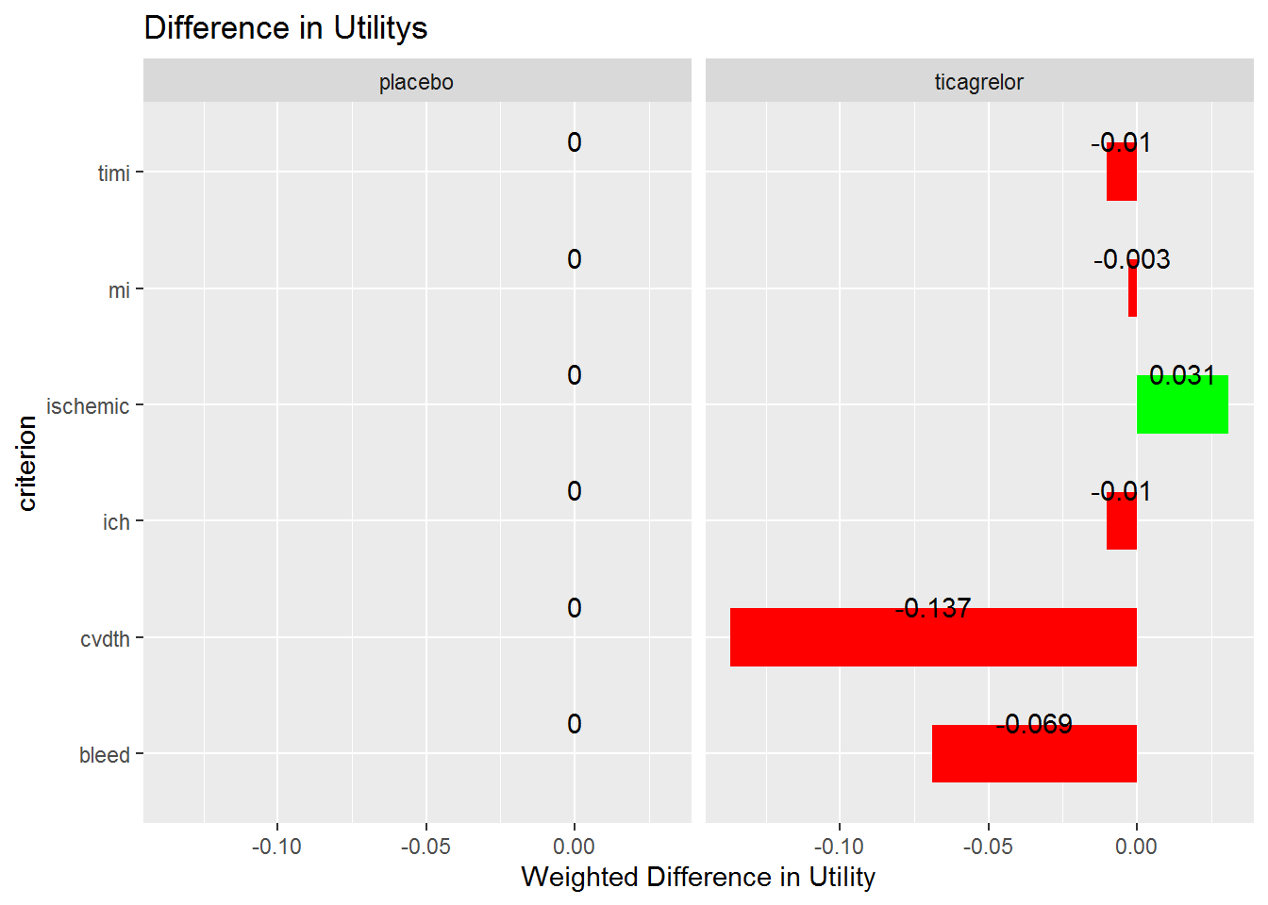
Reviewer B (0-12 months)
Source: Analyses based on data provided in https://www.accessdata.fda.gov/drugsatfda_docs/nda/2020/022433Orig1s028.pdf

Slide 35

Reviewer B (0-12 months), pMCDA
Source: Analyses based on data provided in https://www.accessdata.fda.gov/drugsatfda_docs/nda/2020/022433Orig1s028.pdf

Slide 36
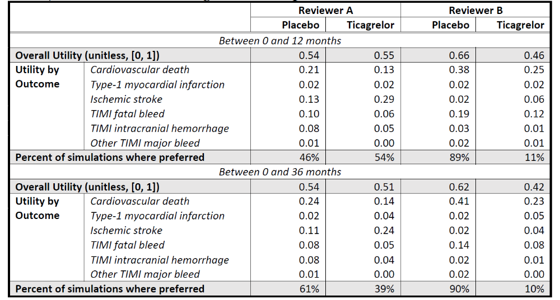
MCDA Results
Source: https://www.accessdata.fda.gov/drugsatfda_docs/nda/2020/022433Orig1s028.pdf

