Slide 1
Innovative Bayesian Approaches in Medical Device Trials
Xuefeng Li
FDA/CDRH/OCEA
2020 BIOP Regulatory-Industry Statistical Workshop

Slide 2
Outline
Background
Recent innovative Bayesian methods
  Propensity score Integrated power prior model
  Dynamic power prior model
Discussion

Slide 3
I. Bayesian Applications at CDRH
CDRH Bayesian guidance on 2010
About 30 original pre-market applications (PMA) and PMA supplements have been approved since 1999 with a Bayesian analysis as primary. Several are for diagnostic devices.
Many investigational device exemptions (IDE) have also been approved.
Several applications for “substantial equivalence” (510(k)s)
A number of reviews are in process.

Slide 4
I. External Evidence Methods (EEM) Project
Project launched formally in April 2019 by Medical Device Innovation Consortium (MDIC)
  MDIC is the first-ever public-private partnership created with the sole objective of advancing medical device regulatory science for patient benefit
Aims to establish a more predictable pathway for use of EEM
  One objective is to develop a statistical framework of methodologies to use EE
  Many of the methodologies are Bayesian

Slide 5
I. Bayesian Models to Incorporate Priors
  Bayesian Hierarchical Model
  Power prior model (Ibrahim and Chen 2000)
  Commensurate prior model (Hobbs et al 2004)
  Robust prior model (Schmidli et al 2014)
  MDIC dynamic borrowing model (Haddad et al 2017)
  Propensity score integrated power prior model (Wang et al 2019)
  Dynamic power prior model (Thompson et al 2020)

Slide 6
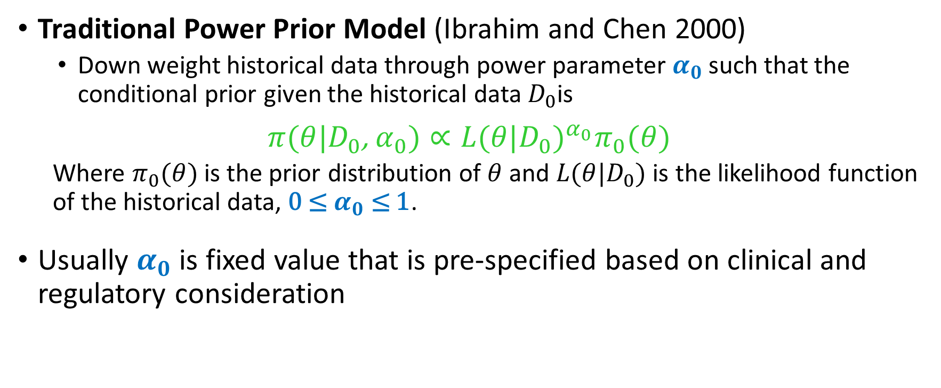
    II. Two Innovative Power Prior Models
Traditional Power Prior Model (Ibrahim and Chen 2000)
  Down weight historical data through power parameter $α_{0}$such that the conditional prior given the historical data $D_{0}$is
$π(θ|D_{0}$, $α_{0})∝{L(θ|D_{0})}^{α_{0}}π_{0}(θ)$
  Where $π_{0}(θ)$ is the prior distribution of $θ$ and $L(θ|D_{0})$ is the likelihood function of the historical data, 0 ≤ $α_{0}$ ≤ 1.
  Usually $α_{0}$ is fixed value that is pre-specified based on clinical and regulatory consideration

Slide 7
    II. New Discounting Ideas
Two new ideas to determine α₀
    Depend on the similarity of baseline covariates between external patients and current patients (Wang et al 2019)
    Depend on the similarity of outcome between external study and current study (Thompson et al 2020)

Slide 8
II.1. Propensity Score Integrated Power Prior Model (PSPP)
Propensity score matching
  To balance observed covariates between the prior patients and the current patients
Two-stage outcome-free design to decide α₀
  Performed by independent statistician with no access to outcome data
  Stage I: Specify key baseline covariates to estimate Propensity Score and for stratification
  Stage II: Run PS modeling, assess covariate balance and submit the PS design
Power prior model for outcome data analysis

Slide 9
II.1. PSPP Model – An Example
An investigational study for indication expansion of an approved device.
Plenty of off-label use data were captured in a patient registry.
Based on clinical and statistical evaluations, the registry was thought relevant to the prospective study with adequate reliability.
Planned to conduct a single-arm investigational study and borrow some data from the registry to save sample size in the prospective investigational study.

Slide 10
II.1. PSPP model – An Example
Parameter of interest θ is responder rate and associated hypothesis
Ho : θ ≤ 50% vs: Ha : θ > 50% (Performance Goal)
17 baseline covariates were identified based on prior clinical knowledge.
Based on clinical decision (case-by-case basis), proposed to
  Enroll 290 patients in the prospective investigational study
  Borrow 90 patients from the registry
  941 registry patients were selected, based on the inclusion/exclusion criteria and PS estimation.
  Idea: Borrow partial info. from each of 941 registry patients so the effective sample size (nominal number of patients) to be borrowed is 90

Slide 11
II.1. PSPP model – An Example
Determine discounting parameter α₀
      PS Stratum 1 2 3 4 5 Total
  Prosp. Study (n) 58 58 58 58 58 290
  Registry (n) 281 210 154 187 109 941
  Overlap Coeff. 0.87 0.78 0.86 0.84 0.77
  Std. Overlap Coef. 21% 19% 21% 20% 19% 100%
  Patients Borrowed 19 17 19 18 17 90
  Discounting α₀ 0.07 0.08 0.12 0.10 0.15
Final analysis using integrated power prior model

Slide 12
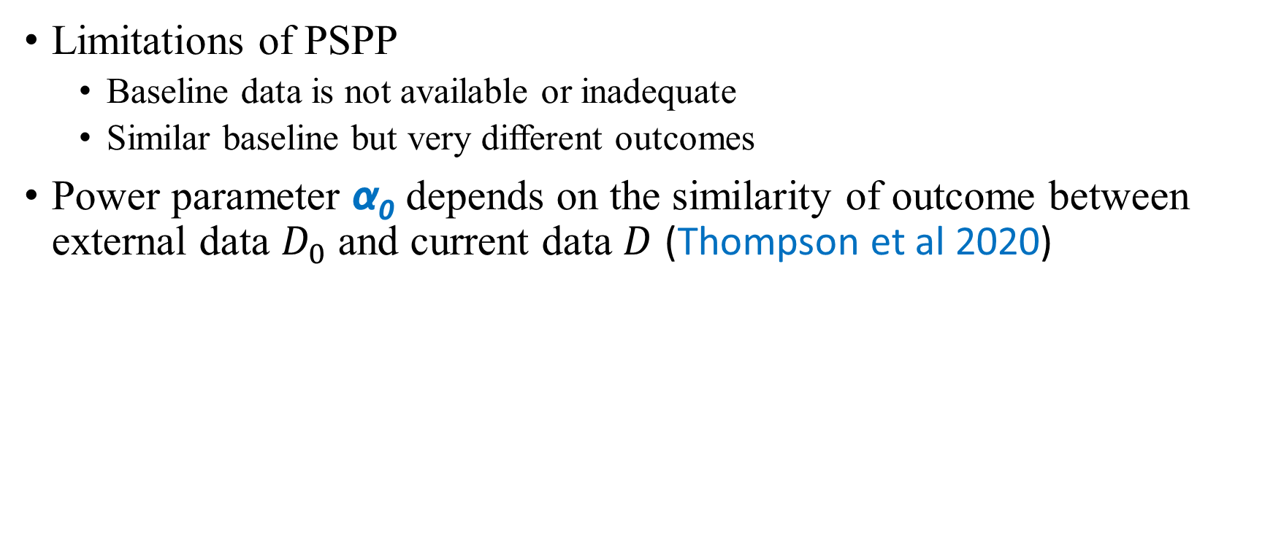
    II.2. Dynamic Power Prior Model (DPP)
Limitations of PSPP
  Baseline data is not available or inadequate
  Similar baseline but very different outcomes
Power parameter α₀ depends on the similarity of outcome between external data $D_{0}$ and current data $D$ (Thompson et al 2020)

Slide 13
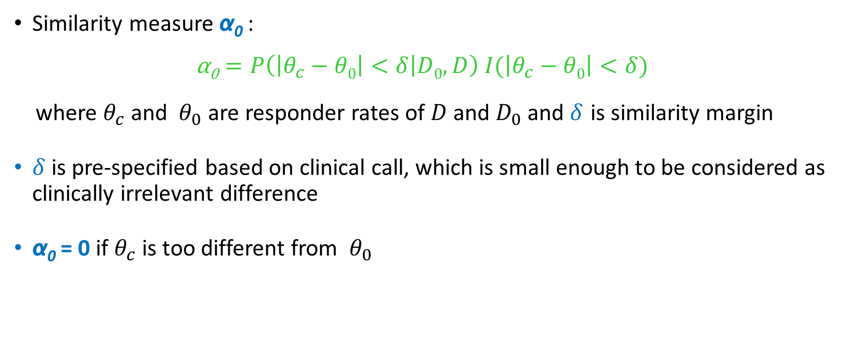
    II.2. DPP Model – Similarity Measure
Similarity measure α₀ :
$$\text{α}\text{0}=P\left(\left|θ_{c}−θ0\right|<δ | D0,D\right) I(\left|θ_{c}−θ0\right|<δ)$$
where $θ_{c}$ and $θ_{0}$ are responder rates of $D$ and $D_{0}$ and $δ$ is similarity margin
$δ$ is pre-specified based on clinical call, which is small enough to be considered as clinically irrelevant difference
α₀ = 0 if $θ_{c}$ is too different from $θ_{0}$

Slide 14
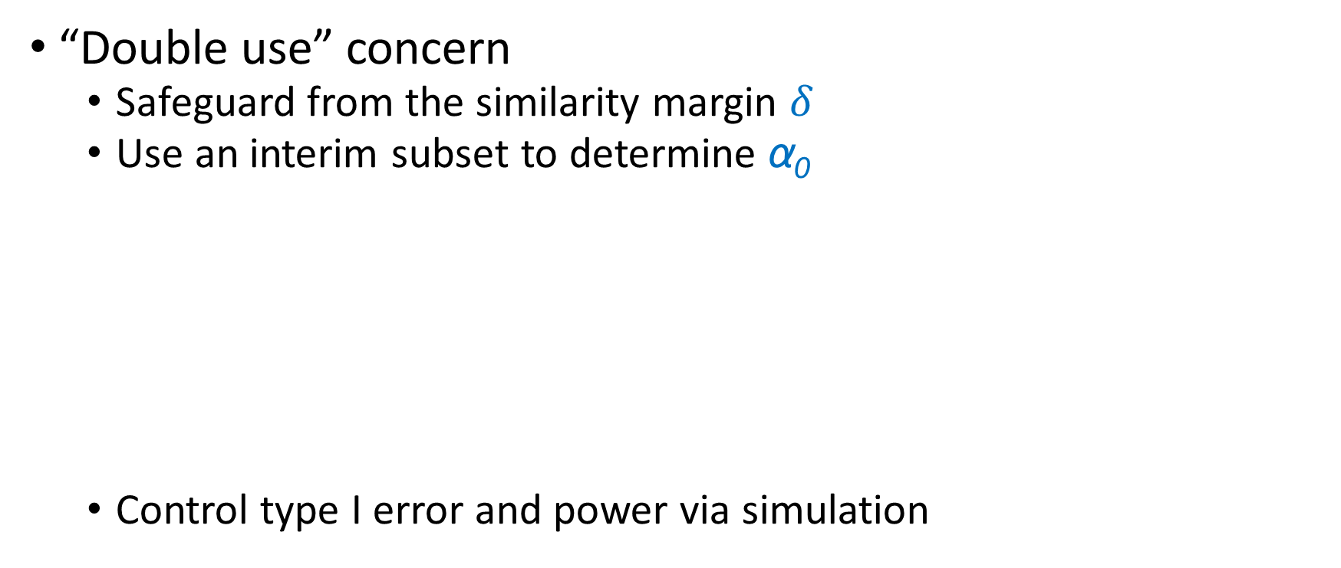
    II.3. DPP Model - Concern
“Double use” concern
  Safeguard from the similarity margin $δ$
  Use an interim subset to determine α₀
  Control type I error and power via simulation
Current Study
D1
D2
Interim Analysis: Determine the % borrowing from D₀

Slide 15
II. Pros and Cons
 | PSPP Model | DPP Model
Probably smaller and shorter trial | Yes | Yes
Straightforward to extend to two-arm trials | Yes | Yes
Assume study level exchangeability upfront | Yes | Yes
Subjective selection of design parameters | Yes | Yes
Outcome free | Yes | No
Requires adequate baseline covariates data | Yes | No

Slide 16
II. Combining PSPP and DPP
Add dynamic feature to the propensity score power prior model
  Multiple layers of safeguard
    Study design similarity
    Patient similarity
    Outcome similarity
  Type I error and power can be controlled via simulation
Adaptive features can be added to enhance efficiency and flexibility

Slide 17
III. Remarks
Always check exchangeability before borrowing
Propensity score power prior method
  Should be used when adequate baseline information is available
Dynamic power prior method
  Add one more layer of safeguard on borrowing
Call for more innovative Bayesian designs

Slide 18
References
FDA Guidance for the Use of Bayesian Statistics in Medical Device Clinical Trials (Feb 2010)
J. G. Ibrahim and M.-H. Chen (2000), Power prior distributions for regression models. Statistical Science, vol. 15, no. 1, pp. 46-60
Hobbs et al (2004), Commensurate Priors for Incorporating Historical Information in Clinical Trials using General and Generalized Linear Models. Bayesian Analysis, 1, Number 1, pp. 1–22
Schmidli et al (2014), Robust Meta-Analytic-Predictive Priors in Clinical Trials with Historical Control Information. Biometrics, 70(4):1023-32
Haddad et al (2017), Incorporation of stochastic engineering models as prior information in Bayesian medical device trials. Journal of Biopharmaceutical Statistics, 27(6):1089-1103
Wang, C. et al. (2019). Propensity Score-Integrated Power Prior Approach for Incorporating Real-World Evidence in Single-Arm Clinical Studies. Journal of Biopharmaceutical Statistics. Advance online publication.
Thompson et al (2020): Dynamic Borrowing from a Single Prior Data Source using the Conditional Power Prior (under revision with Journal of Biopharmaceutical Statistics)

