Slide 1
A Complex Innovative Trial Design Pilot Meeting Program Submission in Pediatric Multiple Sclerosis Patients
Gregory Levin
FDA/CDER/OTS/OB/DBIII
September 25, 2020

Slide 2
Outline
Complex Innovative Design (CID) Pilot Program
Submission in Pediatric Multiple Sclerosis (MS)
  Background and Design
  Potential Value
  Challenges
  Design Iterations
  Points to Consider

Slide 3
Outline
Complex Innovative Design (CID) Pilot Program
Submission in Pediatric Multiple Sclerosis (MS)
  Background and Design
  Potential Value
  Challenges
  Design Iterations
  Points to Consider

Slide 4
CID Pilot Program
Joint CDER/CBER effort
Started in 2018, 5-year duration
Sponsors submit designs and gain two additional meetings with regulatory staff to discuss proposed design
FDA gains ability to publicly discuss aspects of design, use as case study for continuing education and information sharing
FDA will select up to 2 submissions per quarter
Meetings led by biostatistics groups (CDER/OTS/OB or CBER/OBE/DB) with participation from all relevant disciplines
Information at: https://www.fda.gov/Drugs/DevelopmentApprovalProcess/DevelopmentResources/ucm617212.htm

Slide 5
Eligibility Criteria
The sponsor must have a pre-IND or IND number for the medical product(s) included in the CID proposal with the intent of implementing the CID in the pilot program application
The proposed CID is intended to provide substantial evidence of effectiveness to support regulatory approval of the medical product
The trial is not a first in human study, and there is sufficient clinical information available to inform the proposed CID
The sponsor and FDA are able to reach agreement on the trial design information to be publicly disclosed

Slide 6
Outline
Complex Innovative Design (CID) Pilot Program
Submission in Pediatric Multiple Sclerosis (MS)
  Background and Design
  Potential Value
  Challenges
  Design Iterations
  Points to Consider

Slide 7
Background on Pediatric MS
Rare: majority of MS onset is in adults
Characterized by episodes (relapses) that affect quality of life and can lead to morbidity
Unmet need: many disease-modifying therapies approved for adult MS but only fingolimod has been tested and approved in pediatric MS

Slide 8
Pediatric MS Trial Design*
Randomized, double-blind, double-dummy, parallel-group, group sequential, fingolimod-controlled, non-inferiority (NI) trial to evaluate ofatumumab
Information borrowing from external data in adult and pediatric MS patients
  For selection of NI margin and for Bayesian inference
Two-year controlled duration
Primary endpoint: annual relapse rate (ARR)
* Some of these and other details in: Schmidli, Heinz, et al. "Beyond randomized clinical trials: Use of external controls." Clinical Pharmacology & Therapeutics 107.4 (2020): 806-816.

Slide 9
More Details on Design
Interim analysis after last patient reaches one year to allow potential early stopping for efficacy
Borrowing of historical data via mixture prior including meta-analysis-based informative + weakly informative components
Decision criteria based on posterior probability that ARR ratio for ofatumumab relative to fingolimod is less than NI margin
Extensive simulations to evaluate operating characteristics (e.g., power, Type I error, bias and root mean squared error of estimates) in different scenarios (e.g., with varied nuisance parameter values)

Slide 10
Additional Background
Ofatumumab approved to treat relapsing forms of MS in adults based on active-controlled phase 3 studies with different active control, teriflunomide
Fingolimod approved to treat relapsing forms of MS in patients 10 years of age and older
  Approval in adults based on placebo-controlled and interferon-controlled phase 3 studies
  Approval in pediatric patients based on a single interferon-controlled study

Slide 11
Outline
Complex Innovative Design (CID) Pilot Program
Submission in Pediatric Multiple Sclerosis (MS)
  Background and Design
  Potential Value
  Challenges
  Design Iterations
  Points to Consider

Slide 12
Potential Value of Active-Controlled,
Non-Inferiority Design
Expected to result in fewer relapses than alternative, conventional superiority designs (against placebo or interferon)
Easier enrollment/retention as trial compares two therapies expected to be highly effective
Provides direct, reliable comparison between ofatumumab and only approved therapy in pediatric MS to inform actual treatment decisions in clinical practice

Slide 13
Potential Value of Bayesian Borrowing of External Information
Reduces required sample size in setting with unmet need and feasibility constraints
Allows extent of leveraging of adult findings for drug to align with clinical understanding of comparability between adult and pediatric diseases
  In between full extrapolation and no extrapolation
Facilitates learning about appropriate use of such approaches in regulatory setting

Slide 14
Outline
Complex Innovative Design (CID) Pilot Program
Submission in Pediatric Multiple Sclerosis (MS)
  Background and Design
  Potential Value
  Challenges
  Design Iterations
  Points to Consider

Slide 15
Appropriate NI Margin Selection
Only one controlled trial of fingolimod in pediatric MS
  Large uncertainty + inability to evaluate trial-to-trial heterogeneity
Use of placebo- and interferon-controlled trials of fingolimod in adult MS relies on model assumptions about relationship between age and treatment effect
Feasibility challenges with narrow margins

Slide 16
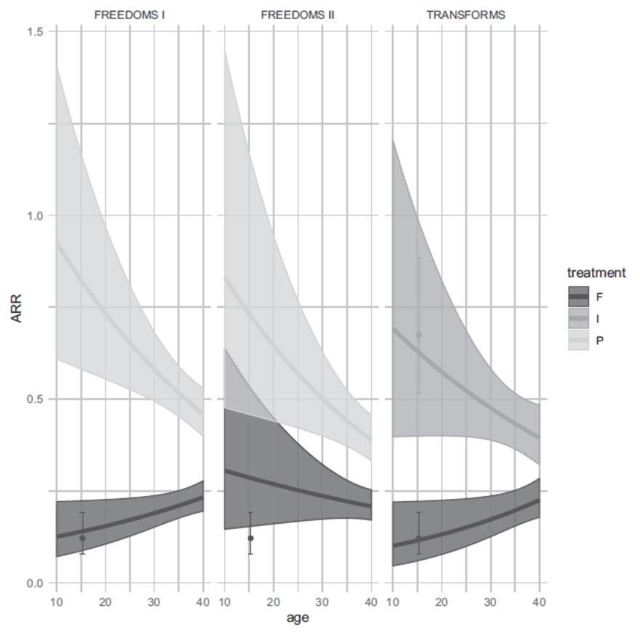
ARRs by Age in Adult Fingolimod Trials
F: fingolimod
I: interferon beta-1a
P: placebo
Points/error bars at age of 15 years show estimates (95% CI) in historical pediatric study
Source: Schmidli, Heinz, et al. "Beyond randomized clinical trials: Use of external controls." Clinical Pharmacology & Therapeutics 107.4 (2020): 806-816.

Slide 17
Bayesian Borrowing
Use of external adult data borrows from individual arms of studies, not randomized comparisons
  Relies on assumption of similar prognostic variables (e.g., patient characteristics, background care), not only similar effect modifiers
  Relies on assumptions about age-outcome relationship
Mixture prior utilizes 50-80% weight for informative historical data-based component
  Appropriate given uncertainties in historical data relevance?
Gain in efficiency worth potential bias and error inflation?

Slide 18
Double Use of Historical Data
Historical data used to both inform NI margin and priors
What is a Type I error?
  Conclusion of non-inferiority conditional on drug being truly inferior to active control by magnitude of NI margin
  Conclusion of non-inferiority conditional on drug not being superior to placebo or interferon
Concern that double use of historical data could impact second type of error

Slide 19
Outline
Complex Innovative Design (CID) Pilot Program
Submission in Pediatric Multiple Sclerosis (MS)
  Background and Design
  Potential Value
  Challenges
  Design Iterations
  Points to Consider

Slide 20
Notable Design Iterations
Agreement on NI margin for ARR ratio of 2 (first proposal: 3), with additional criterion for ARR on drug arm alone
  Balanced feasibility and goal of ensuring reliable evidence despite assumptions and uncertainties underlying NI approach
Additional simulations to evaluate double use of historical data
  Scenarios where drug not effective (not superior to placebo or interferon) but inferior to active control by less than NI margin of 2
Prospective planning of additional important analyses
  Bayesian “synthesis”* analyses to estimate superiority to interferon
  Analyses varying weight on informative component, including no borrowing
Design added another experimental product
* See FDA Guidance Non-Inferiority Clinical Trials to Establish Effectiveness

Slide 21
Outline
Complex Innovative Design (CID) Pilot Program
Submission in Pediatric Multiple Sclerosis (MS)
  Background Design
  Potential Value
  Challenges
  Design Iterations
  Points to Consider

Slide 22
Points to Consider
Consider flexibility to facilitate active-controlled trials given their value for patients and public health
CIDs often about bias-variance tradeoffs
  Substantial precision gain may be worth some bias, particularly with unmet need and feasibility constraints
Supplementary analyses utilizing spectrum of informative priors useful when formal borrowing
  Represent range of stakeholder beliefs

Slide 23
Thank you!

