Slide 1
Statistical challenges in designing combination-therapy trials in Oncology
Ram Suresh, Ph.D.
Amgen Inc.

Slide 2
Disclaimer
The views expressed herein represent those of the presenter and do not necessarily represent the views or practices of the presenter’s employer or any other party.

Slide 3
Outline
Oncology Landscape
Progression on PD L(1) Therapy
Single-Arm Trials
Challenges in Designing Trials – A SCLC Example
Summary

Slide 4
Oncology Landscape
Recently, CTLA-4 and PD-(L)1 therapies have been approved and became SOC for several indications.
Development of novel combination regimens has become the focus of industry
Bispecific ADCs, BiTEs and Targeted therapies are under investigation
Most combinations under investigation are with PD-(L)1 inhibitors

Slide 5
Progression on PD-(L)1 therapy
Definition of Relapse/Refractory Disease
  Assessing PD-(L)1 response is difficult because response to immunotherapies behaves differently than traditional cytotoxic agents.
  How to identify patient population whose disease has truly progressed past PD-(L)1 inhibitors is complex and challenging
Three main principles:
  Adequate exposure to PD-(L)1 therapies before progression
  Correctly identify and confirming progressive disease
  Identify the likelihood of responding to re-exposure to PD-(L)1 therapies.

Slide 6
Progression on PD-(L)1 therapy
Example Definitions from Industry
Example 1: PD-1 treatment progression is defined by meeting all of the following criteria:
  Has received at least 2 doses of an approved PD-(L)1 mAb
  Has demonstrated disease progression after PD-(L)1 as defined by RECIST v1.1. The initial evidence of disease progression (PD) is to be confirmed by a second assessment no less than four weeks from the date of the first documented PD, in the absence of rapid clinical progression
  Progressive disease has been documented within 12 weeks from the last dose of PD-(L)1 mAb
Example 2: Three distinct patient populations that are important to study separately:
  Patients who do not respond & progress on PD-(L)1 (or within 6 months of treatment)
  Patients who progress after initial response while on PD-(L)1
  Patients who progress after initial response to PD-(L)1 off drug
Additional Criteria:
  Patients must have confirmed disease progression on PD-(L)1 therapy
  Previous exposure to PD-(L)1 containing regimen for at least 12 consecutive weeks
  Progression must be while on treatment with PD-(L)1 or within 6 months of discontinuing PD-(L)1
Source: immuno-oncology combination drug development for patients with disease progression after initial anti-PD-(L)1 therapy: a friends of cancer research whitepaper

Slide 7
Example startegies
Different approaches in dealing with ipi-refractory population
Pembrolizumab: KEYNOTE-001
(Uncontrolled Study)
Nivolumab: CheckMate 037
(Controlled Study)
Previously treated with at least 2 doses of ipilimumab 3 mg/kg or higher administered every 3 weeks
Confirmed disease progression using immune related response criteria within 24 weeks of the last dose of ipilimumab
Patients must have had progression after anti-CTLA-4 treatment, such as ipilimumab
ORR result: 31.7% vs 10.6%
ORR result: 24%
Both trials served as pivotal evidence to support AA in ipi-refractory metastatic melanoma

Slide 8
Single-Arm Trials for accelerated approval
General requirements
  Unmet Clinical need
  Centrally Confirmed ORR, Durability
  Six-month follow-up on responses
Statistical Approach
Lower limit of 95% Confidence Interval to exceed pre-established benchmark
Demonstration of durability

Slide 9
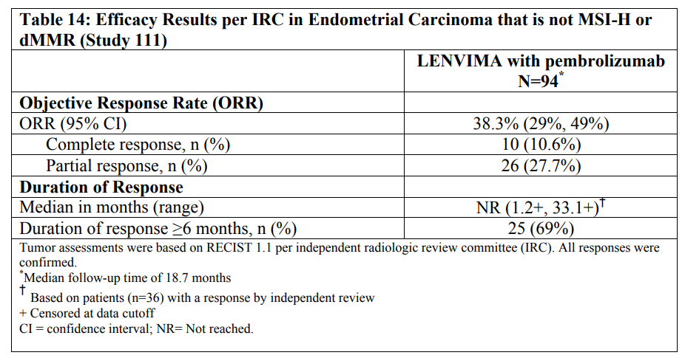
Example of Single-Arm approval of combination therapy
On Sep 17th, 2019, FDA granted accelerated approval for Lenvatinib + Pembrolizumab for advanced endometrial carcinoma that is not microsatellite instability high (MSI-H) or mismatch repair deficient (dMMR) and who have disease progression following prior systemic therapy.
Accelerated approval based on a single arm phase 2 study (KEYNOTE-146)
KEYNOTE-146 Efficacy Results
Historical results of Pembro monotherapy in endometrial cancer was evaluated in Keynote-028, with an ORR of 13% (3/23)
Source: Lenvatinib USPI

Slide 10
KRAS G12C mutated NSCLC
KRAS G12C mutation is found in approximately 13% of lung cancer,¹ 3% of colorectal cancer² and appendix cancer, and 1%–3% of other solid tumors³
Unmet Clinical Need in second line
  Currently, there is no approved therapy targeting this mutation
  KRAS p.G12C mutation rarely occurs concomitantly with other targetable mutations (Scheffler et al, 2018; Gainor et al, 2013)
  Standard of care outcomes for advanced/metastatic NSCLC subjects in 2L+, following first line platinum-containing chemotherapy doublets (typically cisplatin/pemetrexed), are poor (Gridelli et al, 2018; Rittmeyer et al, 2017; Herbst et al, 2016; Borghaei et al, 2015; Herbst et al, 2007)
  Treatment outcomes are poor in the unselected population
    For docetaxel and ramucirumab: ORR of <23% and mPFS and mOS of 4.5 and 10.5 months respectively

Slide 11
Designing a single-arm trial in KRAS G12C mutated NSCLC for a targeted agent
Questions/Challenges:
Prognosis of KRAS G12C mutated patient population?
  Is current SOC benefit agnostic to KRAS G12C status?
Changing landscape: More adoption of PD L(1) therapies in first-line
  Role of PD L(1) therapy in 2nd line after failure in first-line?
Is Docetaxel more effective in 2nd line after prior PD L(1) exposure?
  Interpretation of single-arm trial in 2nd line?
Combinations with PD L(1) therapy in 2nd line
  Contribution of components
    Randomized trial versus Single-Arm?
  Role of biomarker

Slide 12
Designing a single-arm trial in KRAS G12C mutated NSCLC for a targeted agent
Opportunities:
Real World Data can inform
Natural history of KRAS G12C mutated patients
  Prognosis of KRAS G12C mutated patients
  Efficacy of the non-targeted SOC
Patient Characteristics
  Relationship between KRAS G12C status and histology ( squamous versus Non Squamous)
  Overlapping actionable mutations
  Distribution of biomarkers that are predictive for PD L(1) therapies
Treatment Patterns
  Chemo followed by PD L(1) versus PD L(1) followed by Chemo
  Chemo-induction followed by PD L(1) maintenance

Slide 13
Extensive disease ( ED) Small cell lung cancer ( SCLC)
ED-SCLC is a very aggressive cancer that is usually diagnosed with advanced, often metastatic disease, posing a worse prognosis when compared to other lung cancers
SCLC space has changed little in 40 years, however innovation has begun to appear
  Anti-PD-L1 therapy has recently changed SOC in 1st L SCLC, but with minimal impact on patient OS
  SCLC is a growing health threat in JPAC while shrinking in the ROW
New approaches are required to change the trajectory of advanced disease
  30-40% of ED-SCLC patients fail to reach 2L, those who do have limited options with minimal OS
  Multiple failed trials in the 2L+ setting, including IO agents

Slide 14
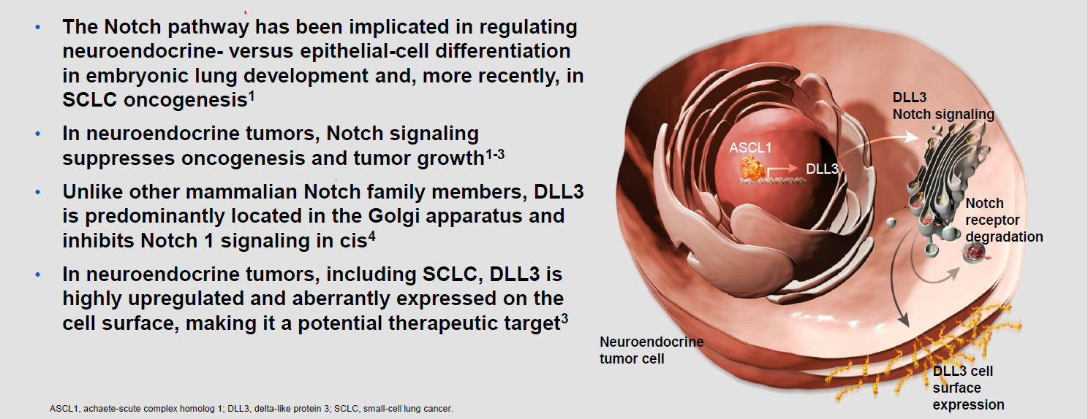
DLL3 is an Inhibitory Notch Ligand Overexpressed in Small Cell Lung Cancer
1.Saunders LR, et al. Sci Transl Med. 2015;7:302ra136.
2.George J, et al. Nature. 2015;524:47-53.
3.KunnimalaiyaanM, et al. Oncologist. 2007;12:535-542.
4.Sabri JK, et al. Nat Rev Clin Oncol. 2017;14;549-561.

Slide 15
Emerging SCLC Treatment Landscape
Positive OS reported
Current treatment options
Under study
Phase 3 failed / terminated
Future DLL3
Extensive Stage Small Cell Lung Cancer
Chemotherapy
Platinum/Etoposide
Atezolizumab + Platinum/Etoposide
Tislelizumab, Toripalimab and HLX10 + Platinum/Etoposide
Durvalumab + Platinum/Etoposide
1L
1L
maint.
ROVA-T
Niraparib (China only)
PD-1+/-CTLA-4
(Nivo+/-Ipi)
Atezolizumab
Durvalumab
Pembro
Durva/Treme
Anti-PD(L)-1
+ DLL3
Nivo ± Ipi or Pembro
(US NCCN guidelines, Relapse < 6 months)
Nivolumab
Lurbinectedin
(US AA 2020)
ROVA-T
DLL3
+/-
Anti-PD(L)-1
Topotecan
Lurbinectedin
± Dox
ROVA-T
CLINICAL
TRIALS
Clinical trials
2L
PD-1
(Nivo & Pembro)
US only
Single agent Chemotherapy
DLL3
Supportive Care
Clinical trials
3L
Atezo = atezolizumab; CT = chemotherapy; CTLA-4 = cytotoxic T-lymphocyte associated protein 4; durva = durvalumab; EP = etoposide/platinum; ipi, ipilimumab; monoTX, monotherapy; nivo, nivolumab; PD-1 = programmed cell death-1; PD-L1 = programmed death-ligand 1; pembro = pembrolizumab; ROVA-T = rovalpituzumab tesirine; sBLA, supplemental biologics application;
SCLC = small cell lung cancer; treme = tremelimumab.
Notes:
SCLC: PharmaMar announces intentions to submit NDA under accelerated approval for lurbinectedin monotherapy for the treatment of 2L SCLC
SCLC: Roche/Chugai announce Tecentriq approval for 1L ES-SCLC in Japan
SCLC: AbbVie officially announces discontinuing ROVA-T (DLL3 ADC) development following another pivotal trial failure in SCLC
AstraZeneca has announced that the global Phase 3 Caspian study evaluating durvalumab (PD-L1) + chemotherapy has met its primary endpoint of OS at a planned interim analysis. The 1L extensive-stage SCLC study will continue to final analysis and will include the durvalumab + tremelimumab (CTLA-4) + chemotherapy arm
PharmaMar today announced intentions to submit an NDA for lurbinectedin (Zepsyre) monotherapy in 2L SCLC

Slide 16
Investigating DLL3 + Novel PD L(1) combination in 2nd line ED-SCLC
Strong biological rationale for DLL3 BiTE and PD L(1) combination
Challenges:
  DLL3 ADC failed in first and second-line
  PD(1) not effective in second-line
  Is there a difference between PD (1) and PD L(1)?
  Novel-PD L(1) not extensively studied
  SOC in second line is changing
  Patients in second-line transitioning to prior PD L(1) exposed/progressed

Slide 17
Design considerations for PD L(1) combination in SCLC
Change in SOC in front-line resulting in most second-line patients being PD L(1) exposed.
  Changing landscape
Is a global trial feasible in second-line ED-SCLC?
  SOC in US different than ROW in first-line
Contribution of components, PD L(1) & DLL3.
  PD L(1) arm in a second-line trial not feasible
Benefit of PD L(1) combination may not manifest as a benefit in ORR, PFS and may need OS data
Biomarker may define the role for monotherapy DLL3 versus combination

Slide 18
Summary
Definition of Progression on prior PD L(1) therapy should be standardized
The role of Single-Arm versus RCT should be carefully evaluated in Early Development
Real World Data have a powerful role in the design and interpretation of clinical trials

