Slide 1
Bayesian Modeling in Evaluating Effectiveness in Multiple Stem Cell Lines for Therapeutic Use in Animals
Qiao Zhang, FDA/CVM
2020-09-23
2020 ASA Biopharmaceutical Section Regulatory-Industry Statistics Workshop

Slide 2
Disclaimer
The views expressed in this presentation are solely those of the speaker and do not represent the views or policies of the US Food and Drug Administration.

Slide 3
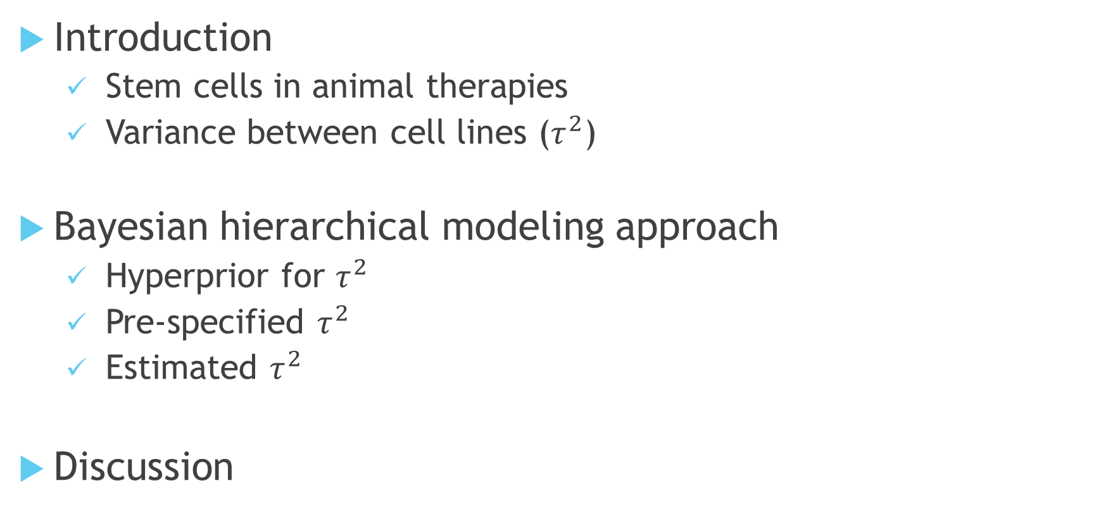
Outline
Introduction
  Stem cells in animal therapies
  Variance between cell lines ($τ^{2}$)
Bayesian hierarchical modeling approach
  Hyperprior for $τ^{2}$
  Pre-specified $τ^{2}$
  Estimated $τ^{2}$
Discussion

Slide 4
Introduction: Stem cells
Undifferentiated or partially differentiated cells that can differentiate into various types of cells
Inherent variability in biologic activity which can result in different safety and effectiveness profiles
No clinically relevant, validated bioassay is available in veterinary stem cell therapies.
Notes:
1. Variation in biologic activity may be due to genetic differences between donors, differences in cells obtained from different sites or at different points in time (even if from the same donor), differences in the manufacturing process, and/or inability of the manufacturing process/specifications to provide a product with consistent biologic activity.
2. It is critical to assure that all approved marketed stem cell product is as consistent as possible and has a reasonably similar safety and effectiveness profile. The most efficient method to confirm the comparability between cell lines would be a clinically relevant, validated bioassay.
3. Currently, the only stem cell treatments used on humans approved by CBER are products that treat certain cancers and disorders of the blood and immune system. “https://www.cdc.gov/hai/outbreaks/stem-cell-products.html”

Slide 5
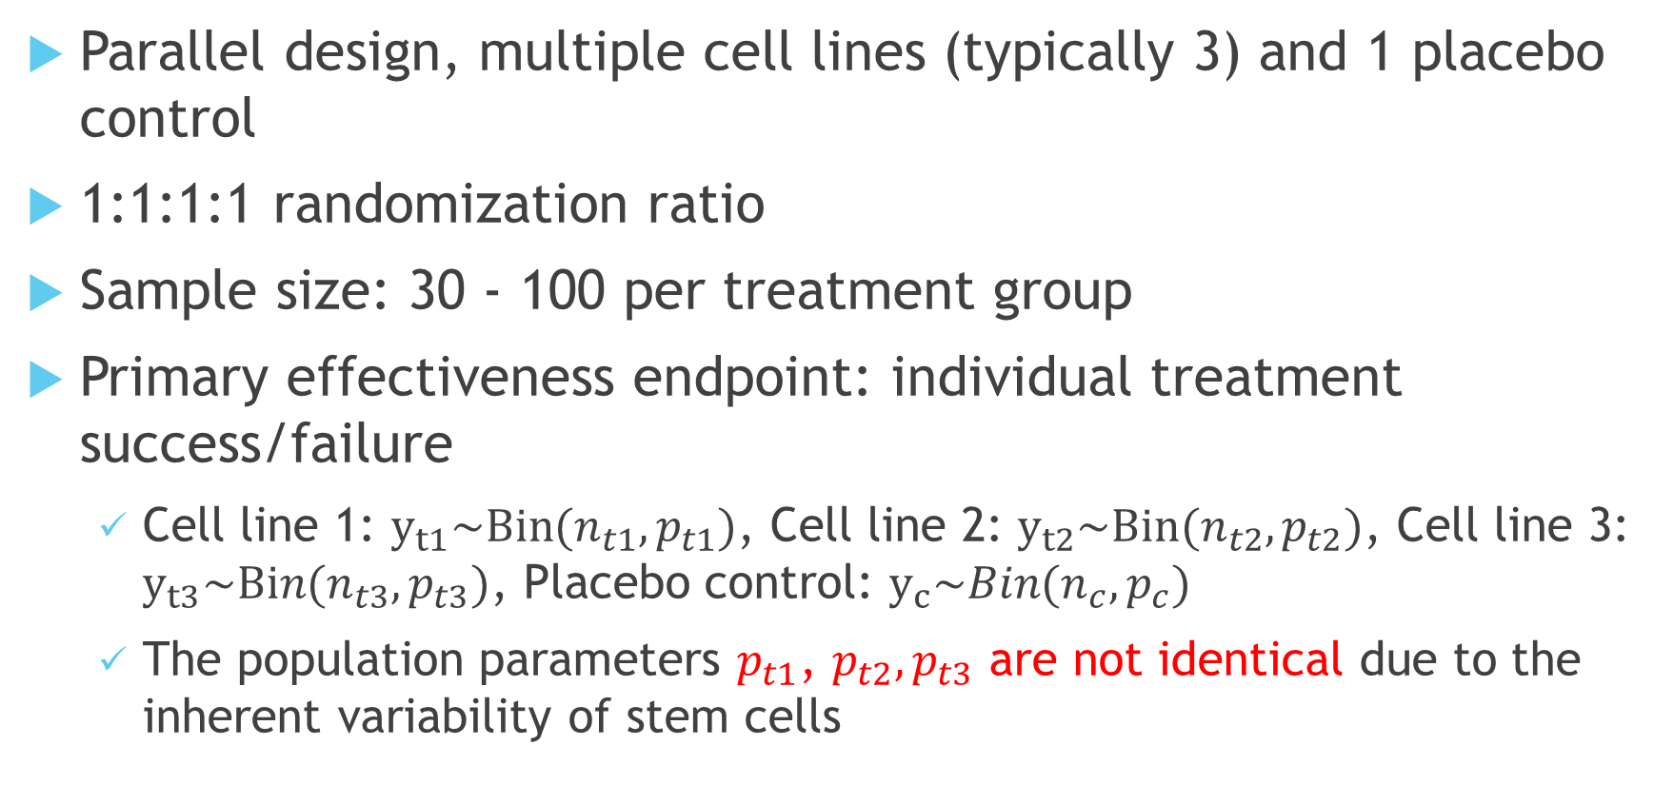
Study Design
Parallel design, multiple cell lines (typically 3) and 1 placebo control
1:1:1:1 randomization ratio
Sample size: 30 - 100 per treatment group
Primary effectiveness endpoint: individual treatment success/failure
  Cell line 1: $y_{t1}\sim Bin(n_{t1},p_{t1})$, Cell line 2: $y_{t2}\sim Bin(n_{t2},p_{t2})$, Cell line 3: $y_{t3}\sim Bin(n_{t3},p_{t3})$, Placebo control: $y_{c}\sim Bin(n_{c},p_{c})$
  The population parameters $p_{t1}$, $p_{t2},p_{t3}$ are not identical due to the inherent variability of stem cells
Notes:
This is the a typical study design for stem cell products but not a standard.
Comparability is a requirement for the evaluation of the cell lines no matter which approach to use for effectiveness evaluation.

Slide 6
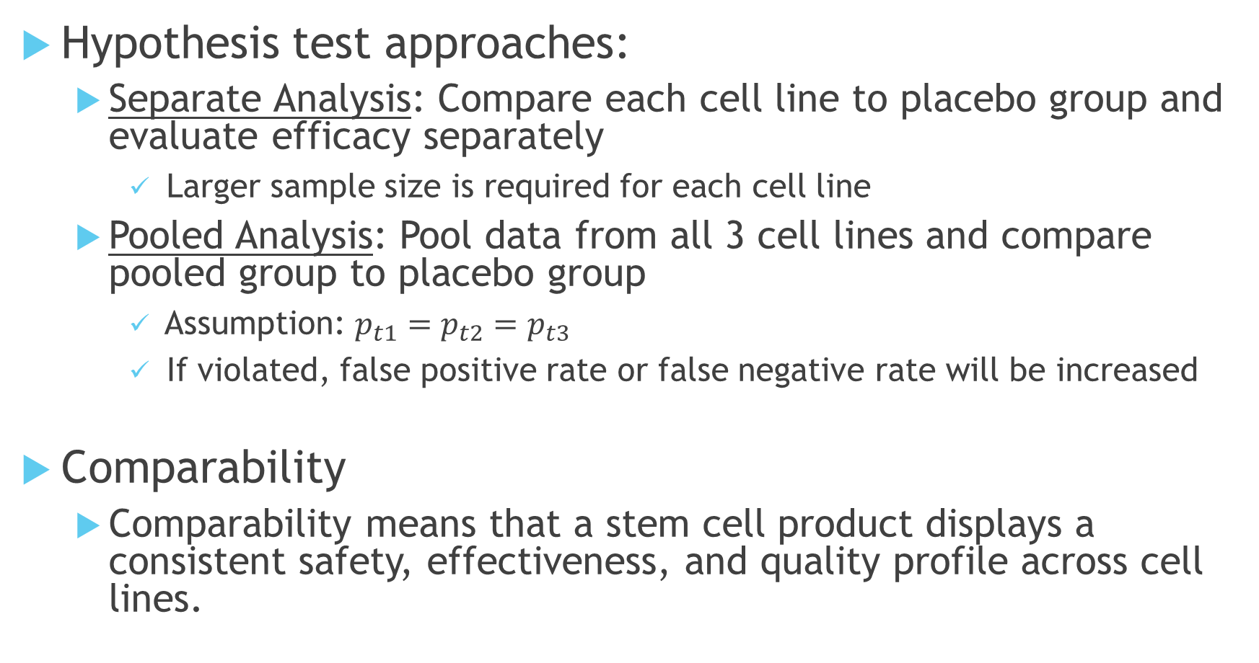
Study Design-Continued
Hypothesis test approaches:
  Separate Analysis: Compare each cell line to placebo group and evaluate efficacy separately
    Larger sample size is required for each cell line
  Pooled Analysis: Pool data from all 3 cell lines and compare pooled group to placebo group
    Assumption: $p_{t1}=p_{t2}=p_{t3}$
    If violated, false positive rate or false negative rate will be increased
Comparability
  Comparability means that a stem cell product displays a consistent safety, effectiveness, and quality profile across cell lines.
Notes:
Comparability is a requirement for the evaluation of the cell lines no matter which approach to use for effectiveness evaluation.

Slide 7
Challenge
To incorporate comparability evaluation into the effectiveness evaluation → borrow information across cell lines
  Increase power while controlling type I error
  Evaluate the between-cell line variance

Slide 8
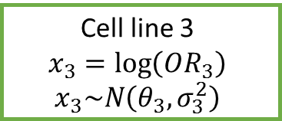
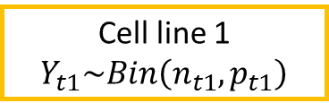
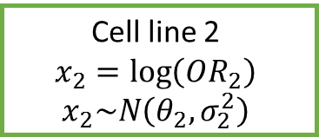
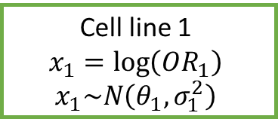
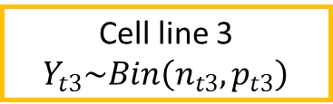
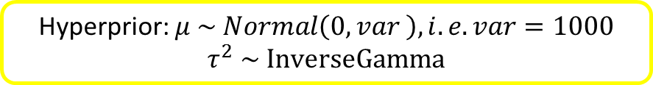

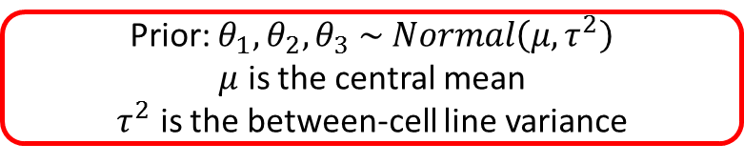
Bayesian Hierarchical Model
Cell line 1 $Y_{t1}\sim Bin\left(n_{t1},p_{t1}\right)$
Cell line 2 $Y_{t2}\sim Bin\left(n_{t2},p_{t2}\right)$
Cell line 3 $Y_{t3}\sim Bin\left(n_{t3},p_{t3}\right)$
Cell line 1
$$x_{1}=\log\left(OR_{1}\right)$$
$x_{1}\sim N\left(θ_{1},σ_{1}^{2}\right)$
Cell line 2
$$x_{2}=\log\left(OR_{2}\right)$$
$x_{2}\sim N\left(θ_{2},σ_{2}^{2}\right)$
Cell line 3
$$x_{3}=\log\left(OR_{3}\right)$$
$x_{3}\sim N\left(θ_{3},σ_{3}^{2}\right)$
Prior: $θ_{1},θ_{2},θ_{3} \sim Normal\left(μ,τ^{2}\right)$
$μ$ is the central mean
$τ^{2}$ is the between-cell line variance
Hyperprior: $μ \sim Normal\left(0, var \right), i.e. var=1000$
$$τ^{2} \sim InverseGamma$$
The sampling error $σ_{j}^{2}$ is assumed known → $\hat{σ^{2}}=\frac{1}{y_{tj}}+\frac{1}{n_{tj}−y_{tj}}+\frac{1}{y_{c}}+\frac{1}{n_{c}−y_{c}}$
Notes:
The assumption of exchangeability between cell lines is valid because the study design for the 3 cell lines are the same, in terms of target population, covariates, endpoints, randomization, masking, etc.
The borrowing strength across cell lines can be adjusted by using different hyperpriors for Tau2

Slide 9
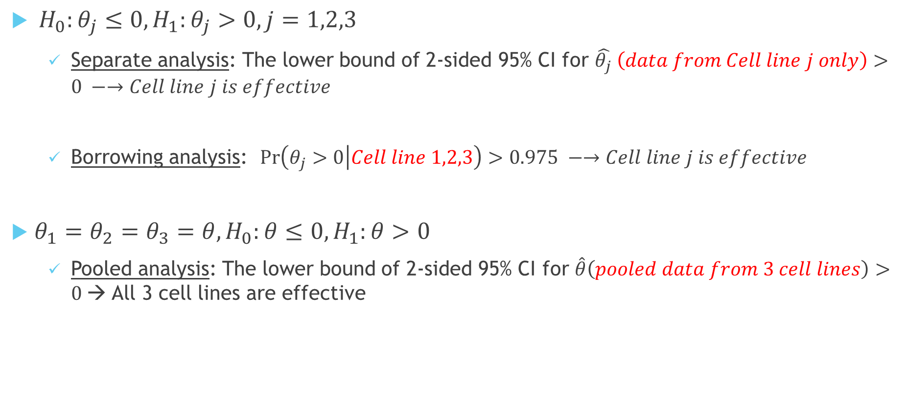
Hypothesis Testing
$H_{0}:θ_{j}≤0, H_{1}:θ_{j}>0, j=1,2,3$
  Separate analysis: The lower bound of 2-sided 95% CI for $\hat{θ_{j}} \left(data from Cell line j only\right)>0 −→Cell line j is effective$
  Borrowing analysis: $\operatorname{Pr}\left(θ_{j}>0 | Cell line 1,2,3\right)>0.975 −→Cell line j is effective$
$θ_{1}=θ_{2}=θ_{3}=θ,H_{0}:θ≤0, H_{1}:θ>0$
  Pooled analysis: The lower bound of 2-sided 95% CI for $\hat{θ}\left(pooled data from 3 cell lines\right)>0$→ All 3 cell lines are effective

Slide 10
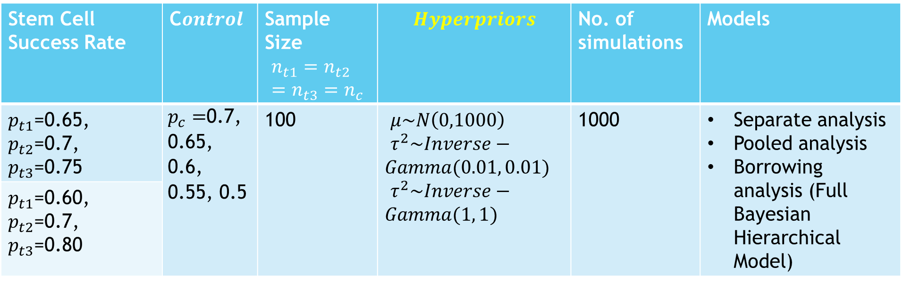
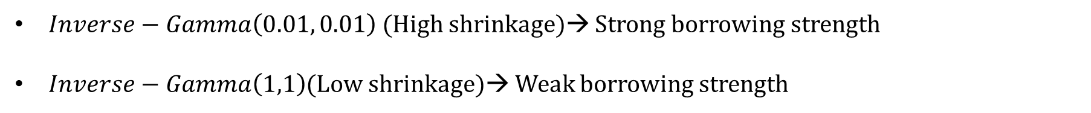
Simulations for Full Bayesian Method
Stem Cell Success Rate | C$ontrol$ | Sample Size $$n_{t1}=n_{t2}=n_{t3}=n_{c}$$ | $$Hyperpriors$$ | No. of simulations | Models
$p_{t1}$=0.65, $p_{t2}$=0.7, $p_{t3}$=0.75 | $p_{c}=$0.7, 0.65, 0.6, 0.55, 0.5 | 100 | $μ\sim N\left(0,1000\right)$ $τ^{2}\sim Inverse−Gamma(0.01, 0.01)$ $τ^{2}\sim Inverse−Gamma(1, 1)$ | 1000 | Separate analysis Pooled analysis Borrowing analysis (Full Bayesian Hierarchical Model)
$p_{t1}$=0.60, $p_{t2}$=0.7, $p_{t3}$=0.80
$Inverse−Gamma\left(0.01, 0.01\right)$(High shrinkage)→ Strong borrowing strength
$Inverse−Gamma\left(1,1\right)$(Low shrinkage)→ Weak borrowing strength

Slide 11
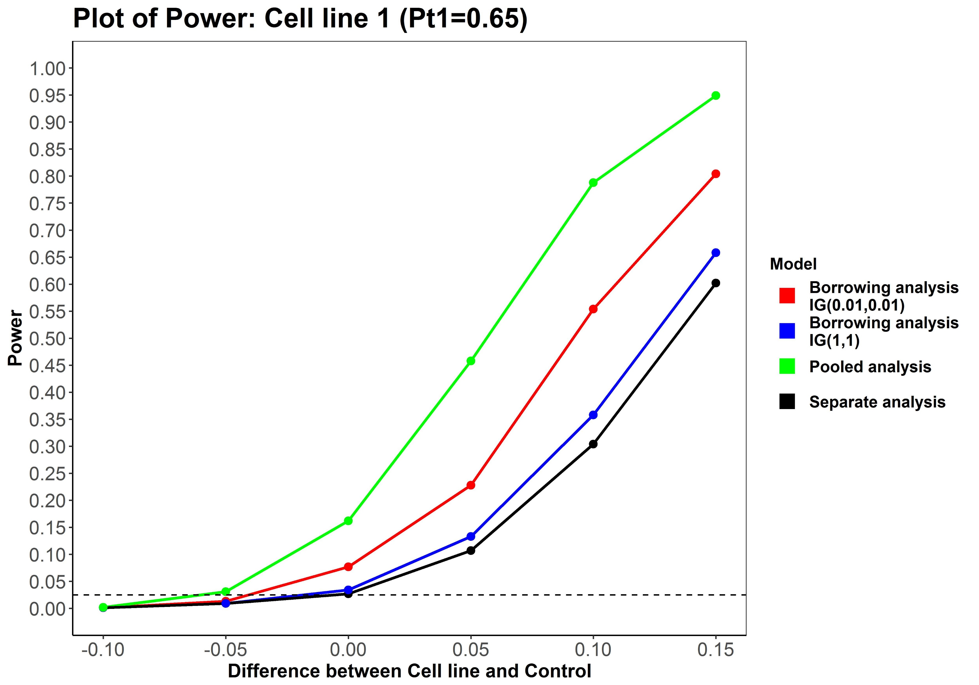
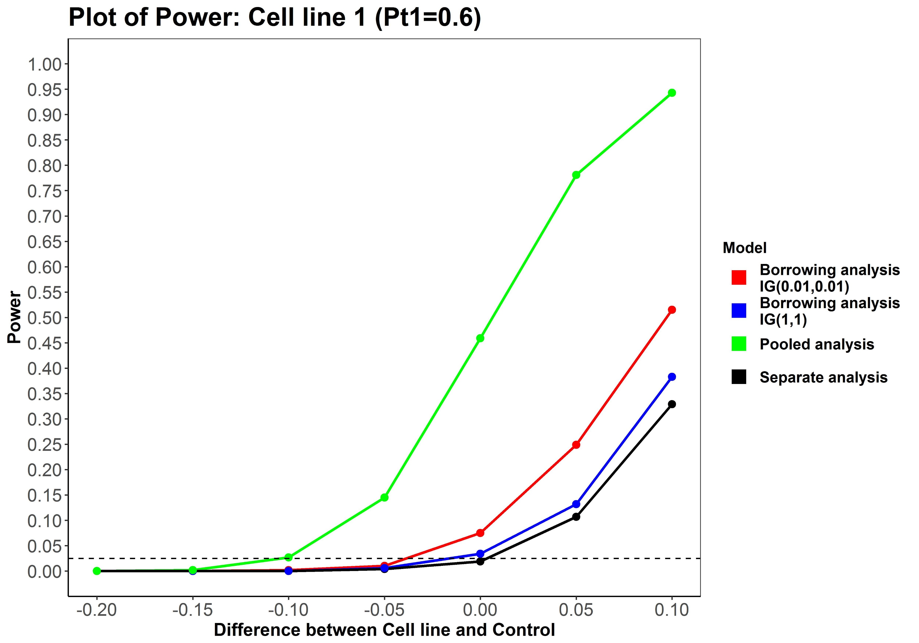
Simulations for Full Bayesian Method
Cell line 2: 0.7, Cell line 3: 0.75
Cell line 2: 0.7, Cell line 3: 0.8
Notes:
The green arrows are to point out the Type I errors.

Slide 12
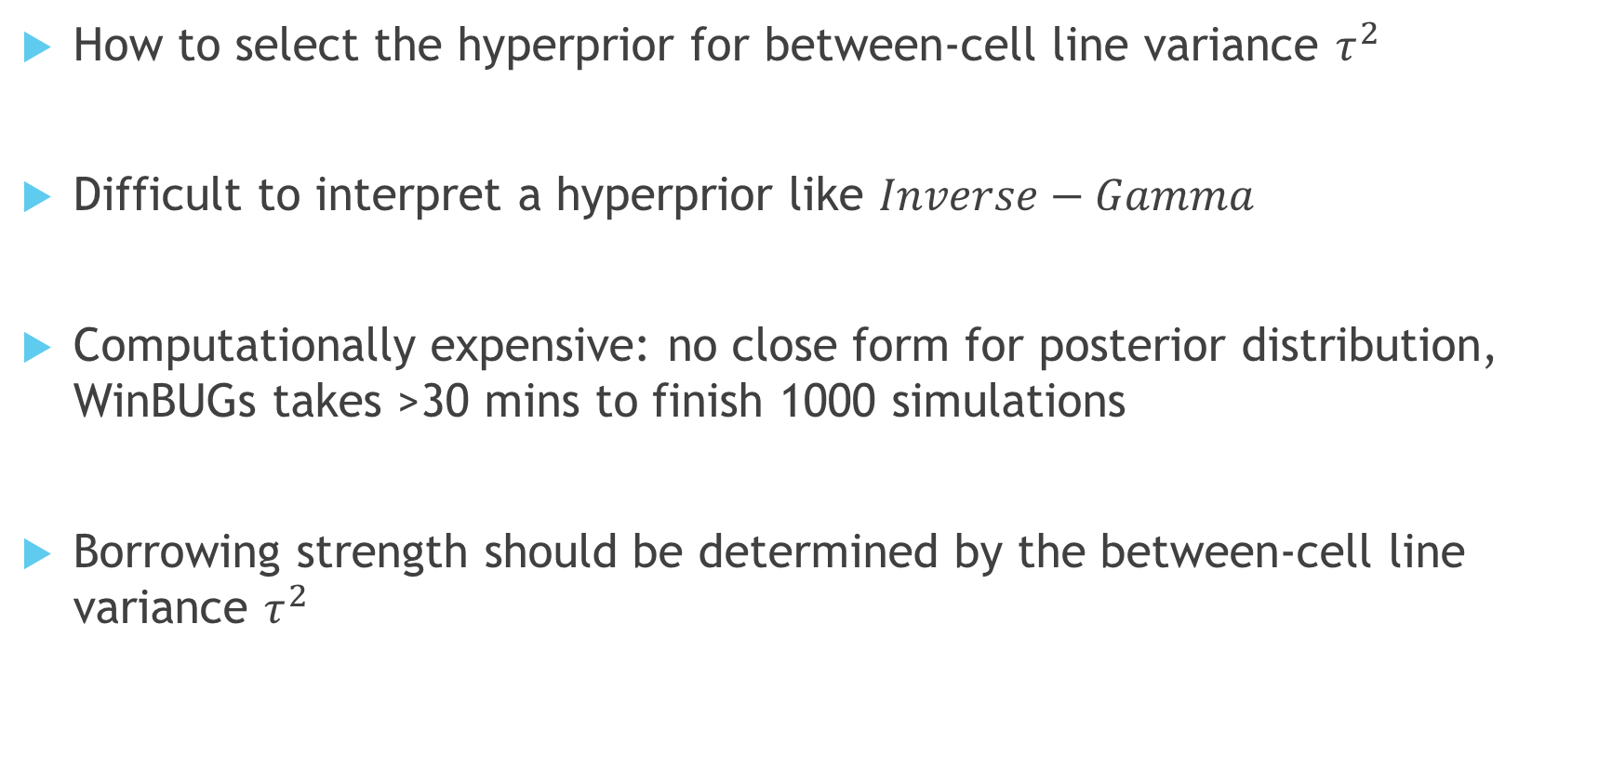
Difficulties in using Full Bayesian Method
How to select the hyperprior for between-cell line variance $τ^{2}$
Difficult to interpret a hyperprior like $Inverse−Gamma$
Computationally expensive: no close form for posterior distribution, WinBUGs takes >30 mins to finish 1000 simulations
Borrowing strength should be determined by the between-cell line variance $τ^{2}$

Slide 13
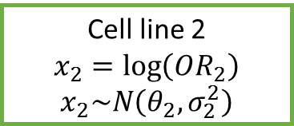


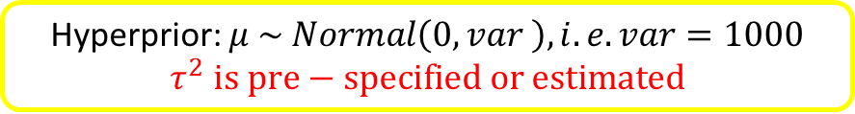


Bayesian Hierarchical Model with $τ^{2}$estimate
Cell line 1 $Y_{t1}\sim Bin\left(n_{t1},p_{t1}\right)$
Cell line 2 $Y_{t2}\sim Bin\left(n_{t2},p_{t2}\right)$
Cell line 3 $Y_{t3}\sim Bin\left(n_{t3},p_{t3}\right)$
Cell line 1
$$x_{1}=\log\left(OR_{1}\right)$$
$x_{1}\sim N\left(θ_{1},σ_{1}^{2}\right)$
Cell line 2
$$x_{2}=\log\left(OR_{2}\right)$$
$x_{2}\sim N\left(θ_{2},σ_{2}^{2}\right)$
Cell line 3
$$x_{3}=\log\left(OR_{3}\right)$$
$x_{3}\sim N\left(θ_{3},σ_{3}^{2}\right)$
Prior: $θ_{1},θ_{2},θ_{3} \sim Normal\left(μ,τ^{2}\right)$
$μ$ is the central mean
$τ^{2}$ is the between-cell line variance
Hyperprior: $μ \sim Normal\left(0, var \right), i.e. var=1000$
$$τ^{2} is pre−specified or estimated$$
The sampling error $σ_{j}^{2}$ is assumed known → $\hat{σ^{2}}=\frac{1}{y_{tj}}+\frac{1}{n_{tj}−y_{tj}}+\frac{1}{y_{c}}+\frac{1}{n_{c}−y_{c}}$
Notes:
Instead of providing a hyperprior to Tau2, we used a pre-specified Tau2 or an estimated Tau2. It facilitates the communications with clinicians when the discussions are on Tau2 itself instead of the distribution

Slide 14
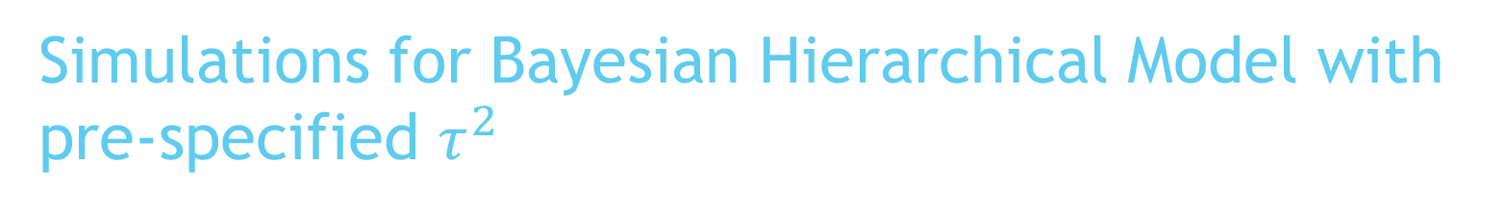
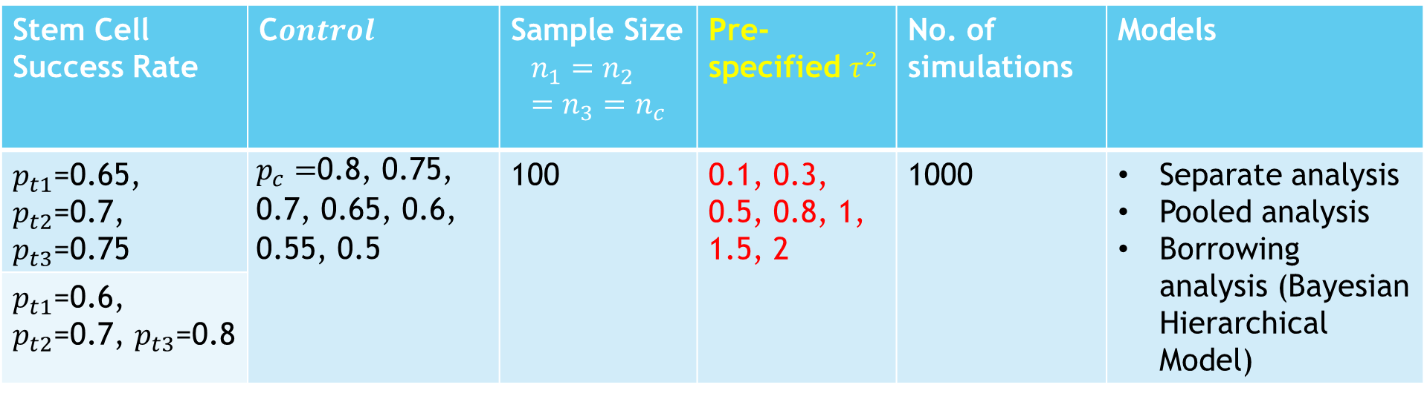
Simulations for Bayesian Hierarchical Model with pre-specified $τ^{2}$
Stem Cell Success Rate | C$ontrol$ | Sample Size $$n_{1}=n_{2}=n_{3}=n_{c}$$ | Pre-specified $τ^{2}$ | No. of simulations | Models
$p_{t1}$=0.65, $p_{t2}$=0.7, $p_{t3}$=0.75 | $p_{c}=$0.8, 0.75, 0.7, 0.65, 0.6, 0.55, 0.5 | 100 | 0.1, 0.3, 0.5, 0.8, 1, 1.5, 2 | 1000 | Separate analysis Pooled analysis Borrowing analysis (Bayesian Hierarchical Model)
$p_{t1}$=0.6, $p_{t2}$=0.7, $p_{t3}$=0.8

Slide 15
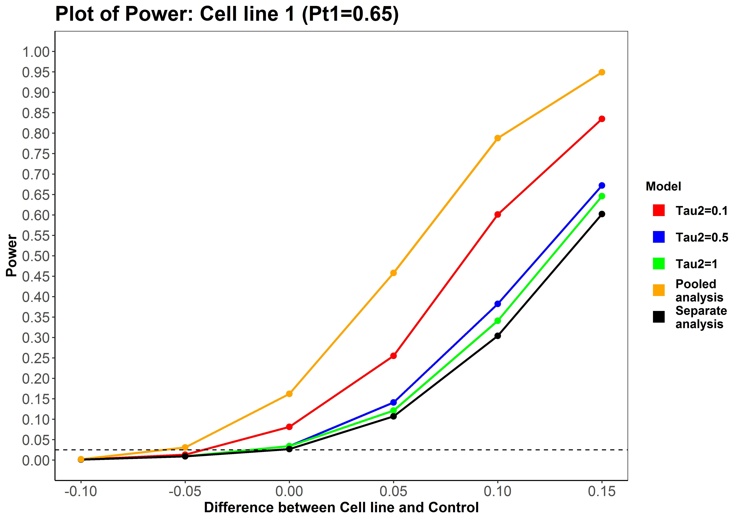
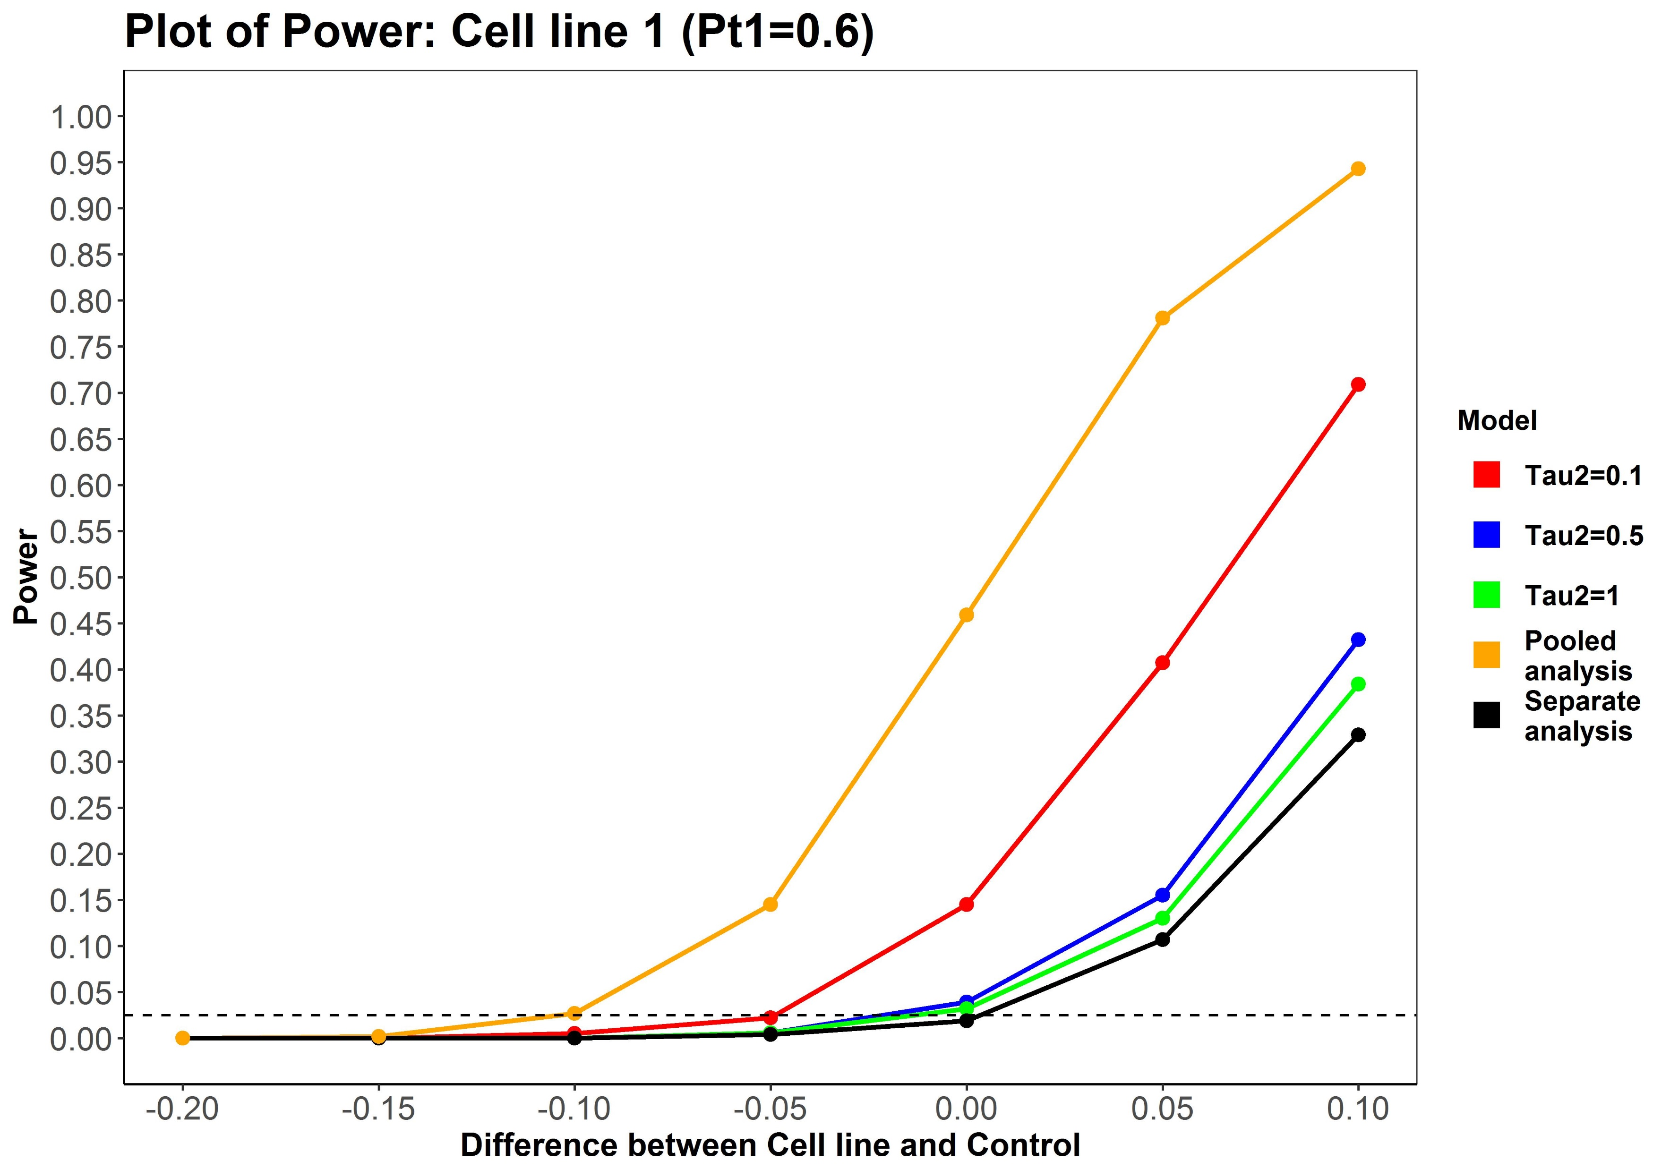
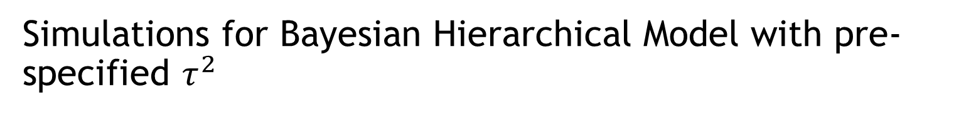
Simulations for Bayesian Hierarchical Model with pre-specified $τ^{2}$
Cell line 2: 0.7, Cell line 3: 0.75
Cell line 2: 0.7, Cell line 3: 0.8
We need a priori knowledge about $τ^{2}$ → not available at this point for stem cells
The Type I error cannot be properly controlled if the pre-specified $τ^{2}$ is underestimates the true parameter

Slide 16
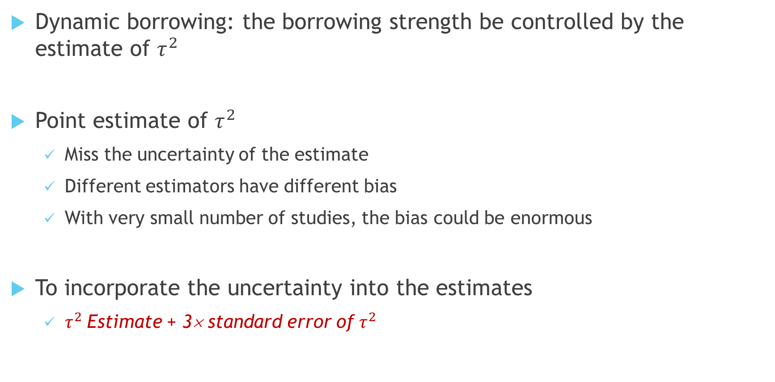
Bayesian Hierarchical Model with estimated $τ^{2}$
Dynamic borrowing: the borrowing strength be controlled by the estimate of $τ^{2}$
Point estimate of $τ^{2}$
  Miss the uncertainty of the estimate
  Different estimators have different bias
  With very small number of studies, the bias could be enormous
To incorporate the uncertainty into the estimates
  $τ^{2}$Estimate + 3× standard error of $τ^{2}$

Slide 17
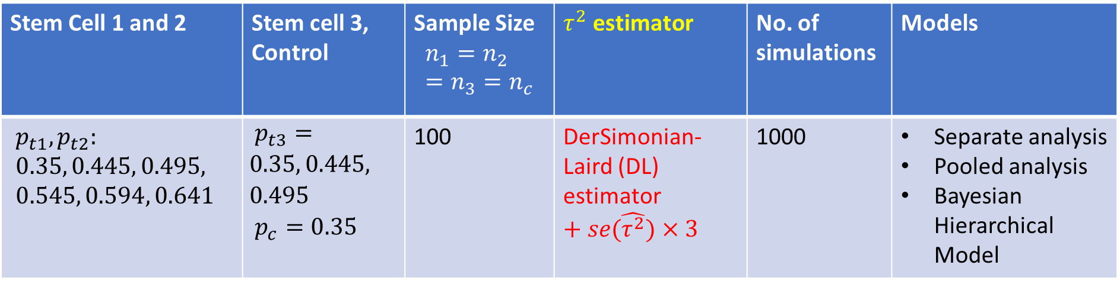
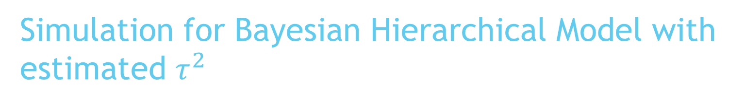
Simulation for Bayesian Hierarchical Model with estimated $τ^{2}$
Stem Cell 1 and 2 | Stem cell 3, Control | Sample Size $$n_{1}=n_{2}=n_{3}=n_{c}$$ | $τ^{2}$ estimator | No. of simulations | Models
$p_{t1}, p_{t2}:$ $0.35, 0.445, 0.495,$ $0.545, 0.594, 0.641$ | $p_{t3}=0.35, 0.445, 0.495$ $p_{c}=0.35$ | 100 | DerSimonian-Laird (DL) estimator$+se(\hat{τ^{2}})×3$ | 1000 | Separate analysis Pooled analysis Bayesian Hierarchical Model

Slide 18
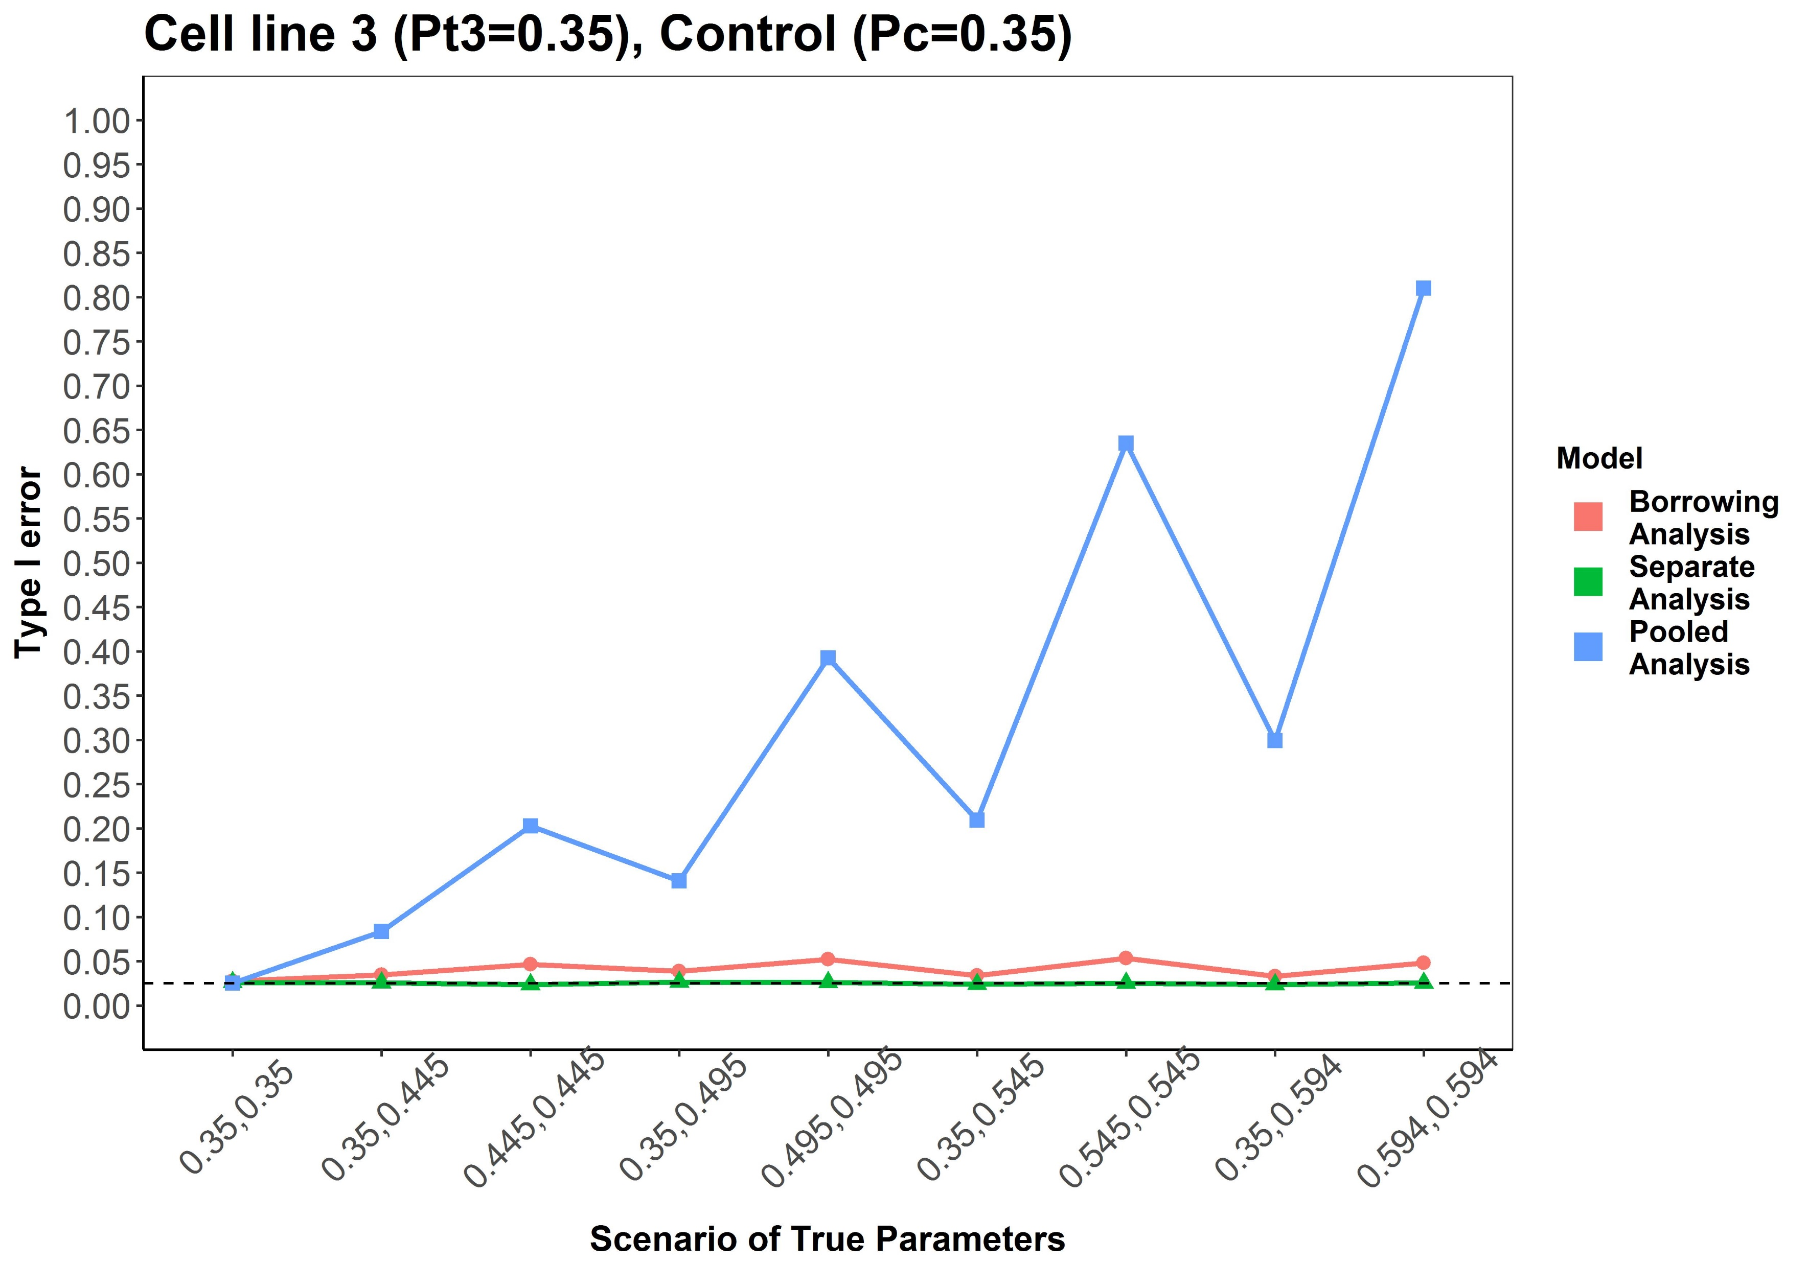
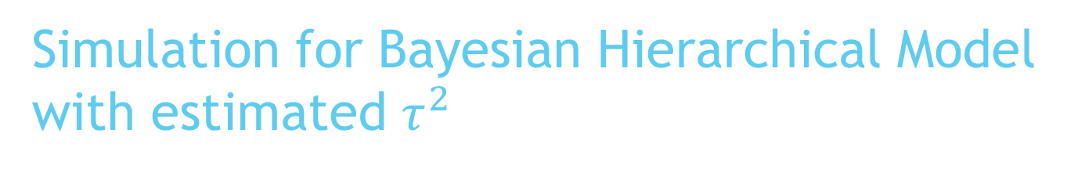
Simulation for Bayesian Hierarchical Model with estimated $τ^{2}$
Sample size: 100 per group
Borrowing analysis and separate analysis can properly control Type I error but the pooled analysis cannot

Slide 19
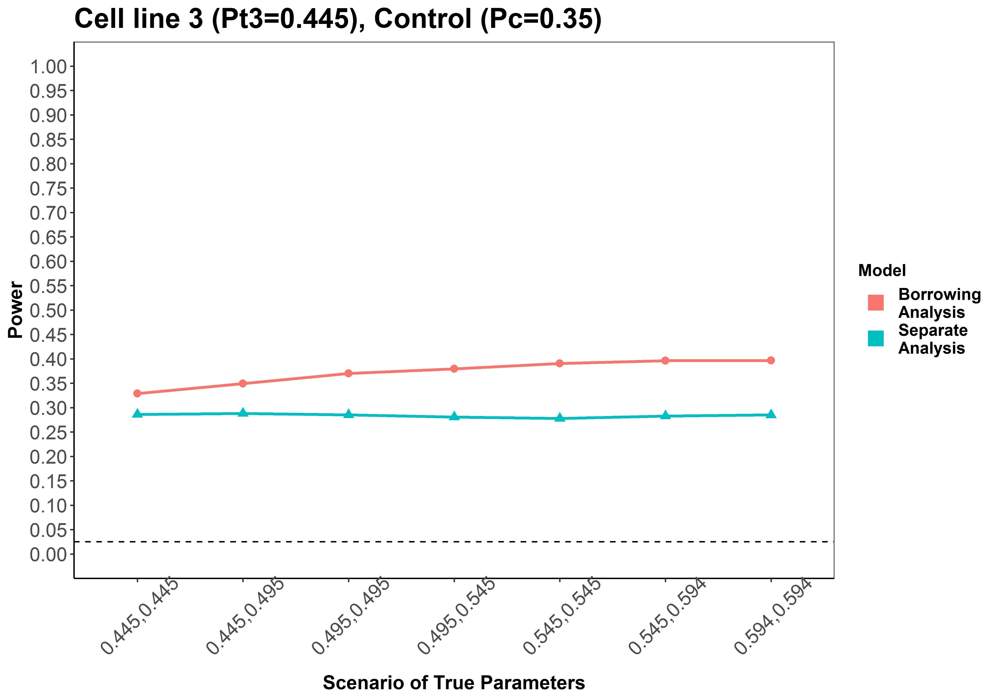
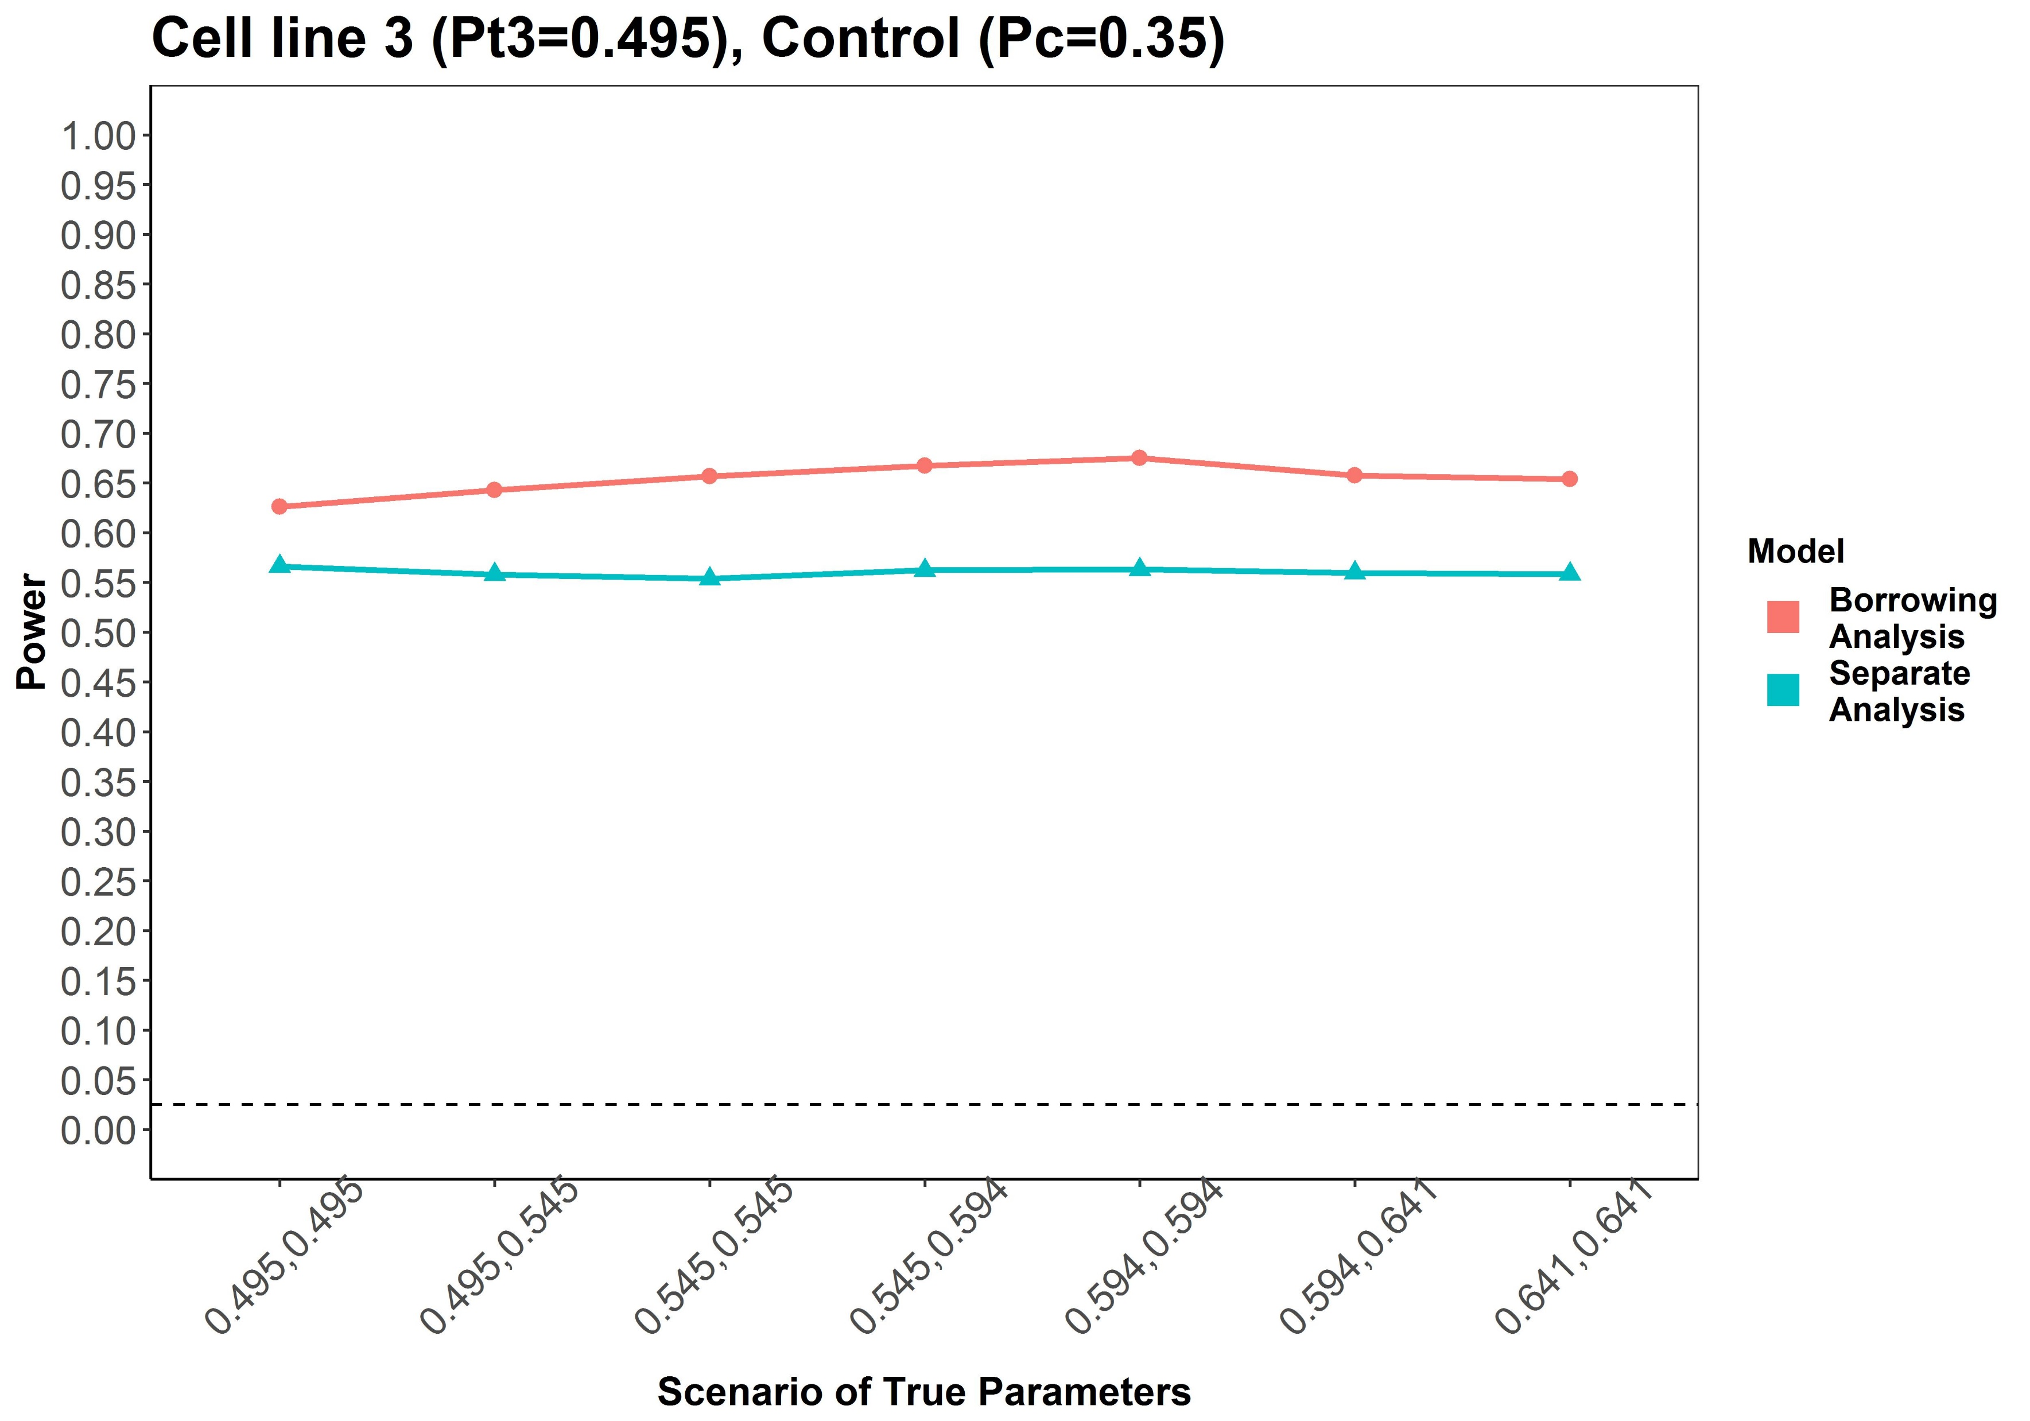
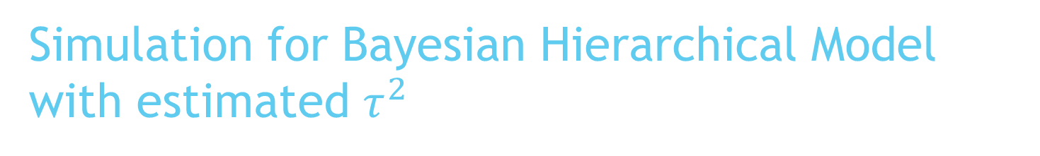
Simulation for Bayesian Hierarchical Model with estimated $τ^{2}$
Sample size: 100 per group

Slide 20
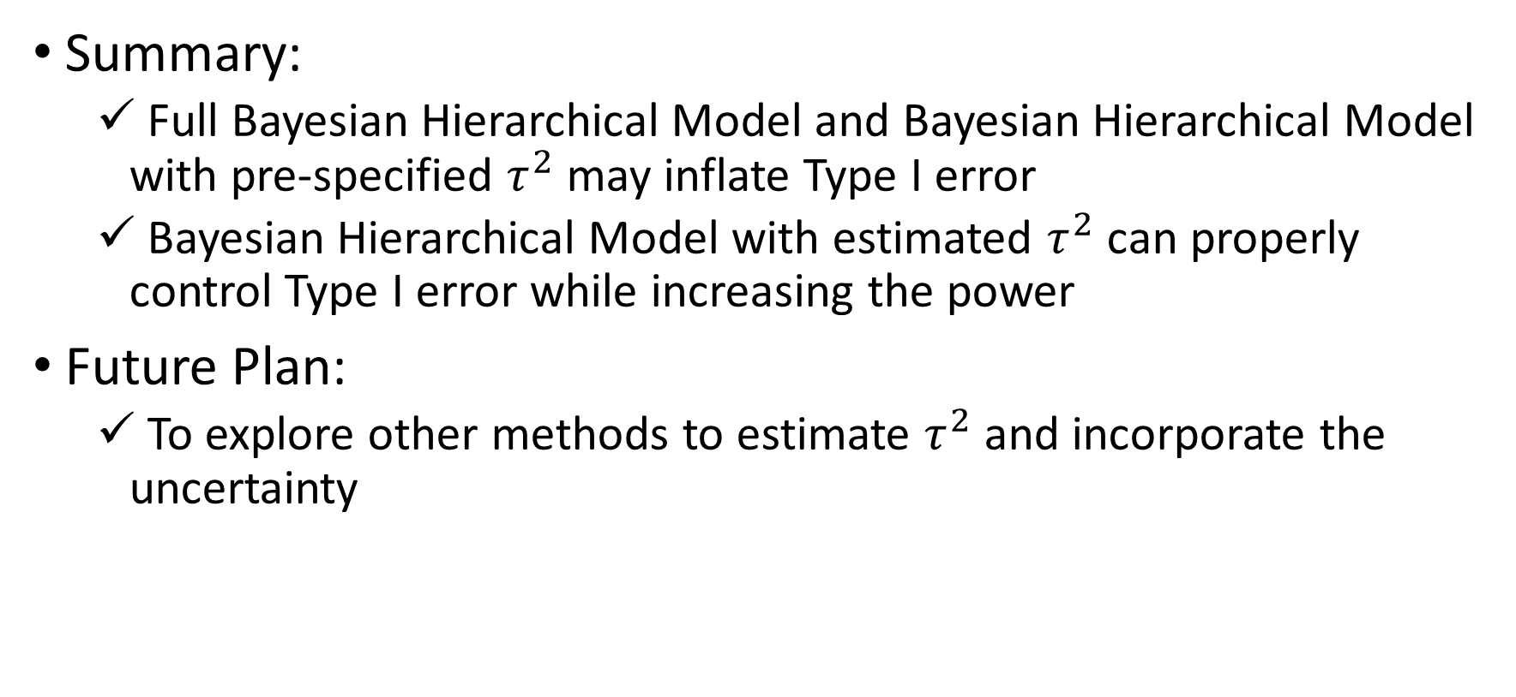
Discussion
Summary:
  Full Bayesian Hierarchical Model and Bayesian Hierarchical Model with pre-specified $τ^{2}$ may inflate Type I error
  Bayesian Hierarchical Model with estimated $τ^{2}$ can properly control Type I error while increasing the power
Future Plan:
  To explore other methods to estimate $τ^{2}$and incorporate the uncertainty

Slide 21
References
https://en.wikipedia.org/wiki/Stem_cell
https://www.rdocumentation.org/packages/R2WinBUGS/versions/2.1-21
Bayesian Adaptive Methods for Clinical Trials, S. Berry, et al., CRC, 2011
Bayesian Data Analysis, A. Gelman, et al., CRC, 2013
Meta-Analysis in Clinical Trials, R. DerSimonian, N. Laird, Controlled Clinical Trials 7: 177-188 (1986)
Methods to estimate the between-study variance and its uncertainty in meta-analysis, A. A. Veroniki, et al., Research Synthesis Methods 7: 55-79 (2016)

Slide 22
Acknowledgements
Kyle Lee, FDA/CDER
Virginia Recta, FDA/CVM
Haiwen Shi, FDA/CVM
Claire Ruberman, FDA/CVM
Stella Karuri, FDA/CVM
Cherry Gupta, FDA/CVM

Slide 23
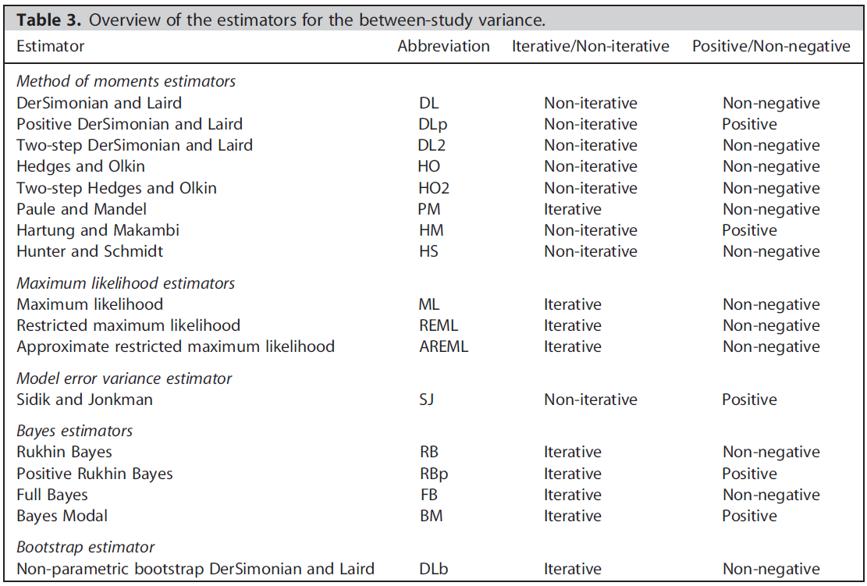
Estimators for between-study variance $τ^{2}$
Methods to estimate the between-study variance and its uncertainty in meta-analysis, A. A. Veroniki, et al., Research Synthesis Methods 7: 55-79 (2016)
Notes:
This is a backup slide for the available estimators for the between-study variance

