Slide 1

Biostatistical Landscape of Real-World Study Design and Analysis
Weili He, PhD, AbbVie
On Behalf of ASA BIOP RWE Scientific Working Group
September 24, 2020
ASA BIOP RISW

Slide 2
Disclaimer
The comments provided here are solely those of the presenters and are not necessarily reflective of the positions, policies or practices of presenters’ employers.

Slide 3
ASA BIOP RWE SWG Members
Industry | Affiliation | Academic/FDA† | Affiliation
Weili He ^{§,1} Jie Chen Yixin Fang Doug Faries Qi Jiang Kwan Lee ² Xiwu Lin Zhaoling Meng Yang Song Hongwei Wang Roseann White Richard Zink | AbbVie Merck AbbVie Eli Lily Seattle Genetics Janssen Janssen Sanofi Vertex Pharma. Inc. AbbVie The Third Opinion Target Pharma. Solution | Martin Ho ^{§,2} Telba Irony Mark van der Laan Hana Lee Mark Levenson ¹ Pallavi Mishra-Kalyani Frank Rockhold Ben Goldstein | CBER CBER UC Berkeley CDER CDER CDER Duke Duke
§ Co-chairs of the SWG; ¹ Co-leads of Workstream #1; ² Co-leads of Workstream #2
† Liz Stuart (Johns Hopkins University) participates as non-member

Slide 4

Outline
Introduction of Real-World (RW) Studies
Bias and confounding control in study design or analysis stages
Clinical study design using external controls
Concluding remarks

Slide 5
Beyond the traditional Randomized Clinical Trials (RCTs)
Under FDA’s RWE Framework (Dec. 2018), evidence from traditional RCTs will not be considered RWE. However, various hybrid or pragmatic trial designs and observational studies could generate RWE
There are primarily two types of study designs, categorized by having intervention or not
Clinical trials
Observational studies
Traditional RCT for efficacy
Pragmatic RCT for effectiveness
Hybrid RCT for both efficacy and effectiveness
      Prospective, retrospective cohort, or hybrid cohort study with both retrospective and prospective components
      Case-control study
      Cross-sectional observational study
Section 2: Research objective
5

Slide 6

RCTs or Real-World (RW) Observational studies? This is a question!
The rise and fall of hormone replacement therapy (HRT)
In 1992, an observational study compared women who were taking HRT with others who were not
Conclusion: HRT can reduce the risk of heart disease
In 2002, an experiment assigned women to either HRT or placebo, where the assignment is done by coin toss (i.e., RCT – randomized controlled trial)
Conclusion: HRT does not reduce the risk of heart disease
  Interpretation: In observational studies, women who choose to take HRT are very different from women who do not: they are richer and better educated and see doctors more often. In addition to taking HRT, these women do many things to maintain their health, so it is not surprising that they have fewer heart diseases. Possible confounders: income, education, etc.

Slide 7
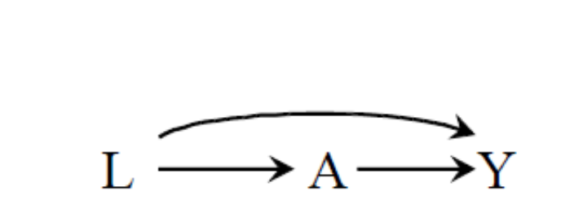
Debating: RCTs and RW observational studies?
The directed acyclic graph (DAG) displaying the structure of confounding
A: Binary variable (HRT or not)
Y: Binary variable (heart disease
or not at the end of follow-up)
L: Confounders such as education
and income
RCTs are the gold standard for evaluating the efficacy and safety of pharmaceutical drugs, but their costs, duration, and limited generalizability have caused some to look for observational studies as alternatives
On the other hand, observational studies may be much less convincing due to the lack of randomized treatment assignment and the presence of confounding bias
7

Slide 8
Study design principles - Adequate and Well-Controlled Study
Regulations 21CFR314.126
Clear objectives, summary of methods and results
Design permits a valid comparison with a control (concurrent and historical controls)
Adequate selection of patients
Assigning patients to treatment and control groups minimizes bias
Adequate measures to minimize biases on subjects, observers, and analysts
Well-defined and reliable assessment of subjects’ responses
Adequate analysis to assess drug results
Reserved for special circumstances
Ordinarily randomization
Blinding

Slide 9
21st Century Cures Act (2016)
Establish a program to evaluate the potential use of real-world evidence
  to help to support the approval of a new indication for a drug approved under section 355(c) of this title;
  to help to support or satisfy post approval study requirements.
No change in
evidentiary standard
SEC. 505F. UTILIZING REAL WORLD EVIDENCE. Amended by Food and Drug Administration Reauthorization Act 2017

Slide 10
Outline
Introduction of Real-World (RW) Studies
Bias and confounding control in study design stage and analysis stages
Clinical study design using external controls
Concluding remarks

Slide 11
Biases in Study Design
Bias - Lack of internal validity or incorrect assessment of the association between an exposure and an effect. It can occur in both non-randomized studies and randomized studies
Selection bias: selecting subjects based on a common effect of two variables, one of which is either the treatment or associated with the treatment, and the other is either the outcome or associated with the outcome
Confounding bias: refers to a distortion in the estimated effect of exposure on outcome because of the presence of unadjusted shared causes for both exposure and outcome.
Although definitions may vary, confounding bias is a major concern in nonrandomized studies but less of a concern in randomized trials.
Information bias: erroneously measuring or recording exposure, outcome or any covariates, and is also known as misclassification bias when the measured variables are discrete

Slide 12
Biases Control
selection bias
Information bias
Best done through design, by choosing the population and other aspects of the estimand appropriately
We often have more information on sicker patients.
This information bias can be mitigated by accounting for the degree to which a patient interacts with the health care system

Slide 13

Confounding Control in Design Stage
Method | Description | Strengths/Weaknesses
Randomization | Assigns patients randomly to exposure groups to ensure similar distributions at baseline of measured and unmeasured covariates among comparison groups | Cannot guarantee post-randomization balance due to patient attrition for a variety of reasons (e.g., withdrawal due to adverse events, loss-to-follow up, death). Can be performed at patient level or cluster level, e.g., at hospital or doctor level
Matching | Forms a sample of individuals in an untreated group who are matched with those in a treated group in terms of pre-identified covariates such as age and gender | Cannot control unmeasured confounding variables. May result in exclusion of subjects when close matches in the opposite treatment group are not found
Population restriction | Limits admission into the study to those who meet the criteria about some confounding variables | Reduces the size of subject pool and may cause generalizability problem of treatment effect. Effect of confounding may not be estimable and residual confounding effect may still exist

Slide 14
Confounding Control in Analysis Stage
Method | Description | Strengths/Weaknesses
Matching | Control subjects are selected to match treated subjects according to a balance score or propensity score that is a function of many covariates | Similar to the matching methods in the design stage, matching in the analysis stage may also not be able to control unmeasured confounding covariates
Restriction | Restrict the analysis set of subjects at the pre-specified levels of the confounding variables. | Simple to implement and easy to understand. Can cause the loss of study power due to reduced sample size and the loss of generalizability of the results
Stratification | Allows the association between exposure and outcome to be examined within strata of confounding covariates, so that each stratum can be regarded as having approximately the same values of the confounding covariates | Stratification can be done directly with a small number of discrete variables or categorized continuous variables. When the number of covariates is larger, the quartiles or percentiles of a balance score (e.g., PS ) can be used for stratification. (Chen et al. 2018)

Slide 15
Confounding Control in Analysis Stage (Cont’d)
Method | Description | Strengths/Weaknesses
Weighting | Usually using the inverse probability of treatment weighting (IPTW) to create a pseudo-population in which the characteristics are similar across comparable groups (see also G-methods). Typically used to estimate average treatment effect. | Potentially more efficient in creating pseudo comparative groups. Weighting can be done using on PS. May not be robust with a low PS values for either treated or untreated.
Multiple regression | Include ordinary regression for continuous outcomes and generalized regression models for discrete outcomes. Estimated balance scores (e.g., propensity score) may be used as a variable in the outcome regression model. | Principles governing the selection of covariates depend on the availability of domain knowledge. May introduce bias if outcomes are used to develop model.

Slide 16
Key challenges and opportunities with Confounding Control
Limited experience regarding quantification of residual bias after performing bias reduction analysis
Need more education and influence for better and more appropriate use of confounding adjustment methods
Require better understanding of the operating characteristics of these methods under certain confounding circumstances
There is no consensus or statistical guidance on the best practice for control of confounding in real-world studies for practitioners

Slide 17
Outline
Introduction of Real-World (RW) Studies and evidence pyramid
Bias and confounding control in study design stage and analysis stages
Clinical study design using external controls
Concluding remarks

Slide 18
Three Principles for Evidence Synthesis
Transitivity
Also called similarity or exchangeability – patients and study designs are similar, i.e., distribution of effect modifiers (difference in treatment-control difference) across studies are not systematically different.
Homogeneity
Variances between studies should be similar enough to be pooled for analysis; and
Consistency
Agreements among the estimated treatment effects from direct and indirect comparisons for a given pair of treatments to be pooled

Slide 19
Clinical Contexts using External Control
Rare disease population with low incidence rate, or in unmet medical needs areas with no available treatment
  Serve as an external control group without data integration for single-arm trials
In unmet medical needs areas with demonstration of early treatment efficacy
  Augment (with pre-defined algorithm) the concurrent control group of an RCT, i.e., “borrowing” external information,
  Simply pool together with the concurrent control group if predefined criteria (e.g., exchangeability assumption) are met regarding the concurrent control and external parallel control data

Slide 20
Type of External Data Sources
 | Category I: Research data sources (Data used primarily for research) | Category II: Transaction data sources (Data used secondarily for research)
Generation & collection purposes | Research objective prospectively specified in study protocols | Billing, administrative, clinical management
Examples | Completed RCTs, natural history studies, registries | Claims, EHRs, prescriptions
Data Quality | Data monitored per protocol | Provider- and purpose-dependent
Auditability | Legally auditable for clinical trials with source data | Regulatory framework for auditable EHRs & claims has set to be setup
Outcome definition | Defined prospectively in study protocols | Defined retrospectively; Data, source, and purpose dependent
Collection methods & schedules | Prospectively specified in study protocols | Provider- and purpose-dependent, e.g., bill collection, clinical visits
Treatment regimen | Prospectively specified in interventional study protocols | Patients and providers dependent
Missing data vs. unavailable data | Data points are missing if they are not collected as specified in the study protocols | Data points that do not exist are not necessarily missing, e.g., a patient might feel well, with no need to see doctors

Slide 21
Single-arm Trials using External Control
A challenging issue of such design is the comparability or exchangeability of the external control population
Select a set of (baseline) covariates that might impact treatment assignment and/or the outcome of interest
  Choose a distance metric (e.g., propensity score) and calculate the distance score using the pre-selected covariates for each individual,
Key considerations to ensure comparability
  Use the distance score to obtain comparable samples between the treated and the untreated through, e.g., matching, subclassification, or PS-based inverse probability weighting

Slide 22
Augment RCT concurrent controls with External Control
To augment or enrich the concurrent controls (CC) of a trial, Stuart and Rubin (2008) proposed an algorithm to obtain matches from multiple control groups,
  adjusting for differences in observed covariates between groups while capturing the additional otherwise unobserved differences between control groups.
To pool external controls with the concurrent controls, Viele et al. (2014) review several methods in using external (historical) data to assess treatment effect and investigate their performance with regard to
  mean squared error, power and type I error control, and
  emphasizing dynamic (instead of “static”) “borrowing” and sequential decision process to determine sufficient similarity of external controls with the CCs in a clinical trial.

Slide 23
Key Considerations in the use of External Data in Study Design
A two-stage approach was proposed by Rubin (2001, 2007, 2008) and Yue et al. (2014):
Stage 1
Specifying covariates and matching methods to be used to identify appropriate control groups from the external data,
  Conducting preliminary sample size estimation for the clinical trial, and
  Prospectively selecting fit-for-purpose external data,
  Submitting the initial statistical analysis plan to the FDA

Slide 24
Key Considerations in the use of External Data in Study Design (Cont’d)
Stage 2
Matching all subjects in the investigative study with external control subject according to pre-defined criteria (e.g., PS-based matching with appropriate caliper)
Maintaining blinding of outcomes until the final outcome analysis
Adjusting for sample size based on the recruited patients
Submitting the final statistical analysis plan to the FDA
1
3
5
7
9
Recruiting patients and collects information
Assessing covariate distribution balances
Identifying the control group according to the matching methods specified at the first stage
Unblinding outcomes data and conducting final outcome analysis
2
Estimating the pre-selected balance score (e.g., PS) for all subjects in the study and in the external control group
4
6
8

Slide 25
Key Challenges and Opportunities
Clinical judgement in determining “fit-for-purpose” control sample, due to possible unobserved or incomplete confounders
A set of robust yet feasible criteria to accurately characterize the uncertainty around the retrospectively defined variables derived from RWD
Journey
Journey
Concerns from the regulatory agencies on the inflation of the Type-I error rate due to introduction of external information and the potential bias in the treatment effect estimates
Journey

Slide 26
Outline
Introduction of Real-World (RW) Studies
Bias and confounding control in study design stage and analysis stages
Clinical study design using external controls
Concluding remarks

Slide 27

Concluding Remarks
Further regulatory inputs and guidance are still needed to inform the design and analysis of clinical studies using RWD
More regulatory use cases and sharing will be helpful to promote the uptake of using RWE for regulatory purposes
Further methodological developments on bias reduction or type I error control with the use of RWD external control will increase the uptake

Slide 28
A Few Selected References
    FDA (2018), “Framework for FDA’s Real-world Evidence Program,” Available athttps://www.fda.gov/media/120060/download.
    Chen J., et al. (2020) The Current Landscape in Biostatistics of Real-World Data and Evidence: Use of RWD/RWE to Inform Clinical Study Design and Analysis. Submitted to SBR
    Levenson M. et al. (2020) The Current Landscape in Biostatistics of Real-World Data and Evidence: Label Expansion. Submitted to SBR
Rubin, D. B. (2001), “Using Propensity Scores to Help Design Observational Studies: Application to the Tobacco Litigation,” Health Services and Outcomes Research Methodology, 2, 169–188. https://doi.org/10.1023/A:1020363010465.
Rubin, D. B. (2007), “The design versus the analysis of observational studies for causal effects: parallels with the design of randomized trials,” Statistics in Medicine, 26, 20–36. https://doi.org/10.1002/sim.2739.
Rubin, D. B. (2008), “For objective causal inference, design trumps analysis,” The Annals of Applied Statistics, 2, 808–840. https://doi.org/10.1214/08-AOAS187.
    Stuart, E. A., and Rubin, D. B. (2008), “Matching with multiple control groups with adjustment for group differences,” Journal of Educational and Behavioral Statistics, 33, 279–306.
    Viele, K., Berry, S., Neuenschwander, B., Amzal, B., Chen, F., Enas, N., Hobbs, B., Ibrahim, J. G., Kinnersley, N., Lindborg, S., Micallef, S., Roychoudhury, S., and Thompson, L. (2014), “Use of historical control data for assessing treatment effects in clinical trials,” Pharmaceutical statistics, 13, 41–54. https://doi.org/10.1002/pst.1589.
    Yue, L. Q., Lu, N., and Xu, Y. (2014), “Designing Premarket Observational Comparative Studies Using Existing Data as Controls: Challenges and Opportunities,” Journal of Biopharmaceutical Statistics, 24, 994–1010. https://doi.org/10.1080/10543406.2014.926367.

Slide 29
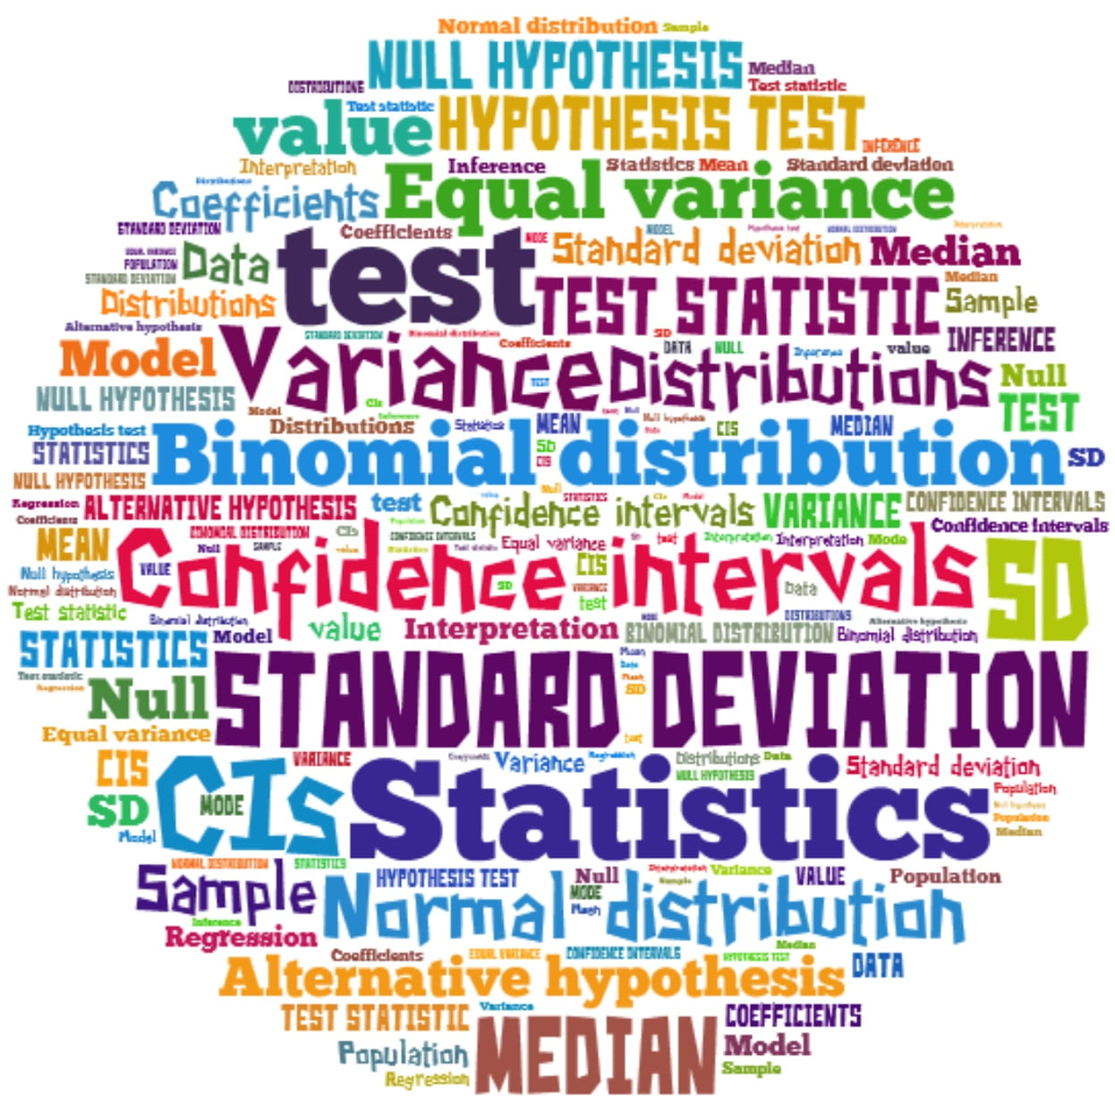
Thank You!

