Slide 1
Conditional Restricted Mean Survival
Time
John Lawrence
Collaborators:
Junshan Qiu, Ennan Gu, Dali Zhou, Steven Bai & H. M. James Hung
* The views expressed are those of the authors and not necessarily those of the U.S. Food and Drug Administration.

Slide 2
Background
The idea of Restricted Mean Survival Time (RMST) goes back to Irwin (1949) and is further implemented in survival analysis by Uno et al. (2014).
RMST is defined as the area under the survival curve up to t*, which should be pre-specified for a randomized trial.
RMST for a CV outcome may be loosely described as the event free expectancy over the restricted period between randomization and a defined, clinically relevant time horizon, called t*.
Notes:
RMST for a CV outcome may be loosely described as the event free expectancy over the restricted period between randomization and a defined, clinically relevant time horizon, called t*.

Slide 3

The Darth Vader rule
Muldowney, Ostaszewski, and Wojdowski (2012)

Slide 4
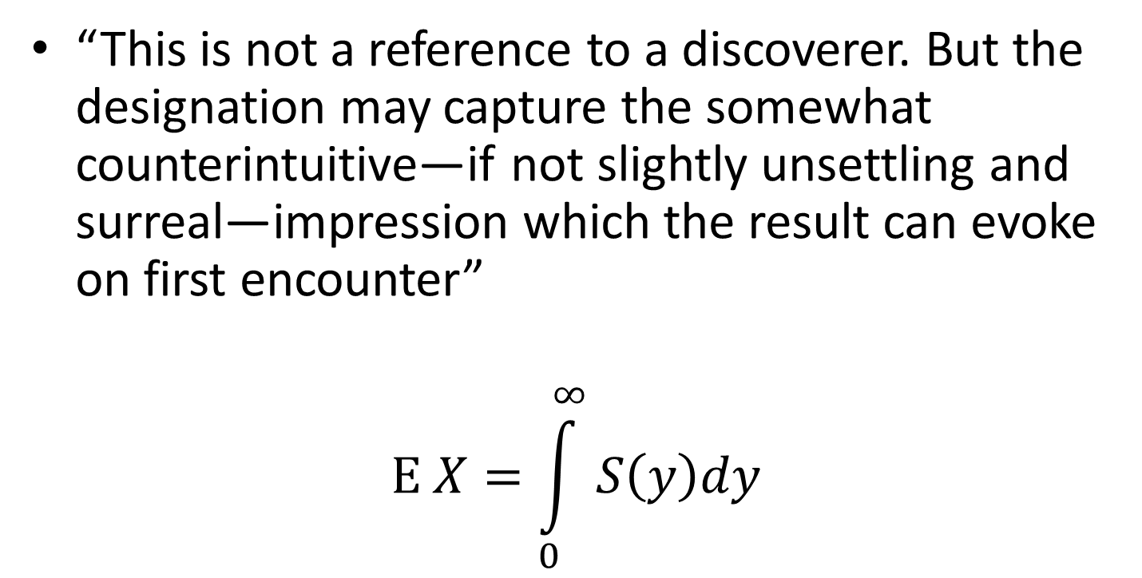
The Darth Vader rule
“This is not a reference to a discoverer. But the designation may capture the somewhat counterintuitive—if not slightly unsettling and surreal—impression which the result can evoke on first encounter”
$$\text{E} X=\int_{0}^{∞}{S\left(y\right)dy}$$

Slide 5
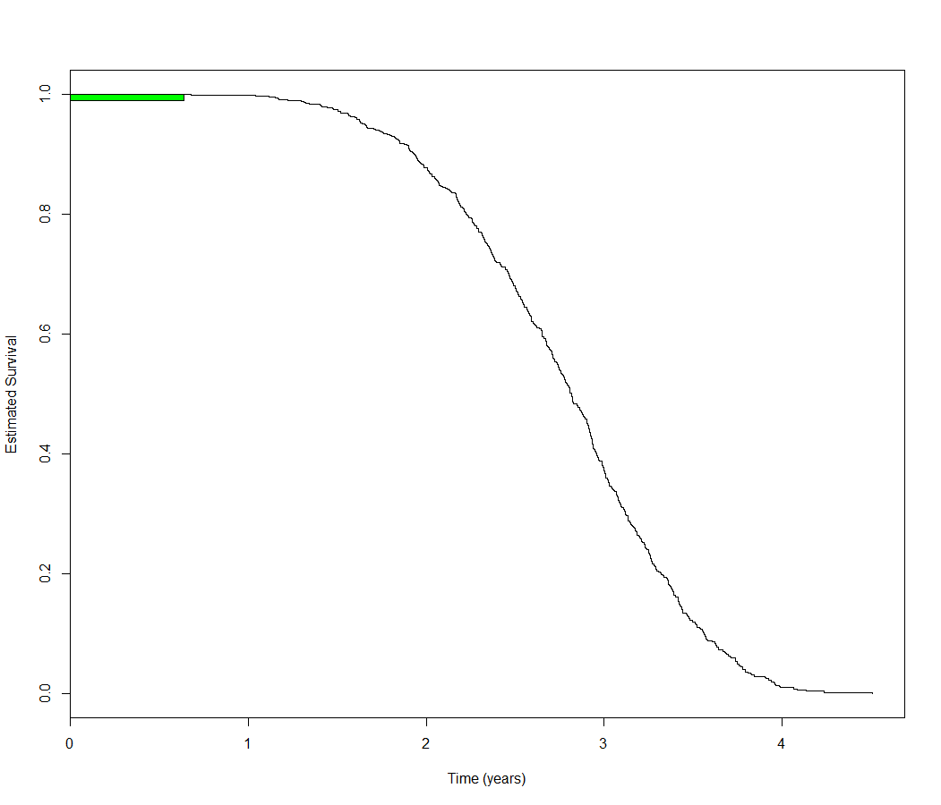
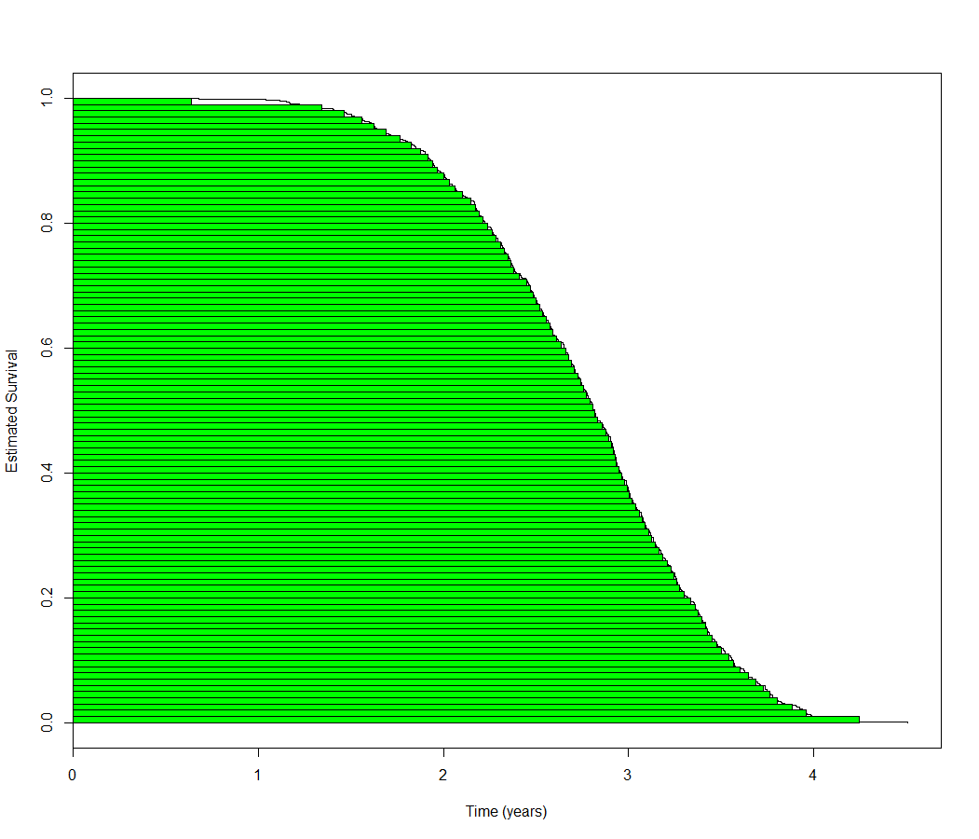
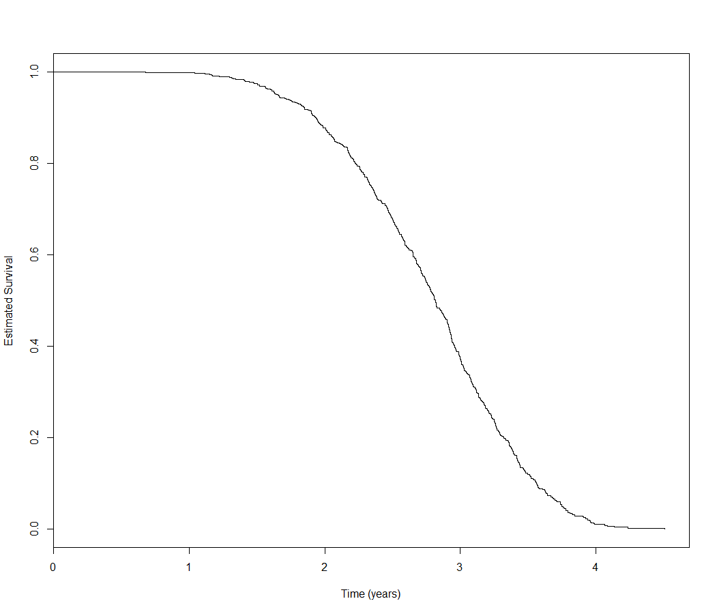
Mean as Area Under Curve
Notes:
The main goal of Case I is to assess the effect of prevention of CV events with Drug A vs. placebo.
Primary endpoint: a composite of cardiovascular events.
Although the survival plots show a jump in separation of the two curves, a better indication of proportionality might be gained by log-log survival plots. That is, the proportionality is transformed into equal distance between the two curves across the time.

Slide 6
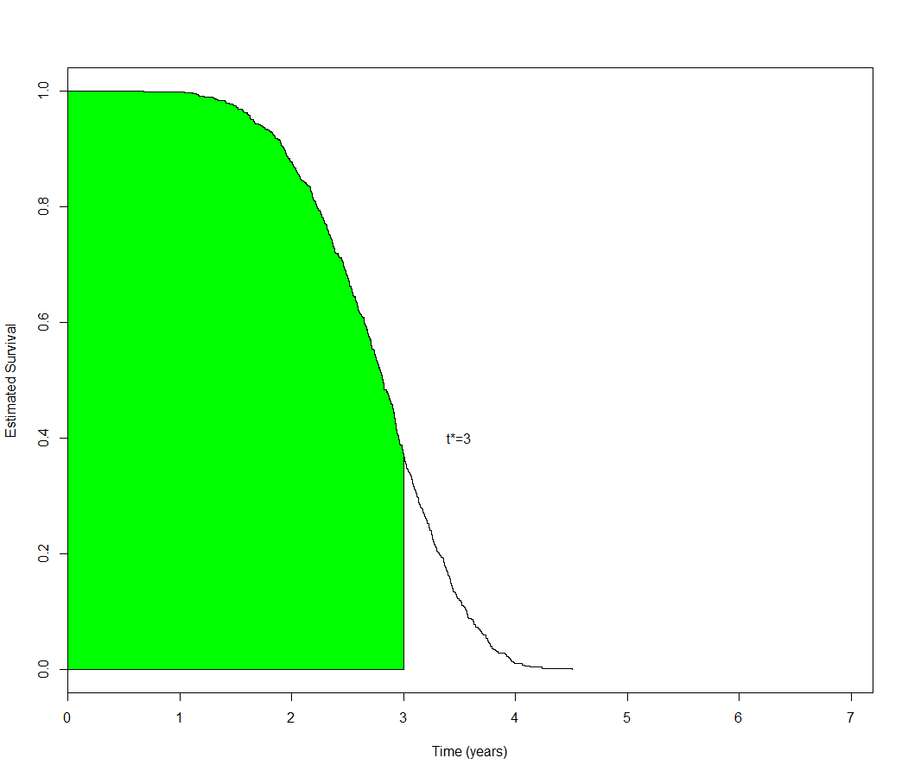
RMST as Area Under Curve
Notes:
The main goal of Case I is to assess the effect of prevention of CV events with Drug A vs. placebo.
Primary endpoint: a composite of cardiovascular events.
Although the survival plots show a jump in separation of the two curves, a better indication of proportionality might be gained by log-log survival plots. That is, the proportionality is transformed into equal distance between the two curves across the time.

Slide 7
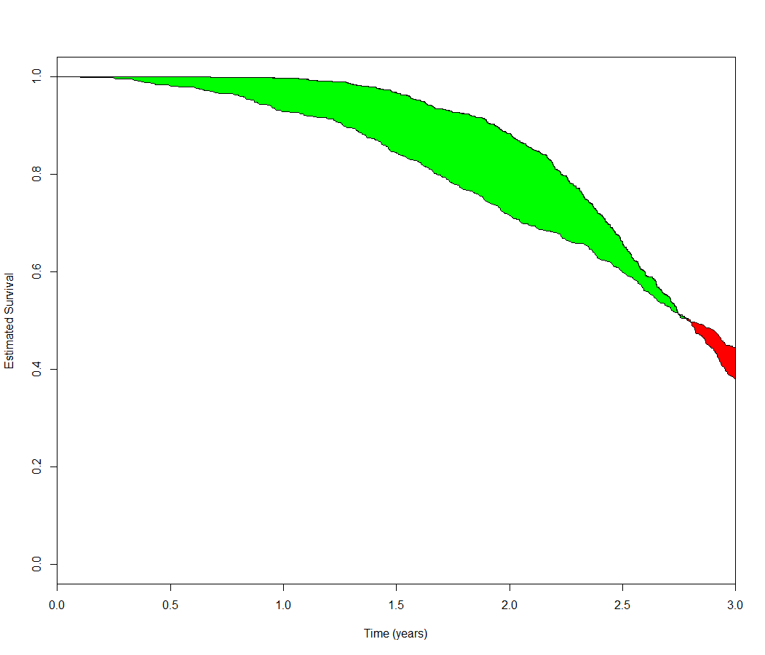
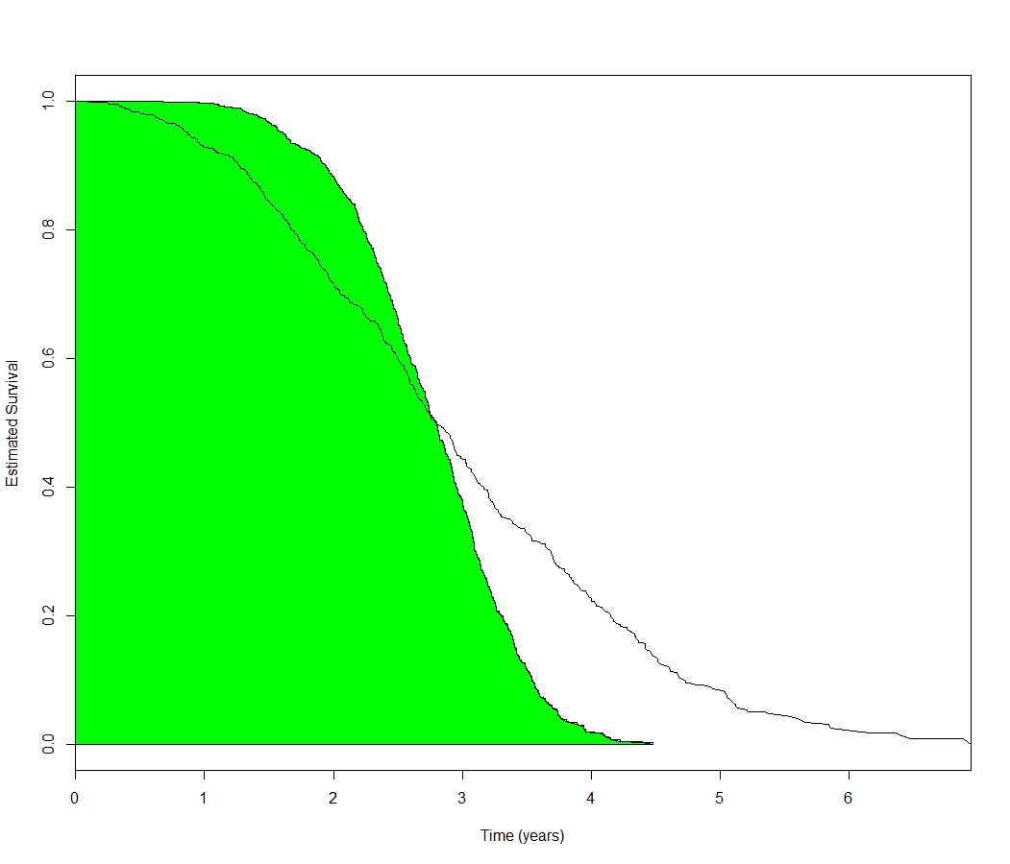
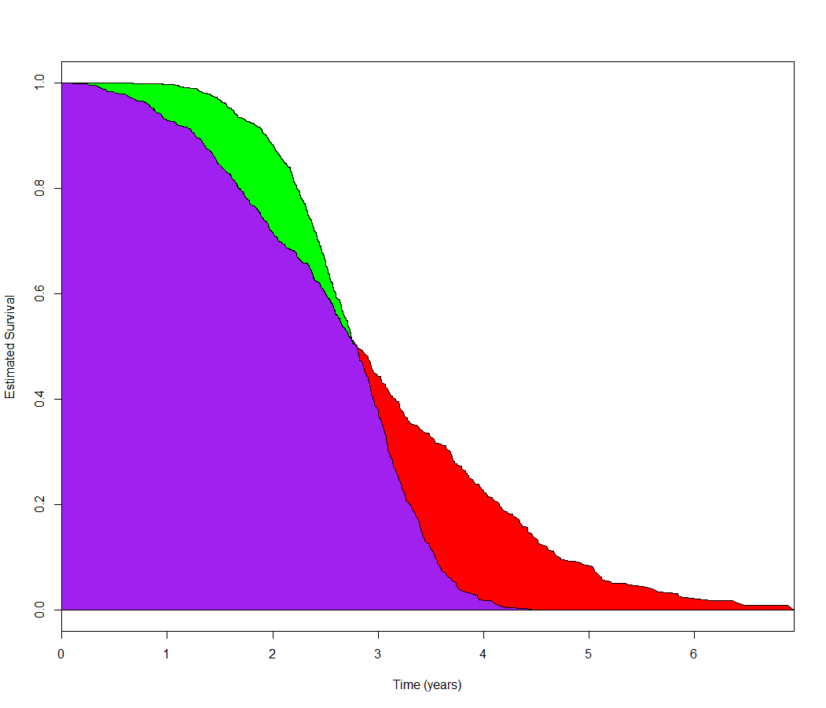
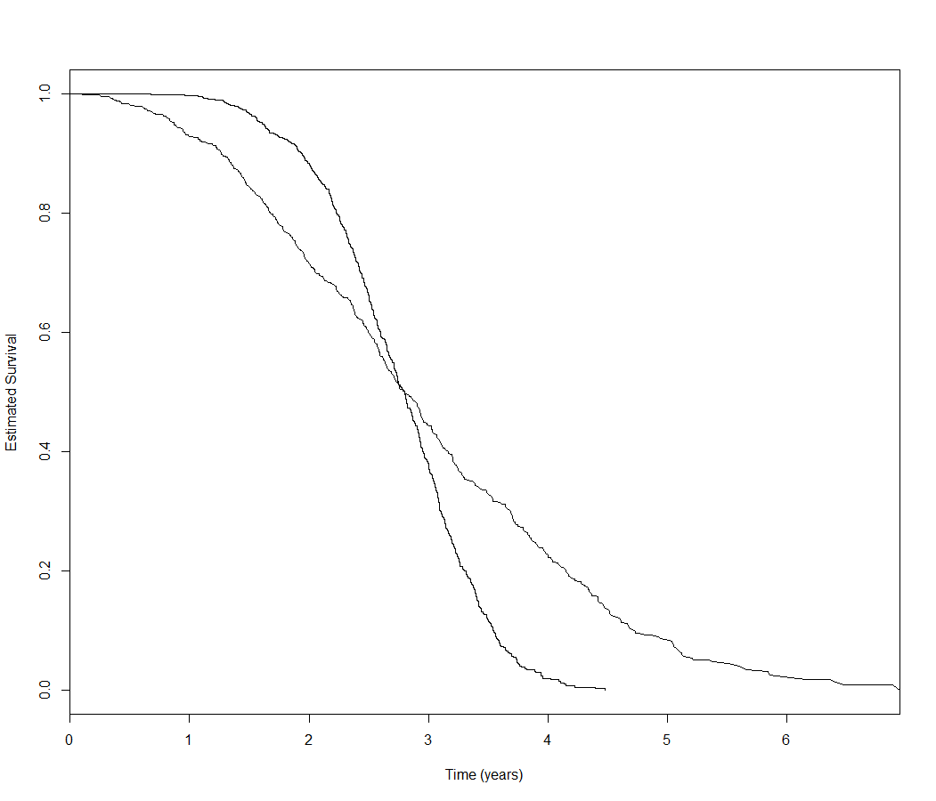
Difference in RMST
Notes:
The main goal of Case I is to assess the effect of prevention of CV events with Drug A vs. placebo.
Primary endpoint: a composite of cardiovascular events.
Although the survival plots show a jump in separation of the two curves, a better indication of proportionality might be gained by log-log survival plots. That is, the proportionality is transformed into equal distance between the two curves across the time.

Slide 8
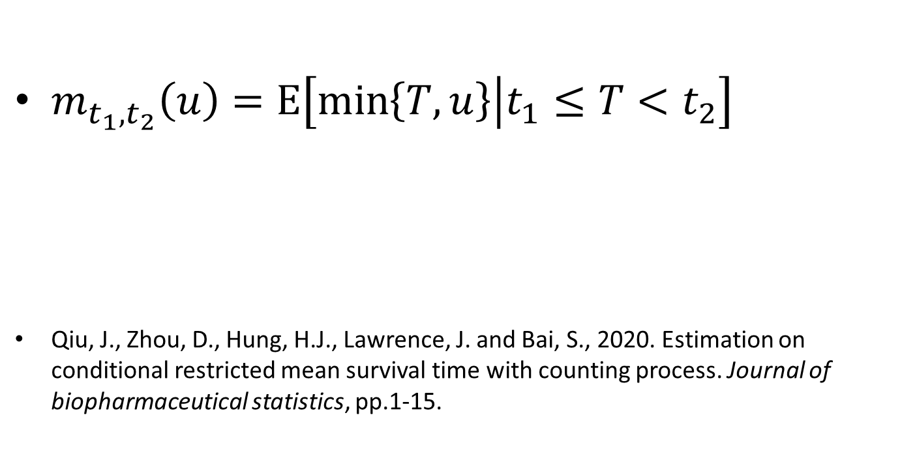
Conditional Restricted Mean Survival
$m_{t_{1},t_{2}}\left(u\right)=\text{E}\left[\min\left\{T,u\right\}\left|t_{1}≤T<t_{2}\right.\right]$
Qiu, J., Zhou, D., Hung, H.J., Lawrence, J. and Bai, S., 2020. Estimation on conditional restricted mean survival time with counting process. Journal of biopharmaceutical statistics, pp.1-15.

Slide 9
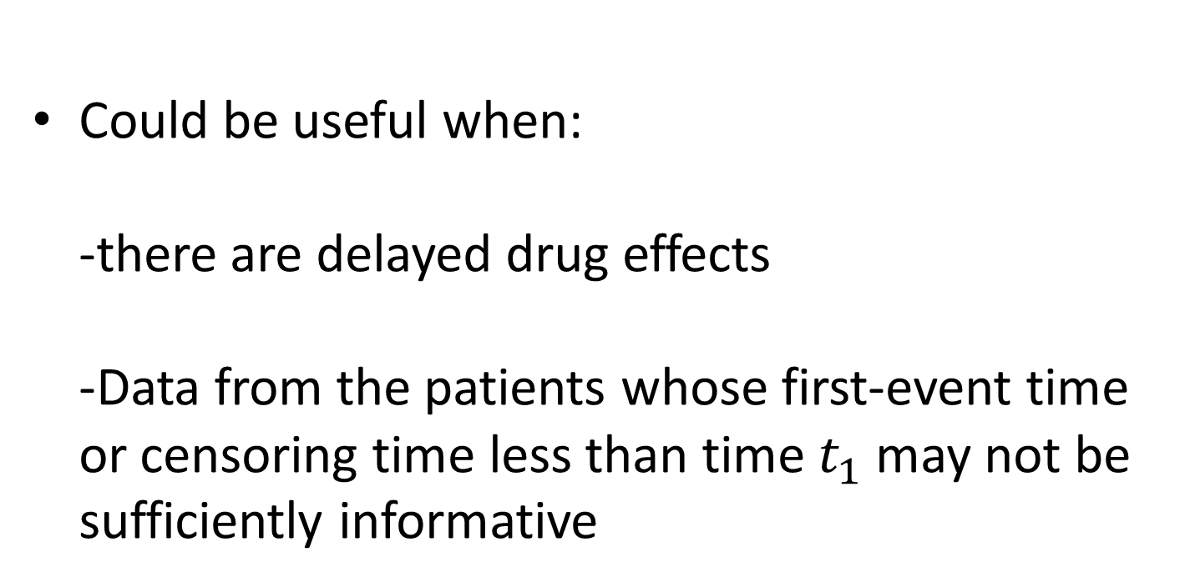
Conditional Restricted Mean Survival
Could be useful when:
-there are delayed drug effects
-Data from the patients whose first-event time or censoring time less than time $t_{1}$may not be sufficiently informative

