Slide 1
Prospective Study Plan for Combining Multiple Real-World Data Sources
Xiwu Lin¹, Hui Quan², and Gang Li¹
¹Janssen Pharmaceutical R&D
²Sanofi
September 25, 2020

Slide 2
Background
Individual real world data (RWD) sources may not have adequate sample sizes to address resaerch questions; it is necessary to combine multiple RWD data sources for the analysis
However, IP data from different European countries may not be simultaneously accessible due to privacy policies
  Summary data is provided by each data owner for the researcher
  The final analysis combines summary data of individual dataset
This presentation proposes a prospective plan to
  Establish a standard process for patient selection and endpoint derivation, for comparability of study and control cohorts in baseline covariates
  Generate summary statistics consistently across all data sources
  Utilize the matching adjusted indirect comparison (MAIC) method to adjust the distribution of baseline covariates to that of a target population

Slide 3
Prospective Study Plan for Combining RWD Sources
Select patients consistently for all data sources to ensure the balance of a predetermined set of covariates/ confounders; study endpoints, e.g., a time to event endpoint; compute the summary statistic for these covariates.
Decide a target population (may be one of the RWE or weighted population)
Apply the matching adjusted indirect comparison (MAIC) method to estimate the weights for the patients in each data source such that the weighted mean of all data source matching the mean of the target population
Apply the estimated weights to each data source to conduct weighted analysis for estimating the treatment effect within each data source
Combine the results using meta-analysis

Slide 4
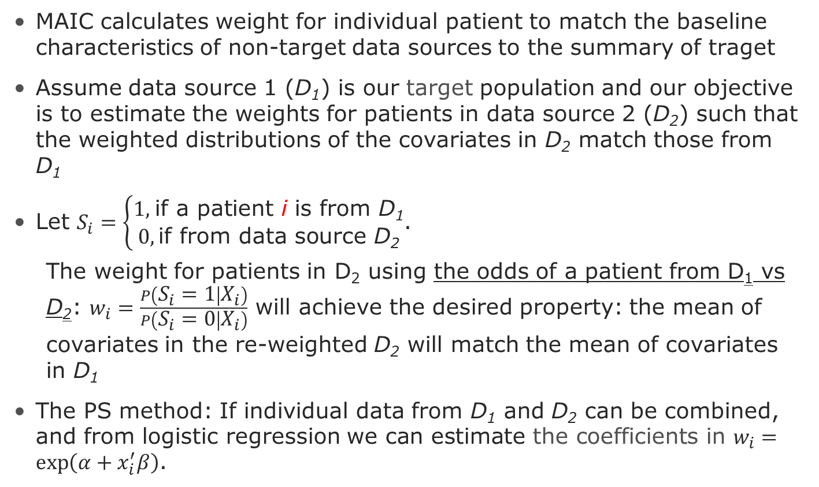
Matching adjusted indirect comparison (MAIC)
MAIC calculates weight for individual patient to match the baseline characteristics of non-target data sources to the summary of traget
Assume data source 1 (D₁) is our target population and our objective is to estimate the weights for patients in data source 2 (D₂) such that the weighted distributions of the covariates in D₂ match those from D₁
Let $S_{i}=\left\{\begin{aligned}1\text{, }\text{if} \text{a} \text{patient} \text{i} \text{is} \text{from} \text{D}\text{1} \\ 0, \text{if} \text{from} \text{data} \text{source} \text{D}\text{2}\end{aligned}\right.$.
  The weight for patients in D₂ using the odds of a patient from D₁ vs D₂: $w_{i}=\frac{P\left(S_{i}=1 | X_{i}\right)}{P\left(S_{i}=0 | X_{i}\right)}$ will achieve the desired property: the mean of covariates in the re-weighted D₂ will match the mean of covariates in D₁
The PS method: If individual data from D₁ and D₂ can be combined, and from logistic regression ${\text{we} \text{can} \text{estimate} \text{the} \text{coefficients} \text{in} w}_{i}=\exp\left(α+x_{i}^{′}β\right)$.

Slide 5
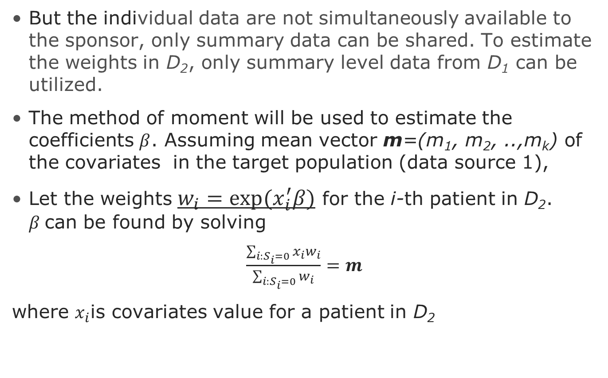
Matching adjusted indirect comparison (MAIC) method to estimate the weights
But the individual data are not simultaneously available to the sponsor, only summary data can be shared. To estimate the weights in D₂, only summary level data from D₁ can be utilized.
The method of moment will be used to estimate the coefficients $β$. Assuming mean vector m=(m₁, m₂, ..,m_{k}) of the covariates in the target population (data source 1),
Let the weights $w_{i}=exp(x_{i}^{′}β)$ for the i-th patient in D₂. $β$can be found by solving
$\frac{\sum_{i:S_{i}=0}{x_{i}w_{i}}}{\sum_{i:S_{i}=0}{w_{i}}}=m$
where $x_{i}$is covariates value for a patient in D₂

Slide 6
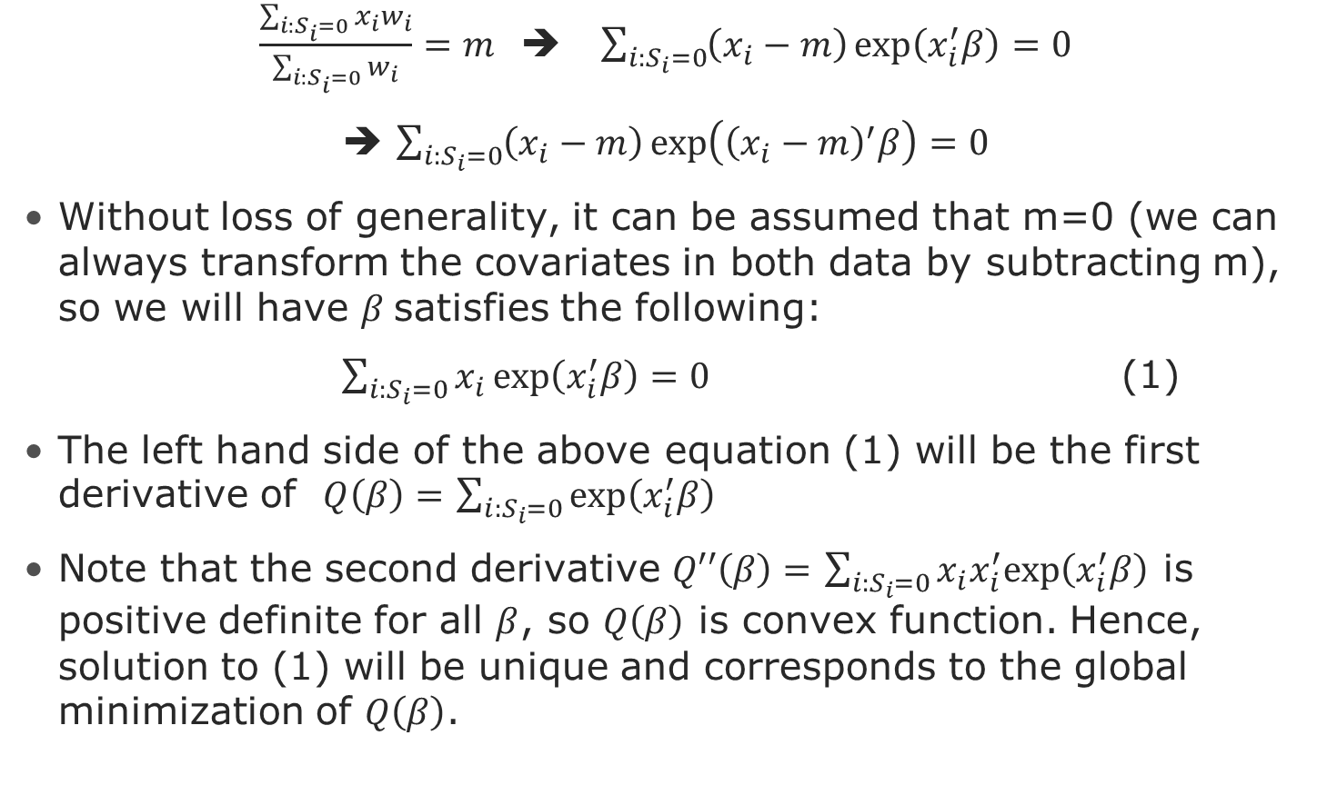

Estimating $β$using method of moment
$\frac{\sum_{i:S_{i}=0}{x_{i}w_{i}}}{\sum_{i:S_{i}=0}{w_{i}}}=m$ ➔ $\sum_{i:S_{i}=0}{\left(x_{i}−m\right)\exp\left(x_{i}^{′}β\right)=0}$
➔ $\sum_{i:S_{i}=0}{\left(x_{i}−m\right)\exp\left({\left(x_{i}−m\right)}^{′}β\right)=0}$
Without loss of generality, it can be assumed that m=0 (we can always transform the covariates in both data by subtracting m), so we will have $β$satisfies the following:
$\sum_{i:S_{i}=0}{x_{i}\exp\left(x_{i}^{′}β\right)=0}$ (1)
The left hand side of the above equation (1) will be the first derivative of $Q\left(β\right)=$ $\sum_{i:S_{i}=0}{\exp\left(x_{i}^{′}β\right)}$
Note that the second derivative $Q′′\left(β\right)=$ $\sum_{i:S_{i}=0}{x_{i}x_{i}^{′}exp\left(x_{i}^{′}β\right)}$ is positive definite for all $β$, so $Q\left(β\right)$ is convex function. Hence, solution to (1) will be unique and corresponds to the global minimization of $Q\left(β\right)$.

Slide 7
Apply MAIC to adjust analysis results
Select patients consistently for all data sources to ensure the balance of a predetermined set of covariates/ confounders; study endpoints, e.g., a time to event endpoint; compute the summary statistic for these covariates.
Decide a target population (may be one of the RWE or weighted population)
Apply the matching adjusted indirect comparison (MAIC) method to estimate the weights for the patients in each data source such that the weighted mean of all data source matching the mean of the target population (Data owner/ Sponsor)
Apply the estimated weights to each data source to conduct weighted analysis for estimating the treatment effect within each data source (Data owner/ Sponsor)
Combine the summary results using meta-analysis (Sponsor)

Slide 8
Illustrative example
Three data sources, Data I, II and III
Same protocol, including patient selection algorithm and endpoint derivation, has been applied to each data source to analysis data
  Two treatment arms
  Time to event (relapse)
We have IP data so we can compare results from the 2 weighting methods MAIC and PS

Slide 9
Summary of covariate with MAIC weights
using Data I as the target population
Variable | Target Population |  | Data II |  |  |  | Data III
 | Data I |  | Before weighting |  | After weighting |  | Before weighting |  | After weighting
 | Mean | SD | Mean | SD | Mean | SD | Mean | SD | Mean | SD
Length of Stable | 9.18 | 9.34 | 7.65 | 8.85 | 9.18 | 11 | 10.4 | 10.6 | 9.18 | 7.73
Age | 37.6 | 11.99 | 33.6 | 15 | 37.6 | 16.2 | 49.2 | 12.5 | 37.6 | 10.2
Elixhauser score | 3.22 | 2.34 | 3.17 | 2.14 | 3.22 | 2.3 | 3.99 | 2.64 | 3.22 | 2.36
CCI score | 0.7 | 1.4 | 0.54 | 1.11 | 0.7 | 1.34 | 1.3 | 2.05 | 0.7 | 1.35
Gender (Female) | 0.34 |  | 0.33 |  | 0.34 |  | 0.6 |  | 0.34
Low dose | 0.17 |  | 0.23 |  | 0.17 |  | 0.2 |  | 0.17
Med dose | 0.41 |  | 0.39 |  | 0.41 |  | 0.35 |  | 0.41
High dose | 0.42 |  | 0.38 |  | 0.42 |  | 0.45 |  | 0.42
Bipolar | 0.28 |  | 0.36 |  | 0.28 |  | 0.27 |  | 0.28
Depression | 0.25 |  | 0.38 |  | 0.25 |  | 0.23 |  | 0.25

Slide 10
Summary of covariate with PS weights using Data I as the target population
Variable | Data I (target) |  | Data II |  |  | Data III
 | Mean | SD | Mean | SD | Absolute Standardized difference (vs Data I) | Mean | SD | Absolute Standardized difference (vs Data I)
Length of Stable | 9.18 | 9.34 | 11.43 | 13.33 | 0.20 | 8.80 | 8.14 | 0.04
Age | 37.56 | 11.99 | 41.35 | 16.8 | 0.26 | 40.10 | 11.53 | 0.22
Elixhauser score | 3.22 | 2.34 | 3.39 | 2.42 | 0.07 | 3.62 | 2.47 | 0.16
CCI score | 0.7 | 1.4 | 0.89 | 1.5 | 0.13 | 0.83 | 1.47 | 0.09
Gender (Female) | 0.34 |  | 0.45 |  | 0.22 | 0.50 |  | 0.34
Low dose | 0.17 |  | 0.17 |  | 0.01 | 0.16 |  | 0.02
Med dose | 0.41 |  | 0.42 |  | 0.01 | 0.40 |  | 0.03
High dose | 0.42 |  | 0.41 |  | 0.00 | 0.44 |  | 0.04
Bipolar | 0.28 |  | 0.27 |  | 0.01 | 0.30 |  | 0.03
Depression | 0.25 |  | 0.21 |  | 0.09 | 0.30 |  | 0.10

Slide 11
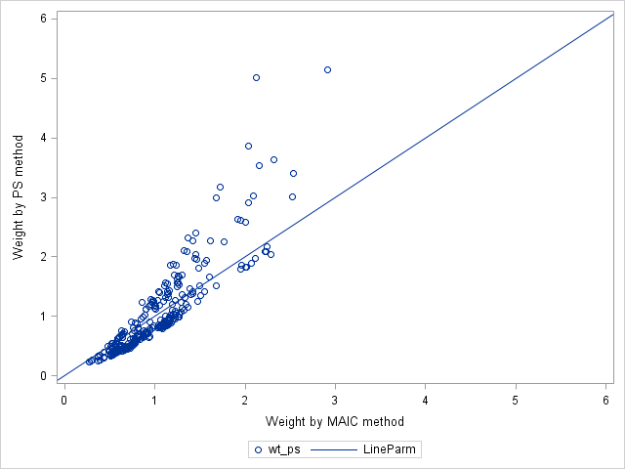
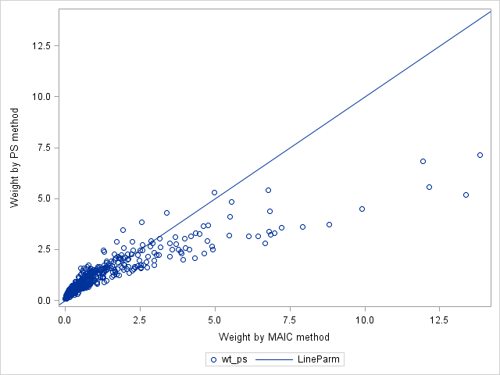
Estimated MAIC and PS weights are highly correlated
(Target Population: Data I)
PS vs MAIC of individual patients
Data II
Data III
r=.89
r=.91

Slide 12
Results of analysis using Data I as the Target population
Use summary of baseline characteristics of target to calculate MAIC and produce adjusted results
Hazard ratios between two arms for time to relapse
Data sources | Hazard ratio (95% C.I.)
 | Original | MAIC method | PS method
Data I | 0.572(0.479,0.683)
Data II | 0.456(0.224,0.926) | 0.452(0.211,0.966) | 0.415(0.183,0.942)
Data III | 0.626(0.411,0.952) | 0.718(0.325,1.584) | 0.629(0.355,1.113)
Meta analysis (fixed effect) | 0.573(0.488, 0.672) | 0.571(0.482, 0.676) | 0.569(0.482, 0.672)

Slide 13
Discussion
The MAIC and PS weights are similar, when PS achieves good covariate balancing.
Analysis results from MAIC and PS are similar in most situations.
A likelihood approach can be implemented to recover the information without using the individual patient data when the number of covariates is small.
With MAIC, the sponsor can conduct a pooled analysis based on summary statistics from the data owners, without simultaneous access IP data souces

Slide 14
References
Signorovitch et al (2010), Comparative effectiveness without head to head trials: a method for matching-adjusted indirect comparisons applied to psoriasis treatment with ada

