Slide 1
Extensions of the 2-in-1 Adaptive Design
Cong Chen*, Wen Li, and Qiqi Deng
*Executive Director and Head of Early Oncology Statistics, BARDS
Merck & Co., Inc., Kenilworth, NJ, USA
2020 ASA Biopharmaceutical Section Regulatory-Industry Workshop

Slide 2


Status Quo of Early-to-Late Transition in Oncology
A typical program tests a new drug combination with an approved IO in Phase 1 and intends to go directly to Phase 3 once encouraging signal is observed
Phase 1B
Phase 3

Slide 3
Options Post Phase 1B Efficacy Screening
Follow-up trials in those with a positive outcome
Go to Phase 3
Traditional Phase 2 with a separate Phase 3
Phase 2 with an option to expand to Phase 3 (2-in-1)
A small Phase 3 for AA
A large Phase 3 for FA
All data used in Phase 3 analysis

Slide 4

A Generic Statistically Seamless 2-in-1 Design
Y>w?
Keep as a Phase 2 trial
No
X>C?
Phase 2 trial
Yes
Expand to Phase 3
Z>w?
The 3 endpoints that the standardized test statistics are based upon can be different
  The expansion bar C is prespecified and binding
No penalty for multiplicity control as long as ρ_{XY}≥ρ_{XZ} (automatically holds when Phase 2 endpoint is also used for expansion decision-making)
  w=1.96 to keep alpha controlled at 2.5% (test Phase 2 at higher level if not for registration)
Chen C, et al. Contemp Clin Trials. 2018;64:238-242.

Slide 5

Extensions
Multiple Adaptive Decisions Overtime
Multiple Cutpoints at Same Time
Application of Group Sequential Method
Multiple Intermediate Endpoints for Expansion Decision
Multiple Clinical Endpoints
Keep overall Type I error under control under least assumptions
David Slepian 1923-2007
Chen C, Li W, and Deng Q. Extensions of the 2-in-1 design. Contemp Clin Trials 2020.

Slide 6
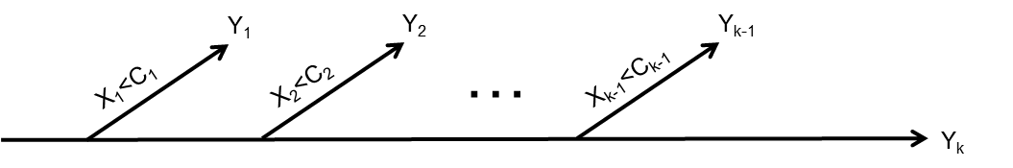
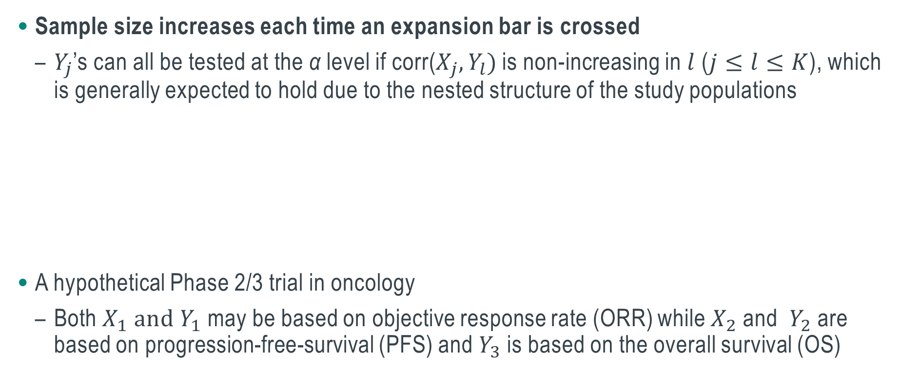
Multiple Adaptive Decisions Overtime
Sample size increases each time an expansion bar is crossed
  $Y_{j}$’s can all be tested at the α level if corr(${X_{j}, Y}_{l})$ is non-increasing in $l$ ($j≤l≤K$), which is generally expected to hold due to the nested structure of the study populations
A hypothetical Phase 2/3 trial in oncology
  Both $X_{1}{ and Y}_{1}$ may be based on objective response rate (ORR) while $X_{2}$ and ${ Y}_{2}$ are based on progression-free-survival (PFS) and $Y_{3}$ is based on the overall survival (OS)

Slide 7
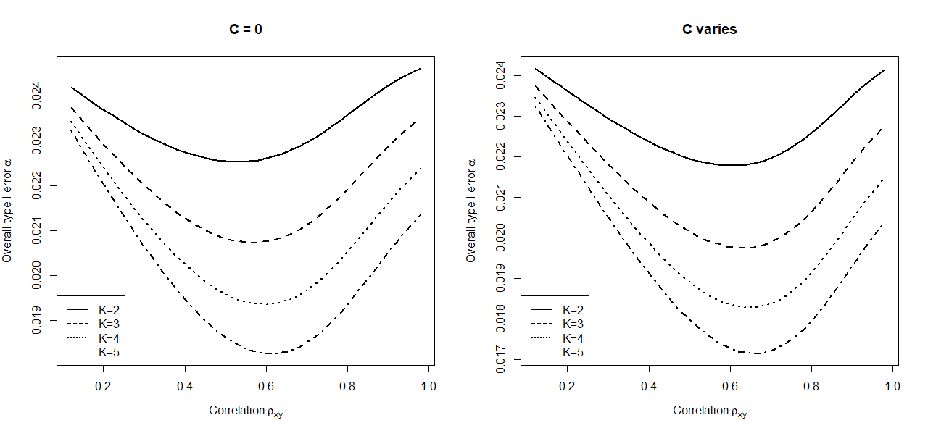
Illustration of Type I Error Control
Overall Type I error tends to decrease with K
Two test statistics $(X_{i}{, Y}_{j})$ have a constant correlation $ρ_{XY}$

Slide 8
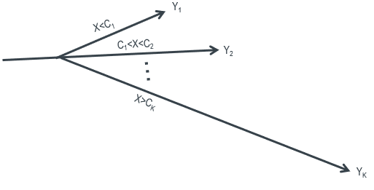
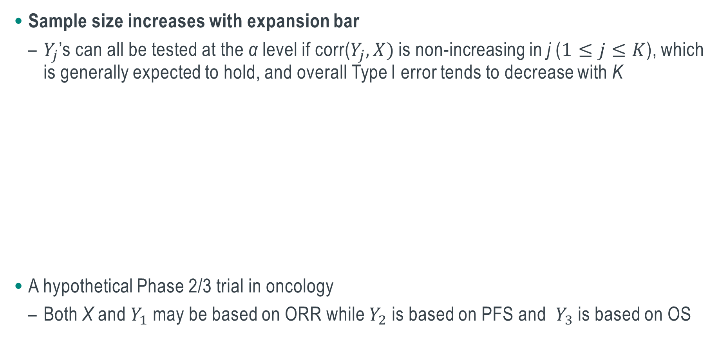
Multiple Cutpoints at Same Time
Sample size increases with expansion bar
  $Y_{j}$’s can all be tested at the α level if corr($Y_{j},X)$ is non-increasing in j ($1≤j≤K$), which is generally expected to hold, and overall Type I error tends to decrease with K
A hypothetical Phase 2/3 trial in oncology
  Both X and $Y_{1}$ may be based on ORR while $Y_{2}$ is based on PFS and ${ Y}_{3}$is based on OS

Slide 9
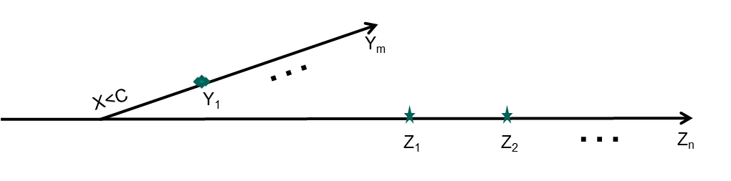
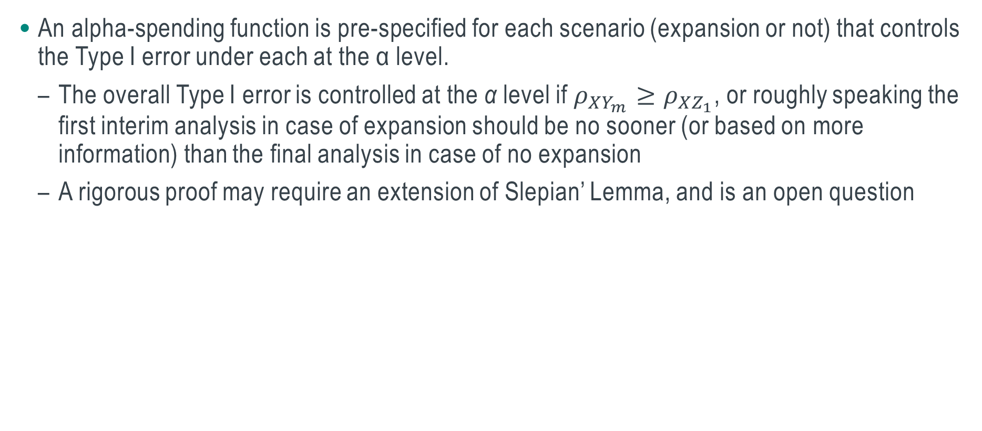
Group Sequential Design
An alpha-spending function is pre-specified for each scenario (expansion or not) that controls the Type I error under each at the α level.
  The overall Type I error is controlled at the α level if $ρ_{XY_{m}}≥ρ_{XZ_{1}}$, or roughly speaking the first interim analysis in case of expansion should be no sooner (or based on more information) than the final analysis in case of no expansion
  A rigorous proof may require an extension of Slepian’ Lemma, and is an open question

Slide 10
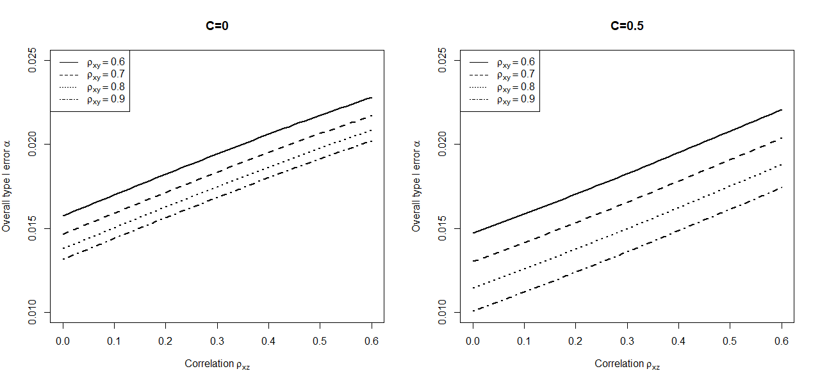
An Hypothetical Longitudinal Trial in Neuroscience
Overall Type I error with 3 interim analyses in case of expansion and with 2 otherwise
  O’Brien Fleming alpha-spending function is used for data monitoring in each scenario
  Primary endpoint is continuous whereas measurement at an early time point (X) is used for adaptive decision and at later timepoints (Y and Z) are for hypothesis testing

Slide 11
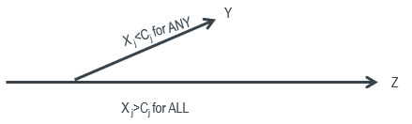
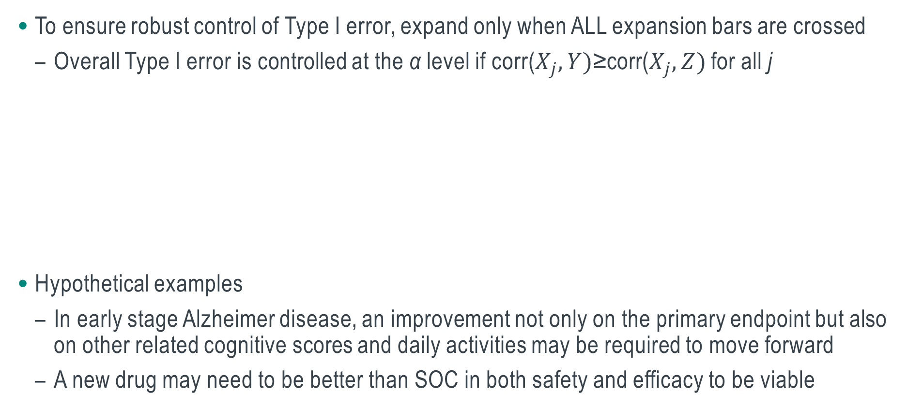
Multiple Intermediate Endpoints for Expansion Decision
To ensure robust control of Type I error, expand only when ALL expansion bars are crossed
  Overall Type I error is controlled at the α level if corr($X_{j}, Y)$≥corr($X_{j}, Z)$ for all j
Hypothetical examples
  In early stage Alzheimer disease, an improvement not only on the primary endpoint but also on other related cognitive scores and daily activities may be required to move forward
  A new drug may need to be better than SOC in both safety and efficacy to be viable

Slide 12
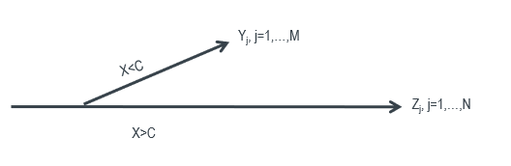
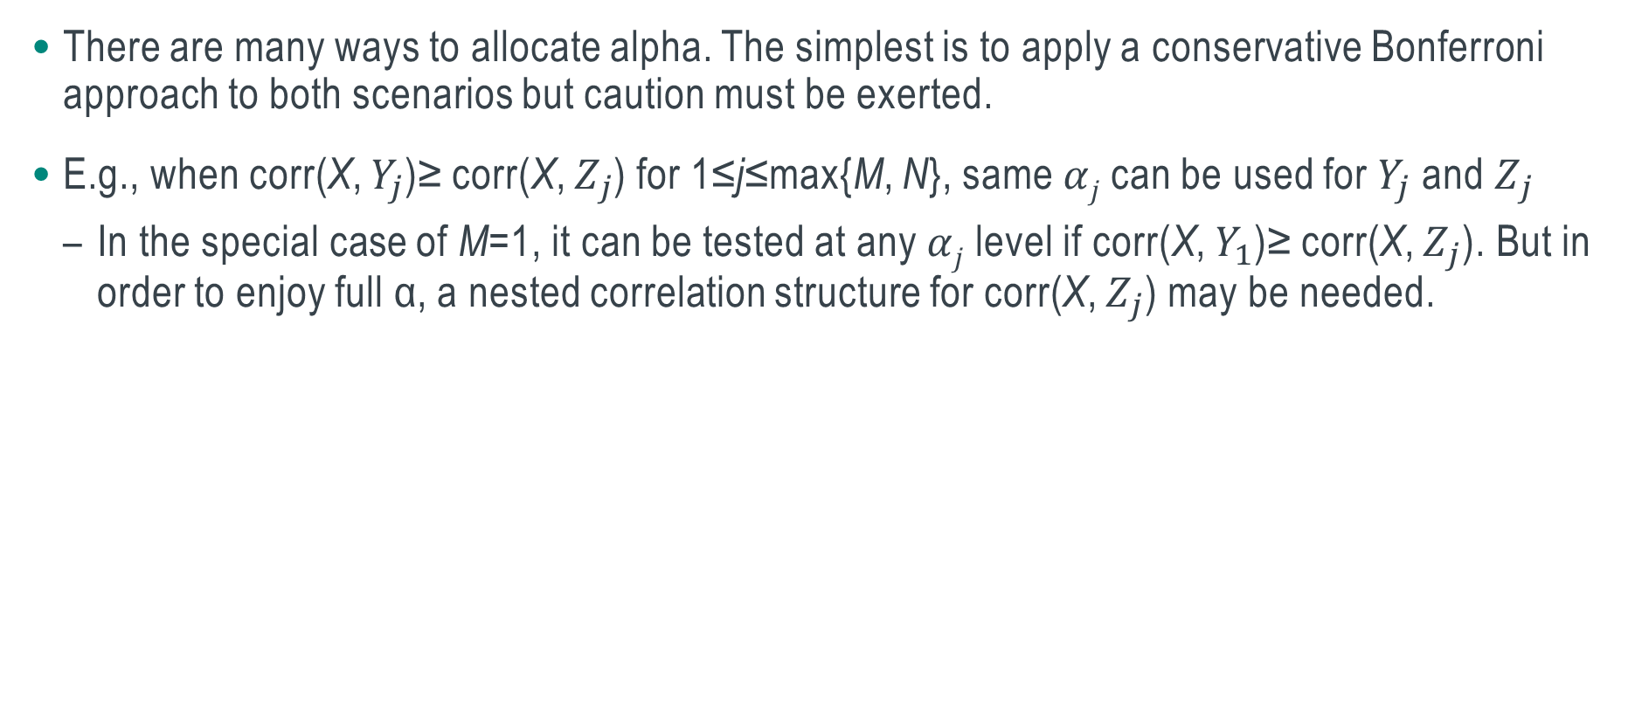
Multiple Clinical Endpoints
There are many ways to allocate alpha. The simplest is to apply a conservative Bonferroni approach to both scenarios but caution must be exerted.
E.g., when corr(X, $Y_{j}$)≥ corr(X, $Z_{j}$) for 1≤j≤max{M, N}, same $αj$can be used for $Y_{j}$ and $Z_{j}$
  In the special case of M=1, it can be tested at any $αj$ level if corr(X, $Y_{1}$)≥ corr(X, $Z_{j}$). But in order to enjoy full α, a nested correlation structure for corr(X, $Z_{j}$) may be needed.

Slide 13
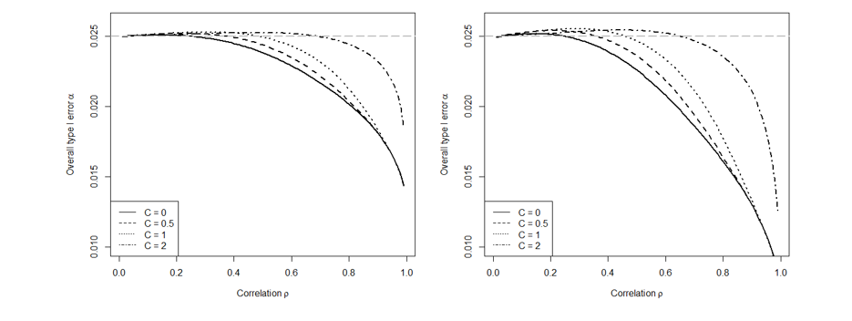
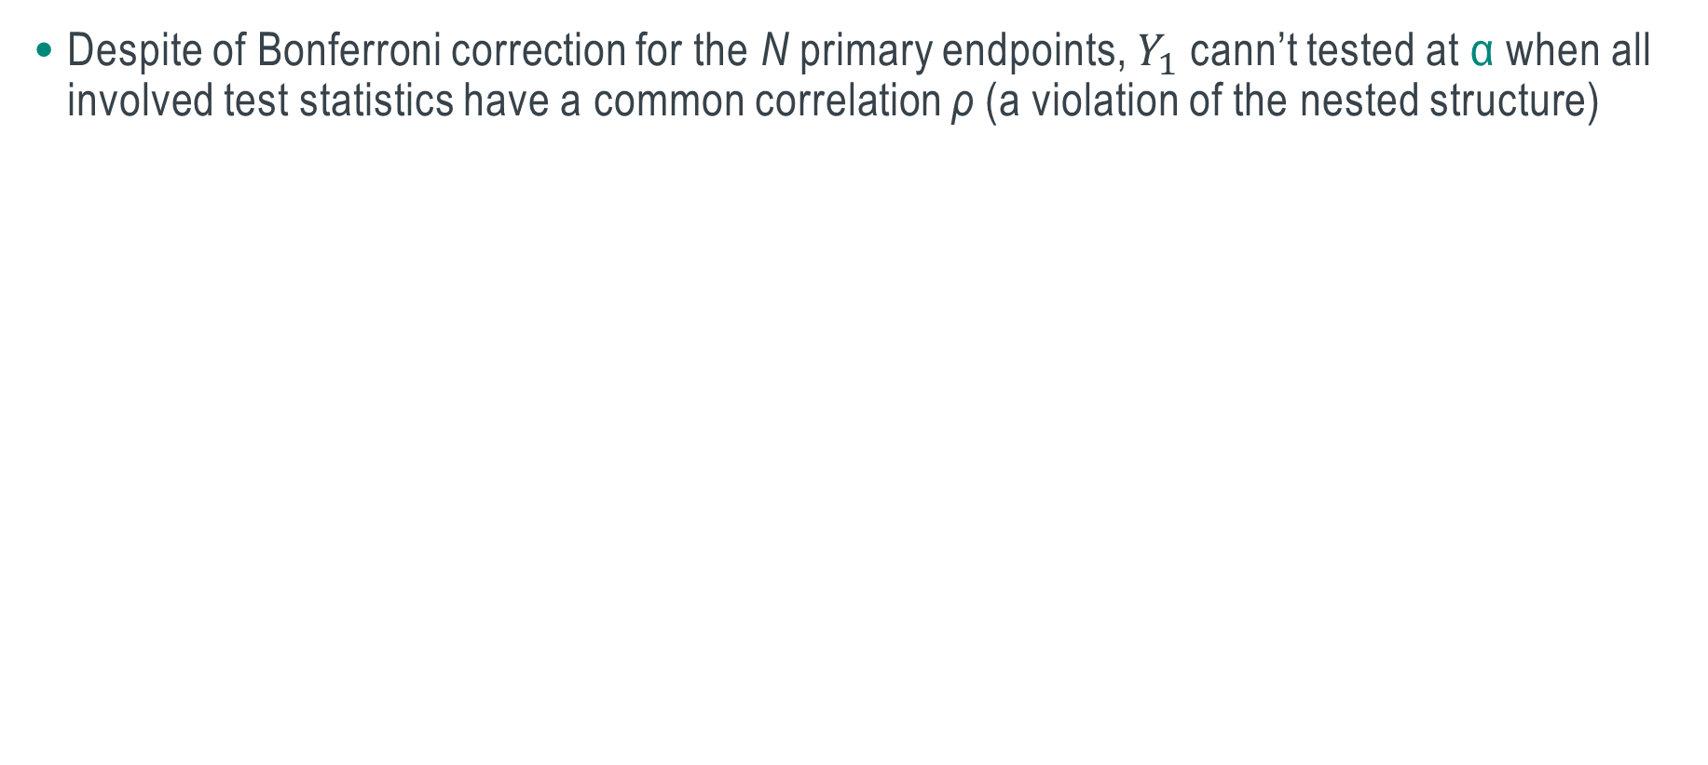
Illustration of a Counter Example Against Full α under M=1
Despite of Bonferroni correction for the N primary endpoints, $Y_{1}$cann’t tested at α when all involved test statistics have a common correlation ρ (a violation of the nested structure)
N=2
N=4

Slide 14
Discussions
The designs are devised under minimum assumptions to remain robust and conservative
  In practice, some of the conditions may be relaxed and more alpha may be recouped
  Graphical approach may be incorporated to further improve the efficiency
  Validity of the designs hinges upon relationship of correlations among test statistics, which is expected to hold in general but may require examination otherwise
In practice, a clinical trial may contain a mixture of the extended features and other features
  Careful investigation may be needed to ensure Type I error control
A decision of no expansion is not the same as termination of futility
  When it comes to deciding the expansion bars, both statistical operating characteristics and risk-adjusted cost-effectiveness should be considered.

Slide 15


