Slide 1
Statistical Review of Gene Therapies for Rare Diseases
Xue Lin, PhD
Office of Biostatistics and Epidemiology (OBE)
Center for Biologics Evaluation and Research (CBER)
US Food and Drug Administration
2020 ASA Biopharmaceutical section regulatory-industry statistics workshop virtual presentation
xue.lin@fda.hhs.gov
Disclaimer: This presentation reflects views of the presenter and should not be construed to represent the view or policies of US FDA

Slide 2
Outline
Background
Two case studies
Summary and discussion

Slide 3
Background: rare diseases (1)
The Orphan Drug Act of 1983 defines a rare disease or condition as one affecting fewer than 200,000 subjects in the US
The National Institutes of Health (NIH) reports that there are approximately 7,000 rare diseases affecting more than 25 million Americans. Approximately 80% of them are caused by a single-gene defect, and about half of all rare diseases affect children
Many of these diseases are serious and life-threatening and most of them do not have approved therapies, there remains a significant unmet medical need for effective treatments

Slide 4
Background: rare diseases (2)
  Challenges for rare diseases product development
  The patient populations can be heterogeneous: difficulties in identification of suitable patients for recruitment in clinical trials that are conducted to support product licensure
  Limited clinical and biological understanding of many rare diseases: difficult to set clinical endpoints or identify surrogate endpoints for clinical trials
  Patients may include sensitive subpopulations such as children or patients with co-morbidities: additional ethical considerations arise when conducting clinical trials

Slide 5
Background: gene therapies (1)
Center for Biologics Evaluation and Research (CBER) at FDA regulates a variety of biological products including gene therapy products
FDA’s guidance has defined human gene therapy products as all products that mediate their effects by transcription or translation of transferred genetic material or by specifically altering host (human) genetic sequences

Slide 6
Background: gene therapies (2)
Gene therapies require additional special considerations in trial design and assessment of safety and efficacy:
gene therapy administration cannot, and often does not need to be repeated and, in some cases, one dose can have a durable effect
due to their long-acting, sometimes possibly permanent effects, gene therapy recipients may be at increased risk of undesirable and unpredictable outcomes
FDA recommends long term follow-up for some gene therapy studies, depending on the product / vector type
In particular, for retroviral vector-based human gene therapy products, FDA requires strict testing to ensure absence of replication competent retrovirus during product manufacture and patient follow-up

Slide 7
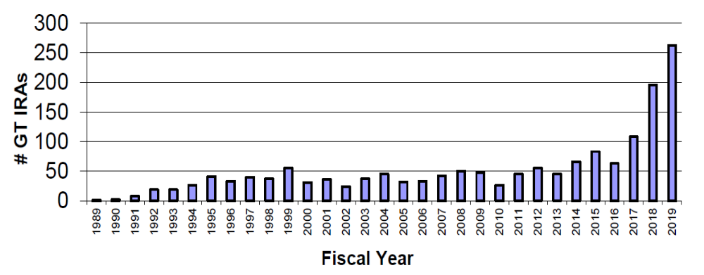
Background: gene therapies (3)
Gene Therapy INDs/IDEs Received FY89-FY19 through 9/30/19
Source: Gene Therapy, Somatic Cell Therapy, and Xenotransplantation IND/IDE Statistical Report, CBER, FDA

Slide 8
Background: gene therapies (4)
FDA granted biological licensure to four gene therapy products so far:
In August 2017, KYMRIAH®, a cell-based gene therapy, was approved for relapsed/refractory (r/r) pediatric and young adult B-cell precursor acute lymphoblastic leukemia (ALL)
In October 2017, YESCARTA®, also a cell-based gene therapy, was approved for the treatment of adults with r/r large B-cell lymphoma after two or more lines of systemic therapy
In December 2017, FDA approved LUXTURNA® for the treatment of vision loss due to confirmed biallelic RPE65 mutation-associated retinal dystrophy
In May 2019, ZOLGENSMA® was approved for the treatment of pediatric patients with infantile-onset spinal muscular atrophy (SMA) with confirmed biallelic mutations in the human survival motor neuron Type 1 (SMN1) gene

Slide 9
Background: gene therapies (5)
A common characteristic of all four approvals was that the clinical evidence to support the efficacy and safety of the products came from studies with a limited sample size
In addition, in three of the licensure applications (all but LUXTURNA®), the primary source of evidence to support the efficacy and safety of gene therapy products was derived from single-arm studies

Slide 10
Case studies: Case 1 KYMRIAH®
Indication: Patients up to 25 years of age with B-cell precursor acute lymphoblastic leukemia (ALL) that is refractory or in second or later relapse
Product: autologous T cells genetically modified ex vivo using a lentiviral vector encoding an anti-CD19 chimeric antigen receptor (CAR)
Administration: single intravenous infusion

Slide 11
Case study 1: KYMRIAH®
The primary source of evidence to support the initial approval was a Phase 2, single-arm, multicenter study
The primary efficacy endpoint: overall remission rate (ORR), which includes complete remission (CR) and complete remission with incomplete hematologic recovery (CRi), as assessed by an independent review committee during the 3 months after KYMRIAH® administration
The key secondary endpoint was the percentage of patients who achieved CR or CRi with a minimal residual disease (MRD) negative bone marrow during the 3 months after KYMRIAH® administration
The secondary efficacy endpoints included duration of remission (DOR) defined only for those who achieved CR or CRi (responders) and others

Slide 12
Case study 1: KYMRIAH®
For the efficacy analysis set including 63 subjects, a total of 52 subjects achieved a best overall response (BOR) of CR or CRi
This was an ORR of 82.5% (95% CI: 70.9%, 91.0%). Forty subjects (63%) achieved CR
All 52 subjects (100%) who achieved a BOR of CR or CRi had negative MRD when the status was initially achieved
The median follow-up time for DOR was 4.8 months (min=1.2, max= 14.1 months). Fewer than 50% of patients had experienced relapse or death at the time of product approval, so the median DOR was not estimated

Slide 13
Case study 1: KYMRIAH®
Although the summary statistics above provide certain critical pieces of information about the outcomes for patients in the study, there are many additional important details that are cumbersome to communicate in this way
As part of the regulatory statistical review of KYMRIAH®, we generated several graphical displays to compactly convey critical information about the study and to facilitate regulatory decision-making

Slide 14
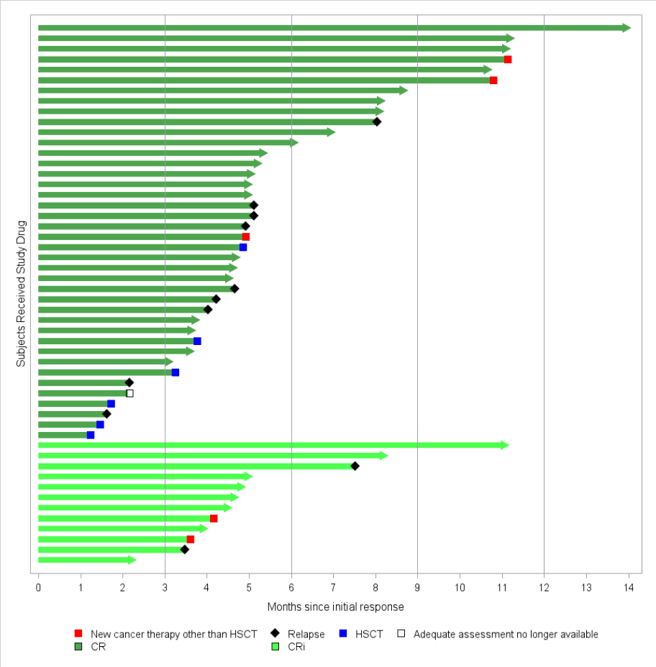
Swimmer plot of DOR

Slide 15
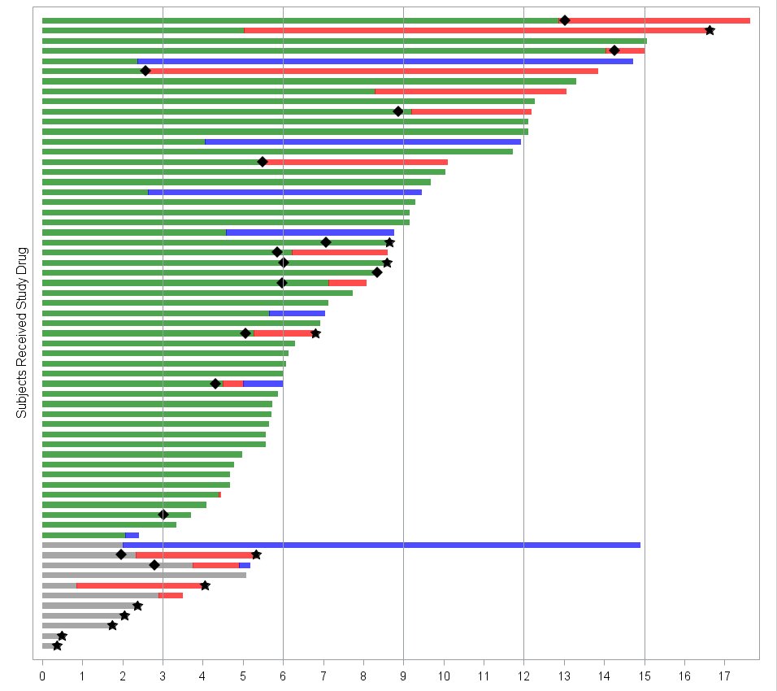
Swimmer plot of overall survival
Continued response
No response/unknown
New cancer therapy other than SCT
SCT
Relapsed disease
Death
Month since Kymriah infusion

Slide 16
Case Study 2: ZOLGENSMA®
Indication: pediatric patients less than 2 years of age with spinal muscular atrophy (SMA) with bi -allelic mutations in the survival motor neuron 1 (SMN1) gene
Product: adeno-associated virus serotype 9 expressing the human Survival Motor Neuron gene
Administration: single-dose intravenous infusion

Slide 17
Case study 2: ZOLGENSMA®
The primary source of evidence to support the Phase 1, open-label, single-infusion, single-center, dose-escalation clinical trial
Safety endpoint:
incidence of Grade III or higher, unanticipated, treatment-related toxicity.
Efficacy endpoint:
Permanent ventilation free survival, defined as time to death or until patient requires at least 16-hour per day of ventilation support for breathing for ≥14 consecutive days in the absence of an acute reversible illness, excluding perioperative use
Score change in CHOP-INTEND (Children’s Hospital of Philadelphia Infant Test of Neuromuscular Disorders) from baseline
Achievement of significant development milestones including but not limited to the ability to sit alone and roll over unassisted

Slide 18
Case study 2: ZOLGENSMA®
Fifteen (15) subjects were enrolled, and 3 subjects were treated at the low dose of 6.7 X 10^13 vg/kg (Cohort 1) and the other 12 were treated at the proposed therapeutic dose of 2.0x 10^14 vg/kg (Cohort 2)
For Cohort 2 (n=12), no subjects died or needed permanent ventilation within 24 months after infusion. Eleven subjects (92%) reached the developmental milestone of holding head erect for at least 3 seconds unsupported, 9 (75%) were able to roll back to side from both sides, 9 (75%) were able to sit alone for at least 30 seconds, 2 subjects were able to stand alone and walk independently.
In addition, the mean Chop-INTEND score increased from baseline of 28.2 (standard error=3.5) to 49.6 (standard error=3.8) at 6 months, 53.6 (standard error=1.8) at 12 months, and 55.5 (standard error=0.5) at 24 months
For Cohort 1 (n=3), one subject needed permanent ventilation. No subject developed any major developmental milestone. Their CHOP-INTEND scores only changed slightly over the course of the trial

Slide 19
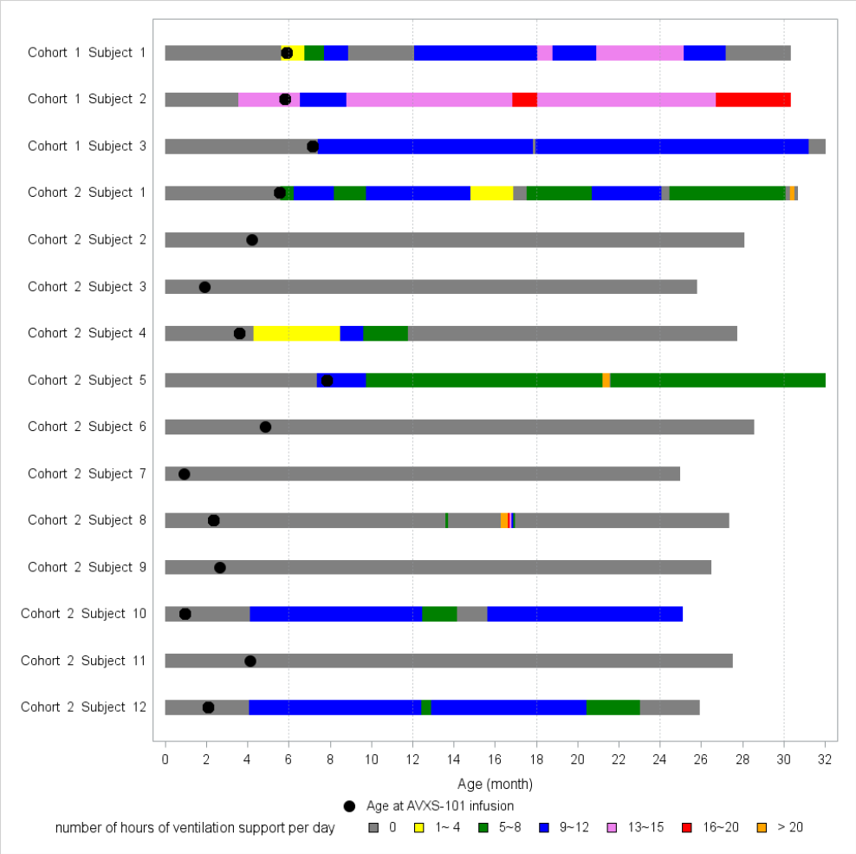
Figure 1. Swimmer plot of ventilation support hours for each subject

Slide 20
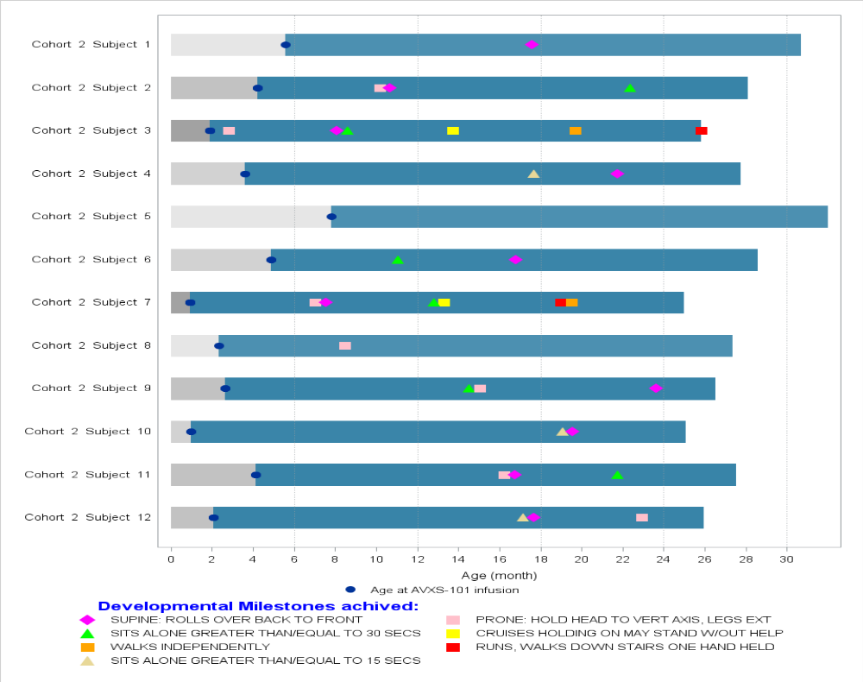
Swimmer plot of developmental milestone achievement for Cohort 2

Slide 21
Summary and discussion
  Number of IND submissions for gene therapy products increases in recent years, we expect an increase in the number of licensure applications for gene therapy products in the near future
  Studies of gene therapies on rare diseases often has the feature of limited sample sizes, and many may include single-arm studies

Slide 22
Summary and discussion
  It is well recognized that single-arm studies are prone to bias and their results can be difficult to interpret
  Single-arm studies are only acceptable as pivotal trials under special circumstances
  The KYMRIAH® and ZOLGENSMA® case studies provide good examples of the kinds of considerations that go into determining whether a single-arm trial can provide substantial evidence of effectiveness:
    The indicated disease population was small. Both products had an Orphan Drug Designation.
    The available FDA-approved treatment options were limited and there remained unmet medical needs. Both products had a Breakthrough Therapy Designation.
    It was expected that the treatment effect size could be so substantial compared to what was known about the natural history of the diseases that improvements could be confidently attributed to the treatment.

Slide 23
Summary and discussion
  Studies with limited sample size are an ideal candidate for data visualization, graphical presentation of data
  Graphical data presentations are a useful and powerful tool to evaluate the treatment effect of gene therapy products in rare diseases
  Graphical presentation of each subject’s treatment outcomes provides much more information than summary statistics can convey
  Such graphical analyses can deliver transparent and succinct key points to provide unambiguous insight into a treatment effect
  The examples in this paper show a range of settings and uses for some very simple yet effective graphical displays
  We encourage the use of similar approaches in future small trials for gene therapies

Slide 24
References
US Food and Drug Administration: FDA Draft Guidance for Industry. Rare Diseases: Common Issues in Drug Development, January 2019.
US Food and Drug Administration: Guidance for Industry – Human Gene Therapy for Rare Diseases, January 2020. https://www.fda.gov/regulatory-information/search-fda-guidance-documents/human-gene-therapy-rare-diseases
US Food and Drug Administration: Guidance for Industry. Chemistry, Manufacturing, and Controls (CMC) Information for Human Gene Therapy Investigational New Drug Applications (INDs), January 2020. https://www.fda.gov/regulatory-information/search-fda-guidance-documents/chemistry-manufacturing-and-control-cmc-information-human-gene-therapy-investigational-new-drug
US Food and Drug Administration: Guidance for FDA Reviewers and Sponsors: Content and Review of Chemistry, Manufacturing, and Control (CMC) Information for Human Gene Therapy Investigational New Drug Applications (INDs), April 2008.
Guidance for Industry: Testing of Retroviral Vector-based Human Gene Therapy Products for Replication Competent Retrovirus During Product Manufacture and Patient follow-up, January 2020.
US Food and Drug Administration: Guidance for Industry – Long Term Follow-up After Administration of Human Gene Therapy Products, January 2020. https://www.fda.gov/regulatory-information/search-fda-guidance-documents/long-term-follow-after-administration-human-gene-therapy-products
US Food and Drug Administration: Guidance for Industry – Testing of Retroviral Vector-Based Human Gene Therapy Products for Replication Competent Retrovirus During Product Manufacture and Patient Follow-up, January 2020. https://www.fda.gov/regulatory-information/search-fda-guidance-documents/testing-retroviral-vector-based-human-gene-therapy-products-replication-competent-retrovirus-during

Slide 25
Thank You

