Slide 1



Assessing benefit / risk in
randomized basket design trials
Marc Buyse, ScD
IDDI, San Francisco, CA

Slide 2
OUTLINE
    (Randomized) basket designs
    Benefit / risk vs. Safety
    Marginal benefit / risk
    Generalized pairwise comparisons
    The « net benefit »

Slide 3
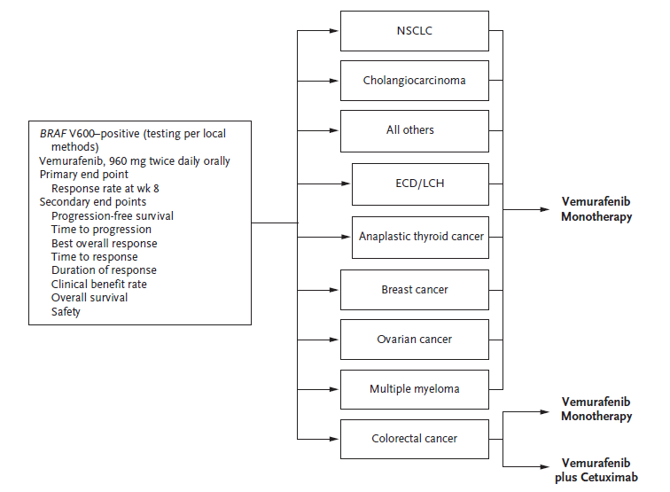
BASKET DESIGN
Ref: Heyman, NEJM 2015; 373: 726-36.

Slide 4
RANDOMIZED PHASE I/II BASKET DESIGN
Patients with incurable
non-small cell lung cancer
malignant melanoma
renal cell cancer
triple-negative breast cancer
Metastatic castrate-resistant prostate cancer
1:1:1 randomized
phase I
Low dose
High dose
Dose escalation in combination
1:1 randomized
stratified phase II
Single agent
Combination
Three stages: 28 / 52 / 78 patients per histology
ClinicalTrials.gov Identifier: NCT03454451

Slide 5
BENEFIT / RISK vs. SAFETY
    Safety comes first, but benefit / risk comes next for regimens that have « acceptable » toxicities
    Benefit may be highly histology-specific
    Safety, in contrast, may be histology-independent
    How can we assess benefit / risk?

Slide 6
MARGINAL NET BENEFIT
 | Experimental | Control | Difference
% responding | 0.6 | 0.2 | 0.4
% without serious toxicity | 0.5 | 1.0 | - 0.5
Net benefit ? | - | - | - 0.1 ?

Slide 7
NET BENEFIT DEPENDS ON ASSOCIATION
 | No Toxicity | Toxicity | Total
No response | 0.2 | 0.2 | 0.4
Response | 0.3 | 0.3 | 0.6
Total | 0.5 | 0.5 | 1
 | Odds ratio = 1
No association
 | No Toxicity | Toxicity | Total
No response | 0.4 | 0 | 0.4
Response | 0.1 | 0.5 | 0.6
Total | 0.5 | 0.5 | 1
 | Odds ratio = ∞
Positive
association
 | No Toxicity | Toxicity | Total
No response | 0 | 0.4 | 0.4
Response | 0.5 | 0.1 | 0.6
Total | 0.5 | 0.5 | 1
 | Odds ratio = 0
Negative
association

Slide 8
NET BENEFIT DEPENDS ON ASSOCIATION
 | No Toxicity | Toxicity | Total
No response | 0.2 | 0.2 | 0.4
Response | 0.3 | 0.3 | 0.6
Total | 0.5 | 0.5 | 1
 | Odds ratio = 1
Example : anthracyclines induce cardiac toxicities in patients with pre-existing cardiac conditions, independently of tumor response
No association
 | No Toxicity | Toxicity | Total
No response | 0.4 | 0 | 0.4
Response | 0.1 | 0.5 | 0.6
Total | 0.5 | 0.5 | 1
 | Odds ratio = ∞
Example : inhibitors of the epidermal growth factor receptor pathway induce severe skin rash that is highly predictive of tumor response
Positive
association
 | No Toxicity | Toxicity | Total
No response | 0 | 0.4 | 0.4
Response | 0.5 | 0.1 | 0.6
Total | 0.5 | 0.5 | 1
 | Odds ratio = 0
Example : patients with enzyme deficiencies may experience severe toxicity to fluoropyrimidine and irinotecan that leads to stopping therapy
Negative
association

Slide 9


GENERALIZED PAIRWISE COMPARISONS
Let X_{i} and Y_{j} be observed outcomes for a vector of n prioritized outcomes for subject i in treatment group (T ) and subject j in control group (C )
pairwise
comparison
X_{i}
Y_{j}
favors T
(win)
favors C
(loss)
neutral
(tie)
Ref: Buyse, Stat Med 2010; 29: 3245; Pocock et al. Eur Heart J 2012; 33: 176.

Slide 10
GENERALIZED PAIRWISE COMPARISONS
Response | Lack of toxicity | Pair is
Win |  | Win
Loss |  | Loss
Tie | Win | Win
Tie | Loss | Loss
Tie | Tie | Tie
Ref: Buyse, Prioritized multiple outcomes, Wiley StatsRef stat08158, 2019.

Slide 11
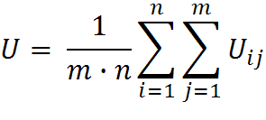
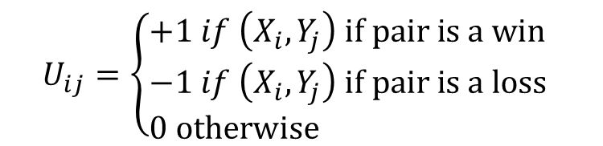
NET BENEFIT
U is the difference between the proportion of wins and the proportion of losses. It is the « net treatment benefit ».
Pocock similarly proposed the « win ratio ».
$$U_{ij}=\left\{\begin{aligned}&+1 if \left(X_{i}, Y_{j}\right) if pair is a win \\ &−1 if \left(X_{i}, Y_{j}\right) if pair is a loss \\ &0 otherwise \end{aligned} \right.$$
Ref: Buyse, Generalized pairwise comparisons, Wiley StatsRef stat08224, 2019.

Slide 12
NET BENEFIT DEPENDS ON ASSOCIATION
 | No Toxicity | Toxicity | Total
No response | 0.2 | 0.2 | 0.4
Response | 0.3 | 0.3 | 0.6
Total | 0.5 | 0.5 | 1
 | Net benefit = 0.18
No association
 | No Toxicity | Toxicity | Total
No response | 0.4 | 0 | 0.4
Response | 0.1 | 0.5 | 0.6
Total | 0.5 | 0.5 | 1
 | Net benefit = 0.30
Positive
association
 | No Toxicity | Toxicity | Total
No response | 0 | 0.4 | 0.4
Response | 0.5 | 0.1 | 0.6
Total | 0.5 | 0.5 | 1
 | Net benefit = 0.08
Negative
association

Slide 13
NET BENEFIT
    The net benefit cannot generally be calculated using marginal treatment benefits (e.g., tumor response) and harms (e.g., serious or irreversible toxicities).
    In our example, the marginal net benefit is equal to - 0.1, hence treatment would not be recommended.
    In contrast, the net benefit ranges from + 0.08 to + 0.30 if response is assigned higher priority than avoidance of toxicity, thus treatment would be recommended regardless of the association between response and toxicity.
    A similar analysis can be done with first priority assigned to toxicity instead. This approach paves the way to personalized medicine.

Slide 14
Buyse M. Generalized pairwise comparisons for prioritized outcomes in the two-sample problem. Statist Med 29: 3245-57, 2010.
Péron J, Roy P, Ding K, Parulekar W, Roche L, Buyse M. Benefit-risk assessment of adding erlotinib to gemcitabine for the treatment of advanced pancreatic cancer. Brit J Cancer 112: 971-976, 2015.
Péron J, Roy P, Conroy T, Desseigne F, Ychou M, Gourgou-Bourgade S, Stanbury T, Roche L, Ozenne B, Buyse M. An assessment of the benefit-risk balance of FOLFORINOX in metastatic pancreatic adenocarcinoma. Oncotarget 7:82953-60, 2017.
Péron J, Giai J, Maucourt-Boulche D, Buyse M. The benefit-risk balance of nab-paclitaxel in metatstatic pancreatic adenocarcinoma. Pancreas 48:2, 2019.
Buyse M. Prioritized multiple outcomes. In: Wiley StatsRef: Statistics Reference Online, https://onlinelibrary.wiley.com/doi/abs/10.1002/9781118445112.stat08158, 2019.
Buyse M. Generalized pairwise comparisons. In: Wiley StatsRef: Statistics Reference Online, https://onlinelibrary.wiley.com/doi/10.1002/9781118445112.stat08224, 2019.

