Slide 1
Estimating Treatment Effects Across Subgroups
Mark Rothmann
U.S. Food and Drug Administration
ASA Biopharmaceutical Section Regulatory-Industry Statistical Workshop
September 24, 2019

Slide 2
Outline
Drug Trials Snapshots
Alternative Approaches to Subgroup Estimation
  What? Why?
Story
Shrinkage Estimation
Bayesian Hierarchical Models
Example
Myths
References

Slide 3

Drug Trials Snapshots

Slide 4
Purpose of Drug Snapshots
Provide Information to public on who participated in clinical trials for NMEs and original biologics
Also includes information on study design, efficacy and safety results, and whether there were differences among sex, race, and age subgroups and any other appropriate subgroup

Slide 5
Snapshots are not a PI
Drug Trials Snapshot Intended for public Consumer-friendly Language Focus on subgroup data and analyses Links to PI and reviews in Drugs@FDA Published on fda.gov 30 days after drug approval | Package Insert Intended for Physicians Technical Language Comprehensive Resource for drug information No links to reviews Finalized with drug approval

Slide 6
Alternative Approaches to Subgroup Estimation

Slide 7
Traditional Practice
Usually effects of medical products are studied for a subgroup using only data from that subgroup (analyzed in isolation)
Data from outside the subgroup are treated as irrelevant
Sometimes the overall estimate is used as the subgroup estimate

Slide 8
Why do something different?
To provide the best information/advice for patients (this is not about claims)
Need statistical analyses and interpretations relative to providing advice to patients (not with respect to making claims)

Slide 9
What may this require?
May simultaneously consider the results across studies (e.g., a meta-analysis)
  Should provide particular, simplified advice to a patient
  Should not provide different pieces of information that contradicts itself
Consider the relevancy of data outside the subgroup
  Shrinkage Estimation

Slide 10
What We are Starting
Using shrinkage estimation via Bayesian Hierarchical Models for subgroup analysis in Drug Trials Snapshots
  Begin with one-way models (within a given factor)
  Later with multi-way models (multiple factors/combinations of levels)

Slide 11
Introductory Paragraph from the Impact Story
When evaluating drug treatments, determining how and to what extent a drug works in different patient subgroups can be addressed by statistical approaches that make use of results from every subgroup when understanding the treatment effect for a given subgroup.
using-innovative-statistical-approaches-provide-most-reliable-treatment-outcomes

Slide 12
Story

Slide 13
Treatment Decisions
Physicians make treatment decisions on past experience with patients

Slide 14
New Drug
Sex may or may not be an effect modifier
No other factor is considered as a possible effect modifier
Physician has experience on the use of the new drug and outcomes in 2 males and 2 females
The next patient, a female, is prescribed the new drug from that physician. What can she expect?
  Probably use information from all four previous patients.
  Outcomes from females may be more relevant than the outcomes from males.

Slide 15
As Previous Experience Grows
Observe the outcomes from more and more males and females
The relevancy of the results from males in what the next female can expect. Depends on
  How similar the results from males are to the results from females
  How much data on females

Slide 16
Shrinkage Estimation from Bayesian Hierarchical Models Works this Way
Data from a subject in the given subgroup are more relevant than data from a subject outside that subgroup
  The relevancy goes to zero as the number of subjects in the subgroup of interest goes to infinity
The data decide how much borrowing is done
  Depends on ratio of variability within subgroup to variability between subgroup
    Less borrowing when within subgroup variability decreases (its sample size increases)

Slide 17
Shrinkage Estimation

Slide 18
What is Shrinkage Estimation?
A shrinkage estimate of a parameter for a subgroup
  a weighted average of sample estimate and overall estimate (stratified by subgroup).
    Could be a posterior mean in a Bayesian setting
  Sample estimate is “shrunk” towards the overall estimate

Slide 19
Two components of variability in sample estimates across subgroups
The total variability in the sample estimates is sum of
  the within subgroup variability of the sample estimator and
  the across subgroups variability in the underlying/true parameter values

Slide 20
Purpose of Shrinkage Estimation
To address within subgroup variability in the estimation
  Obtain estimates where the unaccounted variability is primarily across subgroups variability
  The difference between the sample estimate and the shrinkage estimate is the estimated sample deviation (no longer estimating the sample deviation as zero)

Slide 21
Properties of Shrinkage Estimation
Greater precision
  narrower 95% CIs
Addresses random highs and random lows
  95% CIs have 95% coverage after the data are known

Slide 22
Bayesian Hierarchical Models

Slide 23
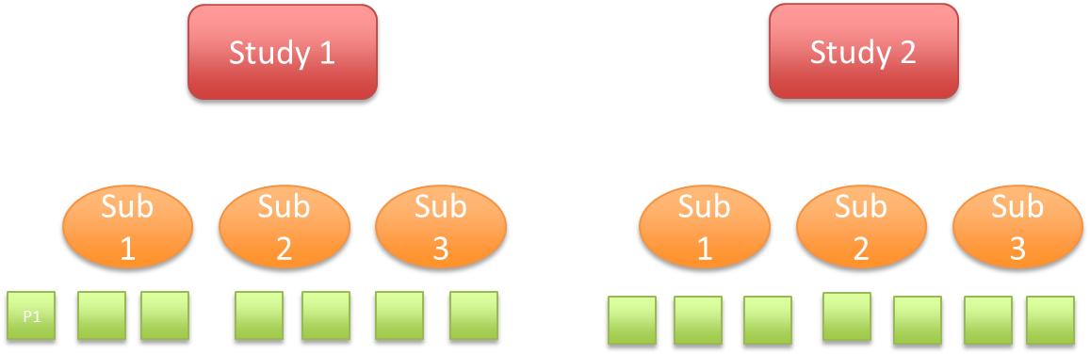
Hierarchical Models
Statistical model written in multiple levels (hierarchical form).

Slide 24
Linking
Treatment effects (e.g., across studies, subgroups, products in the same class) are linked. This linking of the parameters makes their estimation linked.

Slide 25
Exchangeability – a starting point
Subgroups treatment effects are exchangeable if possible orderings of treatment effects are considered equally likely a priori (i.e., before seeing data)
  This is fair, not favoring any subgroup treatment effects over any other
  Joint prior distribution of subgroup treatment effects is exchangeable
  Very unlikely that the joint posterior distribution will be exchangeable

Slide 26
Common choice for a model
Treatment effects drawn randomly from the same distribution implies that treatment effects are exchangeable

Slide 27
Exchangeability
Exchangeability of subgroup treatment effects not always a correct assumption.
  Drug expected to be more effective in subgroup of cancer patients who exhibit molecular target than subgroup of patients without target.
Shrinkage analysis incorrectly assuming exchangeability still accounts for a component of variability

Slide 28
Example

Slide 29
SOLVD trial
Examined impact on survival of the drug Enalapril vs. placebo in a group of patients with congestive heart failure and low ejection fraction.
2569 patients
Time to death or hospilization
  Cox model: Log hazard ratio = -0.32, SE = 0.06
Source: “Bayesian analysis of heterogeneous treatment effects for patient-centered outcomes research” by Henderson, Louis, Wang and Varadhan

Slide 30
Application of one-way and multi-way Bayesian Hierarchical Models
Factors
  Ejection fraction (high, medium, low)
  Age (> 65, < 65)
  Sex (Male, Female)
A total of 3 x 2 x 2 = 12 subgroups

Slide 31
Exchangeability – a starting point
Subgroups treatment effects are exchangeable if possible orderings of treatment effects are considered equally likely a priori (i.e., before seeing data)
  This is fair, not favoring any subgroup treatment effects over any other
  Joint prior distribution of subgroup treatment effects is exchangeable
  Very unlikely that the joint posterior distribution will be exchangeable

Slide 32
Assumption for one-way model
Treatments effects across the 12 subgroups are exchangeable

Slide 33
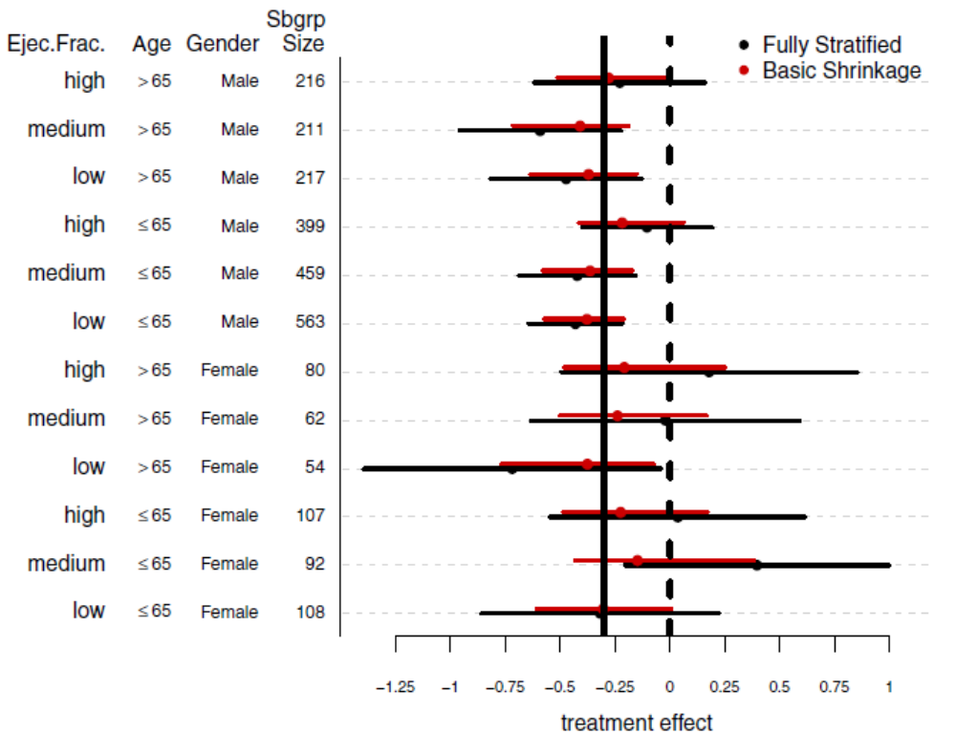
One-way case
Sample estimates, 95% CIs Shrinkage Estimates, 95% CIs

Slide 34
Assumptions for a three-way model
Main effects for ejection fraction level are exchangeable
Main effects for age group are exchangeable
Main effects for sex are exchangeable
For each pair among ejection fraction, age group and sex, the interaction effects with treatment are exchangeable
The three-way interaction effects with treatment are exchangeable

Slide 35
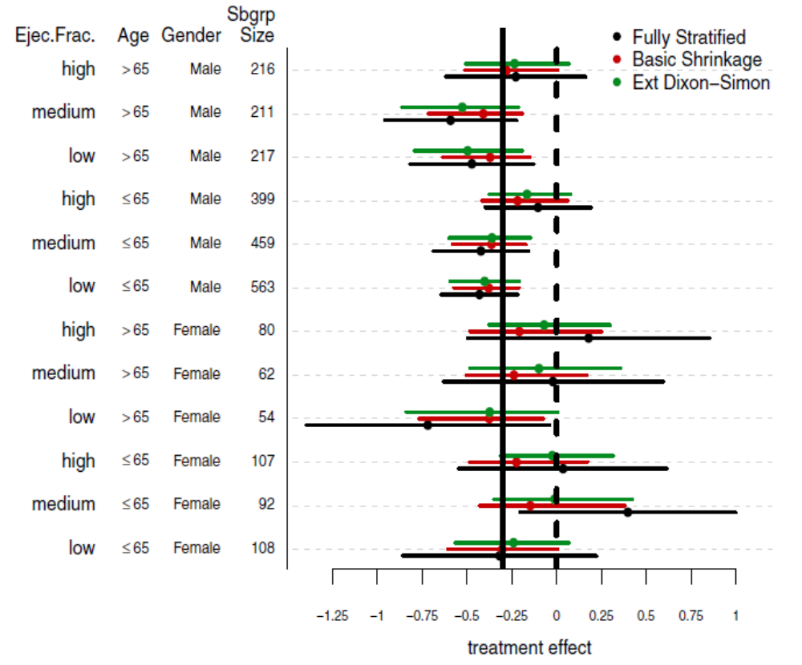
Three-way case
Sample estimates and CIs, one-way estimates and CIs, three-way estimates and CIs

Slide 36
Myths

Slide 37
Myths
Bayesian Hierarchical Models on subgroup effects work best when there are many groups
  Usually interested in a fixed subgroups whose levels are exhaustive
  Asymptotics: when the subgroup sizes go to infinity, not as the number of subgroups go to infinity
Frequentist shrinkage estimation works just as well or better
  Need (approximate) formulas for estimator and the corresponding variance

Slide 38
Concluding Remarks

Slide 39
Concluding Remarks
Let’s Do Things Better
Greater precision
  narrower 95% CIs
Addresses random highs and random lows
  95% CIs have 95% coverage after the data are known
When exchangeability assumptions do not hold, can possibly do even better

Slide 40
References

Slide 41
Pennello G., Rothmann M., Bayesian Subgroup Analysis with Hierarchical Models, in Biopharmaceutical Applied Statistics Symposium Volume 2: Biostatistical Analysis of Clinical Trials, Eds. Karl E. Peace, Ding-Geng Chen, Sandeep Menon, Springer
Rothmann, M., Applying Hierarchical Models When Evaluating Treatment Effects Across Regions presented at 2018 ASA Biopharmaceutical Section Regulatory-Industry Statistics Workshop
Henderson, N., Louis, T., Wang, C. and Varadhan, R. “Bayesian analysis of heterogeneous treatment effects for patient-centered outcomes research” Health Serv Outcomes Res Method (2016) 16:213–233

Slide 42
Thank you!
Questions?

